Slide 1
Unbalanced Random Matching Markets: the Start Effect of Competition
Itai Ashlagi, Yash Kanoria, Jacob Leshno

Slide 2
Matching Markets
We study two-sided matching markets where
  Agents have private preferences
  There are no transfers
  [Gale & Shapley 1962]
Stable matchings are equilibrium outcomes in matching markets.
  Centralized matching markets: Medical residency match (NRMP), School choice (NYC, Boston, New Orleans,…)
  Decentralized matching markets: Online dating, labor markets, college admissions
This work: characterizing stable matchings
  What can we say about typical outcomes?

Slide 3
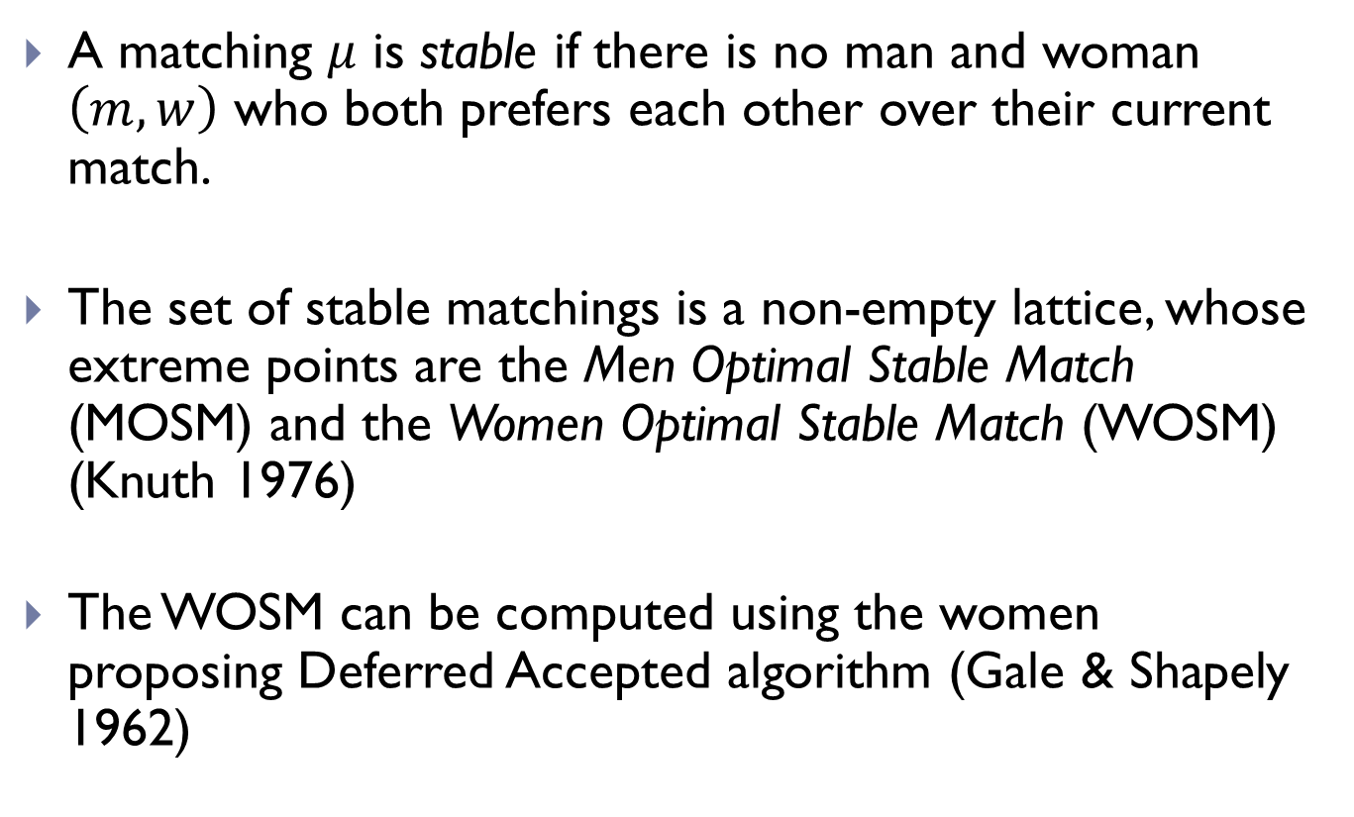
Background:
Stable Matchings (Core Allocations)
A matching $μ$ is stable if there is no man and woman $\left(m,w\right)$ who both prefers each other over their current match.
The set of stable matchings is a non-empty lattice, whose extreme points are the Men Optimal Stable Match (MOSM) and the Women Optimal Stable Match (WOSM) (Knuth 1976)
The WOSM can be computed using the women proposing Deferred Accepted algorithm (Gale & Shapely 1962)

Slide 4
Example
The preferences of 3 men and 4 women:
A | B | C
1 | 2 | 4
2 | 4 | 1
3 | 3 | 2
4 | 1 | 3
1 | 2 | 3 | 4
A | C | A | B
B | A | C | C
C | B | B | A

Slide 5
Example
A non stable matching ( A and 2 would block)
A | B | C
1 | 2 | 4
2 | 4 | 1
3 | 3 | 2
4 | 1 | 3
1 | 2 | 3 | 4
A | C | A | B
B | A | C | C
C | B | B | A

Slide 6
Example
The MOSM:
(3 is unmatched)
A | B | C
1 | 2 | 4
2 | 4 | 1
3 | 3 | 2
4 | 1 | 3
1 | 2 | 3 | 4
A | C | A | B
B | A | C | C
C | B | B | A

Slide 7
Example
The WOSM:
(3 is unmatched)
A | B | C
1 | 2 | 4
2 | 4 | 1
3 | 3 | 2
4 | 1 | 3
1 | 2 | 3 | 4
A | C | A | B
B | A | C | C
C | B | B | A

Slide 8
Clearinghouses that find stable matchings
Medical Residencies in the U.S. (NRMP) (1952)
Abdominal Transplant Surgery (2005)
Child & Adolescent Psychiatry (1995)
Colon & Rectal Surgery (1984)
Combined Musculoskeletal Matching Program (CMMP)
Hand Surgery (1990)
Medical Specialties Matching Program (MSMP)
Cardiovascular Disease (1986)
Gastroenterology (1986-1999; rejoined in 2006)
Hematology (2006)
Hematology/Oncology (2006)
Infectious Disease (1986-1990; rejoined in 1994)
Oncology (2006)
Pulmonary and Critical Medicine (1986)
Rheumatology (2005)
Minimally Invasive and Gastrointestinal Surgery (2003)
Obstetrics/Gynecology
Reproductive Endocrinology (1991)
Gynecologic Oncology (1993)
Maternal-Fetal Medicine (1994)
Female Pelvic Medicine & Reconstructive Surgery (2001)
Ophthalmic Plastic & Reconstructive Surgery (1991)
Pediatric Cardiology (1999)
Pediatric Critical Care Medicine (2000)
Pediatric Emergency Medicine (1994)
Pediatric Hematology/Oncology (2001)
Pediatric Rheumatology (2004)
Pediatric Surgery (1992)
Primary Care Sports Medicine (1994)
Radiology
Interventional Radiology (2002)
Neuroradiology (2001)
Pediatric Radiology (2003)
Surgical Critical Care (2004)
Thoracic Surgery (1988)
Vascular Surgery (1988)
Postdoctoral Dental Residencies in the United States
Oral and Maxillofacial Surgery (1985)
General Practice Residency (1986)
Advanced Education in General Dentistry (1986)
Pediatric Dentistry (1989)
Orthodontics (1996)
Psychology Internships (1999)
Neuropsychology Residencies in the U.S. & CA (2001)
Osteopathic Internships in the U.S. (before 1995)
Pharmacy Practice Residencies in the U.S. (1994)
Articling Positions with Law Firms in Alberta, CA(1993)
Medical Residencies in CA (CaRMS) (before 1970)
British (medical) house officer positions
Edinburgh (1969)
Cardiff (197x)
New York City High Schools (2003)
Boston Public Schools (2006), Denver, New Orleans

Slide 9
This Paper
  So far theory does not explain the success of centralized markets
    Theorem [Roth 1982]: No stable mechanism is strategyproof
    Theorem [Demange, Gale, Sotomayor (1987)]: Agents can successfully manipulate if only if they have multiple stable partners
  This paper provides an explanation for why stable matchings are essentially unique.

Slide 10
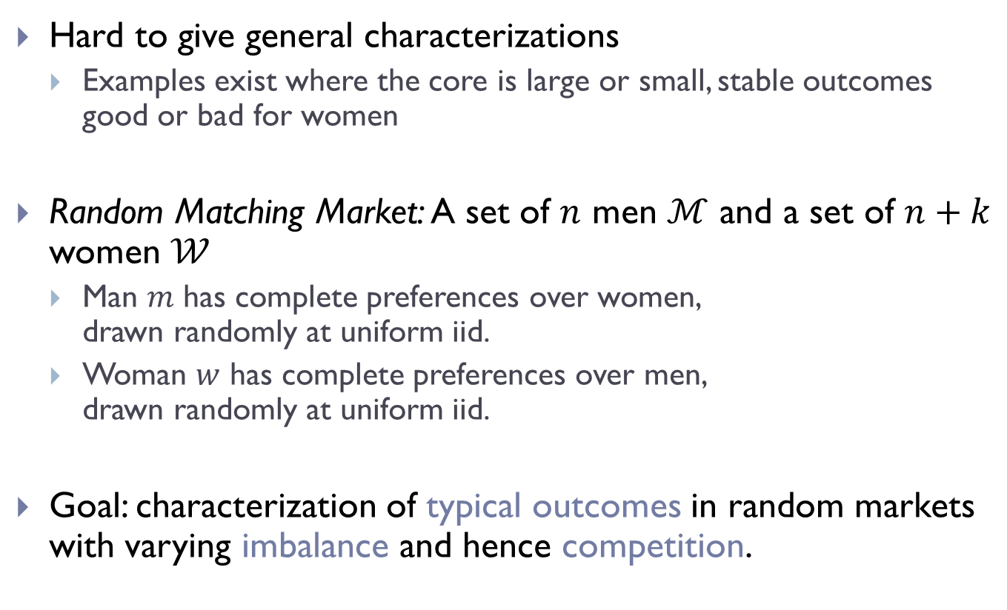
Random Matching Markets
Hard to give general characterizations
  Examples exist where the core is large or small, stable outcomes good or bad for women
Random Matching Market: A set of $n$ men $ℳ$ and a set of $n+k$ women $𝒲$
  Man $m$ has complete preferences over women,
  drawn randomly at uniform iid.
  Woman $w$ has complete preferences over men,
  drawn randomly at uniform iid.
Goal: characterization of typical outcomes in random markets with varying imbalance and hence competition.

Slide 11
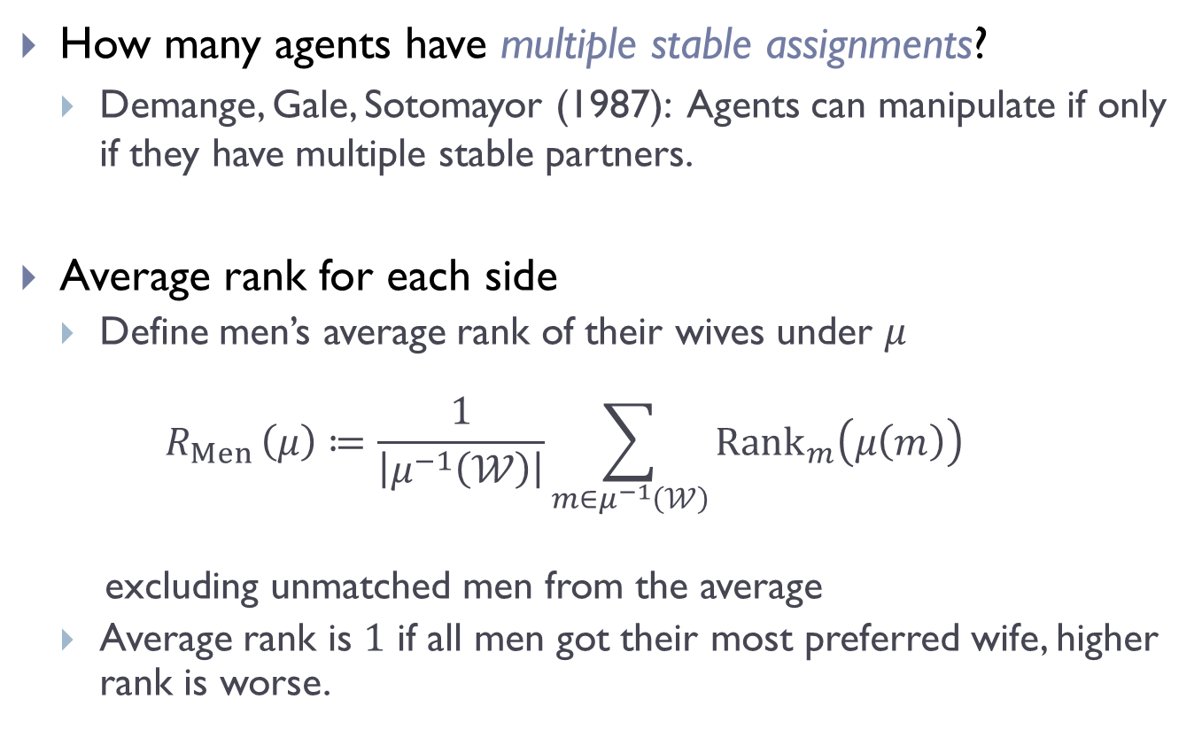
Questions
How many agents have multiple stable assignments?
  Demange, Gale, Sotomayor (1987): Agents can manipulate if only if they have multiple stable partners.
Average rank for each side
  Define men’s average rank of their wives under $μ$
  $R_{Men }\left(μ\right)≔\frac{1}{\left|μ^{−1}\left(𝒲\right)\right|}\sum_{m∈μ^{−1}\left(𝒲\right)}{{Rank}_{m}\left(μ\left(m\right)\right)}$
  excluding unmatched men from the average
  Average rank is $1$ if all men got their most preferred wife, higher rank is worse.

Slide 12
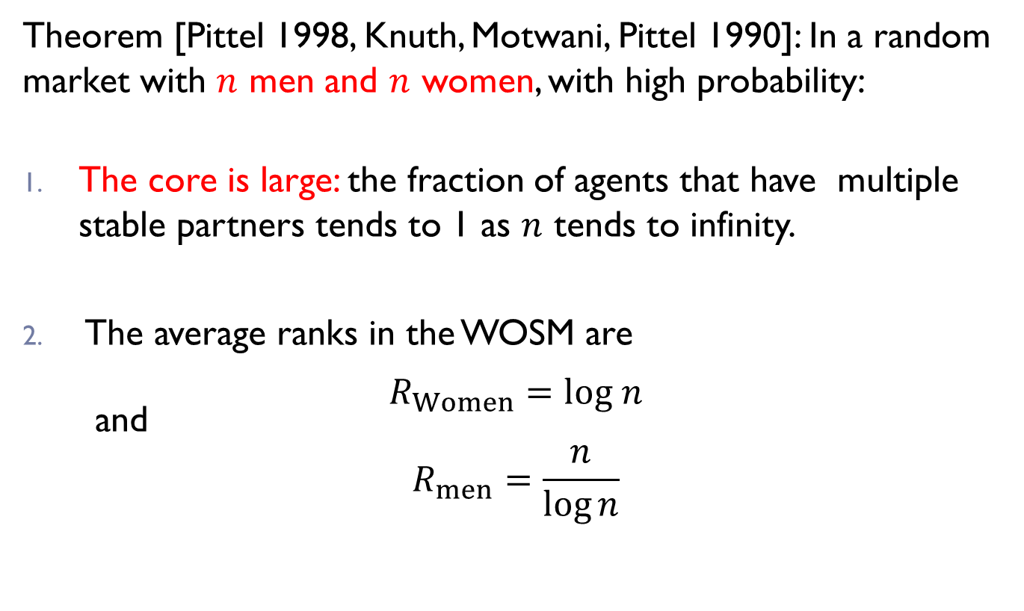
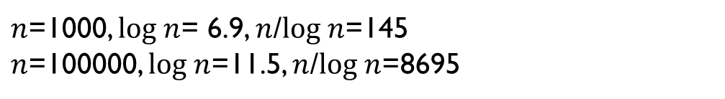
Large core in balanced random markets
Theorem [Pittel 1998, Knuth, Motwani, Pittel 1990]: In a random market with $n$ men and $n$ women, with high probability:
The core is large: the fraction of agents that have multiple stable partners tends to 1 as $n$ tends to infinity.
The average ranks in the WOSM are
$$R_{Women}=log n$$
and
$$R_{men}=\frac{n}{log⁡n}$$
How large is the core when there n men and n+1 women?
What is the average rank of women in the WOSM?
$n$=1000, $log n$= 6.9, $n$/$log n$=145
$n$=100000, $log n$=11.5, $n$/$log n$=8695

Slide 13
Related literature
All documented evidence shows the core is small:
  Roth, Peranson (1999) – small core in the NRMP
  Hitsch, Hortascu, Ariely (2010) – small core in online dating
  Banerjee et al. (2009) – small core in Indian marriage markets
We can explain small cores in restricted settings:
  Immorlica, Mahdian (2005) and Kojima, Pathak (2009) show that if one side has short random preference lists the core is small
    But many agents are unmatched
  Small core when preferences are highly correlated (e.g., Holzman, Samet (2013))
Comparative statics on adding men but only in a given extreme stable matching, Crawford (1991)

Slide 14
Results – unbalanced markets
When there are unequal number of men and women:
  The core is small; small difference between the MOSM and the WOSM
    Small core despite long lists and uncorrelated preferences
  The short side is much better off under all stable matchings;
  roughly, the short side chooses and the long side gets chosen
    sharp effect of competition
  Out results suggest that real matching markets will have an essentially unique stable matching

Slide 15
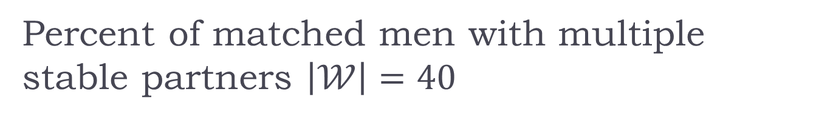
Percent of matched men with multiple stable partners $\left|𝒲\right|=40$

Slide 16

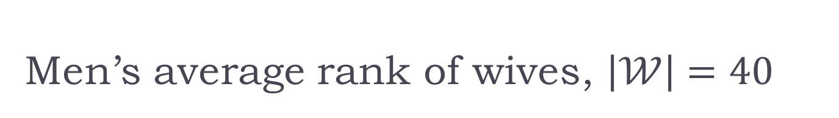

Men’s average rank of wives, $\left|𝒲\right|=40$
$$10\sim 40/log⁡(40)$$
$$4\sim log⁡(40)$$

Slide 17
Men’s average rank of wives, $\left|𝒲\right|=40$

Slide 18
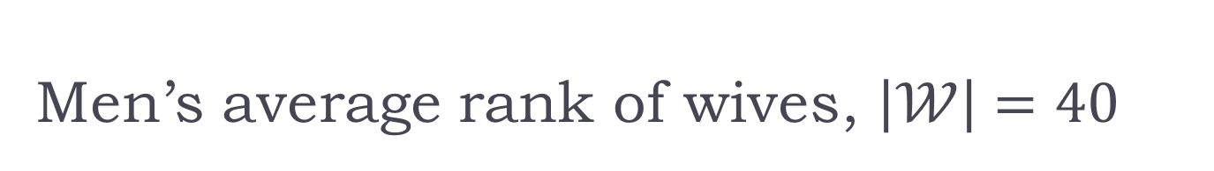
Men’s average rank of wives, $\left|𝒲\right|=40$

Slide 19
Men’s average rank of wives, $\left|𝒲\right|=40$

Slide 20
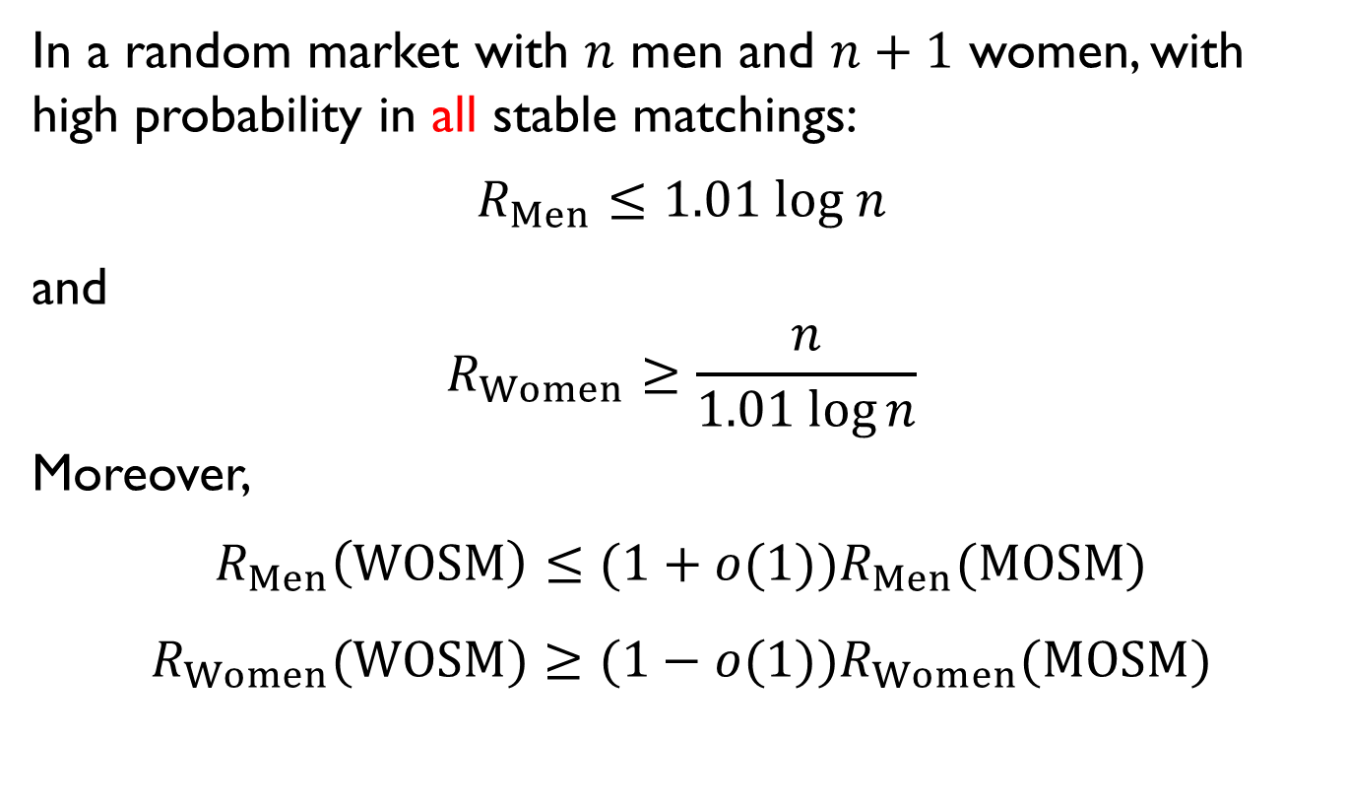
Theorem 2: One woman makes a difference
In a random market with $n$ men and $n+1$ women, with high probability in all stable matchings:
$$R_{Men}≤1.01 log n$$
and
$$R_{Women}≥\frac{n}{1.01 log⁡n}$$
Moreover,
$$R_{Men}\left(WOSM\right)≤(1+o(1))R_{Men}(MOSM)$$
$$R_{Women}(WOSM)≥(1−o(1))R_{Women}(MOSM)$$

Slide 21
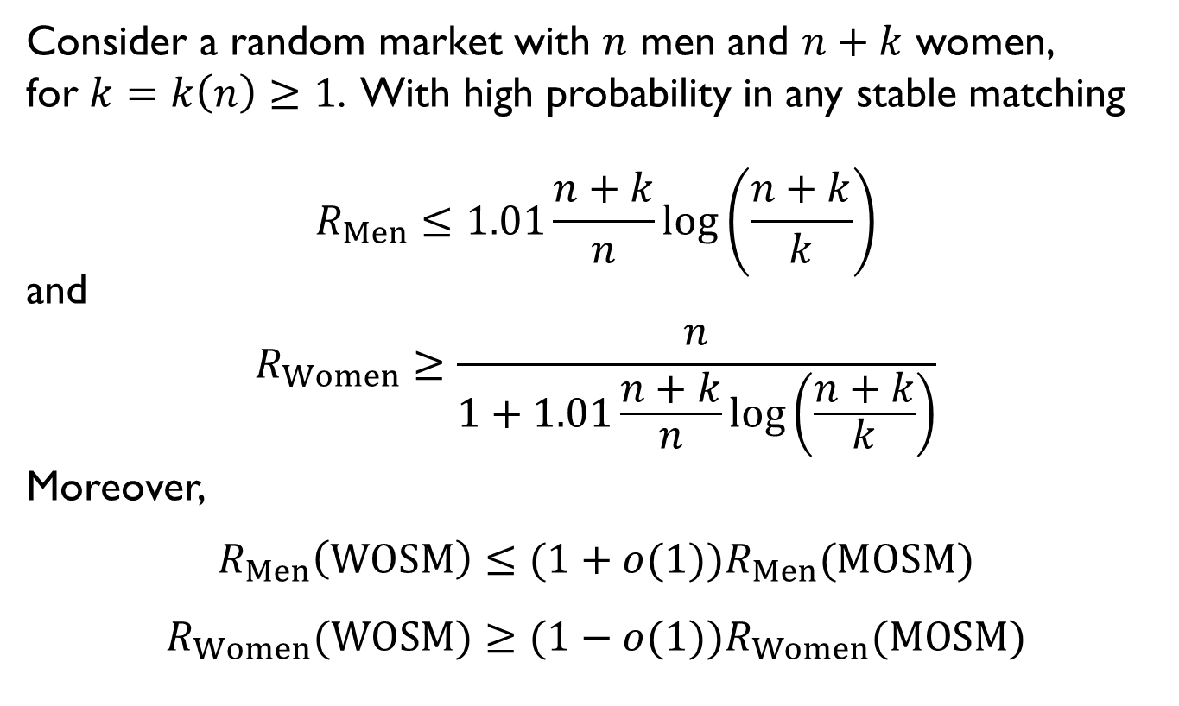
Theorem 2 (for any k)
Consider a random market with $n$ men and $n+k$ women,
for $k=k\left(n\right)≥1$. With high probability in any stable matching
$$R_{Men}≤1.01\frac{n+k}{n}log\left(\frac{n+k}{k}\right)$$
and
$$R_{Women}≥\frac{n}{1+1.01\frac{n+k}{n}log\left(\frac{n+k}{k}\right)}$$
Moreover,
$$R_{Men}\left(WOSM\right)≤(1+o(1))R_{Men}(MOSM)$$
$$R_{Women}(WOSM)≥(1−o(1))R_{Women}(MOSM)$$

Slide 22
Theorem 2
That is, with high probability under all stable matchings when the men are on the short side
  Men do almost as well as they would if they chose, ignoring women’s preferences.
  Women are either unmatched or roughly getting a randomly assigned man.

Slide 23
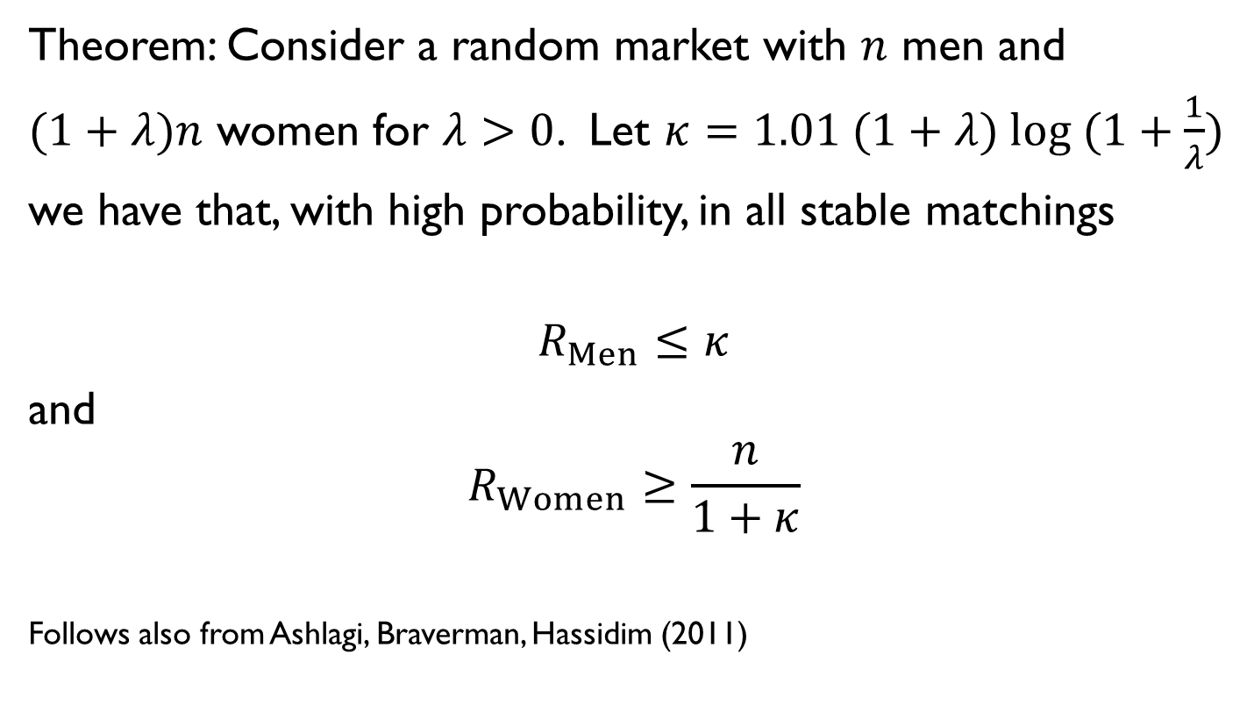
Large imbalance
Theorem: Consider a random market with $n$ men and $(1+λ)n$ women for $λ>0$. Let $κ=1.01 (1+λ) log (1+\frac{1}{λ})$ we have that, with high probability, in all stable matchings
$$R_{Men}≤κ$$
and
$$R_{Women}≥\frac{n}{1+κ}$$
Follows also from Ashlagi, Braverman, Hassidim (2011)

Slide 24
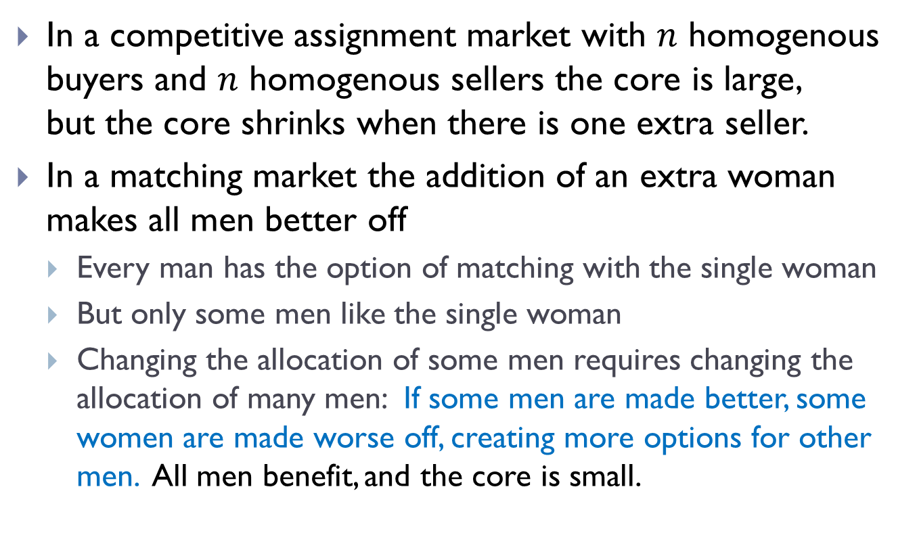
Intuition
In a competitive assignment market with $n$ homogenous buyers and $n$ homogenous sellers the core is large,
but the core shrinks when there is one extra seller.
In a matching market the addition of an extra woman makes all men better off
  Every man has the option of matching with the single woman
  But only some men like the single woman
  Changing the allocation of some men requires changing the allocation of many men: If some men are made better, some women are made worse off, creating more options for other men. All men benefit, and the core is small.

Slide 25
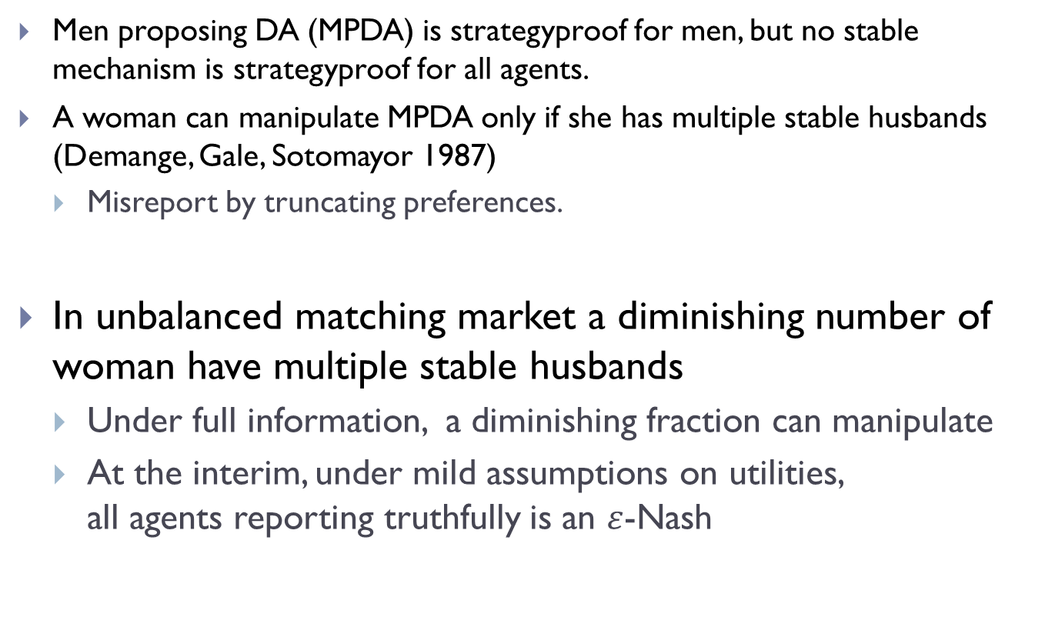
Strategic implications
Men proposing DA (MPDA) is strategyproof for men, but no stable mechanism is strategyproof for all agents.
A woman can manipulate MPDA only if she has multiple stable husbands (Demange, Gale, Sotomayor 1987)
  Misreport by truncating preferences.
In unbalanced matching market a diminishing number of woman have multiple stable husbands
  Under full information, a diminishing fraction can manipulate
  At the interim, under mild assumptions on utilities,
  all agents reporting truthfully is an $ε$-Nash

Slide 26
Proof overview
1st step: Count proposals under the Men-proposing Deferred Acceptance (which finds the MOSM)

Slide 27
Proof overview
Calculate the WOSM using:
Algorithm 1: Men-proposing Deferred Acceptance gives MOSM
Algorithm 2: MOSM→WOSM
Both algorithms use a sequence of proposals by men
Stochastic analysis by sequential revelation of preferences.

Slide 28
Men-proposing Deferred Acceptance (Gale & Shapley)
Everyone starts unmatched.
Repeat until all men are matched:
  Each rejected or unmatched man proposes to his most preferred woman he has yet proposed to.
  Each woman who receives at least one proposal, rejects all but her most preferred proposal so far.

Slide 29
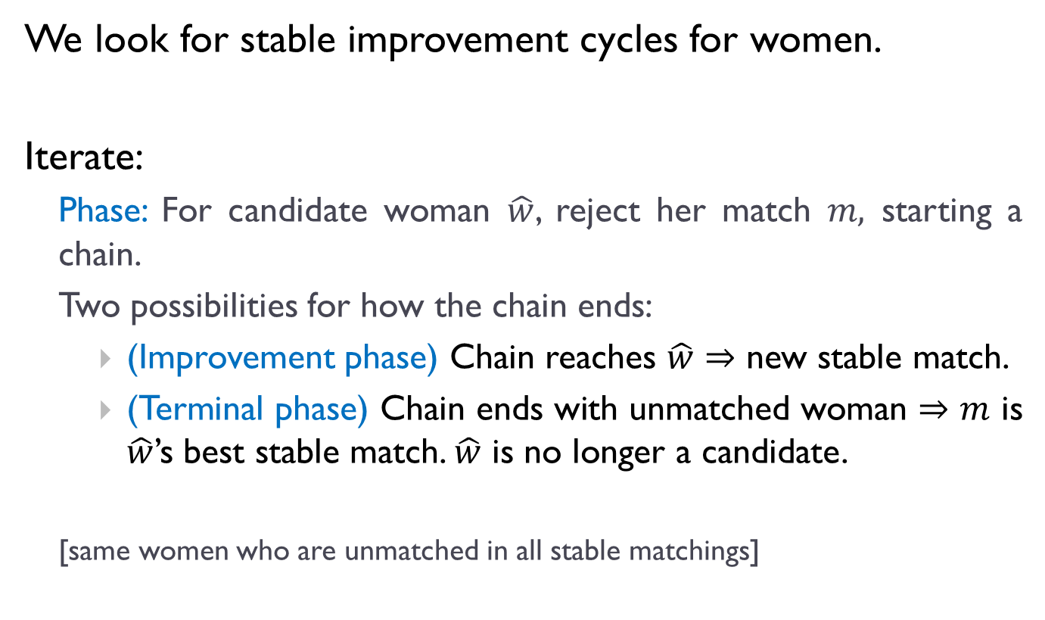
Algorithm 2: MOSM → WOSM
We look for stable improvement cycles for women.
Iterate:
  Phase: For candidate woman $\hat{w}$, reject her match $m,$ starting a chain.
  Two possibilities for how the chain ends:
    (Improvement phase) Chain reaches $\hat{w}⇒$ new stable match.
    (Terminal phase) Chain ends with unmatched woman $⇒m$ is $\hat{w}$’s best stable match. $\hat{w}$ is no longer a candidate.
  [same women who are unmatched in all stable matchings]

Slide 30






Illustration of Algorithm 2: MOSM → WOSM
$$w_{1}$$
$$w_{2}$$
$$m_{1}$$
$$m_{2}$$
$w_{2}$ prefers $m_{1}$ to $m_{2}$
$w_{1}$ rejects $m_{1}$ to start a chain

Slide 31


Illustration of Algorithm 2: MOSM → WOSM
$$w_{1}$$
$$w_{2}$$
$$w_{3}$$
$$m_{1}$$
$$m_{2}$$
$$m_{3}$$
$w_{2}$ prefers $m_{1}$ to $m_{2}$

Slide 32
Illustration of Algorithm 2: MOSM → WOSM
$$w_{1}$$
$$w_{2}$$
$$w_{3}$$
$$m_{1}$$
$$m_{2}$$
$$m_{3}$$

Slide 33

Illustration of Algorithm 2: MOSM → WOSM
$$w_{1}$$
$$w_{2}$$
$$w_{3}$$
$$m_{1}$$
$$m_{2}$$
$$m_{3}$$
$w_{1}$ prefers $m_{3}$ to $m_{1}$

Slide 34
Illustration of Algorithm 2: MOSM → WOSM
$$w_{1}$$
$$w_{2}$$
$$w_{3}$$
$$m_{1}$$
$$m_{2}$$
$$m_{3}$$
New stable match found. Update match and continue.

Slide 35
Illustration of Algorithm 2: MOSM → WOSM
$$w_{1}$$
$$m_{3}$$

Slide 36

Illustration of Algorithm 2: MOSM → WOSM
$$w_{1}$$
$$m_{3}$$

Slide 37




Illustration of Algorithm 2: MOSM → WOSM
$$w_{1}$$
$$w_{4}$$
$$m_{3}$$
$$m_{4}$$
$w_{4}$ prefers $m_{3}$ to $m_{4}$
$w_{1}$ rejects $m_{3}$ to start a chain

Slide 38



Illustration of Algorithm 2: MOSM → WOSM
$$w_{1}$$
$$w_{4}$$
$$w_{5}$$
$$m_{3}$$
$$m_{4}$$
$$m_{5}$$
$w_{5}$ prefers $m_{4}$ to $m_{5}$

Slide 39
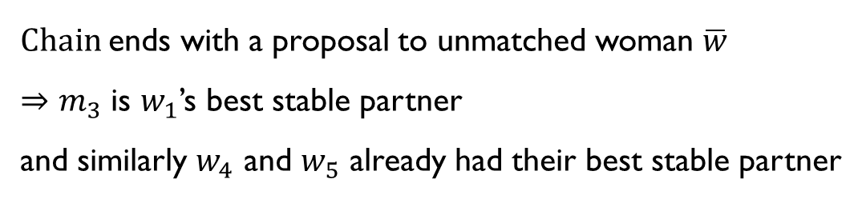

Illustration of Algorithm 2: MOSM → WOSM
$$w_{1}$$
$$w_{4}$$
$$w_{5}$$
$$\overline{w}$$
$$m_{3}$$
$$m_{4}$$
$$m_{5}$$
$Chain$ends with a proposal to unmatched woman $\overline{w}$
$⇒m_{3}$ is $w_{1}$’s best stable partner
and similarly $w_{4}$ and $w_{5}$ already had their best stable partner

Slide 40
Illustration of Algorithm 2: MOSM → WOSM
$$w_{1}$$
$$w_{4}$$
$$w_{5}$$
$$\overline{w}$$
$$m_{3}$$
$$m_{4}$$
$$m_{5}$$
$Chain$ends with a proposal to unmatched woman $\overline{w}$
$⇒m_{3}$ is $w_{1}$’s best stable partner
and similarly $w_{4}$ and $w_{5}$ already had their best stable partner

Slide 41



Illustration of Algorithm 2: MOSM → WOSM
women who found their best stable partner
$$w_{1}$$
$$w_{4}$$
$$w_{5}$$
$$\overline{w}$$
$$m_{3}$$
$$m_{4}$$
$$m_{5}$$
$Chain$ends with a proposal to unmatched woman $\overline{w}$
$⇒m_{3}$ is $w_{1}$’s best stable partner
and similarly $w_{4}$ and $w_{5}$ already had their best stable partner

Slide 42
Illustration of Algorithm 2: MOSM → WOSM
$$w_{1}$$
$$w_{4}$$
$$w_{5}$$
$$\overline{w}$$
$$m_{3}$$
$$m_{4}$$
$$m_{5}$$

Slide 43



Illustration of Algorithm 2: MOSM → WOSM
$$w_{1}$$
$$w_{4}$$
$$w_{5}$$
$$\overline{w}$$
$$m_{3}$$
$$m_{4}$$
$$m_{5}$$
$$w_{8}$$
$w_{8}$ rejects $m_{8}$ to start a new chain
$$m_{8}$$

Slide 44

Illustration of Algorithm 2: MOSM → WOSM
$$w_{1}$$
$$w_{4}$$
$$w_{5}$$
$$\overline{w}$$
$$m_{3}$$
$$m_{4}$$
$$m_{5}$$
$$w_{8}$$
$w_{4}$ prefers $m_{8}$ to $m_{4}$
But $w_{4}$ is already matched to her best stable partner
$$m_{8}$$

Slide 45
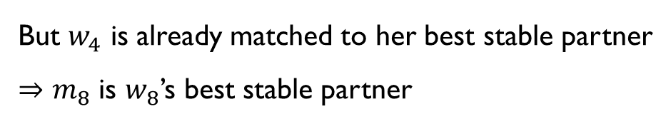
Illustration of Algorithm 2: MOSM → WOSM
$$w_{1}$$
$$w_{4}$$
$$w_{5}$$
$$\overline{w}$$
$$m_{3}$$
$$m_{4}$$
$$m_{5}$$
$$w_{8}$$
$w_{4}$ prefers $m_{8}$ to $m_{4}$
But $w_{4}$ is already matched to her best stable partner
$⇒m_{8}$ is $w_{8}$’s best stable partner
$$m_{8}$$

Slide 46

Illustration of Algorithm 2: MOSM → WOSM
$$w_{1}$$
$$w_{4}$$
$$w_{5}$$
$$\overline{w}$$
$$m_{3}$$
$$m_{4}$$
$$m_{5}$$
$$w_{8}$$
$w_{4}$ prefers $m_{8}$ to $m_{4}$
But $w_{4}$ is already matched to her best stable partner
$⇒m_{8}$ is $w_{8}$’s best stable partner
$$m_{8}$$

Slide 47
Proof idea:
Analysis of men-proposing DA is similar to that of Pittel (1989)
  Coupon collectors problem
Analysis of Algorithm 2: MOSM → WOSM more involved.
  Track S - set of woman matched already to best stable partner
  Once S is large improvement phases are rare
  Together, in a typical market, very few agents participate in improvement cycles

Slide 48

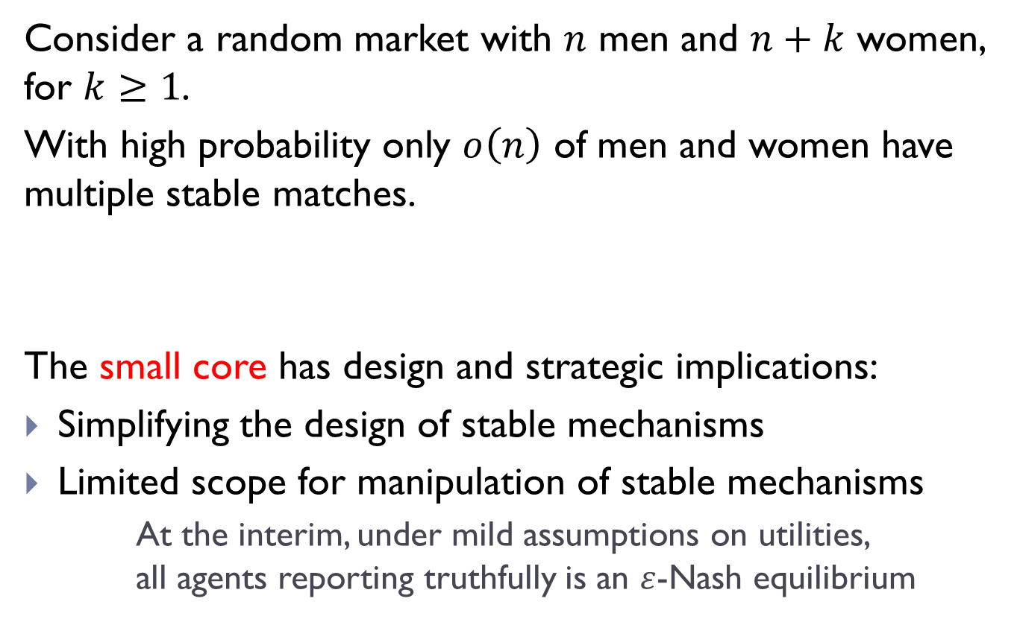









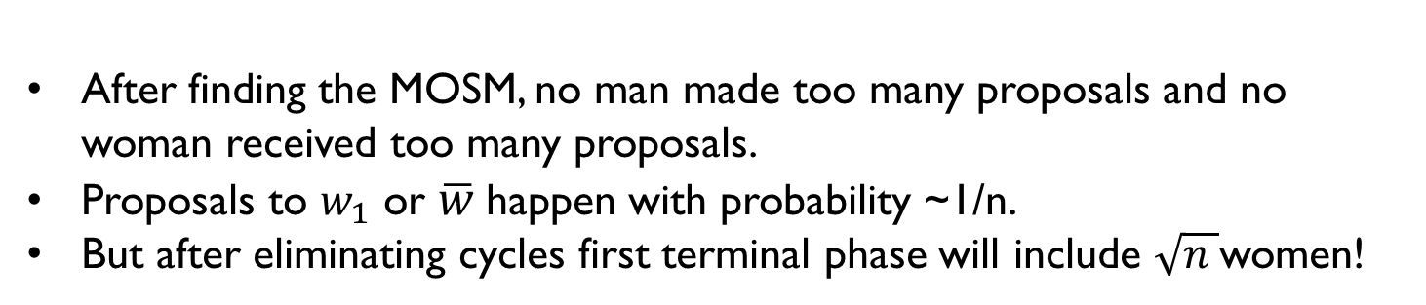

Why does the S (set of women matched to best stable partners) grows quickly?
$$w_{1}$$
$$w_{2}$$
$$w_{5}$$
$$w_{6}$$
$$w_{8}$$
$$w_{9}$$
$$\overline{w}$$
$$m_{1}$$
$$m_{2}$$
$$m_{5}$$
$$m_{6}$$
$$m_{8}$$
$$m_{9}$$
After finding the MOSM, no man made too many proposals and no woman received too many proposals.
Proposals to $w_{1}$ or $\overline{w}$happen with probability ~1/n.
But after eliminating cycles first terminal phase will include $\sqrt{n }$women!

Slide 49
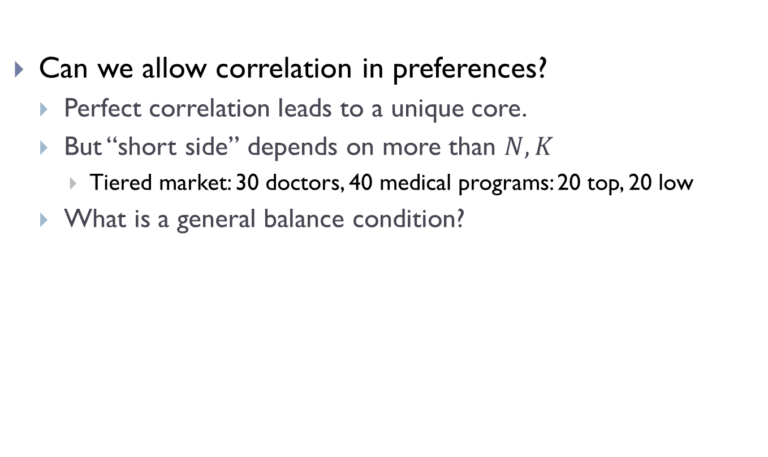
Further questions
Can we allow correlation in preferences?
  Perfect correlation leads to a unique core.
  But “short side” depends on more than $N,K$
    Tiered market: 30 doctors, 40 medical programs: 20 top, 20 low
  What is a general balance condition?

Slide 50

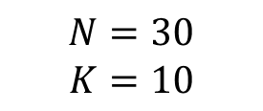
Correlation - $u_{m}\left(w\right)=β⋅w+ε$
$$N=30$$
$$K=10$$

Slide 51
Correlated Preferences – absolute correlation
$$α$$

Slide 52
Correlated Preferences – pos cross correlation

Slide 53
Short Lists

Slide 54
Percent of men with multiple stable matches
$$n$$ | Diff: | -10 | -1 | 0 | +1 | +5 | +10
100 |  | 2.1 | 15.1 | 75.3 | 15.4 | 4.5 | 2.3
200 |  | 2.2 | 14.6 | 83.6 | 14.6 | 4.1 | 2.1
500 |  | 2.0 | 12.6 | 91.0 | 13.1 | 3.6 | 2.0
1000 |  | 1.9 | 12.3 | 94.5 | 12.2 | 3.4 | 2.0
2000 |  | 1.8 | 11.1 | 96.7 | 11.1 | 2.9 | 1.7
5000 |  | 1.5 | 10.1 | 98.4 | 10.2 | 2.8 | 1.5

Slide 55
Large Simulations
$$N$$ | $$K=+1$$ |  |  | $$K=+10$$
 | Men's rank under |  | % Men with | Men's rank under |  | % Men with
 | MOSM | WOSM | Multiple Stable | MOSM | WOSM | Multiple Stable
10 | 1.98 (0.45) | 2.29 (0.60) | 13.84 (18.82) | 1.31 (0.20) | 1.33 (0.21) | 1.19 (5.13)
100 | 4.09 (0.72) | 4.89 (1.08) | 15.16 (12.98) | 2.55 (0.26) | 2.61 (0.27) | 2.30 (3.15)
1,000 | 6.47 (0.79) | 7.44 (1.28) | 11.9 (10.17) | 4.59 (0.30) | 4.69 (0.31) | 1.95 (2.03)
10,000 | 8.80 (0.79) | 9.80 (1.30) | 9.45 (8.30) | 6.88 (0.30) | 6.98 (0.32) | 1.46 (1.47)
100,000 | 11.11 (0.83) | 12.09 (1.31) | 7.66 (6.60) | 9.16 (0.31) | 9.26 (0.32) | 1.08 (1.02)
1,000,000 | 13.40 (0.80) | 14.41 (1.27) | 6.62 (6.04) | 11.46 (0.30) | 11.56 (0.32) | 0.85 (0.80)

Slide 56
Conclusion
Random unbalanced matching markets are highly competitive:
  Essentially a unique stable matching
  The short side is highly favored and “gets to choose”
Results suggest that every matching market has a small core
  Clearinghouses that implement stable outcomes make it safe for all agents to reveal their information!
Remark: in order to find an “optimal” allocation, one can focus on the set of feasible matchings (or on choice menus)

