Slide 1
LSA 311
Computational Lexical Semantics
Dan Jurafsky
Stanford University
Introduction and Course Overview

Slide 2
What is Computational Lexical Semantics
Any computational process involving word meaning!
Computing Word Similarity
  Distributional (Vector) Models of Meaning
Computing Word Relations
Word Sense Disambiguation
Semantic Role Labeling
Computing word connotation and sentiment

Slide 3
Synonyms and near-synonymy: computing the similarity between words
“fast” is similar to “rapid”
“tall” is similar to “height”
Question answering:
Q: “How tall is Mt. Everest?”
Candidate A: “The official height of Mount Everest is 29029 feet”

Slide 4
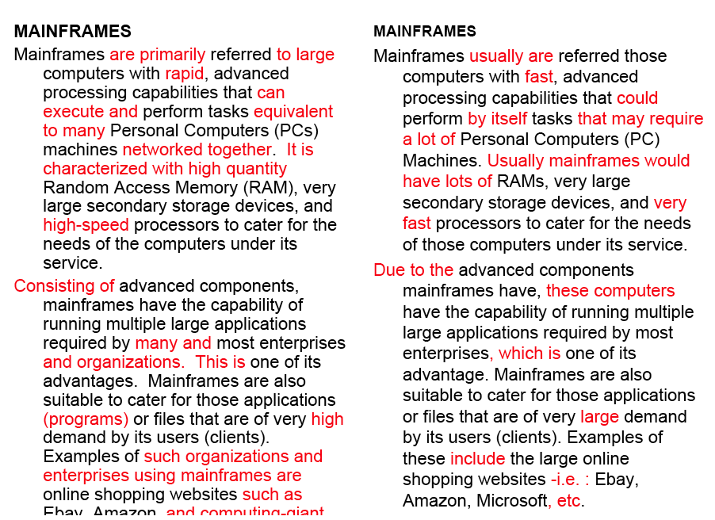
Word similarity for plagiarism detection

Slide 5
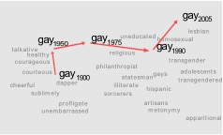
Word similarity for historical linguistics: semantic change over time
Sagi, Kaufmann Clark 2013
Kulkarni, Al-Rfou, Perozzi, Skiena 2015

Slide 6
Word Relations:
Part-Whole or Supertype-Subtype
A “collie” is-a “dog”
A “wheel” is-part-of a “car”
  Question answering:
    Q: Does Sean have a dog? Candidate A: “Sean has two collies”
  Reference resolution
    “How’s your car?” “I’m having problems with the wheels”
    Bridging anaphora: how do we know which wheels there are?
    And why is it ok to use the define article “the”?
      Because we know that “wheels” are a part of a car

Slide 7
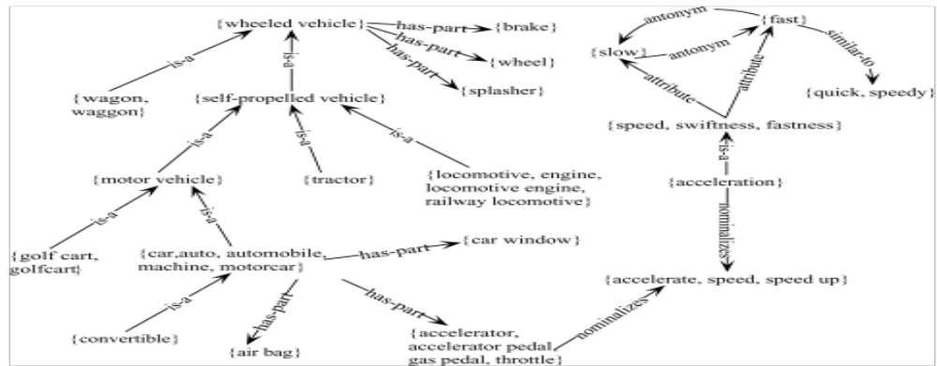
WordNet: Online thesaurus

Slide 8
Word Sense Disambiguation
Motivating example, Google translate from http://laylita.com/recetas/2008/02/28/platanos-maduros-fritos/
A veces siento que no como suficiente plátanos maduros fritos, quizás es porque los comía casi todos los días cuando vivía en Ecuador.
Sometimes I feel like not enough fried plantains, perhaps because he ate almost every day when I lived in Ecuador.
como: “like”, “I eat”

Slide 9
Question Answering
“Analysts have been expecting a GM-Jaguar pact that would give the U.S. car maker an eventual 30% stake in the British company.”
How do we answer questions about who did what to whom?

Slide 10
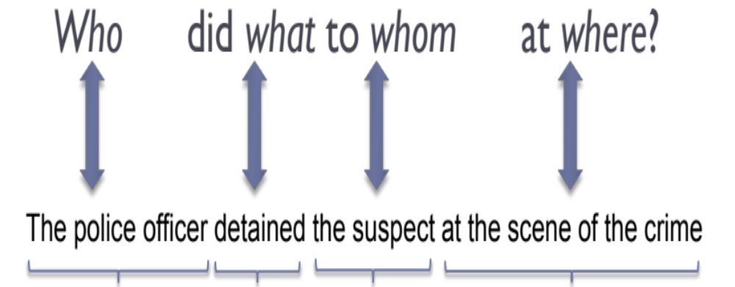
Semantic Role Labeling
Agent
Predicate
Theme
Location

Slide 11
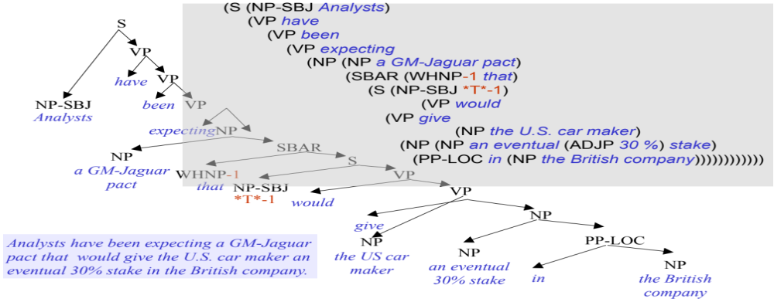
Semantic Role Labeling: Who did what to whom
Martha Palmer 2013
A sample parse tree

Slide 12
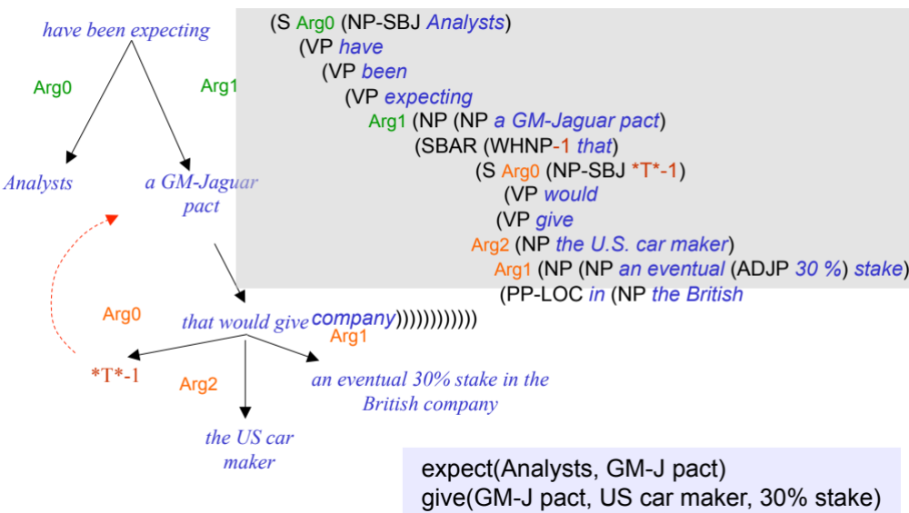
Semantic Role Labeling: Who did what to whom
The same parse tree PropBanked
Martha Palmer 2013

Slide 13
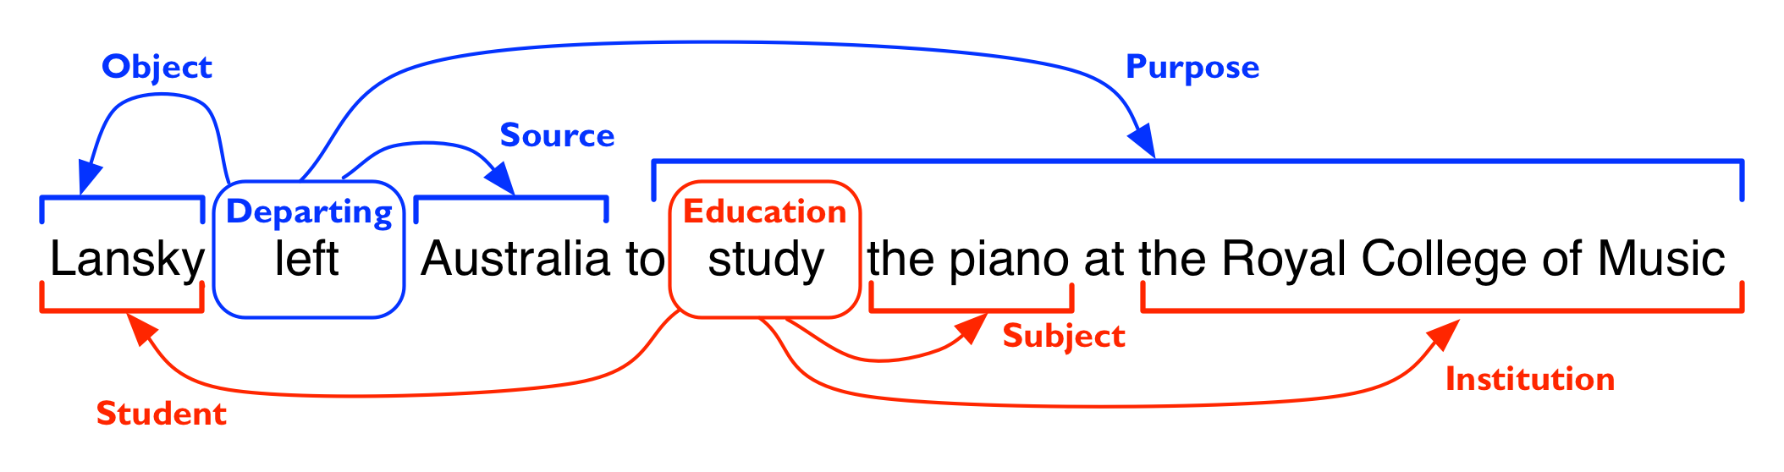
Frame Semantics
Figure from Ivan Titov!

Slide 14
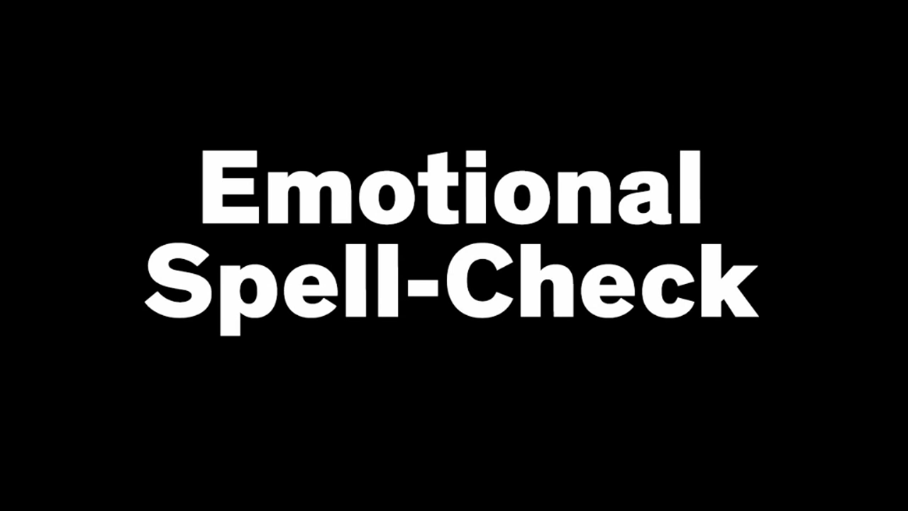
Sentiment Analysis

Slide 15
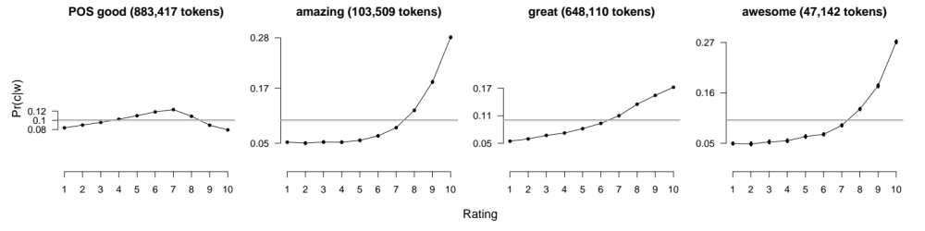
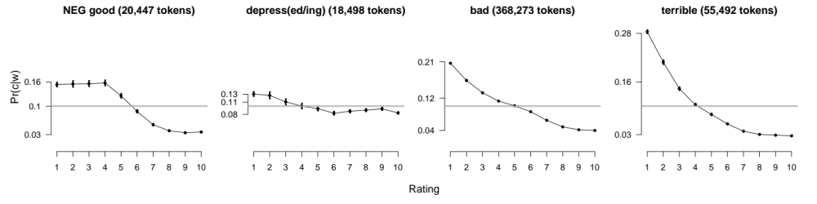
Analyzing the polarity of each word in IMDB
Potts, Christopher. 2011. On the negativity of negation. SALT 20, 636-659.
Scaled likelihood
P(w|c)/P(w)
Scaled likelihood
P(w|c)/P(w)
Notes:
Thanks to Chris Potts for permission to use figures

Slide 16
July 7 Computing with online thesauri like WordNet
    Word Similarity
    Word Sense Disambiguation (WSD) and Classification
July 10 Distributional Semantics (vector models of meaning)
    Co-occurrence vectors and mutual information
    Singular Value Decomposition and LSA
    “Embeddings”: skip-grams & neural network models
July 14 Learning Thesauri and Dictionaries from text
    Lexicons for affect and sentiment
    Inducing hypernym relations
July 17 Semantic Role Labeling (Charles J. Fillmore Day)
    FrameNet, PropBank, labeling
    Selectional restrictions

Slide 17
Computing with a Thesaurus
Word Senses and Word Relations

Slide 18
Quick brushup on word senses and relations

Slide 19
Terminology: lemma and wordform
A lemma or citation form
  Same stem, part of speech, rough semantics
A wordform
  The inflected word as it appears in text
Wordform | Lemma
banks | bank
sung | sing
duermes | dormir

Slide 20
Lemmas have senses
One lemma “bank” can have many meanings:
    …a bank can hold the investments in a custodial account…
    “…as agriculture burgeons on the east bank the river will shrink even more”
Sense (or word sense)
  A discrete representation
  of an aspect of a word’s meaning.
The lemma bank here has two senses
Sense 1:
1
Sense 2:
2

Slide 21
Homonymy
Homonyms: words that share a form but have unrelated, distinct meanings:
  bank₁: financial institution, bank₂: sloping land
  bat₁: club for hitting a ball, bat₂: nocturnal flying mammal
Homographs (bank/bank, bat/bat)
Homophones:
  Write and right
  Piece and peace

Slide 22
Homonymy causes problems for NLP applications
Information retrieval
  “bat care”
Machine Translation
  bat: murciélago (animal) or bate (for baseball)
Text-to-Speech
  bass (stringed instrument) vs. bass (fish)

Slide 23
Polysemy
1. The bank was constructed in 1875 out of local red brick.
2. I withdrew the money from the bank
Are those the same sense?
  Sense 2: “A financial institution”
  Sense 1: “The building belonging to a financial institution”
A polysemous word has related meanings
  Most non-rare words have multiple meanings

Slide 24
Metonymy or Systematic Polysemy:
A systematic relationship between senses
Lots of types of polysemy are systematic
  School, university, hospital
  All can mean the institution or the building.
A systematic relationship:
  Building Organization
Other such kinds of systematic polysemy:
Author (Jane Austen wrote Emma)
Works of Author (I love Jane Austen)
Tree (Plums have beautiful blossoms)
Fruit (I ate a preserved plum)

Slide 25
How do we know when a word has more than one sense?
The “zeugma” test: Two senses of serve?
  Which flights serve breakfast?
  Does Lufthansa serve Philadelphia?
  ?Does Lufthansa serve breakfast and San Jose?
Since this conjunction sounds weird,
  we say that these are two different senses of “serve”

Slide 26
Synonyms
Word that have the same meaning in some or all contexts.
  filbert / hazelnut
  couch / sofa
  big / large
  automobile / car
  vomit / throw up
  Water / H₂0
Two lexemes are synonyms
  if they can be substituted for each other in all situations
  If so they have the same propositional meaning

Slide 27
Synonyms
But there are few (or no) examples of perfect synonymy.
  Even if many aspects of meaning are identical
  Still may not preserve the acceptability based on notions of politeness, slang, register, genre, etc.
Example:
  Water/H₂0
  Big/large
  Brave/courageous

Slide 28
Synonymy is a relation between senses rather than words
Consider the words big and large
Are they synonyms?
  How big is that plane?
  Would I be flying on a large or small plane?
How about here:
  Miss Nelson became a kind of big sister to Benjamin.
  ?Miss Nelson became a kind of large sister to Benjamin.
Why?
  big has a sense that means being older, or grown up
  large lacks this sense

Slide 29
Antonyms
Senses that are opposites with respect to one feature of meaning
Otherwise, they are very similar!
  dark/light short/long fast/slow rise/fall
  hot/cold up/down in/out
More formally: antonyms can
  define a binary opposition
    or be at opposite ends of a scale
    long/short, fast/slow
  Be reversives:
    rise/fall, up/down

Slide 30
Hyponymy and Hypernymy
One sense is a hyponym of another if the first sense is more specific, denoting a subclass of the other
  car is a hyponym of vehicle
  mango is a hyponym of fruit
Conversely hypernym/superordinate (“hyper is super”)
  vehicle is a hypernym of car
  fruit is a hypernym of mango
Superordinate/hyper | vehicle | fruit | furniture
Subordinate/hyponym | car | mango | chair

Slide 31
Hyponymy more formally
Extensional:
  The class denoted by the superordinate extensionally includes the class denoted by the hyponym
Entailment:
  A sense A is a hyponym of sense B if being an A entails being a B
Hyponymy is usually transitive
  (A hypo B and B hypo C entails A hypo C)
Another name: the IS-A hierarchy
  A IS-A B (or A ISA B)
  B subsumes A

Slide 32
Hyponyms and Instances
WordNet has both classes and instances.
An instance is an individual, a proper noun that is a unique entity
    San Francisco is an instance of city
  But city is a class
    city is a hyponym of municipality...location...

Slide 33
Meronymy
The part-whole relation
  A leg is part of a chair; a wheel is part of a car.
Wheel is a meronym of car, and car is a holonym of wheel.

Slide 34
Computing with a Thesaurus
Word Senses and Word Relations

Slide 35
Computing with a Thesaurus
WordNet

Slide 36
WordNet 3.0
A hierarchically organized lexical database
On-line thesaurus + aspects of a dictionary
    Some other languages available or under development
      (Arabic, Finnish, German, Portuguese…)
Category | Unique Strings
Noun | 117,798
Verb | 11,529
Adjective | 22,479
Adverb | 4,481

Slide 37
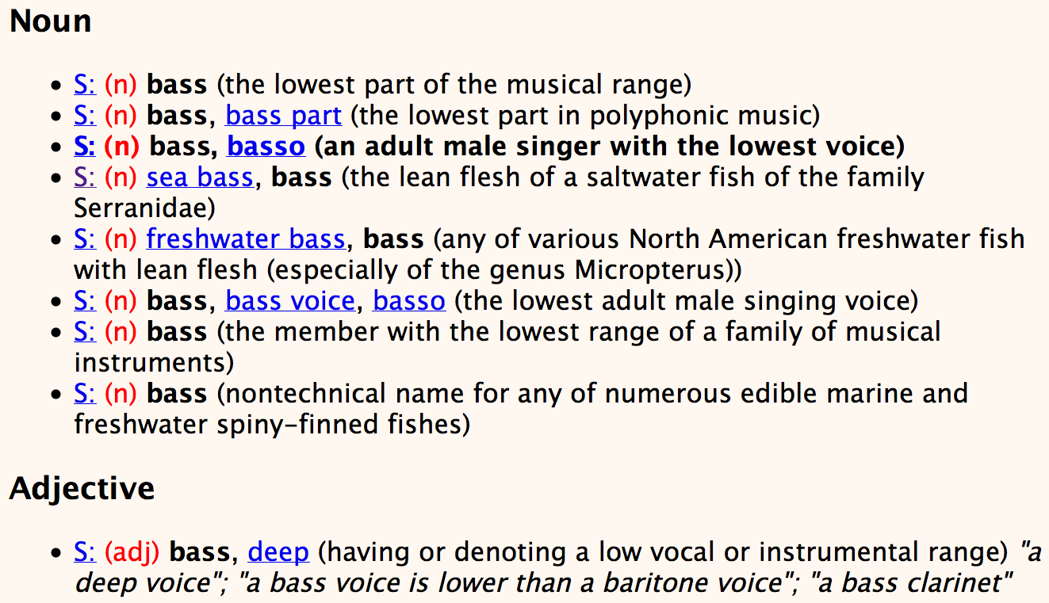
Senses of “bass” in Wordnet

Slide 38
How is “sense” defined in WordNet?
The synset (synonym set), the set of near-synonyms, instantiates a sense or concept, with a gloss
Example: chump as a noun with the gloss:
  “a person who is gullible and easy to take advantage of”
This sense of “chump” is shared by 9 words:
  chump¹, fool², gull¹, mark⁹, patsy¹, fall guy¹, sucker¹, soft touch¹, mug²
Each of these senses have this same gloss
  (Not every sense; sense 2 of gull is the aquatic bird)

Slide 39
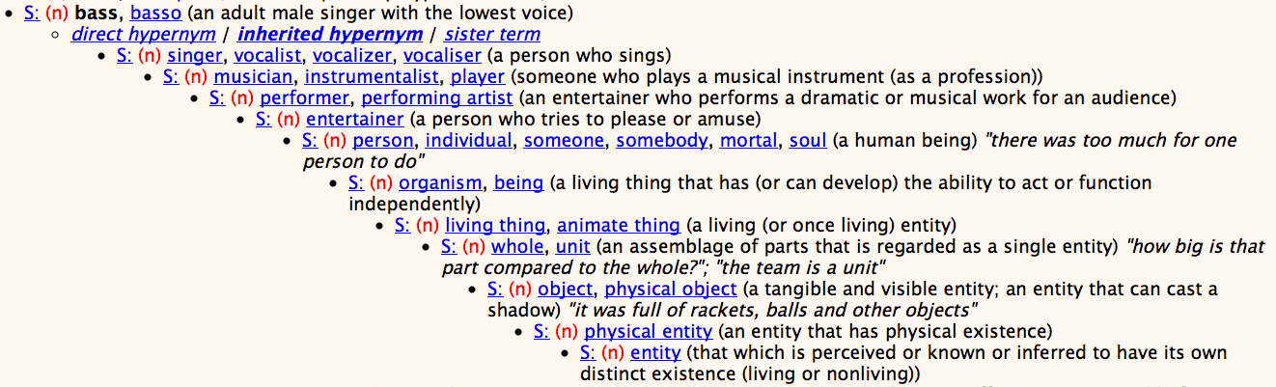
WordNet Hypernym Hierarchy for “bass”

Slide 40
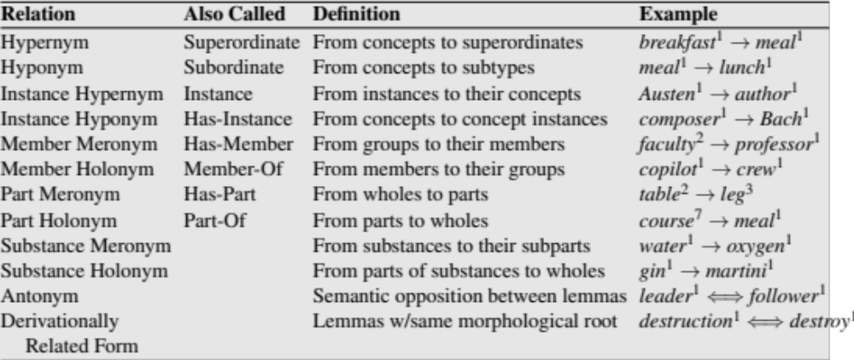
WordNet Noun Relations

Slide 41
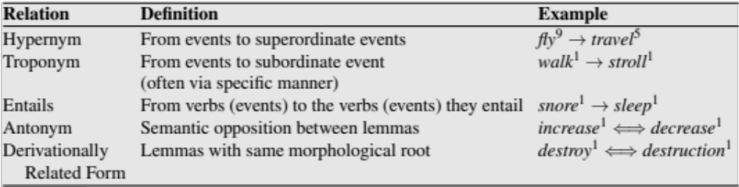
WordNet VerbRelations

Slide 42
WordNet: Viewed as a graph

Slide 43
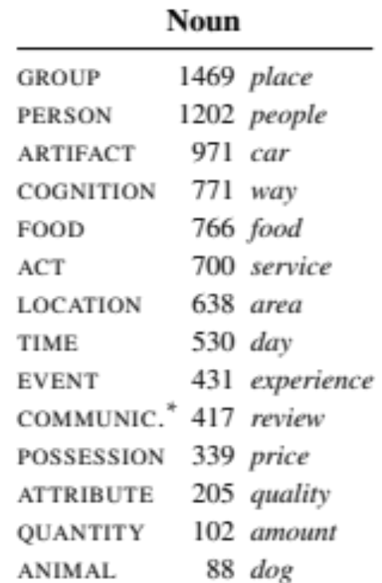
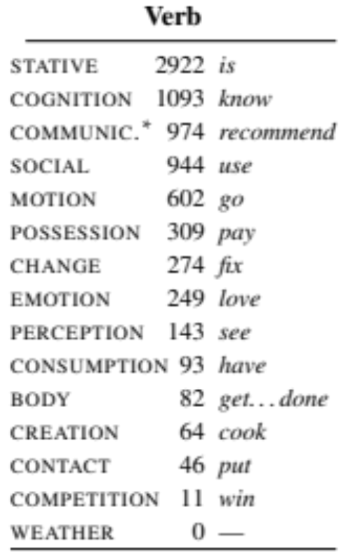
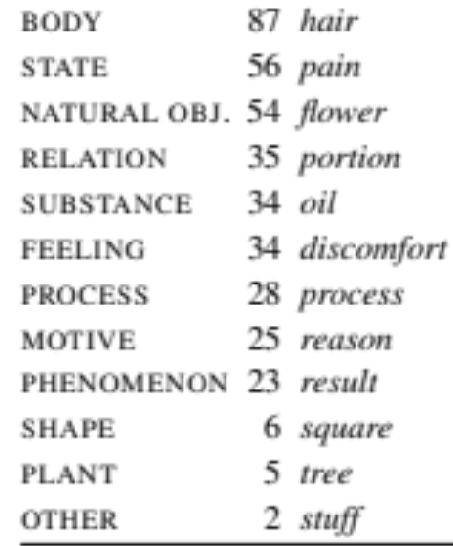
“Supersenses”
The top level hypernyms in the hierarchy
(counts from Schneider and Smith 2013’s Streusel corpus)

Slide 44
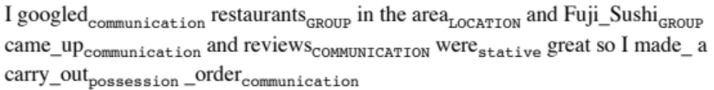
Supersenses
A word’s supersense can be a useful coarse-grained representation of word meaning for NLP tasks

Slide 45
WordNet 3.0
Where it is:
  http://wordnetweb.princeton.edu/perl/webwn
Libraries
  Python: WordNet from NLTK
    http://www.nltk.org/Home
  Java:
    JWNL, extJWNL on sourceforge

Slide 46
Other (domain specific) thesauri

Slide 47
MeSH: Medical Subject Headings thesaurus from the National Library of Medicine
MeSH (Medical Subject Headings)
  177,000 entry terms that correspond to 26,142 biomedical “headings”
Hemoglobins
  Entry Terms: Eryhem, Ferrous Hemoglobin, Hemoglobin
  Definition: The oxygen-carrying proteins of ERYTHROCYTES. They are found in all vertebrates and some invertebrates. The number of globin subunits in the hemoglobin quaternary structure differs between species. Structures range from monomeric to a variety of multimeric arrangements
Synset

Slide 48
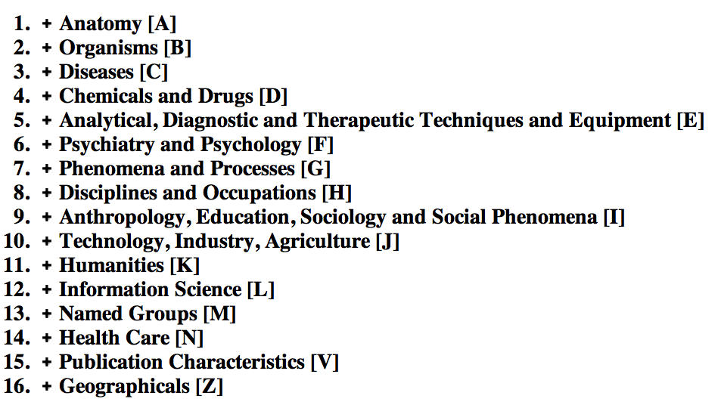
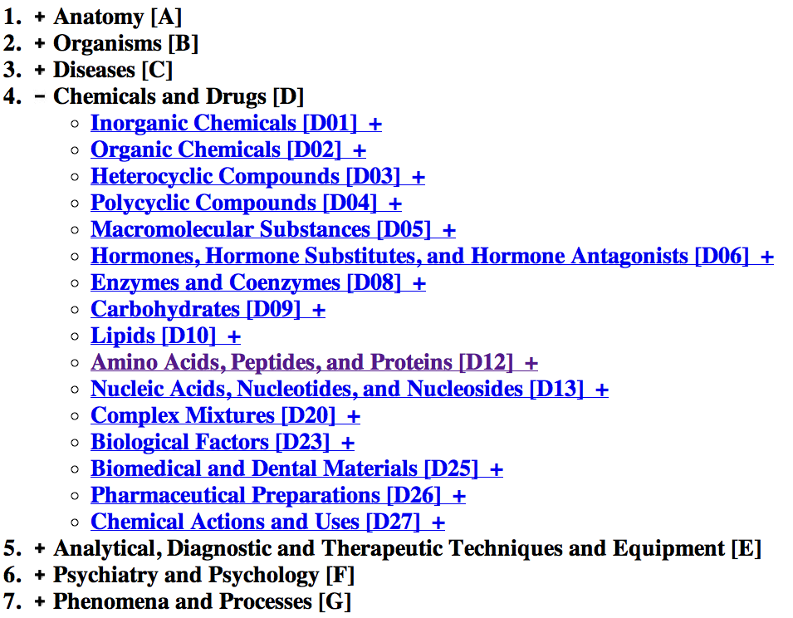
The MeSH Hierarchy
a

Slide 49
Uses of the MeSH Ontology
Provide synonyms (“entry terms”)
  E.g., glucose and dextrose
Provide hypernyms (from the hierarchy)
  E.g., glucose ISA monosaccharide
Indexing in MEDLINE/PubMED database
  NLM’s bibliographic database:
    20 million journal articles
    Each article hand-assigned 10-20 MeSH terms

Slide 50
Computing with a thesaurus
WordNet

Slide 51
Computing with a thesaurus
Word Similarity: Thesaurus Methods

Slide 52
Word Similarity
Synonymy: a binary relation
  Two words are either synonymous or not
Similarity (or distance): a looser metric
  Two words are more similar if they share more features of meaning
Similarity is properly a relation between senses
  The word “bank” is not similar to the word “slope”
  Bank¹ is similar to fund³
  Bank² is similar to slope⁵
But we’ll compute similarity over both words and senses

Slide 53
Why word similarity
A practical component in lots of NLP tasks
  Question answering
  Natural language generation
  Automatic essay grading
  Plagiarism detection
A theoretical component in many linguistic and cognitive tasks
  Historical semantics
  Models of human word learning
  Morphology and grammar induction

Slide 54
Word similarity and word relatedness
We often distinguish word similarity from word relatedness
  Similar words: near-synonyms
  Related words: can be related any way
    car, bicycle: similar
    car, gasoline: related, not similar

Slide 55
Two classes of similarity algorithms
Thesaurus-based algorithms
  Are words “nearby” in hypernym hierarchy?
  Do words have similar glosses (definitions)?
Distributional algorithms
  Do words have similar distributional contexts?
  Distributional (Vector) semantics on Thursday!

Slide 56
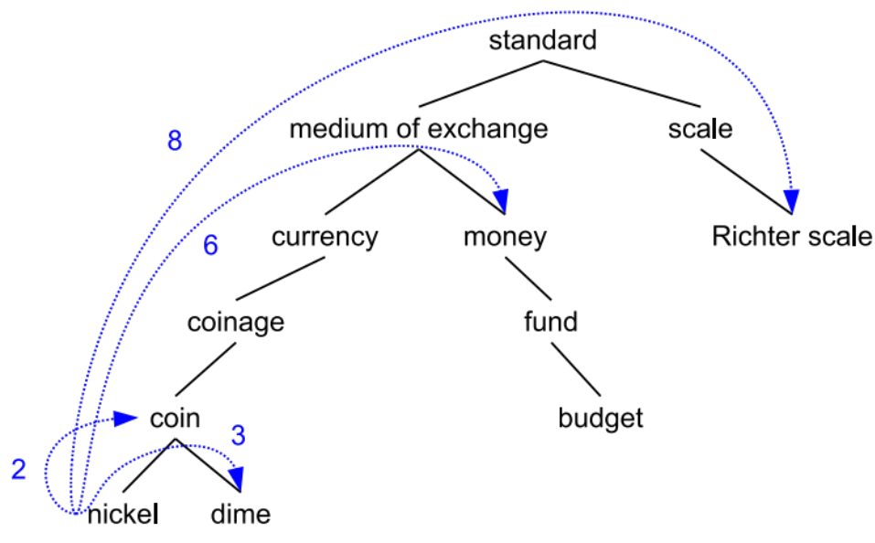
Path based similarity
Two concepts (senses/synsets) are similar if they are near each other in the thesaurus hierarchy
  =have a short path between them
  concepts have path 1 to themselves

Slide 57
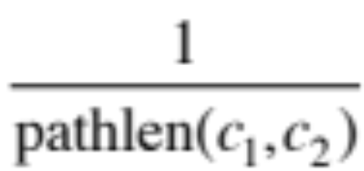
Refinements to path-based similarity
pathlen(c₁,c₂) = 1 + number of edges in the shortest path in the hypernym graph between sense nodes c₁ and c₂
ranges from 0 to 1 (identity)
simpath(c₁,c₂) =
wordsim(w₁,w₂) = max sim(c₁,c₂)
c₁∈senses(w₁),c₂∈senses(w₂)

Slide 58
Example: path-based similarity simpath(c₁,c₂) = 1/pathlen(c₁,c₂)
simpath(nickel,coin) = 1/2 = .5
simpath(fund,budget) = 1/2 = .5
simpath(nickel,currency) = 1/4 = .25
simpath(nickel,money) = 1/6 = .17
simpath(coinage,Richter scale) = 1/6 = .17

Slide 59
Problem with basic path-based similarity
Assumes each link represents a uniform distance
  But nickel to money seems to us to be closer than nickel to standard
  Nodes high in the hierarchy are very abstract
We instead want a metric that
  Represents the cost of each edge independently
  Words connected only through abstract nodes
    are less similar

Slide 60
Information content similarity metrics
Resnik 1995
Let’s define P(c) as:
  The probability that a randomly selected word in a corpus is an instance of concept c
  Formally: there is a distinct random variable, ranging over words, associated with each concept in the hierarchy
    for a given concept, each observed noun is either
      a member of that concept with probability P(c)
      not a member of that concept with probability 1-P(c)
  All words are members of the root node (Entity)
    P(root)=1
  The lower a node in hierarchy, the lower its probability

Slide 61
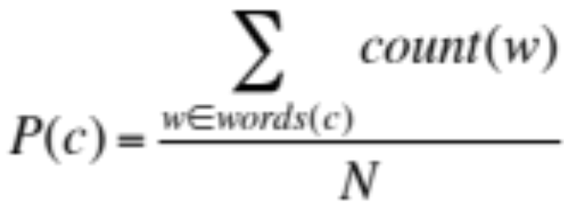
Information content similarity
entity
…
geological-formation
Train by counting in a corpus
  Each instance of hill counts toward frequency
  of natural elevation, geological formation, entity, etc
  Let words(c) be the set of all words that are children of node c
    words(“geo-formation”) = {hill,ridge,grotto,coast,cave,shore,natural elevation}
    words(“natural elevation”) = {hill, ridge}
natural elevation
cave
shore
hill
ridge
grotto
coast

Slide 62
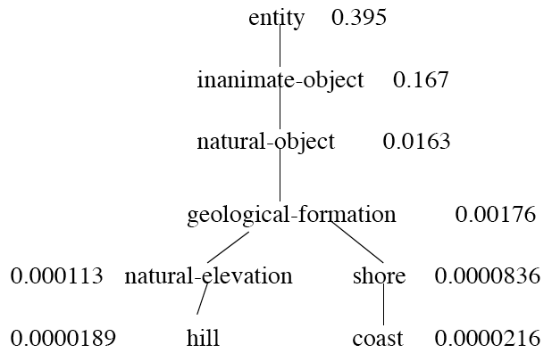
Information content similarity
WordNet hierarchy augmented with probabilities P(c)
D. Lin. 1998. An Information-Theoretic Definition of Similarity. ICML 1998

Slide 63
Information content and probability
The self-information of an event, also called its surprisal:
  how surprised we are to know it; how much we learn by knowing it.
  The more surprising something is, the more it tells us when it happens
  We’ll measure self-information in bits.
  I(w)= -log2 P(w)
I flip a coin; P(heads)= 0.5
How many bits of information do I learn by flipping it?
  I(heads) = -log2(0.5) = -log2 (1/2) = log2 (2) = 1 bit
I flip a biased coin: P(heads )= 0.8 I don’t learn as much
  I(heads) = -log2(0.8) = -log2(0.8) = .32 bits

Slide 64
Information content: definitions
1.3 bits
Information content:
  IC(c) = -log P(c)
Most informative subsumer (Lowest common subsumer)
  LCS(c₁,c₂) =
  The most informative (lowest) node in the hierarchy subsuming both c₁ and c₂
5.9 bits
9.1 bits
15.7 bits

Slide 65
Using information content for similarity: the Resnik method
Philip Resnik. 1995. Using Information Content to Evaluate Semantic Similarity in a Taxonomy. IJCAI 1995.
Philip Resnik. 1999. Semantic Similarity in a Taxonomy: An Information-Based Measure and its Application to Problems of Ambiguity in Natural Language. JAIR 11, 95-130.
The similarity between two words is related to their common information
The more two words have in common, the more similar they are
Resnik: measure common information as:
  The information content of the most informative
  (lowest) subsumer (MIS/LCS) of the two nodes
  sim_{resnik}(c₁,c₂) = -log P( LCS(c₁,c₂) )

Slide 66
Dekang Lin method
Dekang Lin. 1998. An Information-Theoretic Definition of Similarity. ICML
Intuition: Similarity between A and B is not just what they have in common
The more differences between A and B, the less similar they are:
  Commonality: the more A and B have in common, the more similar they are
  Difference: the more differences between A and B, the less similar
Commonality: IC(common(A,B))
Difference: IC(description(A,B)-IC(common(A,B))

Slide 67
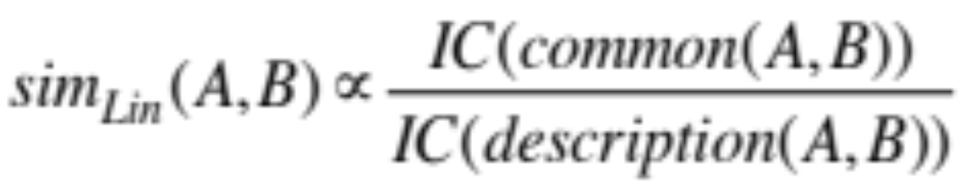
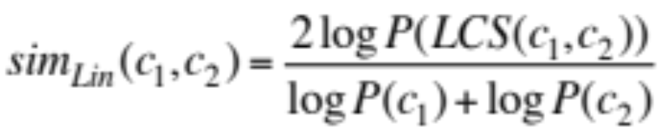
Dekang Lin similarity theorem
The similarity between A and B is measured by the ratio between the amount of information needed to state the commonality of A and B and the information needed to fully describe what A and B are
Lin (altering Resnik) defines IC(common(A,B)) as 2 x information of the LCS

Slide 68
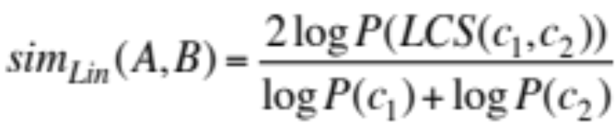
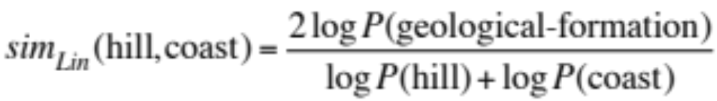
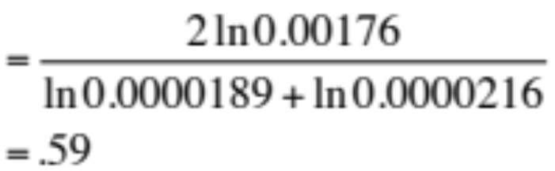
Lin similarity function

Slide 69
The (extended) Lesk Algorithm
A thesaurus-based measure that looks at glosses
Two concepts are similar if their glosses contain similar words
  Drawing paper: paper that is specially prepared for use in drafting
  Decal: the art of transferring designs from specially prepared paper to a wood or glass or metal surface
For each n-word phrase that’s in both glosses
  Add a score of n²
  Paper and specially prepared for 1 + 2² = 5
  Compute overlap also for other relations
    glosses of hypernyms and hyponyms

Slide 70
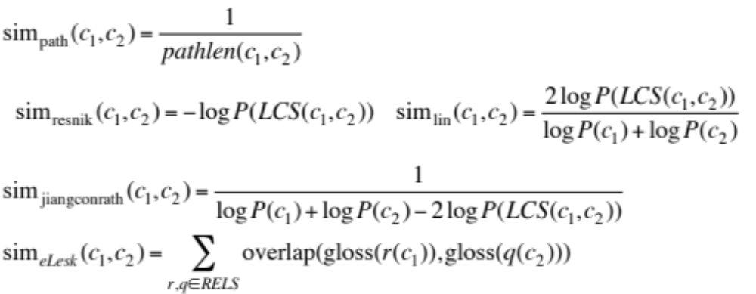
Summary: thesaurus-based similarity

Slide 71
Libraries for computing thesaurus-based similarity
NLTK
  http://nltk.github.com/api/nltk.corpus.reader.html?highlight=similarity - nltk.corpus.reader.WordNetCorpusReader.res_similarity
WordNet::Similarity
  http://wn-similarity.sourceforge.net/
  Web-based interface:
    http://marimba.d.umn.edu/cgi-bin/similarity/similarity.cgi

Slide 72
Evaluating similarity
Extrinsic (task-based, end-to-end) Evaluation:
  Question Answering
  Spell Checking
  Essay grading
Intrinsic Evaluation:
  Correlation between algorithm and human word similarity ratings
    Wordsim353: 353 noun pairs rated 0-10. sim(plane,car)=5.77
  Taking TOEFL multiple-choice vocabulary tests
    Levied is closest in meaning to:
    imposed, believed, requested, correlated

Slide 73
Computing with a thesaurus
Word Similarity: Thesaurus Methods

