Slide 1
LSA 311
Computational Lexical Semantics
Dan Jurafsky
Stanford University
Lecture 2: Word Sense Disambiguation

Slide 2
Word Sense Disambiguation (WSD)
Given
  A word in context
  A fixed inventory of potential word senses
  Decide which sense of the word this is
Why? Machine translation, QA, speech synthesis
What set of senses?
  English-to-Spanish MT: set of Spanish translations
  Speech Synthesis: homographs like bass and bow
  In general: the senses in a thesaurus like WordNet

Slide 3
Two variants of WSD task
Lexical Sample task
  Small pre-selected set of target words (line, plant)
  And inventory of senses for each word
  Supervised machine learning: train a classifier for each word
All-words task
  Every word in an entire text
  A lexicon with senses for each word
  Data sparseness: can’t train word-specific classifiers

Slide 4
WSD Methods
Supervised Machine Learning
Thesaurus/Dictionary Methods
Semi-Supervised Learning

Slide 5
Word Sense Disambiguation
Supervised Machine Learning

Slide 6
Supervised Machine Learning Approaches
Supervised machine learning approach:
  a training corpus of words tagged in context with their sense
  used to train a classifier that can tag words in new text
Summary of what we need:
  the tag set (“sense inventory”)
  the training corpus
  A set of features extracted from the training corpus
  A classifier

Slide 7
Supervised WSD 1: WSD Tags
What’s a tag?
  A dictionary sense?
For example, for WordNet an instance of “bass” in a text has 8 possible tags or labels (bass1 through bass8).

Slide 8
8 senses of “bass” in WordNet
bass - (the lowest part of the musical range)
bass, bass part - (the lowest part in polyphonic music)
bass, basso - (an adult male singer with the lowest voice)
sea bass, bass - (flesh of lean-fleshed saltwater fish of the family Serranidae)
freshwater bass, bass - (any of various North American lean-fleshed freshwater fishes especially of the genus Micropterus)
bass, bass voice, basso - (the lowest adult male singing voice)
bass - (the member with the lowest range of a family of musical instruments)
bass - (nontechnical name for any of numerous edible marine and freshwater spiny-finned fishes)

Slide 9
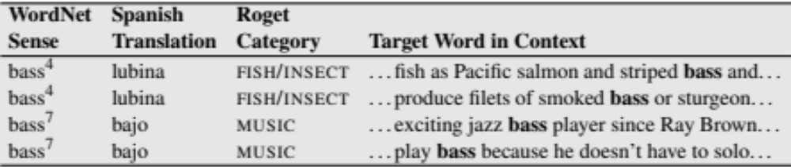
Inventory of sense tags for bass

Slide 10
Supervised WSD 2: Get a corpus
Lexical sample task:
  Line-hard-serve corpus - 4000 examples of each
  Interest corpus - 2369 sense-tagged examples
All words:
  Semantic concordance: a corpus in which each open-class word is labeled with a sense from a specific dictionary/thesaurus.
    SemCor: 234,000 words from Brown Corpus, manually tagged with WordNet senses
    SENSEVAL-3 competition corpora - 2081 tagged word tokens

Slide 11
SemCor
<wf pos=PRP>He</wf>
<wf pos=VB lemma=recognize wnsn=4 lexsn=2:31:00::>recognized</wf>
<wf pos=DT>the</wf>
<wf pos=NN lemma=gesture wnsn=1 lexsn=1:04:00::>gesture</wf>
<punc>.</punc>

Slide 12
Supervised WSD 3: Extract feature vectors
Intuition from Warren Weaver (1955):
  “If one examines the words in a book, one at a time as through an opaque mask with a hole in it one word wide, then it is obviously impossible to determine, one at a time, the meaning of the words…
  But if one lengthens the slit in the opaque mask, until one can see not only the central word in question but also say N words on either side, then if N is large enough one can unambiguously decide the meaning of the central word…
  The practical question is : ``What minimum value of N will, at least in a tolerable fraction of cases, lead to the correct choice of meaning for the central word?”

Slide 13
Feature vectors
A simple representation for each observation
  (each instance of a target word)
  Vectors of sets of feature/value pairs
  Represented as a ordered list of values
  These vectors represent, e.g., the window of words around the target

Slide 14
Two kinds of features in the vectors
Collocational features and bag-of-words features
  Collocational
    Features about words at specific positions near target word
      Often limited to just word identity and POS
  Bag-of-words
    Features about words that occur anywhere in the window (regardless of position)
      Typically limited to frequency counts

Slide 15
Examples
Example text (WSJ):
  An electric guitar and bass player stand off to one side not really part of the scene
Assume a window of +/- 2 from the target

Slide 16
Examples
Example text (WSJ)
  An electric guitar and bass player stand off to one side not really part of the scene,
Assume a window of +/- 2 from the target

Slide 17
Collocational features
Position-specific information about the words and collocations in window
guitar and bass player stand
word 1,2,3 grams in window of ±3 is common

Slide 18
Bag-of-words features
“an unordered set of words” – position ignored
Counts of words occur within the window.
First choose a vocabulary
Then count how often each of those terms occurs in a given window
  sometimes just a binary “indicator” 1 or 0

Slide 19
Co-Occurrence Example
Assume we’ve settled on a possible vocabulary of 12 words in “bass” sentences:
[fishing, big, sound, player, fly, rod, pound, double, runs, playing, guitar, band]
The vector for:
  guitar and bass player stand
[0,0,0,1,0,0,0,0,0,0,1,0]

Slide 20
Word Sense Disambiguation
Classification

Slide 21
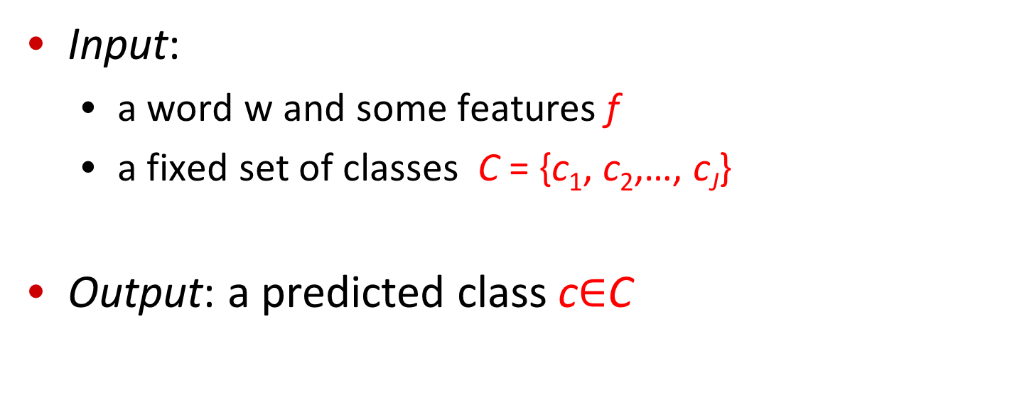
Classification: definition
Input:
  a word w and some features f
  a fixed set of classes C = {c₁, c₂,…, c_{J}}
Output: a predicted class c$∈$C

Slide 22
Classification Methods:
Supervised Machine Learning
Input:
  a word w in a text window d (which we’ll call a “document”)
  a fixed set of classes C = {c₁, c₂,…, c_{J}}
  A training set of m hand-labeled text windows again called “documents” (d₁,c₁),....,(d_{m},c_{m})
Output:
  a learned classifier γ:d → c

Slide 23
Classification Methods:
Supervised Machine Learning
Any kind of classifier
  Naive Bayes
  Logistic regression
  Neural Networks
  Support-vector machines
  k-Nearest Neighbors
  …

Slide 24
Word Sense Disambiguation
The Naive Bayes Classifier

Slide 25
Naive Bayes Intuition
Simple (“naive”) classification method based on Bayes rule
Relies on very simple representation of document
  Bag of words

Slide 26
I’ll introduce classification with an even simpler supervised learning task
Let’s classify a movie review as positive (+) or negative (-)
Suppose we have lots of reviews labeled as (+) or (-) and I give you a new review.
Given: the words in this new movie review
Return: one of 2 classes: + or –

Slide 27
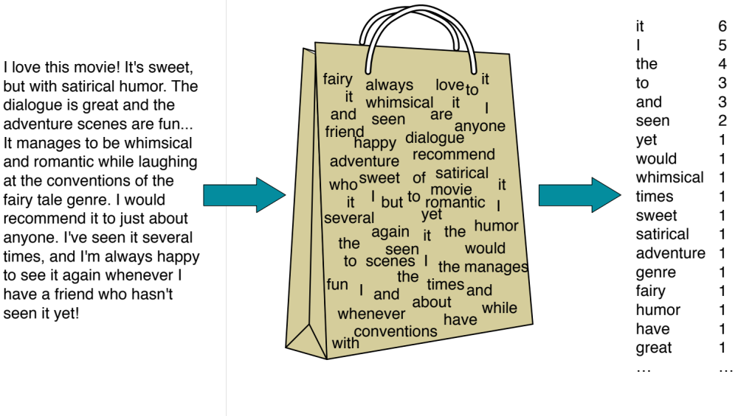
The Bag of Words Representation

Slide 28


The bag of words representation
seen | 2
sweet | 1
whimsical | 1
recommend | 1
happy | 1
... | ...
γ(
)=c

Slide 29
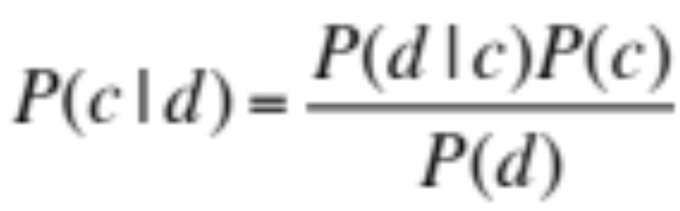
Bayes’ Rule Applied to Documents and Classes
For a document d and a class c

Slide 30
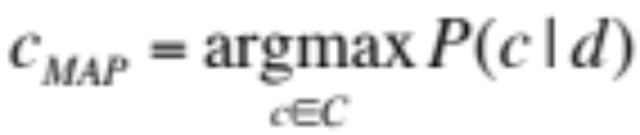
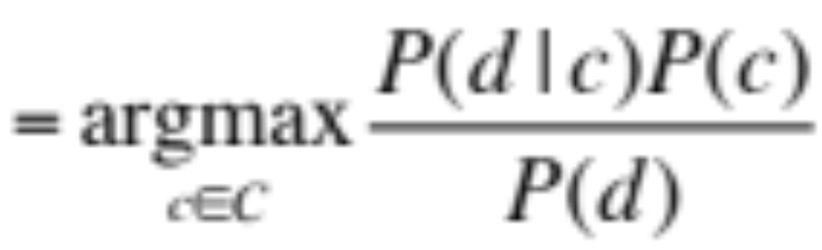
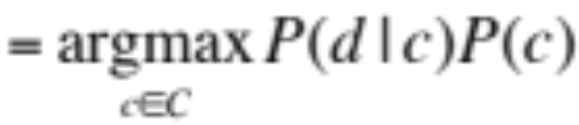
Naive Bayes Classifier (I)
MAP is “maximum a posteriori” = most likely class
Bayes Rule
Dropping the denominator

Slide 31
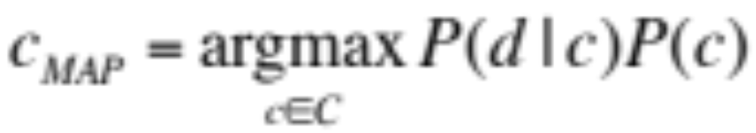
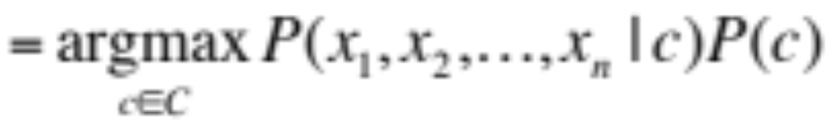
Naive Bayes Classifier (II)
Document d represented as features x1..xn

Slide 32
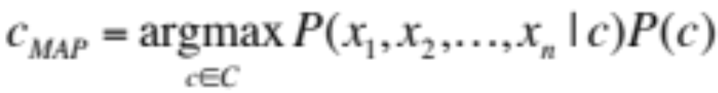
Naive Bayes Classifier (IV)
  O(|X|^{n}•|C|) parameters
How often does this class occur?
  Could only be estimated if a very, very large number of training examples was available.
We can just count the relative frequencies in a corpus

Slide 33
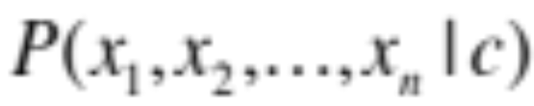
Multinomial Naive Bayes Independence Assumptions
Bag of Words assumption: Assume position doesn’t matter
Conditional Independence: Assume the feature probabilities P(x_{i}|c_{j}) are independent given the class c.

Slide 34
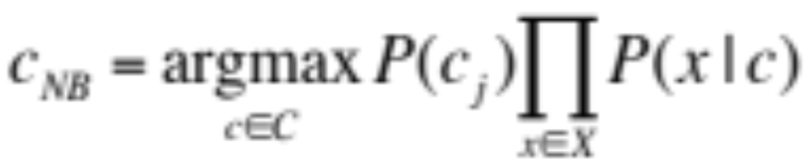
Multinomial Naive Bayes Classifier

Slide 35
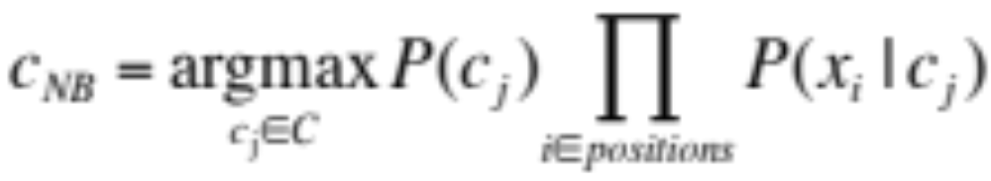
Applying Multinomial Naive Bayes Classifiers to Text Classification
positions = all word positions in test document

Slide 36
Classification
Naive Bayes

Slide 37
Classification
Learning the Naive Bayes Classifier

Slide 38
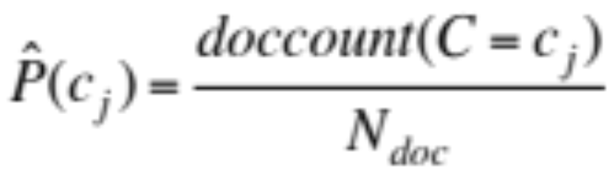
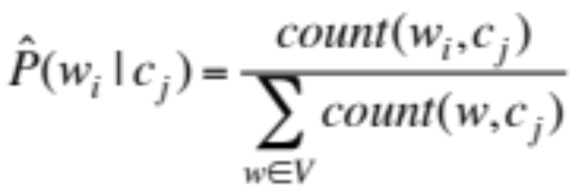
Learning the Multinomial Naive Bayes Model
Sec.13.3
First attempt: maximum likelihood estimates
  simply use the frequencies in the data

Slide 39
Parameter estimation
fraction of times word w_{i} appears
among all words in documents of topic c_{j}
Create mega-document for topic j by concatenating all docs in this topic
  Use frequency of w in mega-document

Slide 40
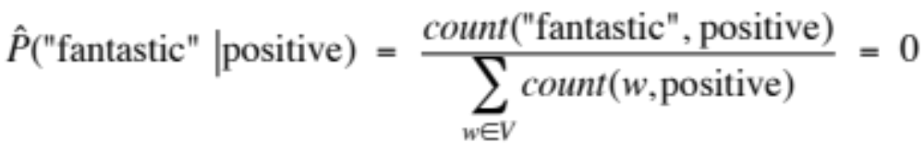
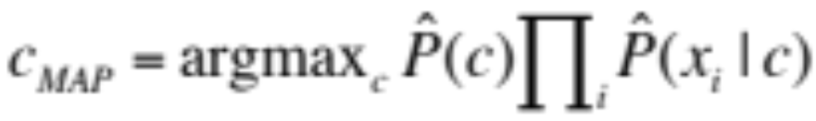
Problem with Maximum Likelihood
Sec.13.3
What if we have seen no training documents with the word fantastic and classified in the topic positive (thumbs-up)?
Zero probabilities cannot be conditioned away, no matter the other evidence!

Slide 41
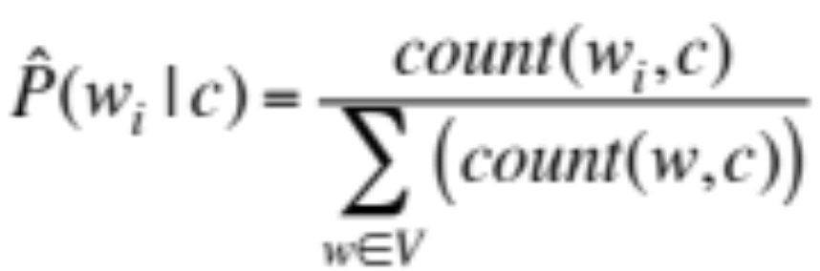
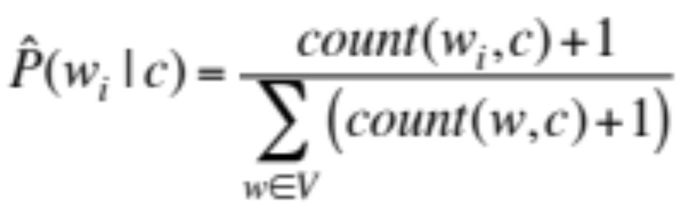
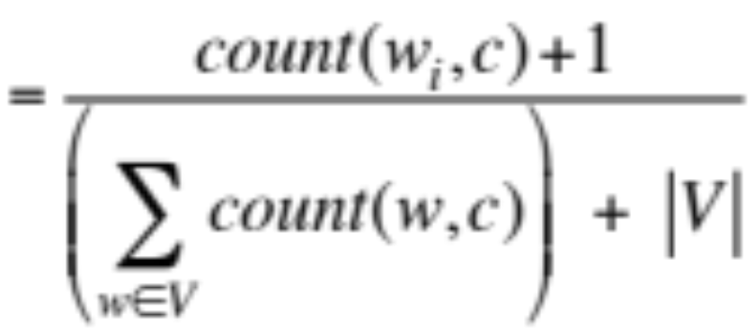
Laplace (add-1) smoothing for Naïve Bayes

Slide 42


Multinomial Naïve Bayes: Learning
From training corpus, extract Vocabulary
Calculate P(c_{j}) terms
  For each c_{j} in C do
    docs_{j} ← all docs with class =c_{j}
Calculate P(w_{k} | c_{j}) terms
  Text_{j} ← single doc containing all docs_{j}
  For each word w_{k} in Vocabulary
    n_{k} ← # of occurrences of w_{k} in Text_{j}

Slide 43
Word Sense Disambiguation
Learning the Naive Bayes Classifier

Slide 44
Word Sense Disambiguation
Multinomial Naive Bayes: A Worked Example for WSD

Slide 45
Applying Naive Bayes to WSD
P(c) is the prior probability of that sense
  Counting in a labeled training set.
P(w|c) conditional probability of a word given a particular sense
  P(w|c) = count(w,c)/count(c)
We get both of these from a tagged corpus like SemCor
Can also generalize to look at other features besides words.
  Then it would be P(f|c)
    Conditional probability of a feature given a sense

Slide 46
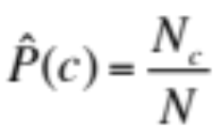
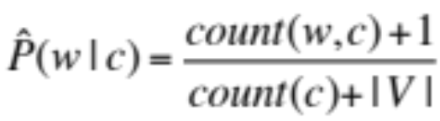
 | Doc | Words | Class
Training | 1 | fish smoked fish | f
 | 2 | fish line | f
 | 3 | fish haul smoked | f
 | 4 | guitar jazz line | g
Test | 5 | line guitar jazz jazz | ?
Priors:
P(f)=
P(g)=
V = {fish, smoked, line, haul, guitar, jazz}
3
4
1
Choosing a class:
P(f|d5)
P(g|d5)
4
  3/4 * 2/14 * (1/14)² * 1/14
  ≈ 0.00003
Conditional Probabilities:
P(line|f) =
P(guitar|f) =
P(jazz|f) =
P(line|g) =
P(guitar|g) =
P(jazz|g) =
(1+1) / (8+6) = 2/14
(0+1) / (8+6) = 1/14
  1/4 * 2/9 * (2/9)² * 2/9
  ≈ 0.0006
(0+1) / (8+6) = 1/14
(1+1) / (3+6) = 2/9
(1+1) / (3+6) = 2/9
(1+1) / (3+6) = 2/9

Slide 47
Word Sense Disambiguation
Evaluations and Baselines

Slide 48
WSD Evaluations and baselines
Best evaluation: extrinsic (‘end-to-end’, `task-based’) evaluation
  Embed WSD algorithm in a task and see if you can do the task better!
What we often do for convenience: intrinsic evaluation
  Exact match sense accuracy
    % of words tagged identically with the human-manual sense tags
  Usually evaluate using held-out data from same labeled corpus
Baselines
  Most frequent sense
  The Lesk algorithm

Slide 49
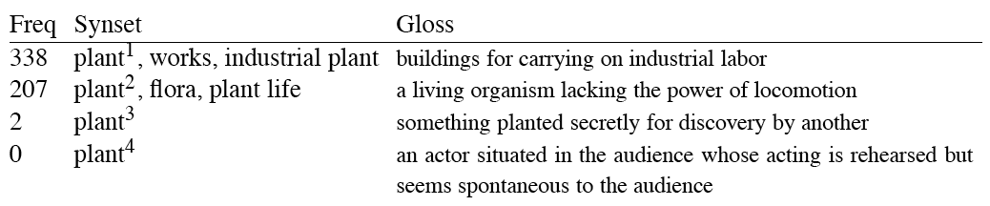
Most Frequent Sense
WordNet senses are ordered in frequency order
So “most frequent sense” in WordNet = “take the first sense”
Sense frequencies come from the SemCor corpus

Slide 50
Ceiling
Human inter-annotator agreement
  Compare annotations of two humans
  On same data
  Given same tagging guidelines
Human agreements on all-words corpora with WordNet style senses
  75%-80%

Slide 51
Word Sense Disambiguation
Dictionary and Thesaurus Methods

Slide 52
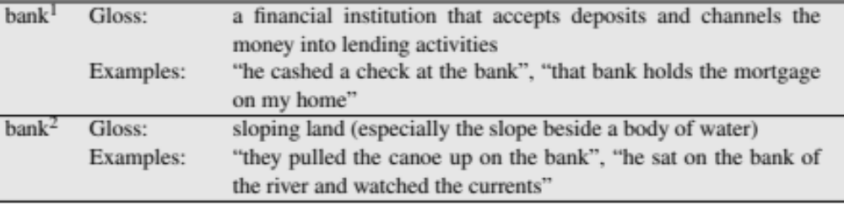
The Simplified Lesk algorithm
Let’s disambiguate “bank” in this sentence:
  The bank can guarantee deposits will eventually cover future tuition costs because it invests in adjustable-rate mortgage securities.
given the following two WordNet senses:

Slide 53
The Simplified Lesk algorithm
Choose sense with most word overlap between gloss and context
(not counting function words)
  The bank can guarantee deposits will eventually cover future tuition costs because it invests in adjustable-rate mortgage securities.

Slide 54
The Corpus Lesk algorithm
Assumes we have some sense-labeled data (like SemCor)
Take all the sentences with the relevant word sense:
  These short, "streamlined" meetings usually are sponsored by local banks¹, Chambers of Commerce, trade associations, or other civic organizations.
Now add these to the gloss + examples for each sense, call it the “signature” of a sense.
Choose sense with most word overlap between context and signature.

Slide 55
Corpus Lesk: IDF weighting
Instead of just removing function words
  Weigh each word by its `promiscuity’ across documents
  Down-weights words that occur in every `document’ (gloss, example, etc)
  These are generally function words, but is a more fine-grained measure
Weigh each overlapping word by inverse document frequency

Slide 56
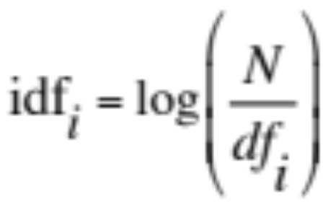
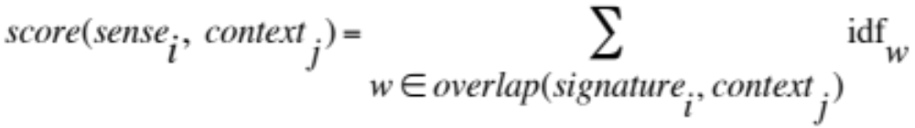
Corpus Lesk: IDF weighting
Weigh each overlapping word by inverse document frequency
  N is the total number of documents
  df_{i} = “document frequency of word i”
  = # of documents with word I

Slide 57
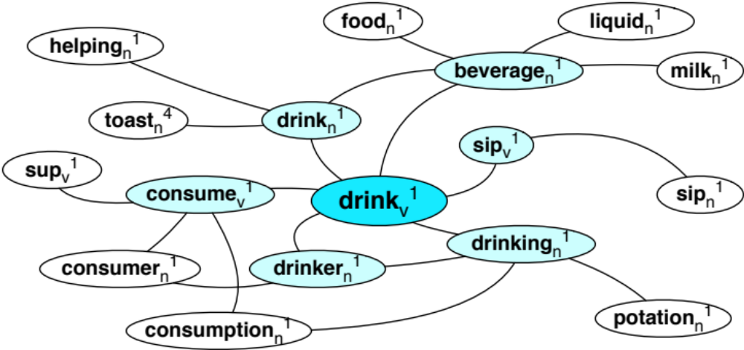
Graph-based methods
First, WordNet can be viewed as a graph
  senses are nodes
  relations (hypernymy, meronymy) are edges
  Also add edge between word and unambiguous gloss words

Slide 58
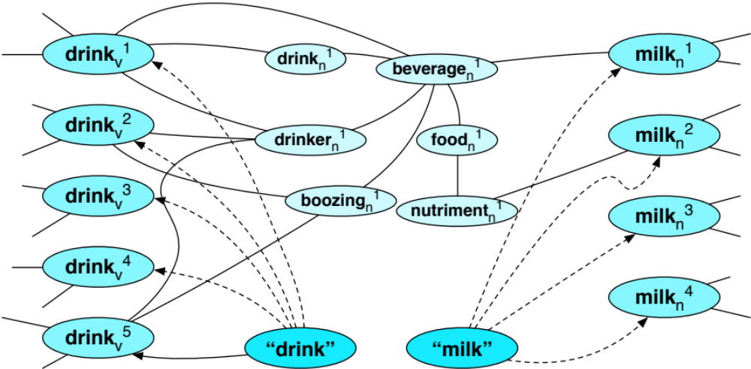
How to use the graph for WSD
Insert target word and words in its sentential context into the graph, with directed edges to their senses
“She drank some milk”
Now choose the
most central sense
Add some probability to
“drink” and “milk” and
compute node with
highest “pagerank”

Slide 59
Word Sense Disambiguation
Semi-Supervised Learning

Slide 60
Semi-Supervised Learning
Problem: supervised and dictionary-based approaches require large hand-built resources
  What if you don’t have so much training data?
Solution: Bootstrapping
  Generalize from a very small hand-labeled seed-set.

Slide 61
Bootstrapping
For bass
  Rely on “One sense per collocation” rule
    A word reoccurring in collocation with the same word will almost surely have the same sense.
  the word play occurs with the music sense of bass
  the word fish occurs with the fish sense of bass

Slide 62
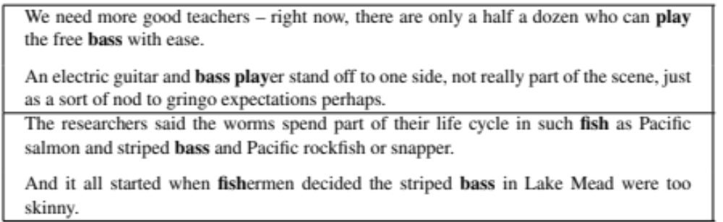
Sentences extracting using “fish” and “play”

Slide 63
Summary: generating seeds
Hand labeling
“One sense per collocation”:
  A word reoccurring in collocation with the same word will almost surely have the same sense.
“One sense per discourse”:
  The sense of a word is highly consistent within a document - Yarowsky (1995)
  (At least for non-function words, and especially topic-specific words)

Slide 64
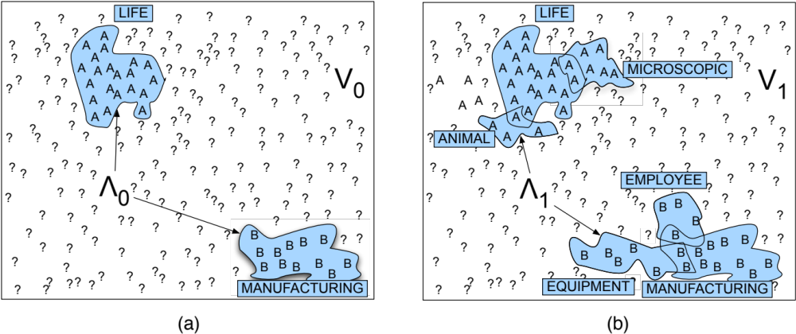
Stages in the Yarowsky bootstrapping algorithm for the word “plant”

Slide 65
Summary
Word Sense Disambiguation: choosing correct sense in context
Applications: MT, QA, etc.
Three classes of Methods
  Supervised Machine Learning: Naive Bayes classifier
  Thesaurus/Dictionary Methods
  Semi-Supervised Learning
Main intuition
  There is lots of information in a word’s context
  Simple algorithms based just on word counts can be surprisingly good

