Slide 1
Computational Lexical Semantics
Lecture 9: Learning Narrative Frames
Linguistic Institute 2005
University of Chicago

Slide 2
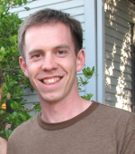
Unsupervised Semantic Role Labeling
Could we learn frames from text?
  Inducing Semantic Roles:
  Swier and Stevenson (2004), He and Gildea, 2006, Grenegar and Manning 2006, Titov and Klementiev (2012), Lang and Lapata (2014)
We’ll see how to learn something similar:
  Narrative frames
  The work of Nate Chambers:

Slide 3
Something in the air around 1975 about “background knowledge”
Framing (Goffman 1974)
Frames (Minsky 1974)
Interactional frames (Hymes 1974)
Schemata (Norman 1975)
Scripts (Shank and Abelson 1975)
Frames (Fillmore 1976)
With influences dating back to Bartlett 1932 and Bateson 1955…

Slide 4
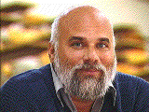
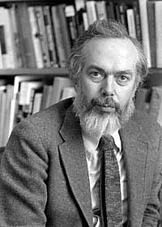
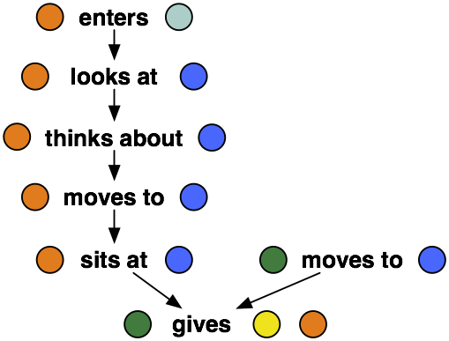
Scripts
Schank and Abelson. 1977. Scripts Plans Goals and Understanding. Lawrence Erlbaum.
Background models, like frames, focused on sequences of events and participants
Restaurant Script

Slide 5
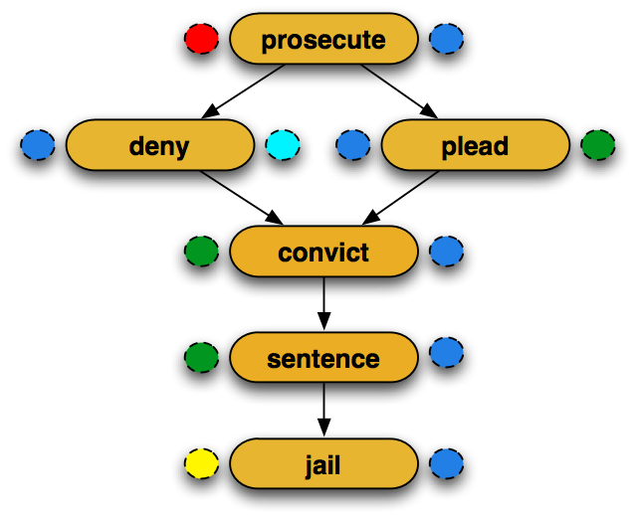


Learning Scripts/Frames:
Nate’s Two Joint Tasks
1. Events in the Narrative
2. Semantic Roles of the Participants
suspect, criminal, client, immigrant, journalist, government, …
police, agent, officer, authorities, troops, official, investigator, …
Notes:
- Mention subject/object during talk

Slide 6
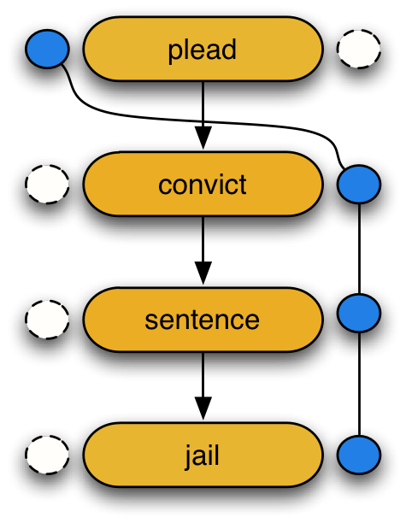
1. Learning Narrative Event Chains
Chambers and Jurafsky. Unsupervised Learning of Narrative Event Chains. ACL-08
Narrative Event Chain: a partially ordered set of narrative events that share a common actor (the protagonist)

Slide 7
Intuition for learning meaning from text
Narrative Coherence Assumption
Narratives are about protagonists.
Events with shared arguments are connected.
Centering (Grosz, Joshi, Weinstein 1983)
Cohesion (Halliday and Hasan 1976)
.
…blizzard dumped snow…
…They’ve been shoveling it…
Dumping shoveling
is-related-to

Slide 8
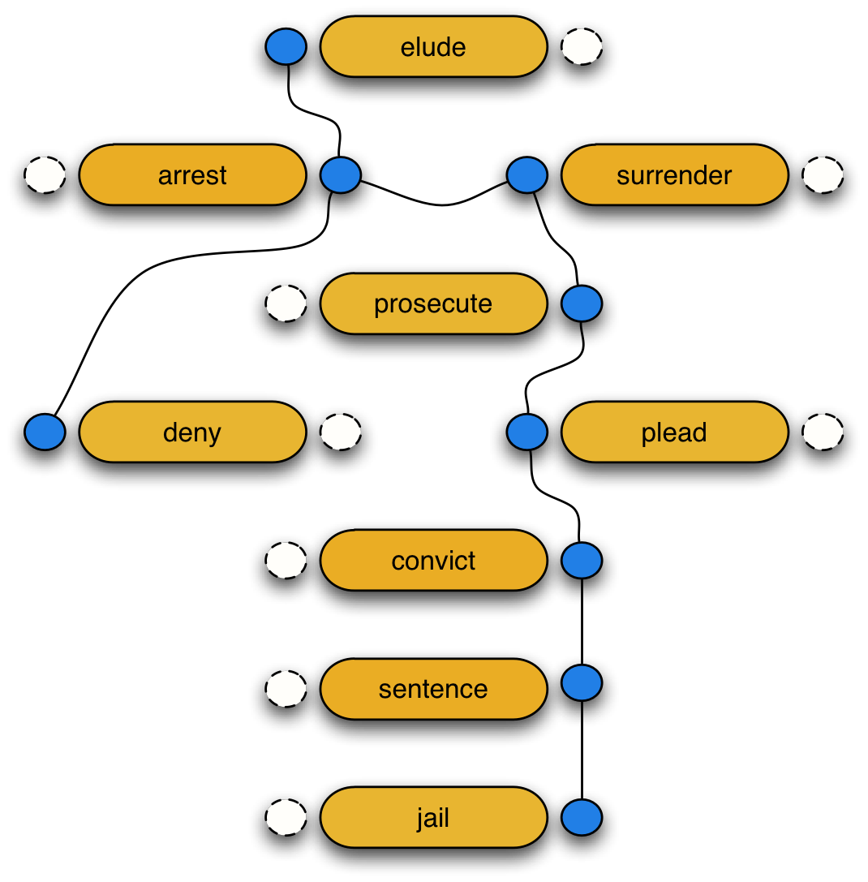
The Protagonist
protagonist:
(noun)
the principal character in a drama or other literary work
a leading actor, character, or participant in a literary work or real event

Slide 9
Processing a sample text
The oil stopped gushing from BP’s ruptured well in the Gulf of Mexico when it was capped on July 15 and engineers have since been working to permanently plug it. The damaged Macondo well has spewed about 4.9m barrels of oil into the gulf after an explosion on April 20 aboard the Deepwater Horizon rig which killed 11 people. BP said on Monday that its costs for stopping and cleaning up the spill had risen to $6.1bn.

Slide 10
Sample text: find events
The oil stopped gushing from BP’s ruptured well in the Gulf of Mexico when it was capped on July 15 and engineers have since been working to permanently plug it. The damaged Macondo well has spewed about 4.9m barrels of oil into the gulf after an explosion on April 20 aboard the Deepwater Horizon rig which killed 11 people. BP said on Monday that its costs for stopping and cleaning up the spill had risen to $6.1bn.

Slide 11
Sample text: find arguments
The oil stopped gushing from BP’s ruptured well in the Gulf of Mexico when it was capped on July 15 and engineers have since been working to permanently plug it. The damaged Macondo well has spewed about 4.9m barrels of oil into the gulf after an explosion on April 20 aboard the Deepwater Horizon rig which killed 11 people. BP said on Monday that its costs for stopping and cleaning up the spill had risen to $6.1bn.

Slide 12
Sample text: coreference
The oil stopped gushing from BP’s ruptured well in the Gulf of Mexico when it was capped on July 15 and engineers have since been working to permanently plug it. The damaged Macondo well has spewed about 4.9m barrels of oil into the gulf after an explosion on April 20 aboard the Deepwater Horizon rig which killed 11 people. BP said on Monday that its costs for stopping and cleaning up the spill had risen to $6.1bn.
The oil stopped
The damaged Macondo well spewed
gushing from BP’s ruptured well
spewed 4.9m barrels of oil
it capped
spewed into the gulf
engineers working
killed 11 people
engineers plug
BP said
plug it
risen to $6.1bn

Slide 13
Sample text: coreference
The oil stopped gushing from BP’s ruptured well in the Gulf of Mexico when it was capped on July 15 and engineers have since been working to permanently plug it. The damaged Macondo well has spewed about 4.9m barrels of oil into the gulf after an explosion on April 20 aboard the Deepwater Horizon rig which killed 11 people. BP said on Monday that its costs for stopping and cleaning up the spill had risen to $6.1bn.
The oil stopped
The damaged Macondo well spewed
gushing from BP’s ruptured well
spewed 4.9m barrels of oil
it capped
spewed into the gulf
engineers working
killed 11 people
engineers plug
BP said
plug it
risen to $6.1bn

Slide 14
Sample text: group events
The oil stopped gushing from BP’s ruptured well in the Gulf of Mexico when it was capped on July 15 and engineers have since been working to permanently plug it. The damaged Macondo well has spewed about 4.9m barrels of oil into the gulf after an explosion on April 20 aboard the Deepwater Horizon rig which killed 11 people. BP said on Monday that its costs for stopping and cleaning up the spill had risen to $6.1bn.
gushing from BP’s ruptured well
The oil stopped
spewed 4.9m barrels of oil
it capped
The damaged Macondo well spewed
engineers working
plug it
engineers plug

Slide 15
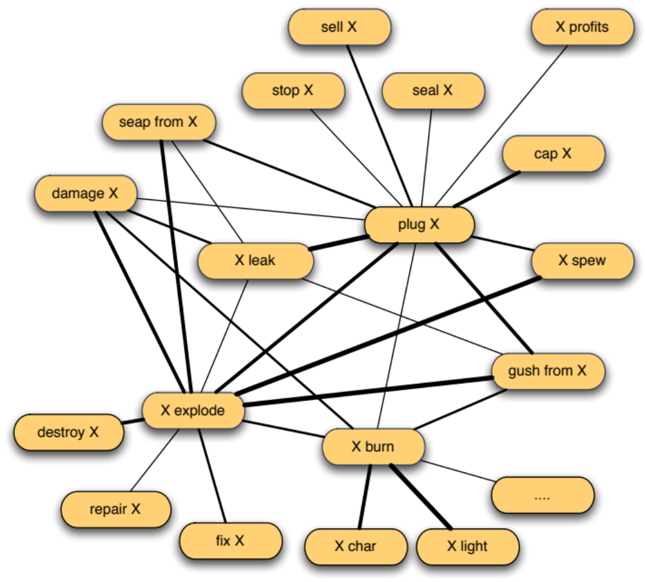
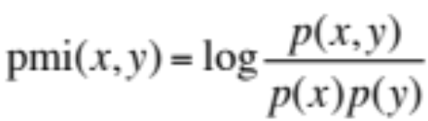
Pointwise Mutual Information
Linking grouped events

Slide 16
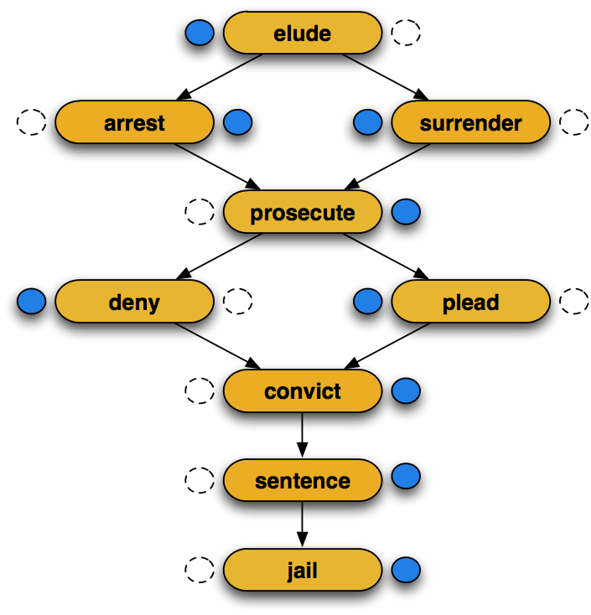
Resulting Chain Example

Slide 17
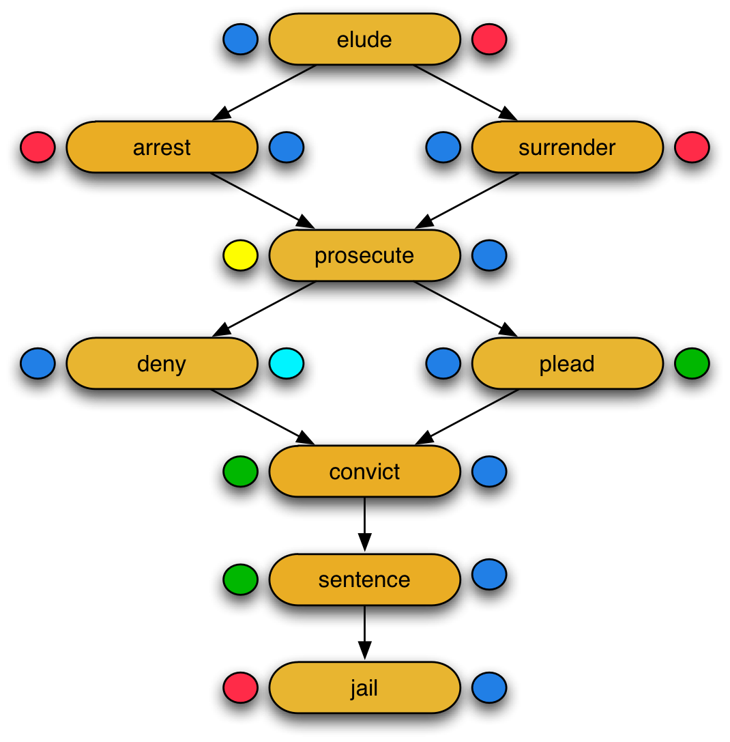
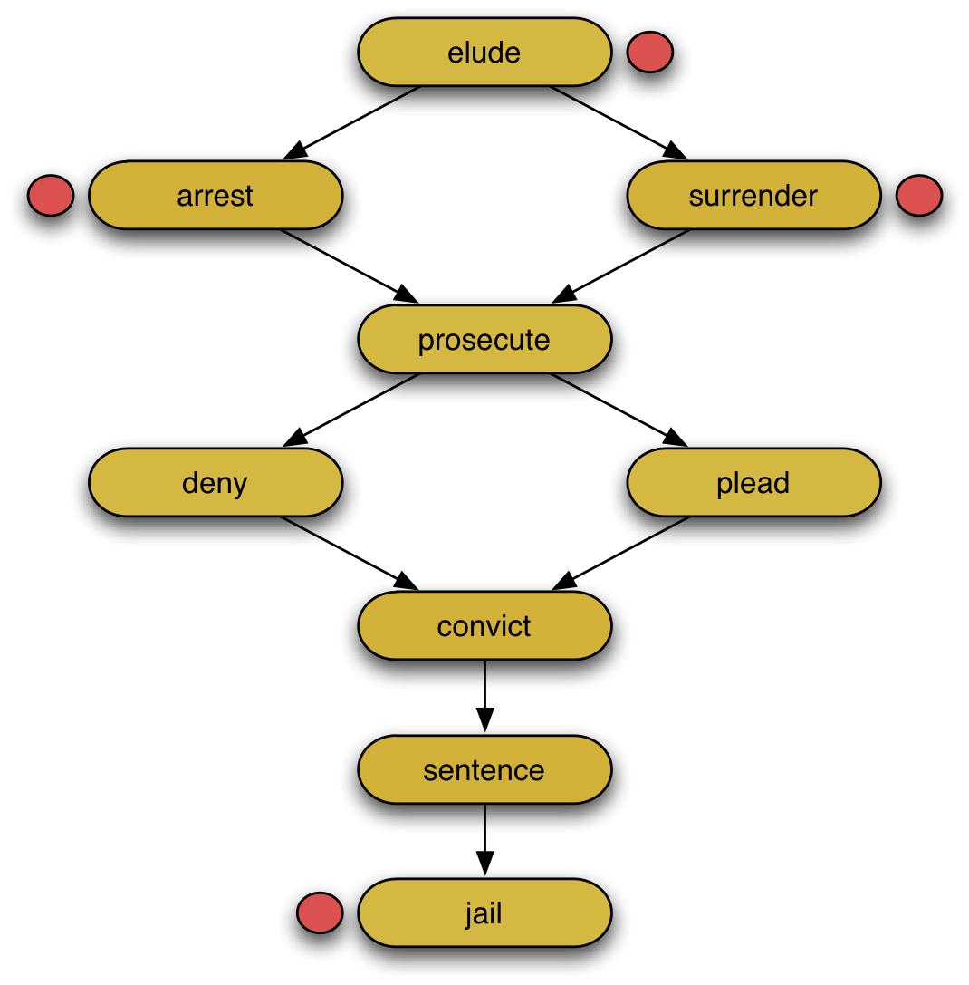
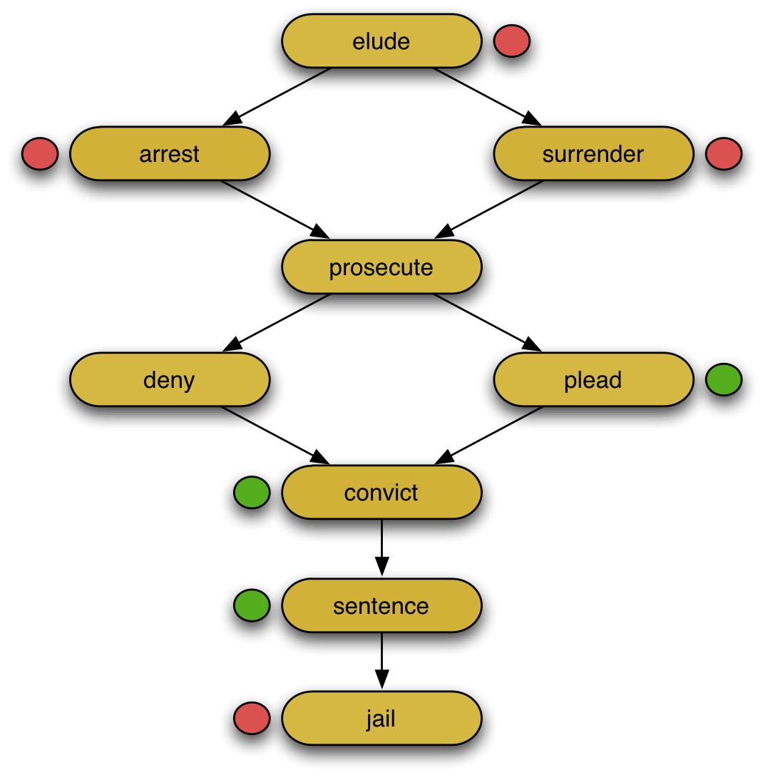
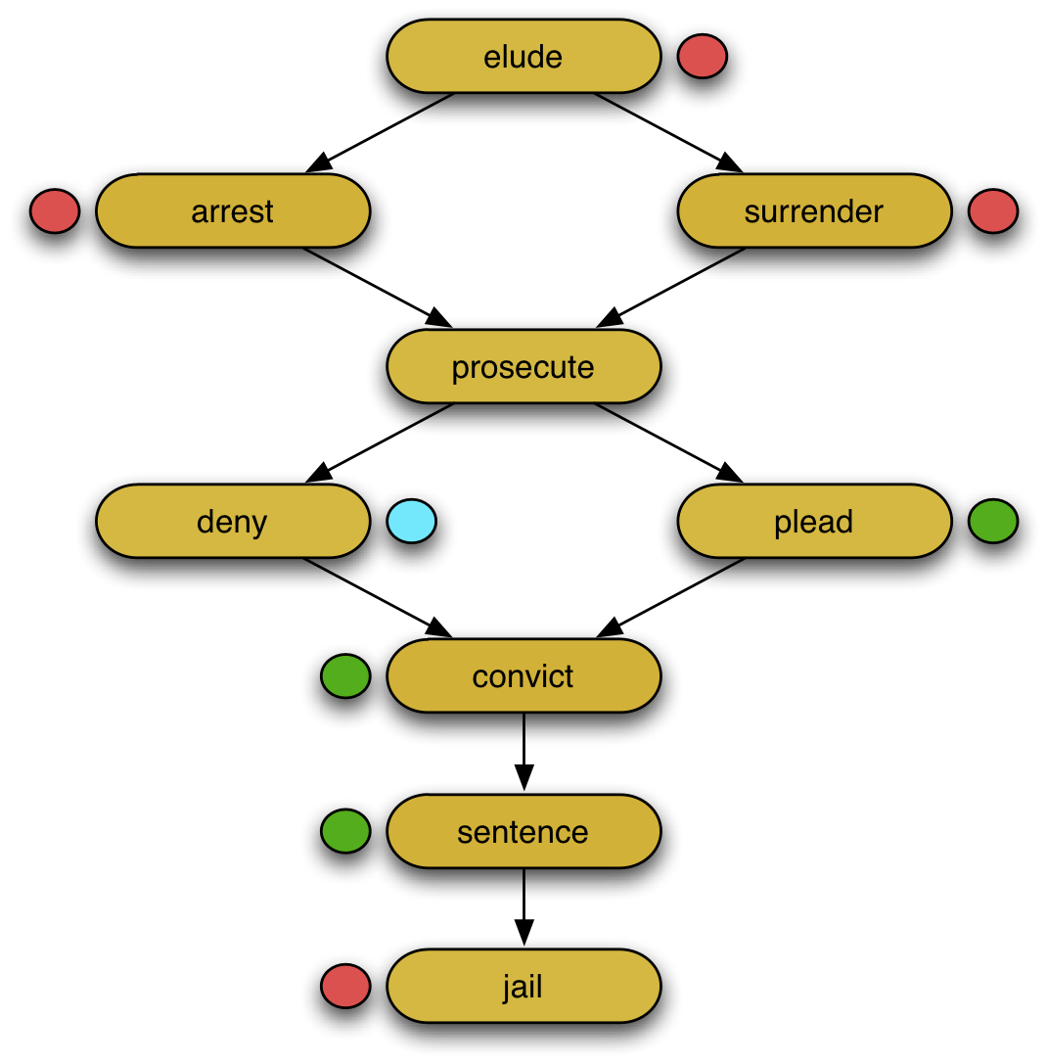
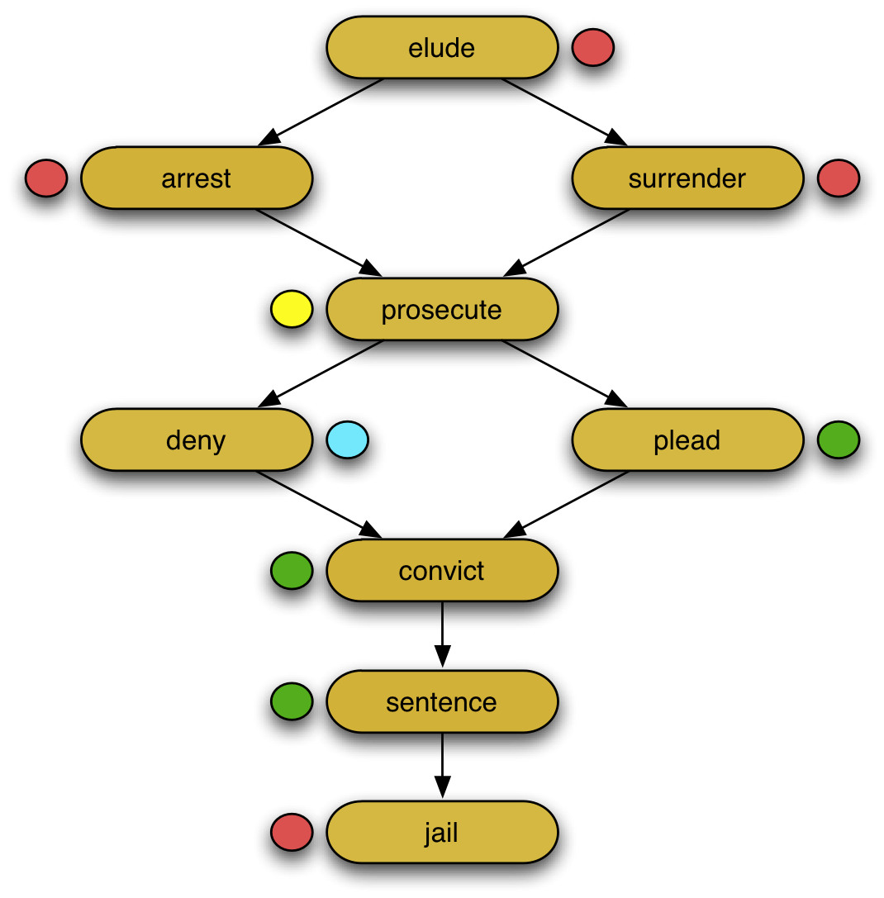
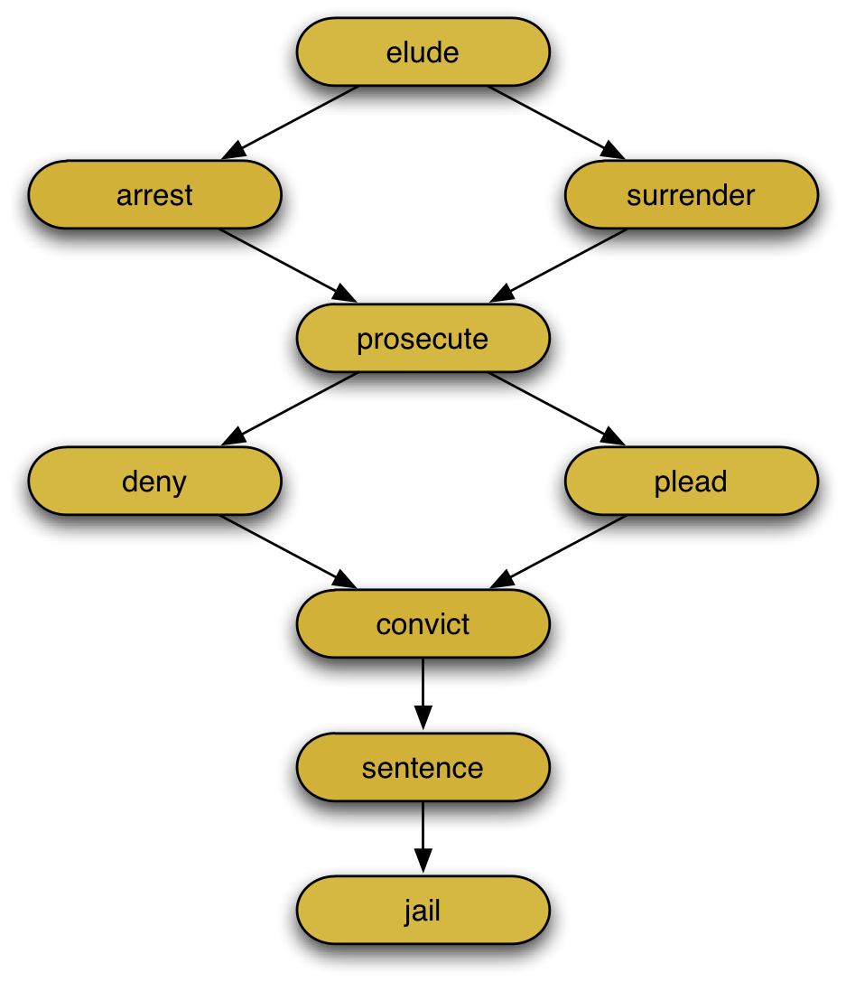
Goal: A Schema with its Arguments
Police, Agent,
Authorities
Prosecutor, Attorney
Plea, Guilty, Innocent
Suspect, Criminal,
Terrorist, …
Judge, Official

Slide 18
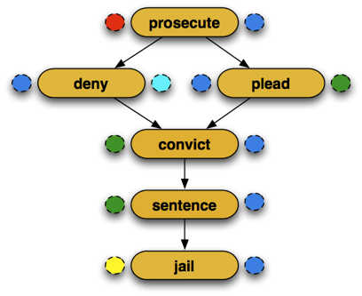
Two Joint Tasks
Nathanael Chambers and Dan Jurafsky. 2009. Unsupervised Learning of Narrative Schemas and their Participants. Proceedings of ACL-IJCNLP 2009.
Events in a Narrative
Semantic Roles
suspect, criminal…
judge, official, …

Slide 19
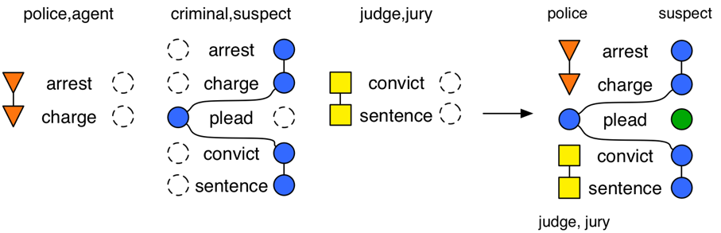
Narrative Schemas

Slide 20
Second cue for learning meaning from text: Distributional context
hurricane was downgraded
typhoon was downgraded
hurricane typhoon
is-related-to
hurricane struck
typhoon devastated…
strike devastate
is-related-to

Slide 21
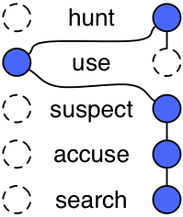


Joint Learning of Events and Roles
  Use verb relations to induce semantic roles.
    Link head nouns of coreferring arguments.
=
criminal
suspect
man
student
immigrant
person
  Use semantic roles to learn verb relations.
    Include argument-role-type counts in relation scores.

Slide 22
Training Data
NYT portion of the Gigaword Corpus
  David Graff. 2002. English Gigaword. Linguistic Data Consortium.
  1.2 million documents

Slide 23
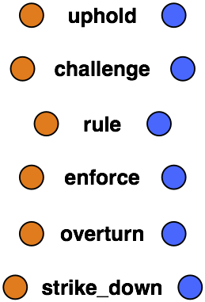

Learned Examples
NYT portion of the Gigaword Corpus
  David Graff. 2002. English Gigaword. LDC.
  1.2 million documents
court, judge, justice, panel, Osteen, circuit, nicolau, sporkin, majority
law, ban, rule, constitutionality, conviction, ruling, lawmaker,

Slide 24
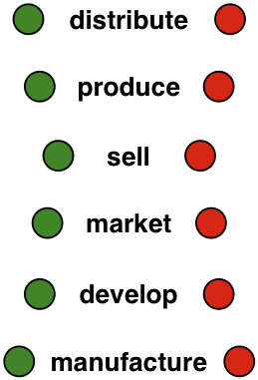


Learned Examples
company, inc, corp, microsoft, iraq, co, unit, maker, …
drug, product, system, test, software, funds, movie, …

Slide 25
Comparison to FrameNet
Narrative Schemas
  Focuses on events that occur together in a narrative.
FrameNet
  Focuses on events that share core roles.
Notes:
Cite framenet

Slide 26
Comparison to FrameNet
Narrative Schemas
  Focuses on events that occur together in a narrative.
  Schemas represent larger situations.
FrameNet
  Focuses on events that share core roles.
  Frames typically represent single events.

Slide 27
Conclusion
Semantic roles are really only a piece of larger knowledge structures
This background knowledge (scripts, frames, schemata) can be learned from text
Lots of fun open problems in this line of work!

