Slide 1
Central Application Service for Podiatric Residencies

Slide 2
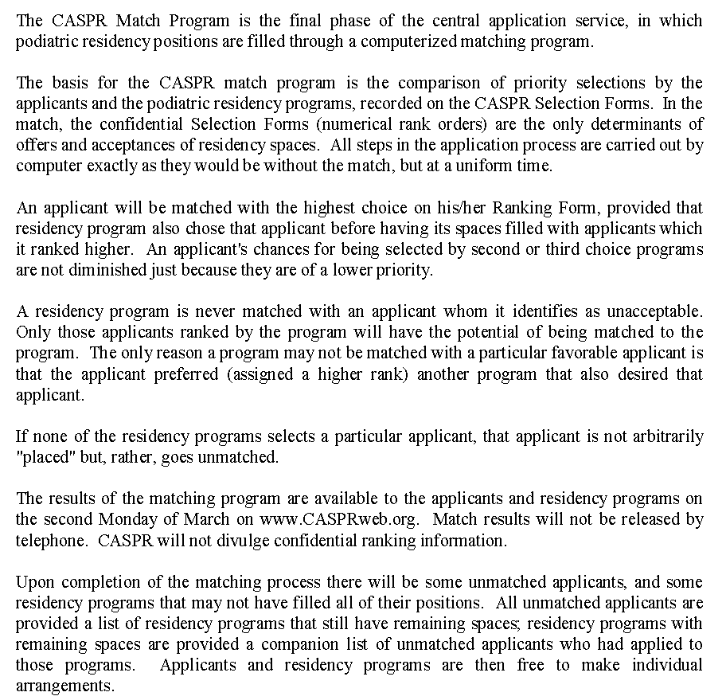

Slide 3
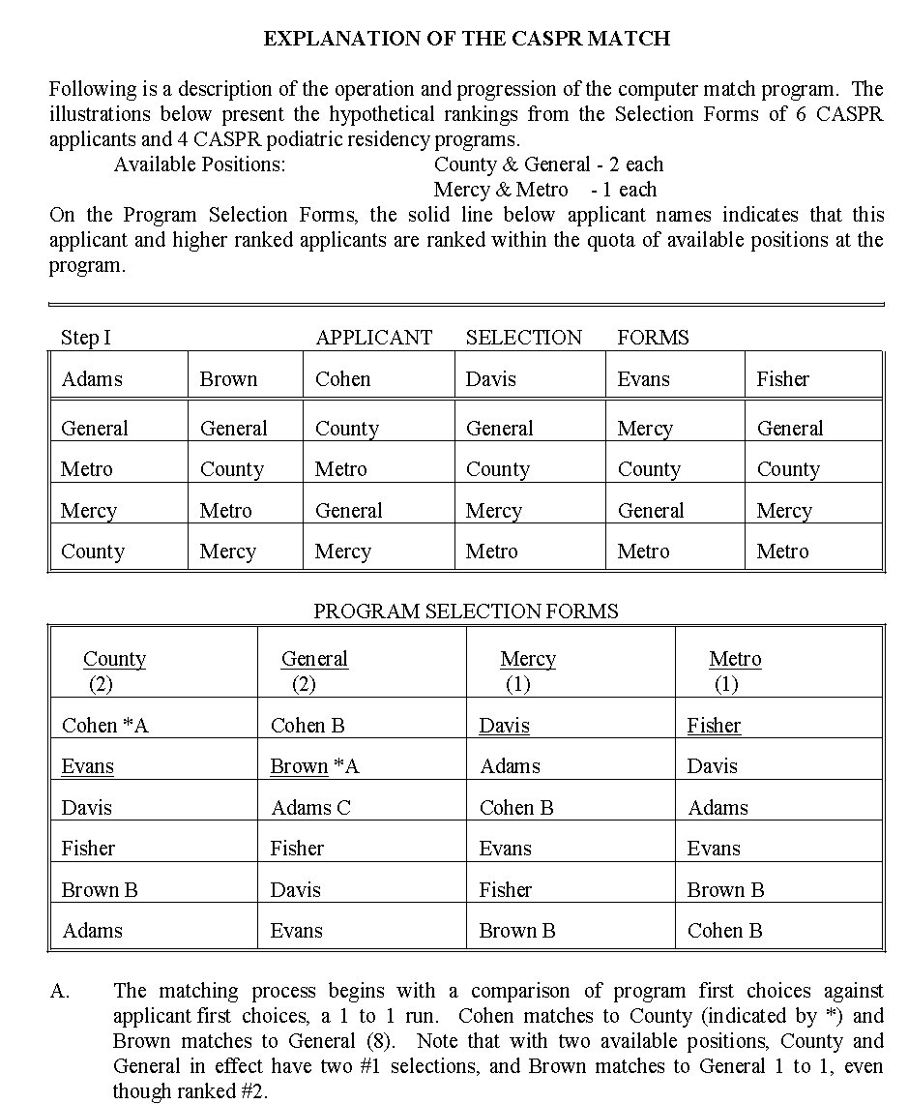

Slide 4
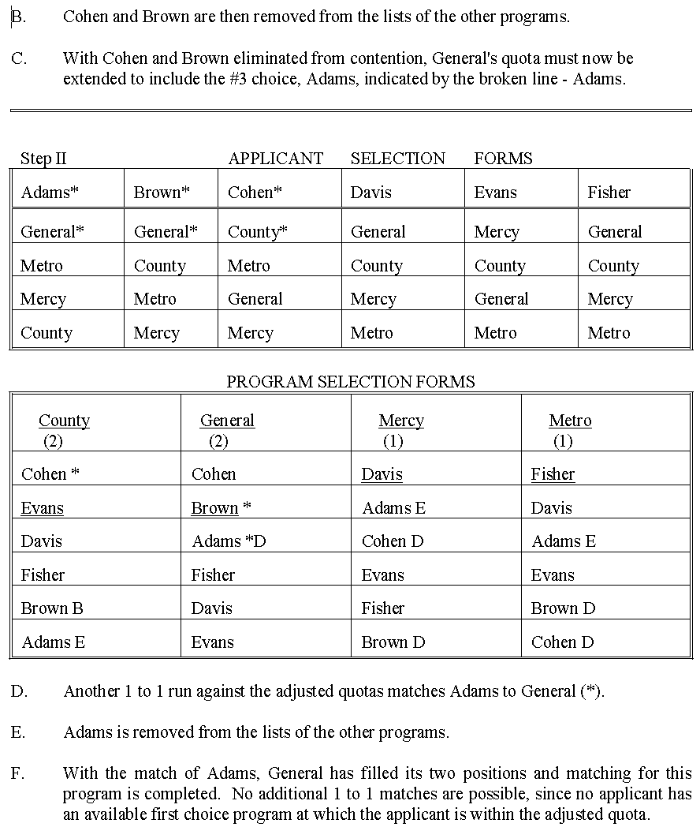

Slide 5
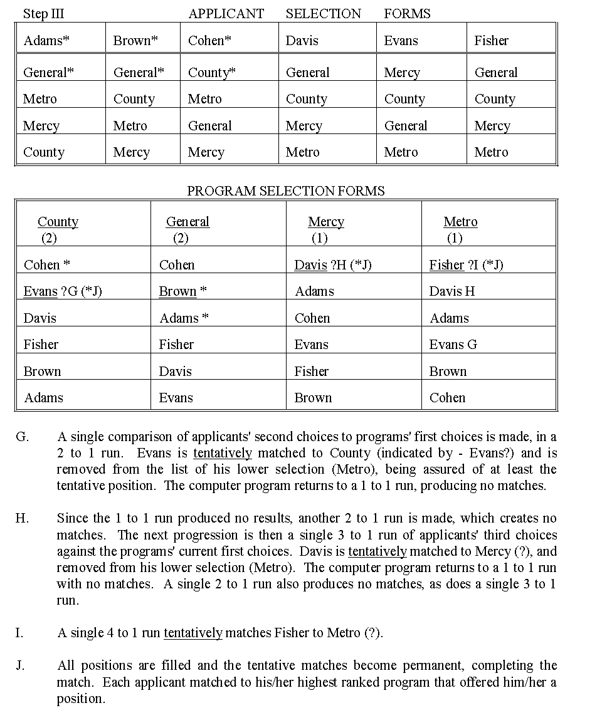

Slide 6
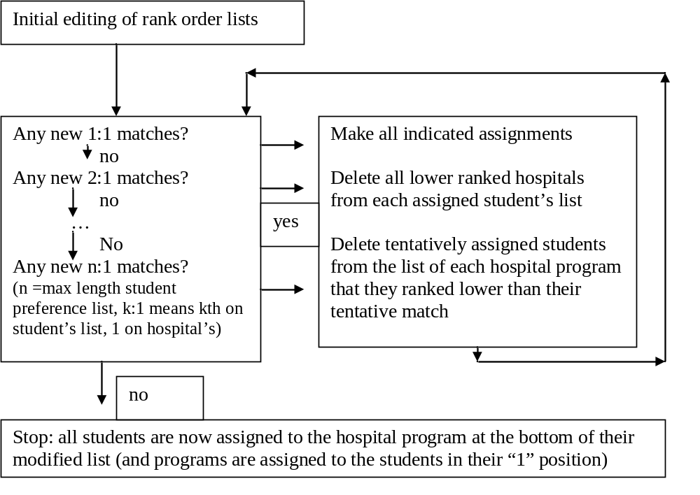
The 1952 NIMP (Boston Pool Plan) deferred acceptance algorithm
(from Roth, 1984)

Slide 7
What would happen to a student who listed only Hospital 1, which doesn’t rank him anywhere on its list, and was ranked only by hospital 2 (which ranks him first)?

