Slide 1
Kidney Exchange

Slide 2
Economists As Engineers
A certain amount of humility is called for: successful designs most often involve incremental changes to existing practices, both because
  It is easier to get incremental changes adopted, rather than radical departures from preceding practice, and
  There may be lots of hidden institutional adaptations and knowledge in existing institutions, procedures, and customs.

Slide 3
A general market design framework to keep in mind:
To achieve efficient outcomes, marketplaces need make markets sufficiently
  Thick
    Enough potential transactions available at one time
  Uncongested
    Enough time for offers to be made, accepted, rejected, transactions carried out…
  Safe
    Safe to participate, and to reveal relevant preferences
Some kinds of transactions are repugnant…and this can constrain market design.

Slide 4
Kidney exchange--background
There are 89,994 patients on the waiting list for cadaver kidneys in the U.S. (as of 10/26/11)
In 2010 34,418 patients were added to the waiting list, and 27,775 patients were removed from the list.
In 2010 there were 10,622 transplants of cadaver kidneys performed in the U.S.
In the same year, 4,652 patients died while on the waiting list (and more than 2,110 others were removed from the list as “Too Sick to Transplant”.
In 2010 there were also 6,276 transplants of kidneys from living donors in the US.
Sometimes donors are incompatible with their intended recipient.
This opens the possibility of exchange .

Slide 5
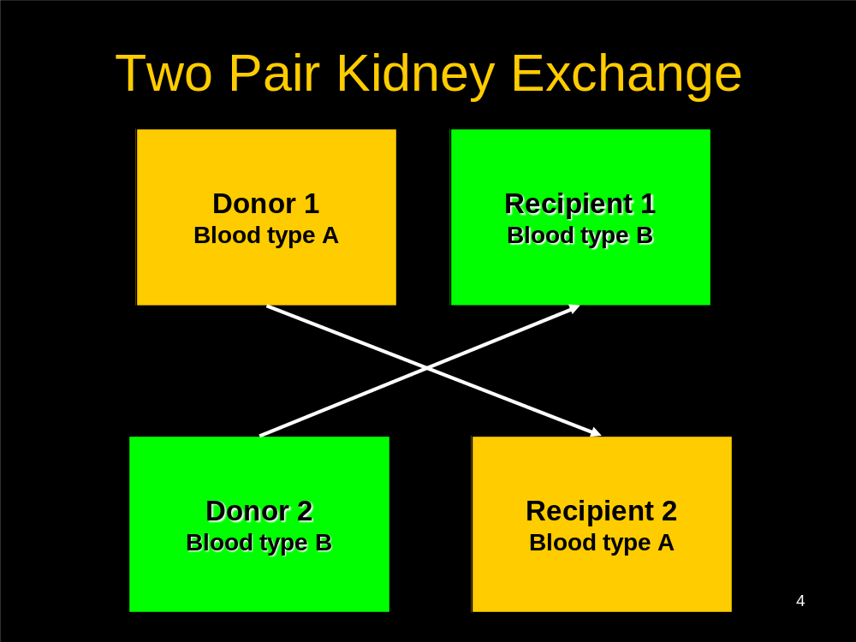

Slide 6
Technical Issues with Kidney Donation
Donor needs to be compatible with the patient
4 Blood types: A, B, AB, 0. Each person has 2 positions to receive A, B, 0, hence generating the 4 phenotypes
Anyone can get 0, Only AB can take AB, A (B) can take A(B) and 0.
0: universal donor, AB: universal recipient.
HLA: (Human Leukocyte Antigen): 6 major antigens and many others…

Slide 7
Brief history
First kidney transplant: 1954, at the Brigham, living (identical twin) donor, Dr. Joseph Murray
Kidney exchange--important early conceptual papers:
  F. T. Rapaport (1986) "The case for a living emotionally related international kidney donor exchange registry," Transplantation Proceedings 18: 5-9.
  L. F. Ross, D. T. Rubin, M. Siegler, M. A. Josephson, J. R. Thistlethwaite, Jr., and E. S. Woodle (1997) "Ethics of a paired-kidney-exchange program," The New England Journal of Medicine 336: 1752-1755.
The very first kidney exchanges were (I think) carried out in S. Korea in the early 1990’s (where the percentage of blood types A and B are roughly equal)
The first kidney exchange in the U.S. was carried out in New England, at the Rhode Island Hospital in 2000, by surgeons Anthony P Monaco and Paul E Morrissey
  Pre 2004: only 5 in the 14 transplant centers in New England

Slide 8
A classic economic problem:
Coincidence of wants
(Money and the Mechanism of Exchange, Jevons 1876)
Chapter 1: "The first difficulty in barter is to find two persons whose disposable possessions mutually suit each other's wants. There may be many people wanting, and many possessing those things wanted; but to allow of an act of barter, there must be a double coincidence, which will rarely happen. ... the owner of a house may find it unsuitable, and may have his eye upon another house exactly fitted to his needs. But even if the owner of this second house wishes to part with it at all, it is exceedingly unlikely that he will exactly reciprocate the feelings of the first owner, and wish to barter houses. Sellers and purchasers can only be made to fit by the use of some commodity... which all are willing to receive for a time, so that what is obtained by sale in one case, may be used in purchase in another. This common commodity is called a medium, of exchange..."

Slide 9
Section 301,National Organ Transplant Act (NOTA), 42 U.S.C. 274e 1984:
“it shall be unlawful for any person
to knowingly acquire, receive or otherwise transfer any human organ for valuable consideration for use in human transplantation”.

Slide 10
Charlie W. Norwood Living Organ
Donation Act
Public Law 110-144, 110th Congress, Dec. 21,’07
Section 301 of the National Organ Transplant Act (42 U.S.C. 274e) is amended-- (1) in subsection (a), by adding at the end the following:
“The preceding sentence does not apply with respect to human organ paired donation.”
Incentive Constraint: 2-way exchange involves 4 simultaneous surgeries.

Slide 11
Kidney exchange clearinghouse design
Roth, Alvin E., Tayfun Sönmez, and M. Utku Ünver, “Kidney Exchange,” Quarterly Journal of Economics, 119, 2, May, 2004, 457-488.
________started talking to docs________
____ “Pairwise Kidney Exchange,” Journal of Economic Theory, 125, 2, 2005, 151-188.
___ “A Kidney Exchange Clearinghouse in New England,” American Economic Review, Papers and Proceedings, 95,2, May, 2005, 376-380.
_____ “Efficient Kidney Exchange: Coincidence of Wants in Markets with Compatibility-Based Preferences,” American Economic Review, June 2007, 97, 3, June 2007, 828-851
___multi-hospital exchanges become common—hospitals become players in a new “kidney game”________
Ashlagi, Itai and Alvin E. Roth ”Individual rationality and participation in large scale, multi-hospital kidney exchange,” working paper, January 2011.
Ashlagi, Itai, David Gamarnik and Alvin E. Roth, The Need for (long) Chains in Kidney Exchange,

Slide 12
And in the medical literature
Saidman, Susan L., Alvin E. Roth, Tayfun Sönmez, M. Utku Ünver, and Francis L. Delmonico, “Increasing the Opportunity of Live Kidney Donation By Matching for Two and Three Way Exchanges,” Transplantation, 81, 5, March 15, 2006, 773-782.
Roth, Alvin E., Tayfun Sönmez, M. Utku Ünver, Francis L. Delmonico, and Susan L. Saidman, “Utilizing List Exchange and Undirected Donation through “Chain” Paired Kidney Donations,” American Journal of Transplantation, 6, 11, November 2006, 2694-2705.
Rees, Michael A., Jonathan E. Kopke, Ronald P. Pelletier, Dorry L. Segev, Matthew E. Rutter, Alfredo J. Fabrega, Jeffrey Rogers, Oleh G. Pankewycz, Janet Hiller, Alvin E. Roth, Tuomas Sandholm, Utku Ünver, and Robert A. Montgomery, “A Non-Simultaneous Extended Altruistic Donor Chain,” New England Journal of Medicine , 360;11, March 12, 2009, 1096-1101.
Ashlagi, Itai, Duncan S. Gilchrist, Alvin E. Roth, and Michael A. Rees, “Nonsimultaneous Chains and Dominos in Kidney Paired Donation – Revisited,” American Journal of Transplantation, 11, 5, May 2011, 984-994
Ashlagi, Itai, Duncan S. Gilchrist, Alvin E. Roth, and Michael A. Rees, “NEAD Chains in Transplantation,” American Journal of Transplantation, forthcoming.

Slide 13
There’s also a growing CS literature
Abraham, D., Blum, A., and Sandholm, T. 2007. Clearing Algorithms for Barter Exchange Markets: Enabling Nationwide Kidney Exchanges. In Proceedings of the ACM Conference on Electronic Commerce (EC).
Ashlagi, Itai, Felix Fischer, Ian A. Kash, Ariel D. Procaccia,2010, Mix and Match, EC’10, June 7–11, 2010, Cambridge, MA.
Ashlagi, Itai, and Alvin E. Roth 2011 “Participation (versus free riding) in large scale, multi-hospital kidney exchange”
Biro, Peter, and Katarina Cechlarova (2007), Inapproximability of the kidney exchange problem, Information Processing Letters, 101, 5, 16 March 2007, 199-202
Ioannis Caragiannis, Aris Filos-Ratsikas, and Ariel D. Procaccia. An Improved 2-Agent Kidney Exchange Mechanism, July 2011.

Slide 14
Kidney Exchange Institutions
New England Program for Kidney Exchange—approved in 2004, started 2005 (will be shut in favor of the national pilot program Dec 31, 2011).
    Organized kidney exchanges among the 14 transplant centers in New England
Ohio Paired Kidney Donation Consortium, Alliance for Paired Donation, 2006-07 (Rees)
  81 transplant centers and growing…
National (U.S.) kidney exchange—2010
  A national exchange pilot program was begun in 2010, but obstacles remain…

Slide 15
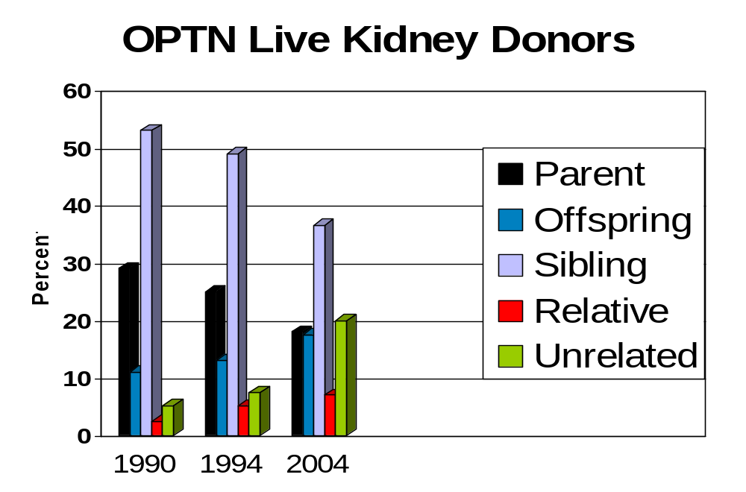
From 1990 – 2000: Living donor kidney
transplants: 2094 to 5300.
Notes:
Between 1990 and 2000, the total number of living donor kidney transplants more than doubled from 2094 to 5300. While the number of living-related donor kidney transplants approximately doubled, the number of living-unrelated donor transplants increased nearly 15-fold, from 87 in 1990 to 1243 in 2000.

Slide 16
Graft Survival Rates
100
90
80
70
60
50
40
30
20
10
0
82
64
Percent Survival
Relationship
n
T1/2
47
Id Sib
1-haplo Sib
Unrelated
Cadaver
2,129
3,140
2,071
34,572
39.2
16.1
16.7
10.2
0
1
2
3
4
5
6
7
8
9
10
Cecka, M.
UNOS
1994-1999
Years Post transplant

Slide 17
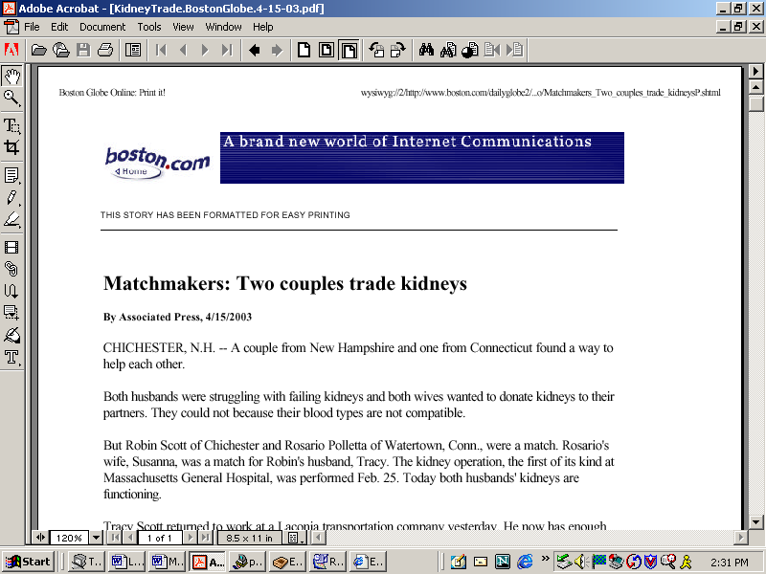
Paired Exchange
(rare enough to make the news in 2003)

Slide 18
How might more frequent and larger-scale kidney exchanges be organized?
Building on existing practices in kidney transplantation, consider how exchanges might be organized to produce efficient outcomes, providing consistent incentives (dominant strategy equilibria) to patients-donors-doctors.
Why are incentives/equilibria important? (becoming ill is not something anyone chooses…)
  But if patients, donors, and the doctors acting as their advocates are asked to make choices, we need to understand the incentives they have, in order to know the equilibria of the game and understand the resulting behavior.
  Experience with the cadaver queues make this clear…

Slide 19
Incentives: liver transplants
Chicago hospitals accused of transplant fraud
2003-07-29 11:20:07 -0400 (Reuters Health)
CHICAGO (Reuters) – “Three Chicago hospitals were accused of fraud by prosecutors on Monday for manipulating diagnoses of transplant patients to get them new livers.
“Two of the institutions paid fines to settle the charges.
‘By falsely diagnosing patients and placing them in intensive care to make them appear more sick than they were, these three highly regarded medical centers made patients eligible for liver transplants ahead of others who were waiting for organs in the transplant region,’ said Patrick Fitzgerald, the U.S. attorney for the Northern District of Illinois.”
These things look a bit different to economists than to prosecutors☺: it looks like these docs may simply be acting in the interests of their patients…

Slide 20
Incentives and efficiency:
Neonatal heart transplants
Heart transplant candidates gain priority through time on the waiting list
Some congenital defects can be diagnosed in the womb.
A fetus placed on the waiting list has a better chance of getting a heart
And when a heart becomes available, a C-section might be in the patient’s best interest.
  But fetuses (on Mom’s circulatory system) get healthier, not sicker, as time passes and they gain weight.
  So hearts transplanted into not-full-term babies may have less chance of surviving.
Michaels, Marian G, Joel Frader, and John Armitage [1993], "Ethical Considerations in Listing Fetuses as Candidates for Neonatal Heart Transplantation," Journal of the American Medical Association, January 20, vol. 269, no. 3, pp401-403

Slide 21
How might more frequent and larger-scale kidney exchanges be organized?
First, how can the market be made thicker?
  Task 1: Assembling appropriate databases
  Task 2: Coordinating hospital logistics
Then, building on existing practices in kidney transplantation, consider how exchanges might be organized to produce efficient outcomes, providing consistent incentives (dominant strategy equilibria) to patients-donors-doctors.

Slide 22
First pass (2004 QJE paper)
Shapley & Scarf [1974] housing market model: n agents each endowed with an indivisible good, a “house”.
Each agent has preferences over all the houses and there is no money, trade is feasible only in houses.
Gale’s top trading cycles (TTC) algorithm: Each agent points to her most preferred house (and each house points to its owner). There is at least one cycle in the resulting directed graph (a cycle may consist of an agent pointing to her own house.) In each such cycle, the corresponding trades are carried out and these agents are removed from the market together with their assignments.
The process continues (with each agent pointing to her most preferred house that remains on the market) until no agents and houses remain.

Slide 23
Theorem (Shapley and Scarf): the allocation x produced by the top trading cycle algorithm is in the core (no set of agents can all do better than to participate)
When preferences are strict, Gale’s TTC algorithm yields the unique allocation in the core (Roth and Postlewaite 1977).
Theorem (Roth ’82): if the top trading cycle procedure is used, it is a dominant strategy for every agent to state his true preferences.

Slide 24
The model
Kidney exchange model
Donor-transplant (donor-recipient) pairs (ki,ti)
Each recipient has preferences over kidneys and the waiting list w. If ti ranks ki above w, ti does not want to give up her donor to receive a spot at the waiting list.
Cadaver kidneys
Assumptions:
Waiting list can accommodate anyone, strict preferences over kidneys
No limit on how large cycles can be

Slide 25
Chains that integrate exchange with the waiting list
Paired exchange and list exchange
Deceased
donor
P on
waiting
list
P1-D1
P on
waiting
list
P1-D1
P2-D2
Deceased
donor

Slide 26
Top trading cycles and chains
Unlike cycles, w-chains can intersect, so a kidney or patient can be part of several w-chains, so an algorithm will have choices to make.

Slide 27
The TTCC exchange mechanism
For the mechanism defined below, when one among multiple chains must be selected, a fixed chain selection rule is used.
At a given time and for a given kidney exchange problem, the TTCC mechanism determines the exchanges as follows:
1. Initially all kidneys are available and all agents are active. At each stage of the procedure
  each remaining active patient ti points to the best remaining unassigned kidney or to the waitlist option w, whichever is more preferred,
  each remaining passive patient continues to point to his assignment, and
  each remaining kidney ki points to its paired recipient ti.

Slide 28
Lemma 1, there is either a cycle, or a w-chain, or both.
2(a)Locate each cycle and carry out the corresponding exchange. Remove all patients in a cycle together with their assignments.
(b) Each remaining patient points to its top choice among remaining choices and each kidney points to its paired recipient.
  Proceed to Step 3 if there are no cycles. Otherwise locate all cycles, carry out the corresponding exchanges, and remove them.
(c) Repeat Step 2b until no cycle exists.

Slide 29
3. If there are no pairs left, we are done.
Otherwise each remaining pair initiates a w-chain.
Select only one of the chains with the chain selection rule. The assignment is final for the patients in the selected w-chain. In addition to selecting a w-chain, the chain selection rule also determines
(a) whether the selected w-chain is removed, or
(b) the selected w-chain remains in the procedure although each patient in it is passive henceforth.
4. Each time a w-chain is selected, a new series of cycles may form. Repeat Steps 2 and 3 with the remaining active patients and unassigned kidneys until no patient is left.

Slide 30
Efficiency and incentives
A kidney exchange mechanism is efficient if it always selects a Pareto efficient matching at any given time.
Theorem 1 : The TTCC mechanism is efficient if the chain selection rule is such that any w-chain selected at a non-terminal round remains in the procedure and thus the kidney at its tail remains available for the next round.
Two examples:
  the rule that chooses the longest w-chain and keeps it, and
  the priority based rule that selects the w-chain starting with the highest priority pair and keeps it.

Slide 31
Idea of Proof of Theorem 1
Like the similar result for TTC in the housing market, a patient whose assignment is finalized in round k cannot be made better off without getting a kidney that was someone’s first choice of those remaining in some round j<k.
Note that this wouldn’t be true if kidneys at the end of chains were removed. Then it might be possible to make a patient-donor pair better off without harming any other patient-donor pair.

Slide 32
Theorem 2: The TTCC mechanism is strategy-proof when implemented with a chain selection rule of the following kind:
1. Prioritize patient-donor pairs in a single list. Choose the w-chain starting with the highest priority pair and keep it.
2. Prioritize patient-donor pairs in a single list. Choose the w-chain starting with the highest priority pair and remove it.
TTCC is also strategy proof with the rule of choosing the minimal w-chains and removing them.

Slide 33
Incentives and congestion
For incentive and other reasons, such exchanges have been done simultaneously.
Roth et al. (2004a) noted that large exchanges would arise relatively infrequently, but could pose logistical difficulties.

Slide 34
Suppose exchanges involving more than two pairs are impractical?
New England doctors have (as a first approximation) 0-1 (feasible/infeasible) preferences over kidneys.
  (see also Bogomolnaia and Moulin (2004) for the case of two sided matching with 0-1 prefs)
Initially, exchanges were restricted to pairs.
  This involves a substantial welfare loss compared to the unconstrained case
  No list exchanges: Worry that 0-patients may lose out
  Compatible pairs may prefer not to participate in an exchange
But some elegant graph theory for constrained efficient and incentive compatible mechanisms.

Slide 35
Pairwise matchings and matroids
Let (V,E) be the graph whose vertices are incompatible patient-donor pairs, with mutually compatible pairs connected by edges.
A matching M is a collection of edges such that no vertex is covered more than once.
Let S ={S} be the collection of subsets of V such that, for any S in S, there is a matching M that covers the vertices in S
Then (V, S) is a matroid:
  If S is in S, so is any subset of S.
  If S and S’ are in S, and |S’|>|S|, then there is a point in S’ that can be added to S to get a set in S.

Slide 36
Pairwise kidney exchange
Think of each pair have 0-1 preferences over all other pairs.
Roommate problem: find 2 patient-donor pairs that can swap (share a room).
A matching is a function from the set of patient-donor pairs to itself such that:
  Pairwise exchange
  Pairwise exchange only among compatible pairs (0-1 preferences)
Matching is pareto efficient if there is no other matching that makes all patients weakly and at least one strictly better off
Mechanism is strategy proof if no pair benefits from misreporting who is mutually compatible with them.

Slide 37
Pairwise matching with 0-1 preferences
(December 2005 JET paper)
Proposition (Lemma1):
All maximal (pareto-efficient) matchings match the same number of couples.
If patients (nodes) have priorities, then a “greedy” priority algorithm produces the efficient (maximal) matching with highest priorities (or edge weights, etc)
Any priority matching mechanism makes it a dominant strategy for all couples to
  accept all feasible kidneys
  reveal all available donors
So, there are efficient, incentive compatible mechanisms in the constrained case also.
  Hatfield 2005: these results extend to a wide variety of possible constraints (not just pairwise)

Slide 38
Structure of pareto-efficient pairwise matchings
Partition the set of patients into 3 sets:
Underdemanded pairs (U): Set of patients for each of whom there is at least one Pareto-efﬁcient matching which leaves her unmatched
Overdemanded pairs (O): set of patients each of whom is not in U, but is mutually compatible with at least one patient in U
Perfectly matched pairs (P): set of remaining patients: matched at each Pareto-efﬁcient matching and are not mutually compatible with any patient in U

Slide 39
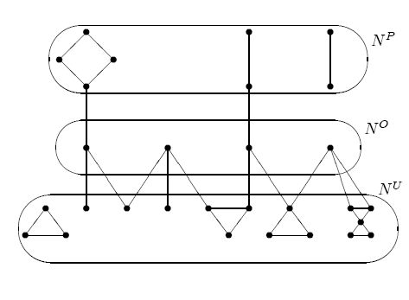
Gallai-Edmonds Decomposition

Slide 40
Efficient Kidney Matching
Two genetic characteristics play key roles:
ABO blood-type: There are four blood types A, B, AB and O.
  Type O kidneys can be transplanted into any patient;
  Type A kidneys can be transplanted into type A or type AB patients;
  Type B kidneys can be transplanted into type B or type AB patients; and
  Type AB kidneys can only be transplanted into type AB patients.
So type O patients are at a disadvantage in finding compatible kidneys.
And type O donors will be in short supply.

Slide 41
2. Tissue type or HLA type:
Combination of six proteins, two of type A, two of type B, and two of type DR.
Prior to transplantation, the potential recipient is tested for the presence of antibodies against HLA in the donor kidney. The presence of antibodies, known as a positive crossmatch, significantly increases the likelihood of graft rejection by the recipient and makes the transplant infeasible.

Slide 42
A. Patient ABO Blood Type | Frequency
O | 48.14%
A | 33.73%
B | 14.28%
AB | 3.85%
B. Patient Gender | Frequency
Female | 40.90%
Male | 59.10%
C. Unrelated Living Donors | Frequency
Spouse | 48.97%
Other | 51.03%
D. PRA Distribution | Frequency
Low PRA | 70.19%
Medium PRA | 20.00%
High PRA | 9.81%

Slide 43
Incompatible patient-donor pairs in long and short supply in a sufficiently large market
Long side of the market— (i.e. some pairs of these types will remain unmatched after any feasible exchange.)
  hard to match: looking for a harder to find kidney than they are offering
  O-A, O-B, O-AB, A-AB, and B-AB,
  |A-B| > |B-A|
Short side:
  Easy to match: offering a kidney in more demand than the one they need.
  A-O, B-O, AB-O, AB-A, AB-B
Not hard to match whether long or short
  A-A, B-B, AB-AB, O-O
All of these would be different if we weren’t confining our attention to incompatible pairs.

Slide 44
Why 3-way exchanges can add a lot
Maximal (2-and) 3-way exchange:6 transplants
3-ways help make best use of O donors, and help highly sensitized patients
Patient ABO
Donor ABO
A
B
O
A
B
O
O
B
Patient ABO
Donor ABO
A
A
A
B
B
A
x
Maximal 2-way exchange: 2 transplants (positive xm between A donor and A recipient)
Three way: Get 6 transplants

Slide 45
Four-way exchanges add less (and mostly involve a sensitized patient)
In connection with blood type (ABO) incompatibilities, 4-way exchanges add less, but make additional exchanges possible when there is a (rare) incompatible patient-donor pair of type AB-O.
  (AB-O,O-A,A-B,B-AB) is a four way exchange in which the presence of the AB-O helps three other couples…
  If only 3 way exchanges were allowed, we would only have (AB-O,O-A,A-B)

Slide 46
Four-way exchanges add less (and mostly involve a sensitized patient)
Simulations (Roth, Sonmez and Unver, 2007)
  Use the data about patient distributions from the empirical distribution of donors and patients (see previous slides)
When n=25: 2-way exchange will allow about 9 transplants (36%), 2 or 3-way 11.3 (45%), 2,3,4-way 11.8 (47%) unlimited exchange 12 transplants (48%)
When n=100, the numbers are 49.7%, 59.7%, 60.3% and 60.4%.
The main gains from exchanges of size >3 have to do with tissue type incompatibility.
  analytic upper bounds based on blood type incompatibilities alone, and here gains from larger exchange diminish for n>3.

Slide 47
The structure of efficient exchange
Assumption 1 (Large market approximation). No patient is tissue-type incompatible with another patient's donor
Assumption 2. There is either no type A-A pair or there are at least two of them. The same is also true for each of the types B-B, AB-AB, and O-O.
Theorem: every efficient matching of patient-donor pairs in a large market can be carried out in exchanges of no more than 4 pairs.
  The easy part of the proof has to do with the fact that there are only four blood types, so in any exchange of five or more, two patients must have the same blood type.

Slide 48
Theorem: every efficient matching of patient-donor pairs can be carried out in exchanges of no more than 4 pairs.
Proof: Consider a 5-way exchange
{P1D1, P2D2, P3D3, P4D4,P5D5}. Since there are only 4 blood types, there must be two patients with the same blood type.
Case 1: neither of these two patients receives the kidney of the other patient’s donor (e.g. P1 and P3 have the same blood type). Then (by assumption 1) we can break the 5-way exchange into {P1D1, P2D2} and {P3D3, P4D4, P5D5}

Slide 49
Case 2: One of the two patients with the same blood type received a kidney from the incompatible donor of the other
W.l.o.g. suppose these patients are P1 and P2. Since P1 receives a kidney from D5, by Assumption 1 patient P2 is also compatible with donor D5 and hence the four-way exchange {P2D2, P3D3, P4D4, P5D5} is feasible.
Since P2 was compatible with D1, P1’s incompatibility must be due to crossmatch (not blood type incompatibiliby, i.e. D1 doesn’t have a blood protein that P1 lacks). So P1D1 is either one of the “easy” types
  A-A, B-B, AB-AB, or O-O, or one of the “short types”
  A-O, B-O, AB-O, AB-A, or AB-B
In either case, P1D1 can be part of a 2 or at most 3-way exchange (with another one or two pairs of the same kind, if “easy,” or with a long side pair, if “short” ).
(Note that this proof uses both mathematics and biology☺)

Slide 50
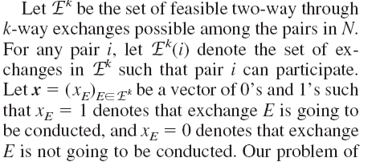
Finding maximal-weight cycles of restricted size

Slide 51
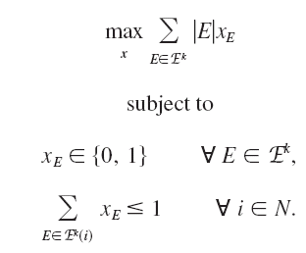
e.g. max number of transplants
Other weights W(E) different from |E| would maximize other objectives

Slide 52
General exchange with type-specific preferences
General model
  Transitive (possibly incomplete) compatibility relation
Computational complexity—finding maximal 2 and 3 way exchanges on general graphs is NP complete
But average problems solve quickly: Abraham, Blum, Sandholm software: Ready for 10,000 pairs
  It uses the observation from Roth et al. 2007 that cycles of length >4 only need to be looked at in special circumstances

Slide 53
(Large) Random Graphs
G(n,p) – n nodes and each two nodes have a non directed edge with probability p
Erdos-Renyi: For any p(n)¸(1+²)(ln n)/n almost every large graph G(n,p(n)) has a perfect matching (i.e. all vertices are matched), i.e. as n!1 the probability that a perfect matching exists converges to 1.
Similar lemma for a random bipartite graph G(n,n,p).
Can extend also for r-partite graphs…

Slide 54
Efficient Allocations
Theorem (Ashlagi and Roth, 2011): In almost every large graph there exist an efficient allocation with exchanges of size at most 3.
In large graphs, looking at incompatible (patient-donor) pairs, they show that
there will be more 0-X than X-0 pairs, for X=A,B,AB
more X-AB than AB-X, for X=A,B
The absolute difference between A-B and B-A is o(m) where m is the number of incompatible patient-donor pairs.

Slide 55
Efficient Allocations
Theorem: In almost every large graph there exists an efficient allocation with exchanges of size at most 3.
Wlog. More B-A than A-B pairs.
Only underdemanded pairs are unmatched. Only AB-0 can help 2 underdemanded pairs to get a transplant.
B-A
AB-B
AB-A
A-O B-O
AB-O
A-B
B-AB A-AB
O-B
O-A
O-AB

Slide 56
Why 4 way exchanges don’t help: The 4-way uses one AB-0 and one A-B pair, which can all matched (see figure before) using 3-way exchanges. With two three way exchanges, can match 3, not only 2 underdemanded pairs.
AB-O
A-B
A-AB
O-A
O-A
B-O
AB-O
B-AB
A-B
O-A
Corollary:
(i) lim X(m,3) >= lim X(m,k) for all k
(ii) lim X(m,3)-lim X(m,2) = O|(AB,O)|)
X(m,k) – size of an efficient allocation in a random compatibility graph of size m given k.

Slide 57
How about when hospitals become players?
Some hospitals withhold internal matches, and contribute only hard-to-match pairs to a centralized clearinghouse.
Mike Rees (APD director) writes: “As you predicted, competing matches at home centers is becoming a real problem. Unless it is mandated, I'm not sure we will be able to create a national system. I think we need to model this concept to convince people of the value of playing together”.

Slide 58
Individual rationality for hospitals
An allocation is individually rational for a hospital, if the allocation gives the hospital at least as many matched pairs than the number of matched pairs the hospital could do on its own.
(Note: do not require that the same set of transplants are allocated).
To find a k-maximal allocation that is IR: choose a k-efficient allocation in every hospital, and then search for allocations that increase the number of matched pairs without unmatching any pair (though maybe matching them differently).

Slide 59
Individual rationality and efficiency: an impossibility theorem (Ashlagi and Roth, 2011)
For every k> 3, there exists a compatibility graph such that no k-maximal allocation which is also individually rational matches more than 1/(k-1) of the number of nodes matched by a k-efficient allocation. Furthermore in every compatibility graph the size of a k-maximal allocation is at least 1/(k-1) times the size of a k-efficient allocation.

Slide 60
Proof (for k=3): only 3 instead of 6 transplants.
a₃
a₁
a₂
e
c
b
d

Slide 61
Costs of IR
Theorem suggests huge costs of IR.
What happens in large markets?

Slide 62
Individually Rational Allocations
Theorem: If every hospital size is regular and bounded then in almost every large graph the efficiency loss from a maximum individually rational allocation is at most (1+²)®_{AB-O}m + o(m) for any ²>0 (less than 1.5%). (where ®_{AB-O} frequency of AB-0 pairs)
So the worst-case impossibility results don’t look at all like what we can expect to see in large kidney exchange pools.

Slide 63
“Cost” of IR is very small for clinically relevant sizes too - Simulations
No. of Hospitals | 2 | 4 | 6 | 8 | 10 | 12 | 14 | 16 | 18 | 20 | 22
IR,k=3 | 6.8 | 18.37 | 35.42 | 49.3 | 63.68 | 81.43 | 97.82 | 109.01 | 121.81 | 144.09 | 160.74
Efficient, k=3 | 6.89 | 18.67 | 35.97 | 49.75 | 64.34 | 81.83 | 98.07 | 109.41 | 122.1 | 144.35 | 161.07

Slide 64
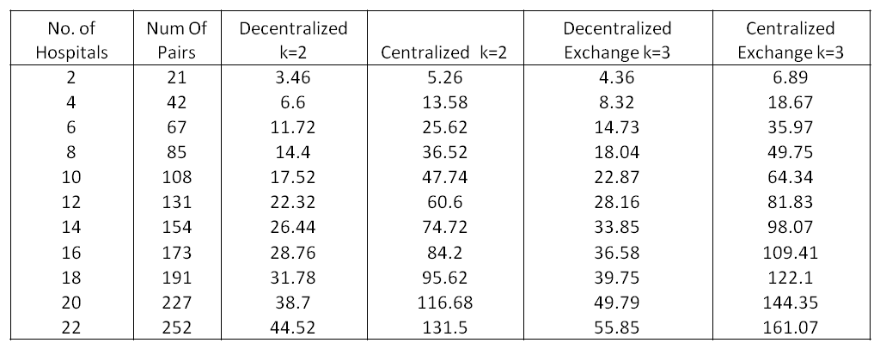
But the cost of not having IR could be very high if it causes centralized matching to break down (so, hospitals only match internally)

Slide 65
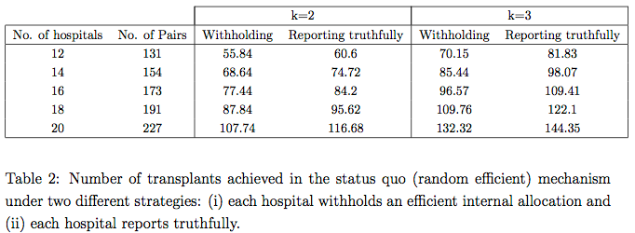
Number of transplants when hospitals withhold

Slide 66
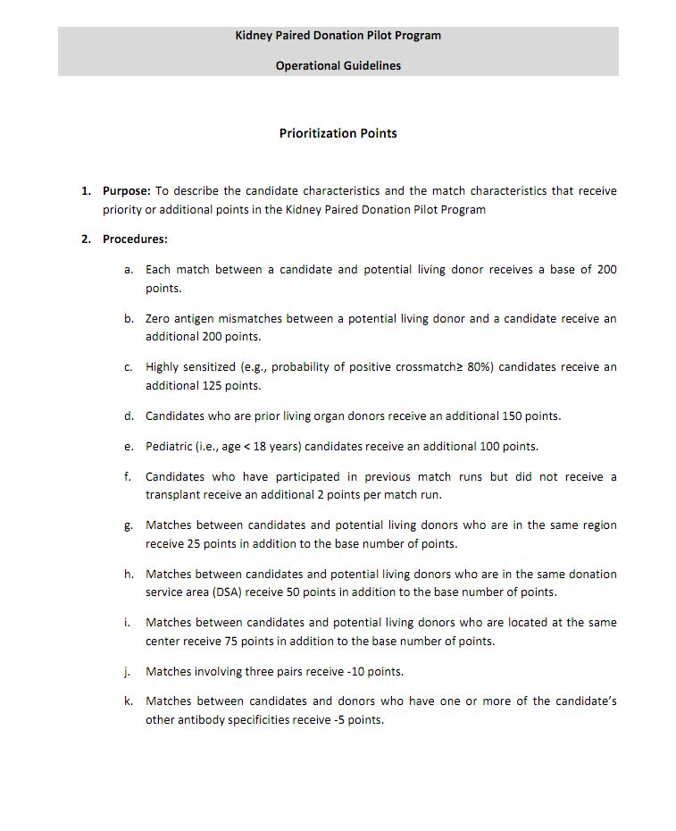
UNOS pilot mechanism

Slide 67
Summary of participation incentives
As kidney exchange institutions grow to include more transplant centers, they will have to fight increasingly hard to get the centers to reveal their most easily matchable patient-donor pairs. This will be an uphill battle as long as the matching algorithm tries to maximize total (or weighted) number of transplants, without regard to internally matchable pairs.
But the fight will be less hard if the matching algorithms pay attention to internally matchable pairs.

Slide 68
Thicker market and more efficient exchange?
Establish a national exchange
Make kidney exchange available not just to incompatible patient-donor pairs, but also to those who are compatible but might nevertheless benefit from exchange
  E.g. a compatible middle aged patient-donor pair, and an incompatible patient-donor pair with a 25 year old donor could both benefit from exchange.
  This would also relieve the present shortage of donors with blood type O in the kidney exchange pool, caused by the fact that O donors are only rarely incompatible with their intended recipient.
    Adding compatible patient-donor pairs to the exchange pool has a big effect: Roth, Sönmez and Ünver (2004a and 2005b)

Slide 69
Other sources of efficiency gains
Non-directed donors
ND-D
P1
P2-D2
P1-D1
ND-D
P3

Slide 70
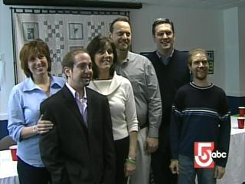
The graph theory representation doesn’t capture the whole story
Rare 6-Way Transplant Performed
Donors Meet Recipients
March 22, 2007
BOSTON -- A rare six-way surgical transplant was a success in Boston.
NewsCenter 5's Heather Unruh reported Wednesday that three people donated their kidneys to three people they did not know. The transplants happened one month ago at Massachusetts General Hospital and Beth Israel Deaconess.
The donors and the recipients met Wednesday for the first time.
Why are there only 6 people in this picture?
Simultaneity congestion: 3 transplants + 3 nephrectomies = 6 operating rooms, 6 surgical teams…

Slide 71
Can simultaneity be relaxed in Non-directed donor chains?
“If something goes wrong in subsequent transplants and the whole ND-chain cannot be completed, the worst outcome will be no donated kidney being sent to the waitlist and the ND donation would entirely benefit the KPD [kidney exchange] pool.” (Roth et al. 2006, p 2704).

Slide 72
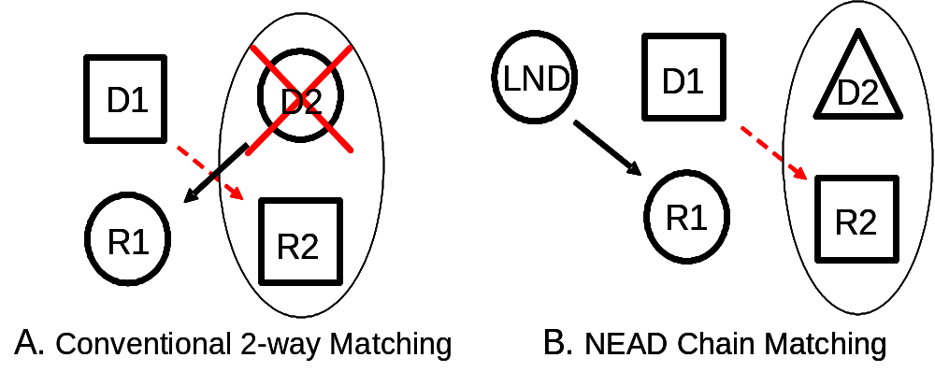
‘Never ending’ altruistic donor chains (non-simultaneous, reduced risk from a broken link)
Since NEAD chains don’t need to be simultaneous, they can be long…if the ‘bridge donors’ are properly identified.

Slide 73
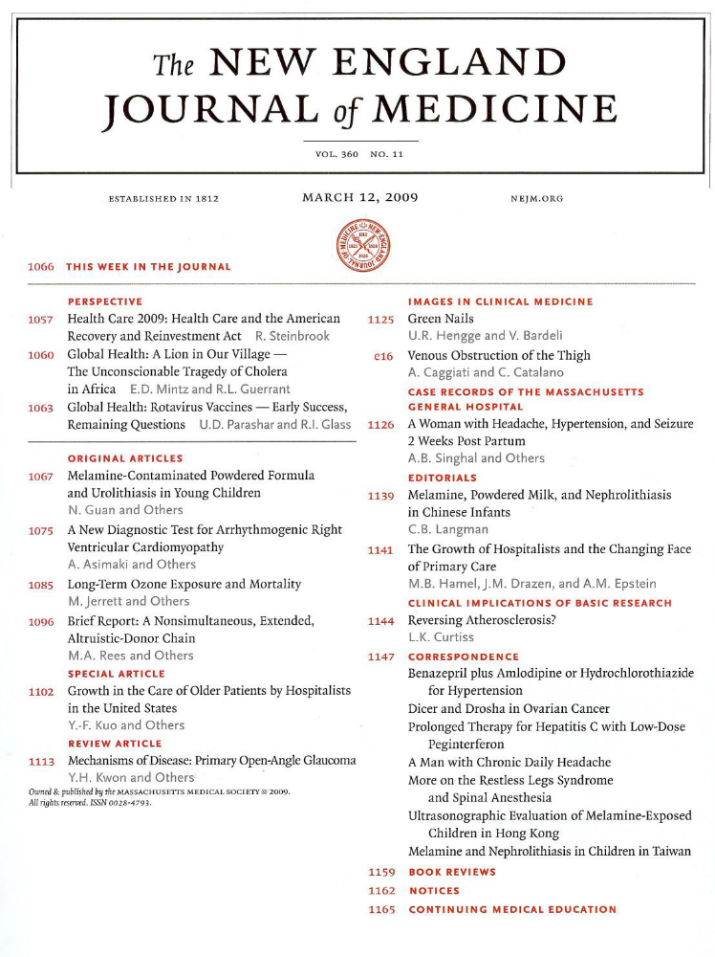
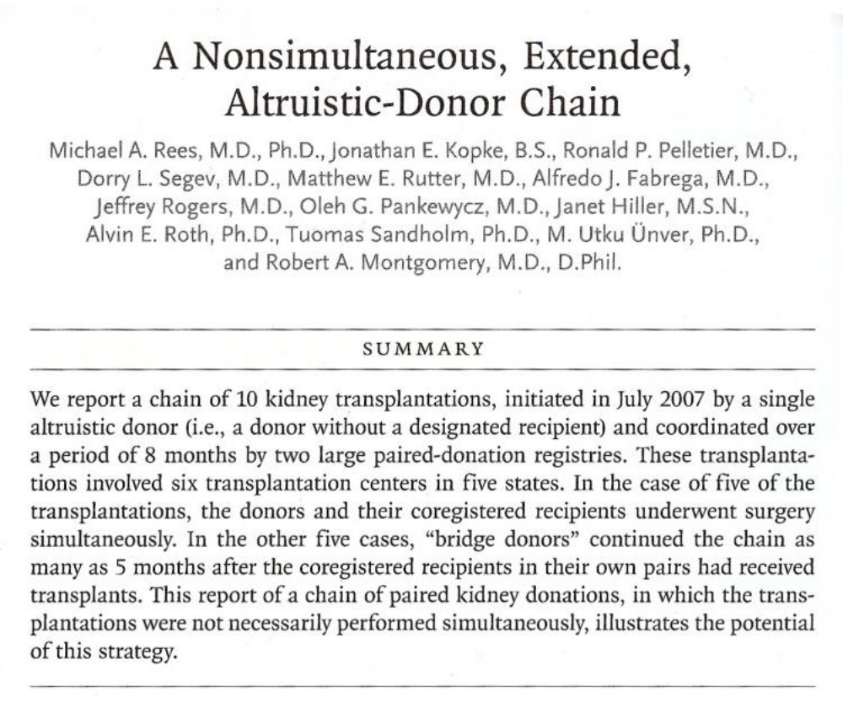

Slide 74
The First NEAD Chain (Rees, APD)
July
July
Sept
Sept
Feb
Feb
Feb
Feb
March
March
2007
2007
2007
2007
2008
2008
2008
2008
2008
2008
MI
AZ
OH
OH
OH
MD
MD
MD
NC
MD
OH
1
2
3
4
5
6
7
8
9
10
O
O
A
A
B
A
A
A
AB
A
AB
O
O
A
A
B
A
#
A
A
A
*
A
Recipient PRA
62
0
23
0
100
78
64
3
100
46
Recipient Ethnicity
Cauc
Cauc
Cauc
Cauc
Cauc
Hisp
Cauc
Cauc
Cauc
AA
Relationship
Husband
Wife
Mother
Daughter
Daughter
Mother
Sister
Brother
Wife
Husband
Father
Daughter
Husband
Wife
Friend
Friend
Brother
Brother
Daughter
Mother
* This recipient required desensitization to Blood Group (AHG Titer of 1/8).
# This recipient required desensitization to HLA DSA by T and B cell flow cytometry.

Slide 75
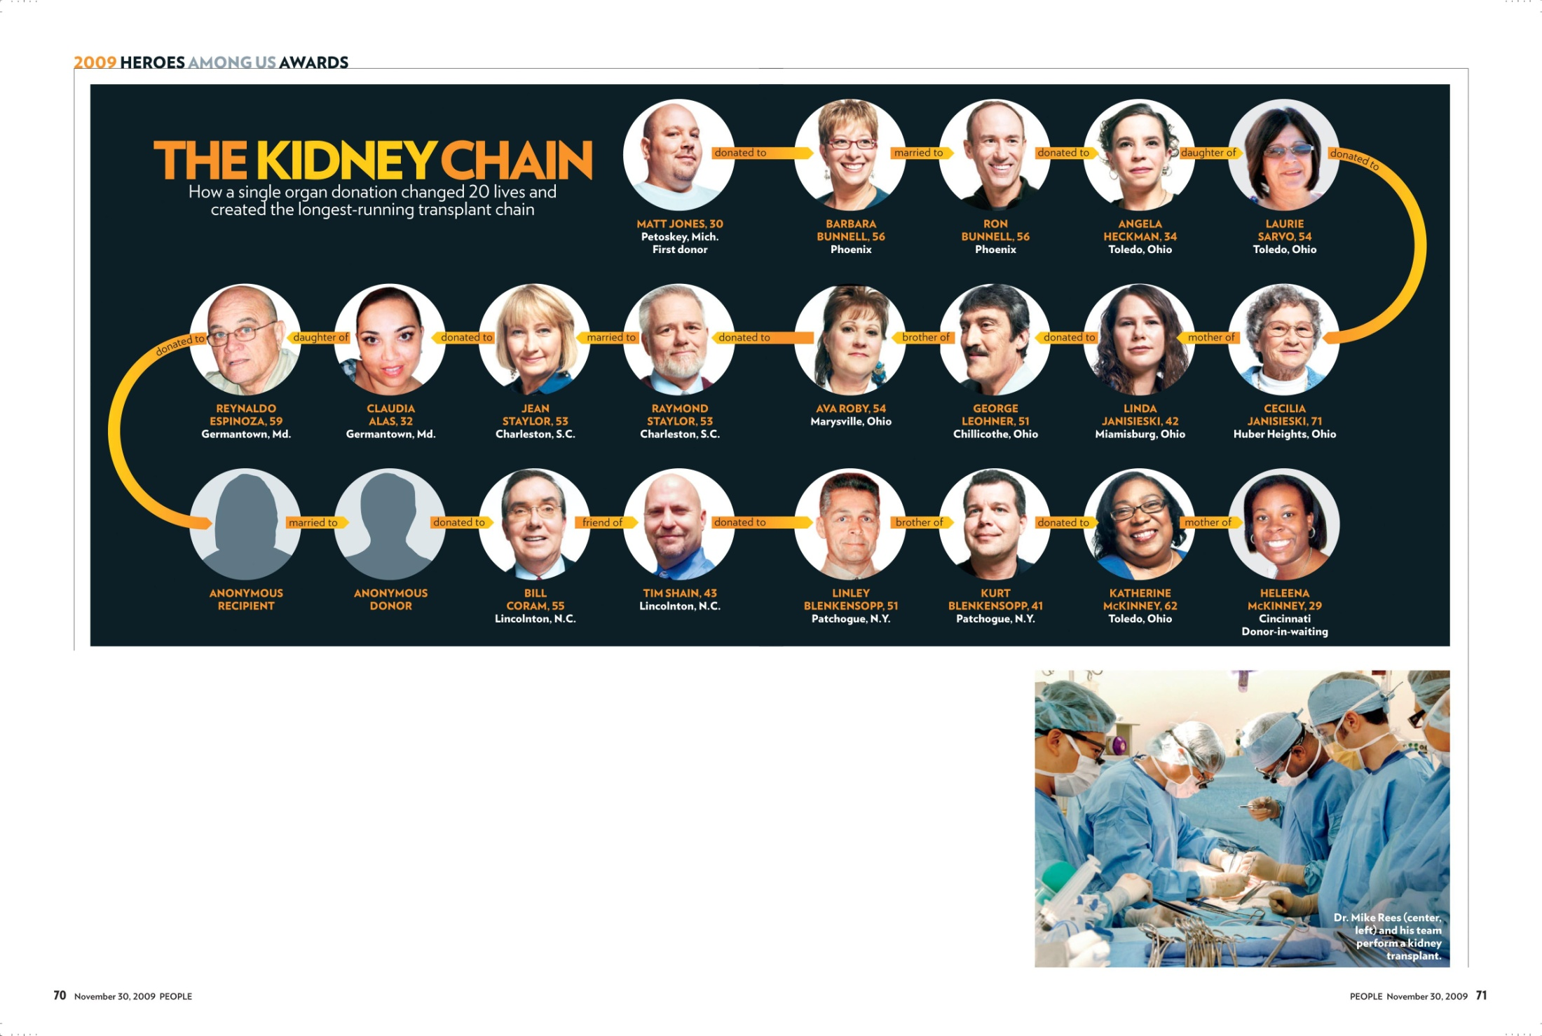

Slide 76
Logistical issues
3 of the kidneys were shipped rather than having the donors travel to the matched recipients
  two live donor kidneys were shipped on commercial airline flights.
  All three recipients had prompt renal function.
2 highly sensitized recipients who had formidable HLA barriers with their co-registered donors were matched with donors with whom they had mild ABO or HLA incompatibilities requiring short courses of plasmapheresis.

Slide 77
NEAD Chain 9 at APD
JULY
JULY
AUG
AUG
AUG
AUG
2010
2010
2010
2010
2010
2010
COUC
OHCO
OHCO
MISM
COSL
COUC
COUC
O
O
B
A
O
O
B
A
O
B
A
O
O
PRA 0% 0%
77%
68%
90%
0%
Ethnicity
Cauc
AA
Cauc
Cauc
Cauc
Cauc
Brother
Wife
Cousin
Husband
Daughter
Wife
Relationship
Brother
Husband
Cousin
Wife
Mother
Husband

Slide 78
Chains
Simultaneous chain (DPD) Nonsimultaneous chain (NEAD)
Alt
Alt
D1
R1
D1
R1
Bridge Donor
R2
Bridge Donor
R2
D3
R3
List
Bridge Donor
R4

Slide 79
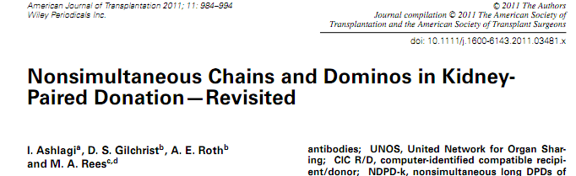
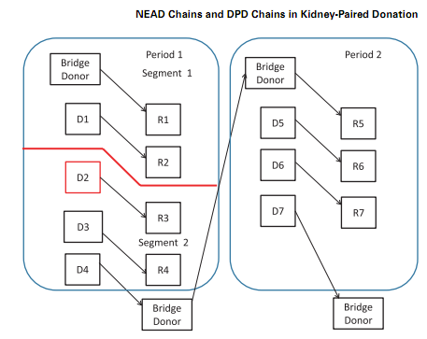

Slide 80
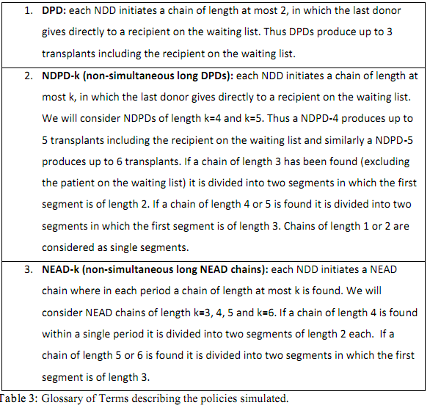

Slide 81
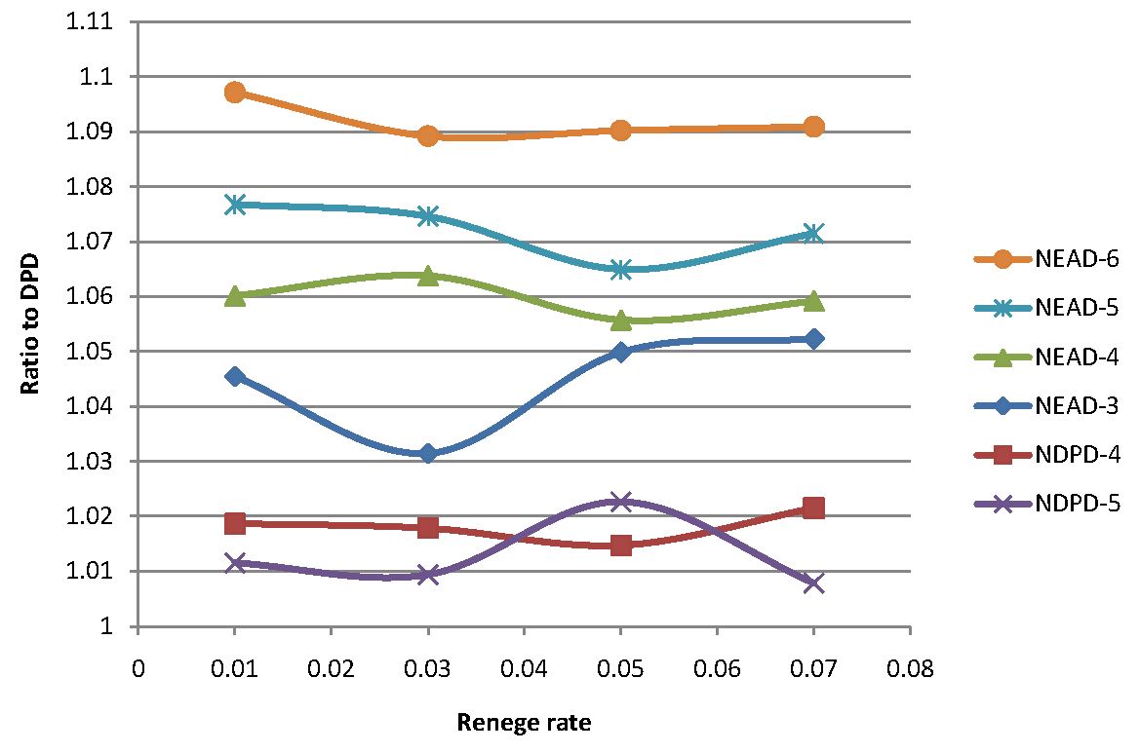
Ratio of #transplants between policies
Ashlagi, Gilchrist, Roth and Rees, AJT, 2011

Slide 82
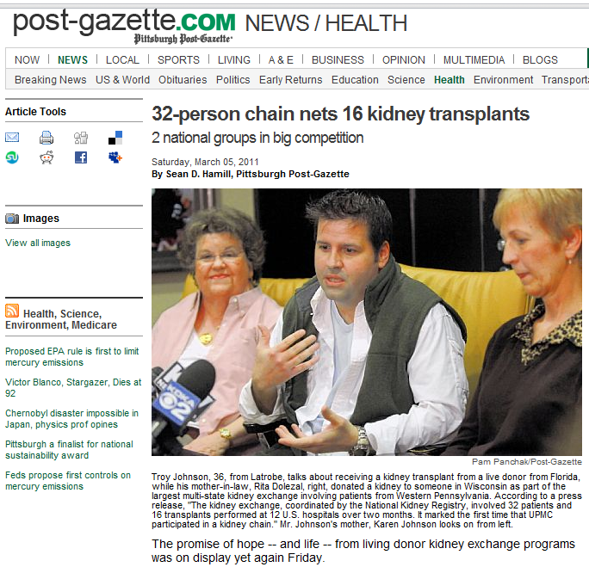

Slide 83
Why are NEAD chains so effective?
In a really large market they wouldn’t be…

Slide 84
Efficiency in a large pool
B-A
O-O
A-A
B-B
AB-AB
AB-B
AB-A
A-O B-O
AB-O
A-B
  V_{A-B}
B-AB A-AB
O-B
O-A
O-AB
altruistic donor
An altruistic donor can increase the match size by at most 2 ☹

Slide 85
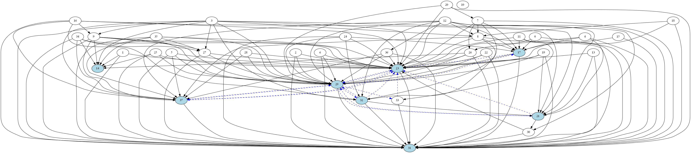
A real graph
Graph induced by pairs with A patients and A donors 38 pairs,
only 5 can be covered by some cycle. Pb: many highly sensitized hard to match patients who can only take a small number of kidneys…

Slide 86
Progress to date
There are several potential sources of increased efficiency from making the market thicker by assembling a database of incompatible pairs (aggregating across time and space), including
More 2-way exchanges
longer cycles of exchange, instead of just pairs
It appears that we will initially be relying on 2- and 3-way exchange, and that this may cover most needs.
3. Integrating non-directed donors with exchange among incompatible patient-donor pairs.
4. Non-simultaneous non-directed donor chains
5. future: integrating compatible pairs (and thus offering them better matches…)

Slide 87
But progress is still slow☹
 | 2000 | 2001 | 2002 | 2003 | 2004 | 2005 | 2006 | 2007 | 2008 | 2009 | 2010
#Kidney exchange transplants in US* | 2 | 4 | 6 | 19 | 34 | 27 | 74 | 121 | 240 | 304 | 422 (+203 +139)*
Deceased donor waiting list (active + inactive) in thousands | 54 | 56 | 59 | 61 | 65 | 68 | 73 | 78 | 83 | 88 | 89.9
*http://optn.transplant.hrsa.gov/latestData/rptData.asp Living Donor Transplants By Donor Relation
* UNOS 2010: Paired exchange + anonymous (ndd?) + list exchange

Slide 88
Behavioral issues: Motivation of donors?
Standard live donors can have standard motivations: love of spouse, etc.
Nondirected live donors are some flavor of altruist.
Bridge donors?
  A deal’s a deal?
  More complicated?
Also need to think about how to increase deceased donation:
  Kessler, Judd B. and Alvin E. Roth, “Organ Allocation Policy and the Decision to Donate,” American Economic Review, forthcoming.

