Slide 1
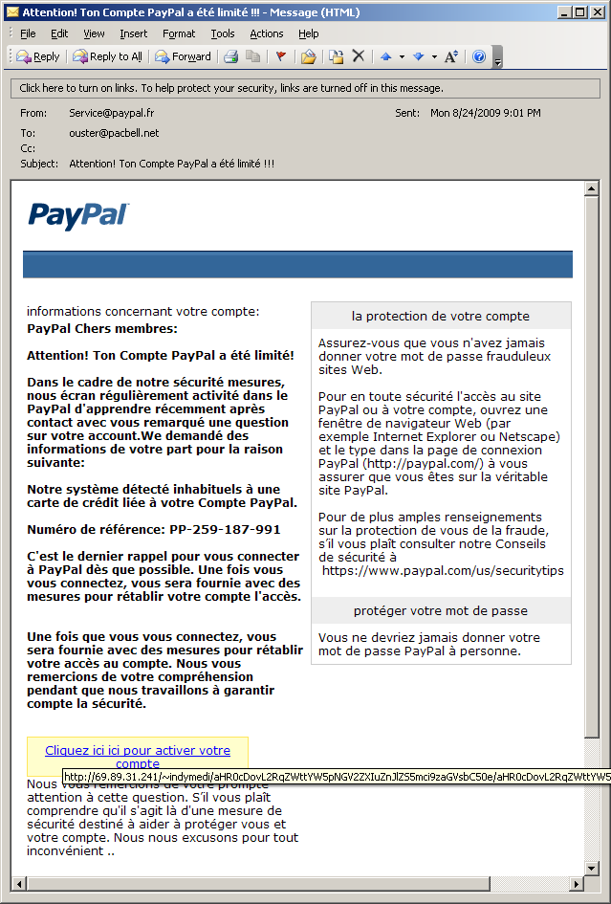
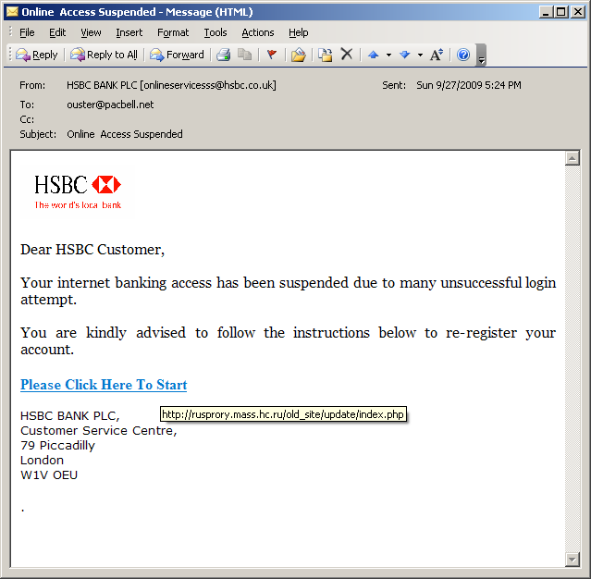
Phishing Emails

Slide 2
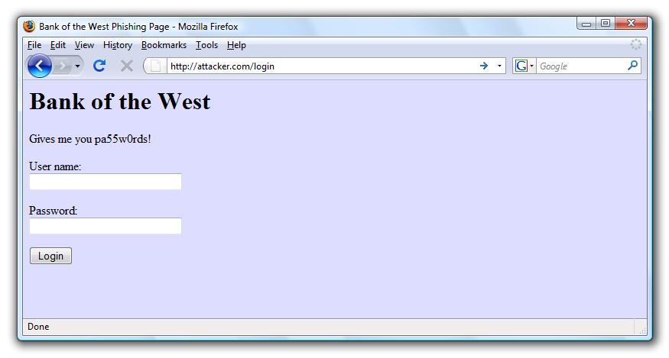
Obviously Illegitimate
http://rusprory.mass.hc.ru/old_site/update/index.php

Slide 3
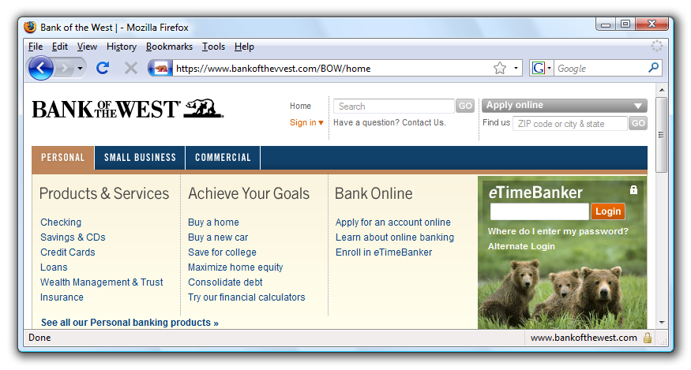

Look-alike Characters

Slide 4
International Character Sets
What does this URL refer to?
www.bank.com/accounts/login.php?q=me.badguy.cn
This is a host name only!
Chinese characters that look like "/", "?", and "="

Slide 5
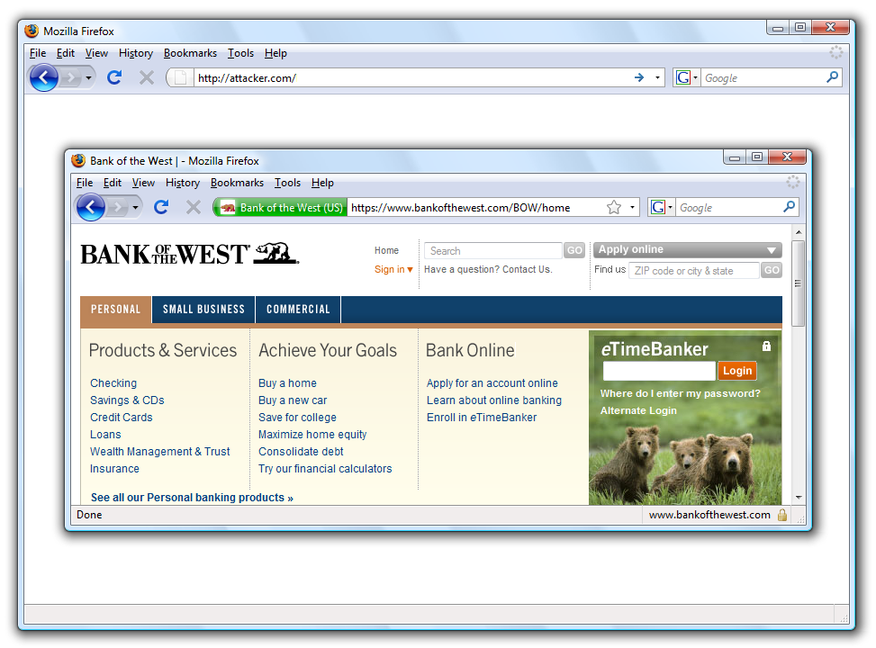
Picture in picture

Slide 6
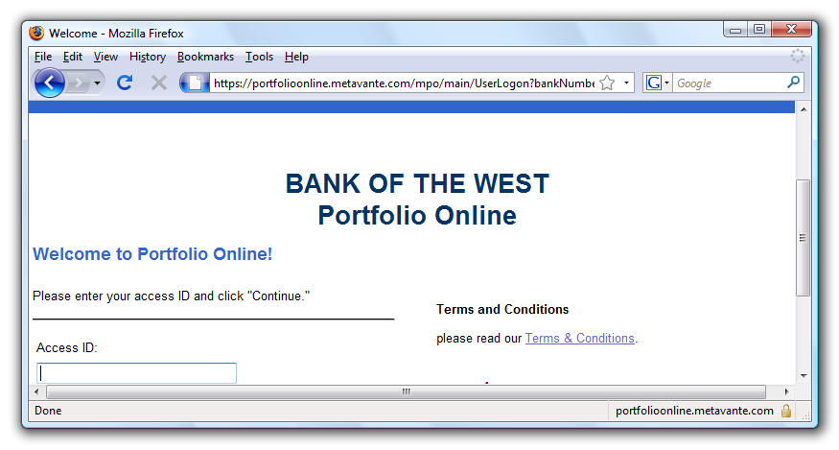
Legitimate Partners Can Look Fishy
???
???

Slide 7






HTTPS Indicators
HTTP
HTTPS
Firefox 10
IE 8
Chrome 17
Notes:
Click on fav icon gives pop-up on bottom.
7

Slide 8
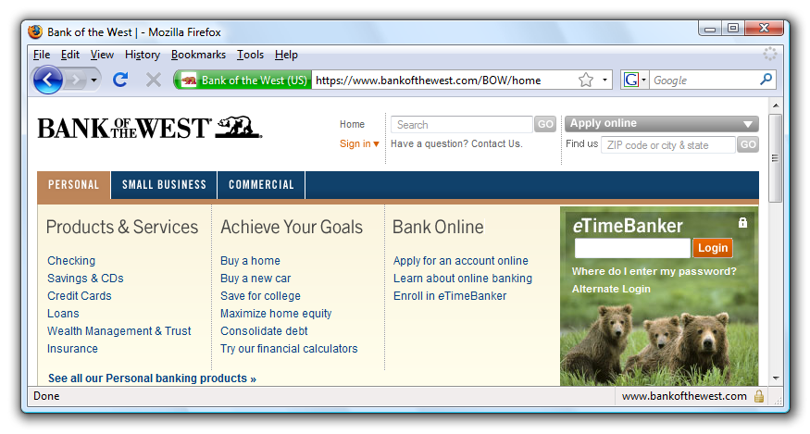
Extended Validation Certificates

Slide 9



Extended Validation Certificates
Extended
Normal HTTPS
Firefox 10
IE 8
Chrome 17
Certificate Authority
Notes:
Click on fav icon gives pop-up on bottom.
9

