Slide 1
Recursive Backtracking
Eric Roberts
CS 106B
January 25, 2013

Slide 2
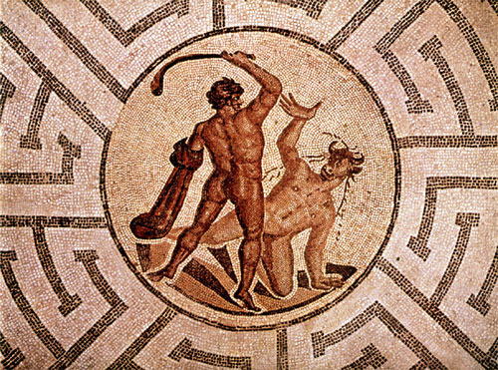
Solving a Maze
A journey of a thousand miles begins with a single step.
—Lao Tzu, 6th century B.C.E.
The example most often used to illustrate recursive backtracking is the problem of solving a maze, which has a long history in its own right.
The most famous maze in history is the labyrinth of Daedalus in Greek mythology where Theseus slays the Minotaur.
There are passing references to this story in Homer, but the best known account comes from Ovid in Metamorphoses.
Metamorphoses
—Ovid, 1 A.C.E.
. . . When Minos, willing to conceal the shame
That sprung from the reports of tatling Fame,
Resolves a dark inclosure to provide,
And, far from sight, the two-form’d creature hide.
Great Daedalus of Athens was the man
That made the draught, and form’d the wondrous plan;
Where rooms within themselves encircled lye,
With various windings, to deceive the eye. . . .
Such was the work, so intricate the place,
That scarce the workman all its turns cou’d trace;
And Daedalus was puzzled how to find
The secret ways of what himself design’d.
These private walls the Minotaur include,
Who twice was glutted with Athenian blood:
But the third tribute more successful prov’d,
Slew the foul monster, and the plague remov’d.
When Theseus, aided by the virgin’s art,
Had trac’d the guiding thread thro’ ev’ry part,
He took the gentle maid, that set him free,
And, bound for Dias, cut the briny sea.
There, quickly cloy’d, ungrateful, and unkind,
Left his fair consort in the isle behind . . .

Slide 3
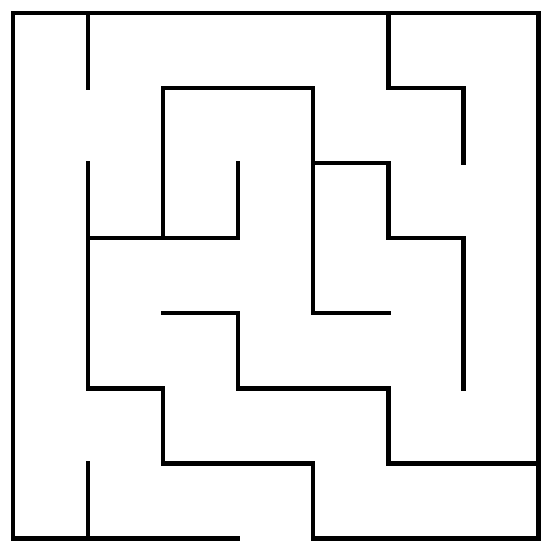
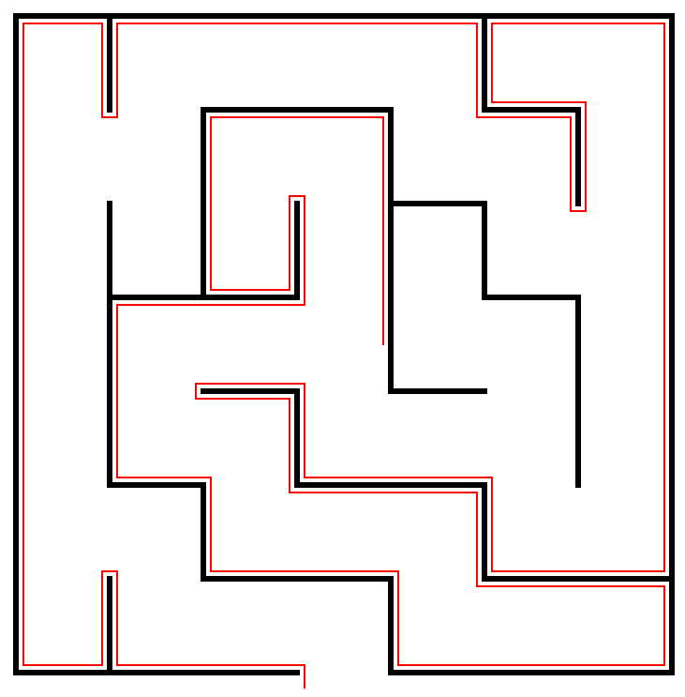
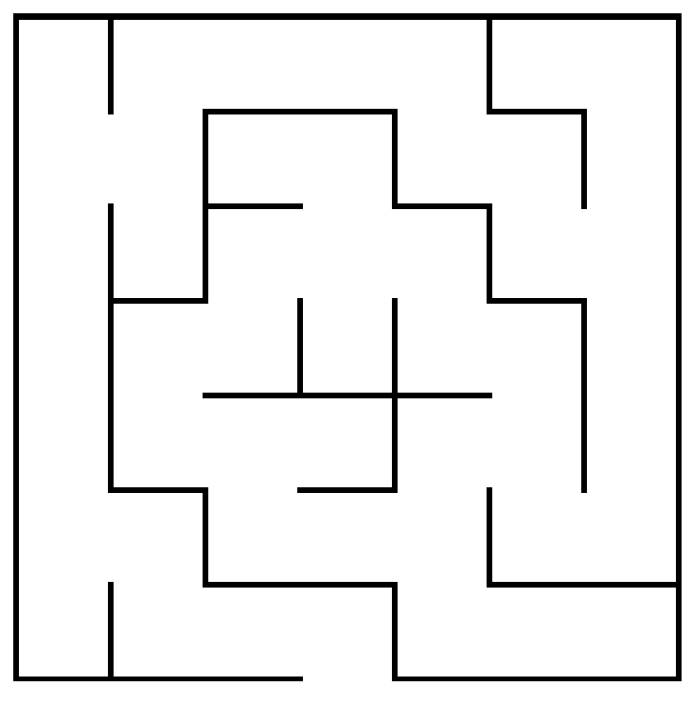
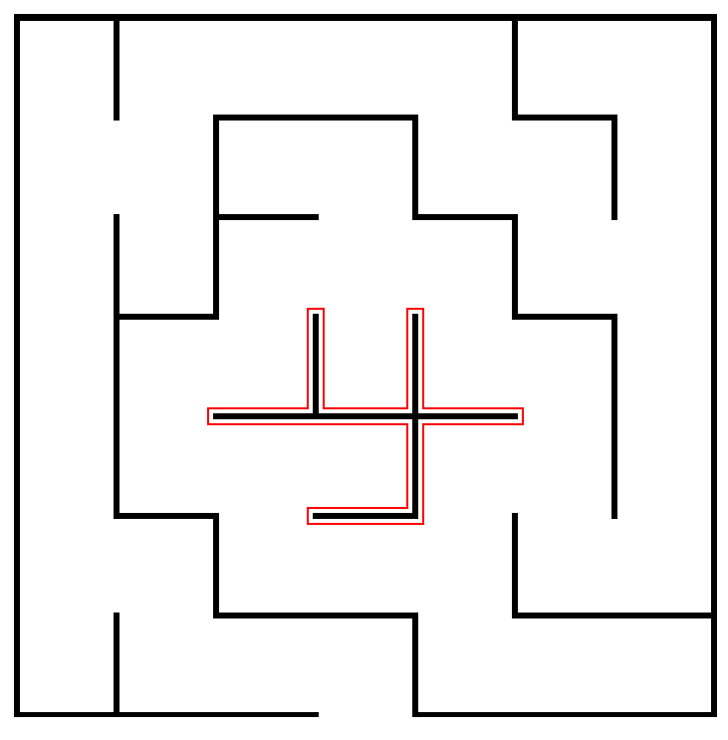
The Right-Hand Rule
The most widely known strategy for solving a maze is called the right-hand rule, in which you put your right hand on the wall and keep it there until you find an exit.
If Theseus applies the right-hand rule in this maze, the solution path looks like this.
Unfortunately, the right-hand rule doesn’t work if there are loops in the maze that surround either the starting position or the goal.
In this maze, the right-hand rule sends Theseus into an infinite loop.
Θ
Θ
Θ

Slide 4
A Recursive View of Mazes
It is also possible to solve a maze recursively. Before you can do so, however, you have to find the right recursive insight.
Consider the maze shown at the right. How can Theseus transform the problem into one of solving a simpler maze?
The insight you need is that a maze is solvable only if it is possible to solve one of the simpler mazes that results from shifting the starting location to an adjacent square and taking the current square out of the maze completely.
Θ

Slide 5
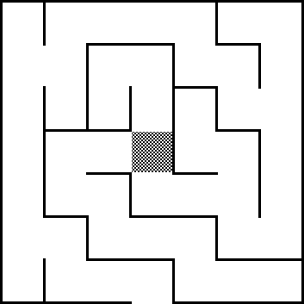
A Recursive View of Mazes
Thus, the original maze is solvable only if one of the three mazes at the bottom of this slide is solvable.
Each of these mazes is “simpler” because it contains fewer squares.
The simple cases are:
  Theseus is outside the maze
  There are no directions left to try
Θ
Θ
Θ
Θ

Slide 6
Enumerated Types in C++
It is often convenient to define new types in which the possible values are chosen from a small set of possibilities. Such types are called enumerated types.
In C++, you define an enumerated type like this:
enum name { list of element names };
The code for the maze program uses enum to define a new type consisting of the four compass points, as follows:
enum Direction {
NORTH, EAST, SOUTH, WEST
};
You can then declare a variable of type Direction and use it along with the constants NORTH, EAST, SOUTH, and WEST.

Slide 7
The Maze Class
/*
* Class: Maze
* -----------
* This class represents a two-dimensional maze contained in a rectangular
* grid of squares. The maze is read in from a data file in which the
* characters '+', '-', and '|' represent corners, horizontal walls, and
* vertical walls, respectively; spaces represent open passageway squares.
* The starting position is indicated by the character 'S'. For example,
* the following data file defines a simple maze:
*
* +-+-+-+-+-+
* | |
* + +-+ + +-+
* |S | |
* +-+-+-+-+-+
*/
class Maze {
public:

Slide 8
The Maze Class
/*
* Class: Maze
* -----------
* This class represents a two-dimensional maze contained in a rectangular
* grid of squares. The maze is read in from a data file in which the
* characters '+', '-', and '|' represent corners, horizontal walls, and
* vertical walls, respectively; spaces represent open passageway squares.
* The starting position is indicated by the character 'S'. For example,
* the following data file defines a simple maze:
*
* +-+-+-+-+-+
* | |
* + +-+ + +-+
* |S | |
* +-+-+-+-+-+
*/
class Maze {
public:
/*
* Constructor: Maze
* Usage: Maze maze(filename);
* Maze maze(filename, gw);
* -------------------------------
* Constructs a new maze by reading the specified data file. If the
* second argument is supplied, the maze is displayed in the center
* of the graphics window.
*/
Maze(std::string filename);
Maze(std::string filename, GWindow & gw);
/*
* Method: getStartPosition
* Usage: Point start = maze.getStartPosition();
* ---------------------------------------------
* Returns a Point indicating the coordinates of the start square.
*/
Point getStartPosition();

Slide 9
The Maze Class
/*
* Constructor: Maze
* Usage: Maze maze(filename);
* Maze maze(filename, gw);
* -------------------------------
* Constructs a new maze by reading the specified data file. If the
* second argument is supplied, the maze is displayed in the center
* of the graphics window.
*/
Maze(std::string filename);
Maze(std::string filename, GWindow & gw);
/*
* Method: getStartPosition
* Usage: Point start = maze.getStartPosition();
* ---------------------------------------------
* Returns a Point indicating the coordinates of the start square.
*/
Point getStartPosition();
/*
* Method: isOutside
* Usage: if (maze.isOutside(pt)) . . .
* ------------------------------------
* Returns true if the specified point is outside the boundary of the maze.
*/
bool isOutside(Point pt);
/*
* Method: wallExists
* Usage: if (maze.wallExists(pt, dir)) . . .
* ------------------------------------------
* Returns true if there is a wall in direction dir from the square at pt.
*/
bool wallExists(Point pt, Direction dir);
/*
* Method: markSquare
* Usage: maze.markSquare(pt);
* ---------------------------
* Marks the specified square in the maze.
*/
void markSquare(Point pt);

Slide 10
The Maze Class
/*
* Method: isOutside
* Usage: if (maze.isOutside(pt)) . . .
* ------------------------------------
* Returns true if the specified point is outside the boundary of the maze.
*/
bool isOutside(Point pt);
/*
* Method: wallExists
* Usage: if (maze.wallExists(pt, dir)) . . .
* ------------------------------------------
* Returns true if there is a wall in direction dir from the square at pt.
*/
bool wallExists(Point pt, Direction dir);
/*
* Method: markSquare
* Usage: maze.markSquare(pt);
* ---------------------------
* Marks the specified square in the maze.
*/
void markSquare(Point pt);
/*
* Method: unmarkSquare
* Usage: maze.unmarkSquare(pt);
* -----------------------------
* Unmarks the specified square in the maze.
*/
void unmarkSquare(Point pt);
/*
* Method: isMarked
* Usage: if (maze.isMarked(pt)) . . .
* -----------------------------------
* Returns true if the specified square is marked.
*/
bool isMarked(Point pt);
/* Private section goes here */
};

Slide 11
The solveMaze Function
/*
* Function: solveMaze
* Usage: solveMaze(maze, start);
* ------------------------------
* Attempts to generate a solution to the current maze from the specified
* start point. The solveMaze function returns true if the maze has a
* solution and false otherwise. The implementation uses recursion
* to solve the submazes that result from marking the current square
* and moving one step along each open passage.
*/
bool solveMaze(Maze & maze, Point start) {
if (maze.isOutside(start)) return true;
if (maze.isMarked(start)) return false;
maze.markSquare(start);
for (Direction dir = NORTH; dir <= WEST; dir++) {
if (!maze.wallExists(start, dir)) {
if (solveMaze(maze, adjacentPoint(start, dir))) {
return true;
}
}
}
maze.unmarkSquare(start);
return false;
}

Slide 12
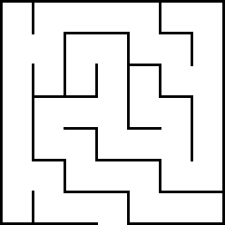

Tracing the solveMaze Function
bool solveMaze(Maze & maze, Point start) {
if (maze.isOutside(start)) return true;
if (maze.isMarked(start)) return false;
maze.markSquare(start);
for (Direction dir = NORTH; dir <= WEST; dir++) {
if (!maze.wallExists(start, dir)) {
if (solveMaze(maze, AdjPt(start, dir))) {
return true;
}
}
}
maze.unmarkSquare(start);
return false;
}
x
x
x
x
x
x
x
bool solveMaze(Maze & maze, Point start) {
if (maze.isOutside(start)) return true;
if (maze.isMarked(start)) return false;
maze.markSquare(start);
for (Direction dir = NORTH; dir <= WEST; dir++) {
if (!maze.wallExists(start, dir)) {
if (solveMaze(maze, AdjPt(start, dir))) {
return true;
}
}
}
maze.unmarkSquare(start);
return false;
}
bool solveMaze(Maze & maze, Point start) {
if (maze.isOutside(start)) return true;
if (maze.isMarked(start)) return false;
maze.markSquare(start);
for (Direction dir = NORTH; dir <= WEST; dir++) {
if (!maze.wallExists(start, dir)) {
if (solveMaze(maze, AdjPt(start, dir))) {
return true;
}
}
}
maze.unmarkSquare(start);
return false;
}
x
x
x
x
x
x
x
x
x
x
x
x
x
Θ
x
x
x
Θ
x
x
x
x
x
Θ
x
x
x
x
x
x
x
Θ
start
dir
dir
(3, 3)
EAST
SOUTH
EAST
SOUTH
NORTH
start
NORTH
start
dir
dir
(3, 2)
(3, 4)
Don’t follow the recursion more than one level.
Depend on the recursive leap of faith.

Slide 13
Reflections on the Maze Problem
The solveMaze program is a useful example of how to search all paths that stem from a branching series of choices. At each square, the solveMaze program calls itself recursively to find a solution from one step further along the path.
To give yourself a better sense of why recursion is important in this problem, think for a minute or two about what it buys you and why it would be difficult to solve this problem iteratively.
In particular, how would you answer the following questions:
  What information does the algorithm need to remember as it proceeds with the solution, particularly about the options it has already tried?
  In the recursive solution, where is this information kept?
  How might you keep track of this information otherwise?

Slide 14
Consider a Specific Example
Suppose that the program has reached the following position:
x
Θ
x
x
x
x
How does the algorithm keep track of the “big picture” of what paths it still needs to explore?

Slide 15
Each Frame Remembers One Choice
bool solveMaze(Maze & maze, Point start) {
if (maze.isOutside(start)) return true;
if (maze.isMarked(start)) return false;
maze.markSquare(start);
for (Direction dir = NORTH; dir <= WEST; dir++) {
if (!maze.wallExists(start, dir)) {
if (solveMaze(maze, AdjPt(start, dir))) {
return true;
}
}
}
maze.unmarkSquare(start);
return false;
}
bool solveMaze(Maze & maze, Point start) {
if (maze.isOutside(start)) return true;
if (maze.isMarked(start)) return false;
maze.markSquare(start);
for (Direction dir = NORTH; dir <= WEST; dir++) {
if (!maze.wallExists(start, dir)) {
if (solveMaze(maze, AdjPt(start, dir))) {
return true;
}
}
}
maze.unmarkSquare(start);
return false;
}
bool solveMaze(Maze & maze, Point start) {
if (maze.isOutside(start)) return true;
if (maze.isMarked(start)) return false;
maze.markSquare(start);
for (Direction dir = NORTH; dir <= WEST; dir++) {
if (!maze.wallExists(start, dir)) {
if (solveMaze(maze, AdjPt(start, dir))) {
return true;
}
}
}
maze.unmarkSquare(start);
return false;
}
bool solveMaze(Maze & maze, Point start) {
if (maze.isOutside(start)) return true;
if (maze.isMarked(start)) return false;
maze.markSquare(start);
for (Direction dir = NORTH; dir <= WEST; dir++) {
if (!maze.wallExists(start, dir)) {
if (solveMaze(maze, AdjPt(start, dir))) {
return true;
}
}
}
maze.unmarkSquare(start);
return false;
}
x
Θ
x
x
Θ
x
x
x
x
x
bool solveMaze(Maze & maze, Point start) {
if (maze.isOutside(start)) return true;
if (maze.isMarked(start)) return false;
maze.markSquare(start);
for (Direction dir = NORTH; dir <= WEST; dir++) {
if (!maze.wallExists(start, dir)) {
if (solveMaze(maze, AdjPt(start, dir))) {
return true;
}
}
}
maze.unmarkSquare(start);
return false;
}
Θ
bool solveMaze(Maze & maze, Point start) {
if (maze.isOutside(start)) return true;
if (maze.isMarked(start)) return false;
maze.markSquare(start);
for (Direction dir = NORTH; dir <= WEST; dir++) {
if (!maze.wallExists(start, dir)) {
if (solveMaze(maze, AdjPt(start, dir))) {
return true;
}
}
}
maze.unmarkSquare(start);
return false;
}
x
x
x
x
x
x
x
x
x
x
x
Θ
Θ
x
Θ
start
dir
start
dir
(3, 3)
SOUTH
(3, 4)
start
dir
EAST
(4, 4)
start
dir
EAST
(3)
NORTH
start
dir
(5, 3)
start
dir
WEST
(4, 3)

Slide 16
Recursion and Concurrency
The recursive decomposition of a maze generates a series of independent submazes; the goal is to solve any one of them.
If you had a multiprocessor computer, you could try to solve each of these submazes in parallel. This strategy is analogous to cloning yourself at each intersection and sending one clone down each path.
6
5
5
5
5
4
4
6
5
1
1
5
5
4
7
5
1
1
2
5
4
7
3
3
1
2
2
4
Θ
7
3
3
2
2
2
4
7
7
3
3
3
4
4
8
7
7
7
3
3
3
7
Is this parallel strategy more efficient?

Slide 17
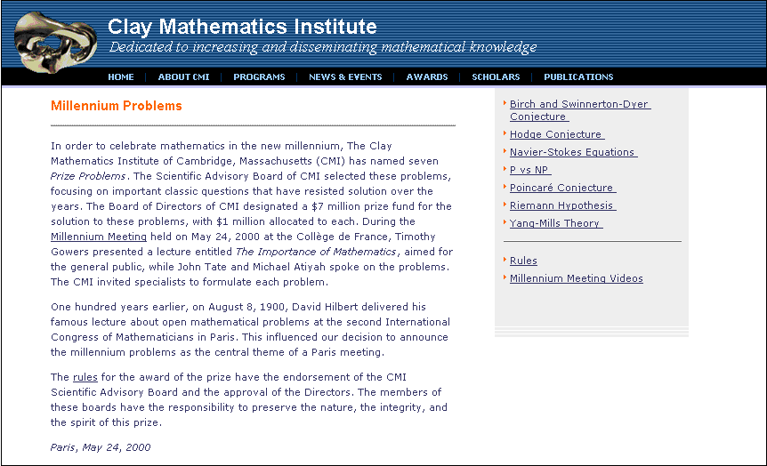
The P = NP Question
The question of whether a parallel solution is fundamentally faster than a sequential one is related to the biggest open problem in computer science, for which there is a $1M prize.

Slide 18
Exercise: Keeping Track of the Path
As described in exercise 3 on page 418, it is possible to build a better version of solveMaze so that it keeps track of the solution path as the computation proceeds.
Write a new function
bool findSolutionPath(Maze & maze, Point start,
Vector<Point> & path);
that records the solution path in a vector of Point values passed as a reference parameter. The findSolutionPath function should return a Boolean value indicating whether the maze is solvable, just as solveMaze does.

Slide 19
The End

