Slide 1
Backtracking and Games
Eric Roberts
CS 106B
January 28, 2013

Slide 2
Searching in a Branching Structure
The recursive structure for finding the solution path in a maze comes up in a wide variety of applications, characterized by the need to explore a range of possibilities at each of a series of choice points.
The primary advantage of using recursion in these problems is that doing so dramatically simplifies the bookkeeping. Each level of the recursive algorithm considers one choice point. The historical knowledge of what choices have already been tested and which ones remain for further exploration is maintained automatically in the execution stack.
Many such applications are like the maze-solving algorithm in which the process searches a branching structure to find a particular solution. Others, however, use the same basic strategy to explore every path in a branching structure in some systematic way.

Slide 3
Exercise: Generating Subsets
Write a function
that generates a vector showing all subsets of the set formed from the letters in set.
Vector<string> generateSubsets(string set);
For example, calling generateSubsets("abc") should return a vector containing the following eight strings, in some order:
""
"a"
"ab"
"abc"
"b"
"ac"
"c"
"bc"
The solution process requires a branching structure similar to that used to solve a maze. At each level of the recursion, you can either exclude or include the current letter from the list of subsets, as illustrated on the following slide.

Slide 4
The Subset Tree
The set of all subsets of { a, b, c } is
Those that don’t include 'a'
Those that do include 'a'
Has no 'b'
Has a 'b'
Has no 'b'
Has a 'b'
Has no 'c'
Has a 'c'
Has no 'c'
Has a 'c'
Has no 'c'
Has a 'c'
Has no 'c'
Has a 'c'
{ }
{ c }
{ b }
{ b, c }
{ a }
{ a, c }
{ a, b }
{ a, b, c }

Slide 5


The Eight Queens Problem

Slide 6

What Most Students Want to Do
bool solveNQueens(Grid<char> & board) {
int n = board.numRows();
for (int c1 = 0; c1 < n; c1++) {
board[0][c1] = 'Q';
for (int c2 = 0; c2 < n; c2++) {
board[1][c2] = 'Q';
for (int c3 = 0; c3 < n; c3++) {
board[2][c2] = 'Q';
. . .
if (solutionFound(board)) return true;
. . .
board[2][c2] = ' ';
}
board[1][c2] = ' ';
}
board[0][c2] = ' ';
}
return false;
}

Slide 7
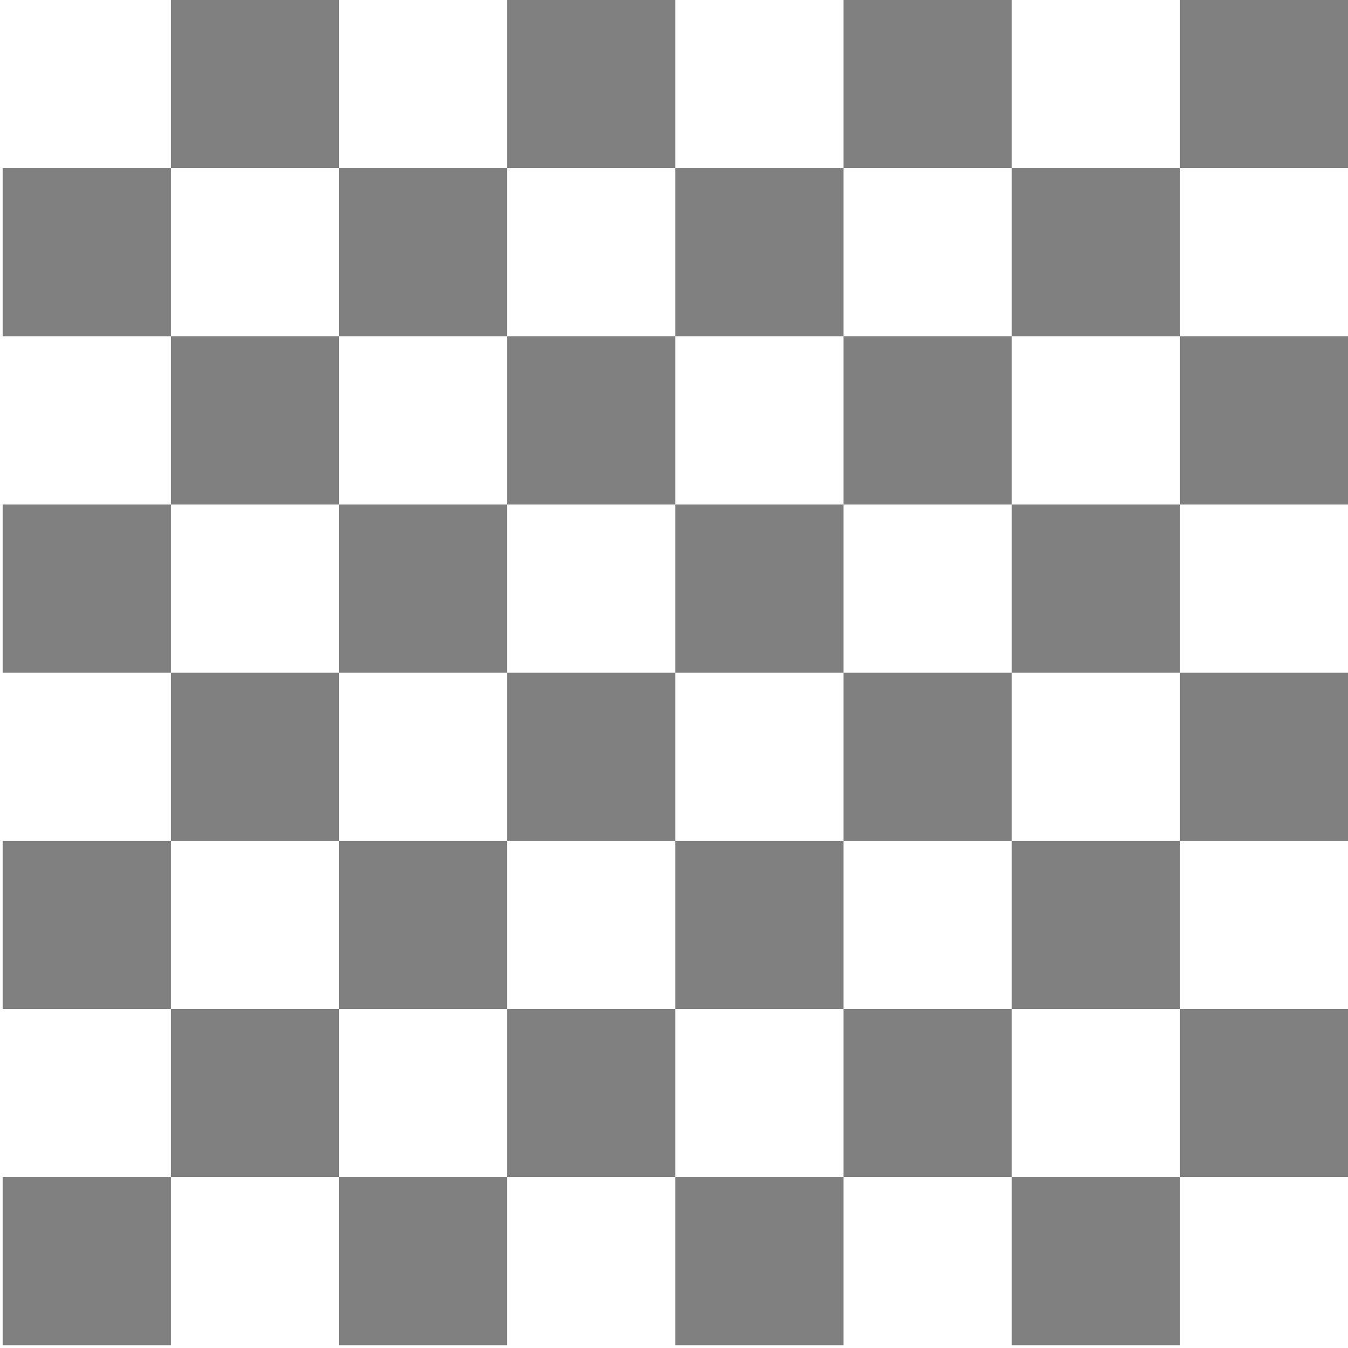















Deep Blue Beats Gary Kasparov
In 1997, IBM’s Deep Blue program beat Gary Kasparov, who was then the world’s human champion. In 1996, Kasparov had won in play that is in some ways more instructive.
Game 6
Kasparov
Deep Blue
30. b6
8
30. Bb8 ??
7
6
5
4
3
2
1
a
b
c
d
e
f
g
h

Slide 8






Recursion and Games
In 1950, Claude Shannon wrote an article for Scientific American in which he described how to write a chess-playing computer program.
Shannon’s strategy was to have the computer try every possible move for white, followed by all of black’s responses, and then all of white’s responses to those moves, and so on.
Even with modern computers, it is impossible to use this strategy for an entire game, because there are too many possibilities.
5
10
20
25
30
35
Positions evaluated:
53
~
1000
2000
3000
4000
5000
6000
7000
8000
9000
10
10
10
10
10
10
10
. . . millions of years later . . .

Slide 9
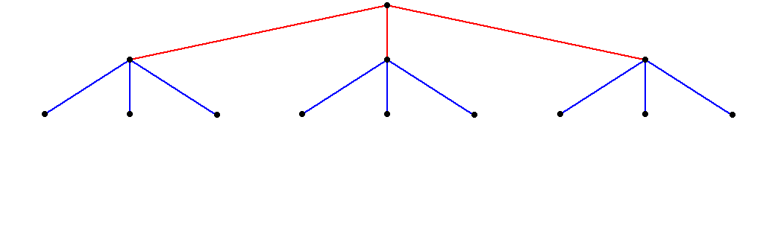
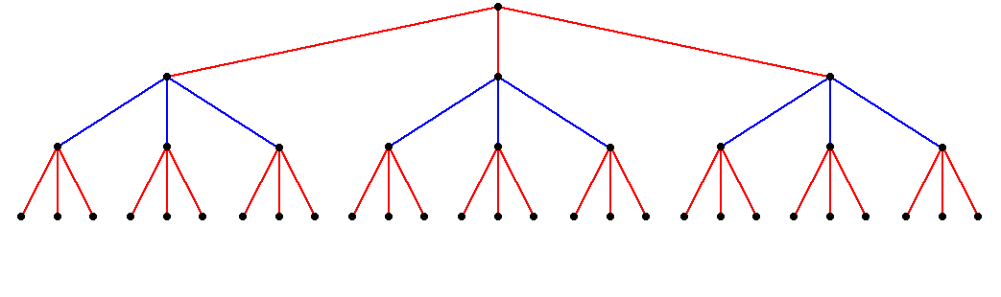
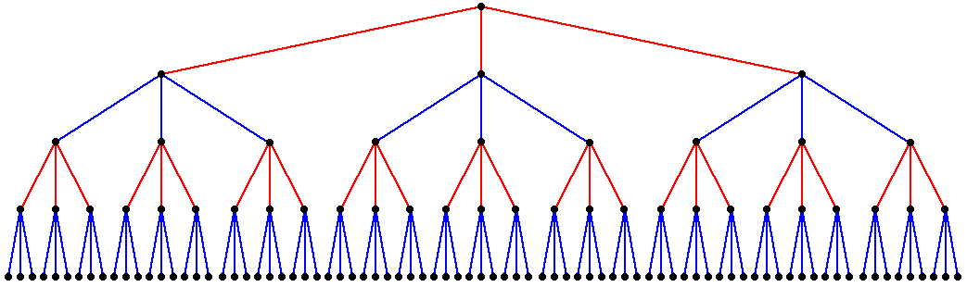
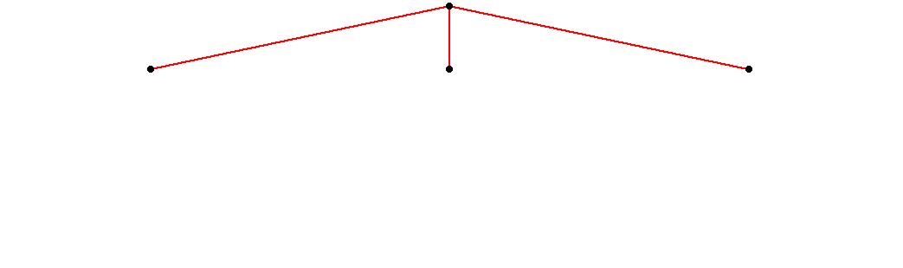
Game Trees
As Shannon observed in 1950, most two-player games have the same basic form:
  The first player (red) must choose between a set of moves
  For each move, the second player (blue) has several responses.
  For each of these responses, red has further choices.
  For each of these new responses, blue makes another decision.
  And so on . . .

Slide 10
A Simpler Game
Chess is far too complex a game to serve as a useful example. The text uses a much simpler game called Nim, which is representative of a large class of two-player games.
In Nim, the game begins with a pile of coins between two players. The starting number of coins can vary and should therefore be easy to change in the program.
In alternating turns, each player takes one, two, or three coins from the pile in the center.
The player who takes the last coin loses.

Slide 11
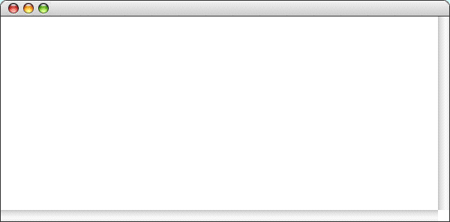
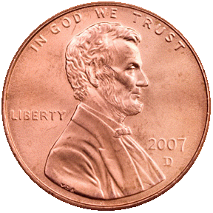
A Sample Game of Nim
Nim
There are 11 coins left.
I'll take 2.
There are 9 coins left.
Your move:
1
There are 8 coins left.
I'll take 3.
There are 5 coins left.
Your move:
2
There are 3 coins left.
I'll take 2.
There is only one coin left.
You lose.

Slide 12
Good Moves and Bad Positions
The essential insight behind the Nim program is bound up in the following mutually recursive definitions:
  A good move is one that leaves your opponent in a bad position.
  A bad position is one that offers no good moves.
The implementation of the Nim game is really nothing more than a translation of these definitions into code.

Slide 13
Coding the Nim Strategy
/*
* Looks for a winning move, given the specified number of coins.
* If there is a winning move in that position, findGoodMove returns
* that value; if not, the method returns the constant NO_GOOD_MOVE.
* This implementation depends on the recursive insight that a good move
* is one that leaves your opponent in a bad position and a bad position
* is one that offers no good moves.
*/
int findGoodMove(int nCoins) {
int limit = (nCoins < MAX_MOVE) ? nCoins : MAX_MOVE;
for (int nTaken = 1; nTaken <= limit; nTaken++) {
if (isBadPosition(nCoins - nTaken)) return nTaken;
}
return NO_GOOD_MOVE;
}
/*
* Returns true if nCoins is a bad position. Being left with a single
* coin is clearly a bad position and represents the simple case.
*/
bool isBadPosition(int nCoins) {
if (nCoins == 1) return true;
return findGoodMove(nCoins) == NO_GOOD_MOVE;
}

Slide 14
The Minimax Algorithm
Games like Nim are simple enough that it is possible to solve them completely in a relatively small amount of time.
For more complex games, it is necessary to cut off the analysis at some point and then evaluate the position, presumably using some function that looks at a position and returns a rating for that position. Positive ratings are good for the player to move; negative ones are bad.
When your game player searches the tree for best move, it can’t simply choose the one with the highest rating because you control only half the play.
What you want instead is to choose the move that minimizes the maximum rating available to your opponent. This strategy is called the minimax algorithm.

Slide 15
A Minimax Illustration
Suppose that the ratings two turns from now are as shown.
From your perspective, the +9 initially looks attractive.
Unfortunately, your can’t get there, since the –5 is better for your opponent.
The best you can do is choose the move that leads to the –2.
+7
+6
–9
–5
+9
–4
–1
+1
–2

Slide 16
The End

