Slide 1
Programming Abstractions in C++
CS106B
Cynthia Lee

Slide 2
Today’s Topics
Introductions
Course structure and procedures
What is this class? What do we mean by “abstractions”?
Introduce the C++ language from the Java programmer’s perspective (but it’s ok if you’re not a Java programmer!)
    Functions
    Strings
    Streams
Next lecture:
  Strings and streams, continued
  Data structures: Grid

Slide 3

Your instructor: Cynthia Lee
Research:
  PhD @ UCSD: market-based resource allocation in large-scale systems
  Recently: computer science education
Teaching:
  2 years at Stanford, 3 years at UCSD
  CS106B, CS106X, CS107, CS109, CS9, SSEA (summer CS106A+B)
Software engineer:
  iPhone educational games
  Document clustering and classification
When I’m not working:
  Family, biking, climbing, hiking, pet chickens

Slide 4
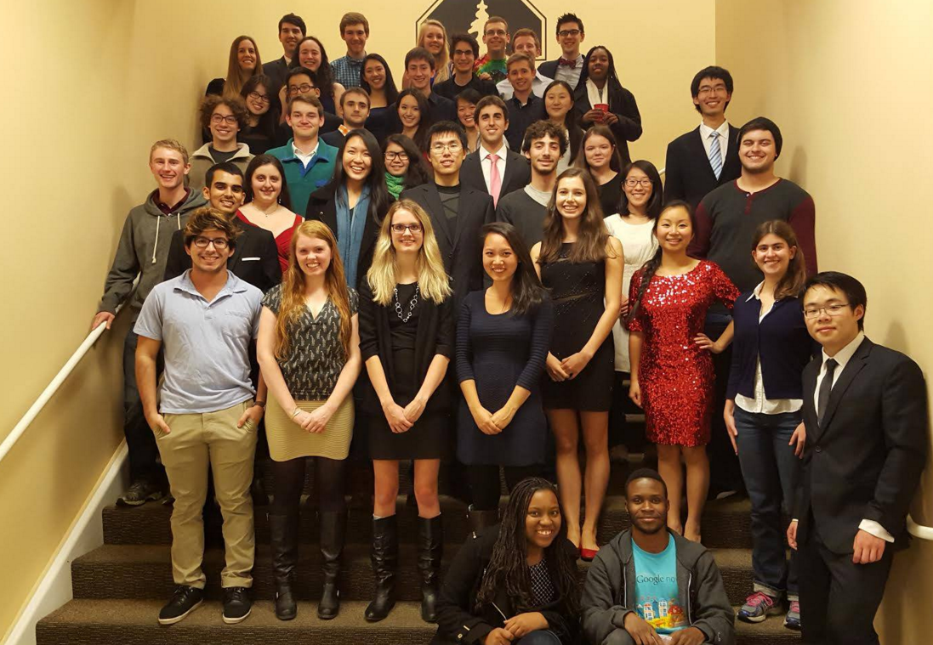
Discussion Section, SLs
section leaders: Helpful undergraduate assistants who will:
  run your discussion section each week
  grade your homework assignments and exams
  help you when you have questions
  ... and much more

Slide 5
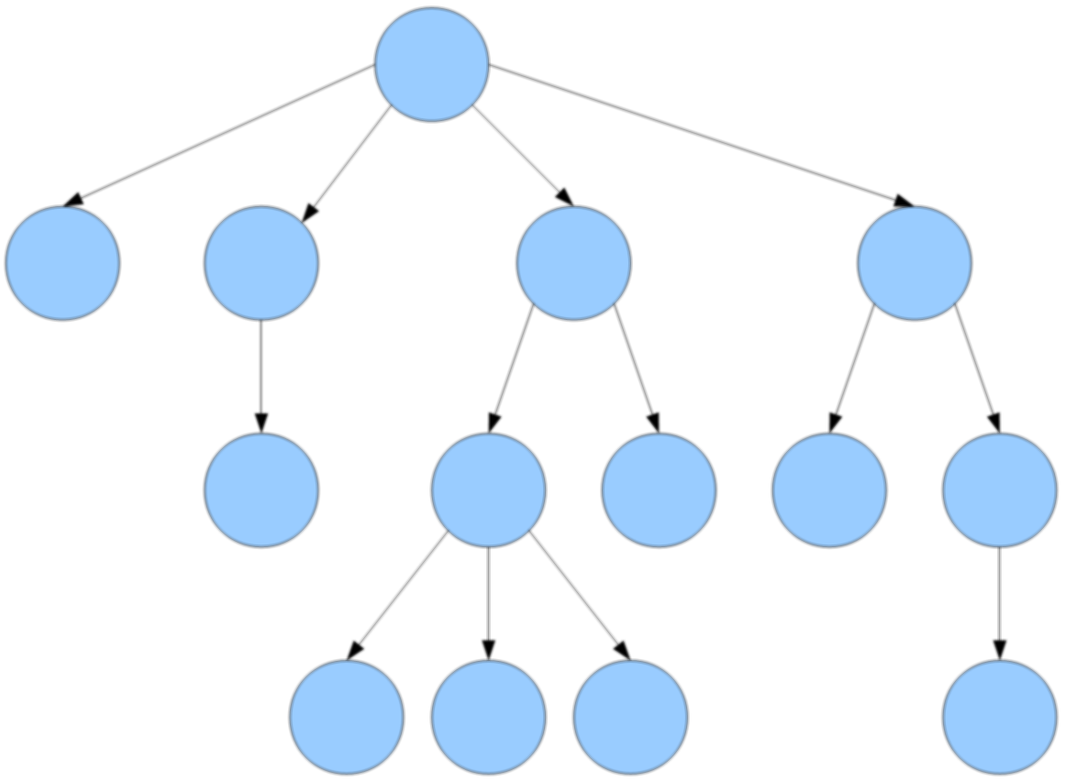
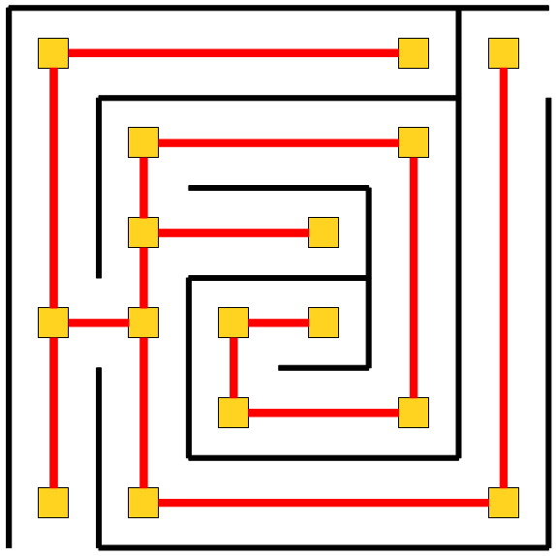
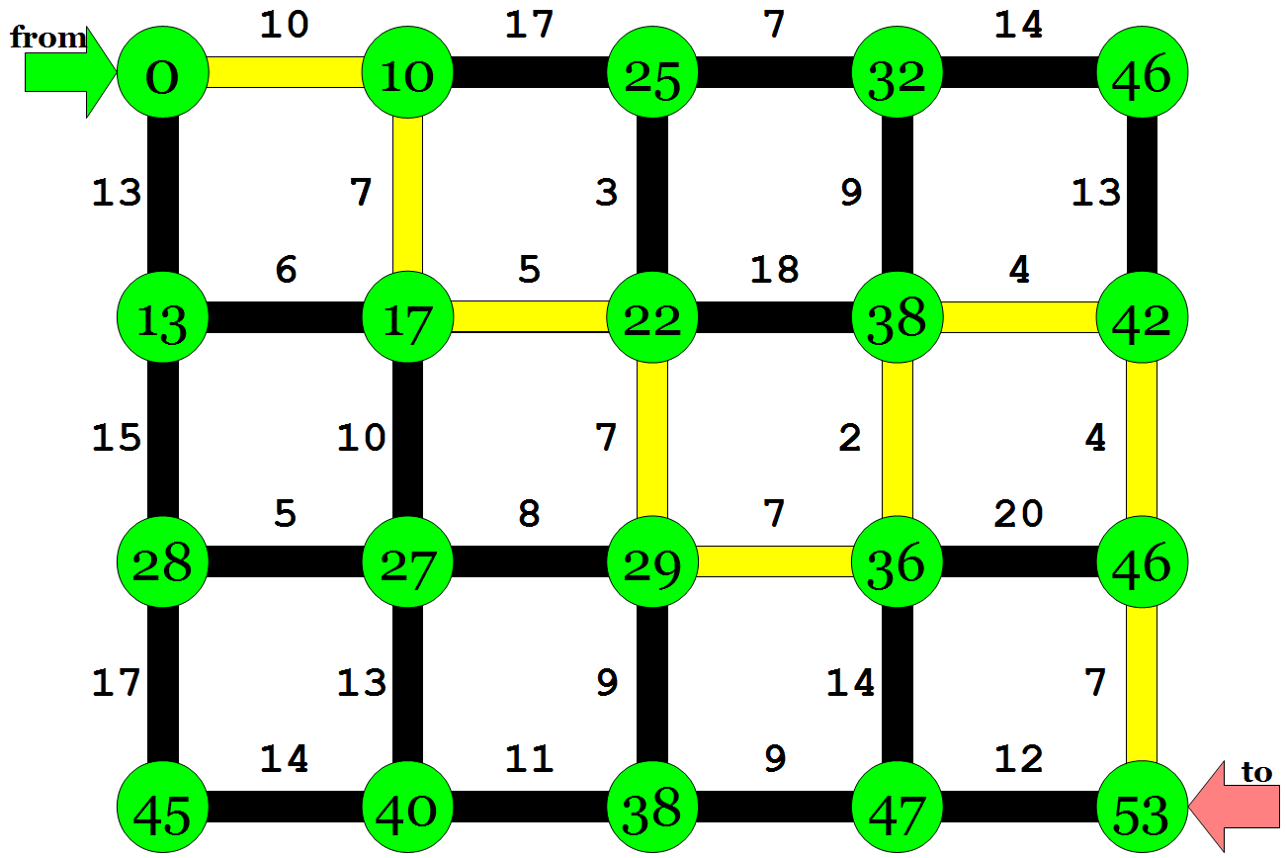

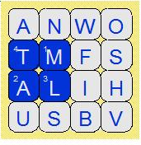
What is CS 106B?
CS 106B: Programming Abstractions
  solving big(ger) problems and processing big(ger) data
  learning to manage complex data structures
  algorithmic analysis and algorithmic techniques such as recursion
  programming style and software development practices
  familiarity with the C++ programming language
Prerequisite: CS 106A or equivalent
http://cs106b.stanford.edu/

Slide 6
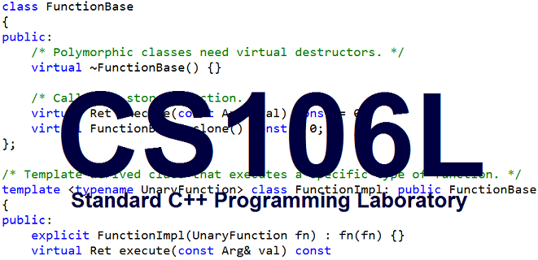
A one-unit course to learn and practice C++ programming in depth
  Tu/Th 1:30-2:20, Littlefield 107
  Take it this quarter if it fits, or it will be offered again in Autumn
  (does not need to be taken in the same quarter as CS106B)

Slide 7
Late Days
Late day: allows you to submit a homework 1 Lecture Day late
You get 3 free (no-penalty) late days for the quarter, but only one or two can be used on a given assignment
After your late days are used up (or for the 3rd late day), 1 bucket grade is deducted per day
NO SUBMISSIONS are accepted after 3 days late
Example:
Week | Sun | Mon | Tue | Wed | Thu | Fri | Sat
1
2 |  |  |  | due | 1 day late | 1 day late | 2 days late
3 | 2 days late | 2 days late | 3 days late | 3 days late

Slide 8

What is this class about?
What do we mean by “abstractions”?
Colatina, Carlos Nemer
This file is licensed under the Creative Commons Attribution 3.0 Unported license.

Slide 9
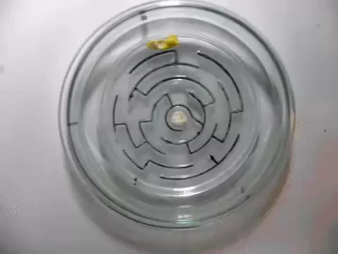

Slide 10

http://www.publicdomainpictures.net/pictures/10000/velka/1-1265899974oKJ9.jpg

Slide 11
http://www.publicdomainpictures.net/pictures/10000/velka/1-1265899974oKJ9.jpg

Slide 12
Sentence
Subject
Verb Phrase
Object
Noun
Adverb
Verb
Possessive
Noun
CS106B
totally
rocks
my
socks

Slide 13
CS106B
totally
rocks
my
socks

Slide 14
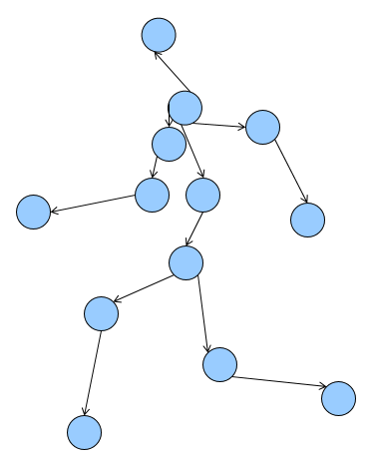
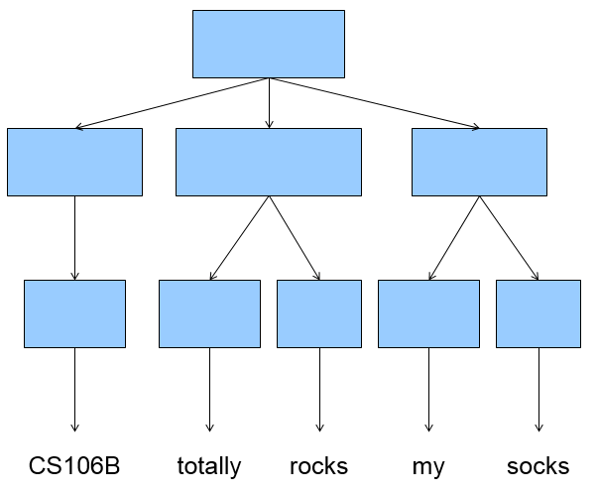

Slide 15
Building a vocabulary of abstractions
makes it possible to represent and solve a huge variety of problems using known tools.

Slide 16
A first C++ program (Error)
firstprogram.cpp
#include <iostream>
#include "console.h"
using namespace std;
int main(){
cout << "|-5| = "
<< absoluteValue(-5) << endl;
return 0;
}
int absoluteValue(int n) {
if (n<0){
return -n;
}
return n;
}
You don’t know what automata is, do you? SOON!
Notes:
-- firstprogram.cpp : unlike java, filename doesn’t have to match class! In fact, don’t need a class!
-- instead of "import" we have "#include" – note some have "" some have <> -- .h extension means "header" interface information as opposed to .cpp for implementation code
-- "using namespace" just don’t worry about why and use it (saves having to do ::)
-- main returns type int, just return zero if everything went ok (ignore why)
-- we use cout instead of System.out.println(), endl puts a newline

Slide 17
C++ from the Java Programmer’s Perspective
(But it’s ok if you don’t know java!)

Slide 18
A first C++ program (Error)
firstprogram.cpp
#include <iostream>
#include "console.h"
using namespace std;
int main(){
cout << "|-5| = "
<< absoluteValue(-5) << endl;
return 0;
}
int absoluteValue(int n) {
if (n<0){
return -n;
}
return n;
}
You don’t know what automata is, do you? SOON!
Notes:
-- firstprogram.cpp : unlike java, filename doesn’t have to match class! In fact, don’t need a class!
-- instead of "import" we have "#include" – note some have "" some have <> -- .h extension means "header" interface information as opposed to .cpp for implementation code
-- "using namespace" just don’t worry about why and use it (saves having to do ::)
-- main returns type int, just return zero if everything went ok (ignore why)
-- we use cout instead of System.out.println(), endl puts a newline

Slide 19
A first C++ program (Fixed #1)
firstprogram.cpp
#include <iostream>
#include "console.h"
using namespace std;
int absoluteValue(int n) {
if (n<0){
return -n;
}
return n;
}
int main(){
cout << "|-5| = "
<< absoluteValue(-5) << endl;
return 0;
}
You don’t know what automata is, do you? SOON!
Notes:
-- firstprogram.cpp : unlike java, filename doesn’t have to match class! In fact, don’t need a class!
-- instead of "import" we have "#include" – note some have "" some have <> -- .h extension means "header" interface information as opposed to .cpp for implementation code
-- "using namespace" just don’t worry about why and use it (saves having to do ::)
-- main returns type int, just return zero if everything went ok (ignore why)
-- we use cout instead of System.out.println(), endl puts a newline

Slide 20
A first C++ program (Fixed #2)
firstprogram.cpp
#include <iostream>
#include "console.h"
using namespace std;
int absoluteValue(int n);
int main(){
cout << "|-5| = "
<< absoluteValue(-5) << endl;
return 0;
}
int absoluteValue(int n) {
if (n<0){
return -n;
}
return n;
}
You don’t know what automata is, do you? SOON!
Notes:
-- firstprogram.cpp : unlike java, filename doesn’t have to match class! In fact, don’t need a class!
-- instead of "import" we have "#include" – note some have "" some have <> -- .h extension means "header" interface information as opposed to .cpp for implementation code
-- "using namespace" just don’t worry about why and use it (saves having to do ::)
-- main returns type int, just return zero if everything went ok (ignore why)
-- we use cout instead of System.out.println(), endl puts a newline

Slide 21
Design Question: Why does C++ have the function prototype syntax?
In other words, why not just have a rule that you must set up the ordering so you define your functions before using them, as in the "FIXED 1" example?
  C++ could have done that, but such a rule would be too cumbersome for programmers to follow.
  C++ could have done that, but good programming style dictates "top-down" approach that logically puts main() first and helper functions it calls to follow.
  C++ could not have done that, because sometimes there is no way to order the functions so that all functions are defined before being used.
  Other/none/more than one of the above

Slide 22
Design Question: Why does C++ have the function prototype syntax?
(A) and (B) The rationales behind choices (A) and (B) (previous slide) are correct
    May or may not have been enough to compel the language designers to introduce the function prototype feature
(C) is true—there are cases where you simply cannot rearrange the ordering of functions to avoid all cases of use before definition
    e.g., mutual recursion

Slide 23
Which came first, the chicken or the egg?
(this code is just for fun, for now—we’ll cover recursion in depth in a few weeks!)
#include<iostream>
#include "console.h"
using namespace std;
void go(int n);
void stanford(int n);
int main(){
int n = 5;
go(n);
return 0;
}
void go(int n) {
if (n == 0) return;
cout << "Go!" << endl;
stanford(n-1);
}
void stanford(int n) {
cout << "Stanford!" << endl;
go(n);
}

