Slide 1
Programming Abstractions
CS106B
Cynthia Lee

Slide 2
Today’s Topics
Introducing C++ from the Java Programmer’s Perspective
  C++ strings and streams, continued
  Reference parameters
  ADTs: Abstract Data Types
  Introduction: What are ADTs?
  Vector data structure
  Grid data structure
    Passing objects by reference
      const reference parameters
    Loop over “neighbors” in a grid

Slide 3
Warm-Up (CS106A review): Parameters
int main(){
int n = -5;
absoluteValue(n);
cout << "|-5| = " << n << endl;
return 0;
}
void absoluteValue(int n) {
if (n<0){
n = -n;
}
}
What is printed?
|-5| = 5
|-5| = -5
Other/none/more than one of the above
You don’t know what automata is, do you? SOON!
Notes:
-- firstprogram.cpp : unlike java, filename doesn’t have to match class! In fact, don’t need a class!
-- instead of "import" we have "#include" – note some have "" some have <> -- .h extension means "header" interface information as opposed to .cpp for implementation code
-- "using namespace" just don’t worry about why and use it (saves having to do ::)
-- main returns type int, just return zero if everything went ok (ignore why)
-- we use cout instead of System.out.println(), endl puts a newline

Slide 4

"Pass by reference"
int main(){
int n = -5;
absoluteValue(n);
cout << "|-5| = " << n << endl;
return 0;
}
void absoluteValue(int& n) {
if (n<0){
n = -n;
}
}
What is printed?
|-5| = 5
|-5| = -5
Other/none/more than one of the above
You don’t know what automata is, do you? SOON!
Notes:
-- firstprogram.cpp : unlike java, filename doesn’t have to match class! In fact, don’t need a class!
-- instead of "import" we have "#include" – note some have "" some have <> -- .h extension means "header" interface information as opposed to .cpp for implementation code
-- "using namespace" just don’t worry about why and use it (saves having to do ::)
-- main returns type int, just return zero if everything went ok (ignore why)
-- we use cout instead of System.out.println(), endl puts a newline

Slide 5
"Pass by value"
(default behavior of parameters)
int main(){
int n = -5;
absoluteValue(n);
cout << "|-5| = " << n << endl;
return 0;
}
void absoluteValue(int n) {
if (n<0){
n = -n;
}
}
What is printed?
|-5| = 5
|-5| = -5
Other/none/more than one of the above
You don’t know what automata is, do you? SOON!
Notes:
-- firstprogram.cpp : unlike java, filename doesn’t have to match class! In fact, don’t need a class!
-- instead of "import" we have "#include" – note some have "" some have <> -- .h extension means "header" interface information as opposed to .cpp for implementation code
-- "using namespace" just don’t worry about why and use it (saves having to do ::)
-- main returns type int, just return zero if everything went ok (ignore why)
-- we use cout instead of System.out.println(), endl puts a newline

Slide 6
Often used when you would want to “return” several values from a function (but there is only one return value allowed)
#include "random.h"
void pickLotto(int& first, int& second, int& third) {
first = randomInteger(0,10);
second = randomInteger(0,10);
third = randomInteger(0,10);
}
int main(){
int lotto1 = 0;
int lotto2 = 0;
int lotto3 = 0;
pickLotto(lotto1, lotto2, lotto3);
cout << lotto1 << " " << lotto2 << " " << lotto3 << endl;
return 0;
}
You don’t know what automata is, do you? SOON!
Notes:
-- firstprogram.cpp : unlike java, filename doesn’t have to match class! In fact, don’t need a class!
-- instead of "import" we have "#include" – note some have "" some have <> -- .h extension means "header" interface information as opposed to .cpp for implementation code
-- "using namespace" just don’t worry about why and use it (saves having to do ::)
-- main returns type int, just return zero if everything went ok (ignore why)
-- we use cout instead of System.out.println(), endl puts a newline

Slide 7
Pass by reference
benefits of reference parameters:
  a useful way to be able to in effect 'return' more than one value
  often used with large structures and objects, to avoid making bulky copies when passing (more on this in a minute)
downsides of reference parameters:
  hard to tell from call whether it is ref; can't tell if it will be changed
    foo(a, b, c); // will foo change a, b, or c? don’t know. ☹
  can't pass a literal value to a ref parameter
    grow(39); // error

Slide 8
ADTs
Vector, Grid

Slide 9
ADTs
Programming language independent models of common containers
They encompass not only the nature of the data, but ways of accessing it
They form a rich vocabulary of nouns and verbs, often drawing on analogies to make their use intuitive, and to give code written in them a certain literary quality

Slide 10
"Hope" is the thing with feathers
BY Emily DickensON
“Hope” is the thing with feathers -
That perches in the soul -
And sings the tune without the words -
And never stops - at all -
And sweetest - in the Gale - is heard -
And sore must be the storm -
That could abash the little Bird
That kept so many warm -
I’ve heard it in the chillest land -
And on the strangest Sea -
Yet - never - in Extremity,
It asked a crumb - of me.
Once we say HOPE = BIRD…
…it now makes sense to say HOPE PERCHES
…or HOPE SINGS
We could have described those aspects of HOPE without the analogy, but casting our abstract idea of HOPE as a well-understood thing gave us access to similarly well-understood and evocative verbs, helping the reader more readily grasp our meaning.
The same thing happens in code with ADTs.

Slide 11
Vector
ADT abstraction similar to an array
Many languages have a version of this
    Java ArrayList
    (remember, ADTs are conceptual abstractions that are language-independent)
In C++ we declare one like this:
This < .. > syntax is called template syntax
    Vectors can hold many things, but they all have to be the same type
    The type goes in the < .. > after the class name Vector
      Vector<int> assignment3Scores;
      Vector<double> measurementsData;
      Vector<Vector<int>> allAssignmentScores;
Vector<string> lines;

Slide 12
Grid ADT
Code example

Slide 13


Slide 14
Handy loop idiom: iterating over “neighbors” in a Grid
static void neighbors(Grid<bool>& board, int row, int col) {
for (int drow = -1; drow <= 1; drow++) {
for (int dcol = -1; dcol <= 1; dcol++) {
// do something with board[row + drow][col + dcol]
}
}
}
R -1 C -1 | R -1 C +0 | R -1 C +1
R +0 C -1 | R +0 C +0 | R +0 C +1
R +1 C -1 | R +1 C +0 | R +1 C +1
These nested for loops generate all the pairs in the cross product {-1,0,1} x {-1,0,1}, and we can add these as offsets to a (row,col) coordinate to generate all the neighbors (note: often want to test for and exclude the (0,0) offset, which is “self” not a neighbor)

Slide 15
CS106 Honor Code
Overview
(Please read full document in detail.)

Slide 16
QT Creator
A few warnings & tips

Slide 17
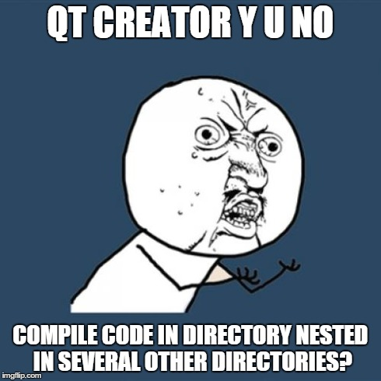
If your code doesn’t compile and gives an error about unknown function Main() (note capital M):
There is more than one reason this could arise, but the most common by far is that QT lost its ability to find the path to our Stanford library includes (which define a special Main()), because you put your code in a directory/folder that is deeply nested on your drive.
For example, C:\Documents and Settings\Documents\classes\Stanford\2015\Summer\CS106B\assignments\C++\Assignment1\...
You need to move the assignment directory closer to C:\ (or on mac, the root directory)

Slide 18
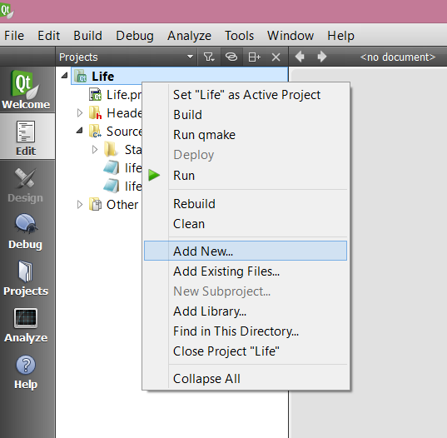
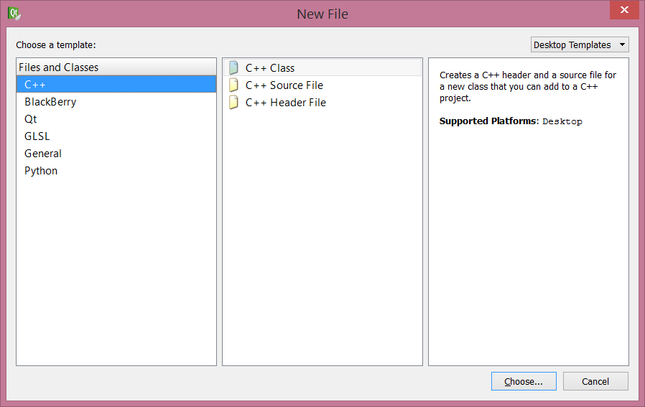
If your code doesn’t compile and gives you “multiple definition” errors for all the functions you have:
This can arise if you add new files to your code inside QT creator using its handy “Add New…” feature.
NOT HANDY! Do not use this feature. It breaks the .pro file.

Slide 19
If it’s too late and you already used the “Add New” feature
QUIT: Close QT Creator
CLEAN UP BROKEN FILES: Delete the .pro and .pro.user files in your code directory; delete the entire build directory (this is an automatically created directory that appears alongside the directory where your code is, it’s name is something like “build-simple-project-Desktop_Qt_5_2_0_MinGW_32bit-Debug”)
GRAB REPLACEMENT: Download/unzip the assignment bundle again, and get a fresh copy of the project file (the one that ends in .pro) and put it in place of the one you deleted (you don’t need anything else in the new bundle).
ALL BETTER! Re-open QT Creator (it will make a new .pro.user)

