Slide 1
Programming Abstractions
CS106B
Cynthia Lee

Slide 2
Today’s Topics
  ADTs
  Stack
    Example: Reverse-Polish Notation calculator
  Queue
    Example: Mouse Events

Slide 3
Stacks

Slide 4
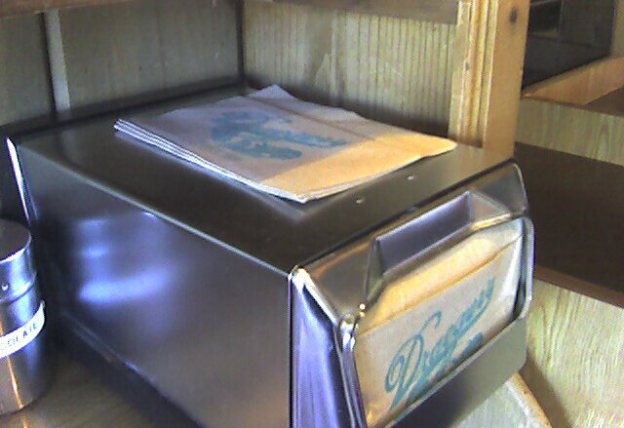
New ADT: Stack
stack.h
template <typename ValueType> class Stack {
public:
Stack();
virtual ~Stack();
int size() const;
bool isEmpty() const;
void clear();
void push(ValueType value);
ValueType pop();
ValueType peek() const;
std::string toString();
private:
};
Source: http://www.flickr.com/photos/35237093334@N01/409465578/
Author: http://www.flickr.com/people/35237093334@N01 Peter Kazanjy]
-Redacted-
Notes:
-- Note destructor and recurring “ValueType” parameter

Slide 5
Using a Stack
Stack<int> s; // {} bottom -> top
s.push(42); // {42}
s.push(-3); // {42, -3}
s.push(17); // {42, -3, 17}
cout << s.pop() << endl; // 17 (s is {42, -3})
cout << s.peek() << endl; // -3 (s is {42, -3})
cout << s.pop() << endl; // -3 (s is {42})
Remember this format—we’ll use it in section examples and on exams

Slide 6
Using a Stack to buffer (i.e., temporarily hold) file input
void mystery(ifstream& infile) {
Stack<string> lines;
string line;
while (getline(infile,line)) {
lines.push(line);
}
infile.close();
while (!lines.isEmpty()) {
cout << lines.pop()
<< endl;
}
}
Reading from a file basics:
ifstream is an input stream (like cin) but from a file
getline takes the file and a string by reference, and reads one line into string
  Returns false when there are no more lines to read
What does this code do?

Slide 7
Using a Stack to buffer (i.e., temporarily hold) file input
void mystery(ifstream& infile) {
Stack<string> lines;
string line;
while (getline(infile,line)) {
lines.push(line);
}
infile.close();
while (!lines.isEmpty()) {
cout << lines.pop()
<< endl;
}
}
Reading from a file basics:
ifstream is an input stream (like cin) but from a file
getline takes the file and a string by reference, and reads one line into string
  Returns false when there are no more lines to read
What does this code do?
Why do I need Stack?
I could have done that with a Vector!

Slide 8
Stack or Vector?
void mystery(ifstream& infile) {
Stack<string> lines;
string line;
while (getline(infile,line)) {
lines.push(line);
}
infile.close();
while (!lines.isEmpty()) {
cout << lines.pop()
<< endl;
}
}
Vector<string> lines;
lines.insert(lines.size(), line);
cout << lines[lines.size()-1]
<< endl;
lines.remove(lines.size()-1);

Slide 9
Vector version
void mystery(ifstream& infile) {
Vector<string> lines;
string line;
while (getline(infile,line)) {
lines.insert(lines.size(),line);
}
infile.close();
while (!lines.isEmpty()) {
cout << lines[lines.size()-1]
<< endl;
lines.remove(lines.size()-1);
}
}
This code isn’t terrible, but it is harder to read quickly, and is probably more error prone.
For example, it would be easy to forget the “-1” when you remove “lines.size()-1”.

Slide 10
Applications of Stacks
We’ve seen one (buffering input and giving it back in reverse—LIFO—order). What else are Stacks good for?

Slide 11
Operator Precedence and Syntax Trees
Ignoring operator precedence rules, how many distinct results are there to the following arithmetic expression?
  3 * 3 + 3 * 3
Notes:
9+9=18
3*(3+9)=36
3*6*3=3*18=54

Slide 12
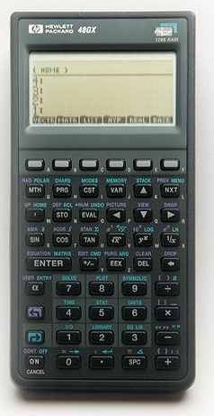
Reverse Polish Notation
Ambiguities don’t exist in RPN! ☺
Also called “postfix notation” because the operator goes after the operands
Postfix (RPN):
  4 3 * 3 +
Equivalent Infix:
  (4*3) + (3)
http://commons.wikimedia.org/wiki/File:Hewlett-Packard_48GX_Scientific_Graphing_Calculator.jpg

Slide 13
Reverse Polish Notation
This postfix expression:
  4 3 * 7 2 5 * + +
Is equivalent to this infix expression:
((4*3) + (7*2)) + 5
(4*3) + ((7+2) + 5)
(4*3) + (7 + (2*5))
Other/none/more than one
http://commons.wikimedia.org/wiki/File:Hewlett-Packard_48GX_Scientific_Graphing_Calculator.jpg

Slide 14
Stacks and RPN
  Evaluate this expression with the help of a stack
    Encounter a number: PUSH it
    Encounter an operator: POP two numbers and PUSH result
  4 3 * 7 2 5 * + +
Contents of the stack, reading from top down:
(A) 7, 12
(B) 10, 7,12
(C) 10, 5, 2, 7, 12
(D) Other
*
*
4
3
4
12
7
12
2
7
12
5
2
7
12
?
?
?
?
?
?

Slide 15
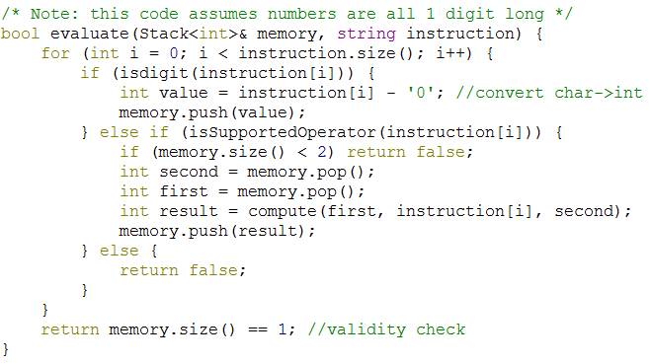
Stacks and RPN:
What does that look like in code?
  Evaluate this expression with the help of a stack
    Encounter a number: PUSH it
    Encounter an operator: POP two numbers and PUSH result
  43*725*++

Slide 16
Queues
What are they?
Example application

Slide 17
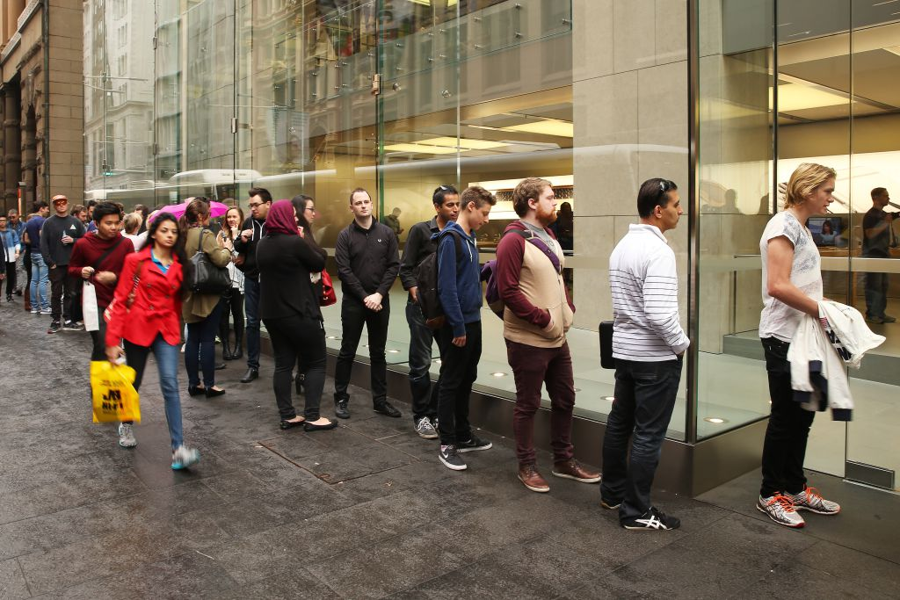
Queues
They work the same way a waiting in line (or, if you’re in the UK, queuing) works.
FIFO = “First in, first out”
“First come, first serve”
Waiting for Apple Watch

Slide 18
New ADT: Queue
queue.h
template <typename ValueType> class Queue {
public:
Queue();
virtual ~Queue();
int size() const;
bool isEmpty() const;
void clear();
void enqueue(ValueType value);
ValueType dequeue();
ValueType& back();
ValueType& front();
ValueType peek() const;
std::string toString();
private:
-Redacted-
Notes:
-- Note destructor and recurring “ValueType” parameter

Slide 19
Using a Queue
Queue<int> q; // {} front -> back
q.enqueue(42); // {42}
q.enqueue(-3); // {42, -3}
q.enqueue(17); // {42, -3, 17}
cout << q.dequeue() << endl; // 42 (q is {-3, 17})
cout << q.peek() << endl; // -3 (q is {-3, 17})
cout << q.dequeue() << endl; // -3 (q is {17})
Remember this format—we’ll use it in section examples and on exams

Slide 20
Where Stack and Queue are accessed
This may seem obvious, but it’s an important point for the behind-the-scenes code implementation of these data structures:
Stack: only accessed on one end Queue: accessed at both ends
Get in line (enqueue)
Push
Next to be served (dequeue)
Pop

Slide 21
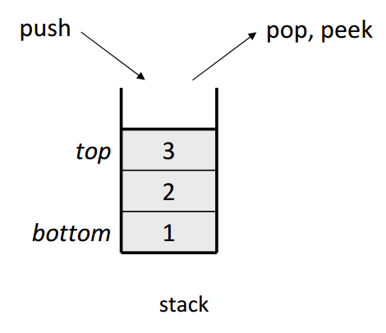
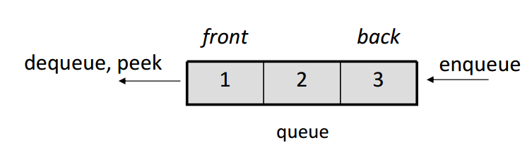
Where Stack and Queue are accessed
This may seem obvious, but it’s an important point for the behind-the-scenes code implementation of these data structures:
Stack: only accessed on one end Queue: accessed at both ends

Slide 22
Event queues (used in Fauxtoshop)
While your code executes, a separate part of the program is constantly running, and its only job is listening for events and recording them
  Mouse moved, mouse clicked, mouse dragged, etc
Every once in a while, your code can call getNextEvent() to see what has happened
  getNextEvent() returns the events one at a time, in the same order they happened
    In other words, returns them in FIFO order
    When it is “recording” events, it is enqueuing events in an event QUEUE
Very common use of the Queue ADT

