Slide 1
Programming Abstractions
CS106B
Cynthia Lee

Slide 2
Recursion!
The exclamation point isn’t there only because this is so exciting, it also relates to one of our recursion examples….

Slide 3
Announcement: Recursive art contest!
  Steps to participate:
  Go to http://recursivedrawing.com/
  Make recursive art
  Email me: cbl@stanford.edu
  Win prizes!
  Come to my office hours and see my Wall of Fame of past recursive art submissions!
  Submission deadline:
    Wednesday of Week 4 (April 20)

Slide 4
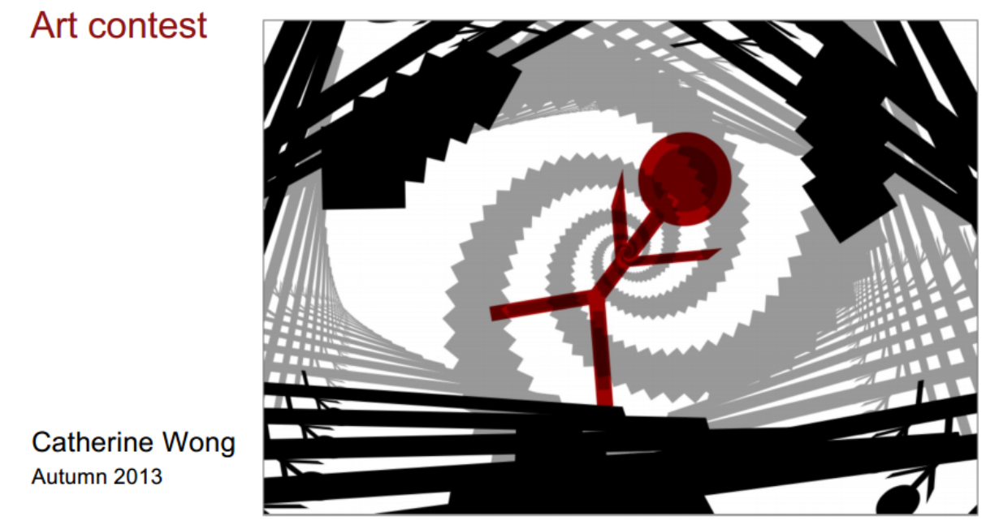

Slide 5
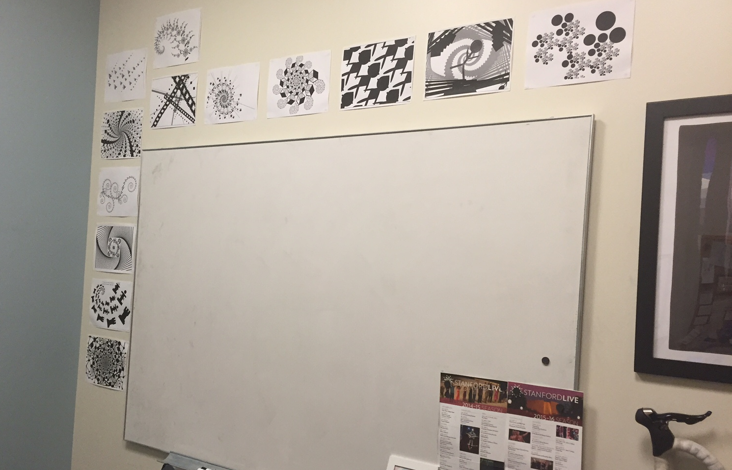
Wall of Fame

Slide 6
Classic and important CS problem: searching

Slide 7

Current issue in computer science: we have loads of data! One we have all this data, how do we find anything?

Slide 8
Imagine storing sorted data in an array
How long does it take us to find a number we are looking for?
0 | 1 | 2 | 3 | 4 | 5 | 6 | 7 | 8 | 9 | 10
2 | 7 | 8 | 13 | 25 | 29 | 33 | 51 | 89 | 90 | 95

Slide 9
Imagine storing sorted data in an array
How long does it take us to find a number we are looking for?
If you start at the front and proceed forward, each item you examine rules out 1 item
0 | 1 | 2 | 3 | 4 | 5 | 6 | 7 | 8 | 9 | 10
2 | 7 | 8 | 13 | 25 | 29 | 33 | 51 | 89 | 90 | 95

Slide 10
Imagine storing sorted data in an array
0 | 1 | 2 | 3 | 4 | 5 | 6 | 7 | 8 | 9 | 10
2 | 7 | 8 | 13 | 25 | 29 | 33 | 51 | 89 | 90 | 95
If instead we jump right to the middle, one of three things can happen:
  The middle one happens to be the number we were looking for, yay!
  We realize we went too far
  We realize we didn’t go far enough

Slide 11
Imagine storing sorted data in an array
0 | 1 | 2 | 3 | 4 | 5 | 6 | 7 | 8 | 9 | 10
2 | 7 | 8 | 13 | 25 | 29 | 33 | 51 | 89 | 90 | 95
If instead we jump right to the middle, one of three things can happen:
  The middle one happens to be the number we were looking for, yay!
  We realize we went too far
  We realize we didn’t go far enough
  Ruling out HALF the options in one step is so much faster than only ruling out one!

Slide 12
Binary search
0 | 1 | 2 | 3 | 4 | 5 | 6 | 7 | 8 | 9 | 10
2 | 7 | 8 | 13 | 25 | 29 | 33 | 51 | 89 | 90 | 95
Let’s say the answer was case 3, “we didn’t go far enough”
We ruled out the entire first half, and now only have the second half to search
We could start at the front of the second half and proceed forward…

Slide 13
Binary search
0 | 1 | 2 | 3 | 4 | 5 | 6 | 7 | 8 | 9 | 10
2 | 7 | 8 | 13 | 25 | 29 | 33 | 51 | 89 | 90 | 95
Let’s say the answer was case 3, “we didn’t go far enough”
We ruled out the entire first half, and now only have the second half to search
We could start at the front of the second half and proceed forward…but why do that when we know we have a better way?
Jump right to the middle of the region to search

Slide 14
Binary search
0 | 1 | 2 | 3 | 4 | 5 | 6 | 7 | 8 | 9 | 10
2 | 7 | 8 | 13 | 25 | 29 | 33 | 51 | 89 | 90 | 95
Let’s say the answer was case 3, “we didn’t go far enough”
We ruled out the entire first half, and now only have the second half to search
We could start at the front of the second half and proceed forward…but why do that when we know we have a better way?
Jump right to the middle of the region to search
RECURSION!!

Slide 15
Designing a recursive algorithm
Recursion is a way of taking a big problem and repeatedly breaking it into smaller and smaller pieces until it is so small that it can be so easily solved that it almost doesn't even need solving.
There are two parts of a recursive algorithm:
    base case: where we identify that the problem is so small that we trivially solve it and return that result
    recursive case: where we see that the problem is still a bit too big for our taste, so we chop it into smaller bits and call our self (the function we are in now) on the smaller bits to find out the answer to the problem we face

Slide 16
To write a recursive function, we need base case(s) and recursive call(s)
What would be a good base case for our Binary Search function?
Only three items remain: save yourself an unnecessary function call that would trivially divide them into halves of size 1, and just check all three.
Only two items remain: so just check the two.
Only one item remains: check it.
No items remain: obviously we didn’t find it.
More than one

Slide 17
Binary Search
bool binarySearch(const Vector<int>& data, int key){
return binarySearch(data, key, 0, data.size()-1);
}
bool binarySearch(const Vector<int>& data, int key,
int start, int end){
//to be continued…
}

Slide 18
Fractals: Boxy Snowflake Fractal
Fractals, squee!!!

Slide 19
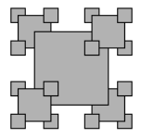
Boxy Snowflake example
static const double SCALE = 0.45;
static void drawFractal(GWindow& window, double cx, double cy,
double dim, int order) {
if (order >= 0) {
drawFractal(window, cx-dim/2, cy+dim/2, SCALE*dim, order-1);
drawFractal(window, cx+dim/2, cy-dim/2, SCALE*dim, order-1);
drawFractal(window, cx-dim/2, cy-dim/2, SCALE*dim, order-1);
drawFractal(window, cx+dim/2, cy+dim/2, SCALE*dim, order-1);
}
}
Where should this line of code be inserted to produce the pattern shown on the right?
drawFilledBox(window, cx, cy, dim, "Gray", "Black");
(A) Insert code here
(B) Insert code here
(C) Insert code here
(D) Insert code here
(E) None of the above

Slide 20
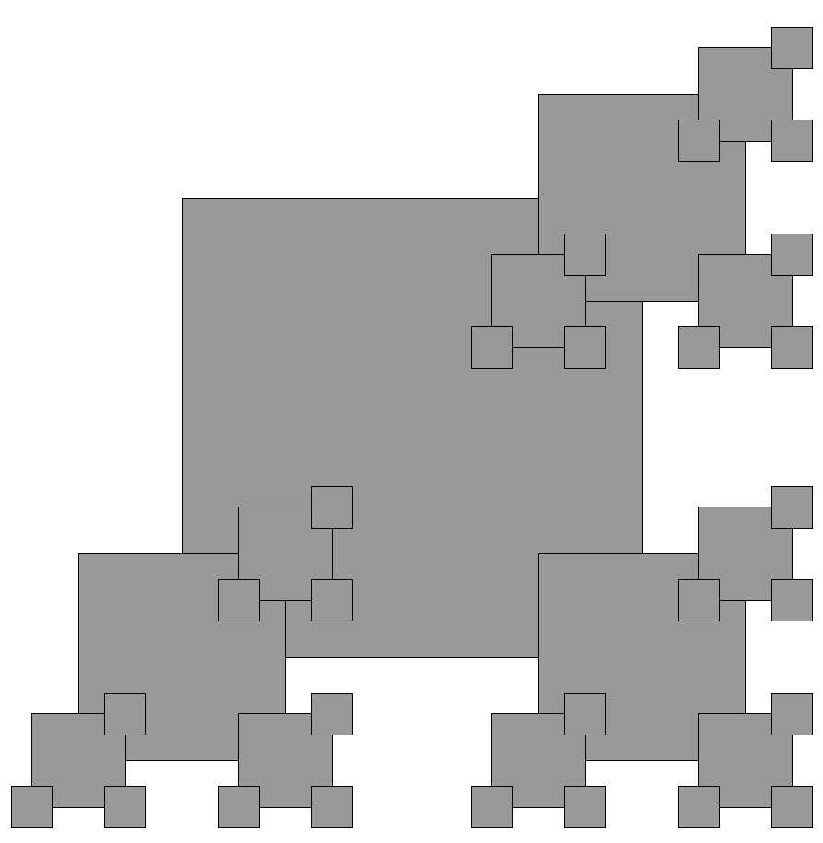
Variants:
How can we code this?

Slide 21
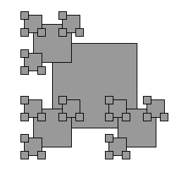
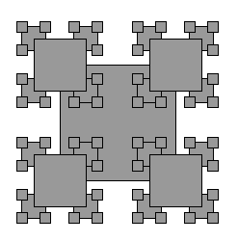
Real or Photoshop?
Can these be made by changing the order of lines and/or deleting lines in the draw function?
(1) (2)
(A) Only 1 is real (B) Only 2 is real
(C) Both are ‘shopped (D) Both are real

