Slide 1
Programming Abstractions
CS106B
Cynthia Lee

Slide 2
Topics roadmap:
  Previous classes:
  Recursion intro: factorial and stack frames (Friday)
  Designing recursive solutions: binary search and fractals (Monday)
  Loops + recursion: permutations and backtracking (Wednesday)
  Today:
  Contrast: Word ladder and Maze solving
    Revisiting Wednesday’s maze solving example
  Performance issues in recursion
  Big-O performance analysis
  Monday:
  More big-O performance analysis

Slide 3
The stack
Stack
 |  |  | Θ
What is the deepest the Stack gets (number of stack frames) during the solving of this maze?
Less than 5
5-10
11-20
More than 20
Other/none/more
Heap
0

Slide 4
Contrast: Recursive maze-solving vs. Word ladder
With word ladder, you did breadth-first search
Our recursive maze-solver uses depth-first search
Both are possible for maze-solving!
The contrast between these approaches is a theme that you’ll see again and again in your CS career

Slide 5
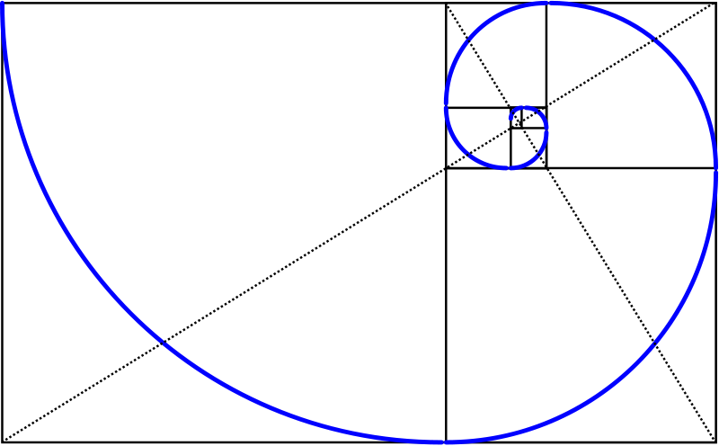
Fibonacci
This image is licensed under the Creative Commons Attribution-Share Alike 3.0 Unported license. http://commons.wikimedia.org/wiki/File:Golden_spiral_in_rectangles.png

Slide 6
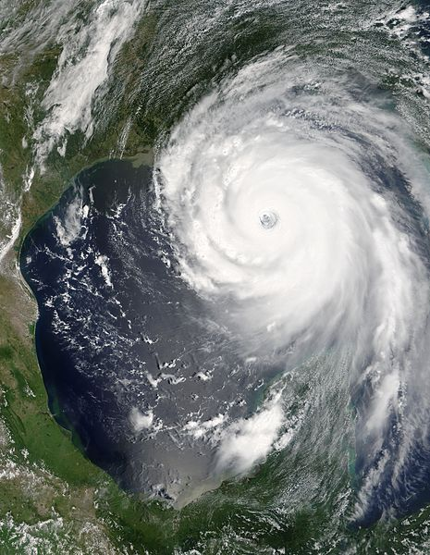
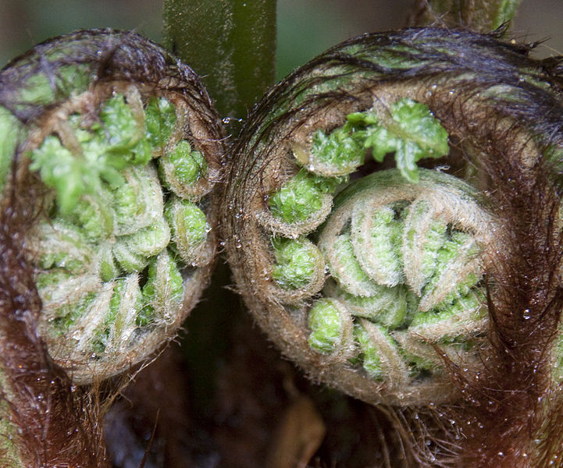
Fibonacci in nature
These files are, respectively: public domain (hurricane) and licensed under the Creative Commons Attribution 2.0 Generic license (fibonacci and fern).

Slide 7
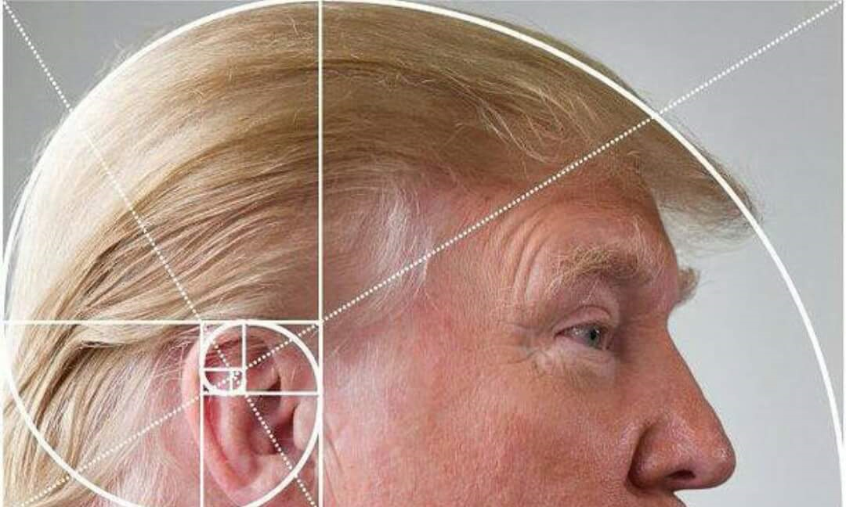
Fibonacci in politics

Slide 8
Fibonacci
f(0) = 0
f(1) = 1
For all n > 1:
  f(n) = f(n-1) + f(n-2)

Slide 9
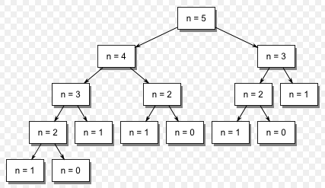
Fibonacci
F(0) = 0
F(1) = 1
F(n) = F(n-1) + F(n-2) for n > 1
Work is duplicated throughout the call tree
  F(2) is calculated 3 separate times when calculating F(5)!
  15 function calls in total for F(5)!
Image is in the public domain. http://commons.wikimedia.org/wiki/File:Fibonacci_call_tree_5.gif

Slide 10
Fibonacci
F(2) is calculated 3 separate times when calculating F(5)!
How many times would we calculate Fib(2) while calculating Fib(6)? See if you can just “read” it off the chart above.
4 times
5 times
6 times
Other/none/more
Image is in the public domain. http://commons.wikimedia.org/wiki/File:Fibonacci_call_tree_5.gif

Slide 11
Fibonacci
N | fib(N) | # of calls to fib(2)
2 | 1 | 1
3 | 2 | 1
4 | 3 | 2
5 | 5 | 3
6 | 8
7 | 13
8 | 21
9 | 34
10 | 55
How many times would we calculate Fib(2) while calculating Fib(7)?
How many times would we calculate Fib(2) while calculating Fib(8)?
Image is in the public domain. http://commons.wikimedia.org/wiki/File:Fibonacci_call_tree_5.gif

Slide 12
Efficiency of naïve Fibonacci implementation
When we added 1 to the input to Fibonacci, the number of times we had to calculate a given subroutine nearly doubled (~1.6 times*)
  Ouch!
Can we predict how much time it will take to compute for arbitrary input n?
* This number is called the “Golden Ratio” in math—cool!

Slide 13
Efficiency of naïve Fibonacci implementation
Can we predict how much time it will take to compute for arbitrary input n?
Each time we add 1 to the input, the time increases by a factor of 1.6
For input n, we multiply the “baseline” time by 1.6 n times:
  b * 1.6 * 1.6 * 1.6 * … * 1.6 = b * 1.6^{n}
  We don’t really care what b is exactly (different on every machine anyway), so we just normalize by saying b = 1 “time unit” (i.e. we remove b)
n times

Slide 14
Aside: recursion isn’t always this bad!
Memory
Recursive code
main()
long factorial(int n) {
cout << n << endl;
if (n == 1) return 1;
else return n * factorial(n – 1);
}
“Roughly” how much time does factorial take, as a function of the input n?
It’s better!! Just b * n = n (when we say that b=1 because we define b = one “time unit”)
myfunction() x:
xfac:
10
10
factorial() n:
Heap
0

Slide 15
Fibonacci
Assume we have to calculate each unique function call once, but never again
We “remember” the answer from the first time
How many rectangles remain in the above chart for n=5?
Image is in the public domain. http://commons.wikimedia.org/wiki/File:Fibonacci_call_tree_5.gif

Slide 16
Memo-ization
Take notes (“memos”) as you go
For Fibonacci, we will have answers for F(i) for all i, 0 ≤ i ≤ n, so a simple array or Vector can store intermediate results:
    results[i] stores Fib(i)

Slide 17
Big-O Performance Analysis

Slide 18
log₂n | n | n log₂n | n² | 2^{n}
2 | 4 | 8 | 16 | 16
3 | 8 | 24 | 64 | 256
4 | 16 | 64 | 256 | 65,536
5 | 32 | 160 | 1,024 | 4,294,967,296
6 | 64
7 | 128
8 | 256
9 | 512
10 | 1,024
30 | 1,300,000,000

Slide 19
log₂n | n | n log₂n | n² | 2^{n}
2 | 4 | 8 | 16 | 16
3 | 8 | 24 | 64 | 256
4 | 16 | 64 | 256 | 65,536
5 | 32 | 160 | 1,024 | 4,294,967,296
6 | 64
7 | 128
8 | 256
9 | 512
10 | 1,024
30 | 1,300,000,000
2.4s
Easy!

Slide 20
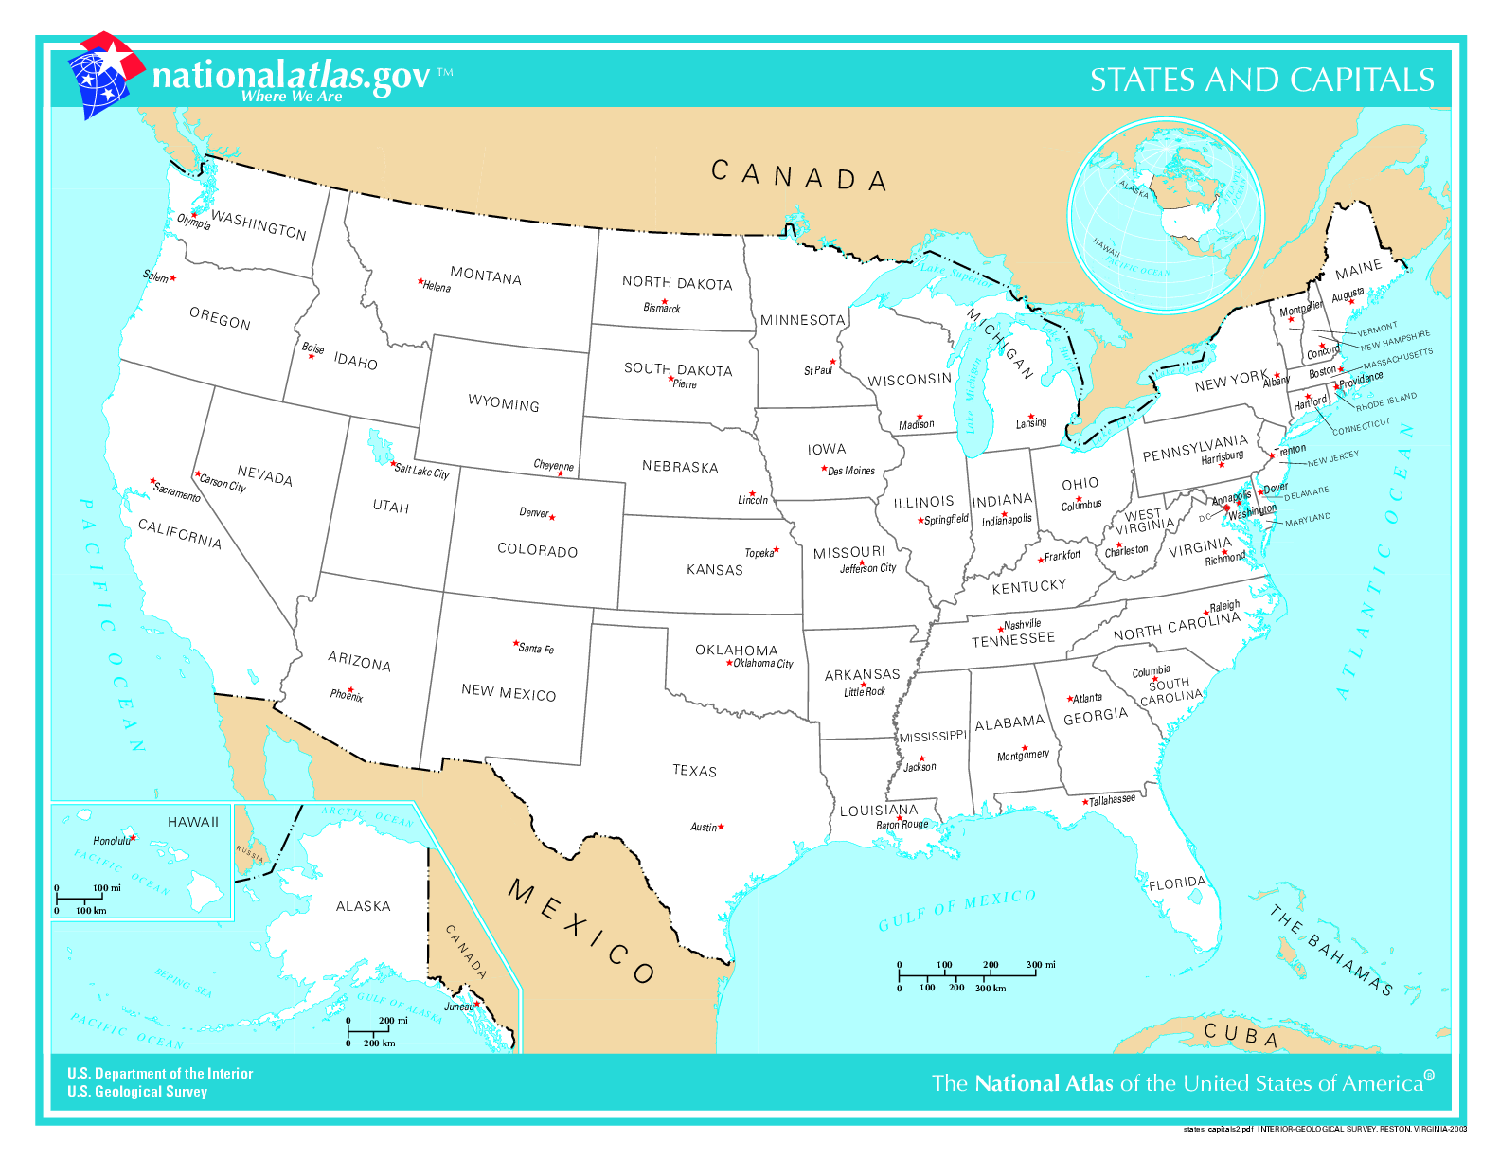
Traveling Salesperson Problem:
We have a bunch of cities to visit. In what order should we visit them to minimize total travel distance?

Slide 21
Exhaustively try all orderings: O(n!)
Use memoization (yay!): O(n²2^{n})
Maybe we could invent an algorithm closer to Fibonacci performance: O(2^{n})

Slide 22
So let’s say we come up with a way to solve Traveling Salesperson Problem in O(2^{n}).
It would take ~4 days to solve Traveling Salesperson Problem on 50 state capitals (with 3GHz computer)

Slide 23

Two tiny little updates
Imagine we approve statehood for Puerto Rico
  Add San Juan, the capital city
Also add Washington, DC
Now 52 capital cities instead of 50
This work has been released into the public domain by its author, Madden. This applies worldwide.

Slide 24
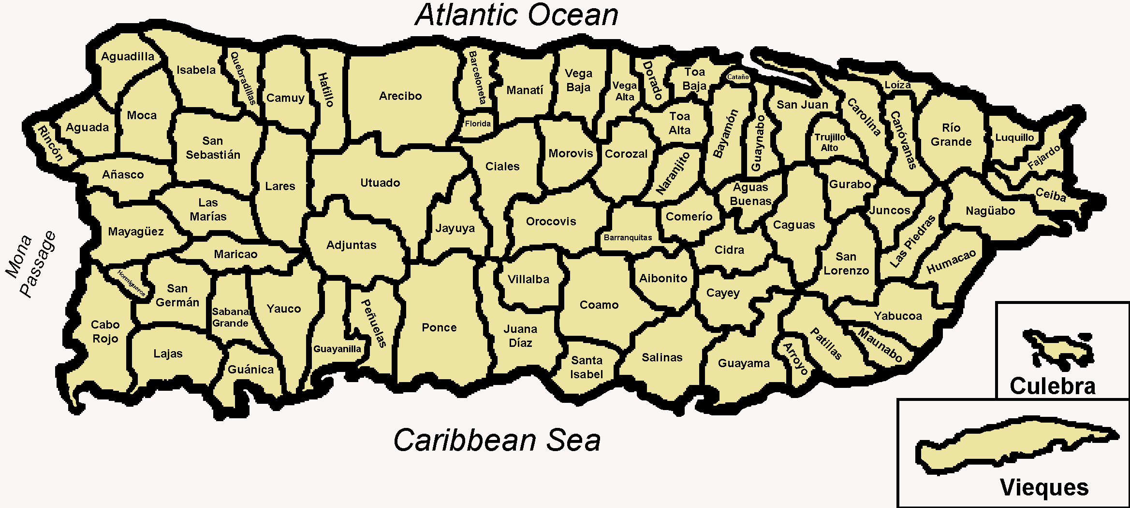
For 50 state capitals: ~4 days
With the O(2^{n}) algorithm we invented, it would take ~__?__ days to solve Traveling Salesperson problem on 50 state capitals + 2 (DC and San Juan)
6 days
8 days
10 days
> 10 days

Slide 25
With the O(2^{n}) algorithm we invented, it would take ~17 days to solve Traveling Salesperson problem on 50 state capitals + 2 (DC and San Juan)

Slide 26
Sacramento is not exactly the most interesting or important city in California (sorry, Sacramento). What if we add the 12 biggest non-capital cities in the United States to our map?

Slide 27
With the O(2^{n}) algorithm we invented,
It would take 194 YEARS to solve Traveling Salesman problem on 64 cities (state capitals + DC + San Juan + 12 biggest non-capital cities)

Slide 28
log₂n | n | n log₂n | n² | 2^{n}
2 | 4 | 8 | 16 | 16
3 | 8 | 24 | 64 | 256
4 | 16 | 64 | 256 | 65,536
5 | 32 | 160 | 1,024 | 4,294,967,296
6 | 64 | 384 | 4,096 | 1.84 x 10¹⁹
7 | 128
8 | 256
9 | 512
10 | 1,024
30 | 1,300,000,000
194 YEARS

Slide 29
log₂n | n | n log₂n | n² | 2^{n}
2 | 4 | 8 | 16 | 16
3 | 8 | 24 | 64 | 256
4 | 16 | 64 | 256 | 65,536
5 | 32 | 160 | 1,024 | 4,294,967,296
6 | 64 | 384 | 4,096 | 1.84 x 10¹⁹
7 | 128 | 896 | 16,384 | 3.40 x 10³⁸
8 | 256
9 | 512
10 | 1,024
30 | 1,300,000,000
3.59E+21 YEARS

Slide 30
log₂n | n | n log₂n | n² | 2^{n}
2 | 4 | 8 | 16 | 16
3 | 8 | 24 | 64 | 256
4 | 16 | 64 | 256 | 65,536
5 | 32 | 160 | 1,024 | 4,294,967,296
6 | 64 | 384 | 4,096 | 1.84 x 10¹⁹
7 | 128 | 896 | 16,384 | 3.40 x 10³⁸
8 | 256
9 | 512
10 | 1,024
30 | 1,300,000,000
3,590,000,000,000,000,000,000 YEARS

Slide 31
log₂n | n | n log₂n | n² | 2^{n}
2 | 4 | 8 | 16 | 16
3 | 8 | 24 | 64 | 256
4 | 16 | 64 | 256 | 65,536
5 | 32 | 160 | 1,024 | 4,294,967,296
6 | 64 | 384 | 4,096 | 1.84 x 10¹⁹
7 | 128 | 896 | 16,384 | 3.40 x 10³⁸
8 | 256 | 2,048 | 65,536 | 1.16 x 10⁷⁷
9 | 512
10 | 1,024
30 | 1,300,000,000
For comparison: there are about 10E+80 atoms in the universe. No big deal.

Slide 32
log₂n | n | n log₂n | n² | 2^{n}
2 | 4 | 8 | 16 | 16
3 | 8 | 24 | 64 | 256
4 | 16 | 64 | 256 | 65,536
5 | 32 | 160 | 1,024 | 4,294,967,296
6 | 64 | 384 | 4,096 | 1.84 x 10¹⁹
7 | 128 | 896 | 16,384 | 3.40 x 10³⁸
8 | 256 | 2,048 | 65,536 | 1.16 x 10⁷⁷
9 | 512 | 4,608 | 262,144 | 1.34 x 10¹⁵⁴
10 | 1,024
30 | 1,300,000,000
1.42E+137 YEARS (another way of thinking about the size: including commas, this number of years cannot be written in a single tweet)

Slide 33
log₂n | n | n log₂n | n² | 2^{n}
2 | 4 | 8 | 16 | 16
3 | 8 | 24 | 64 | 256
4 | 16 | 64 | 256 | 65,536
5 | 32 | 160 | 1,024 | 4,294,967,296
6 | 64 | 384 | 4,096 | 1.84 x 10¹⁹
7 | 128 | 896 | 16,384 | 3.40 x 10³⁸
8 | 256 | 2,048 | 65,536 | 1.16 x 10⁷⁷
9 | 512 | 4,608 | 262,144 | 1.34 x 10¹⁵⁴
10 | 1,024 | 10,240 (.000003s) | 1,048,576 (.0003s) | 1.80 x 10³⁰⁸
30 | 1,300,000,000 | 39000000000 (13s) | 1690000000000000000 (18 years)
LOL

Slide 34
log₂n | n | n log₂n | n² | 2^{n}
2 | 4 | 8 | 16 | 16
3 | 8 | 24 | 64 | 256
4 | 16 | 64 | 256 | 65,536
5 | 32 | 160 | 1,024 | 4,294,967,296
6 | 64 | 384 | 4,096 | 1.84 x 10¹⁹
7 | 128 | 896 | 16,384 | 3.40 x 10³⁸
8 | 256 | 2,048 | 65,536 | 1.16 x 10⁷⁷
9 | 512 | 4,608 | 262,144 | 1.34 x 10¹⁵⁴
10 | 1,024 | 10,240 (.000003s) | 1,048,576 (.0003s) | 1.80 x 10³⁰⁸
30 | 1,300,000,000 | 39000000000 (13s) | 1690000000000000000 (18 years) | 2.3 x 10^{391,338,994}

Slide 35
log₂n | n | n log₂n | n² | 2^{n}
2 | 4 | 8 | 16 | 16
3 | 8 | 24 | 64 | 256
4 | 16 | 64 | 256 | 65,536
5 | 32 | 160 | 1,024 | 4,294,967,296
6 | 64 | 384 | 4,096 | 1.84 x 10¹⁹
7 | 128 | 896 | 16,384 | 3.40 x 10³⁸
8 | 256 | 2,048 | 65,536 | 1.16 x 10⁷⁷
9 | 512 | 4,608 | 262,144 | 1.34 x 10¹⁵⁴
10 | 1,024 | 10,240 (.000003s) | 1,048,576 (.0003s) | 1.80 x 10³⁰⁸
30 | 1,300,000,000 | 39000000000 (13s) | 1690000000000000000 (18 years) | 2.3 x 10^{391,338,994}
2^{n} is way into crazy LOL territory, but look at nlog₂n—only 13 seconds!!

Slide 36
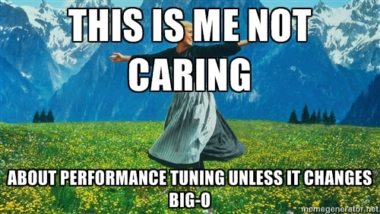

Slide 37
Big-O
Extracting time cost from example code

Slide 38
Translating code to a f(n) model of the performance
 | Statements | Cost
1 | double findAvg ( Vector<int>& grades ){
2 | double sum = 0; | 1
3 | int count = 0; | 1
4 | while ( count < grades.size() ) { | n + 1
5 | sum += grades[count]; | n
6 | count++; | n
7 | }
8 | if ( grades.size() > 0 ) | 1
9 | return sum / grades.size();
10 | else | 1
11 | return 0.0;
12 | }
ALL |  | 3n+5
Do we really care about the +5?
Or the 3 for that matter?

Slide 39
Formal definition of Big-O
We say a function f(n) is “big-O” of another function g(n), and write “f(n) is O(g(n))” if there exist positive constants c and n₀ such that:
f(n) ≤ c g(n) for all n ≥ n₀.

Slide 40
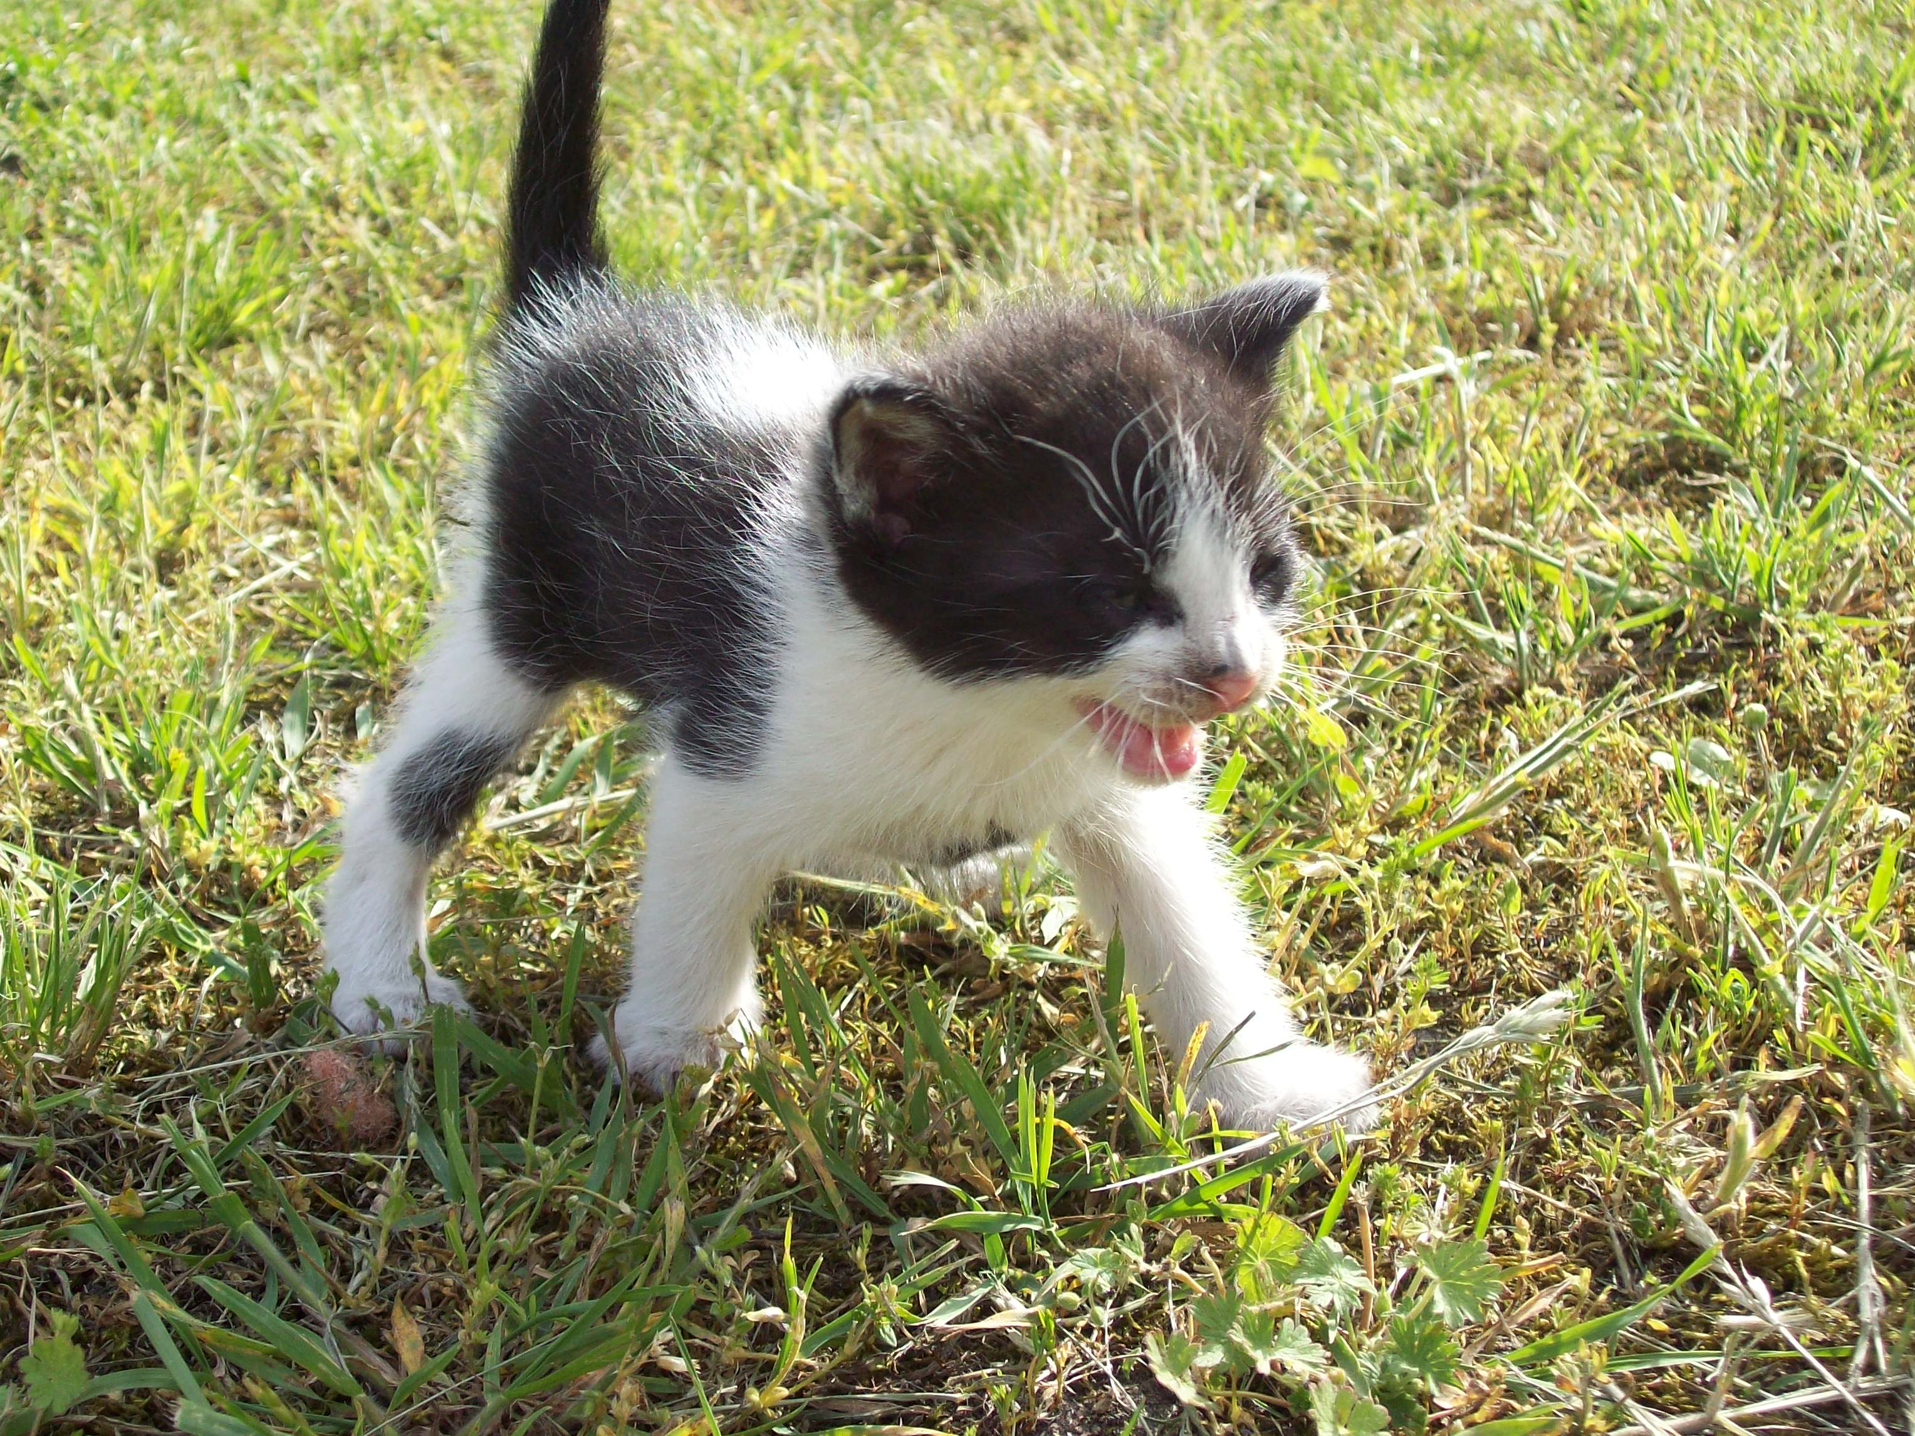
Image has been put in the public domain by its author. http://commons.wikimedia.org/wiki/File:Kitten_(06)_by_Ron.jpg

Slide 41
Big-O
We say a function f(n) is “big-O” of another function g(n), and write “f(n) is O(g(n))” if there exist positive constants c and n₀ such that:
f(n) ≤ c g(n) for all n ≥ n₀.
What you need to know:
O(X) describes an “upper bound”—the algorithm will perform no worse than X
We ignore constant factors in saying that
We ignore behavior for “small” n

