Slide 1
Programming Abstractions
CS106B
Cynthia Lee

Slide 2
Topics du Jour:
  Make your own classes!
    Needed for Boggle assignment!
    We are starting to see a little bit in MarbleBoard assignment as well

Slide 3
Classes in C++
Making your own kinds of objects!

Slide 4



Class examples
A calendar program might want to store information
about dates, but C++ does not have a Date type.
A student registration system needs to store info
about students, but C++ has no Student type.
A bank app might want to store information about
users' accounts, but C++ has no BankAccount type.
However, C++ does provide a feature for us to add
new data types to the language: classes.
  Writing a class defines a new data type.

Slide 5


Classes and objects (6.1)
class: A program entity that represents
a template for a new type of objects.
    e.g. class Vector defines a new data type
    named Vector and allows you to declare
    objects of that type.
objects: Entities that combines state and behavior.
  object-oriented programming (OOP): Programs that perform their behavior as interactions between objects.
  A new kind of abstraction: Separation between concepts and details. Objects provide abstraction.

Slide 6
Client, class, object
Client program
int main() {
...
- interacts with class and objects
asks class to construct a new object
Class
- what goes into each object
- how to construct new objects
send/receive messages with object
by calling member functions
(never directly access private data)
Object
- member functions (public behavior)
memberFunction1()
memberFunction2()
- member variables (private data)
ivar1 [___] (encapsulated)
ivar2 [___]
constructs
object
object
object

Slide 7
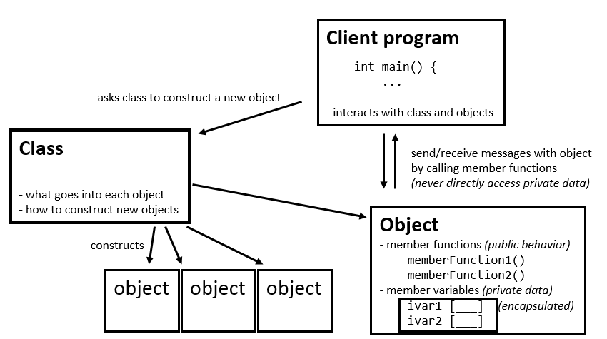
Client, class, object: an example you already know!
This was from the 3rd lecture:
int main() {
Grid<bool> board(8,8);
for (int i=0; i<board.numRows(); i++){
for (int j=0; j<board.numCols(); j++){
board[i][j] = false;
}
}
return 0;
}

Slide 8
Elements of a class
member variables: State inside each object.
  Also called "instance variables" or "fields"
  Declared as private
  Each object created has a copy of each field.
member functions: Behavior that executes inside each object.
  Also called "methods"
  Each object created has a copy of each method.
  The method can interact with the data inside that object.
constructor: Initializes new objects as they are created.
  Sets the initial state of each object as it is being created.
  Often accepts parameters for the initial state of the fields.

Slide 9
Interface vs. code
INTERFACE
declarations
in .h file
IMPLEMENTATION
definitions (code)
in .cpp file
Class

Slide 10
Interface vs. code
In C++, when writing classes you must understand separation of:
  interface: Declarations of functions, classes, members, etc.
  implementation: Definitions of how the above are implemented.
C++ implements this separation using two kinds of code files:
  .h: A "header" file containing only interface (declarations).
  .cpp: A "source" file containing definitions.
    When you define a new class Foo, you write Foo.h and Foo.cpp.
The content of .h files is "#included" inside .cpp files.
  Makes them aware of declarations of code implemented elsewhere.
  At compilation, all definitions are linked together into an executable.

Slide 11
Interface: Structure of a .h file
  // classname.h
  #ifndef _classname_h
  #define _classname_h
  class declaration;
  #endif
This is protection in case
multiple .cpp files include this .h,
so that its contents won't
get declared twice

Slide 12
Interface: A class declaration
  class ClassName { // in ClassName.h
  public:
  ClassName(parameters); // constructor
  returnType name(parameters); // member functions
  returnType name(parameters); // (behavior inside
  returnType name(parameters); // each object)
  private:
  type name; // member variables
  type name; // (data inside each object)
  };
IMPORTANT: must put a semicolon at end of class declaration (argh)

Slide 13
Class example (v1)
  // Initial version of BankAccount.h.
  // Uses public member variables and no functions.
  // Not good style, but we will improve it.
  #ifndef _bankaccount_h
  #define _bankaccount_h
  class BankAccount {
  public:
  string name; // each BankAccount object
  double balance; // has a name and balance
  };
  #endif

Slide 14
Using our objects
ba1
name = "Cynthia"
balance = 1.25
  // v1 with public fields (bad)
  BankAccount ba1;
  ba1.name = "Cynthia";
  ba1.balance = 1.25;
  BankAccount ba2;
  ba2.name = "Mehran";
  ba2.balance = 9999.00;
Think of an object as a way of grouping multiple variables.
  Each object contains a name and balance field inside it.
  We can get/set them individually.
  Code that uses your objects is called client code.
ba2
name = "Mehran"
balance = 9999.00

Slide 15
Member func. bodies
In ClassName.cpp, we write bodies (definitions) for the member functions that were declared in the .h file:
  // ClassName.cpp
  #include "ClassName.h"
  // member function
  returnType ClassName::methodName(parameters) {
  statements;
  }
  Member functions/constructors can refer to the object's fields.
Exercise: Write a withdraw member function to deduct money from a bank account's balance.

Slide 16
The implicit parameter
implicit parameter:
The object on which a member function is called.
  During the call cynthia.withdraw(...),
  the object named cynthia is the implicit parameter.
  During the call mehran.withdraw(...),
  the object named mehran is the implicit parameter.
  The member function can refer to that object's member variables.
    We say that it executes in the context of a particular object.
    The function can refer to the data of the object it was called on.
    It behaves as if each object has its own copy of the member functions.

Slide 17
Member func diagram
// BankAccount.cpp
void BankAccount::withdraw(double amount) {
if (balance >= amount) {
balance -= amount;
}
}
// client program
BankAccount cynthia;
BankAccount mehran;
...
cynthia.withdraw(5.00);
mehran.withdraw(99.00);
void withdraw(double amount) {
if (balance >= amount) {
balance -= amount;
}
}
name | "cynthia" | balance | 1.25
void withdraw(double amount) {
if (balance >= amount) {
balance -= amount;
}
}
name | "mehran" | balance | 9999

Slide 18
Initializing objects
It's bad to take 3 lines to create a BankAccount and initialize it:
  BankAccount ba;
  ba.name = "Cynthia";
  ba.balance = 1.25; // tedious
We'd rather specify the fields' initial values at the start:
  BankAccount ba("Cynthia", 1.25); // better
  We are able to this with most types of objects in C++ and Java.
  You can achieve this functionality using a constructor.

Slide 19
Constructors
  ClassName::ClassName(parameters) {
  statements to initialize the object;
  }
constructor: Initializes state of new objects as they are created.
  runs when the client declares a new object
  no return type is specified;
  it implicitly "returns" the new object being created
  If a class has no constructor, C++ gives it a default constructor with no parameters that does nothing.

Slide 20
Constructor diagram
// BankAccount.cpp
BankAccount::BankAccount(string n, double b) {
name = n;
balance = b;
}
// client program
BankAccount b1(
"Cynthia", 1.25);
BankAccount b2(
"Mehran", 9999);
BankAccount(string n, double b) {
name = n;
balance = b;
}
name |  | balance
BankAccount(string n, double b) {
name = n;
balance = b;
}
name |  | balance

Slide 21
The keyword this
As in Java, C++ has a this keyword to refer to the current object.
  Syntax: this->member
  Common usage: In constructor, so parameter names can match the names of the object's member variables:
  BankAccount::BankAccount(string name,
  double balance) {
  this->name = name;
  this->balance = balance;
  }
  this uses -> not . because it is a "pointer"; we'll discuss that later

Slide 22
Preconditions
precondition: Something your code assumes is true
at the start of its execution.
  Often documented as a comment on the function's header:
  // Initializes a BankAccount with the given state.
  // Precondition: balance is non-negative
  BankAccount::BankAccount(string name, double balance) {
  this->name = name;
  this->balance = balance;
  }
  Stating a precondition doesn't really "solve" the problem, but it at least documents our decision and warns the client what not to do.
  What if we want to actually enforce the precondition?

Slide 23
Throwing exceptions
throw expression;
Generates an exception that will crash the program,
unless it has code to handle ("catch") the exception.
  // Initializes a BankAccount with the given state.
  // Precondition: balance is non-negative
  BankAccount::BankAccount(string name, double balance) {
  if (balance < 0) {
  throw "Illegal negative balance";
  }
  this->name = name;
  this->balance = balance;
  }
Why would anyone ever want a program to crash?

Slide 24
Private data
  private:
  type name;
encapsulation: Hiding implementation details of an
object from its clients.
  Encapsulation provides abstraction.
    separates external view (behavior) from internal view (state)
  Encapsulation protects the integrity of an object's data.
A class's data members should be declared private.
  No code outside the class can access or change it.

Slide 25
Accessor functions
We can provide methods to get and/or set a data field's value:
  // "read-only" access to the balance ("accessor")
  double BankAccount::getBalance() {
  return balance;
  }
  // Allows clients to change the field ("mutator")
  void BankAccount::setName(string newName) {
  name = newName;
  }
  Client code will look like this:
  cout << ba.getName() << ":$" << ba.getBalance() << endl;
  ba.setName("Cynthia");

Slide 26
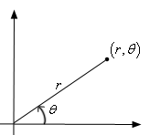
Encapsulation benefits
Provides abstraction between an object and its clients.
Protects an object from unwanted access by clients.
Allows you to change the class implementation.
  Point could be rewritten to use polar coordinates
  (radius r, angle θ), but with the same methods.
Allows you to constrain objects' state (invariants).
  Example: Don't allow a BankAccount with a negative balance.

Slide 27
Extra topics
Operators and const

Slide 28
Operator overloading
Making your own kinds of objects work with operators!

Slide 29
Operator overloading (6.2)
C++ allows you to overload, or redefine, the behavior of many common operators in the language:
  unary: + - ++ -- * & ! ~ new delete
  binary: + - * / % += -= *= /= %= & | && || ^
  == != < > <= >= = [] -> () ,
Overuse of operator overloading can lead to confusing code.
  Rule of Thumb: Don't abuse this feature. Don't define an overloaded operator unless its meaning and behavior are completely obvious.

Slide 30
Op overload syntax
Declare your operator in a .h file, implement it in a .cpp file.
  returnType operator op(parameters); // .h
  returnType operator op(parameters) { // .cpp
  statements;
  };
  where op is some operator like +, ==, <<, etc.
  the parameters are the operands next to the operator;
  for example, a + b becomes operator +(Foo a, Foo b)
  Overloaded operators can also be declared inside a class (not shown here)

Slide 31
Op overload example
  // BankAccount.h
  class BankAccount {
  ...
  };
  bool operator ==(BankAccount& ba1, BankAccount& ba2);
  bool operator !=(BankAccount& ba1, BankAccount& ba2);
  // BankAccount.cpp
  bool operator ==(BankAccount& ba1, BankAccount& ba2) {
  return ba1.getName() == ba2.getName()
  && ba1.getBalance() == ba2.getBalance();
  }
  bool operator !=(BankAccount& ba1, BankAccount& ba2) {
  return !(ba1 == ba2); // calls operator ==
  }

Slide 32
Make objects printable
To make it easy to print your object to cout, overload the << operator between an ostream and your type:
  ostream& operator <<(ostream& out, Type& name) {
  statements;
  return out;
  }
  The operator returns a reference to the stream so it can be chained.
    cout << a << b << c is really ((cout << a) << b) << c
    Technically cout is being returned by each << operation.

Slide 33
<< overload example
  // BankAccount.h
  class BankAccount {
  ...
  };
  ostream& operator <<(ostream& out, BankAccount& ba);
  // BankAccount.cpp
  ostream& operator <<(ostream& out, BankAccount& ba) {
  out << ba.getName() << ": $"
  << setprecision(2) << ba.getBalance();
  return out;
  }

Slide 34
Classes and const

Slide 35
The keyword const
C++ const keyword indicates that a value cannot change.
  const int x = 4; // x will always be 4
a const reference parameter can't be modified by the function:
  void foo(const BankAccount& ba) { // won't change ba
    Any attempts to modify d inside foo's code won't compile.
a const member function can't change the object's state:
  class BankAccount { ...
  double getBalance() const; // won't change account
    On a const reference, you can only call const member functions.

