Slide 1
Programming Abstractions
CS106B
Cynthia Lee

Slide 2
Topics du Jour:
  Make your own classes! (cont.)
    Last time we did a BankAccount class (pretty basic)
    This time we will do something more like the classes you have used from the Stanford libraries
  Arrays in C++
    In order to implement our version of a Vector (we’re calling it ArrayList), we will need an array

Slide 3

CS106B Weeks 1-3:
Learn to use the car

Slide 4
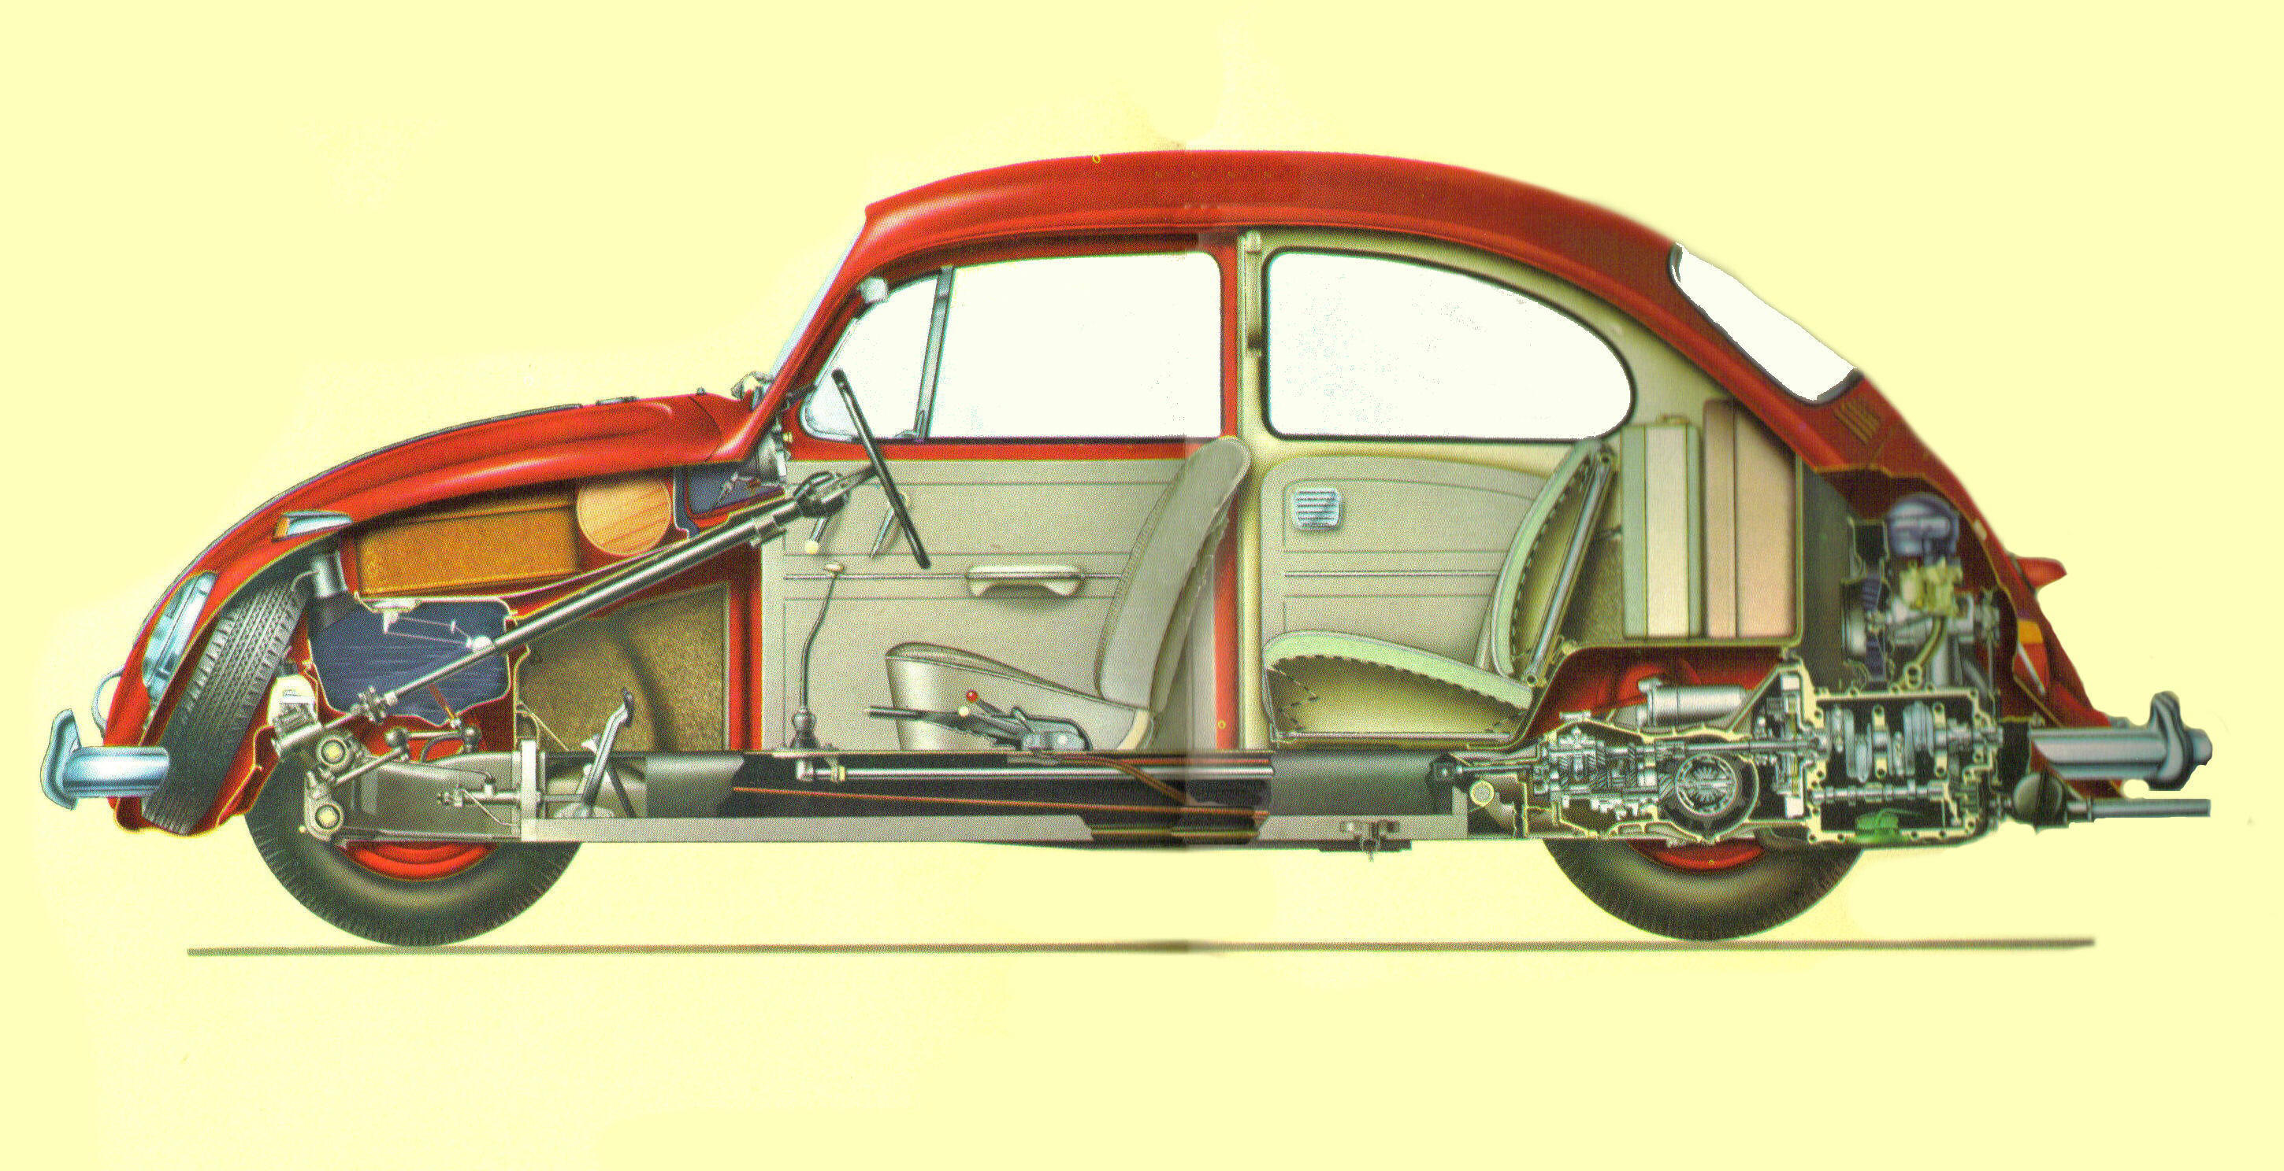
CS106B Weeks 4-8:
Learn to make the car

Slide 5

Relevant: Trailer to “The Love Bug (Herbie)” (1968)
https://www.youtube.com/watch?v=ay3GgrYEa1M

Slide 6
Arrays in C++
(we will need one for our ArrayList class)

Slide 7
Arrays (11.3)
  type* name = new type[length];
    A dynamically allocated array.
    The variable that refers to the array is a pointer.
    The memory allocated for the array must be manually released,
    or else the program will have a memory leak. (>_<)
  Another array creation syntax that we will not use:
  type name[length];
    A fixed array; initialized at declaration; can never be resized.
    Stored in a different place in memory; the first syntax uses the heap and the second uses the stack. (discussed later)

Slide 8
Initialized?
  type* name = new type[length]; // uninitialized
  type* name = new type[length](); // initialize to 0
    If () are written after the array [], it will set all array elements to their default zero-equivalent value for the data type. (slower)
    If no () are written, the elements are uninitialized, so whatever garbage values were stored in that memory beforehand will be your elements.
  int* a = new int[3];
  cout << a[0]; // 2395876
  cout << a[1]; // -197630894
  int* a2 = new int[3]();
  cout << a[0]; // 0
  cout << a[1]; // 0

Slide 9
How a Vector works
Inside a Vector is an array storing the elements you have added.
  Typically the array is larger than the data added so far, so that it has some extra slots in which to put new elements later.
    When we say size, we mean the number of items currently stored, and we say capacity to refer to the total space.
  Vector<int> v;
  v.add(42);
  v.add(-5);
  v.add(17);
index | 0 | 1 | 2 | 3 | 4 | 5 | 6 | 7 | 8 | 9
value | 0 | 0 | 0 | 0 | 0 | 0 | 0 | 0 | 0 | 0
size |  | capacity

Slide 10
Implementing our ArrayList
Making our own container class!

Slide 11
Exercise
Let's write a class that implements a growable array of integers.
  We'll call it ArrayList. It will be very similar to the C++ Vector.
  its behavior:
    add(value) insert(index, value)
    get(index), set(index, value)
    size(), isEmpty()
    remove(index)
    indexOf(value), contains(value)
    toString()
    ...
  We'll start with an array of length (capacity) 10 by default, and grow it as needed.

Slide 12
ArrayList.h
#ifndef _arraylist_h
#define _arraylist_h
#include <string>
using namespace std;
class ArrayList {
public:
ArrayList();
void add(int value);
void clear();
int get(int index) const;
void insert(int index, int value);
bool isEmpty() const;
void remove(int index);
void set(int index, int value);
int size() const;
string toString() const;
private:
int* myElements; // array of elements
int myCapacity; // length of array
int mySize; // number of elements added
};
#endif

Slide 13
Implementing add (bug)
// in ArrayList.cpp
// BUG
// Socrative: what is the bug in this code?
void ArrayList::add(int value) {
myElements[mySize] = value;
}

Slide 14
Implementing add
How do you append to the end of a list? list.add(42);
  place the new value in slot number size
  increment size
index | 0 | 1 | 2 | 3 | 4 | 5 | 6 | 7 | 8 | 9
value | 3 | 8 | 9 | 7 | 5 | 12 | 0 | 0 | 0 | 0
size | 6 | capacity |  |  | 10
index | 0 | 1 | 2 | 3 | 4 | 5 | 6 | 7 | 8 | 9
value | 3 | 8 | 9 | 7 | 5 | 12 | 0 | 0 | 0 | 0
size |  | capacity

Slide 15
Implementing insert
How do you insert in the middle of a list? list.insert(3, 42);
  shift elements right to make room for the new element
  increment size
  Q: In which direction should our array-shifting loop traverse?
    A. left-to-right B. right-to-left C. either is fine
index | 0 | 1 | 2 | 3 | 4 | 5 | 6 | 7 | 8 | 9
value | 3 | 8 | 9 | 7 | 5 | 12 | 0 | 0 | 0 | 0
size | 6 | capacity |  | 10
index | 0 | 1 | 2 | 3 | 4 | 5 | 6 | 7 | 8 | 9
value | 3 | 8 | 9 | 42 | 7 | 5 | 12 | 0 | 0 | 0
size | 7 | capacity |  | 10

Slide 16
insert solution
// in ArrayList.cpp
void ArrayList::insert(int index, int value) {
// shift right to make room
for (int i = mySize; i > index; i--) {
myElements[i] = myElements[i - 1];
}
myElements[index] = value;
mySize++;
}

Slide 17
Implementing clear
How do you clear the list? list.clear();
  change size to 0
  do we need to zero out all the data?
index | 0 | 1 | 2 | 3 | 4 | 5 | 6 | 7 | 8 | 9
value | 3 | 8 | 9 | 7 | 5 | 12 | 0 | 0 | 0 | 0
size | 6 | capacity |  |  | 10
index | 0 | 1 | 2 | 3 | 4 | 5 | 6 | 7 | 8 | 9
value | 3 | 8 | 9 | 7 | 5 | 12 | 0 | 0 | 0 | 0
size |  | capacity

Slide 18
Other members
Let's implement the following member functions in our list:
  size() - Returns the number of elements in the list.
  get(index) - Returns the value at a given index.
  set(index, value) - Changes the value at the given index.
  isEmpty() - Returns true if list contains no elements.
    (Why bother to write this if we already have a size function?)
  toString() - String of the list such as "{4, 1, 5}".
  operator << - Make the list printable to cout

Slide 19
Other members code
// in ArrayList.cpp
int ArrayList::get(int index) {
return myElements[index];
}
void ArrayList::set(int index, int value) {
myElements[index] = value;
}
int ArrayList::size() {
return mySize;
}
bool ArrayList::isEmpty() {
return mySize == 0;
}

Slide 20
Other members code
// in ArrayList.cpp
ostream& operator <<(ostream& out, const ArrayList& list) {
out << "{";
if (!list.isEmpty()) {
out << list.get(0);
for (int i = 1; i < list.size(); i++) {
out << ", " << list.get(i);
}
}
out << "}";
return out;
}
string ArrayList::toString() const {
ostringstream out;
out << *this;
return out.str();
}

Slide 21
Implementing remove
How do you remove an element from a list? list.remove(2);
  shift elements left to cover the deleted element
  decrement size
  Q: In which direction should our array-shifting loop traverse?
    A. left-to-right B. right-to-left C. either is fine
index | 0 | 1 | 2 | 3 | 4 | 5 | 6 | 7 | 8 | 9
value | 3 | 8 | 9 | 7 | 5 | 12 | 0 | 0 | 0 | 0
size | 6 | capacity |  | 10
index | 0 | 1 | 2 | 3 | 4 | 5 | 6 | 7 | 8 | 9
value | 3 | 8 | 7 | 5 | 12 | 0 | 0 | 0 | 0 | 0
size | 5 | capacity |  | 10

Slide 22
remove solution
// in ArrayList.cpp
void ArrayList::remove(int index) {
// shift left to cover up the slot
for (int i = index; i < mySize; i++) {
myElements[i] = myElements[i + 1];
}
myElements[mySize - 1] = 0;
mySize--;
}

Slide 23
Freeing array memory
  delete[] name;
    Releases the memory associated with the given array.
    Must be done for all arrays created with new
      Or else the program has a memory leak. (No garbage collector like Java)
      Leaked memory will be released when the program exits, but for long-running programs, memory leaks are bad and will eventually exhaust your RAM.
  int* a = new int[3];
  a[0] = 42;
  a[1] = -5;
  a[2] = 17;
  for (int i = 0; i < 3; i++) {
  cout << i << ": " << a[i] << endl;
  }
  ...
  delete[] a;

Slide 24
Destructor (12.3)
// ClassName.h // ClassName.cpp
~ClassName(); ClassName::~ClassName() { ...
destructor: Called when the object is deleted by the program.
  (when the object goes out of {} scope; opposite of a constructor)
  Useful if your object needs to do anything important as it dies:
    saving any temporary resources inside the object
    freeing any dynamically allocated memory used by the object's members
    ...
  Does our ArrayList need a destructor? If so, what should it do?

Slide 25
Destructor solution
// in ArrayList.cpp
void ArrayList::~ArrayList() {
delete[] myElements;
}

Slide 26
Running out of space
What if the client wants to add more than 10 elements?
  list.add(75); // add an 11th element
  Answer: Resize the array to one twice as large.
    Make sure to free the memory used by the old array!
index | 0 | 1 | 2 | 3 | 4 | 5 | 6 | 7 | 8 | 9
value | 3 | 8 | 9 | 7 | 5 | 12 | 4 | 8 | 1 | 6
size | 10 | capacity |  | 10
index | 0 | 1 | 2 | 3 | 4 | 5 | 6 | 7 | 8 | 9 | 10 | 11 | 12 | 13 | 14 | 15 | 16 | 17 | 18 | 19
value | 3 | 8 | 9 | 7 | 5 | 12 | 4 | 8 | 1 | 6 | 75 | 0 | 0 | 0 | 0 | 0 | 0 | 0 | 0 | 0
size | 11 | capacity |  |  |  | 20

Slide 27
Resize solution
// in ArrayList.cpp
void ArrayList::checkResize() {
if (mySize == myCapacity) {
// create bigger array and copy data over
int* bigger = new int[2 * capacity]();
for (int i = 0; i < myCapacity; i++) {
bigger[i] = myElements[i];
}
delete[] myElements;
myElements = bigger;
myCapacity *= 2;
}
}

Slide 28
Problem: size vs. capacity
What if the client accesses an element past the size?
  list.get(7)
  Currently the list allows this and returns 0.
    Is this good or bad? What (if anything) should we do about it?
index | 0 | 1 | 2 | 3 | 4 | 5 | 6 | 7 | 8 | 9
value | 3 | 8 | 9 | 7 | 5 | 0 | 0 | 0 | 0 | 0
size | 5 | capacity |  | 10

Slide 29
Private helpers
// in ClassName.h file
private:
returnType name(parameters);
a private member function can be called only by its own class
  your object can call the "helper" function, but clients cannot call it
  void ArrayList::checkIndex(int i, int min, int max) {
  if (i < min || i > max) {
  throw "Index out of range";
  }
  }

Slide 30
Extra topic:
Template classes
Something that Stanford library containers have that our ArrayList lacks.

Slide 31
Template function (14.1-2)
  template<typename T>
  returntype name(parameters) {
  statements;
  }
Template: A function or class that accepts a type parameter(s).
  Allows you to write a function that can accept many types of data.
  Avoids redundancy when writing the same common operation on different types of data.
  Templates can appear on a single function, or on an entire class.
  FYI: Java has a similar mechanism called generics.

Slide 32
Template func example
  template<typename T>
  T max(T a, T b) {
  if (a < b) { return b; }
  else { return a; }
  }
  The template is instantiated each time you use it with a new type.
    The compiler actually generates a new version of the code each time.
    The type you use must have an operator < to work in the above code.
  int i = max(17, 4); // T = int
  double d = max(3.1, 4.6); // T = double
  string s = max(string("hi"), // T = string
  string("bye"));

Slide 33
Template class (14.1-2)
Template class: A class that accepts a type parameter(s).
  In the header and cpp files, mark each class/function as templated.
  Replace occurrences of the previous type int with T in the code.
  // ClassName.h
  template<typename T>
  class ClassName {
  ...
  };
  // ClassName.cpp
  template<typename T>
  type ClassName::name(parameters) {
  ...
  }

Slide 34
Recall: ArrayList.h
class ArrayList {
public:
ArrayList();
~ArrayList();
void add(int value);
void clear();
int get(int index) const;
void insert(int index, int value);
bool isEmpty() const;
void remove(int index);
void set(int index, int value) const;
int size() const;
string toString() const;
private:
int* elements;
int mysize;
int capacity;
void checkIndex(int index, int min, int max) const;
void checkResize();
};

Slide 35
Template ArrayList.h
template <typename T> class ArrayList {
public:
ArrayList();
~ArrayList();
void add(T value);
void clear();
T get(int index) const;
void insert(int index, T value);
bool isEmpty() const;
void remove(int index);
void set(int index, T value) const;
int size() const;
string toString() const;
private:
T* elements;
int mysize;
int capacity;
void checkIndex(int index, int min, int max) const;
void checkResize();
};

Slide 36
Template ArrayList.cpp
template <typename T>
ArrayList<T>::ArrayList() {
myCapacity = 10;
myElements = new T[myCapacity];
mySize = 0;
}
template <typename T>
void ArrayList<T>::add(T value) {
checkResize();
myElements[mySize] = value;
mySize++;
}
template <typename T>
T ArrayList<T>::get(int index) const {
checkIndex(index, 0, mySize - 1);
return myElements[index];
}
...

Slide 37
Template .h and .cpp
Because of an odd quirk with C++ templates, the separation between .h header and .cpp implementation must be reduced.
  Either write all the bodies in the .h file (suggested),
  Or #include the .cpp at the end of .h file to join them together.
  // ClassName.h
  #ifndef _classname_h
  #define _classname_h
  template<typename T>
  class ClassName {
  ...
  };
  #include "ClassName.cpp"
  #endif // _classname_h

