Slide 1
Programming Abstractions
CS106B
Cynthia Lee

Slide 2

Topics:
  Monday:
    Priority Queue implemented as a binary heap
      Enqueue (“bubble up”)
      Dequeue (“trickle down”)
  Today: Map implemented as a Binary Search Tree (BST)
    Starting with a dream: binary search in a linked list?
    How our dream provided the inspiration for the BST
    BST insert
    Big-O analysis of BST
  Friday: BST balance issues

Slide 3
Binary Search Trees
Implementing the Map interface with Binary Search Trees

Slide 4
Implementing Map interface with a Binary Search Tree (BST)
  Binary Search Trees is one option for implementing Map
    C++’s Standard Template Library (STL) uses a Red-Black tree (a type of BST) for their map
    Stanford library also uses a BST
  Another Map implementation is a hash table
    We will talk about this later!
    This is what Stanford’s HashMap uses

Slide 5
Binary Search in a Linked List?
Exploring a good idea, finding way to make it work

Slide 6
Imagine storing sorted data in an array
0 | 1 | 2 | 3 | 4 | 5 | 6 | 7 | 8 | 9 | 10
2 | 7 | 8 | 13 | 25 | 29 | 33 | 51 | 89 | 90 | 95
How long does it take us to find?
    Binary search!
    O(logn): awesome!
  But slow to insert
    Move everyone over to make space
    O(n): not terrible, but pretty bad compared to log(n) or O(1)
    In contrast, linked list stores its nodes scattered all over memory, so it doesn’t have to move things over

Slide 7
Q. Can we do binary search on a linked list to implement a quick insert?
No.
The nodes are spread all over memory, and we must follow “next” pointers one at a time to navigate (the treasure hunt).
Therefore cannot jump right to the middle.
Therefore cannot do binary search.
Find is O(N): not terrible, but pretty bad compared to O(logn) or O(1)
Binary Search Tree can be thought of roughly like a linked list that has pointers to the middle, again and again (recursively), to form a tree structure

Slide 8
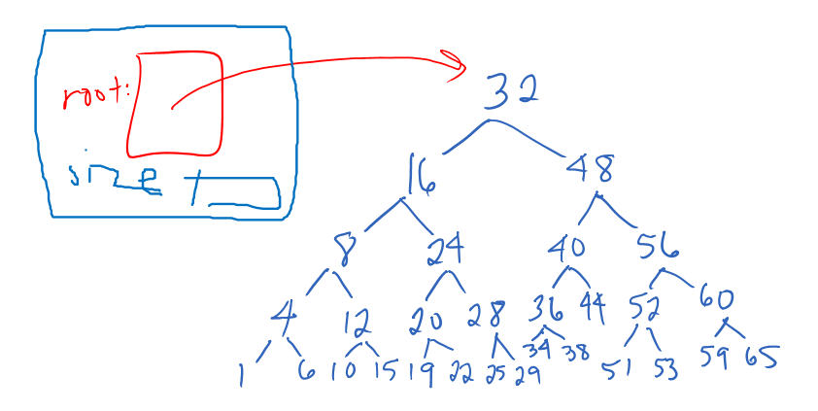
An Idealized Binary Search Tree

Slide 9
TreeMap
This is basically the same as Stanford Map

Slide 10
tree-map.h
template <typename Key, typename Value>
class TreeMap {
public:
TreeMap();
~TreeMap();
bool isEmpty() const;
int size() const { return count; }
bool containsKey(const Key& key) const;
void put(const Key& key, const Value& value);
Value get(const Key& key) const;
Value& operator[](const Key& key);
...

Slide 11
tree-map.h
TreeMap
root:
size:
key:
value:
left:
right:
node
// class TreeMap continued...
private:
struct node {
Key key;
Value value;
node *left, *right;
};
int size;
node *root;
};
key:
value:
left:
right:
node
key:
value:
left:
right:
node

Slide 12
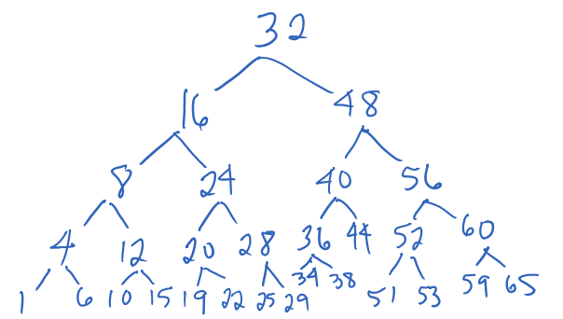
BST put()
Example: insert 2
Pretty simple!
If key > node’s key
    Go right!
  If key < node’s key
    Go left!
  If there is nothing currently in the direction you are going, that’s where you end up
  Example: put(23)

Slide 13
BST put()
Insert: 22, 9, 34, 18, 3
How many of these result in the same tree structure as above?
22, 34, 9, 18, 3
22, 18, 9, 3, 34
22, 9, 3, 18, 34
None of these
1 of these
2 of these
All of these

Slide 14
Question about our put() algorithm:
Pretty simple!
If key > node’s key
    Go right!
  If key < node’s key
    Go left!
Q. What do we do if the key is equal to the node’s key?
Stanford Map example:
Map<int, string> mymap;
mymap.put(5, "five");
mymap.put(5, "cinco"); // what should happen?
cout << mymap.get(5) << endl; // what should print?

Slide 15
Performance analysis:
What is the WORST CASE cost for doing containsKey() in BST?
O(1)
O(log n)
O(n)
O(n log n)
O(n²)

Slide 16
What is the worst case cost for doing containsKey() in BST if the BST is balanced?
O(logN)—awesome!
BSTs are great when balanced
BSTs are bad when unbalanced
…and Balance depends on order of insert of elements…
…but user controls this, not “us” (author of the Map class)
…no way for “us” (author of Map class) to ensure our Map doesn’t perform terribly! ☹ ☹

Slide 17
Ok, so, long-chain BSTs are bad, should we worry about it? [math puzzle time]
One way to create a bad BST is to insert the elements in decreasing order: 34, 22, 9, 3
That’s not the only way…
How many distinctly structured BSTs are there that exhibit the worst case height (height equals number of nodes) for a tree with the 4 nodes listed above?
2-3
4-5
6-7
8-9
More than 9
Bonus question: general formula for any BST of size n?
Extra bonus question (CS109): what is this as a fraction of all trees (i.e., probability of worst-case tree).

Slide 18
Midterm Questions?
Are you nervous? What can I do to help?

