Slide 1
Programming Abstractions
CS106B
Cynthia Lee

Slide 2
Topics:
  Continue discussion of Binary Trees
    So far we’ve studied two types of Binary Trees:
      Binary Heaps (Priority Queue)
      Binary Search Trees/BSTs (Map)
    We also heard about some relatives of the BST: red-black trees, splay tress, B-Trees
  Today we’re going to be talking about Huffman trees
  Misc. announcement:
    Thanks, mom! ♥

Slide 3
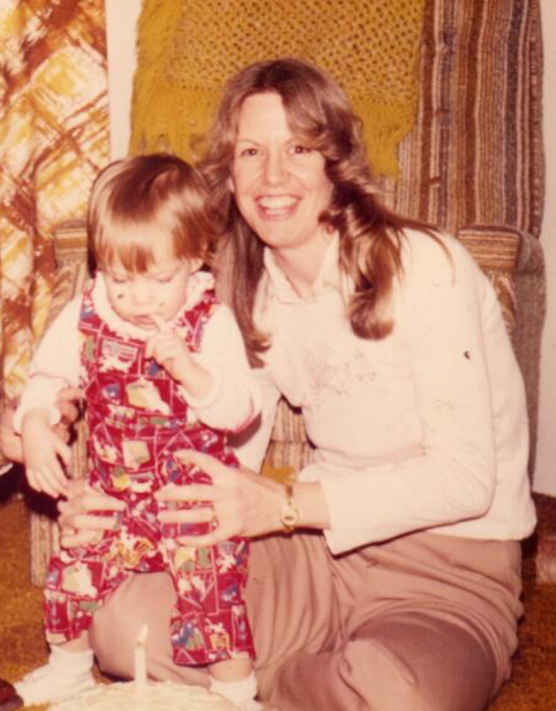
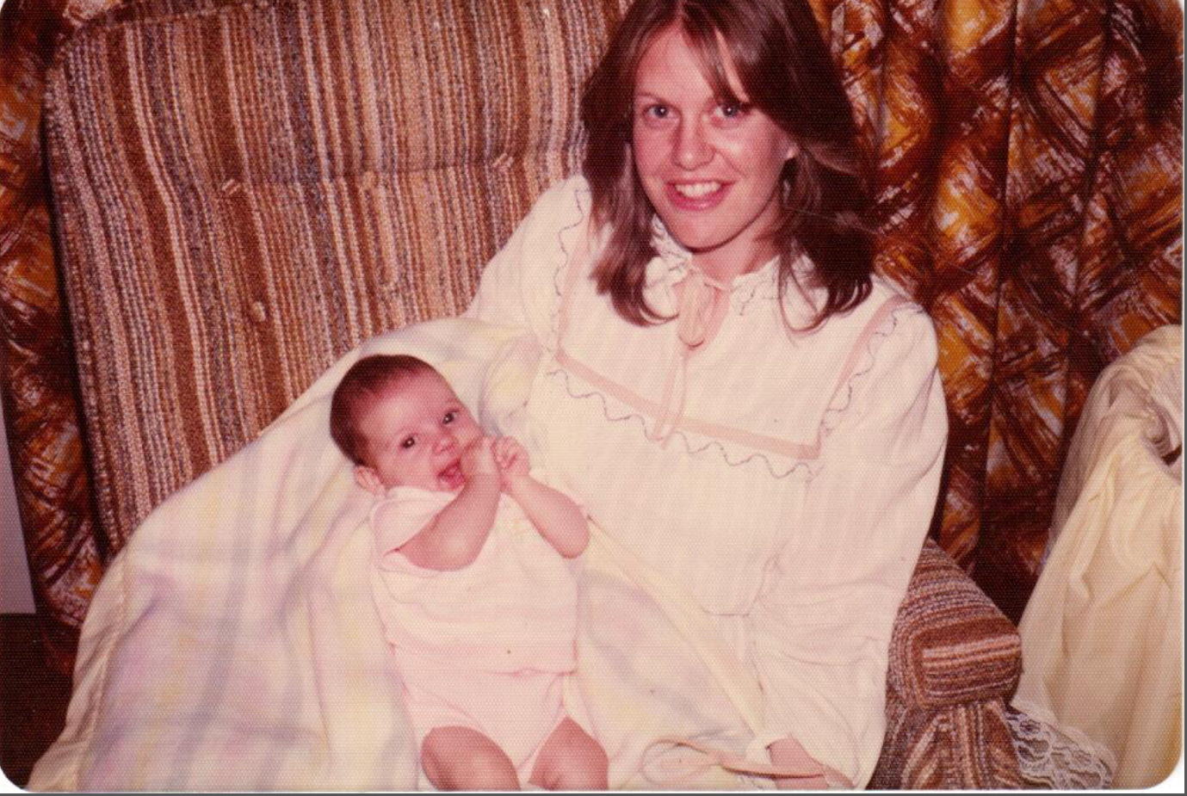

Slide 4
Getting Started on Huffman

Slide 5
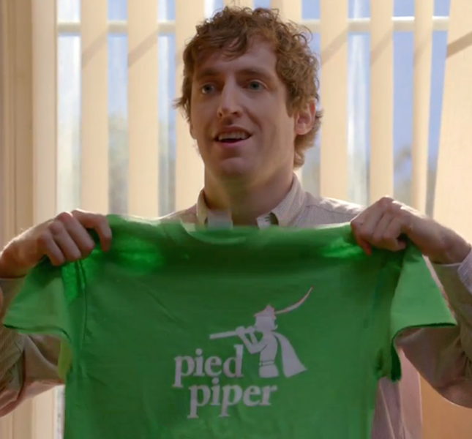
Encoding with Huffman Trees:
  Today we’re going to be talking about your next assignment: Huffman coding
    It’s a compression algorithm
    It’s provably optimal (take that, Pied Piper)
    It involves binary tree data structures, yay!
    (assignment goes out Wednesday)
  But before we talk about the tree structure and algorithm, let’s set the scene a bit and talk about BINARY

Slide 6

In a computer, everything is numbers !
Specifically, everything is binary
Images (gif, jpg, png): binary numbers
Integers (int): binary numbers
Non-integer real numbers (double): binary numbers
Letters and words (ASCII, Unicode): binary numbers
Music (mp3): binary numbers
Movies (streaming): binary numbers
Doge pictures ( ): binary numbers
Email messages: binary numbers
Encodings are what tell us how to translate
    “if we interpret these binary digits as an image, it would look like this”
    “if we interpret these binary digits as a song, it would sound like this”

Slide 7
ASCII is an old-school encoding for characters
The “char” type in C++ is based on ASCII
You interacted with this a bit in WordLadder and midterm Boggle question (e.g., 'A' + 1 = 'B')
Leftover from C in the 1970’s
Doesn’t play nice with other languages, and today’s software can’t afford to be so America-centric, so Unicode is more common
ASCII is simple so we use it for this assignment

Slide 8
ASCII Table
DEC | OCT | HEX | BIN | Symbol
32 | 040 | 20 | 00100000
33 | 041 | 21 | 00100001 | !
34 | 042 | 22 | 00100010 | "
35 | 043 | 23 | 00100011 | #
36 | 044 | 24 | 00100100 | $
37 | 045 | 25 | 00100101 | %
38 | 046 | 26 | 00100110 | &
39 | 047 | 27 | 00100111 | '
40 | 050 | 28 | 00101000 | (
41 | 051 | 29 | 00101001 | )
42 | 052 | 2A | 00101010 | *
43 | 053 | 2B | 00101011 | +
44 | 054 | 2C | 00101100 | ,
45 | 055 | 2D | 00101101 | -
46 | 056 | 2E | 00101110 | .
47 | 057 | 2F | 00101111 | /
48 | 060 | 30 | 00110000 | 0
49 | 061 | 31 | 00110001 | 1
50 | 062 | 32 | 00110010 | 2
51 | 063 | 33 | 00110011 | 3
52 | 064 | 34 | 00110100 | 4
DEC | OCT | HEX | BIN | Symbol
53 | 065 | 35 | 00110101 | 5
54 | 066 | 36 | 00110110 | 6
55 | 067 | 37 | 00110111 | 7
56 | 070 | 38 | 00111000 | 8
57 | 071 | 39 | 00111001 | 9
58 | 072 | 3A | 00111010 | :
59 | 073 | 3B | 00111011 | ;
60 | 074 | 3C | 00111100 | <
61 | 075 | 3D | 00111101 | =
62 | 076 | 3E | 00111110 | >
63 | 077 | 3F | 00111111 | ?
64 | 100 | 40 | 01000000 | @
65 | 101 | 41 | 01000001 | A
66 | 102 | 42 | 01000010 | B
67 | 103 | 43 | 01000011 | C
68 | 104 | 44 | 01000100 | D
69 | 105 | 45 | 01000101 | E
70 | 106 | 46 | 01000110 | F
71 | 107 | 47 | 01000111 | G
72 | 110 | 48 | 01001000 | H
73 | 111 | 49 | 01001001 | I
74 | 112 | 4A | 01001010 | J
Notice each symbol is encoded as 8 binary digits (8 bits)
There are 256 unique sequences of 8 bits, so numbers 0-255 each correspond to one character
(this only shows 32-74)
00111110 = ‘<’

Slide 9
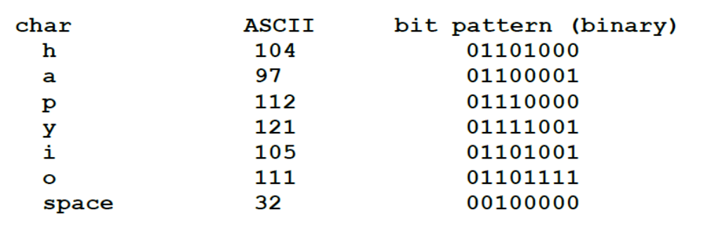
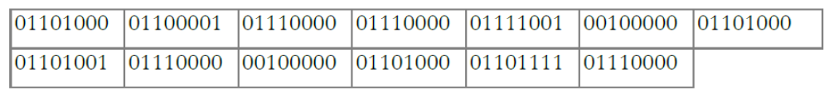
ASCII Example
“happy hip hop” =
104 97 112 112 121 32 104 105 (decimal)
Or this in binary:
FAQ: Why does 104 = ‘h’?
Answer: it’s arbitrary, like most encodings. Some people in the 1970s just decided to make it that way.

Slide 10
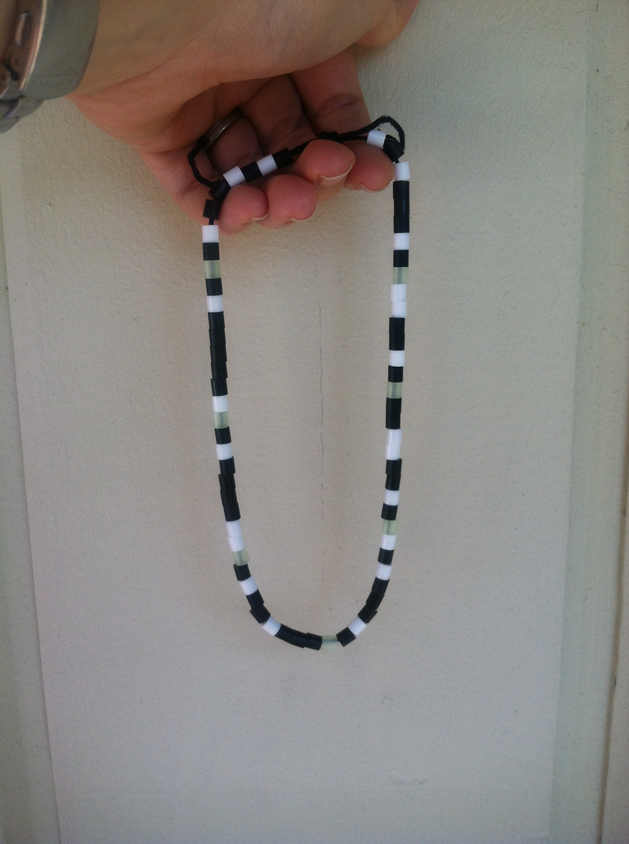
[Aside] Unplugged programming:
The Binary Necklace
Choose one color to represent 0’s and another color to represent 1’s
Write your name in beads by looking up each letter’s ASCII encoding
For extra bling factor, this one uses glow-in-the dark beads as delimiters between letters
DEC | OCT | HEX | BIN | Symbol
65 | 101 | 41 | 01000001 | A
66 | 102 | 42 | 01000010 | B
67 | 103 | 43 | 01000011 | C
68 | 104 | 44 | 01000100 | D
69 | 105 | 45 | 01000101 | E
70 | 106 | 46 | 01000110 | F
71 | 107 | 47 | 01000111 | G
72 | 110 | 48 | 01001000 | H
73 | 111 | 49 | 01001001 | I
74 | 112 | 4A | 01001010 | J
…

Slide 11
ASCII
ASCII’s uniform encoding size makes it easy
    Don’t really need those glow-in-the-dark beads as delimiters, because we know every 9th bead starts a new 8-bit letter encoding
Key insight: also a bit wasteful (ha! get it? a “bit”)
    What if we took the most commonly used characters (according to Wheel of Fortune, some of these are RSTLNE) and encoded them with just 2 or 3 bits each?
    We let seldom-used characters, like &, have encodings that are longer, say 12 bits.
    Overall, we would save a lot of space!

Slide 12
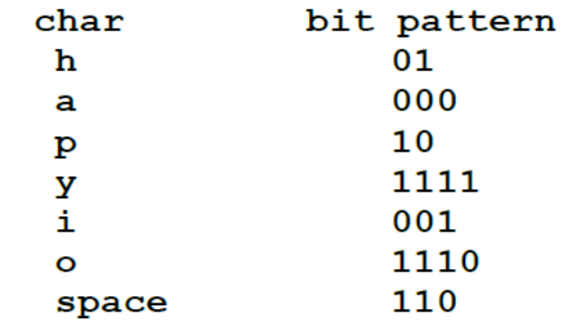
Non-ASCII (variable-length) encoding example
“happy hip hop” =
The variable-length encoding scheme makes a MUCH more space-efficient message than ASCII:

Slide 13
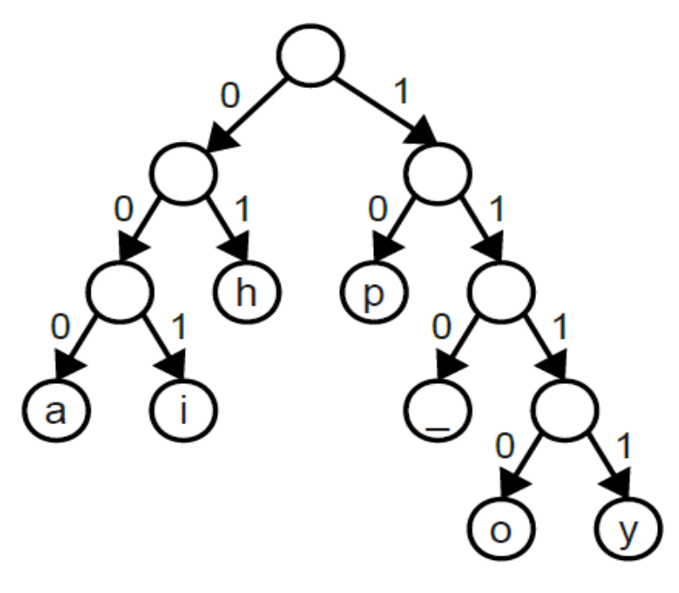
Huffman encoding
Huffman encoding is a way of choosing which characters are encoded which ways, customized to the specific file you are using
Example: character ‘#’
    Rarely used in Shakespeare (code could be longer, say ~10 bits)
    If you wanted to encode a Twitter feed, you’d see # a lot (maybe only ~4 bits) #contextmatters #thankshuffman
  We store the code translation as a tree:

Slide 14
Your turn
What would be the binary encoding of “hippo” using this Huffman encoding tree?
11000
0101101010
0100110101110
0100010101111
Other/none/more than one

Slide 15
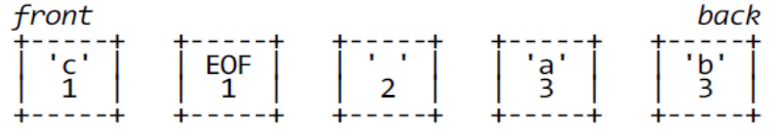
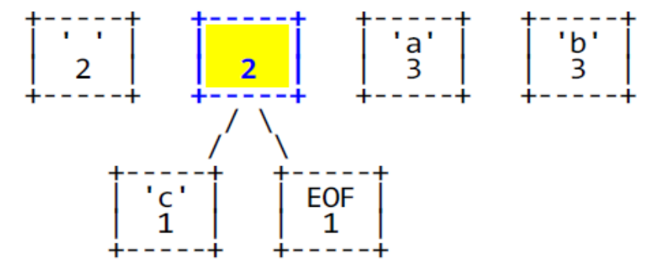
Okay, so how do we make the tree?
Read your file and count how many times each character occurs
Make a collection of tree nodes, each having a key = # of occurrences and a value = the character
    Example: “c aaa bbb”
    For now, tree nodes are not in a tree shape
    We actually store them in a Priority Queue (yay!!) based on highest priority = LOWEST # of occurrences
    Next:
      Dequeue two nodes and make them the two children of a new node, with no character and # of occurrences is the sum,
      Enqueue this new node
      Repeat until PQ.size() == 1

Slide 16
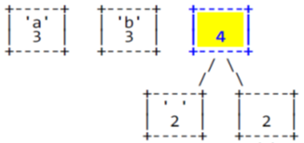
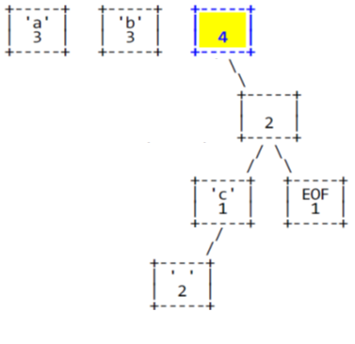
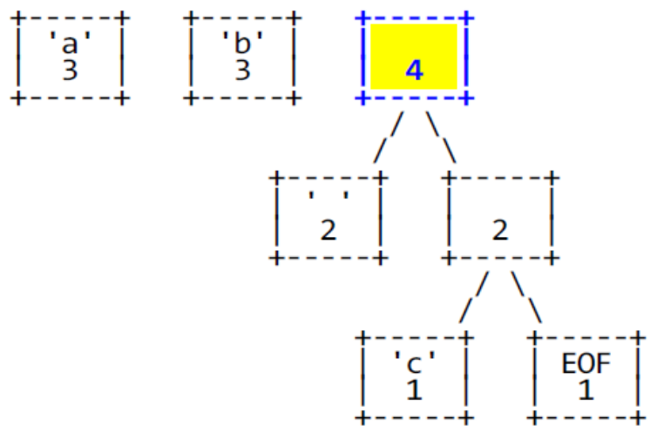
Your turn
(A)
If we start with the Priority Queue above, and execute one more step, what do we get?
(B)
(C)

Slide 17
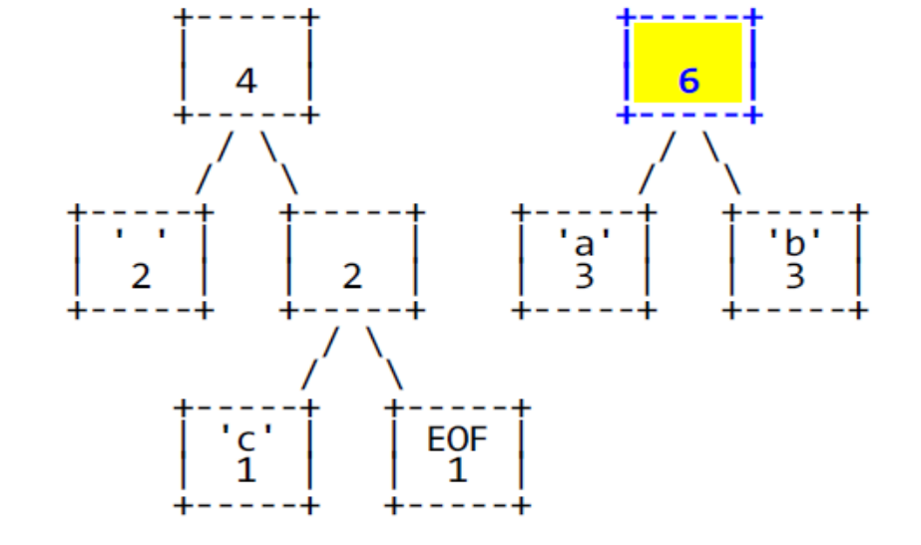
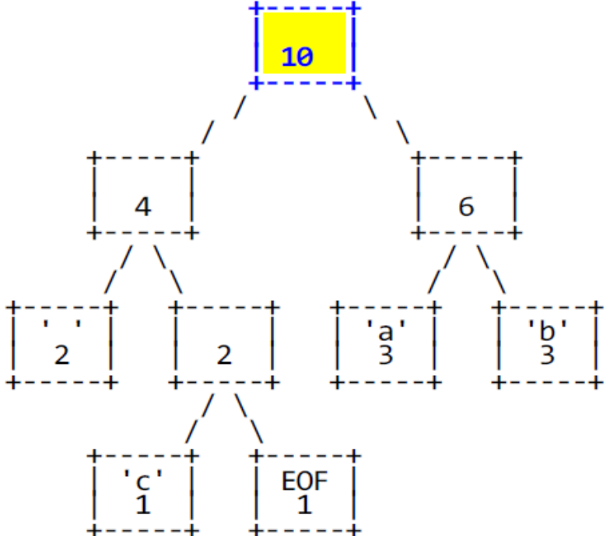
Last two steps

Slide 18
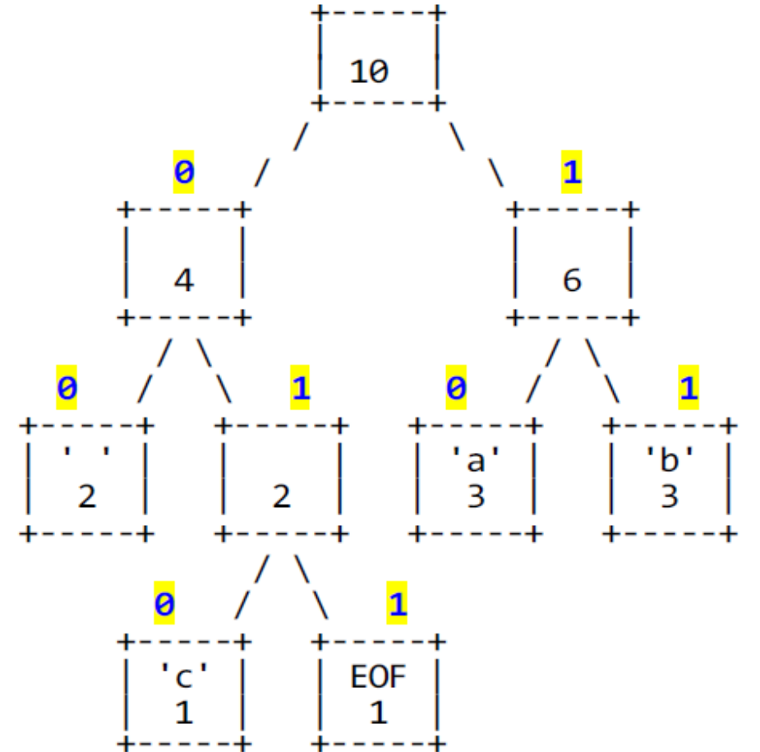
Now assign codes
We interpret the tree as:
Left child = 0
Right child = 1
What is the code for “c”?
00
010
101
Other/none
c | a | b
010 | 10 | 11

Slide 19
Key question: How do we know when one character’s bits end and another’s begin?
Huffman needs delimiters (like the glow-in-the-dark beads), unlike ASCII, which is always 8 bits (and didn’t really need the beads).
TRUE
FALSE
Discuss/prove it: why or why not?
c | a | b
010 | 10 | 11

