Slide 1
Programming Abstractions
CS106B
Cynthia Lee

Slide 2
Upcoming Topics
Graphs!
Basics
  What are they? How do we represent them?
Theorems
  What are some things we can prove about graphs?
Breadth-first search on a graph
  Spoiler: just a very, very small change to tree version
Dijkstra’s shortest paths algorithm
  Spoiler: just a very, very small change to BFS
A* shortest pathsalgorithm
  Spoiler: just a very, very small change to Dijkstra’s
Minimum Spanning Tree
  Kruskal’s algorithm

Slide 3
Graphs
What are graphs? What are they good for?

Slide 4
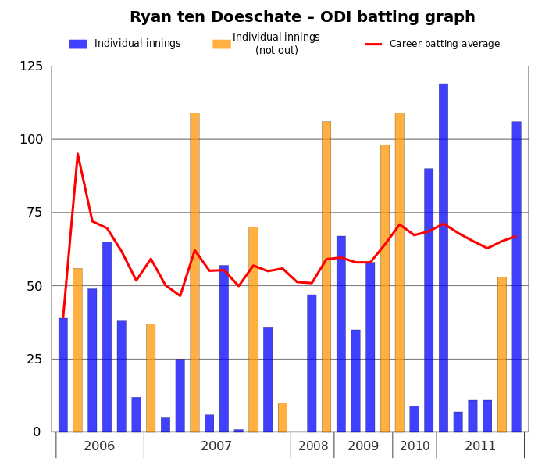
Graph
This file is licensed under the Creative Commons Attribution 3.0 Unported license. Jfd34 http://commons.wikimedia.org/wiki/File:Ryan_ten_Doeschate_ODI_batting_graph.svg

Slide 5
Graphs in Computer Science
A graph is a mathematical structure for representing relationships
  A set V of vertices (or nodes)
  A set E of edges (or arcs) connecting a pair of vertices
Slide by Keith Schwarz

Slide 6
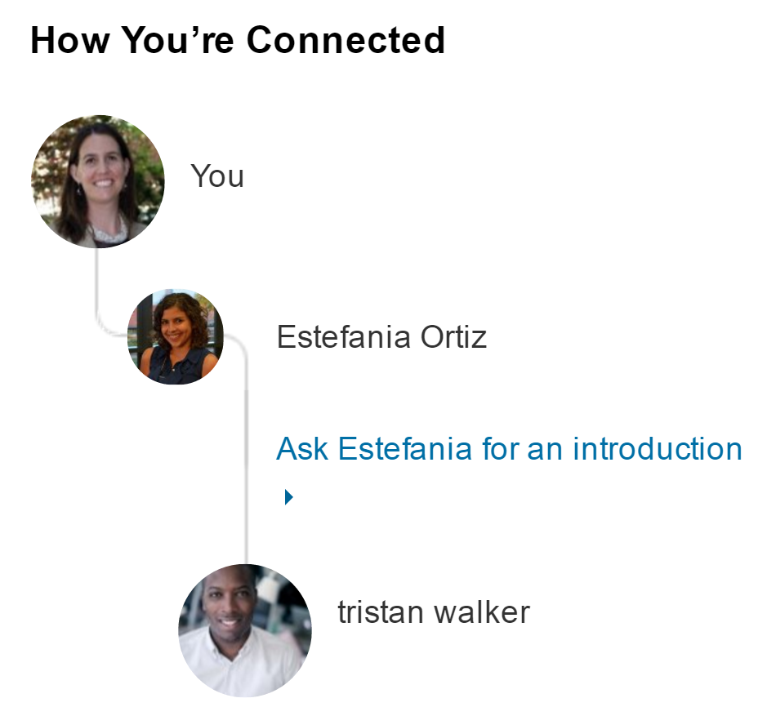

A Social Network
Slide by Keith Schwarz

Slide 7
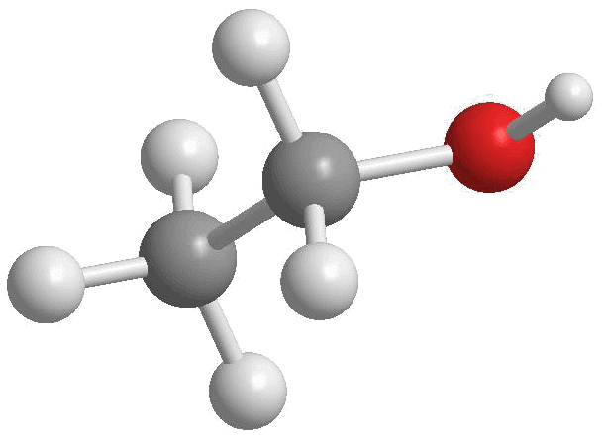
Chemical Bonds
Slide by Keith Schwarz
http://4.bp.blogspot.com/-xCtBJ8lKHqA/Tjm0BONWBRI/AAAAAAAAAK4/-mHrbAUOHHg/s1600/Ethanol2.gif

Slide 8
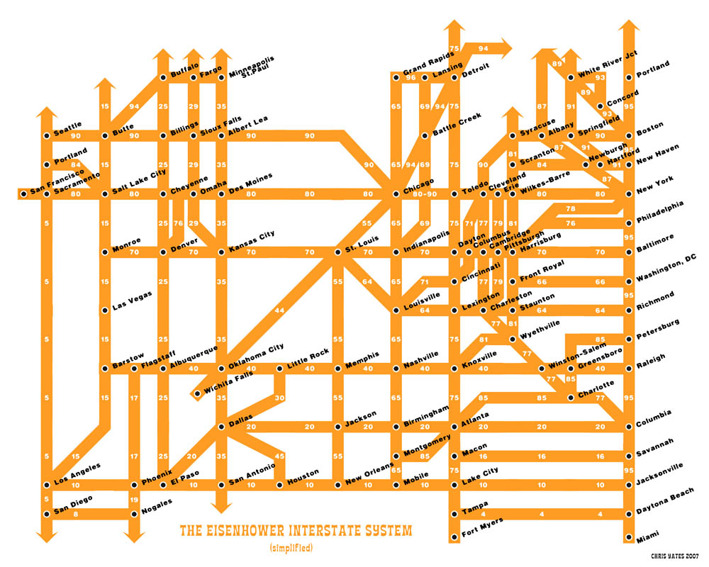
Slide by Keith Schwarz
http://strangemaps.files.wordpress.com/2007/02/fullinterstatemap-web.jpg

Slide 9
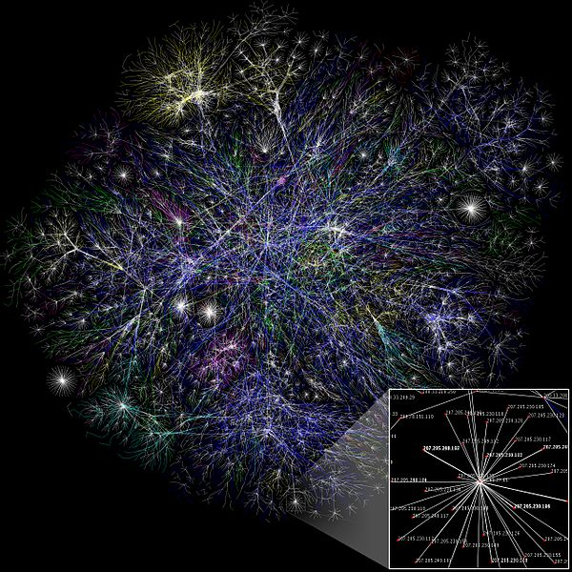
Internet
This file is licensed under the Creative Commons Attribution 2.5 Generic license. The Opte Project http://commons.wikimedia.org/wiki/File:Internet_map_1024.jpg

Slide 10
A graph is a mathematical structure for representing relationships
  A set V of vertices (or nodes)
    Often have an associated label
  A set E of edges (or arcs) connecting a pair of vertices
    Often have an associated cost or weight
  A graph may be directed (an edge from A to B only allow you to go from A to B, not B to A)
  or undirected (an edge between A and B allows travel in both directions)
  We talk about the number of vertices or edges as the size of the set, using the set theory notation for size: |V| and |E|

Slide 11
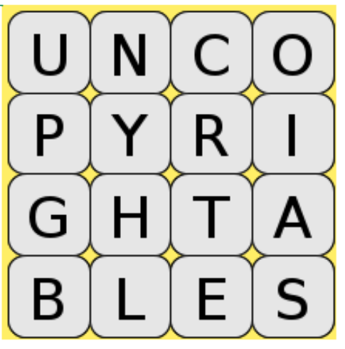
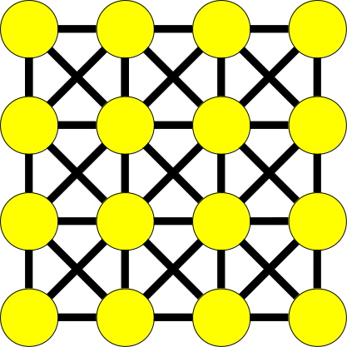
Boggle as a graph
Vertex = letter cube; Edge = connection to neighboring cube

Slide 12
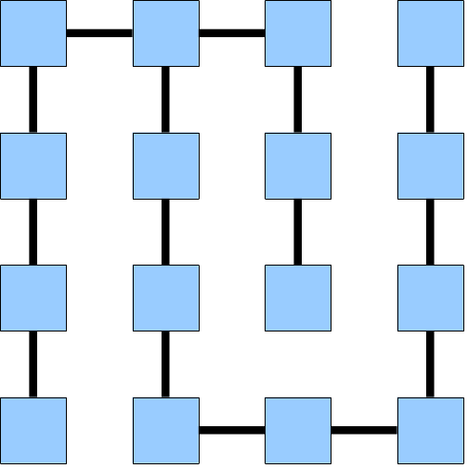
Maze as graph
If a maze is a graph, what is a vertex and what is an edge?

Slide 13



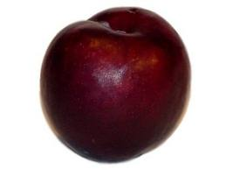
Graphs
Diagrams each show a graph with four vertices: Apple, Banana, Pear, Plum. Each answer choice has different edge sets.
A: no edges
B: Apple to Plum directed, Apple to banana undirected
C: Apple and Banana point to each other. Two edges point from Plum to Pear
How many of the following are valid graphs?
0
1
2
3

Slide 14
Graph Terminology

Slide 15
Graph terminology: Paths
path: A path from vertex a to b is a sequence of edges that can be followed starting from a to reach b.
  can be represented as vertices visited, or edges taken
  Example: one path from V to Z: {b, h} or {V, X, Z}
path length: Number of vertices
or edges contained in the path.
neighbor or adjacent: Two vertices
connected directly by an edge.
  example: V and X
V
a
b
U
d
X
Z
h
c
e
W
g
f
Y

Slide 16
Graph terminology: Reachability, connectedness
reachable: Vertex a is reachable from b
if a path exists from a to b.
connected: A graph is connected if every
vertex is reachable from every other.
complete: If every vertex has a direct
edge to every other.
a
b
d
c
e
a
b
c
d

Slide 17
Graph terminology: Loops and cycles
cycle: A path that begins and ends at the same node.
  example: {V, X, Y, W, U, V}.
  example: {U, W, V, U}.
  acyclic graph: One that does
  not contain any cycles.
loop: An edge directly from
a node to itself.
  Many graphs don't allow loops.
V
a
b
U
d
X
Z
h
c
e
W
g
f
Y

Slide 18
Graph terminology: Weighted graphs
weight: Cost associated with a given edge.
  Some graphs have weighted edges, and some are unweighted.
  Edges in an unweighted graph can be thought of as having equal weight (e.g. all 0, or all 1, etc.)
  Most graphs do not allow negative weights.
example: graph of airline flights, weighted by miles between cities:
849
PVD
1843
ORD
142
SFO
802
LGA
1743
337
1387
HNL
2555
1099
LAX
1233
DFW
1120
MIA

Slide 19
Representing Graphs
Ways we could implement a Graph class

Slide 20
Representing Graphs: Adjacency matrix
We can represent a graph as a Grid<bool> (unweighted)
or
Grid<int> (weighted)
 | 0 | 1 | 1 | 0 | 0 | 0
 | 1 | 0 | 1 | 1 | 1 | 0
 | 1 | 1 | 0 | 1 | 0 | 1
 | 0 | 1 | 1 | 0 | 1 | 1
 | 0 | 1 | 0 | 1 | 0 | 1
 | 0 | 0 | 1 | 1 | 1 | 0

Slide 21
Representing Graphs: Adjacency list
We can represent a graph as a map from nodes to the set of nodes each node is connected to.
Map<Node*, Set<Node*>>
Node
Connected To
Slide by Keith Schwarz

Slide 22
Common ways of representing graphs
Adjacency list:
  Map<Node*, Set<Node*>>
Adjacency matrix:
  Grid<bool> unweighted
  Grid<int> weighted
How many of the following are true?
  Adjacency list can be used for directed graphs
  Adjacency list can be used for undirected graphs
  Adjacency matrix can be used for directed graphs
  Adjacency matrix can be used for undirected graphs
  (A) 0 (B) 1 (C) 2 (D) 3 (E) 4

Slide 23
Graph Theory
Just a little taste of theorems about graphs

Slide 24
Graphs lend themselves to fun theorems and proofs of said theorems!
Any graph with 6 vertices contains either a triangle (3 vertices with all pairs having an edge) or an empty triangle (3 vertices no two pairs having an edge)

Slide 25
Eulerian graphs
Let G be an undirected graph
A graph is Eulerian if it can
drawn without lifting the pen
and without repeating edges
Is this graph Eulerian?
Diagram shows a graph with four vertices, which are all fully connected with each other by undirected edges (6 edges in total).

Slide 26
Eulerian graphs
Diagram shows a graph with five vertices, four of which are all fully connected with each other by undirected edges (6 edges in total). The 5th vertex is connected to two of the remaining four vertices by an edge. (6 + 2 = 8 edges in total)
Let G be an undirected graph
A graph is Eulerian if it can
drawn without lifting the pen
and without repeating edges
What about this graph?

Slide 27
Our second graph theorem
Definition: Degree of a vertex: number of edges adjacent to it
Euler’s theorem: a connected graph is Eulerian iff the number of vertices with odd degrees is either 0 or 2 (eg all vertices or all but two have even degrees)
Does it work for and ?

