Slide 1
Programming Abstractions
CS106B
Cynthia Lee

Slide 2
Graphs Topics
Graphs!
Basics
  What are they? How do we represent them?
Theorems
  What are some things we can prove about graphs?
Breadth-first search on a graph
  Spoiler: just a very, very small change to tree version
Dijkstra’s shortest paths algorithm
  Spoiler: just a very, very small change to BFS
A* shortest paths algorithm
  Spoiler: just a very, very small change to Dijkstra’s
Minimum Spanning Tree
  Kruskal’s algorithm

Slide 3
Breadth-First Search
We’ve seen BFS before this quarter!

Slide 4
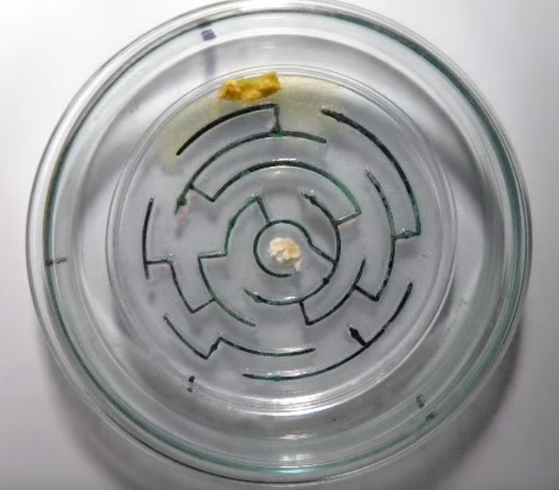
BFS in this class so far
 |  |  | Θ
Word Ladder Assignment
A
Maze
B
C
D
E
F
Trees
Slime Mold

Slide 5
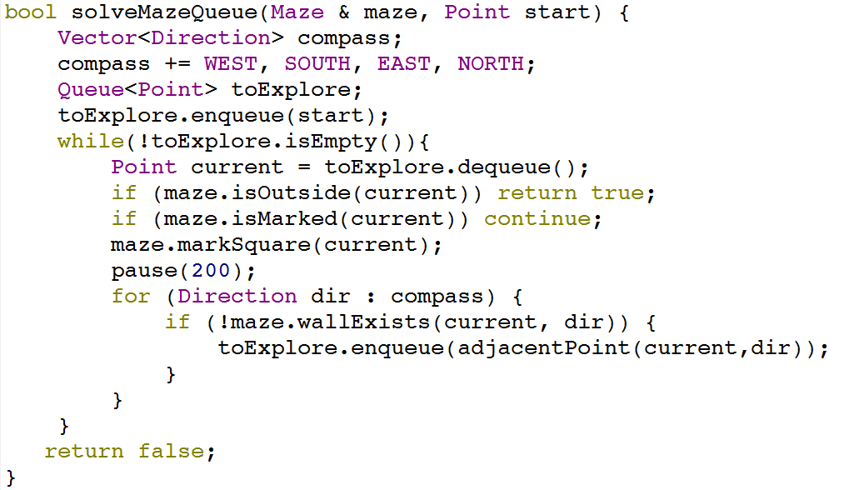
BFS Code (Maze version)
1. Make a Queue to remember places we want to explore in the future
2. Enqueue starting point
4. Dequeue a point and visit it
While there are still things in the queue, keep exploring!
5. Enqueue any new points you discover while visiting the current point

Slide 6
Breadth-First Search in a Graph
Graph algorithms

Slide 7
Breadth-First Search
A
B
C
D
BFS is useful for finding the shortest path between two nodes.
Example:
What is the shortest way to go from F to G?
E
F
G
H
I
J
K
L

Slide 8
Breadth-First Search
A
B
C
D
BFS is useful for finding the shortest path between two nodes.
Example:
What is the shortest way to go from F to G?
Way 1: F->E->I->G
3 edges
E
F
G
H
I
J
K
L

Slide 9
Breadth-First Search
A
B
C
D
BFS is useful for finding the shortest path between two nodes.
Example:
What is the shortest way to go from F to G?
Way 2: F->K->G
2 edges
E
F
G
H
I
J
K
L

Slide 10
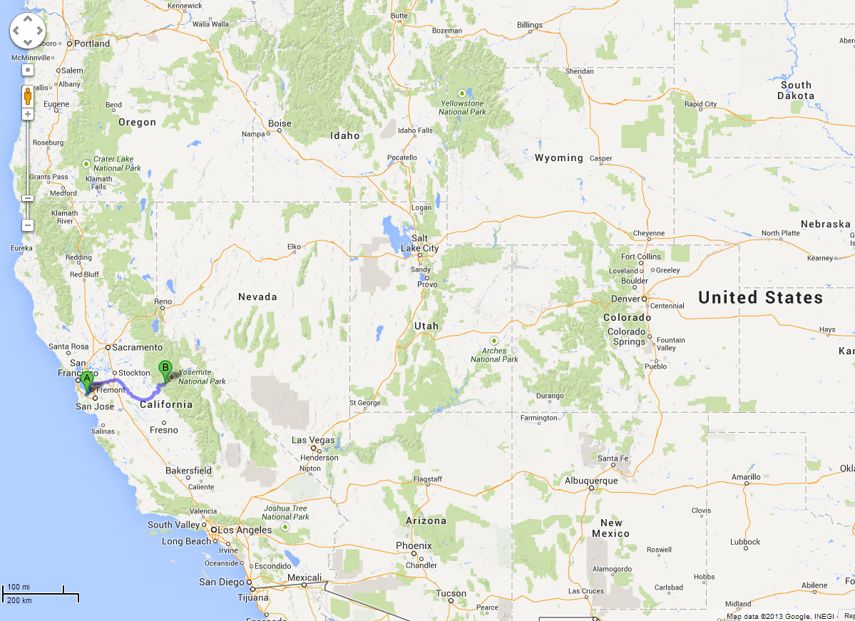
BFS is useful for finding the shortest path between two nodes.
Map Example:
What is the shortest way to go from Yoesmite (F) to Palo Alto (J)?

Slide 11
Breadth-First Search
A
B
C
D
A
B
C
D
TO START:
Color all nodes GREY
Queue is empty
Yoesmite
E
F
G
H
E
F
G
H
Palo Alto
I
J
K
I
J
K
L
L

Slide 12
Breadth-First Search
A
B
C
D
A
B
C
D
TO START (2):
Enqueue the desired start node
Note that anytime we enqueue a node, we mark it YELLOW
E
F
G
H
E
F
G
H
I
J
K
I
J
K
L
L
F

Slide 13
Breadth-First Search
A
B
C
D
A
B
C
D
LOOP PROCEDURE:
Dequeue a node
Mark current node GREEN
Set current node’s GREY neighbors’ parent pointers to current node, then enqueue them (remember: set them YELLOW)
F
E
F
G
H
E
F
G
H
I
J
K
I
J
K
L
L

Slide 14
Breadth-First Search
A
B
C
D
A
B
C
D
F
E
F
G
H
E
F
G
H
I
J
K
I
J
K
L
L

Slide 15
Breadth-First Search
A
B
C
D
A
B
C
D
F
E
F
G
H
E
F
G
H
I
J
K
I
J
K
L
L

Slide 16
Breadth-First Search
A
B
C
D
A
B
C
D
F
E
F
G
H
E
F
G
H
I
J
K
I
J
K
L
L
A
B
D
E
K

Slide 17
Breadth-First Search
A
A
B
C
D
A
B
C
D
E
F
G
H
E
F
G
H
I
J
K
I
J
K
L
L
B
D
E
K

Slide 18
Breadth-First Search
A
A
B
C
D
A
B
C
D
E
F
G
H
E
F
G
H
I
J
K
I
J
K
L
L
B
D
E
K

Slide 19
Breadth-First Search
A
A
B
C
D
A
B
C
D
E
F
G
H
E
F
G
H
I
J
K
I
J
K
L
L
B
D
E
K

Slide 20
Breadth-First Search
B
A
B
C
D
A
B
C
D
E
F
G
H
E
F
G
H
I
J
K
I
J
K
L
L
D
E
K

Slide 21
Breadth-First Search
B
A
B
C
D
A
B
C
D
E
F
G
H
E
F
G
H
I
J
K
I
J
K
L
L
D
E
K

Slide 22
Breadth-First Search
B
A
B
C
D
A
B
C
D
E
F
G
H
E
F
G
H
I
J
K
I
J
K
L
L
D
E
K
C
H

Slide 23
Breadth-First Search
D
A
B
C
D
A
B
C
D
E
F
G
H
E
F
G
H
I
J
K
I
J
K
L
L
E
K
C
H

Slide 24
Breadth-First Search
D
A
B
C
D
A
B
C
D
E
F
G
H
E
F
G
H
I
J
K
I
J
K
L
L
E
K
C
H

Slide 25
Breadth-First Search
D
A
B
C
D
A
B
C
D
E
F
G
H
E
F
G
H
I
J
K
I
J
K
L
L
E
K
C
H

Slide 26
Breadth-First Search
A
B
C
D
A
B
C
D
E
E
F
G
H
E
F
G
H
I
J
K
I
J
K
L
L
K
C
H

Slide 27
Breadth-First Search
A
B
C
D
A
B
C
D
E
E
F
G
H
E
F
G
H
I
J
K
I
J
K
L
L
K
C
H

Slide 28
Breadth-First Search
A
B
C
D
A
B
C
D
E
E
F
G
H
E
F
G
H
I
J
K
I
J
K
L
L
K
C
H
I

Slide 29
Breadth-First Search
A
B
C
D
A
B
C
D
E
F
G
H
E
F
G
H
K
I
J
K
I
J
K
L
L
C
H
I

Slide 30
Breadth-First Search
A
B
C
D
A
B
C
D
E
F
G
H
E
F
G
H
K
I
J
K
I
J
K
L
L
C
H
I

Slide 31
Breadth-First Search
You predict the next slide!
K’s neighbors F,G,H are yellow and in the queue and their parents are pointing to K
K’s neighbors G,H are yellow and in the queue and their parents are pointing to K
K’s neighbors G,H are yellow and in the queue
Other/none/more
A
B
C
D
A
B
C
D
E
F
G
H
E
F
G
H
K
I
J
K
I
J
K
L
L
C
H
I

Slide 32
Breadth-First Search
A
B
C
D
A
B
C
D
E
F
G
H
E
F
G
H
K
I
J
K
I
J
K
L
L
C
H
I
G

Slide 33
Breadth-First Search
A
B
C
D
A
B
C
D
E
F
G
H
E
F
G
H
K
I
J
K
I
J
K
L
L
C
H
I
G

Slide 34
Breadth-First Search
C
A
B
C
D
A
B
C
D
E
F
G
H
E
F
G
H
I
J
K
I
J
K
L
L
H
I
G

Slide 35
Breadth-First Search
C
A
B
C
D
A
B
C
D
E
F
G
H
E
F
G
H
I
J
K
I
J
K
L
L
H
I
G

Slide 36
Breadth-First Search
A
B
C
D
A
B
C
D
H
E
F
G
H
E
F
G
H
I
J
K
I
J
K
L
L
I
G

Slide 37
Breadth-First Search
A
B
C
D
A
B
C
D
H
E
F
G
H
E
F
G
H
I
J
K
I
J
K
L
L
I
G

Slide 38
Breadth-First Search
A
B
C
D
A
B
C
D
E
F
G
H
E
F
G
H
I
J
K
I
J
K
L
L
I
G

Slide 39
Breadth-First Search
A
B
C
D
A
B
C
D
E
F
G
H
E
F
G
H
I
I
J
K
I
J
K
L
L
G

Slide 40
Breadth-First Search
A
B
C
D
A
B
C
D
E
F
G
H
E
F
G
H
I
I
J
K
I
J
K
L
L
G

Slide 41
Breadth-First Search
A
B
C
D
A
B
C
D
E
F
G
H
E
F
G
H
I
I
J
K
I
J
K
L
L
G
L

Slide 42
Breadth-First Search
A
B
C
D
A
B
C
D
G
E
F
G
H
E
F
G
H
I
J
K
I
J
K
L
L
L

Slide 43
Breadth-First Search
A
B
C
D
A
B
C
D
G
E
F
G
H
E
F
G
H
I
J
K
I
J
K
L
L
L

Slide 44
Breadth-First Search
A
B
C
D
A
B
C
D
E
F
G
H
E
F
G
H
I
J
K
I
J
K
L
L
L

Slide 45
Breadth-First Search
A
B
C
D
A
B
C
D
E
F
G
H
E
F
G
H
I
J
K
I
J
K
L
L
L

Slide 46
Breadth-First Search
A
B
C
D
A
B
C
D
E
F
G
H
E
F
G
H
I
J
K
I
J
K
L
L
L
J

Slide 47
Breadth-First Search
A
B
C
D
A
B
C
D
E
F
G
H
E
F
G
H
J
I
J
K
I
J
K
L
L

Slide 48
Breadth-First Search
A
B
C
D
A
B
C
D
E
F
G
H
E
F
G
H
J
I
J
K
I
J
K
L
L

Slide 49
Breadth-First Search
Done!
Now we know that to go from Yoesmite (F) to Palo Alto (J), we should go:
F->E->I->L->J
(4 edges)
(note we follow the parent pointers backwards)
A
B
C
D
A
B
C
D
E
F
G
H
E
F
G
H
J
I
J
K
I
J
K
L
L

Slide 50
Breadth-First Search
A
B
C
D
A
B
C
D
THINGS TO NOTICE:
We used a queue
What’s left is a kind of subset of the edges, in the form of ‘parent’ pointers
If you follow the parent pointers from the desired end point, you will get back to the start point, and it will be the shortest way to do that
E
F
G
H
E
F
G
H
I
J
K
I
J
K
L
L

Slide 51
Quick question about efficiency…
Let’s say that you have an extended family with somebody in every city in the western U.S.

Slide 52
Quick question about efficiency…
You’re all going to fly to Yosemite for a family reunion, and then everyone will rent a car and drive home, and you’ve been tasked with making custom Yosemite-to-home driving directions for everyone.

Slide 53
Quick question about efficiency…
You calculated the shortest path for yourself to return home from the reunion (Yosemite to Palo Alto) and let’s just say that it took time X = O((|E| + |V|)log|V|)
      With respect to the number of cities |V|, and the number of edges or road segments |E|
How long will it take you, in total, to calculate the shortest path for you and all of your relatives?
O(|V|*X)
O(|E|*|V|* X)
X
Other/none/more

Slide 54
Breadth-First Search
A
B
C
D
A
B
C
D
THINGS TO NOTICE:
(4) We now have the answer to the question “What is the shortest path to you from F?” for every single node in the graph!!
E
F
G
H
E
F
G
H
I
J
K
I
J
K
L
L

Slide 55
Dijkstra’s Shortest Paths
(Like Breadth-first Search, but takes into account weight/distance between nodes)

Slide 56
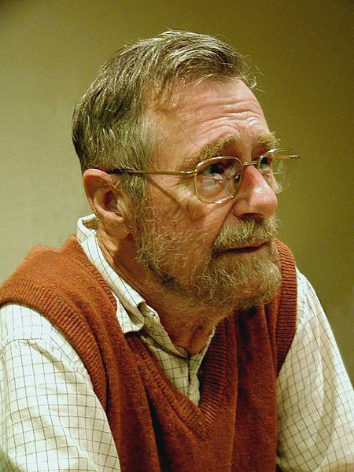
Edsger Dijkstra
1930-2002
THE multiprogramming system (operating system)
  Layers of abstraction!!
Complier for a language that can do recursion
Dining Philosopher’s Problem (resource contention and deadlock)
Dijkstra’s algorithm
“Goto considered harmful” (title given to his letter)
This file is licensed under the Creative Commons Attribution-Share Alike 3.0 Unported license. http://en.wikipedia.org/wiki/File:Edsger_Wybe_Dijkstra.jpg

Slide 57
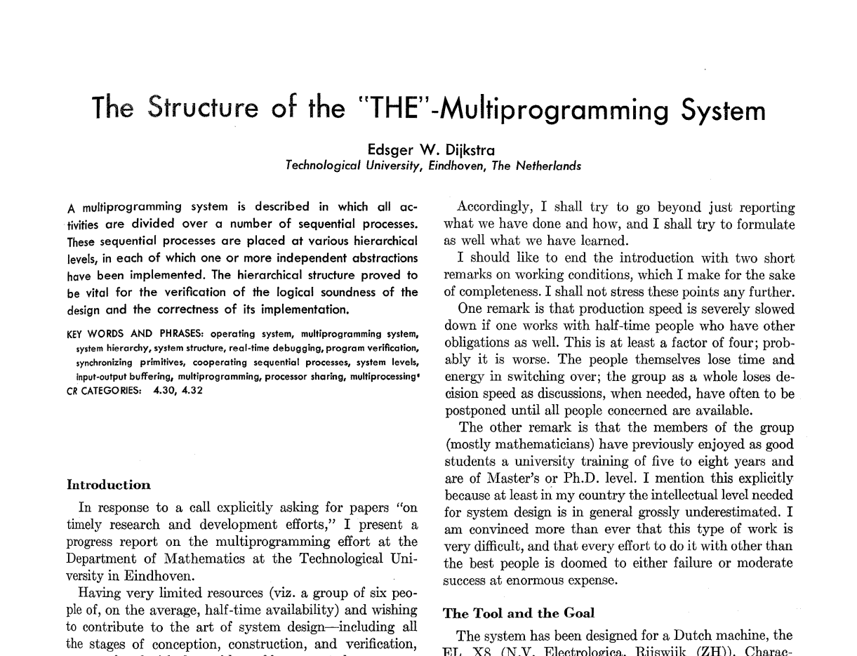

Slide 58
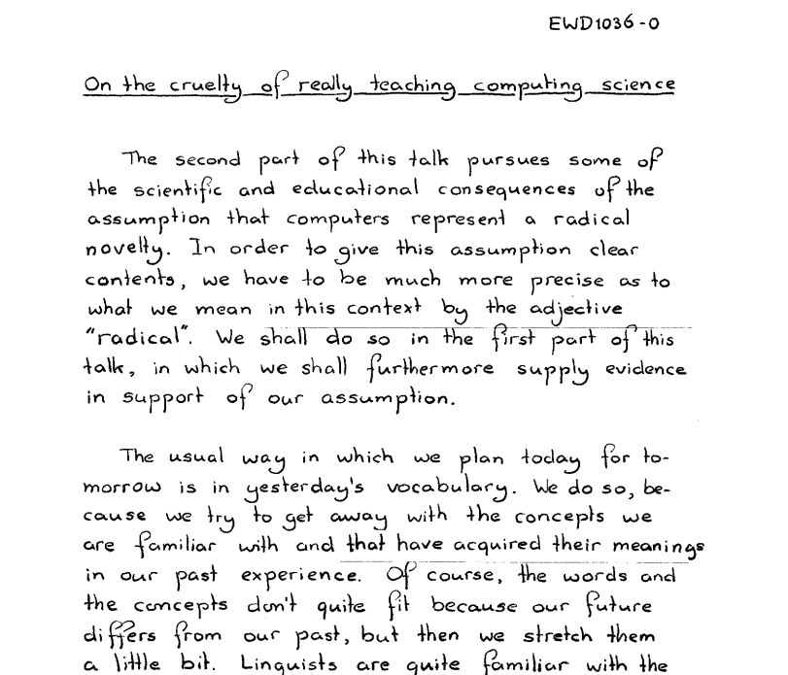

Slide 59
The Shortest Path Problem
Suppose that you have a graph representing different locations
Each edge has an associated cost (or weight, length, etc)
We'll assume costs are nonnegative*
Goal: Find the least-cost (or lowest-weight, lowest-length, etc) path from some node u to a node v
* else use the Bellman–Ford algorithm

Slide 60
A
A
B
B
C
6
3
C
3
1
1
D
D
E
E
F
1
7
F
9
4
7
G
G
H
H
I
2
5
I

Slide 61
Mark all nodes as gray.
Mark the initial node s as yellow and at candidate distance 0.
Enqueue s into the priority queue with priority 0.
While not all nodes have been visited:
  Dequeue the lowest-cost node u from the priority queue.
  Color u green. The candidate distance d that is currently stored for node u is the length of the shortest path from s to u.
  If u is the destination node t, you have found the shortest path from s to t and are done.
  For each node v connected to u by an edge of length L:
    If v is gray:
      Color v yellow.
      Mark v's distance as d + L.
      Set v's parent to be u.
      Enqueue v into the priority queue with priority d + L.
    If v is yellow and the candidate distance to v is greater than d + L:
      Update v's candidate distance to be d + L.
      Update v's parent to be u.
      Update v's priority in the priority queue to d + L.
Dijkstra's
Algorithm

