Slide 1
Programming Abstractions
CS106B
Cynthia Lee

Slide 2
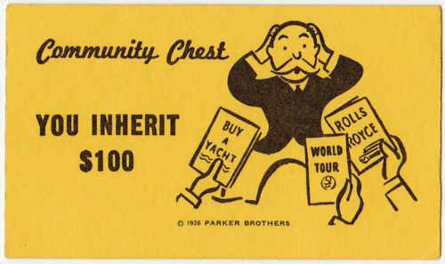
Inheritance Topics
Inheritance
  The basics
    Example: Stanford GObject class
  Polymorphism

Slide 3
Inheritance
What? Why? How?

Slide 4
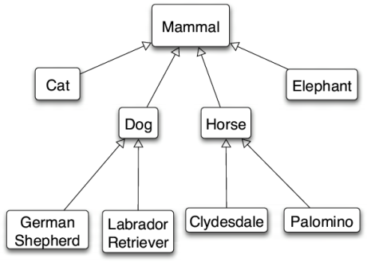
Inheritance: what?
is-a relationship: A hierarchical connection where one category can be treated as a specialized version of another.
  every rectangle is a shape
  every lion is an animal
type hierarchy: A set of data types
connected by is-a relationships
that can share common code.
      Re-use!

Slide 5
Inheritance: why?
Remember the #1 rule of computer scientists:
    Computer scientists are super lazy
    …in a good way!
  We want to reuse code and work as much as possible
  You’ve already seen this going back to the very start of your CS education:
    Loops and Functions (instead of copy&paste to repeat code)
    Arrays (instead of copy&paste to make 100 named variables)
    Data structures (same idea as arrays but more expressive)
  Inheritance is another way of organizing smart reuse of code

Slide 6
Inheritance: how?
inheritance: A way to form new classes based on existing classes, taking on their attributes/behavior.
  a way to group related classes
  a way to share code between two or more classes
One class can extend another, absorbing its data/behavior.

Slide 7
Inheritance vocab
  superclass (base class): Parent class that is being extended.
  subclass (derived class): Child class that inherits from the superclass.
    Subclass gets a copy of every field and method from superclass.
    Subclass can add its own behavior, and/or change inherited behavior.

Slide 8

Inheritance Example
Gob-ject
Stanford Library G-Object family of classes

Slide 9
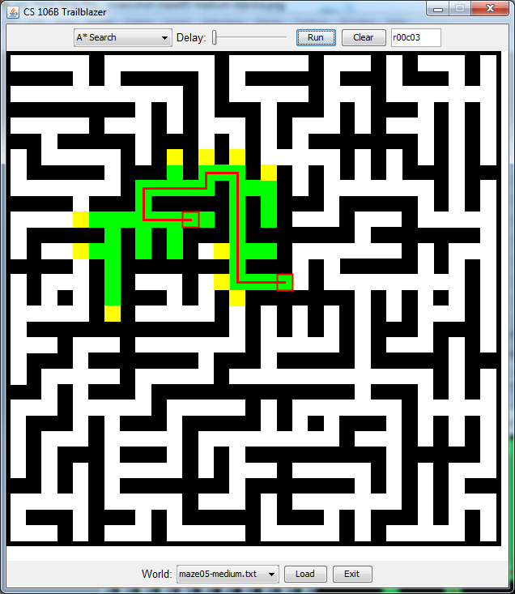
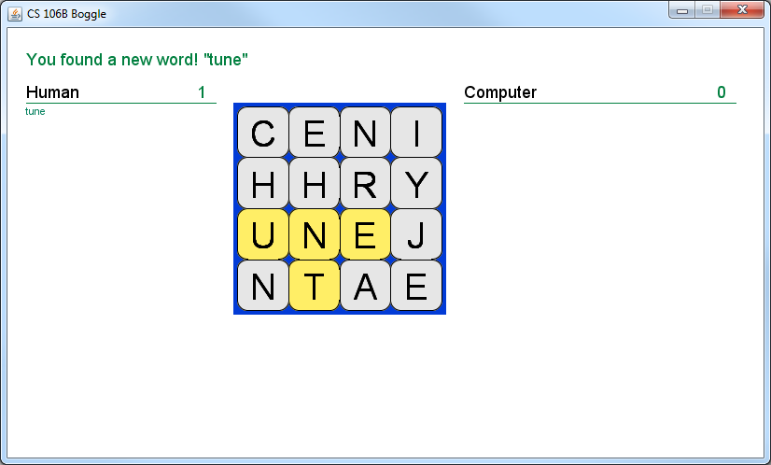
Behind the scenes…
We’ve always told you not to worry about the graphics parts of your assignments.
    “Just call this BoggleGUI function…”
Now you can go ahead and take a look!

Slide 10
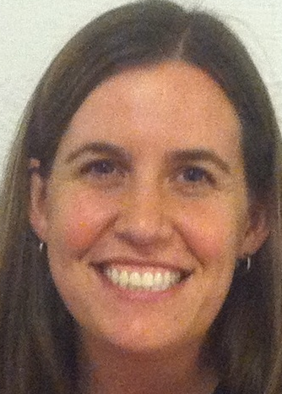
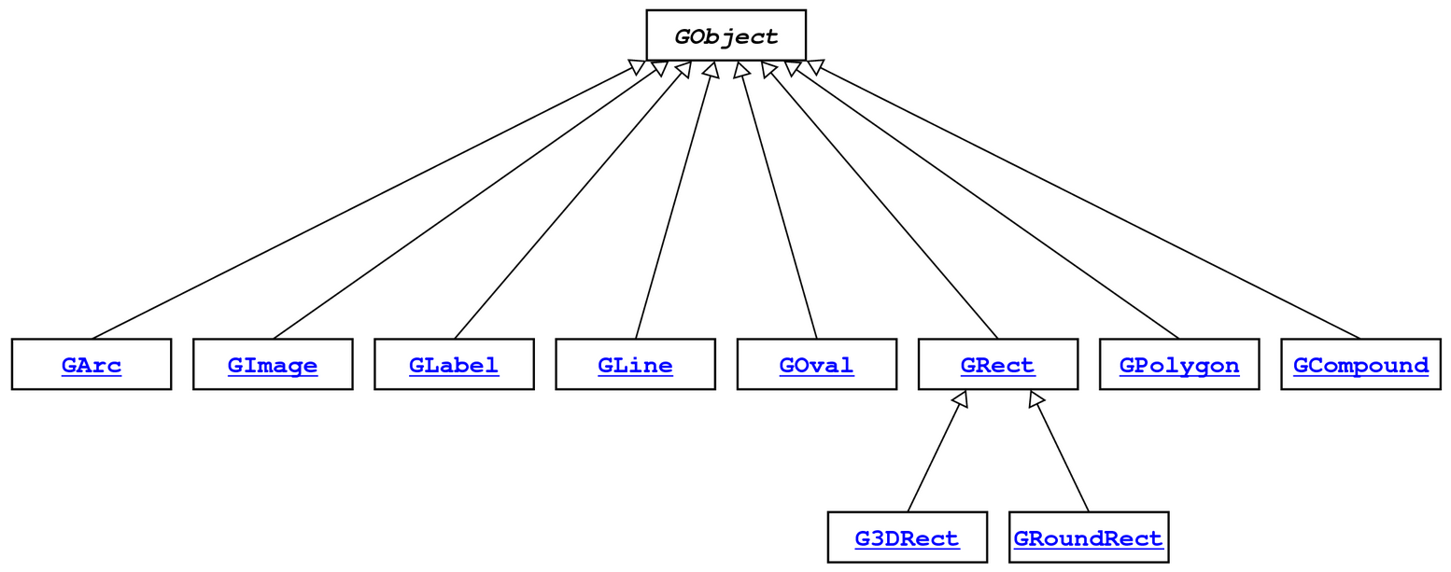
GObject hierarchy
The Stanford C++ library contains a hierarchy of graphical objects based on a common base class named GObject.
  GArc
  GImage
  GLabel
  GLine
  GOval
  GPolygon
  GRect
  G3DRect
  GRoundRect
hi

Slide 11
GObject members
GObject defines the state and behavior common to all shapes:
  contains(x, y)
  get/setColor()
  getHeight(), getWidth()
  get/setLocation(), get/setX(), get/setY()
  move(dx, dy)
  setVisible(visible)
The subclasses add state and behavior unique to them:
  Glabel GLine GPolygon GOval
    get/setFont get/setStartPoint addEdge getSize
    get/setLabel get/setEndPoint addVertex get/setFillColor
    get/setFillColor
    ... ... ... ...
double x;
double y;
double lineWidth;
std::string color;
bool visible;

Slide 12
GObject members
GObject defines the state and behavior common to all shapes:
  contains(x, y)
  get/setColor()
  getHeight(), getWidth()
  get/setLocation(), get/setX(), get/setY()
  move(dx, dy)
  setVisible(visible)
The subclasses add state and behavior unique to them:
  Glabel GLine GPolygon GOval
    get/setFont get/setStartPoint addEdge getSize
    get/setLabel get/setEndPoint addVertex get/setFillColor
    get/setFillColor
    ... ... ... ...
double x;
double y;
double lineWidth;
std::string color;
bool visible;

Slide 13
GObject hierarchy
Q: Rectangle is-a Polygon, right?
Why doesn’t it inherit from Polygon??
Although true in geometry, they don’t share many fields and methods in this case.
The Stanford C++ library contains a hierarchy of graphical objects based on a common base class named GObject.
  GArc
  GImage
  GLabel
  GLine
  GOval
  GPolygon
  GRect
  G3DRect
  GRoundRect
hi

Slide 14
Inheritance Example
Your turn: let’s write an Employee family of classes

Slide 15
Example: Employees
Imagine a company with the following employee regulations:
  All employees work 40 hours / week
  Employees make $40,000 per year plus $500 for each year worked
    Except for lawyers who get twice the usual pay, and programmers who get the same $40k base but $2000 for each year worked
  Employees have 2 weeks of paid vacation days per year
    Except for programmers who get an extra week
Each type of employee has some unique behavior:
  Lawyers know how to sue
  Programmers know how to write code

Slide 16
Employee class
// Employee.cpp
Employee::Employee(string name, int years) {
m_name = name;
m_years = years;
}
int Employee::hours() {
return 40;
}
string Employee::name() {
return m_name;
}
double Employee::salary() {
return 40000.0 + (500 * m_years);
}
int Employee::vacationDays() {
return 10;
}
int Employee::years() {
return m_years;
}
// Employee.h
class Employee {
public:
Employee(string name,
int years);
virtual int hours();
virtual string name();
virtual double salary();
virtual int vacationDays();
virtual int years();
private:
string m_name;
int m_years;
};

Slide 17
Exercise: Employees
Exercise: Implement classes Lawyer and Programmer.
  A Lawyer remembers what law school he/she went to.
  Lawyers make twice as much salary as normal employees.
  Lawyers know how to sue people (unique behavior).
  Lawyers put “, Esq.” at the end of their name.
  Programmers make the same base salary as normal employees,
  but they earn a bonus of $2k/year instead of $500/year.
  Programmers know how to write code (unique behavior).

Slide 18
Inheritance syntax
  class Name : public SuperclassName {
  Example:
  class Lawyer : public Employee {
  ...
  };
By extending Employee, each Lawyer object now:
  receives a hours, name, salary, vacationDays, and years method automatically
  can be treated as an Employee by client code

Slide 19
Call superclass c'tor
  SubclassName::SubclassName(params)
  : SuperclassName(params) {
  statements;
  }
To call a superclass constructor from subclass constructor, use an initialization list, with a colon after the constructor declaration.
  Example:
  Lawyer::Lawyer(string name, string lawSchool, int years)
  : Employee(name, years) {
  // calls Employee constructor first
  m_lawSchool = lawSchool;
  }

Slide 20
Your turn: inheritance
// Employee.h
class Employee {
public:
Employee(string name,
int years);
int hours();
string name();
double salary();
int vacationDays();
string vacationForm();
int years();
private:
string m_name;
int m_years;
};
  string Lawyer::name() {
  ???
  }
  For adding “, Esq.” to the name, which of the following could work?
  return m_name + ", Esq.";
  return name() + ", Esq.";
  return Employee::name() + ", Esq.";
  None of the above
  More than one of the above

Slide 21
Call superclass member
  SuperclassName::memberName(params)
To call a superclass overridden member from subclass member.
  Example:
  double Lawyer::salary() { // paid twice as much
  return Employee::salary() * 2;
  }
  Note: Subclass cannot access private members of the superclass.
  Note: You only need to use this syntax when the superclass's member has been overridden.
    If you just want to call one member from another, even if that member came from the superclass, you don't need to write Superclass:: .

Slide 22
Polymorphism
Start with how

Slide 23
Polymorphism
polymorphism: Ability for the same code to be used with different types of objects and behave differently with each.
  Templates provide a kind of compile-time polymorphism.
    Grid<int> or Grid<string> will output different things for myGrid[0][0], but we can predict at compile time which it will do
  Inheritance provides run-time polymorphism.
    someEmployee.salary() will behave differently at runtime depending on what type of employee—may not be able to predict at compile time which it is

Slide 24
Polymorphism
A pointer of type T can point to any subclass of T.
  Employee *neha = new Programmer("Neha", 2);
  Employee *diane = new Lawyer("Diane", "Stanford", 5);
  Programmer *cynthia = new Programmer("Cynthia", 10);
  Why would you do this?
    Handy if you want to have a function that works on any Employee, but takes advantage of custom behavior by specific employee type:
    void doMonthlyPaycheck(Employee *employee) {
    cout << "You are now $" << employee->salary()/12 << " wealthier!" << endl;
    }

Slide 25
Polymorphism
A pointer of type T can point to any subclass of T.
  Employee *neha = new Programmer("Neha", 2);
  Employee *diane = new Lawyer("Diane", "Stanford", 5);
  Programmer *cynthia = new Programmer("Cynthia", 10);
  When a member function is called on diane, it behaves as a Lawyer.
    diane->salary();
    (This is because all the employee functions are declared virtual.)
  You can not call any Lawyer-only members on diane (e.g. sue).
    diane->sue(); // will NOT compile!
  You can call any Programmer-only members on cynthia (e.g. code).
    cynthia->code("Java"); // ok!

Slide 26
Polymorphism examples
You can use the object's extra functionality by casting.
  Employee *diane = new Lawyer("Diane", "Stanford", 5);
  diane->vacationDays(); // ok
  diane->sue("Cynthia"); // compiler error
  ((Lawyer*) diane)->sue("Cynthia"); // ok
Pro Tip: you should not cast a pointer into something that it is not!
  It will compile, but the code will crash (or behave unpredictably)
  when you try to run it.
  Employee *carlos = new Programmer("Carlos", 3);
  carlos->code(); // compiler error
  ((Programmer*) carlos)->code("C++"); // ok
  ((Lawyer*) carlos)->sue("Cynthia"); // No!!! Compiles but crash!!

Slide 27
Rules for “virtual”: runtime calls
DerivedType * obj = new DerivedType();
If we call a method like this: obj->method(), only one thing could happen:
  DerivedType’s implementation of method is called
BaseType * obj = new DerivedType();
If we call a method like this: obj->method(), two different things could happen:
  If method is not virtual, then BaseType’s implementation of method is called
  If method is virtual, then DerivedType’s implementation of method is called

Slide 28
Rules for “virtual”: pure virtual
If a method of a class looks like this:
  virtual returntype method() = 0;
  then this method is a called “pure virtual” function
  and the class is called an “abstract class”
  Abstract classes are like Java interfaces
  You cannot do “= new Foo();” if Foo is abstract (just like Java interfaces)
  ALSO, you cannot do “= new DerivedFoo();” if DerivedFoo extends Foo and DerivedFoo does not implement all the pure virtual methods of Foo

Slide 29
class Mammal {
public:
virtual void makeSound() = 0;
string toString() { return “Mammal”; }
};
class Cat : public Mammal {
public:
virtual void makeSound() { cout << “rawr” << endl; }
string toString() { return “Cat”; }
};
class Siamese : public Cat {
public:
virtual void makeSound() { cout << “meow” << endl; }
string toString() { return “Siamese”; }
virtual void scratchCouch() { cout << “scraaaatch” << endl; }
};
What is printed?
Siamese * s = new Mammal;
cout << s->toString();
“Mammal”
“Cat”
“Siamese”
Gives an error (identify compiler or crash)
Other/none/more

Slide 30
class Mammal {
public:
virtual void makeSound() = 0;
string toString() { return “Mammal”; }
};
class Cat : public Mammal {
public:
virtual void makeSound() { cout << “rawr” << endl; }
string toString() { return “Cat”; }
};
class Siamese : public Cat {
public:
virtual void makeSound() { cout << “meow” << endl; }
string toString() { return “Siamese”; }
virtual void scratchCouch() { cout << “scraaaatch” << endl; }
};
What is printed?
Siamese * s = new Siamese;
cout << s->toString();
“Mammal”
“Cat”
“Siamese”
Gives an error (identify compiler or crash)
Other/none/more

Slide 31
class Mammal {
public:
virtual void makeSound() = 0;
string toString() { return “Mammal”; }
};
class Cat : public Mammal {
public:
virtual void makeSound() { cout << “rawr” << endl; }
string toString() { return “Cat”; }
};
class Siamese : public Cat {
public:
virtual void makeSound() { cout << “meow” << endl; }
string toString() { return “Siamese”; }
virtual void scratchCouch() { cout << “scraaaatch” << endl; }
};
What is printed?
Mammal * m = new Mammal;
cout << m->toString();
“Mammal”
“Cat”
“Siamese”
Gives an error (identify compiler or crash)
Other/none/more

Slide 32
class Mammal {
public:
virtual void makeSound() = 0;
string toString() { return “Mammal”; }
};
class Cat : public Mammal {
public:
virtual void makeSound() { cout << “rawr” << endl; }
string toString() { return “Cat”; }
};
class Siamese : public Cat {
public:
virtual void makeSound() { cout << “meow” << endl; }
string toString() { return “Siamese”; }
virtual void scratchCouch() { cout << “scraaaatch” << endl; }
};
What is printed?
Mammal * m = new Siamese;
cout << m->toString();
“Mammal”
“Cat”
“Siamese”
Gives an error (identify compiler or crash)
Other/none/more

Slide 33
class Mammal {
public:
virtual void makeSound() = 0;
string toString() { return “Mammal”; }
};
class Cat : public Mammal {
public:
virtual void makeSound() { cout << “rawr” << endl; }
string toString() { return “Cat”; }
};
class Siamese : public Cat {
public:
virtual void makeSound() { cout << “meow” << endl; }
string toString() { return “Siamese”; }
virtual void scratchCouch() { cout << “scraaaatch” << endl; }
};
What is printed?
Mammal * m = new Siamese;
m->scratchCouch();
“Mammal”
“Cat”
“Siamese”
Gives an error (identify compiler or crash)
Other/none/more

Slide 34
class Mammal {
public:
virtual void makeSound() = 0;
string toString() { return “Mammal”; }
};
class Cat : public Mammal {
public:
virtual void makeSound() { cout << “rawr” << endl; }
string toString() { return “Cat”; }
};
class Siamese : public Cat {
public:
virtual void makeSound() { cout << “meow” << endl; }
string toString() { return “Siamese”; }
virtual void scratchCouch() { cout << “scraaaatch” << endl; }
};
What is printed?
Cat * c = new Siamese;
c->makeSound();
“rawr”
“meow”
“Siamese”
Gives an error (identify compiler or crash)
Other/none/more

