Slide 1
Tuesday, June 27th, 2017
CS 106B
Lecture 2: C++ Functions / Computational Complexity
parameters
Programming Abstractions
Summer 2017
Stanford University
Computer Science Department
Lecturer: Chris Gregg
reading:
Programming Abstractions in C++, Chapters 2-3, Section 10.2
function
result

Slide 2
Today's Topics
Logistics:
  sayat.me/chrisgregg feedback -- does not accept links
  Signing up for section
  Qt Creator installation help tonight in the LaIR
Homework 1: Game of Life!
  Due Thursday, July 5th, at Noon
  We will have a "YEAH Hours" session Wednesday evening (it will be recorded) to describe the assignment.
Input / Output in C++
Functions
  Some review — functions are very similar to Java functions!
  Value semantics, Reference semantics
Introduction to Computational Complexity and "Big O"
Reading Assignment: Chapters 2 and 3, Section 10.2

Slide 3
Logistics
Signing up for section: you must put your available times by Tuesday at 5pm
  If you want to pair program — you must be in the same section!
  Go to cs198.stanford.edu to sign up.
Qt Creator installation help: Tuesday at 8pm, in Tressider (eating area). Please attempt to install Qt Creator before you arrive (see the course website for details).
Remember, Assignment 0 is due Wednesday at Noon
Assignment 1 YEAH hours: 3:30-4:20pm in Gates B03 (will be taped)

Slide 4
Assignment 1: Game of Life
The Game of Life is a simulation created by mathematician John Conway in 1971.
The simulation models the life cycle of bacteria using a 2-dimensional grid of cells.
For the assignment, you will will write a version of the simulation using a basic interface.
See the following simulation example: https://bitstorm.org/gameoflife/

Slide 5
Game of Life
The program you write will utilize:
  Functions
  Constants
  Loops
  I/O (cout, getLine(), getInteger())
  Reference semantics, Value semantics
  Strings
  Logic
  Cellular Automation
We will discuss all of the above before the project is due
Get started early!
Due: 12pm (Noon) on Wednesday, July 5th

Slide 6

Input / Output in C++
There are many ways to have input and output in C++.
In this class, you will primarily be either reading input from the console (typed on a keyboard), or read input from a file.
We have already discussed using cout to print to the screen.
There is also a corresponding cin command, which you could use to input specific variables:
    int a;
    cin >> a; // reads an int from the user
Don't do this in this class! The cin function does not read in "whitespace". It will interfere with the Stanford library getLine() and getInteger() functions.

Slide 7
Input / Output in C++
You should use either getInteger() or getLine() to read input from the keyboard. They work as follows:
Note the uppercase L
#include <iostream>
#include "console.h"
#include "simpio.h"
using namespace std;
int main() {
int a;
string s;
a = getInteger("Please enter an integer: ","That wasn't an integer!");
s = getLine("Please type in a string: ");
cout << "Your integer: " << a << endl;
cout << "Your string: " << s << endl;
return 0;
}

Slide 8
Input / Output in C++
To read in input from a file, use the getline() function
Note the lowercase L
#include <iostream>
#include <fstream>
#include "console.h"
#include "simpio.h"
#include "filelib.h"
using namespace std;
int main() {
string s;
ifstream stream;
openFile(stream, "readme.txt");
getline(stream,s);
cout << "The first line of the file is: " << s << endl;
return 0;
}

Slide 9
Defining Functions (2.3)
A C++ function is like a Java method. Similar declaration syntax but without the public or private keyword in front.
type functionName(type name, type name, ..., type name) {
statement;
statement;
...
statement;
return expression; // if return type is not void
}
return type
parameters
arguments (called in the same order as the parameters)
Calling a function:
functionName(value, value, ..., value);

Slide 10
Function Return Types
A C++ function must have a return type, which can be any time (including user-defined types, which we will cover later).
double square(double x); // returns a double
Vector<int> matrixMath(int x, int y); // returns a Vector
// probably not a good
// idea! (covered later)
string lowercase(string s); // returns a string (maybe
// not a good idea...
void printResult(Vector<int> &v); // returns nothing!
A C++ function can only return a single type, and if you want to return multiple "things," you have to do it differently (unlike in languages such as Python). We will cover this later, as well.

Slide 11
Function Example, brought to you by
(bus drivers hate them!)
#include <iostream>
#include "console.h"
using namespace std;
const string DRINK_TYPE = "Coke";
// Function Definition and Code
void bottles(int count) {
cout << count << " bottles of " << DRINK_TYPE << " on the wall." << endl;
cout << count << " bottles of " << DRINK_TYPE << "." << endl;
cout << "Take one down, pass it around, "
<< (count-1) << " bottles of " << DRINK_TYPE
<< " on the wall." << endl << endl;
}
int main() {
for (int i=99; i > 0; i--) {
bottles(i);
}
return 0;
}

Slide 12
Function Example: Output
99 bottles of Coke on the wall.
99 bottles of Coke.
Take one down, pass it around, 98 bottles of Coke on the wall.
98 bottles of Coke on the wall.
98 bottles of Coke.
Take one down, pass it around, 97 bottles of Coke on the wall.
97 bottles of Coke on the wall.
97 bottles of Coke.
Take one down, pass it around, 96 bottles of Coke on the wall.
...
3 bottles of Coke on the wall.
3 bottles of Coke.
Take one down, pass it around, 2 bottles of Coke on the wall.
2 bottles of Coke on the wall.
2 bottles of Coke.
Take one down, pass it around, 1 bottles of Coke on the wall.
1 bottles of Coke on the wall.
1 bottles of Coke.
Take one down, pass it around, 0 bottles of Coke on the wall.

Slide 13
Function Example, brought to you by
(bus drivers hate them!)
#include <iostream>
#include "console.h"
using namespace std;
const string DRINK_TYPE = "Coke";
// Function Definition and Code
void bottles(int count) {
cout << count << " bottles of " << DRINK_TYPE << " on the wall." << endl;
cout << count << " bottles of " << DRINK_TYPE << "." << endl;
cout << "Take one down, pass it around, "
<< (count-1) << " bottles of " << DRINK_TYPE
<< " on the wall." << endl << endl;
}
int main() {
for (int i=99; i > 0; i--) {
bottles(i);
}
return 0;
}
How many functions does this program have?
Answer: 2. bottles() and main()
What does the bottles() function return?
Answer: nothing (void function)

Slide 14
Function Example, brought to you by
(bus drivers hate them!)
#include <iostream>
#include "console.h"
using namespace std;
const string DRINK_TYPE = "Coke";
// Function Definition and Code
void bottles(int count) {
cout << count << " bottles of " << DRINK_TYPE << " on the wall." << endl;
cout << count << " bottles of " << DRINK_TYPE << "." << endl;
cout << "Take one down, pass it around, "
<< (count-1) << " bottles of " << DRINK_TYPE
<< " on the wall." << endl << endl;
}
int main() {
for (int i=99; i > 0; i--) {
bottles(i);
}
return 0;
}
Why is it a good idea to make DRINK_TYPE a constant?
Answer: So we can change it to Pepsi if we are masochists. (actual answer: it allows us to make one change that affects many places in the code)

Slide 15
Function Example 2
// Function example #2: returning values
#include <iostream>
#include "console.h"
using namespace std;
int larger(int a, int b) {
if (a > b) {
return a;
} else {
return b;
}
}
// Returns the larger of the two values.
int main() {
int bigger1 = larger(17, 42); // call the function
int bigger2 = larger(29, -3); // call the function again
int biggest = larger(bigger1, bigger2);
cout << "The biggest is " << biggest << "!!" << endl;
return 0;
}

Slide 16
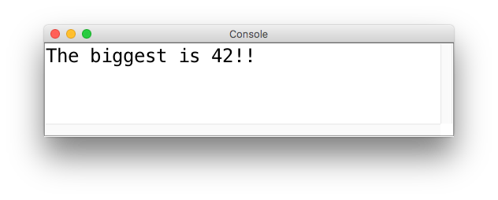
Function Example 2
// Function example #2: returning values
#include <iostream>
#include "console.h"
using namespace std;
int larger(int a, int b) {
if (a > b) {
return a;
} else {
return b;
}
}
// Returns the larger of the two values.
int main() {
int bigger1 = larger(17, 42); // call the function
int bigger2 = larger(29, -3); // call the function again
int biggest = larger(bigger1, bigger2);
cout << "The biggest is " << biggest << "!!" << endl;
return 0;
}
Output:

Slide 17
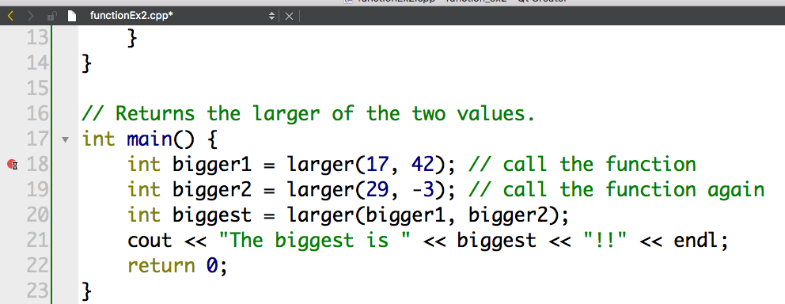
Function Example 2: Debugging (see HW0!)
One of the most powerful features of an Integrated Development Environment (IDE) like Qt Creator is the built-in debugger.
You can stop the program's execution at any point and look at exactly what is going on under the hood!
In your program, click to the left of a line of code (line 18 below, for example)
When you run the program in Debug mode (the green triangle with the bug on it), the program will stop at that point. Let's see this in action!

Slide 18
Function Example 2: Debugging
Notes from live debugging:
  You can see variable values as the program executes
  You use the following buttons to continue the program:
Go to next line and into functions
Go to next line but not into functions
stop running
Finish the function and leave it
continue to next breakpoint
Debugging effectively takes a little time to learn, but is super effective if you have hard to find bugs.

Slide 19
Declaration Order
Believe it or not, this program does not compile!
In C++, functions must be declared somewhere before they are used.
But, we like to put our main() function first, because it is better style.
#include <iostream>
#include "console.h"
using namespace std;
const string DRINK_TYPE = "Coke";
int main() {
for (int i=99; i > 0; i--) {
bottles(i);
}
return 0;
}
// Function Definition and Code
void bottles(int count) {
cout << count << " bottles of " << DRINK_TYPE << " on the wall." << endl;
cout << count << " bottles of " << DRINK_TYPE << "." << endl;
cout << "Take one down, pass it around, "
<< (count-1) << " bottles of " << DRINK_TYPE
<< " on the wall." << endl << endl;
}

Slide 20
Declaration Order
#include <iostream>
#include "console.h"
using namespace std;
const string DRINK_TYPE = "Coke";
// Function Definition
void bottles(int count);
int main() {
for (int i=99; i > 0; i--) {
bottles(i);
}
return 0;
}
// Function Code
void bottles(int count) {
cout << count << " bottles of " << DRINK_TYPE << " on the wall." << endl;
cout << count << " bottles of " << DRINK_TYPE << "." << endl;
cout << "Take one down, pass it around, "
<< (count-1) << " bottles of " << DRINK_TYPE
<< " on the wall." << endl << endl;
}
Believe it or not, this program does not compile!
In C++, functions must be declared somewhere before they are used.
But, we like to put our main() function first, because it is better style.
What we can do is define the function (called a "function prototype") without its body, and that tells the compiler about the function "signature" and the compiler is happy.

Slide 21
C++ Pre-written Functions
You have written a lot of functions before. What if we wanted to find the square root of a number?
We could manually write out a function (remember Newton’s Method??) -- see the textbook!
But, this would be counterproductive, and many math functions have already been coded (and coded well!)
The <cmath> library already has lots and lots of math functions that you can use (you can go look up the code! Actually...it's complicated -- see https://github.com/justincormack/frankenlibc/blob/master/src/lib/libm/src/e_sqrt.c if you are brave. It is most likely true that the square root function is built into your computer's processor, so there isn't any readable code)

Slide 22
<cmath> functions (2.1)
#include <cmath>
Function | Description (returns)
abs(value) | absolute value
ceil(value) | rounds up
floor(value) | rounds down
log10(value) | logarithm, base 10
max(value1, value2) | larger of two values
min(value1, value2) | smaller of two values
pow(base, exp) | base to the exp power
round(value) | nearest whole number
sqrt(value) | square root
sin(value) cos(value) tan(value) | sine/cosine/tangent of an angle in radians
unlike in Java, you don't write Math. in front of the function name
see Stanford "gmath.h" library for additional math functionality

Slide 23
Value semantics
value semantics: In Java and C++, when variables (int, double) are passed as parameters, their values are copied.
  Modifying the parameter will not affect the variable passed in.
void grow(int age) {
age = age + 1;
cout << "grow age is " << age << endl;
}
int main() {
int age = 20;
cout << "main age is " << age << endl;
grow(age);
cout << "main age is " << age << endl;
return 0;
}
Output:
main age is 20
grow age is 21
main age is 20

Slide 24
Reference semantics (2.5)
reference semantics: In C++, if you declare a parameter with an & after its type, instead of passing a copy of its value, it will link the caller and callee functions to the same variable in memory.
  Modifying the parameter will affect the variable passed in.
void grow(int &age) {
age = age + 1;
cout << "grow age is " << age << endl;
}
int main() {
int age = 20;
cout << "main age is " << age << endl;
grow(age);
cout << "main age is " << age << endl;
return 0;
}
Output:
main age is 20
grow age is 21
main age is 21

Slide 25
Reference semantics (2.5)
Notes about references:
  References are super important when dealing with objects that have a lot of elements (Vectors, for instance). Because the reference does not copy the structure, it is fast. You don't want to transfer millions of elements between two functions if you can help it!
  The reference syntax can be confusing, as the "&" (ampersand) character is also used to specify the address of a variable or object. The & is only used as a reference parameter in the function declaration, not when you call the function:
int main() {
grow(age);
grow(&age);
return 0;
}
yes!
void grow(int &age) {
age = age + 1;
cout << "grow age is "
<< age << endl;
}
yes!
no!

Slide 26
Reference pros/cons
benefits of reference parameters:
  a useful way to be able to 'return' more than one value
  often used with objects, to avoid making bulky copies when passing
downsides of reference parameters:
  hard to tell from call whether it is ref; can't tell if it will be changed
foo(a, b, c); // will foo change a, b, or c? :-/
  (very) slightly slower than value parameters
  can't pass a literal value to a ref parameter
grow(39); // error

Slide 27
Reference Example
Without references, you can't write a swap function to swap two integers. This is true about Java. What happens with the following function?
/*
* Attempts to place a's value into b and vice versa.
*/
void swap(int a, int b) {
int temp = a;
a = b;
b = temp;
}
Answer: the original variables are unchanged, because they are passed as copies (values)!

Slide 28
Reference Example
With references, you can write a swap function to swap two integers, because you can access the original variables:
/*
* Places a's value into b and vice versa.
*/
void swap(int &a, int &b) {
int temp = a;
a = b;
b = temp;
}
Answer: the original variables are changed, because they are passed as references !

Slide 29
Tricky Reference Mystery Example
What is the output of this code? Talk to your neighbor!
void mystery(int& b, int c, int& a) {
a++;
b--;
c += a;
}
int main() {
int a = 5;
int b = 2;
int c = 8;
mystery(c, a, b);
cout << a << " " << b << " " << c << endl;
return 0;
}
// A. 5 2 8
// B. 5 3 7
// C. 6 1 8
// D. 61 13
// E. other
Note: please don't obfuscate your code like this! :(
See the International Obfuscated C Contest for much, much worse examples

Slide 30
Tricky Reference Mystery Example
What is the output of this code?
void mystery(int& b, int c, int& a) {
a++;
b--;
c += a;
}
int main() {
int a = 5;
int b = 2;
int c = 8;
mystery(c, a, b);
cout << a << " " << b << " " << c << endl;
return 0;
}
// A. 5 2 8
// B. 5 3 7
// C. 6 1 8
// D. 61 13
// E. other
Note: please don't obfuscate your code like this! :(
See the International Obfuscated C Contest for much, much worse examples

Slide 31
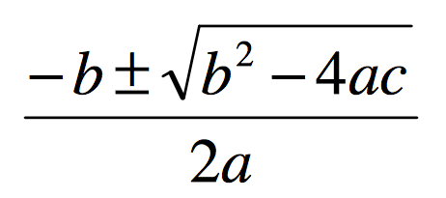
Quadratic Exercise -- how do you return multiple things?
A quadratic equation for variable x is one of the form:
ax² + bx +c = 0, for some numbers a, b, and c.
The two roots of a quadratic equation can be found using the quadratic formula at right.
Example: The roots of x²-3x-4=0 are x=4 and x=-1
How would we write a function named quadratic to solve quadratic equations?
  What parameters should it accept?
  Which parameters should be passed by value, and which by reference?
  What, if anything, should it return?
We have choices!

Slide 32
Quadratic Exercise -- how do you return multiple things?
/*
* Solves a quadratic equation ax^2 + bx + c = 0,
* storing the results in output parameters root1 and root2.
* Assumes that the given equation has two real roots.
*/
void quadratic(double a, double b, double c,
double& root1, double& root2) {
double d = sqrt(b * b - 4 * a * c);
root1 = (-b + d) / (2 * a);
root2 = (-b - d) / (2 * a);
}
How are we "returning" the results?
Answer: by reference
What other choices could we have made? Talk to your neighbor!

Slide 33
Quadratic Exercise -- how do you return multiple things?
Possible choices:
  We could have returned a boolean if the roots were imaginary
  We could have added extra parameters to support some form of imaginary numbers
  We could have called an error function inside this function (but that is not always a good idea -- functions like this should generally have an interface through the parameters and/or return value, and should gracefully fail)
  We could have re-written the function as two functions that return either the positive or negative root, without using references.
  We could have returned a Vector<double> object (tricky syntax!)

Slide 34
Computational Complexity

Slide 35

Computational Complexity
How does one go about analyzing programs to compare how the program behaves as it scales? E.g., let's look at a vectorMax() function:
int vectorMax(Vector<int> &v){
int currentMax = v[0];
int n = v.size();
for (int i=1; i < n; i++){
if (currentMax < v[i]) {
currentMax = v[i];
}
}
return currentMax;
}
What is n? Why is it important to this function?

Slide 36

Computational Complexity
int vectorMax(Vector<int> &v){
int currentMax = v[0];
int n = v.size();
for (int i=1; i < n; i++){
if (currentMax < v[i]) {
currentMax = v[i];
}
}
return currentMax;
}
If we want to see how this algorithm behaves as n changes, we could do the following:
Code the algorithm in C++
Determine, for each instruction of the compiled program the time needed to execute that instruction (need assembly language)
Determine the number of times each instruction is executed when the program is run.
Sum up all the times we calculated to get a running time.

Slide 37
Computational Complexity
int vectorMax(Vector<int> &v){
int currentMax = v[0];
int n = v.size();
for (int i=1; i < n; i++){
if (currentMax < v[i]) {
currentMax = v[i];
}
}
return currentMax;
}
Steps 1-4 on the previous slide…might work, but it is complicated, especially for today’s machines that optimize everything “under the hood.” (and reading assembly code takes a certain patience).

Slide 38

Assembly Code for vectorMax() function...
0x000000010014adf0 <+0>: push %rbp
0x000000010014adf1 <+1>: mov %rsp,%rbp
0x000000010014adf4 <+4>: sub $0x20,%rsp
0x000000010014adf8 <+8>: xor %esi,%esi
0x000000010014adfa <+10>: mov %rdi,-0x8(%rbp)
0x000000010014adfe <+14>: mov -0x8(%rbp),%rdi
0x000000010014ae02 <+18>: callq 0x10014aea0 <std::__1::basic_ostream<char, std::__1::char_traits<char> >::operator<<(long)+32>
0x000000010014ae07 <+23>: mov (%rax),%esi
0x000000010014ae09 <+25>: mov %esi,-0xc(%rbp)
0x000000010014ae0c <+28>: mov -0x8(%rbp),%rdi
0x000000010014ae10 <+32>: callq 0x10014afb0 <std::__1::basic_ostream<char, std::__1::char_traits<char> >::operator<<(long)+304>
0x000000010014ae15 <+37>: mov %eax,-0x10(%rbp)
0x000000010014ae18 <+40>: movl $0x1,-0x14(%rbp)
0x000000010014ae1f <+47>: mov -0x14(%rbp),%eax
0x000000010014ae22 <+50>: cmp -0x10(%rbp),%eax
0x000000010014ae25 <+53>: jge 0x10014ae6c <vectorMax(Vector<int>&)+124>
0x000000010014ae2b <+59>: mov -0xc(%rbp),%eax
0x000000010014ae2e <+62>: mov -0x8(%rbp),%rdi
0x000000010014ae32 <+66>: mov -0x14(%rbp),%esi
0x000000010014ae35 <+69>: mov %eax,-0x18(%rbp)
0x000000010014ae38 <+72>: callq 0x10014aea0 <std::__1::basic_ostream<char, std::__1::char_traits<char> >::operator<<(long)+32>
0x000000010014ae3d <+77>: mov -0x18(%rbp),%esi
0x000000010014ae40 <+80>: cmp (%rax),%esi
0x000000010014ae42 <+82>: jge 0x10014ae59 <vectorMax(Vector<int>&)+105>
0x000000010014ae48 <+88>: mov -0x8(%rbp),%rdi
0x000000010014ae4c <+92>: mov -0x14(%rbp),%esi
0x000000010014ae4f <+95>: callq 0x10014aea0 <std::__1::basic_ostream<char, std::__1::char_traits<char> >::operator<<(long)+32>
0x000000010014ae54 <+100>: mov (%rax),%esi
0x000000010014ae56 <+102>: mov %esi,-0xc(%rbp)
0x000000010014ae59 <+105>: jmpq 0x10014ae5e <vectorMax(Vector<int>&)+110>
0x000000010014ae5e <+110>: mov -0x14(%rbp),%eax
0x000000010014ae61 <+113>: add $0x1,%eax
0x000000010014ae64 <+116>: mov %eax,-0x14(%rbp)
0x000000010014ae67 <+119>: jmpq 0x10014ae1f <vectorMax(Vector<int>&)+47>
0x000000010014ae6c <+124>: mov -0xc(%rbp),%eax
0x000000010014ae6f <+127>: add $0x20,%rsp
0x000000010014ae73 <+131>: pop %rbp
0x000000010014ae74 <+132>: retq

Slide 39
Algorithm Analysis: Primitive Operations
Instead of those complex steps, we can define primitive operations for our C++ code.
Assigning a value to a variable
Calling a function
Arithmetic (e.g., adding two numbers)
Comparing two numbers
Indexing into a Vector
Returning from a function
We assign "1 operation" to each step. We are trying to gather data so we can compare this to other algorithms.

Slide 40

Algorithm Analysis: Primitive Operations
int vectorMax(Vector<int> &v){
int currentMax = v[0];
int n = v.size();
for (int i=1; i < n; i++){
if (currentMax < v[i]) {
currentMax = v[i];
}
}
return currentMax;
}
executed once (2 ops)
executed once (2 ops)
executed once (1 op)
executed n-1 times
(2*(n-1) ops))
ex. n times (n ops)
ex. n-1 times (2*(n-1) ops)
ex. at most n-1 times
(2*(n-1) ops), but as few as
zero times
ex. once (1 op)

Slide 41
Algorithm Analysis: Primitive Operations
Summary:
Primitive operations for vectorMax():
at least:
at most:
i.e., if there are n items in the Vector, there are between 5n+2 operations and 7n operations completed in the function.

Slide 42
Algorithm Analysis: Primitive Operations
Summary:
Primitive operations for vectorMax():
best case:
worst case:
In other words, we can get a "best case" and "worst case" count

Slide 43
Algorithm Analysis: Simplify!
Do we really need this much detail? Nope!
Let's simplify: we want a "big picture" approach.
It is enough to know that vectorMax() grows
linearly proportionally to n
In other words, as the number of elements increases, the algorithm has to do proportionally more work, and that relationship is linear. 8x more elements? 8x more work.

Slide 44
Algorithm Analysis: Big-O
Our simplification uses a mathematical construct known as
“Big-O” notation — think “O” as in “on the Order of.”
Wikipedia:
“Big-O notation describes the limiting behavior of a function when the argument tends towards a particular value or infinity, usually in terms of simpler functions.”

Slide 45
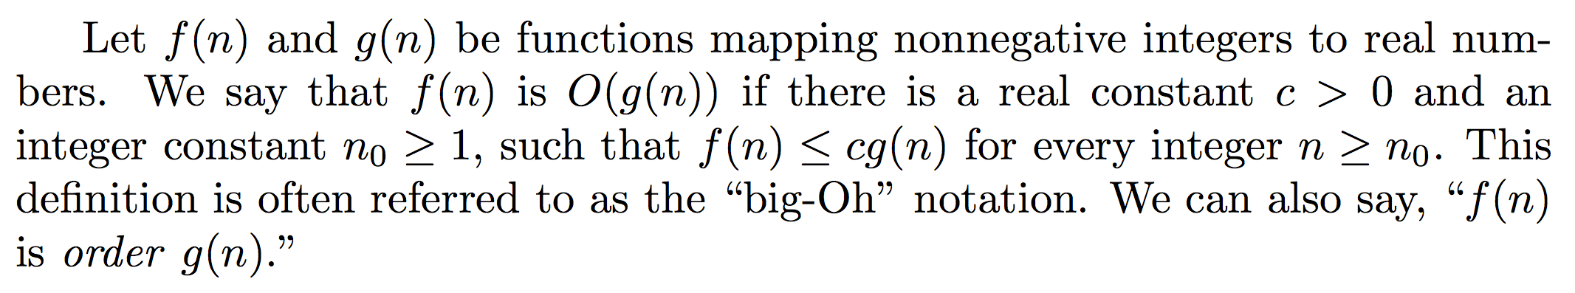
Algorithm Analysis: Big-O
g(n)
Running Time
f(n)
n₀
input size

Slide 46
Algorithm Analysis: Big-O
Dirty little trick for figuring out Big-O: look at the number of steps you calculated, throw out all the constants, find the “biggest factor” and that’s your answer:
5n + 2 is O(n)
Why? Because constants are not important at this level of understanding.

Slide 47
Algorithm Analysis: Big-O
We will care about the following functions that appear often in data structures:
When you are deciding what Big-O is for an algorithm or function, simplify until you reach one of these functions, and you will have your answer.
constant | logarithmic | linear | n log n | quadratic | polynomial (other than n²) | exponential
O(1) | O(log n) | O(n) | O(n log n) | O(n²) | O(n^{k}) (k≥1) | O(a^{n}) (a>1)

Slide 48
Algorithm Analysis: Big-O
constant | logarithmic | linear | n log n | quadratic | polynomial (other than n²) | exponential
O(1) | O(log n) | O(n) | O(n log n) | O(n²) | O(n^{k}) (k≥1) | O(a^{n}) (a>1)
Practice: what is Big-O for this function?
20n³ + 10n log n + 5
Answer: O(n³)
First, strip the constants: n³ + n log n
Then, find the biggest factor: n³

Slide 49
Algorithm Analysis: Big-O
constant | logarithmic | linear | n log n | quadratic | polynomial (other than n²) | exponential
O(1) | O(log n) | O(n) | O(n log n) | O(n²) | O(n^{k}) (k≥1) | O(a^{n}) (a>1)
Practice: what is Big-O for this function?
2000 log n + 7n log n + 5
Answer: O(n log n)
First, strip the constants: log n + n log n
Then, find the biggest factor: n log n

Slide 50

Algorithm Analysis: Back to vectorMax()
int vectorMax(Vector<int> &v){
int currentMax = v[0];
int n = v.size();
for (int i=1; i < n; i++){
if (currentMax < v[i]) {
currentMax = v[i];
}
}
return currentMax;
}
When you are analyzing an algorithm or code for its computational complexity using Big-O notation, you can ignore the primitive operations that would contribute less-important factors to the run-time. Also, you always take the worst case behavior for Big-O.

Slide 51
Algorithm Analysis: Back to vectorMax()
int vectorMax(Vector<int> &v){
int currentMax = v[0];
int n = v.size();
for (int i=1; i < n; i++){
if (currentMax < v[i]) {
currentMax = v[i];
}
}
return currentMax;
}
When you are analyzing an algorithm or code for its computational complexity using Big-O notation, you can ignore the primitive operations that would contribute less-important factors to the run-time. Also, you always take the worst case behavior for Big-O.
So, for vectorMax(): ignore the original two variable initializations, the return statement, the comparison, and the setting of currentMax in the loop.

Slide 52
Algorithm Analysis: Back to vectorMax()
int vectorMax(Vector<int> &v){
int currentMax = v[0];
int n = v.size();
for (int i=1; i < n; i++){
if (currentMax < v[i]) {
currentMax = v[i];
}
}
return currentMax;
}
So, for vectorMax(): ignore the original two variable initializations, the return statement, the comparison, and the setting of currentMax in the loop.
Notice that the important part of the function is the fact that the loop conditions will change with the size of the array: for each extra element, there will be one more iteration. This is a linear relationship, and therefore O(n).

Slide 53
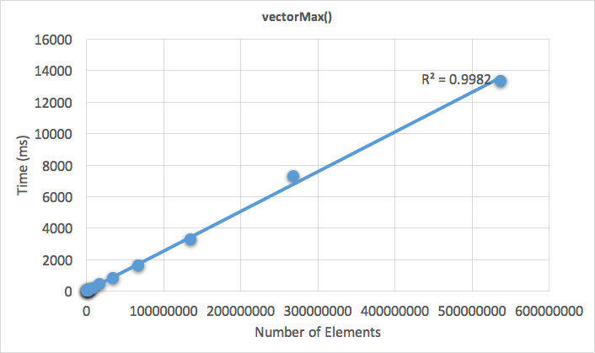
Algorithm Analysis: Back to vectorMax()
Data: In the lecture code, you will find a test program for vectorMax(), which runs the function on an increasing (by powers of two) number of vector elements. This is the data I gathered from my computer.
As you can see, it's a linear relationship!

Slide 54

Algorithm Analysis: Nested Loops
int nestedLoop1(int n){
int result = 0;
for (int i=0;i<n;i++){
for (int j=0;j<n;j++){
result++;
}
}
return result;
}
Also go through the outer loop n times
Inner loop complexity: O(n)
Total complexity: O(n²)
(quadratic)
In general, we don't like O(n²) behavior! Why?
As an example: let's say an O(n²) function takes 5 seconds for a container with 100 elements.
How much time would it take if we had 1000 elements?
500 seconds! This is because 10x more elements is (10²)x more time!

Slide 55

Algorithm Analysis: Nested Loops
int nestedLoop1(int n){
int result = 0;
for (int i=0;i<n;i++){
for (int j=0;j<n;j++){
for (int k=0;k<n;k++)
result++;
}
}
return result;
}
What would the complexity be of a 3-nested loop?
Answer: n³ (polynomial)
In real life, this comes up in 3D imaging, video, etc., and it is slow!
Graphics cards are built with hundreds or thousands of processors to tackle this problem!

Slide 56

Algorithm Analysis: Linear Search
void linearSearchVector(Vector<int> &vec, int numToFind){
int numCompares = 0;
bool answer = false;
int n = vec.size();
for (int i = 0; i < n; i++) {
numCompares++;
if (vec[i]==numToFind) {
answer = true;
break;
}
}
cout << "Found? " << (answer ? "True" : "False") << ", "
<< "Number of compares: " << numCompares << endl << endl;
}
Best case?
O(1)
Worst case?
O(n)
Complexity: O(n) (linear, worst case)
You have to walk through the entire vector one element at a time.

Slide 57
Algorithm Analysis: Binary Search
There is another type of search that we can perform on a list that is in order: binary search (as seen in 106A!)
If you have ever played a "guess my number" game before, you will have implemented a binary search, if you played the game efficiently!
The game is played as follows:
one player thinks of a number between 0 and 100 (or any other maximum).
the second player guesses a number between 1 and 100
the first player says "higher" or "lower," and the second player keeps guessing until they guess correctly.

Slide 58
Algorithm Analysis: Binary Search
The most efficient guessing algorithm for the number guessing game is simply to choose a number that is between the high and low that you are currently bound to. Example:
bounds: 0, 100
guess: 50 (no, the answer is lower)
new bounds: 0, 49
guess: 25 (no, the answer is higher)
new bounds: 26, 49
guess: 38
etc.
With each guess, the search space is divided into two.

Slide 59

Algorithm Analysis: Binary Search
void binarySearchVector(Vector<int> &vec, int numToFind) {
int low=0;
int high=vec.size()-1;
int mid;
int numCompares = 0;
bool found=false;
while (low <= high) {
numCompares++;
//cout << low << ", " << high << endl;
mid = low + (high - low) / 2; // to avoid overflow
if (vec[mid] > numToFind) {
high = mid - 1;
}
else if (vec[mid] < numToFind) {
low = mid + 1;
}
else {
found = true;
break;
}
}
cout << "Found? " << (found ? "True" : "False") << ", " <<
"Number of compares: " << numCompares << endl << endl;
}
Complexity: O(log n)
(logarithmic, worst case)
Best case?
O(1)
Technically, this is O(log2n), but we will not worry about the base.
The general rule for determining if something is logarithmic: if the problem is one of "divide and conquer," it is logarithmic. If, at each stage, the problem size is cut in half (or a third, etc.), it is logarithmic.
Worst case?
O(log n)

Slide 60
Algorithm Analysis: Constant Time
When an algorithm's time is independent of the number of elements in the container it holds, this is constant time complexity, or O(1). We love O(1) algorithms! Examples include (for efficiently designed data structures):
Adding or removing from the end of a Vector.
Pushing onto a stack or popping off a stack.
Enqueuing or dequeuing from a queue.
Other cool data structures we will cover soon (hint: one is a "hash table"!)

Slide 61

Algorithm Analysis: Exponential Time
There are a number of algorithms that have exponential behavior. If we don't like quadratic or polynomial behavior, we really don't like exponential behavior.
Example: what does the following beautiful recursive function do?
long mysteryFunc(int n) {
if (n == 0) {
return 0;
}
if (n == 1) {
return 1;
}
return mysteryFunc(n-1) + mysteryFunc(n-2);
}
This is the fibonacci sequence! 0, 1, 1, 2, 3, 5, 8, 13, 21 …

Slide 62

Algorithm Analysis: Exponential Time
long fibonacci(int n) {
if (n == 0) {
return 0;
}
if (n == 1) {
return 1;
}
return fibonacci(n-1) + fibonacci(n-2);
}
Beautiful, but a flawed algorithm! Yes, it works, but why is it flawed? Let's look at the call tree for fib(6):

Slide 63
Algorithm Analysis: Exponential Time
long fibonacci(int n) {
if (n == 0) {
return 0;
}
if (n == 1) {
return 1;
}
return fibonacci(n-1) + fibonacci(n-2);
}
Beautiful, but a flawed algorithm! Yes, it works, but why is it flawed? Let's look at the call tree for fib(6):
fib(6)
fib(5)
fib(4)
fib(4)
fib(3)
fib(3)
fib(2)
fib(3)
fib(2)
fib(2)
fib(1)
fib(2)
fib(1)
fib(2)
fib(1)
Look at all the functional duplication! Each call (down to level 3) has to make two recursive calls, and many are duplicated!

Slide 64
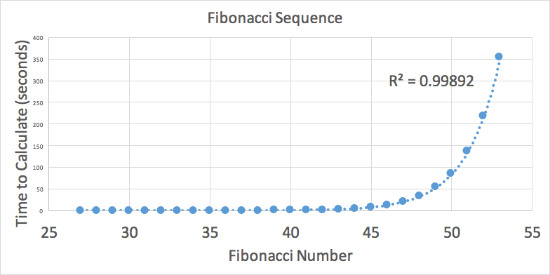
Fibonacci Sequence Time to Calculate Recursively

Slide 65
Ramifications of Big-O Differences
Some numbers:
If we have an algorithm that has 1000 elements, and the O(log n) version runs in 10 nanoseconds…
constant | logarithmic | linear | n log n | quadratic | polynomial (n³) | exponential (a==2)
O(1) | O(log n) | O(n) | O(n log n) | O(n²) | O(n^{k}) (k≥1) | O(a^{n}) (a>1)
1ns | 10ns | 1microsec | 10microsec | 1millisec | 1 sec | 10²⁹² years

Slide 66
Ramifications of Big-O Differences
Some numbers:
If we have an algorithm that has 1000 elements, and the O(log n) version runs in 10 milliseconds…
constant | logarithmic | linear | n log n | quadratic | polynomial (n³) | exponential (a==2)
O(1) | O(log n) | O(n) | O(n log n) | O(n²) | O(n^{k}) (k≥1) | O(a^{n}) (a>1)
1ms | 10ms | 1sec | 10sec | 17 minutes | 277 hours | heat death of the universe

Slide 67
Summary of Big-O Functions
Constant, O(1): not dependent on n
Linear, O(n): at each step, reduce the problem by a constant amount like 1 (or two, three, etc.)
Logarithmic, O(log n): cut the problem by 1/2, 1/3, etc.
Quadratic, O(n²): doubly nested things
O(n³): triply nested things
Exponential, O(a^{n}): reduce a problem into two or more subproblems of a smaller size.

Slide 68
Recap (functions)
Life is out — start early!
There are plenty of opportunities to get help before the deadline next Thursday!
Functions are to C++ as methods are to Java (and very, very similar)
The Qt Creator debugger can show you real-time details of what your program is doing, and it will come in super handy when you are trying to find tricky bugs in your code.
You must declare function prototypes before using them in C++!
There are lots of pre-written functions (e.g., <cmath> and the Stanford Library functions) that have been written already. Use them!
Value semantics: pass by "value" means that you get a copy of a variable, not the original!
Reference semantics: using the & in a parameter definition will give the function access to the original variable. This can be tricky until you get used to it.

Slide 69
Recap (Big O)
Asymptotic Analysis / Big-O / Computational Complexity
  We want a "big picture" assessment of our algorithms and functions
  We can ignore constants and factors that will contribute less to the result!
  We most often care about worst case behavior.
  We love O(1) and O(log n) behaviors!
Big-O notation is useful for determining how a particular algorithm behaves, but be careful about making comparisons between algorithms -- sometimes this is helpful, but it can be misleading.
Algorithmic complexity can determine the difference between running your program over your lunch break, or waiting until the Sun becomes a Red Giant and swallows the Earth before your program finishes -- that's how important it is!

Slide 70
References and Advanced Reading (Functions)
References (in general, not the C++ references!):
  Textbook Chapters 2 and 3
  <cmath> functions: http://en.cppreference.com/w/cpp/header/cmath
  Obfuscated C contest: http://www.ioccc.org
  Code from class: see class website (https://cs106b.stanford.edu)
  Game of Life: https://bitstorm.org/gameoflife/
  More on Game of Life (Wikipedia): https://en.wikipedia.org/wiki/Conway%27s_Game_of_Life
Advanced Reading:
  Wikipedia article on C++ References: https://en.wikipedia.org/wiki/Reference_(C%2B%2B)
  More information on C++ references: http://www.learncpp.com/cpp-tutorial/611-references/
  C++ Newton's Method question on StackOverflow: http://codereview.stackexchange.com/questions/43456/square-root-approximation-with-newtons-method
  If you are super-brave, look at the square root C++ function in the C library: https://github.com/justincormack/frankenlibc/blob/master/src/lib/libm/src/e_sqrt.c

Slide 71
References and Advanced Reading (Big O)
References:
  Wikipedia on BigO: https://en.wikipedia.org/wiki/Big_O_notation
  Binary Search: https://en.wikipedia.org/wiki/Binary_search_algorithm
  Fibonacci numbers: https://en.wikipedia.org/wiki/Fibonacci_number
Advanced Reading:
  Big-O Cheat Sheet: http://bigocheatsheet.com
  More details on Big-O: http://web.mit.edu/16.070/www/lecture/big_o.pdf
  More details: http://dev.tutorialspoint.com/data_structures_algorithms/asymptotic_analysis.htm
  GPUs and GPU-Accelerated computing: http://www.nvidia.com/object/what-is-gpu-computing.html
  Video on Fibonacci sequence: https://www.youtube.com/watch?v=Nu-lW-Ifyec
  Fibonacci numbers in nature: http://www.maths.surrey.ac.uk/hosted-sites/R.Knott/Fibonacci/fibnat.html

