Slide 1
Monday, August 14, 2017
CS 106B
Lecture 26: Esoteric Data Structures: Skip Lists and Bloom Filters
Programming Abstractions
Summer 2017
Stanford University
Computer Science Department
Lecturer: Chris Gregg

Slide 2
Today's Topics
Logistics
  Final Exam Review materials posted: http://web.stanford.edu/class/cs106b/handouts/final.html
  We will have a review session some time this week.
Esoteric Data Structures
  Skip Lists
  Bloom Filters

Slide 3
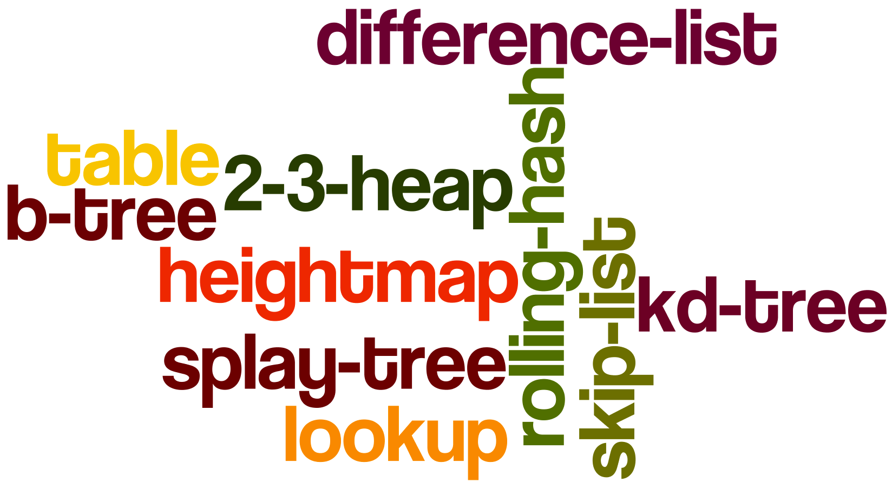
Esoteric Data Structures
In CS 106B, we have talked about many standard, famous, and commonly used data structures: Vectors, Linked Lists, Trees, Hash Tables, Graphs
However, we only scratched the surface of available data structures, and data structure research is alive and well to this day.
Let's take a look at two interesting data structures that have interesting properties and you might not see covered in detail in a standard course: the skip list and the bloom filter.

Slide 4
Skip Lists
A "skip list" is a balanced search structure that maintains an ordered, dynamic set for insertion, deletion and search
What other efficient (log n or better) sorted search structures have we talked about?
Hash Tables (nope, not sorted)
Heaps (nope, not searchable)
Sorted Array (kind of, but, insert/delete is O(n))
Binary Trees (only if balanced, e.g., AVL or Red/Black)

Slide 5
Skip Lists
A skip list is a simple, randomized search structure that will give us O(log N) in expectation for search, insert, and delete, but also with high probability.
Invented by William Pugh in 1989 -- fairly recent!

Slide 6
Improving the Linked List
Let's see what we can do with a linked list to make it better.
How long does it take to search a sorted, doubly-linked list for an element?
head
14 | 23 | 34 | 42 | 50 | 59 | 66 | 72 | 79
log(N) nope!
it is O(n) … we must traverse the list!

Slide 7
Improving the Linked List
How might we help this situation?
14 | 23 | 34 | 42 | 50 | 59 | 66 | 72 | 79

Slide 8
Improving the Linked List
What if we put another link into the middle?
middle
head
14 | 23 | 34 | 42 | 50 | 59 | 66 | 72 | 79
This would help a little…we could start searching from the middle, but we would still have to traverse
O(n) becomes ...
O((½)n) becomes ...
O(n)

Slide 9
Improving the Linked List
Maybe we could add more pointers…
23
50
66
head
14 | 23 | 34 | 42 | 50 | 59 | 66 | 72 | 79
This would help some more…but still doesn't solve the underlying problem.

Slide 10
Improving the Linked List
Let's play a game. I've chosen the numbers for this list in a particular way. Does anyone recognize the sequence?
14 | 23 | 34 | 42 | 50 | 59 | 66 | 72 | 79

Slide 11
Improving the Linked List
Let's play a game. I've chosen the numbers for this list in a particular way. Does anyone recognize the sequence?
14 | 23 | 34 | 42 | 50 | 59 | 66 | 72 | 79
These are the subway stops on the NYC 7th Avenue line :)

Slide 12
Improving the Linked List
A somewhat unique feature in the New York City subway system is that it has express lines:
14 |  | 34 | 42 |  |  |  | 72
14 | 23 | 34 | 42 | 50 | 59 | 66 | 72 | 79
This models a skip list almost perfectly!

Slide 13
Improving the Linked List
To search the list (or ride the subway): Walk right in the top list (L1) and when you’ve gone too far, go back and then down to the bottom list (L2) (e.g., search for 59)
L1 | 14 |  | 34 | 42 |  |  |  | 72
L2 | 14 | 23 | 34 | 42 | 50 | 59 | 66 | 72 | 79

Slide 14
Improving the Linked List
What is the best placement for the nodes in L1?
This placement might be good for subways, but we care about worst-case performance, which we want to minimize. How about equally spaced nodes?
L1 | 14 |  | 34 | 42 |  |  |  | 72
L2 | 14 | 23 | 34 | 42 | 50 | 59 | 66 | 72 | 79

Slide 15
Improving the Linked List
The “search cost” can be represented by |L1| + (|L2| / |L1|), or |L1| + (n / |L1|), where n is the number of nodes in L2 (L2 must have all stops)
Let’s do some calculus to minimize this amount…
The minimum will be when |L1| is equal to (n/|L1|), or when |L1|=√n
L1 | 14 |  | 34 | 42 |  |  |  | 72
L2 | 14 | 23 | 34 | 42 | 50 | 59 | 66 | 72 | 79

Slide 16
Improving the Linked List
The minimum will be when |L1| is equal to (n/|L1|), or when |L1|=√n
So, the search cost with a minimum second list is √n + n/√n = 2√n
We want them equally spaced.
L1 | 14 |  |  |  | 50 |  |  |  | 79
} √n
L2 | 14 | 23 | 34 | 42 | 50 | 59 | 66 | 72 | 79
√n
√n
√n

Slide 17
Improving the Linked List
The minimum will be when |L1| is equal to (n/|L1|), or when |L1|=√n
So, the search cost with a minimum second list is √n + n/√n = 2√n
We want them equally spaced. Big O?
O(2√n) = O(√n)
Good? Let's compare to O(log n)
L1 | 14 |  |  |  | 50 |  |  |  | 79
} √n
L2 | 14 | 23 | 34 | 42 | 50 | 59 | 66 | 72 | 79
√n
√n
√n

Slide 18
Improving the Linked List
What if we had more linked lists??
2 sorted lists: 2√n
L1 | 14 |  |  | 42 |  |  | 66 |  | 79
} √n
L2 | 14 | 23 | 34 | 42 | 50 | 59 | 66 | 72 | 79
√n
√n
√n

Slide 19
What if we had more linked lists??
2 sorted lists: 2√n
Improving the Linked List
3 sorted lists: 3∛n
L1 | 14 |  |  |  | 50 |  |  |  | 79
} 3
L2 | 14 | 23 | 34 | 42 | 50 | 59 | 66 | 72 | 79
} 9
∛n
∛n
∛n
} 27
L3 | --- | --- | --- | --- | --- | --- | --- | --- | ---

Slide 20
What if we had more linked lists??
2 sorted lists: 2√n
Improving the Linked List
3 sorted lists: 3∛n
k sorted lists: k√n
k
L1 | 14 |  |  |  | 50 |  |  |  | 79
L1 | 14 |  |  | 42 |  |  | 66 | } √n
L2 | 14 | 23 | 34 | 42 | 50 | 59 | 66 | 72 | 79
√n
√n
√n

Slide 21
What if we had more linked lists??
2 sorted lists: 2√n
Improving the Linked List
3 sorted lists: 3∛n
k sorted lists: k√n
k
log n sorted lists:
L1 | 14 |  |  |  | 50 |  |  |  | 79
L1 | 14 |  |  | 42 |  |  | 66 | } √n
L2 | 14 | 23 | 34 | 42 | 50 | 59 | 66 | 72 | 79
√n
√n
√n

Slide 22
What if we had more linked lists??
2 sorted lists: 2√n
Improving the Linked List
3 sorted lists: 3∛n
k sorted lists: k√n
k
What is √n equal to?
log n
log n sorted lists: log n √n
log n
L1 | 14 |  |  |  | 50 |  |  |  | 79
L1 | 14 |  |  | 42 |  |  | 66 | } √n
L2 | 14 | 23 | 34 | 42 | 50 | 59 | 66 | 72 | 79
√n
√n
√n

Slide 23
What if we had more linked lists??
2 sorted lists: 2√n
Improving the Linked List
3 sorted lists: 3∛n
k sorted lists: k√n
k
What is √n equal to?
log n
log n sorted lists: log n √n
log n
log n
√n = 2
L1 | 14 |  |  |  | 50 |  |  |  | 79
L1 | 14 |  |  | 42 |  |  | 66 | } √n
L2 | 14 | 23 | 34 | 42 | 50 | 59 | 66 | 72 | 79
√n
√n
√n

Slide 24
What if we had more linked lists??
2 sorted lists: 2√n
Improving the Linked List
3 sorted lists: 3∛n
k sorted lists: k√n
k
log n sorted lists: log n √n = 2 log n : logarithmic behavior!
log n
L1 | 14 |  |  |  | 50 |  |  |  | 79
L1 | 14 |  |  | 42 |  |  | 66 | } √n
L2 | 14 | 23 | 34 | 42 | 50 | 59 | 66 | 72 | 79
√n
√n
√n

Slide 25
log n linked lists look like a binary tree (and act like one!)
Skip Lists
14 |  |  |  |  |  |  |  | 79
14 |  |  |  | 50 |  |  |  | 79
14 |  | 34 |  | 50 |  | 66 |  | 79
14 | 23 | 34 | 42 | 50 | 59 | 66 | 72 | 79

Slide 26
We just determined that the best option if we have n elements is to have log2n lists.
Building a Skip List

Slide 27
To build a skip list, we could try to keep all the elements perfectly aligned — in the lowest list, we have n elements, and in the next list up we have n/2 elements, etc.
Building a Skip List

Slide 28
To build a skip list, we could try to keep all the elements perfectly aligned — in the lowest list, we have n elements, and in the next list up we have n/2 elements, etc.
This is not efficient…we would have to be moving links all over the place!
Building a Skip List

Slide 29
So…what we do instead is implement a probabilistic strategy — we flip a coin!
Building a Skip List

Slide 30
Building a Skip List Probabilistically
All elements must go into the bottom list (search to find the spot)
After inserting into the bottom list, flip a fair, two sided coin. If the coin comes up heads, add the element to the next list up, and flip again, repeating step 2.
If the coin comes up tails, stop.
(example on board - you do have to have -∞ on each level)
Let's build one!

Slide 31
Skip Lists: Big(O) for Building, Searching, Deleting
To search a skip list, we "traverse" the list level-by-level, and there is a high probability that there are log n levels. Each level up has a good probability to have approximately half the number of elements. There is a high probability that searching is O(log n).
To insert, we first search O(log n), and then we must flip the coin to keep adding. Worst case? O(∞). But, there is a very good probability that we will have to do a small number of inserts up the list. So, this has a high probability of also being simply O(log n)
To delete? Find the first instance of your value, then delete from all the lists — also O(log n).

Slide 32
Bloom Filters
Our second esoteric data structure is called a bloom filter, named for its creator, Burton Howard Bloom, who invented the data structure in 1970.
A bloom filter is a space efficient, probabilistic data structure that is used to tell whether a member is in a set.

Slide 33
Bloom Filters
Bloom filters are a bit odd because they can definitely tell you whether an element is not in the set, but can only say whether the element is possibly in the set.

Slide 34
Bloom Filters
In other words: “false positives” are possible, but “false negatives” are not.
(A false positive would say that the element is in the set when it isn’t, and a false negative would say that the element is not in the set when it is.

Slide 35
Bloom Filters
The idea is that we have a “bit array.” We will model a bit array with a regular array, but you can compress a bit array by up to 32x because there are 8 bits in a byte, and there are 4 bytes to a 32-bit number (thus, 32x!) (although Bloom Filters themselves need more space per element than 1 bit).

Slide 36
Bloom Filters
a bit array:
1 | 0 | 1 | 1 | 0 | 1 | 1 | 1

Slide 37
Bloom Filters: start with an empty bit array (all zeros), and k hash functions.
k1 = (13 - (x % 13))% 7, k2 = (3 + 5x) % 7, etc.
Bloom Filters
0 | 1 | 2 | 3 | 4 | 5 | 6 | 7
0 | 0 | 0 | 0 | 0 | 0 | 0 | 0

Slide 38
Bloom Filters: start with an empty bit array (all zeros), and k hash functions.
The hash functions should be independent, and the optimal amount is calculable based on the number of items you are hashing, and the length of your table (see Wikipedia for details).
Bloom Filters
0 | 1 | 2 | 3 | 4 | 5 | 6 | 7
0 | 0 | 0 | 0 | 0 | 0 | 0 | 0

Slide 39
Values then get hashed by all k hashes, and the bit in the hashed position is set to 1 in each case.
Bloom Filters
0 | 1 | 2 | 3 | 4 | 5 | 6 | 7
0 | 0 | 0 | 0 | 0 | 0 | 0 | 0

Slide 40
Insert 129: x=129, k1=1, k2=4
k1 = (13 - (x % 13))% 7, k2 = (3 + 5x) % 7, etc.
Bloom Filter Example
0 | 1 | 2 | 3 | 4 | 5 | 6 | 7
0 | 1 | 0 | 0 | 1 | 0 | 0 | 0
k1 == 1, so we change bit 1 to a 1
k2 == 4, so we change bit 4 to a 1

Slide 41
Insert 479: x=479, k1=2, k2=4
k1 = (13 - (x % 13))% 7, k2 = (3 + 5x) % 7, etc.
Bloom Filters
0 | 1 | 2 | 3 | 4 | 5 | 6 | 7
0 | 1 | 1 | 0 | 1 | 0 | 0 | 0
k1 == 2, so we change bit 2 to a 1
k2 == 4, so we would change bit
3 to a 1, but it is already a 1.

Slide 42
To check if 129 is in the table, just hash again and check the bits.
k1=1, k2=4: probably in the table!
Bloom Filters
0 | 1 | 2 | 3 | 4 | 5 | 6 | 7
0 | 1 | 1 | 0 | 1 | 0 | 0 | 0
k1 = (13 - (x % 13))% 7, k2 = (3 + 5x) % 7, etc.

Slide 43
To check if 123 is in the table, hash and check the bits. k1=0, k2=2: cannot be in table because the 0 bit is still 0.
Bloom Filters
0 | 1 | 2 | 3 | 4 | 5 | 6 | 7
0 | 1 | 1 | 0 | 1 | 0 | 0 | 0
k1 = (13 - (x % 13))% 7, k2 = (3 + 5x) % 7, etc.

Slide 44
To check if 402 is in the table, hash and check the bits. k1=1, k2=4:
Probably in the table (but isn’t! False positive!).
Bloom Filters
0 | 1 | 2 | 3 | 4 | 5 | 6 | 7
0 | 1 | 1 | 0 | 1 | 0 | 0 | 0
Online example: http://billmill.org/bloomfilter-tutorial/
k1 = (13 - (x % 13))% 7, k2 = (3 + 5x) % 7, etc.

Slide 45
Bloom Filters: Probability of a False Positive
What is the probability that we have a false positive?
If m is the number of bits in the array, then the probability that a bit is not set to 1 is

Slide 46
Bloom Filters: Probability of a False Positive
If k is the number of hash functions, the probability that the bit is not set to 1 by any hash function is

Slide 47
Bloom Filters: Probability of a False Positive
If we have inserted n elements, the probability that a certain bit is still 0 is

Slide 48
Bloom Filters: Probability of a False Positive
To get the probability that a bit is 1 is just 1- the answer on the previous slide:

Slide 49
Bloom Filters: Probability of a False Positive
Now test membership of an element that is not in the set. Each of the k array positions computed by the hash functions is 1 with a probability as above. The probability of all of them being 1, (false positive):

Slide 50
Bloom Filters: Probability of a False Positive
For our previous example, m=8, n=2, k=2, so:
                = 0.17, or 17% of the time we will get
                a false positive.

Slide 51
Bloom Filters: Why?
Why would we want a structure that can produce false positives?
Example: Google Chrome uses a local Bloom Filter to check for malicious URLs — if there is a hit, a stronger check is performed.

Slide 52
Bloom Filters: Why?
There is one more negative issue with a Bloom Filter: you can’t delete! If you delete, you might delete another inserted value, as well! You could keep a second bloom filter of removals, but then you could get false positives in that filter…

Slide 53
Bloom Filters: Why?
You have to perform k hashing functions for an element, and then either flip bits, or read bits. Therefore, they perform in O(k) time, which is independent of the number of elements in the structure. Additionally, because the hashes are independent, they can be parallelized, which gives drastically better performance with multiple processors.

Slide 54
References and Advanced Reading
References:
  MIT Skip Lists lecture: http://ocw.mit.edu/courses/electrical-engineering-and-computer-science/6-046j-introduction-to-algorithms-sma-5503-fall-2005/video-lectures/lecture-12-skip-lists/
  Online Bloom Filter example: http://billmill.org/bloomfilter-tutorial/
  Wikipedia Bloom Filters: https://en.wikipedia.org/wiki/Bloom_filter

Slide 55
Extra Slides

Slide 56
Esoteric Data Structure: Ropes
Normally, strings are kept in memory in contiguous chunks:
“The_quick_fox_jumps_over_the_dog”
0 | 1 | 2 | 3 | 4 | 5 | 6 | 7 | 8 | 9 | 10 | 11 | 12 | 13 | 14 | 15 | 16 | 17 | 18 | 19 | 20 | 21 | 22 | 23 | 24 | 25 | 26 | 27 | 28 | 29 | 30 | 31
T | h | e | _ | q | u | i | c | k | _ | f | o | x | _ | j | u | m | p | s | _ | o | v | e | r | _ | t | h | e | _ | d | o | g
Notes:
Sequential programming: one instruction at a time, instructions follow each other, with the possibility of branching.

Slide 57
Ropes
However, this doesn’t make it easy to insert into a string: you have to break the whole string up each time, and re-create a new string.
0 | 1 | 2 | 3 | 4 | 5 | 6 | 7 | 8 | 9 | 10 | 11 | 12 | 13 | 14 | 15 | 16 | 17 | 18 | 19 | 20 | 21 | 22 | 23 | 24 | 25 | 26 | 27 | 28 | 29 | 30 | 31
T | h | e | _ | q | u | i | c | k | _ | f | o | x | _ | j | u | m | p | s | _ | o | v | e | r | _ | t | h | e | _ | d | o | g
Notes:
Sequential programming: one instruction at a time, instructions follow each other, with the possibility of branching.

Slide 58
Ropes
A “rope” is a tree of smaller strings (eventually—it can start as a long string) that makes it efficient to store and manipulate the entire string.
16
10
24
10
6
19
3
The_quick_
brown_
19
5
dog
fox_jumps_over_the_
lazy_
Notes:
Sequential programming: one instruction at a time, instructions follow each other, with the possibility of branching.

Slide 59
Ropes
Strings are only kept at leaves, and the weight of a node is the length of the string plus the sum of all of the weights in its left subtree.
16
10
24
10
6
19
3
The_quick_
brown_
19
5
dog
fox_jumps_over_the_
lazy_
Notes:
Sequential programming: one instruction at a time, instructions follow each other, with the possibility of branching.

Slide 60
Ropes
Searching for a character at a position, do a recursive search from the root: to search for the “j” at character position 21:
The root is 16, which is less than 21. We subtract 21-16==5, and we go right.
24 > 5, no subtraction (only on right), go left
19 > 5, go left.
19 > 5, but no more left! The character at the index of the string at that node is “j”
16
10
24
10
6
19
3
The_quick_
brown_
19
5
dog
fox_jumps_over_the_
lazy_
Notes:
Sequential programming: one instruction at a time, instructions follow each other, with the possibility of branching.

Slide 61
Ropes: Full search algorithm: O(log n)
16
// Note: Assumes 1-based indexing.
function index(RopeNode node, integer i)
if node.weight < i then
return index(node.right, i - node.weight)
else
if exists(node.left) then
return index(node.left, i)
else
return node.string[i]
endif
endif
end
10
24
10
6
19
3
The_quick_
brown_
19
5
dog
fox_jumps_over_the_
lazy_
Notes:
Sequential programming: one instruction at a time, instructions follow each other, with the possibility of branching.

Slide 62
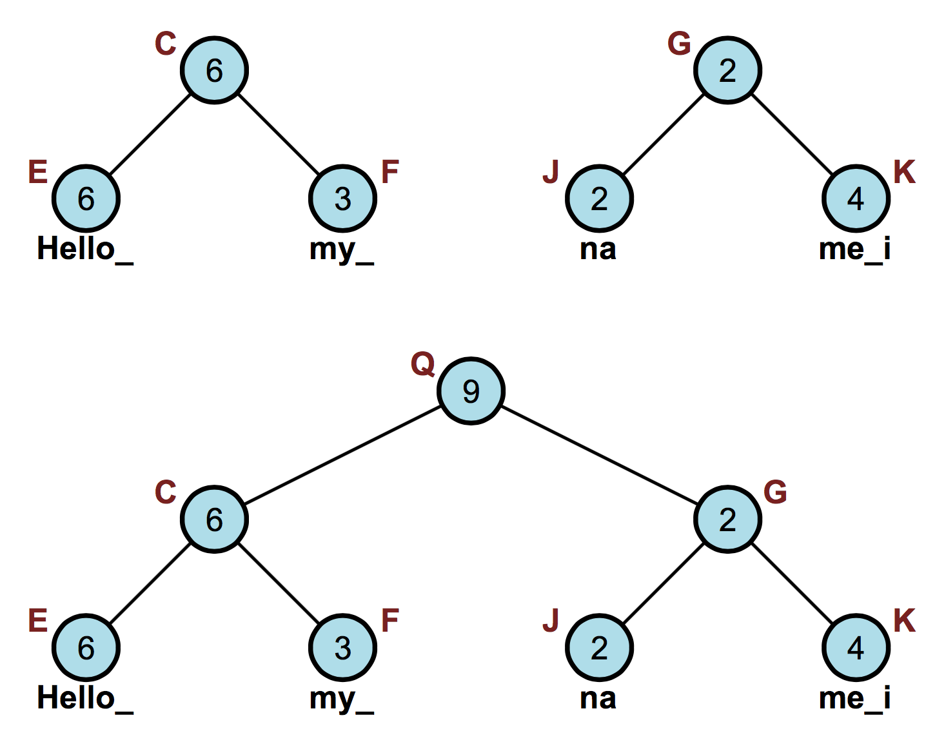
Ropes: Concatenate(S1,S2)
Time: O(1) (or O(log N) time to compute the root weight)
Simply create a new root node, with left=S1 and right=S2.
Notes:
Sequential programming: one instruction at a time, instructions follow each other, with the possibility of branching.

Slide 63
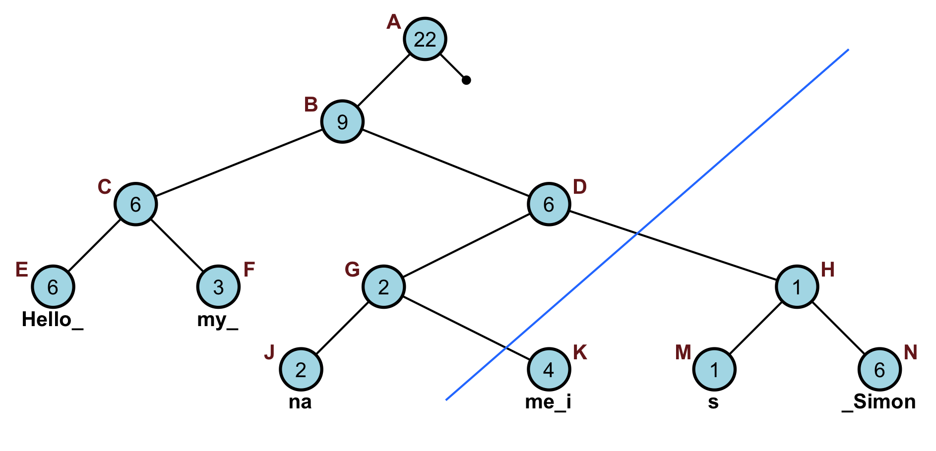
Ropes: Split(i,S)
split the string S into two new strings S1 and S2, S1 = C1, …, Ci and S2 = Ci + 1, …, Cm.
Time complexity: O(log N)
(step 1: split)
Notes:
Sequential programming: one instruction at a time, instructions follow each other, with the possibility of branching.

Slide 64
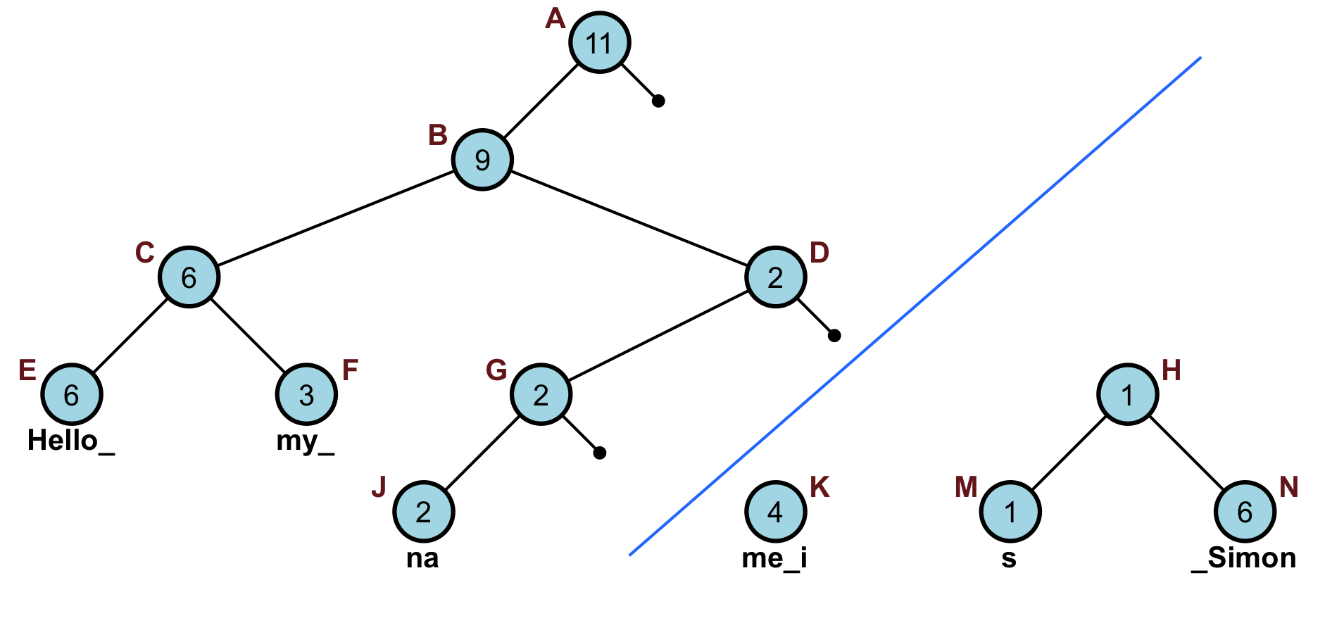
Ropes: Split(i,S)
split the string S into two new strings S1 and S2, S1 = C1, …, Ci and S2 = Ci + 1, …, Cm.
Time complexity: O(log N)
(step 2: update left (node D),
and elements on right still need
to be combined)
Notes:
Sequential programming: one instruction at a time, instructions follow each other, with the possibility of branching.

Slide 65
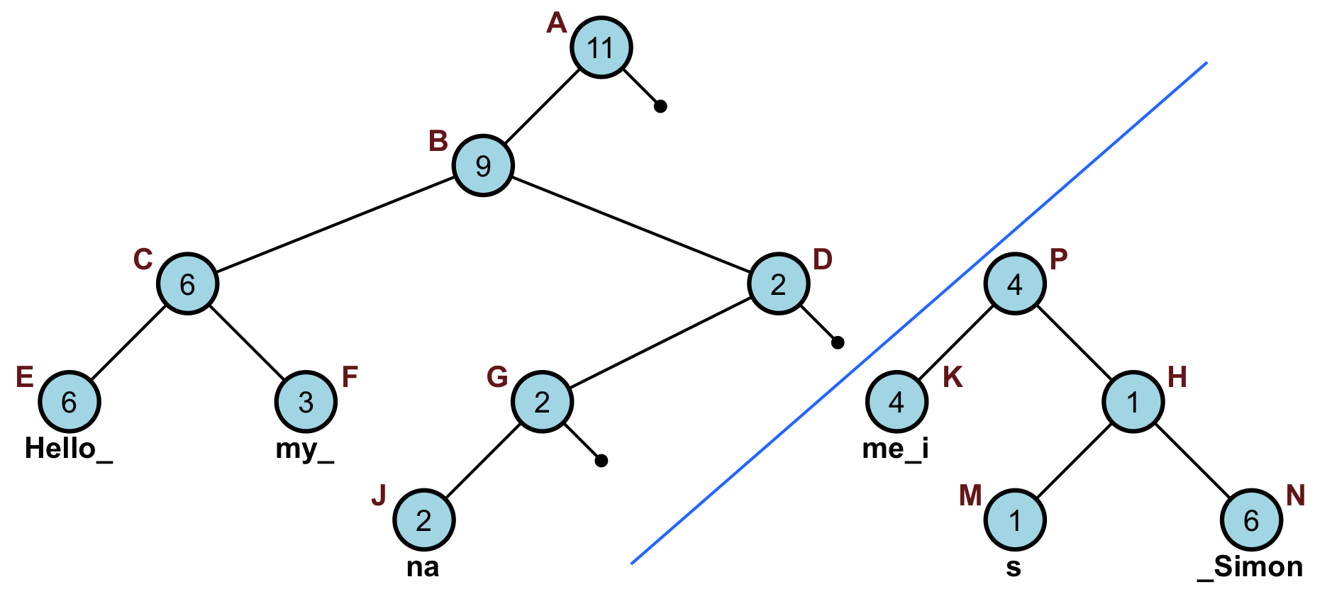
Ropes: Split(i,S)
split the string S into two new strings S1 and S2, S1 = C1, …, Ci and S2 = Ci + 1, …, Cm.
Time complexity: O(log N)
(step 3: combine with new root
P for right side)
(may need to balance)
Notes:
Sequential programming: one instruction at a time, instructions follow each other, with the possibility of branching.

Slide 66
Ropes: Insert(i,S’)
insert the string S’ beginning at position i in the string s, to form a new string C1, …, Ci, S’, Ci + 1, …, Cm.
Time complexity: O(log N).
Can be done by a Split() and two Concat() operations
16
10
24
10
6
19
3
The_quick_
brown_
19
5
dog
fox_jumps_over_the_
lazy_
Notes:
Sequential programming: one instruction at a time, instructions follow each other, with the possibility of branching.

Slide 67
Ropes: Delete(i,j)
delete the substring Ci, …, Ci + j − 1, from s to form a new string C1, …, Ci − 1, Ci + j, …, Cm.
Time complexity: O(log N).
Can be done by two Split() operations and one Concat() operation
16
10
24
10
6
19
3
The_quick_
brown_
19
5
dog
fox_jumps_over_the_
lazy_
Notes:
Sequential programming: one instruction at a time, instructions follow each other, with the possibility of branching.

Slide 68
Ropes: Report(i,j)
output the string Ci, …, Ci + j − 1.
Time complexity: O(j + log N)
To report the string Ci, …, Ci + j − 1, output Ci, …, Ci + j − 1 by doing an in-order traversal of T starting at the node that has the i^{th} element.
16
10
24
10
6
19
3
The_quick_
brown_
19
5
dog
fox_jumps_over_the_
lazy_
Notes:
Sequential programming: one instruction at a time, instructions follow each other, with the possibility of branching.

Slide 69
Comparison: Ropes -vs- Strings (from Wikipedia)
Rope Advantages:
• Ropes enable much faster insertion and deletion of text than monolithic string arrays, on which operations have time complexity O(n).
• Ropes don't require O(n) extra memory when operated upon (arrays need that for copying operations)
• Ropes don't require large contiguous memory spaces.
• If only nondestructive versions of operations are used, rope is a persistent data structure. For the text editing program example, this leads to an easy support for multiple undo levels.
Notes:
Sequential programming: one instruction at a time, instructions follow each other, with the possibility of branching.

Slide 70
Comparison: Ropes -vs- Strings (from Wikipedia)
Rope Disadvantages:
• Greater overall space usage when not being operated on, mainly to store parent nodes. There is a trade-off between how much of the total memory is such overhead and how long pieces of data are being processed as strings; note that the strings in example figures above are unrealistically short for modern architectures. The overhead is always O(n), but the constant can be made arbitrarily small.
• Increase in time to manage the extra storage
• Increased complexity of source code; greater risk for bugs
Notes:
Sequential programming: one instruction at a time, instructions follow each other, with the possibility of branching.

