Slide 1
Lecture 12
More Bellman-Ford, Floyd-Warshall,
and Dynamic Programming!

Slide 2
Announcements
HW5 due Friday
Midterms have been graded!
  Available on Gradescope.
  Mean/Median: 66 (it was a hard test!)
  Max: 97
  Std. Dev: 14
Please look at the solutions and come to office hours if you have questions about your midterm!

Slide 3
Recall
Weights on edges represent costs.
The cost of a path is the sum of the weights along that path.
A shortest path from s to t is a directed path from s to t with the smallest cost.
The single-source shortest path problem is to find the shortest path from s to v for all v in the graph.
A weighted directed graph:
u
s
3
32
1
5
1
This is a path from s to t of cost 22.
b
v
13
a
21
2
16
t
This is a path from s to t of cost 10. It is the shortest path from s to t.

Slide 4
Last time
Dijkstra’s algorithm!
Bellman-Ford algorithm !
  Both solve single-source shortest path in weighted graphs.
u
s
3
32
1
5
1
We didn’t quite finish with the Bellman-Ford algorithm so let’s do that now.
b
v
13
a
21
2
16
t

Slide 5
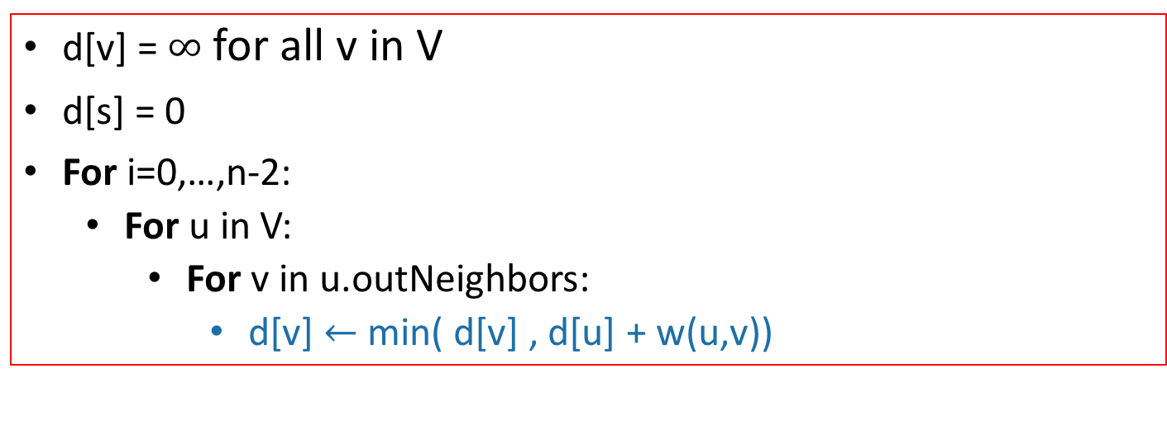
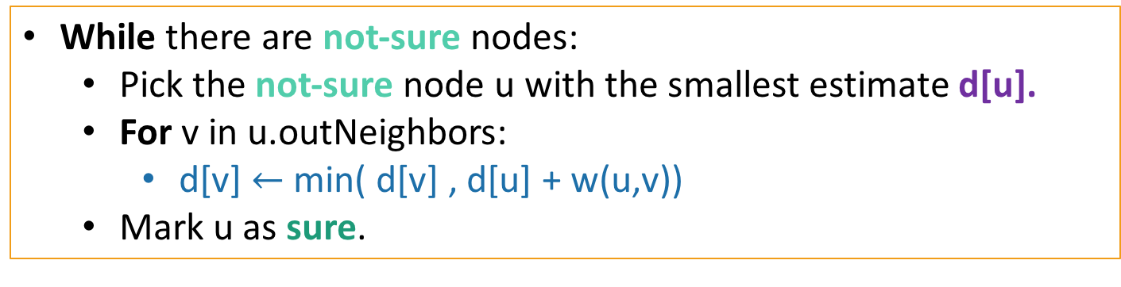
Bellman-Ford vs. Dijkstra
Bellman-Ford(G,s):
d[v] = $∞$ for all v in V
d[s] = 0
For i=0,…,n-2:
  For u in V:
    For v in u.outNeighbors:
      d[v] $←$min( d[v] , d[u] + w(u,v))
Instead of picking u cleverly, just update for all of the u’s.
Dijkstra(G,s):
While there are not-sure nodes:
  Pick the not-sure node u with the smallest estimate d[u].
  For v in u.outNeighbors:
    d[v] $←$min( d[v] , d[u] + w(u,v))
  Mark u as sure.

Slide 6
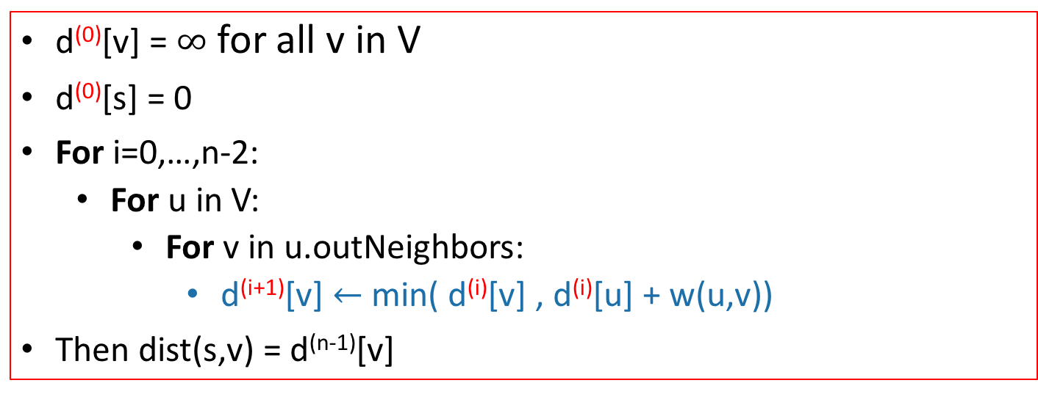
For pedagogical reasons which we will see later today…
We are actually going to change this to be dumber.
Keep n arrays: d⁽⁰⁾, d⁽¹⁾, …, d^{(n-1)}
Bellman-Ford*(G,s):
d⁽⁰⁾[v] = $∞$ for all v in V
d⁽⁰⁾[s] = 0
For i=0,…,n-2:
  For u in V:
    For v in u.outNeighbors:
      d^{(i+1)}[v] $←$min( d^{(i)}[v] , d^{(i)}[u] + w(u,v))
Then dist(s,v) = d^{(n-1)}[v]

Slide 7
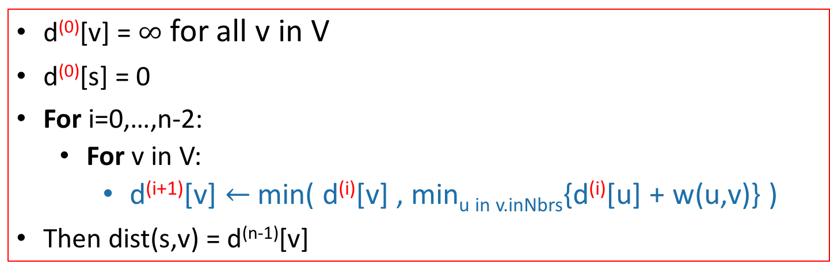
Another way of writing this
We are actually going to change this to be dumber.
Keep n arrays: d⁽⁰⁾, d⁽¹⁾, …, d^{(n-1)}
Bellman-Ford*(G,s):
d⁽⁰⁾[v] = $∞$ for all v in V
d⁽⁰⁾[s] = 0
For i=0,…,n-2:
  For v in V:
    d^{(i+1)}[v] $←$min( d^{(i)}[v] , min_{u in v.inNbrs}{d^{(i)}[u] + w(u,v)} )
Then dist(s,v) = d^{(n-1)}[v]
The for loop over u gets picked up in this min.

Slide 8




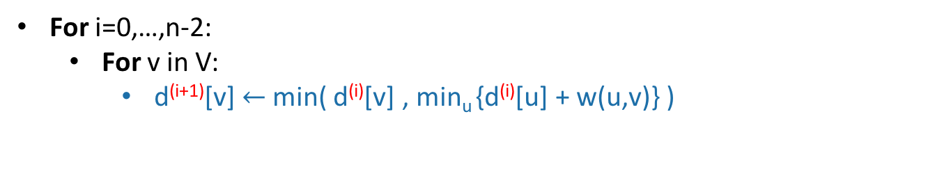



Bellman-Ford
=
Gates
0
How far is a node from Gates?
$$∞$$
1
Gates Packard CS161 Union Dish
CS161
d⁽⁰⁾
0
$$∞$$
$$∞$$
$$∞$$
$$∞$$
d⁽¹⁾
1
Packard
d⁽²⁾
4
$$∞$$
d⁽³⁾
22
$$∞$$
Union
d⁽⁴⁾
25
20
For i=0,…,n-2:
  For v in V:
    d^{(i+1)}[v] $←$min( d^{(i)}[v] , min_{u} {d^{(i)}[u] + w(u,v)} )
Dish
$$∞$$

Slide 9


Bellman-Ford
Gates
0
How far is a node from Gates?
$$∞$$
1
Gates Packard CS161 Union Dish
CS161
d⁽⁰⁾
0
$$∞$$
$$∞$$
$$∞$$
$$∞$$
d⁽¹⁾
1
0
1
$$∞$$
$$∞$$
25
Packard
d⁽²⁾
4
$$1$$
d⁽³⁾
22
$$∞$$
Union
d⁽⁴⁾
25
i=0
20
For i=0,…,n-2:
  For v in V:
    d^{(i+1)}[v] $←$min( d^{(i)}[v] , min_{u} {d^{(i)}[u] + w(u,v)} )
Dish
$$25$$

Slide 10




Bellman-Ford
Gates
0
How far is a node from Gates?
$$2$$
1
Gates Packard CS161 Union Dish
CS161
d⁽⁰⁾
0
$$∞$$
$$∞$$
$$∞$$
$$∞$$
d⁽¹⁾
1
0
1
$$∞$$
$$∞$$
25
Packard
d⁽²⁾
0
1
2
45
23
4
$$1$$
d⁽³⁾
22
$$45$$
Union
d⁽⁴⁾
25
i=1
20
For i=0,…,n-2:
  For v in V:
    d^{(i+1)}[v] $←$min( d^{(i)}[v] , min_{u} {d^{(i)}[u] + w(u,v)} )
Dish
$$23$$

Slide 11

Bellman-Ford
Gates
0
How far is a node from Gates?
$$2$$
1
Gates Packard CS161 Union Dish
CS161
d⁽⁰⁾
0
$$∞$$
$$∞$$
$$∞$$
$$∞$$
d⁽¹⁾
1
0
1
$$∞$$
$$∞$$
25
Packard
d⁽²⁾
0
1
2
45
23
4
$$1$$
d⁽³⁾
0
1
2
6
23
22
$$6$$
Union
d⁽⁴⁾
25
i=2
20
For i=0,…,n-2:
  For v in V:
    d^{(i+1)}[v] $←$min( d^{(i)}[v] , min_{u} {d^{(i)}[u] + w(u,v)} )
Dish
$$23$$

Slide 12
Bellman-Ford
Gates
0
How far is a node from Gates?
$$2$$
1
Gates Packard CS161 Union Dish
CS161
d⁽⁰⁾
0
$$∞$$
$$∞$$
$$∞$$
$$∞$$
d⁽¹⁾
1
0
1
$$∞$$
$$∞$$
25
Packard
d⁽²⁾
0
1
2
45
23
4
$$1$$
d⁽³⁾
0
1
2
6
23
22
$$6$$
Union
d⁽⁴⁾
0
1
2
6
23
25
i=3
20
For i=0,…,n-2:
  For v in V:
    d^{(i+1)}[v] $←$min( d^{(i)}[v] , min_{u} {d^{(i)}[u] + w(u,v)} )
Dish
$$23$$

Slide 13


Interpretation of d^{(i)}
Gates
0
$$2$$
1
d^{(i)}[v] is equal to the cost of the shortest path between s and v with at most i edges.
CS161
1
Packard
Gates Packard CS161 Union Dish
$$1$$
4
d⁽⁰⁾
0
$$∞$$
$$∞$$
$$∞$$
$$∞$$
22
$$6$$
d⁽¹⁾
0
1
$$∞$$
$$∞$$
25
Union
d⁽²⁾
0
1
2
45
23
25
d⁽³⁾
0
1
2
6
23
20
d⁽⁴⁾
0
1
2
6
23
Dish
$$23$$

Slide 14
Why does Bellman-Ford work?
Inductive hypothesis:
  d^{(i)}[v] is equal to the cost of the shortest path between s and v with at most i edges.
Conclusion:

Slide 15
Aside: simple paths
Assume there is no negative cycle.
Then not only are there shortest paths, but actually there’s always a simple shortest path.
A simple path in a graph with n vertices has at most n-1 edges in it.
s
-2
v
10
t
2
-5
x
y
This cycle isn’t helping. Just get rid of it.
3
s
u
“Simple” means that the path has no cycles in it.
t
Can’t add another edge without making a cycle!
v

Slide 16
Why does it work?
Inductive hypothesis:
  d^{(i)}[v] is equal to the cost of the shortest path between s and v with at most i edges.
Conclusion(s):
    d^{(n-1)}[v] is equal to the cost of the shortest path between s and v with at most n-1 edges.
    If there are no negative cycles, d^{(n-1)}[v] is equal to the cost of the shortest path.
Notice that negative edge weights are fine. Just not negative cycles.

Slide 17
Note on implementation
Don’t actually keep all n arrays around.
Just keep two at a time: “last round” and “this round”
Gates Packard CS161 Union Dish
d⁽⁰⁾
0
$$∞$$
$$∞$$
$$∞$$
$$∞$$
d⁽¹⁾
0
1
$$∞$$
$$∞$$
25
d⁽²⁾
0
1
2
45
23
d⁽³⁾
0
1
2
6
23
Only need these two in order to compute d⁽⁴⁾
d⁽⁴⁾
0
1
2
6
23

Slide 18
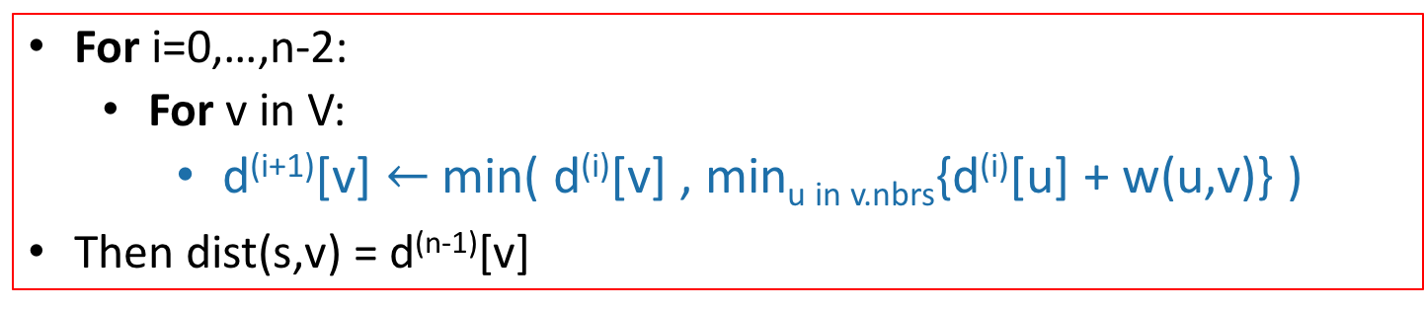
This seems much slower than Dijkstra
And it is:
Running time O(mn)
However, it’s also more flexible in a few ways.
  Can handle negative edges
  If we keep on doing these iterations, then changes in the network will propagate through.
For i=0,…,n-2:
  For v in V:
    d^{(i+1)}[v] $←$min( d^{(i)}[v] , min_{u in v.nbrs}{d^{(i)}[u] + w(u,v)} )
Then dist(s,v) = d^{(n-1)}[v]

Slide 19
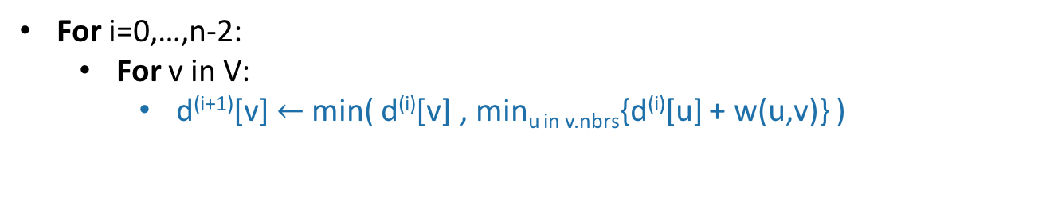
Negative cycles
Gates
Gates Packard CS161 Union Dish
d⁽⁰⁾
1
0
$$∞$$
$$∞$$
$$∞$$
$$∞$$
CS161
d⁽¹⁾
0
1
$$∞$$
$$∞$$
-3
1
d⁽²⁾
0
-5
2
7
-3
Packard
4
d⁽³⁾
-4
-5
-4
6
-3
d⁽⁴⁾
-4
-5
-4
6
-7
-2
Union
This is not looking good!
-3
10
For i=0,…,n-2:
  For v in V:
    d^{(i+1)}[v] $←$min( d^{(i)}[v] , min_{u in v.nbrs}{d^{(i)}[u] + w(u,v)} )
Dish

Slide 20

Negative edge weights
Gates
Gates Packard CS161 Union Dish
d⁽⁰⁾
1
0
$$∞$$
$$∞$$
$$∞$$
$$∞$$
CS161
d⁽¹⁾
0
1
$$∞$$
$$∞$$
-3
1
d⁽²⁾
0
-5
2
7
-3
Packard
4
d⁽³⁾
-4
-5
-4
6
-3
d⁽⁴⁾
-4
-5
-4
6
-7
-2
Union
But we can tell that it’s not looking good:
d⁽⁵⁾
-4
-9
-4
3
-3
-7
10
Some stuff changed!
For i=0,…,n-2:
  For v in V:
    d^{(i+1)}[v] $←$min( d^{(i)}[v] , min_{u in v.nbrs}{d^{(i)}[u] + w(u,v)} )
Dish

Slide 21
Negative cycles in Bellman-Ford
If there are no negative cycles:
  Everything works as it should, and stabilizes.
If there are negative cycles:
  Not everything works as it should…
    Note: it couldn’t possibly work, since shortest paths aren’t well-defined if there are negative cycles.
  The d[v] values will keep changing.
Solution:
  Go one round more and see if things change.

Slide 22
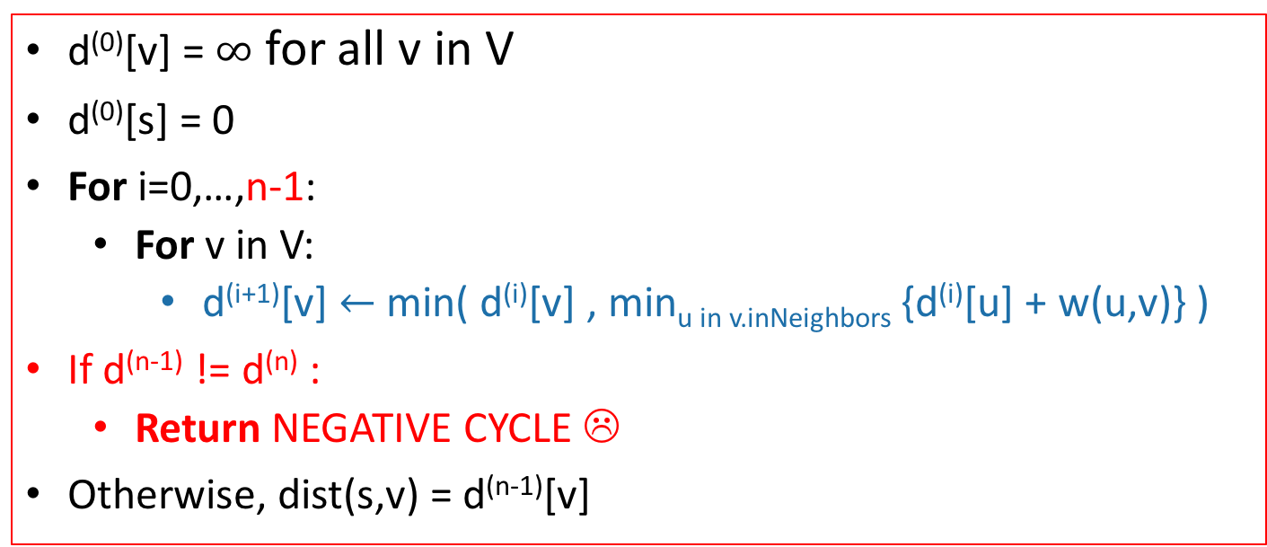
Bellman-Ford algorithm
Bellman-Ford*(G,s):
d⁽⁰⁾[v] = $∞$ for all v in V
d⁽⁰⁾[s] = 0
For i=0,…,n-1:
  For v in V:
    d^{(i+1)}[v] $←$min( d^{(i)}[v] , min_{u in v.inNeighbors} {d^{(i)}[u] + w(u,v)} )
If d^{(n-1)} != d^{(n)} :
  Return NEGATIVE CYCLE ☹
Otherwise, dist(s,v) = d^{(n-1)}[v]
Running time: O(mn)

Slide 23
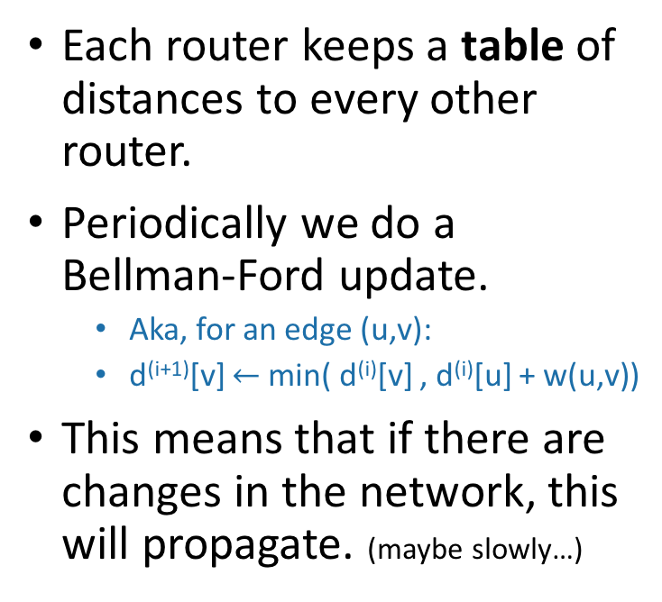
Bellman-Ford is also used in practice.
eg, Routing Information Protocol (RIP) uses something like Bellman-Ford.
  Older protocol, not used as much anymore.
Destination | Cost to get there | Send to whom?
172.16.1.0 | 34 | 172.16.1.1
10.20.40.1 | 10 | 192.168.1.2
10.155.120.1 | 9 | 10.13.50.0
Each router keeps a table of distances to every other router.
Periodically we do a Bellman-Ford update.
  Aka, for an edge (u,v):
  d^{(i+1)}[v] $←$min( d^{(i)}[v] , d^{(i)}[u] + w(u,v))
This means that if there are changes in the network, this will propagate. (maybe slowly…)
Notes:
In general this is called a “distance-vector” routing protocol which means it maintains a vector of distances. OTOH, the OSPF algorithm that uses Dijkstra is “link-state” routing protocol which means that a node should broadcast to everyone if the topology changes.

Slide 24
Recap: shortest paths
BFS:
    (+) O(n+m)
  (-) only unweighted graphs
Dijkstra’s algorithm:
  (+) weighted graphs
  (+) O(nlog(n) + m) if you implement it right.
  (-) no negative edge weights
  (-) very “centralized” (need to keep track of all the vertices to know which to update).
The Bellman-Ford algorithm:
  (+) weighted graphs, even with negative weights
  (+) can be done in a distributed fashion, every vertex using only information from its neighbors.
  (-) O(nm)

Slide 25
Important thing about B-F for the rest of this lecture
Gates
0
$$2$$
1
d^{(i)}[v] is equal to the cost of the shortest path between s and v with at most i edges.
CS161
1
Packard
Gates Packard CS161 Union Dish
$$1$$
4
d⁽⁰⁾
0
$$∞$$
$$∞$$
$$∞$$
$$∞$$
22
$$6$$
d⁽¹⁾
0
1
$$∞$$
$$∞$$
25
Union
d⁽²⁾
0
1
2
45
23
25
d⁽³⁾
0
1
2
6
23
20
d⁽⁴⁾
0
1
2
6
23
Dish
$$23$$

Slide 26
Bellman-Ford is an example of…
Dynamic Programming!
Today:
Example of Dynamic programming:
  Fibonacci numbers.
  (And Bellman-Ford)
What is dynamic programming, exactly?
  And why is it called “dynamic programming”?
Another example: Floyd-Warshall algorithm
  An “all-pairs” shortest path algorithm

Slide 27
Pre-Lecture exercise:
How not to compute Fibonacci Numbers
Definition:
  F(n) = F(n-1) + F(n-2), with F(0) = F(1) = 1.
  The first several are:
  1, 1, 2, 3, 5, 8, 13, 21, 34, 55, 89, 144,…
Question:
  Given n, what is F(n)?

Slide 28
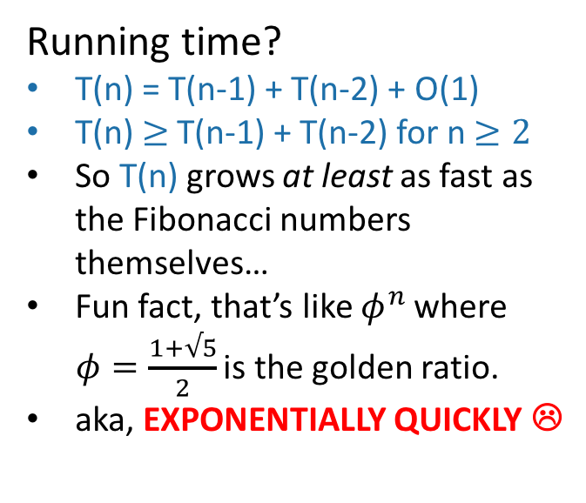
Candidate algorithm
See CLRS Problem 4-4 for a walkthrough of how fast the Fibonacci numbers grow!
def Fibonacci(n):
  if n == 0 or n == 1:
    return 1
  return Fibonacci(n-1) + Fibonacci(n-2)
(Seems to work, according to the IPython notebook…)
Running time?
T(n) = T(n-1) + T(n-2) + O(1)
T(n) $≥$T(n-1) + T(n-2) for n $≥2$
So T(n) grows at least as fast as the Fibonacci numbers themselves…
Fun fact, that’s like $φ^{n}$ where $φ=\frac{1+√5}{2}$ is the golden ratio.
aka, EXPONENTIALLY QUICKLY ☹

Slide 29
What’s going on?
Consider Fib(8)
That’s a lot of repeated computation!
8
6
7
4
5
5
6
2
3
3
4
3
4
4
5
0
1
1
2
1
2
2
3
1
2
2
3
2
3
3
4
1
2
2
etc
0
1
0
1
0
1
1
2
0
1
0
1
0
1
1
1
2
0
1
0
1
0
1
0
1

Slide 30
Maybe this would be better:
8
def fasterFibonacci(n):
  F = [1, 1, None, None, …, None ]
    \\ F has length n
  for i = 2, …, n:
    F[i] = F[i-1] + F[i-2]
  return F[n]
7
6
Much better running time!
5
4
3
2
1
0

Slide 31
This was an example of…
Dynamic
Programming!

Slide 32
What is dynamic programming?
It is an algorithm design paradigm
  like divide-and-conquer is an algorithm design paradigm.
Usually it is for solving optimization problems
  eg, shortest path
  (Fibonacci numbers aren’t an optimization problem, but they are a good example…)

Slide 33
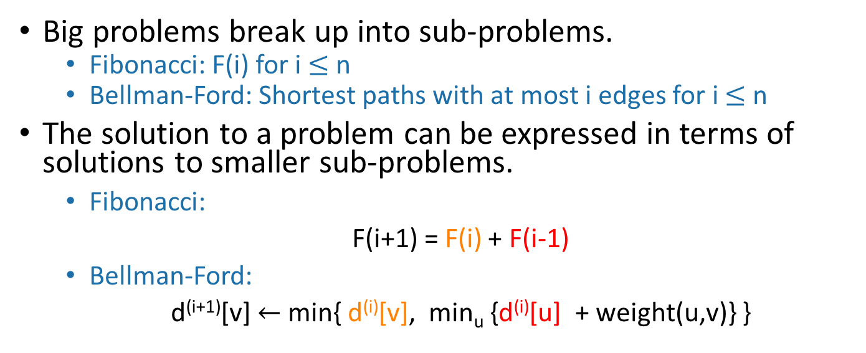
Elements of dynamic programming
1. Optimal sub-structure:
Big problems break up into sub-problems.
  Fibonacci: F(i) for i $≤$ n
  Bellman-Ford: Shortest paths with at most i edges for i $≤$ n
The solution to a problem can be expressed in terms of solutions to smaller sub-problems.
      Fibonacci:
      F(i+1) = F(i) + F(i-1)
      Bellman-Ford:
      d^{(i+1)}[v] $←$ min{ d^{(i)}[v], min_{u} {d^{(i)}[u] + weight(u,v)} }
Shortest path with at most i edges from s to v
Shortest path with at most i edges from s to u.

Slide 34
Elements of dynamic programming
2. Overlapping sub-problems:
The sub-problems overlap a lot.
  Fibonacci:
    Lots of different F[j] will use F[i].
  Bellman-Ford:
    Lots of different entries of d^{(i+1)} will use d^{(i)}[v].
  This means that we can save time by solving a sub-problem just once and storing the answer.

Slide 35
Elements of dynamic programming
Optimal substructure.
  Optimal solutions to sub-problems are sub-solutions to the optimal solution of the original problem.
Overlapping subproblems.
  The subproblems show up again and again
Using these properties, we can design a dynamic programming algorithm:
  Keep a table of solutions to the smaller problems.
  Use the solutions in the table to solve bigger problems.
  At the end we can use information we collected along the way to find the solution to the whole thing.

Slide 36
Two ways to think about and/or implement DP algorithms
Top down
Bottom up
This picture isn’t hugely relevant but I like it.

Slide 37
Bottom up approach what we just saw.
For Fibonacci:
Solve the small problems first
  fill in F[0],F[1]
Then bigger problems
  fill in F[2]
…
Then bigger problems
  fill in F[n-1]
Then finally solve the real problem.
  fill in F[n]

Slide 38
Bottom up approach what we just saw.
For Bellman-Ford:
Solve the small problems first
  fill in d⁽⁰⁾
Then bigger problems
  fill in d⁽¹⁾
…
Then bigger problems
  fill in d^{(n-2)}
Then finally solve the real problem.
  fill in d^{(n-1)}

Slide 39
Top down approach
Think of it like a recursive algorithm.
To solve the big problem:
  Recurse to solve smaller problems
    Those recurse to solve smaller problems
      etc..
The difference from divide and conquer:
  Memo-ization
  Keep track of what small problems you’ve already solved to prevent re-solving the same problem twice.

Slide 40
Example of top-down Fibonacci
define a global list F = [1,1,None, None, …, None]
def Fibonacci(n):
  if F[n] != None:
    return F[n]
  else:
    F[n] = Fibonacci(n-1) + Fibonacci(n-2)
  return F[n]
Memo-ization: Keeps track (in F) of the stuff you’ve already done.

Slide 41
Memo-ization visualization
Collapse repeated nodes and don’t do the same work twice!
8
6
7
4
5
5
6
2
3
3
4
3
4
4
5
0
1
1
2
1
2
2
3
1
2
2
3
2
3
3
4
1
2
2
etc
0
1
0
1
0
1
1
2
0
1
0
1
0
1
1
1
2
0
1
0
1
0
1
0
1

Slide 42
Memo-ization Visualization ctd
8
7
Collapse repeated nodes and don’t do the same work twice!
But otherwise treat it like the same old recursive algorithm.
6
5
4
define a global list F = [1,1,None, None, …, None]
def Fibonacci(n):
  if F[n] != None:
    return F[n]
  else:
    F[n] = Fibonacci(n-1) + Fibonacci(n-2)
  return F[n]
3
2
1
0

Slide 43
What have we learned?
Dynamic programming:
  Paradigm in algorithm design.
  Uses optimal substructure
  Uses overlapping subproblems
  Can be implemented bottom-up or top-down.
  It’s a fancy name for a pretty common-sense idea:
Don’t duplicate work if you don’t have to!

Slide 44
Why “dynamic programming” ?
Programming refers to finding the optimal “program.”
  as in, a shortest route is a plan aka a program.
Dynamic refers to the fact that it’s multi-stage.
But also it’s just a fancy-sounding name.
Manipulating computer code in an action movie?

Slide 45
Why “dynamic programming” ?
Richard Bellman invented the name in the 1950’s.
At the time, he was working for the RAND Corporation, which was basically working for the Air Force, and government projects needed flashy names to get funded.
From Bellman’s autobiography:
  “It’s impossible to use the word, dynamic, in the pejorative sense…I thought dynamic programming was a good name. It was something not even a Congressman could object to.”

Slide 46
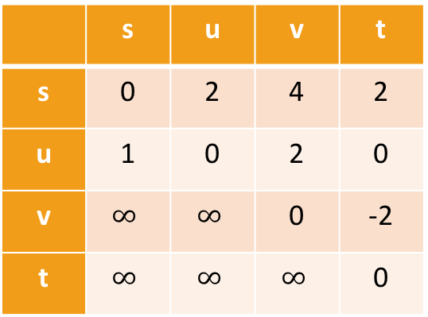
Floyd-Warshall Algorithm
Another example of DP
This is an algorithm for All-Pairs Shortest Paths (APSP)
  That is, I want to know the shortest path from u to v for ALL pairs u,v of vertices in the graph.
  Not just from a special single source s.
Destination
Source
 | s | u | v | t
s | 0 | 2 | 4 | 2
u | 1 | 0 | 2 | 0
v | $$∞$$ | $$∞$$ | 0 | -2
t | $$∞$$ | $$∞$$ | $$∞$$ | 0
s
2
u
1
5
2
t
v
-2

Slide 47
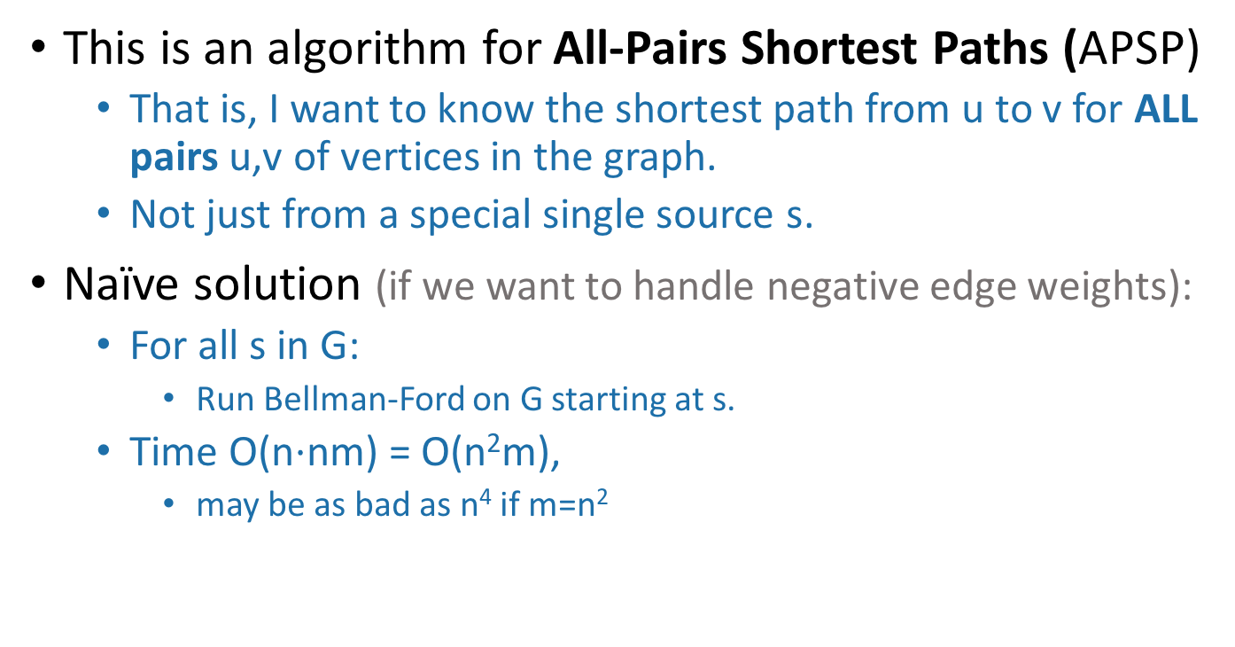
Floyd-Warshall Algorithm
Another example of DP
This is an algorithm for All-Pairs Shortest Paths (APSP)
  That is, I want to know the shortest path from u to v for ALL pairs u,v of vertices in the graph.
  Not just from a special single source s.
Naïve solution (if we want to handle negative edge weights):
  For all s in G:
    Run Bellman-Ford on G starting at s.
  Time O(n$⋅$nm) = O(n²m),
    may be as bad as n⁴ if m=n²
Can we do better?

Slide 48
Optimal substructure
Label the vertices 1,2,…,n
(We omit some edges in the picture below).
Sub-problem(k-1):
For all pairs, u,v, find the cost of the shortest path from u to v, so that all the internal vertices on that path are in {1,…,k-1}.
Our DP algorithm will fill in the
n-by-n arrays
D⁽⁰⁾, D⁽¹⁾, …, D^{(n)} iteratively and then we’ll be done.
k
Let D^{(k-1)}[u,v] be the solution to Sub-problem(k-1).
k+1
u
1
2
v
3
…
k-1
This is the shortest path from u to v through the blue set. It has length D^{(k-1)}[u,v]
n
Vertices 1, …, k-1

Slide 49
Optimal substructure
Label the vertices 1,2,…,n
(We omit some edges in the picture below).
Sub-problem(k-1):
For all pairs, u,v, find the cost of the shortest path from u to v, so that all the internal vertices on that path are in {1,…,k-1}.
Our DP algorithm will fill in the
n-by-n arrays
D⁽⁰⁾, D⁽¹⁾, …, D^{(n)} iteratively and then we’ll be done.
k
Let D^{(k-1)}[u,v] be the solution to Sub-problem(k-1).
k+1
Question: How can we find D^{(k)}[u,v] using D^{(k-1)}?
u
1
2
v
3
…
k-1
This is the shortest path from u to v through the blue set. It has length D^{(k-1)}[u,v]
n
Vertices 1, …, k-1

Slide 50
How can we find D^{(k)}[u,v] using D^{(k-1)}?
D^{(k)}[u,v] is the cost of the shortest path from u to v so that all internal vertices on that path are in {1, …, k}.
k
k+1
Vertices 1, …, k
u
1
2
v
3
…
k-1
n
Vertices 1, …, k-1

Slide 51
How can we find D^{(k)}[u,v] using D^{(k-1)}?
D^{(k)}[u,v] is the cost of the shortest path from u to v so that all internal vertices on that path are in {1, …, k}.
Case 1: we don’t need vertex k.
k
k+1
Vertices 1, …, k
u
1
2
v
3
…
k-1
This path was the shortest before, so it’s still the shortest now.
n
Vertices 1, …, k-1
D^{(k)}[u,v] = D^{(k-1)}[u,v]

Slide 52
How can we find D^{(k)}[u,v] using D^{(k-1)}?
D^{(k)}[u,v] is the cost of the shortest path from u to v so that all internal vertices on that path are in {1, …, k}.
Case 2: we need vertex k.
k
k+1
Vertices 1, …, k
u
1
2
v
3
…
k-1
n
Vertices 1, …, k-1

Slide 53
Case 2 continued
Suppose there are no negative cycles.
  Then WLOG the shortest path from u to v through {1,…,k} is simple.
If that path passes through k, it must look like this:
This path is the shortest path from u to k through {1,…,k-1}.
  sub-paths of shortest paths are shortest paths
Same for this path.
Case 2: we need vertex k.
k
Vertices 1, …, k
u
1
2
v
3
…
k-1
n
Vertices 1, …, k-1
D^{(k)}[u,v] = D^{(k-1)}[u,k] + D^{(k-1)}[k,v]

Slide 54
How can we find D^{(k)}[u,v] using D^{(k-1)}?
D^{(k)}[u,v] = min{ D^{(k-1)}[u,v], D^{(k-1)}[u,k] + D^{(k-1)}[k,v] }
Optimal substructure:
  We can solve the big problem using smaller problems.
Overlapping sub-problems:
  D^{(k-1)}[k,v] can be used to help compute D^{(k)}[u,v] for lots of different u’s.
Case 1: Cost of shortest path through {1,…,k-1}
Case 2: Cost of shortest path from u to k and then from k to v through {1,…,k-1}

Slide 55
How can we find D^{(k)}[u,v] using D^{(k-1)}?
D^{(k)}[u,v] = min{ D^{(k-1)}[u,v], D^{(k-1)}[u,k] + D^{(k-1)}[k,v] }
Using our Dynamic programming paradigm, this immediately gives us an algorithm!
Case 1: Cost of shortest path through {1,…,k-1}
Case 2: Cost of shortest path from u to k and then from k to v through {1,…,k-1}

Slide 56
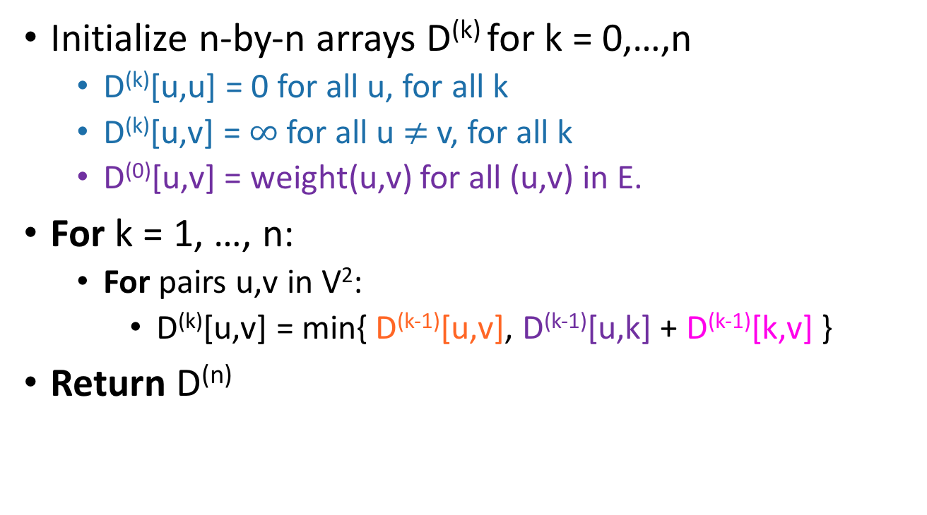
Floyd-Warshall algorithm
Initialize n-by-n arrays D^{(k)} for k = 0,…,n
  D^{(k)}[u,u] = 0 for all u, for all k
  D^{(k)}[u,v] = $∞$ for all u $≠$ v, for all k
  D⁽⁰⁾[u,v] = weight(u,v) for all (u,v) in E.
For k = 1, …, n:
  For pairs u,v in V²:
    D^{(k)}[u,v] = min{ D^{(k-1)}[u,v], D^{(k-1)}[u,k] + D^{(k-1)}[k,v] }
Return D^{(n)}
The base case checks out: the only path through zero other vertices are edges directly from u to v.
This is a bottom-up Dynamic programming algorithm.

Slide 57
We’ve basically just shown
Theorem:
  If there are no negative cycles in a weighted directed graph G, then the Floyd-Warshall algorithm, running on G, returns a matrix D^{(n)} so that:
D^{(n)}[u,v] = distance between u and v in G.
Running time: O(n³)
  Better than running BF n times!
  Not really better than running Dijkstra n times.
    But it’s simpler to implement and handles negative weights.
Storage:
  Need to store two n-by-n arrays, and the original graph.
Work out the details of the proof! (Or see Lecture Notes for a few more details).
As with Bellman-Ford, we don’t really need to store all n of the D^{(k)}.

Slide 58
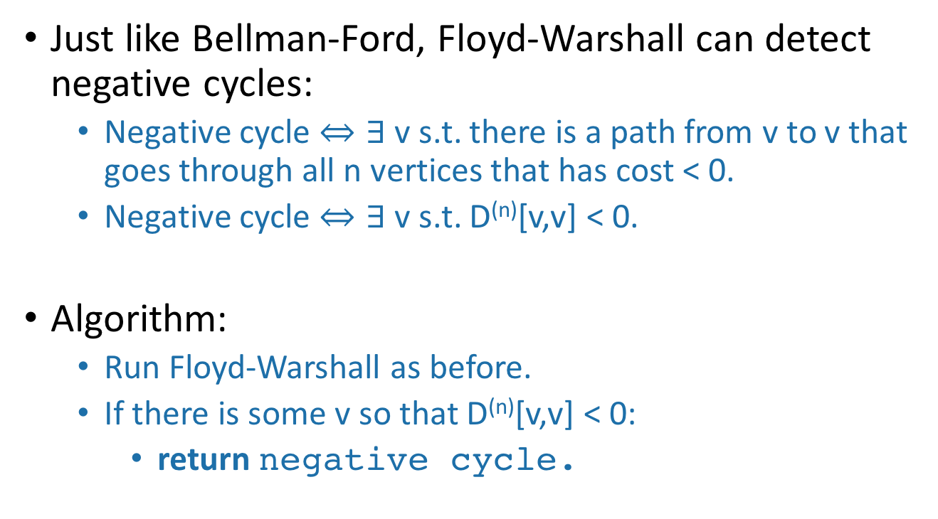
What if there are negative cycles?
Just like Bellman-Ford, Floyd-Warshall can detect negative cycles:
  Negative cycle $⇔∃$ v s.t. there is a path from v to v that goes through all n vertices that has cost < 0.
  Negative cycle $⇔∃$ v s.t. D^{(n)}[v,v] < 0.
Algorithm:
  Run Floyd-Warshall as before.
  If there is some v so that D^{(n)}[v,v] < 0:
    return negative cycle.

Slide 59
What have we learned?
The Floyd-Warshall algorithm is another example of dynamic programming.
It computes All Pairs Shortest Paths in a directed weighted graph in time O(n³).

Slide 60
Another Example of DP?
Longest simple path (say all edge weights are 1):
s
a
t
b
What is the longest simple path from s to t?

Slide 61
This is an optimization problem…
Can we use Dynamic Programming?
Optimal Substructure?
  Longest path from s to t = longest path from s to a
  + longest path from a to t?
s
a
NOPE!
t
b

Slide 62
This doesn’t give optimal sub-structure
Optimal solutions to subproblems don’t give us an optimal solution to the big problem. (At least if we try to do it this way).
The subproblems we came up with aren’t independent:
  Once we’ve chosen the longest path from a to t
    which uses b,
  our longest path from s to a shouldn’t be allowed to use b
    since b was already used.
Actually, the longest simple path problem is NP-complete.
  We don’t know of any polynomial-time algorithms for it, DP or otherwise!
s
a
t
b

Slide 63
Recap
Two more shortest-path algorithms:
  Bellman-Ford for single-source shortest path
  Floyd-Warshall for all-pairs shortest path
Dynamic programming!
  This is a fancy name for:
    Break up an optimization problem into smaller problems
      The optimal solutions to the sub-problems should be sub-solutions to the original problem.
    Build the optimal solution iteratively by filling in a table of sub-solutions.
      Take advantage of overlapping sub-problems!

Slide 64
Next time
More examples of dynamic programming!
Pre-lecture exercise: finding optimal substructure
We will stop bullets with our action-packed coding skills, and also maybe find longest common subsequences.
Before next time

