Slide 1
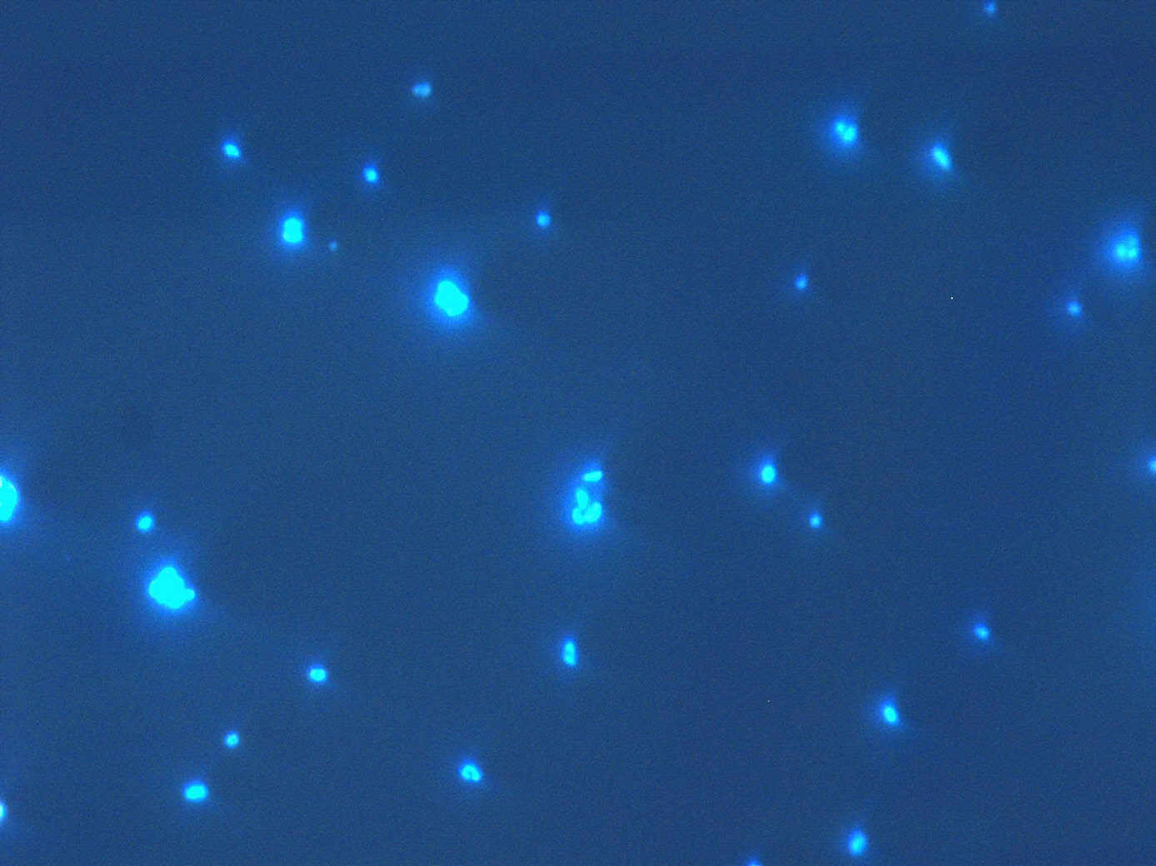
Gamma-proteobacteria in seawater
Sidhartha Goyal
Hyunsoo Na

Slide 2
Contents
Introduction on (CARD-)FISH
Procedures
Results
Discussion

Slide 3
Fluorescent in-situ hybridization
Detection and localization
- Unculturable bacteria
- Specific mRNAs in tissue
Capture live bacteria by targeting rRNA

Slide 4

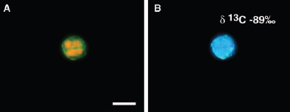
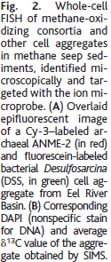
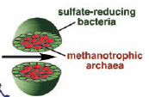

Slide 5
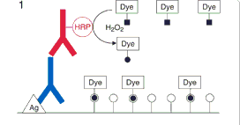
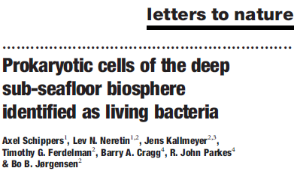
CARD-FISH
Cy3
DAPI

Slide 6
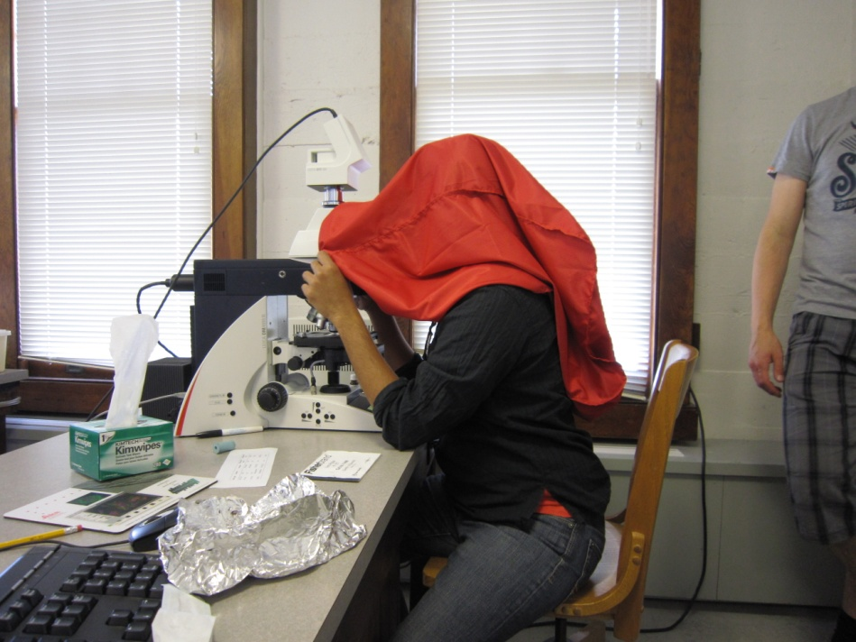
Procedures
Sample preparation
- Fixation and immobilization
Permeabilization & inactivation of endogenous peroxidases
Hybridization
CARD
Microscopy

Slide 7
Results – relative abundance
Requires training!
Can
Beach sample

Slide 9
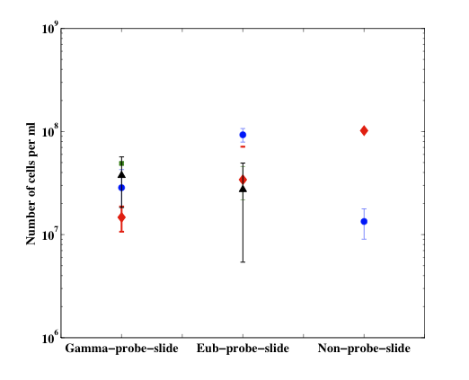
Results – cells/ ml at C1/M1 - 200m
Requires training!
Can

Slide 10
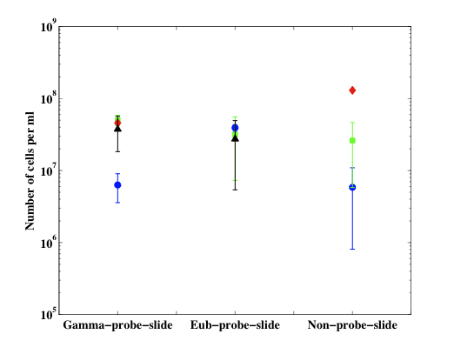
Results – cells/ml at Hopkins beach
Requires training!
Can

Slide 11
Distribution of cells on the filter
Cy3
DAPI

Slide 12
Discussion
Training - Distinguish between cells and particles
Probe design may be challenging
Consortium analysis
  Physical association of cells
Community composition…?
Cheap and quick!
`

Slide 13
Thank you

Slide 14
