Slide 1
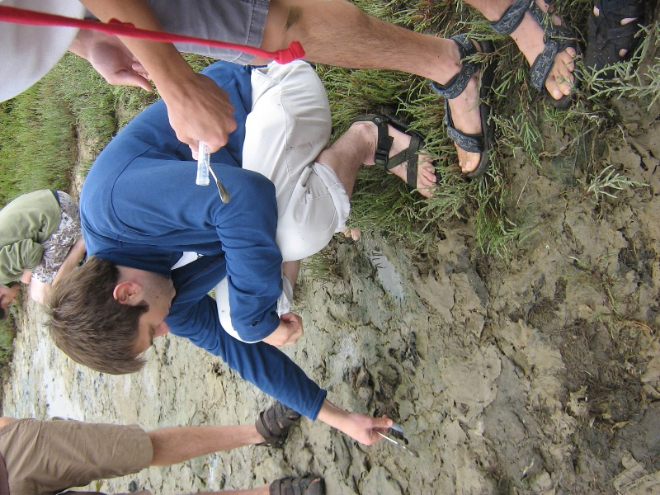
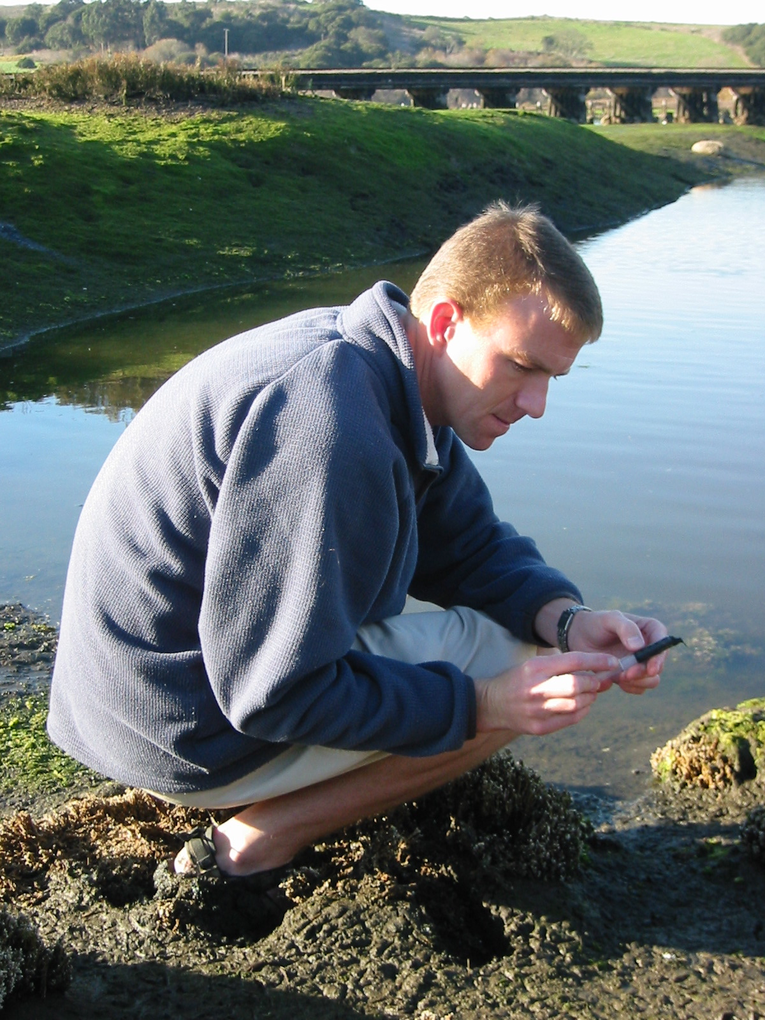
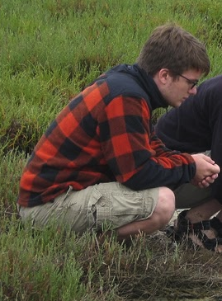
Enrichment of
phototrophic sulfur bacteria from Elkhorn Slough
Hopkins Microbiology Course 2010
Pacific Grove, CA

Slide 2
O₂
O₂
870nm
Oxygenic Photosynthesis
H₂O
Oxic
Sulfidic
660nm
SO₄²
S⁰
H₂S
Anoxygenic Photosynthesis
bchl. a
Organic
C
bchl. e
dsrA
H₂S
28 mM SO₄²⁻
Sulfate Reduction
Physical Chemical Environment

Slide 3
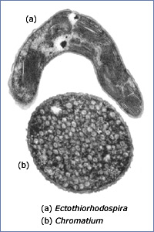
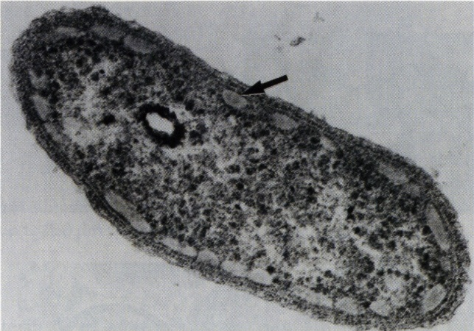
 | Purple | Green
Light | 880 nm | 660 nm
H₂S Concentration | 1.2 mM | 2.5 mM
Energy Conservation | Photo Phosphorylation | Photo Phosphorylation
Reducing Power | Reverse Electron Transport | Greater Excitation of Rxn Center
Sulfur storage | Inside and outside | Outside
Motility | Yes | No (Maybe)
Organism

Slide 4
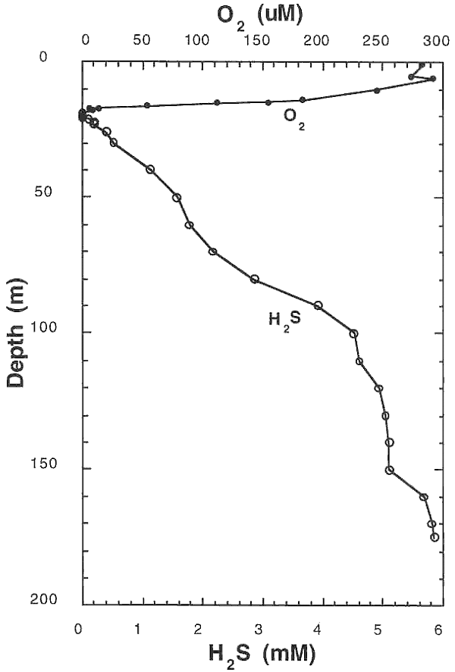
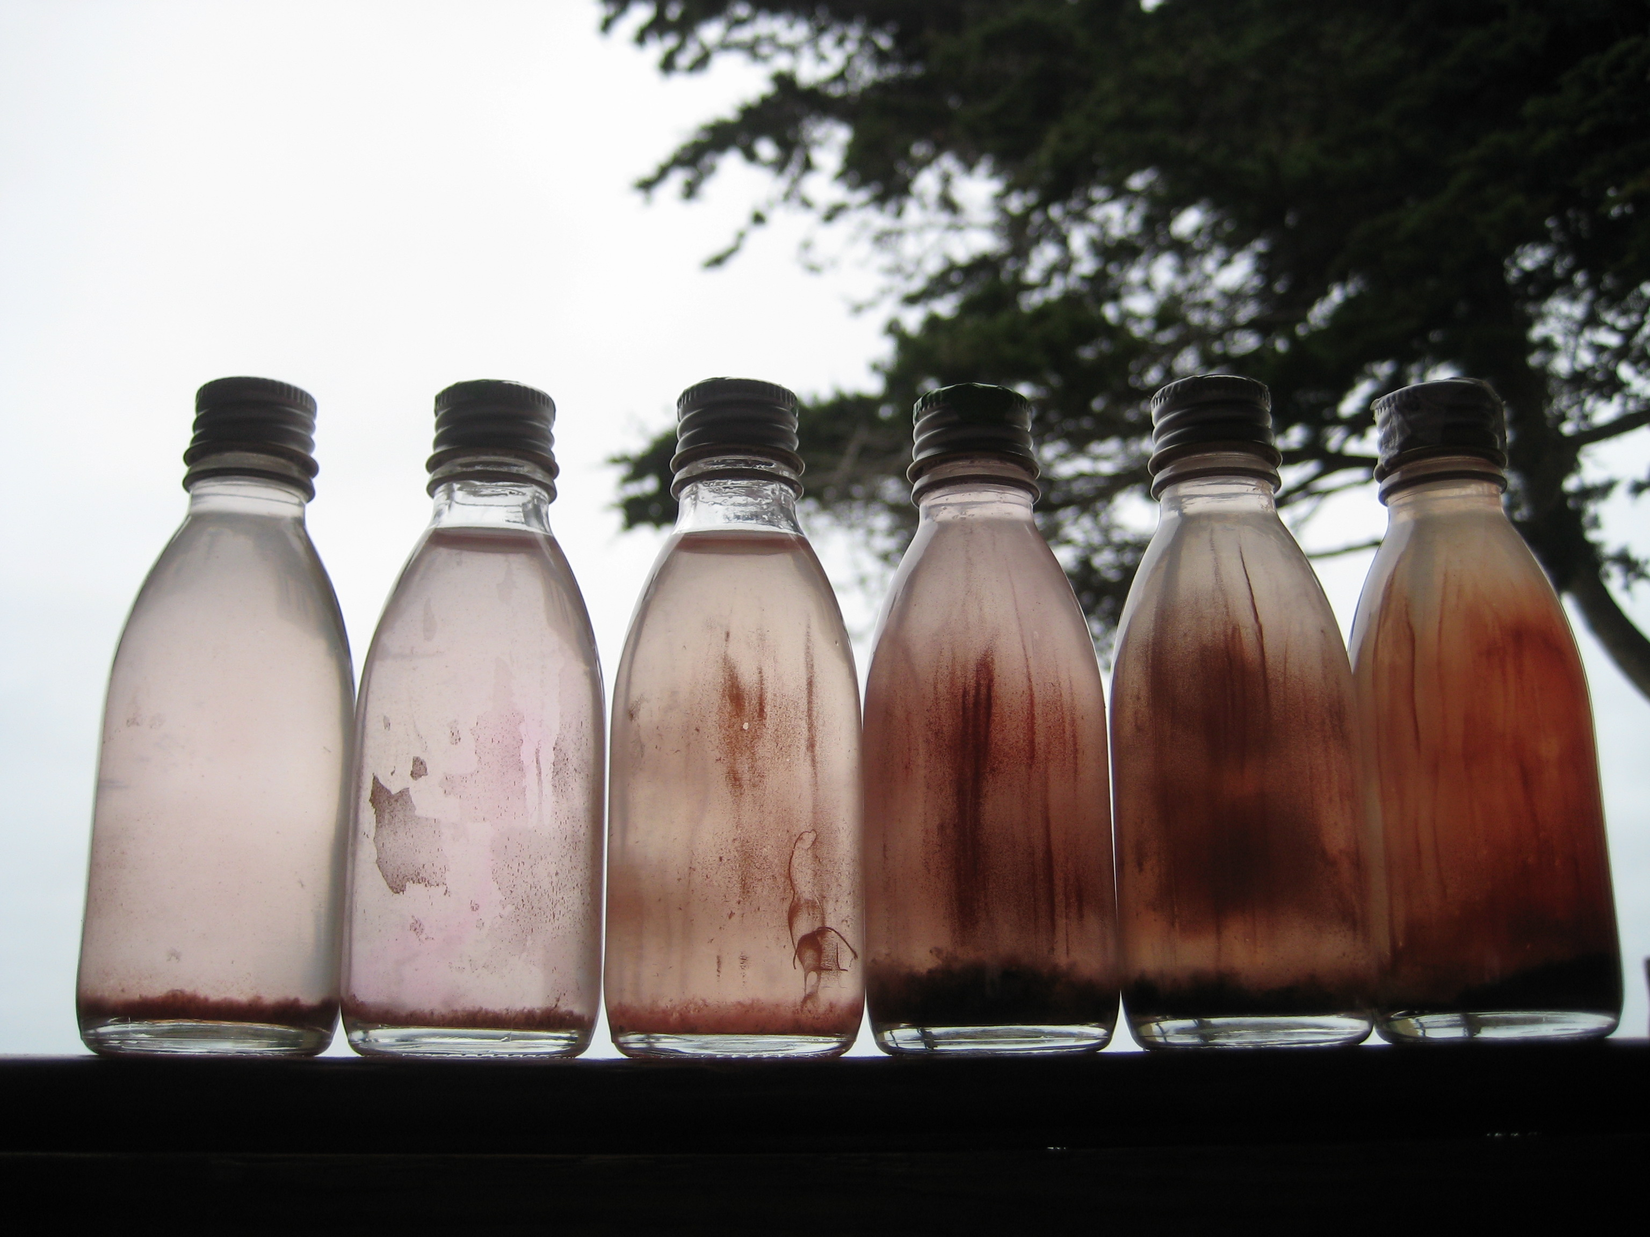
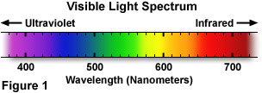
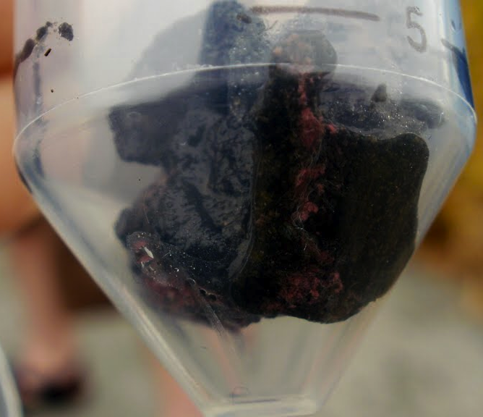
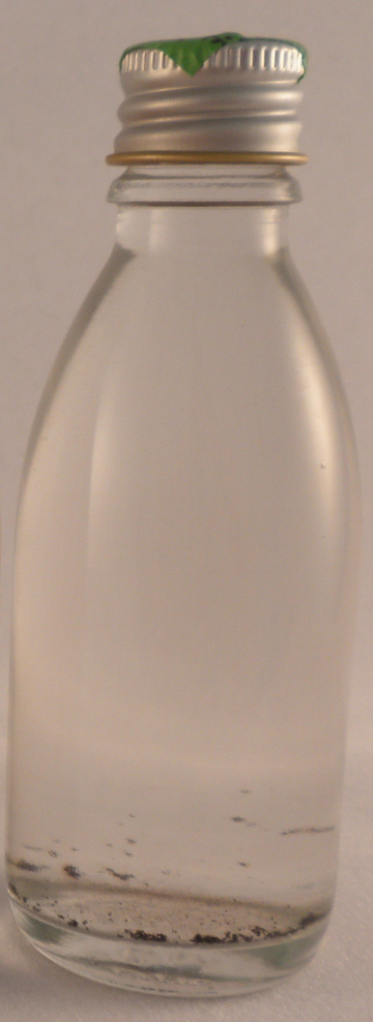
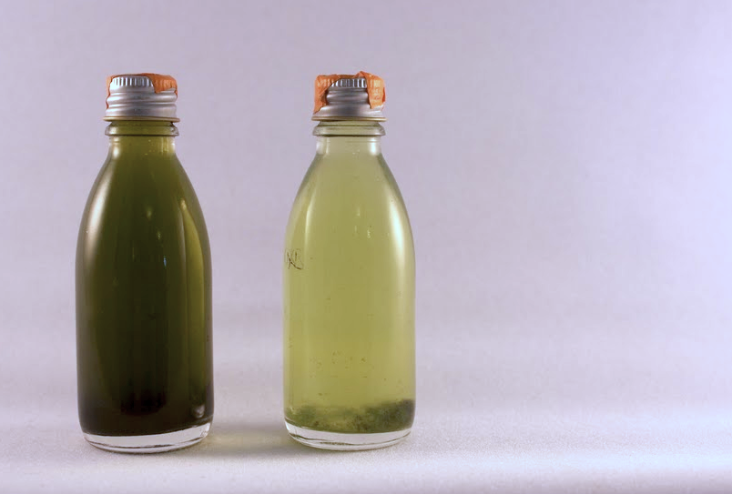
Isolation

Slide 6
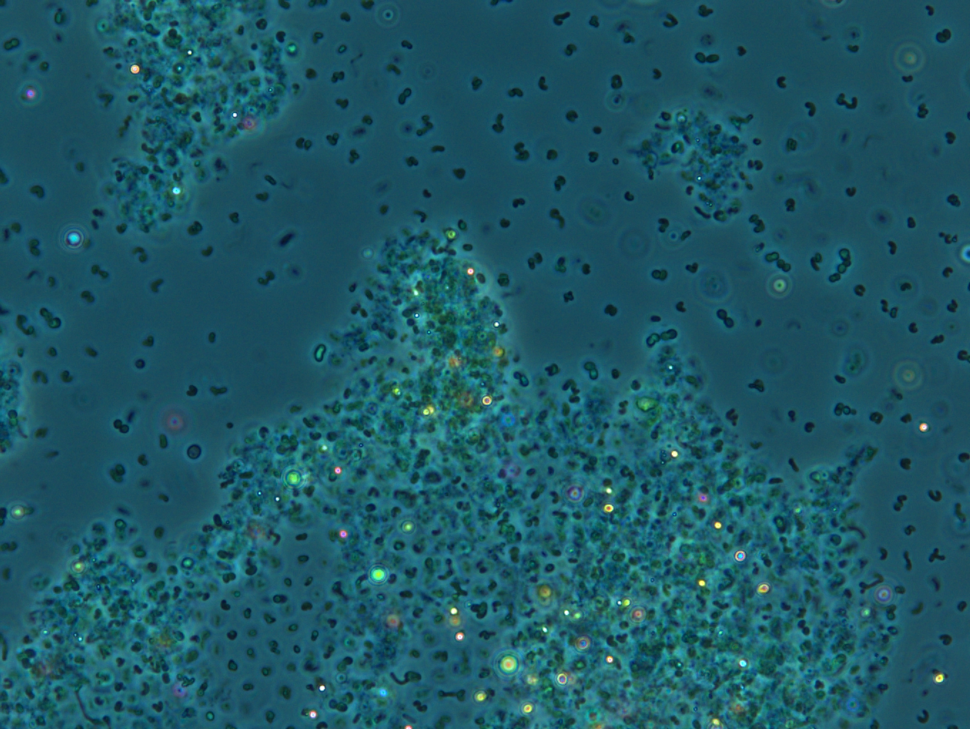
Isolation

Slide 7
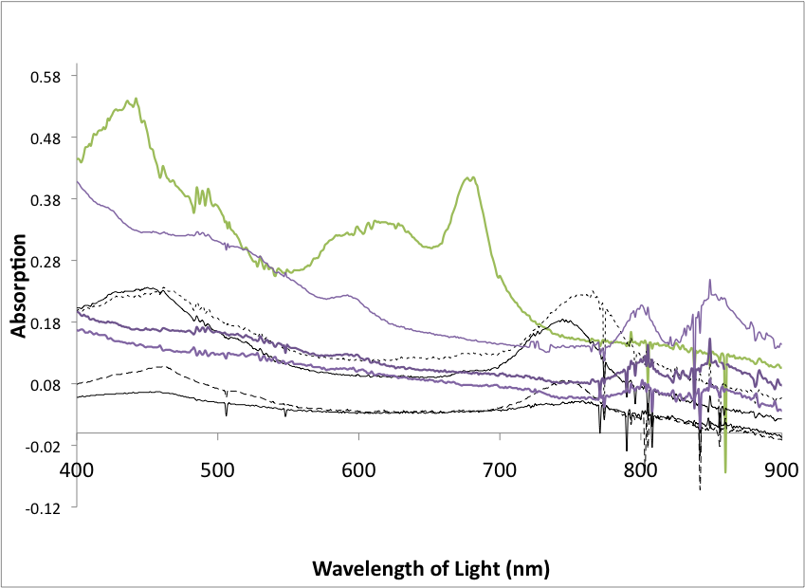


Slide 8
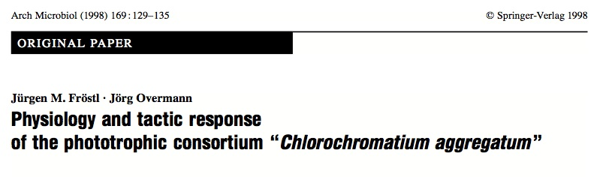
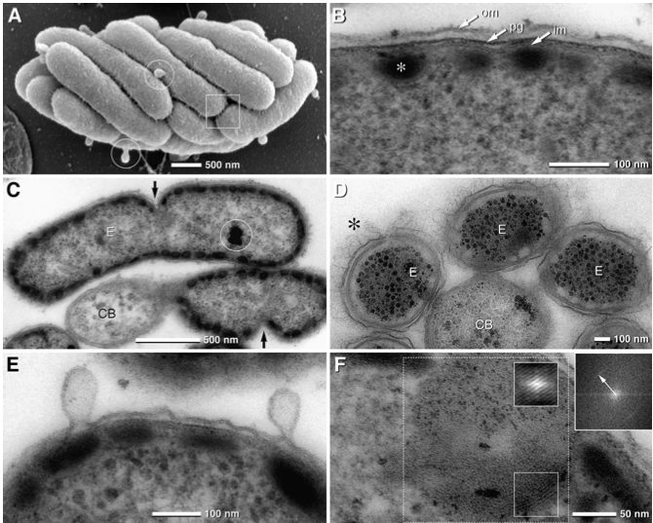
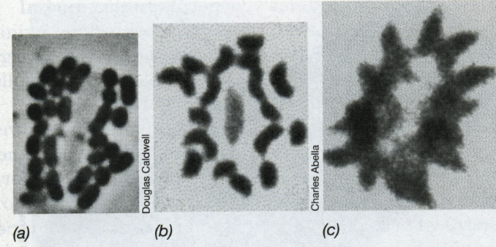
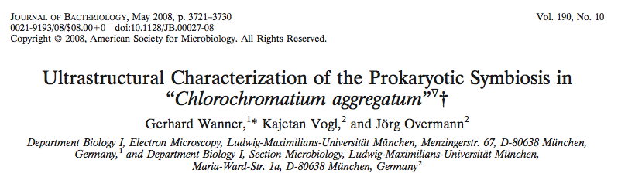

Slide 9
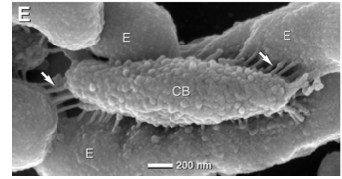
Thanks

Slide 11
Oxidation of H2S
Sulfur, Sulfate
Organic carbon
Bacteriochlorophyll a/b
Bacteriochloropyll d/e
Purple Sulfur Bacteria
Green Sulfur Bacteria

Slide 12
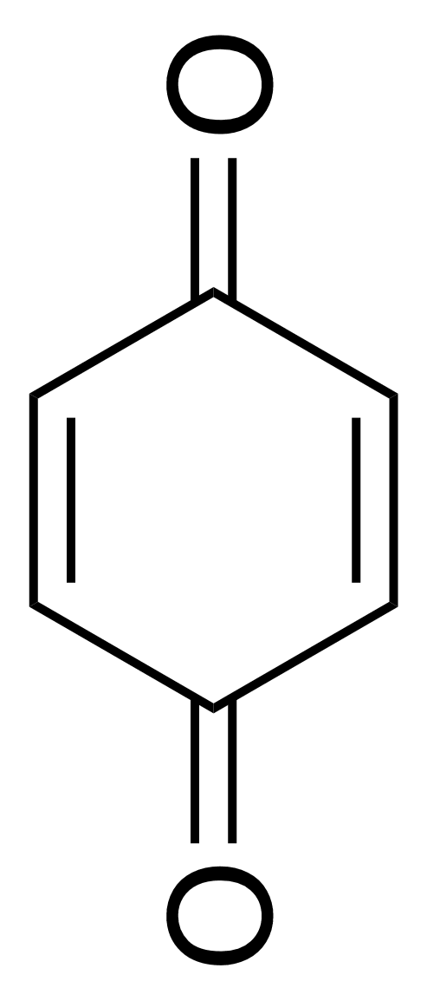
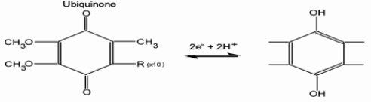
Quinone Chemistry

