Slide 1

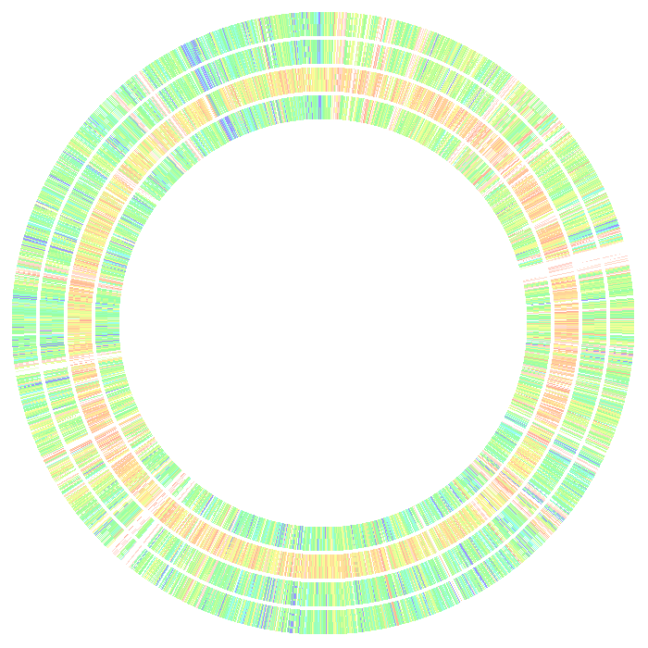
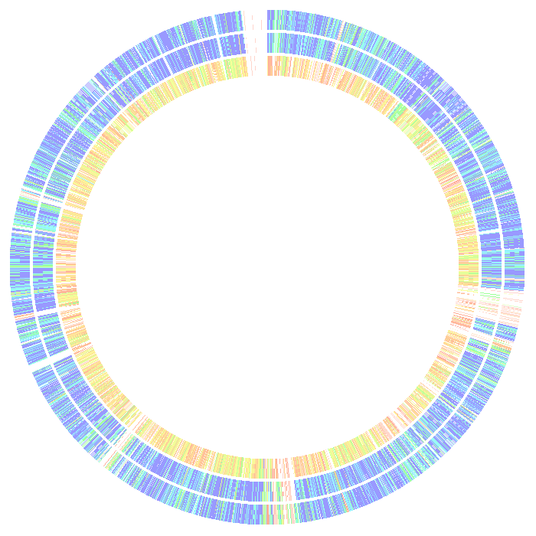
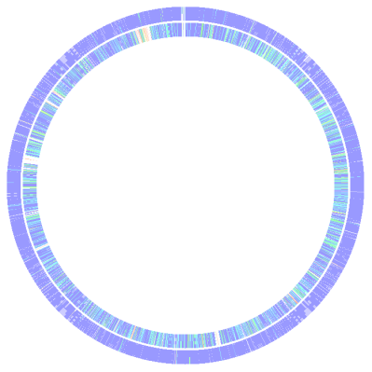
Vibrio Genomes
Naama Dekel,
Koshlan Mayer-Blackwell,
Marcus Schicklberger,
Holly Sewell,
Will Stork
June 23rd 2010

Slide 2

Comparison with Vibrio splendidus LGP32
Which of these genomes is not like the others?
2010-PA1E
2010-HA8H
2009-PA16E
2009-HA7E

Slide 3
Finding the Core Genome
2009-HA7E
2009-PA16E
98
128
54
2010-HA8H
17
25
2010-PA1E
994
308
20
453
3669
8
51
0
0
26
Core?
Is this an accurate representation?

Slide 4
Finding the Core Genome
95% “Species” Cutoff
2009-HA7E
2009-PA16E
162
183
189
2010-HA8H
1
103
2010-PA1E
1176
431
0
3767
121
1
76
1
0
49
“Species” Core?

Slide 5
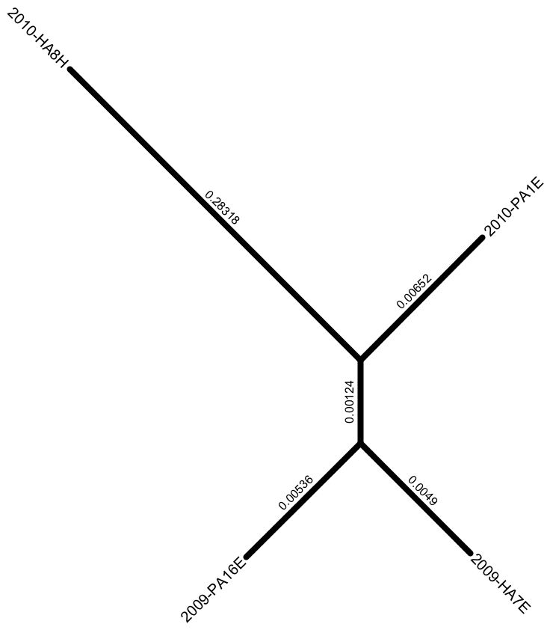
Core Gene Tree
2010-HA8H
0.28318
2010-HA8H is completely different from the other organisms!
0.00124
2009-PA16E and 2009-HA7E are most closely related
0.00124
0.00536
0.0049

Slide 6
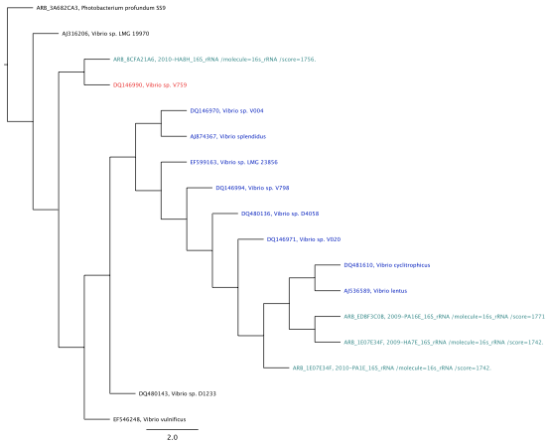
16s RNA tree
2010-HA8H
2009-PA16E
2010-PA1E
2009-HA7E

Slide 7
Pathway/Functional differences
What functions are unique to 2010-HA8H?
2010-HA8H:
Polymyxin Resistance
Siderophore biosynthesis
What functions make the three similar organisms distinct?
2010-PA1E
Xylitol transport and utilization

Slide 8
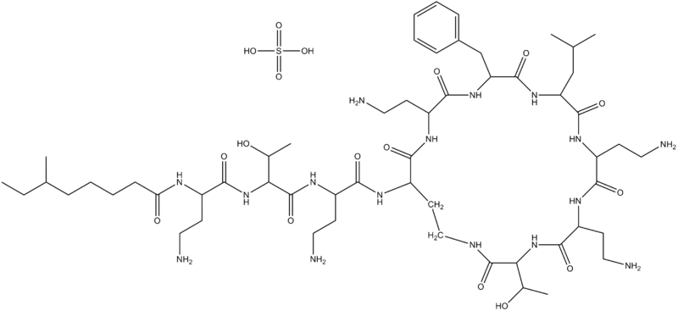
Function differences:
Polymyxin Resistance in 2010-HA8H
Polymyxin: Antibiotic that is selectively toxic for Gram-negative lipopolysaccharide outer membranes
Polymyxin B
Naturally produced by Bacillus polymyxa
Best BLAST: Shewanella sediminis

Slide 9
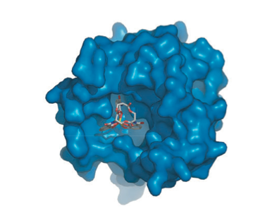
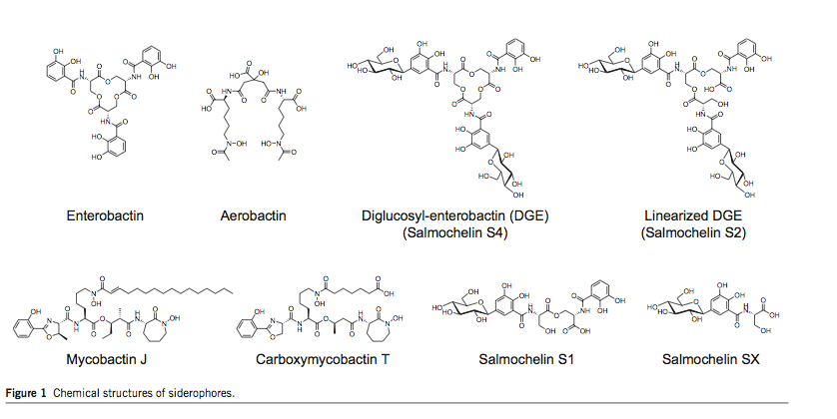
Function differences:
Aerobactin in 2010-HA8H

Slide 10
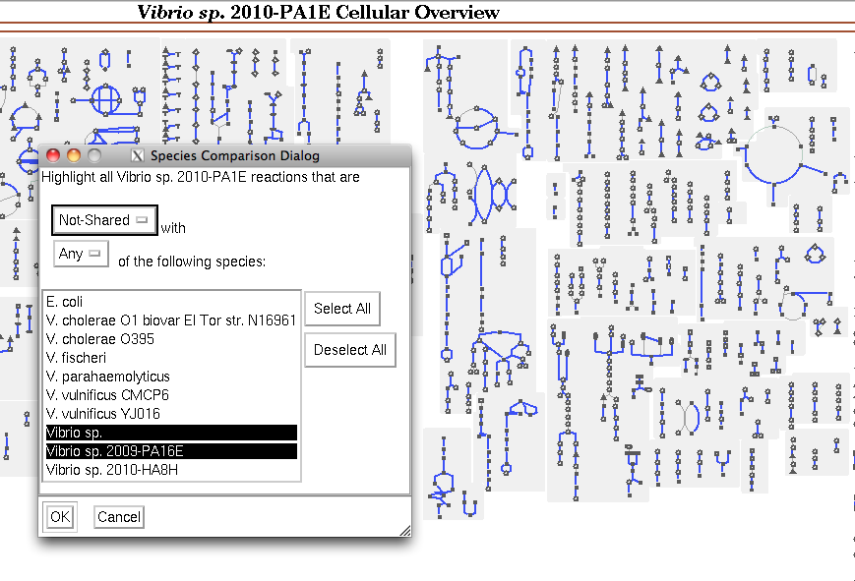
Function differences:
Aerobactin in 2010-HA8H

Slide 11
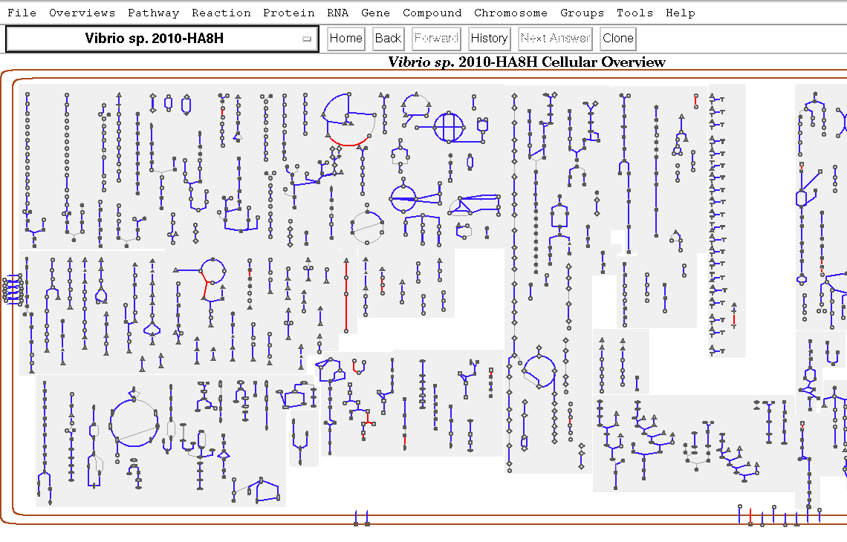
Function differences:
Aerobactin in 2010-HA8H

Slide 12
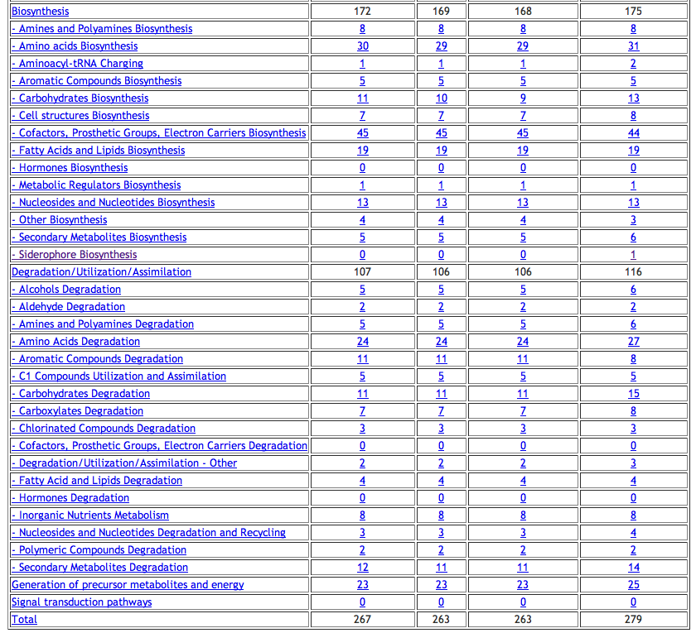

Slide 13
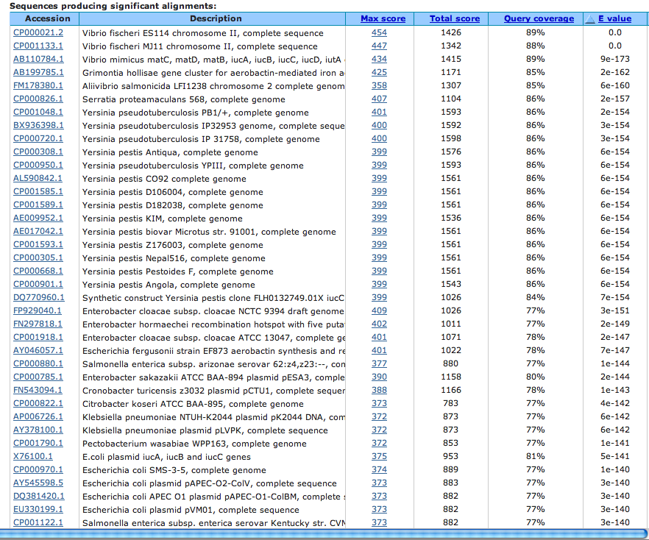

Slide 14
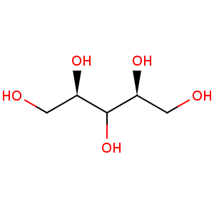
Pathway differences:
Where does Xylitol come from?
D-glucuronate degredation I
xylose degredation II
L-arabinose degredation II
xylithol
P. Mieke et al. 1988

Slide 15





Pathway differences:
Xylitol Import and Degradation in 2010-PA1E
Transcriptional regulator of xylitol utilization
Xylitol dehydrogenase
Xylulose kinase
Xylitol ABC transporter, ATP binding
Xylitol ABC transporter, permease
Xylitol ABC transporter, periplasmic substrate
Xylitol
NAD+
Xylitol-5-P
NADH
Xylulose-5-P
phosphoketolase
aerobic
anaerobic
Ethanol
Acetate
Pyruvate
Pentose Phosphate Pathway
3ATP +

Slide 16
Elaboration of MLSA
How quickly do polymorphisms accumulate outside the housekeeping genes?
Polymorphisms up and downstream
Possible recombination events

Slide 17
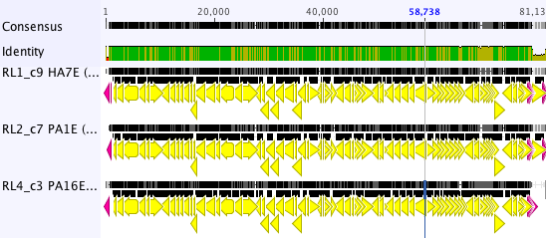
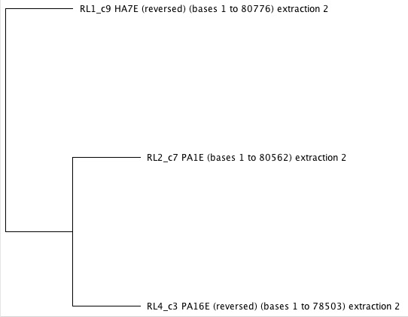
Recombination events upstream of recA
HA7E (2009)
HA7E (2009)
PA16E (2009)
PA1E (2010)
PA1E (2010)
PA16E (2009)

Slide 18
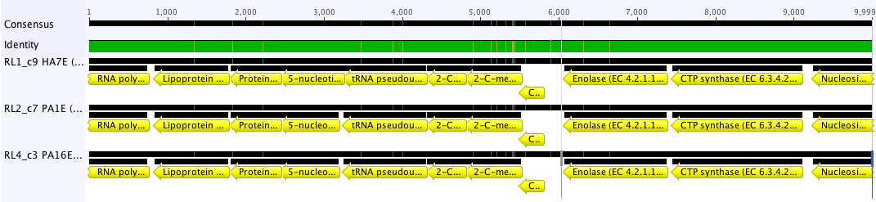
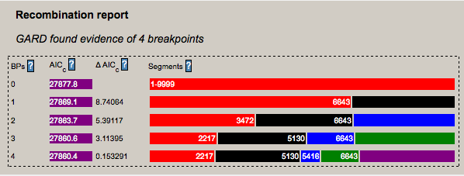
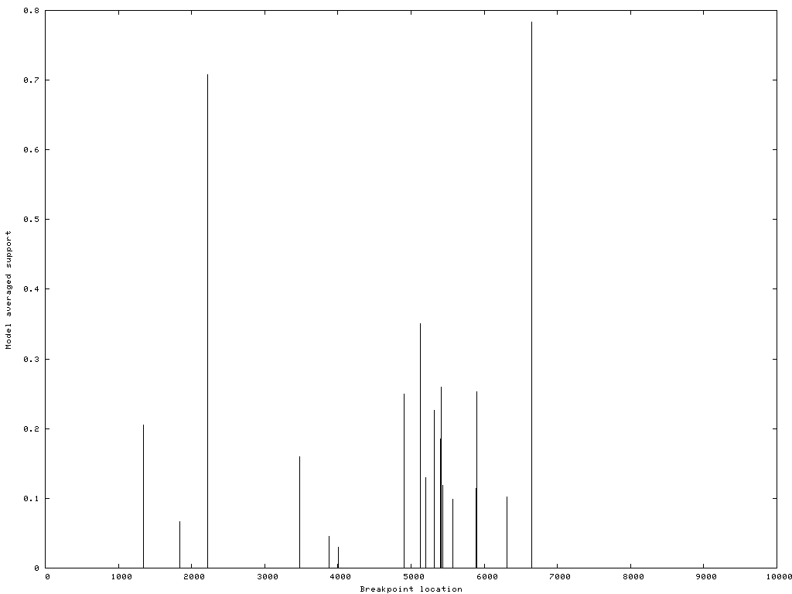
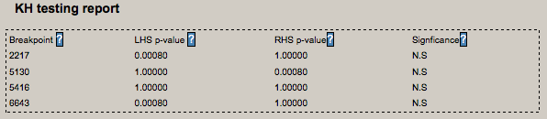
recA upstream 10-20 kb
Recombination events upstream of recA
HA7E (2009)
PA16E (2009)
PA1E (2010)

Slide 19
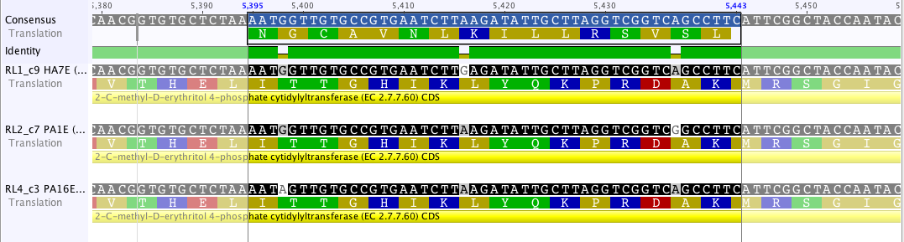
HA7E (2009)
PA16E (2009)
PA1E (2010)
HA7E (2009)
HA7E (2009)
PA16E (2009)
PA1E (2010)
PA1E (2010)
PA16E (2009)

Slide 20
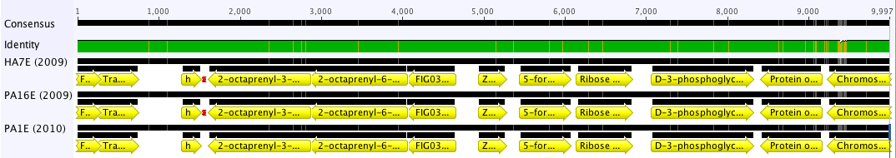
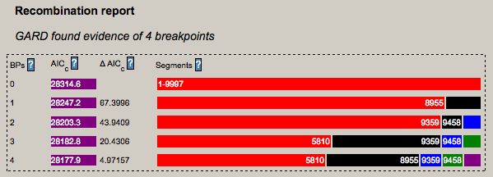
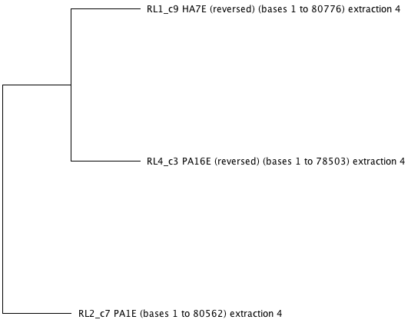
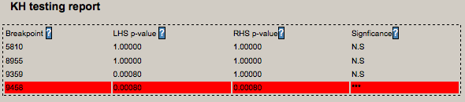
recA upsteam 30 – 40 kb
Recombination events upstream of recA
HA7E (2009)
PA16E (2009)
PA1E (2010)

Slide 21
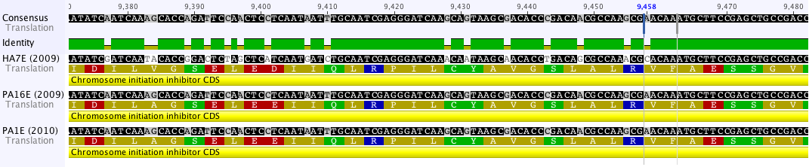
Polymorphisms
Polymorphisms in a 1000 bp region upstream of recA
A A G A C T A G A C C C G T G C G T A A G G G G A T T A A G G G G
G T A G A T G A A T C G A T G T A A T C A A G A G C A T C A A G A
A A G A C C G G T C G G G G A T A A T C A A A A A C A A C A A A A

Slide 22
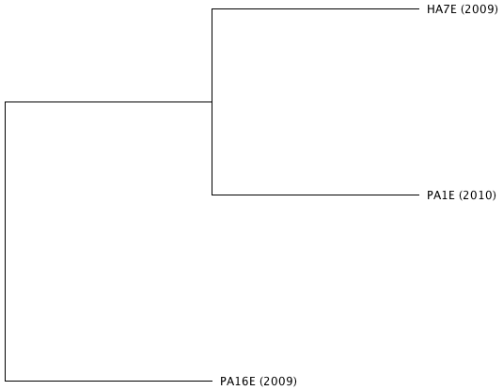
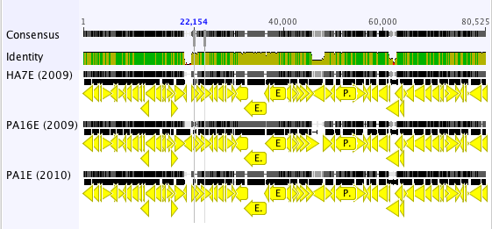
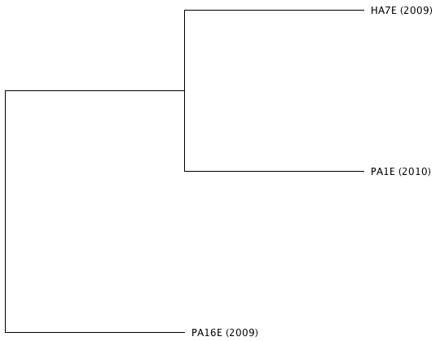
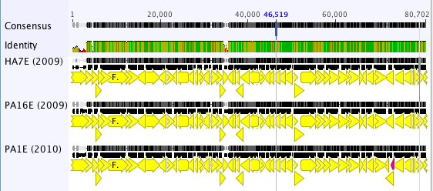
Comparison to other “MLSA” genes
ompK
mdh

Slide 23
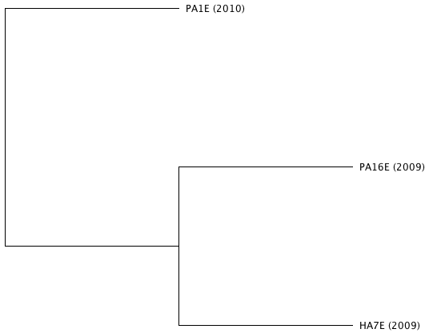
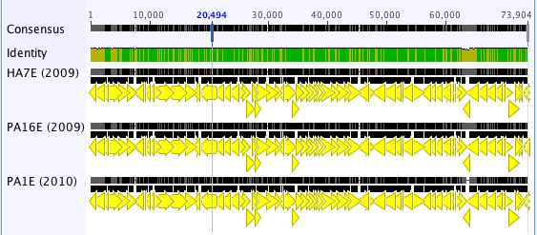
Comparison to other “MLSA” genes
gyrB
Summary:
“Hmm, hmm, yes…veeery interesting. Something is going on here…!” (Paul)

Slide 24
Genetic differences
What are the sources and maintenance of diversity?
Large Contig Alignment
Identifying Insertion Sequences
Analysis of nucleotide signatures

Slide 25
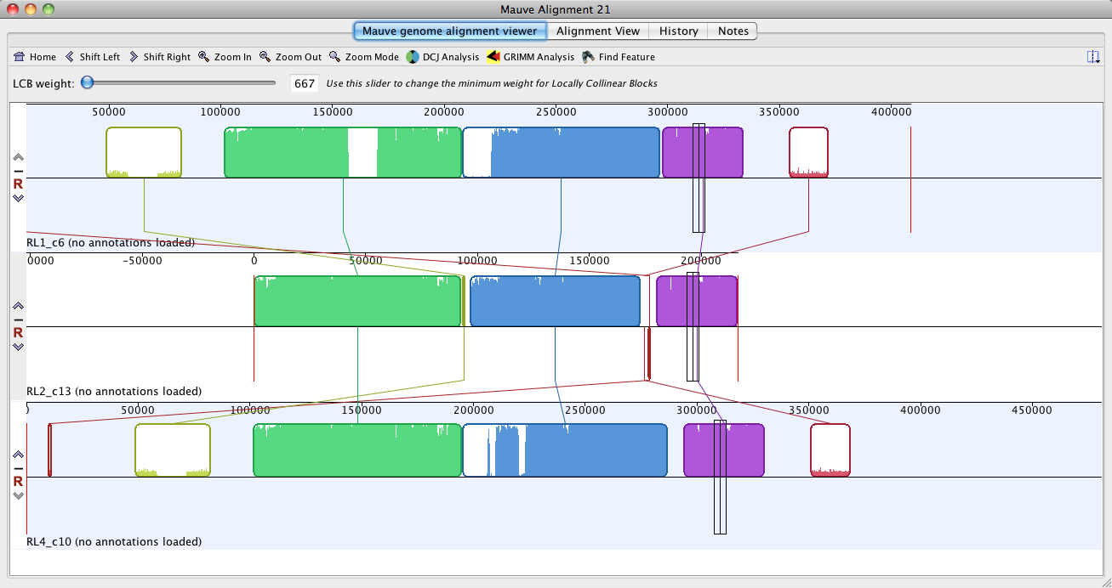
Large Contig Alignment

Slide 26
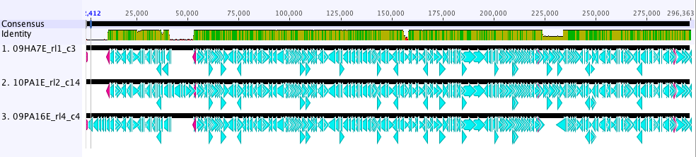
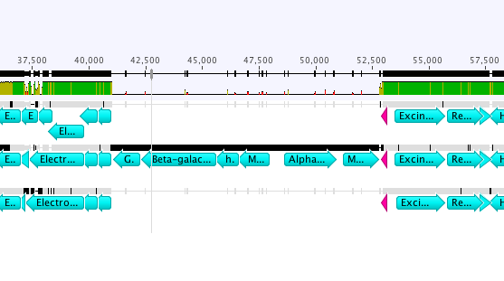
Identifying Insertion Sequences

Slide 27
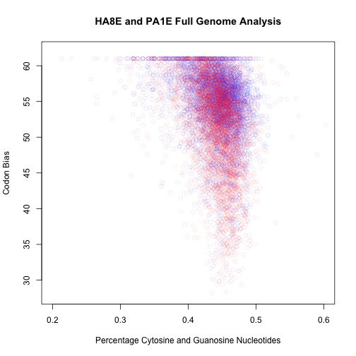
2010-HA8H and 2010-PA1E full genome analysis

Slide 28
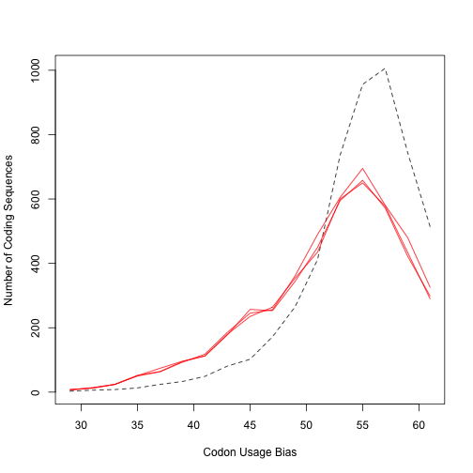
2010-HA8H and 2010-PA1E full genome analysis

Slide 29
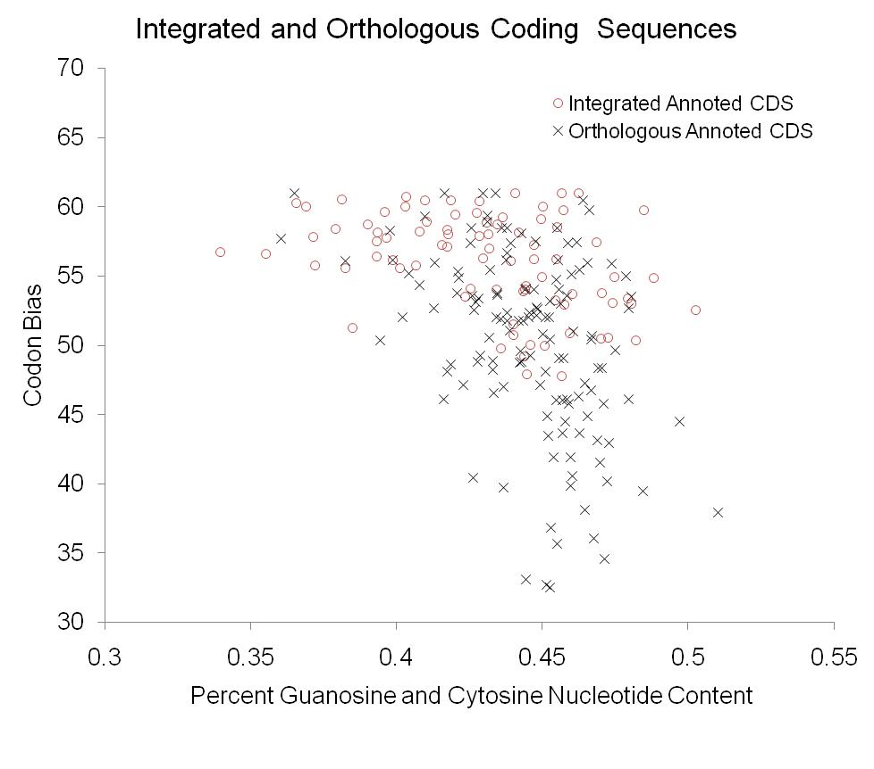

Slide 30
META-BLASTOMICS RESULTS
 | Genes | Vibrio | Non Vibrio | Phage/Mobile Element
Total Unique Genes | 141 | 103 | 38 | 22
Total Quasi Unique Genes | 180 | 162 | 18 | 27

Slide 31
META-BLASTOMICS RESULTS
Total Unique Genes | 141 | Percentage
In at least one Vibrio | 103 | 73%
In at least one Model Vibrio | 58 | 41%
In a Single Model Vibrio | 15 | 11%
In 2 Model Vibrio | 22 | 16%
In 3 Model Vibrio | 21 | 15%

Slide 32
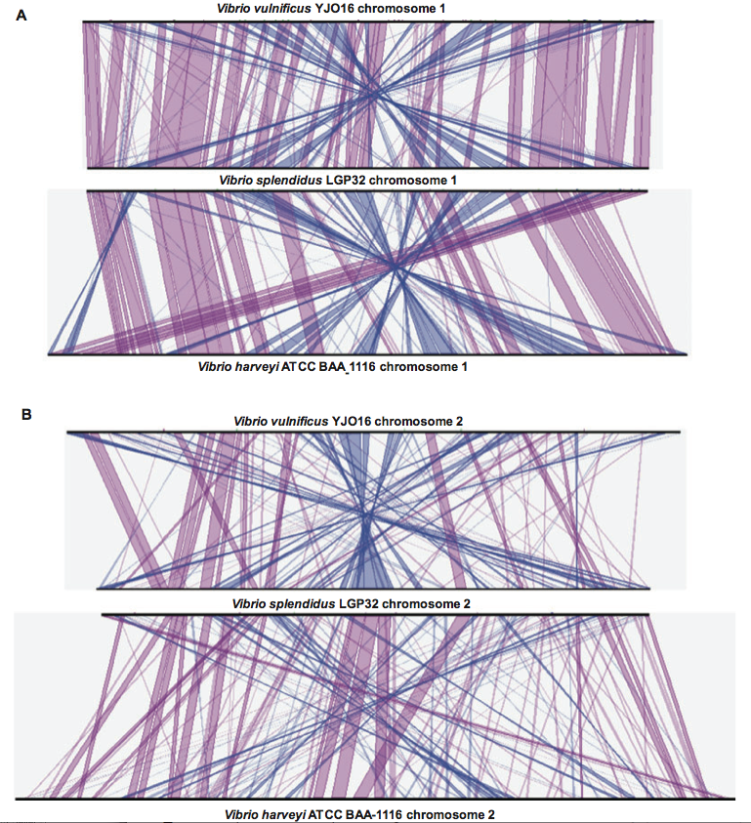

Slide 33
Summary
Analysis of Core Genome:
2010-HA8H has low similarity to the other sequences
Functional/Pathway differences:
2010-HA8H: Polymyxin Resistance and Arabactin
2010-PA1E: Xylitol Transport and Utilization
Elaboration of MLSA:
No distinct pattern of recombination events among the three compared strains.
Genetic differences:
may arise from phage integration events, where most unique genes appear to come from other vibrio species.

Slide 34
Gene
Physical and Chemical
Environment
Function
Organism

Slide 35
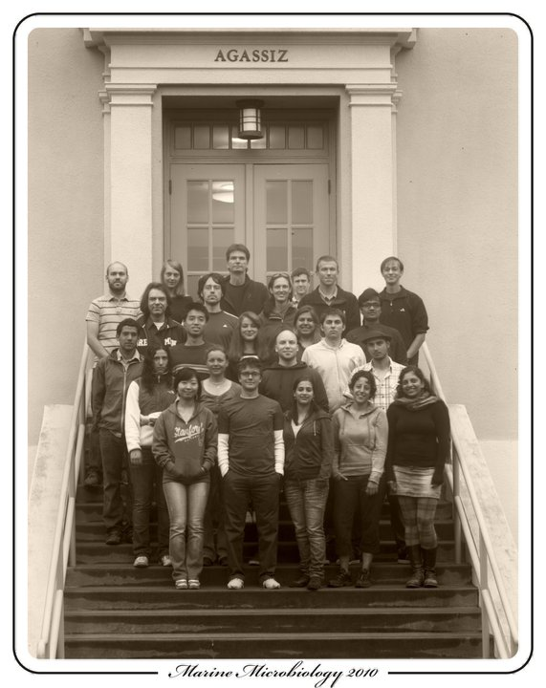
Thanks!
Hopkins 2010 Class, Teaching Team and Intern

Slide 36
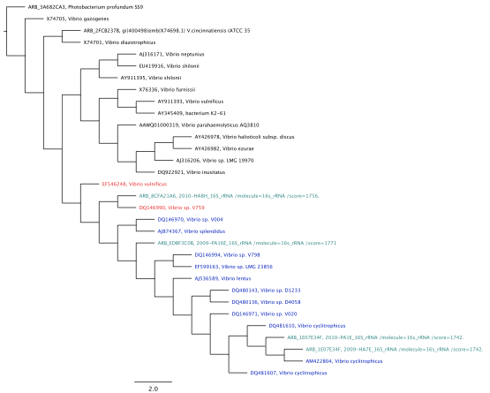
16s RNA tree
2010-HA8H
2009-PA16E
2010-PA1E
2009-HA7E

