Slide 1
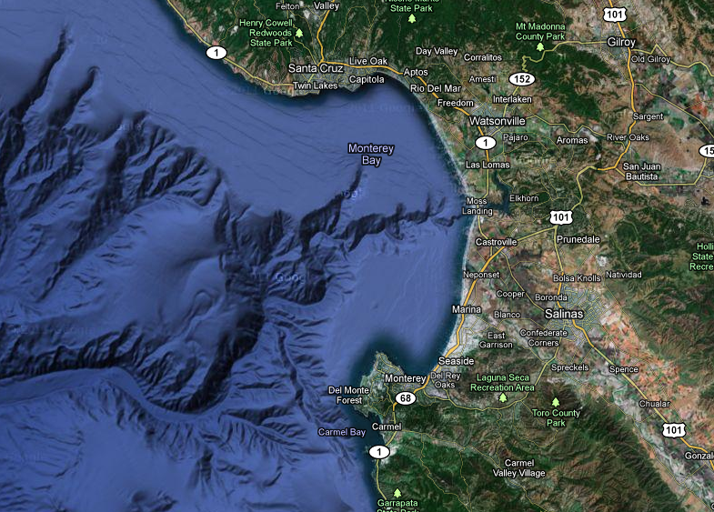
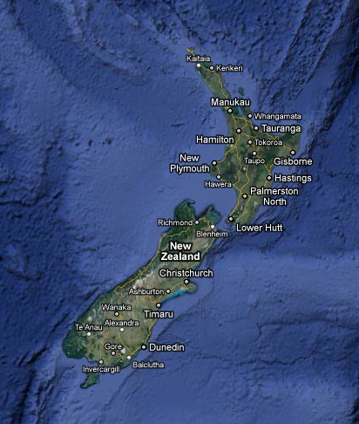
Vibrio Population Genetics
Hopkins Microbiology Course 2011
Frank, Elsa, Bernal, Sasha, Tyler

Slide 2
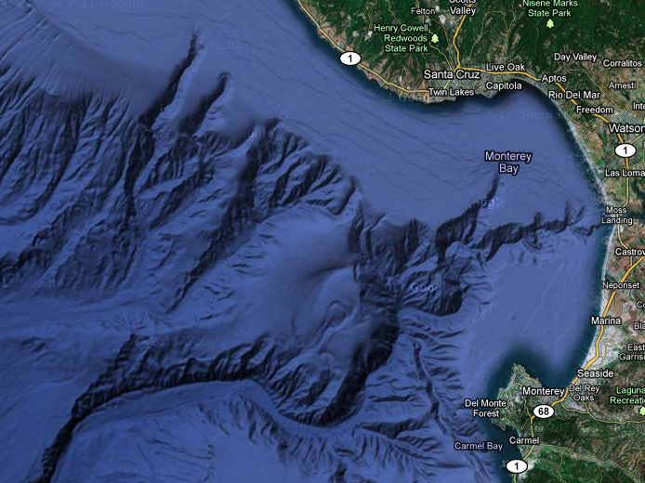
Vibrio Population Genetics
How are Vibrios and their genes distributed locally and globally?

Slide 3
Sampling Scheme for Multilocus Sequencing
New Zealand:
(2 coasts) x (2 beaches each) x (10 anemones each) x (5 Vibrio isolates each)
California, 2007-2011:
(Hopkins and Pt Lobos) x (8 anemones + 4 water each) x (5 Vibrio isolates each)
Sequenced:
recA, gyrB, mdh & ompK
ATCGAT
ATCGCG

Slide 4
Rarefaction
1%
Notes:
How exhaustive was our sampling of diversity?

Slide 5
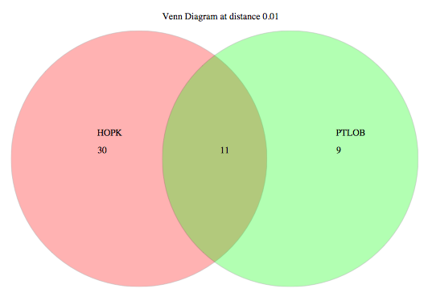
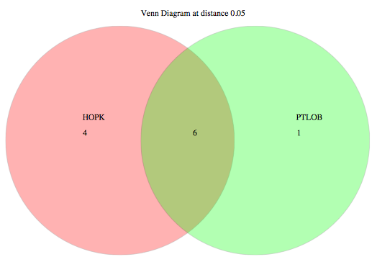
California vs. New Zealand
1% Cutoff
5% Cutoff
CA NZ
CA NZ
49 1 50
9 2 16
Total OTUs = 100 Total OTUs = 27

Slide 6
California - Anemone vs. Water
1% Cutoff
5% Cutoff
Anemone Water
Anemone Water
22 13 15
2 7 2
Total OTUs = 50 Total OTUs = 11

Slide 7
California - Hopkins vs. Point Lobos
1% Cutoff
5% Cutoff
Hopkins Pt. Lobos
Hopkins Pt. Lobos
30 11 9
4 6 1
Total OTUs = 50 Total OTUs = 11

Slide 8
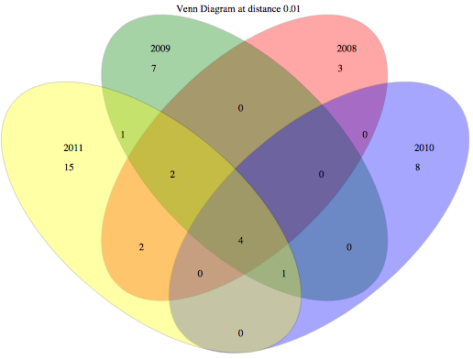
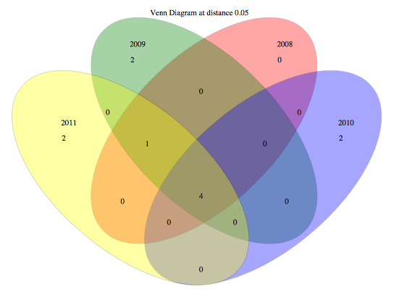
California – 2008 to 2011
1% Cutoff
5% Cutoff
2009
2008
2009
2008
7
3
2011
2
0
2010
2011
2010
0
0
1
0
0
0
15
8
2
2
2
0
1
0
4
0
4
2
0
0
0
1
0
0
0
0
Total OTUs = 43 Total OTUs = 11

Slide 9
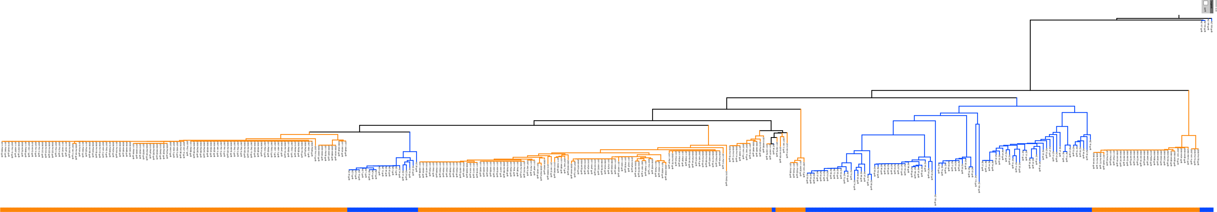
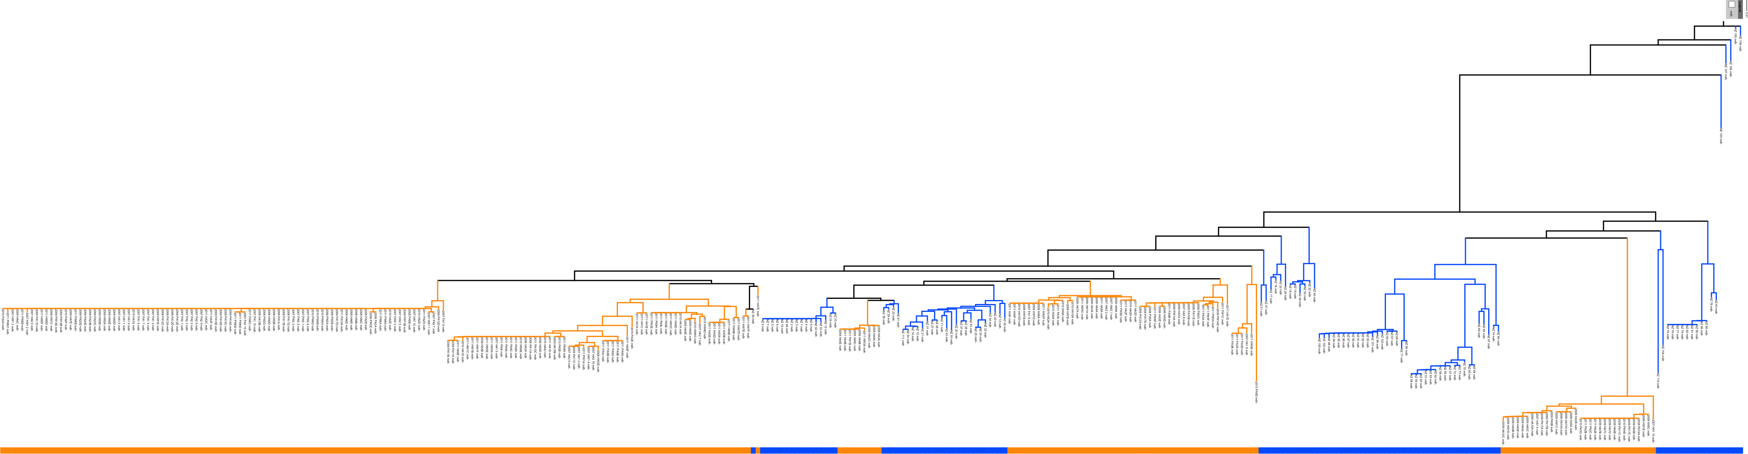
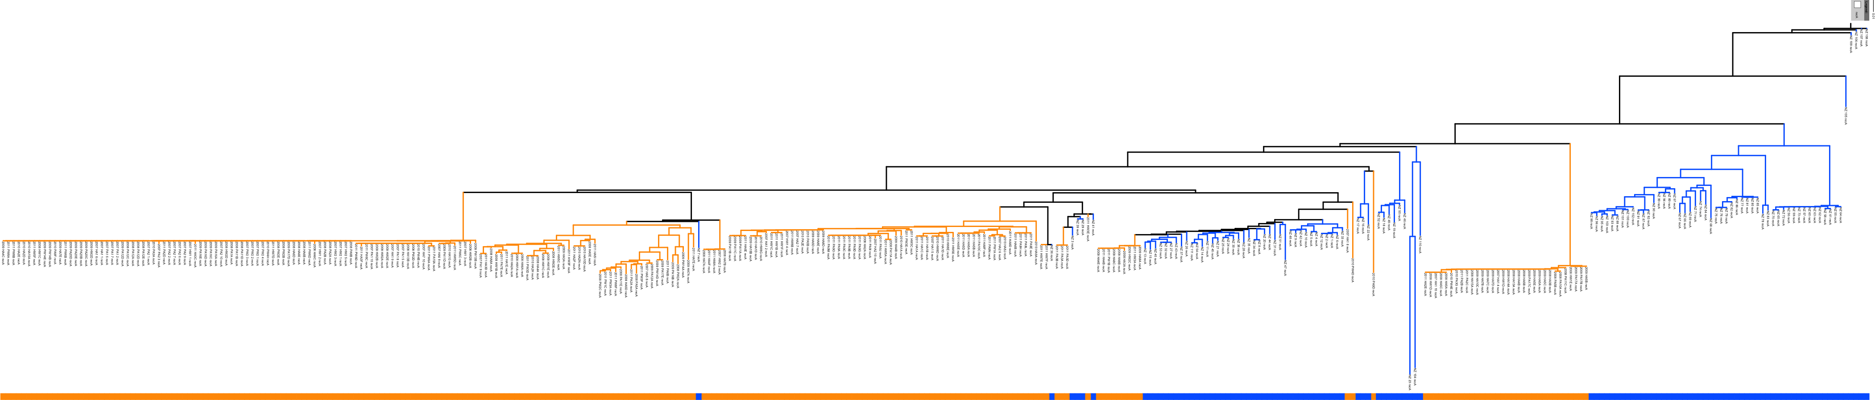
gyrB
California
New Zealand
mdh
recA
Notes:
Fun Fact: phi test says there’s evidence for recombination in the recA gene but not the other two genes

Slide 10
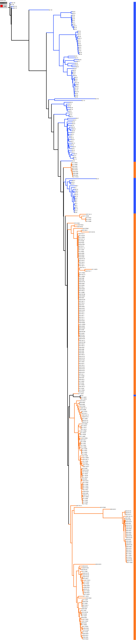
Concatenated Housekeeping by Location
California New Zealand

Slide 11
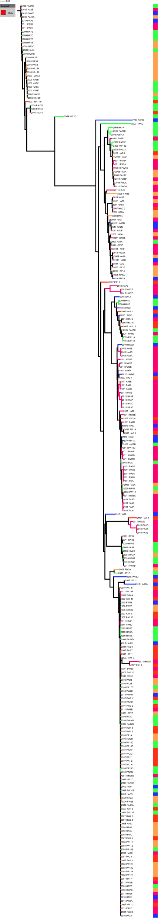
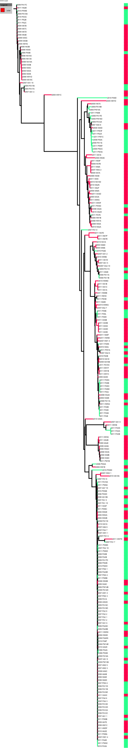
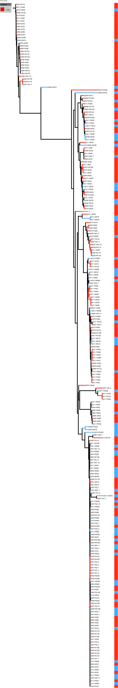
California Concatenated by:
Location
Hopkins
Point Lobos
Association
Anemone
Water
Year
2007
2008
2009
2010
2011

Slide 12
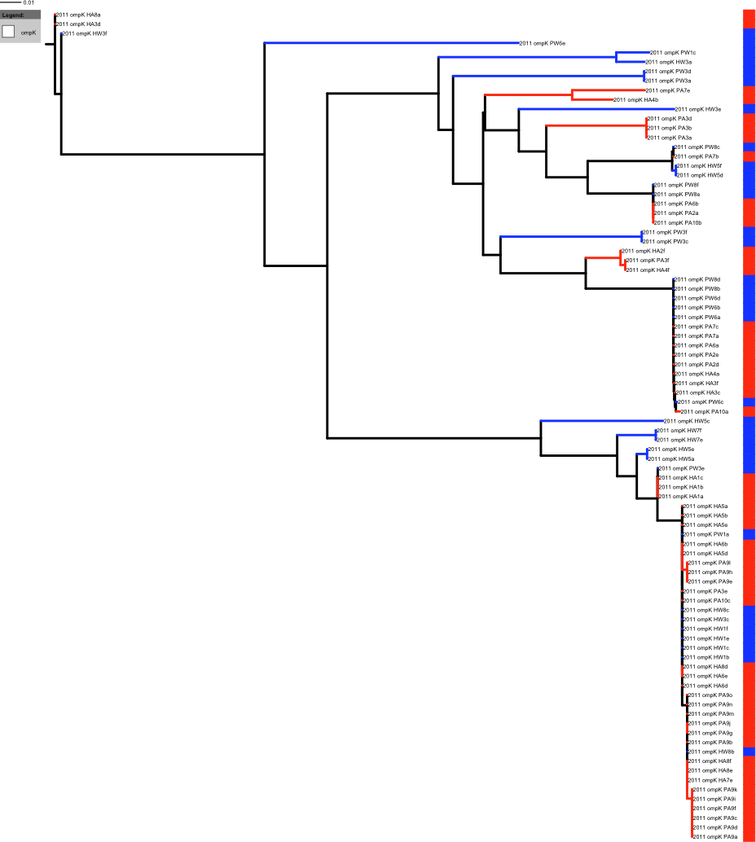
Variable
Selection
ompK
(2011 only)
Hopkins
Point Lobos

Slide 13
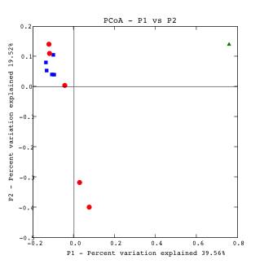
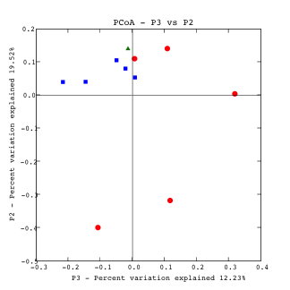
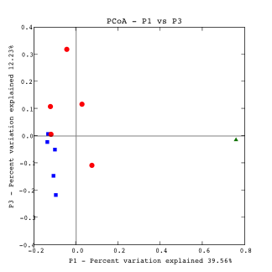
UNIFRAC
• Water  Anemone  NZ
2009
2008
2011
2007
2009
2009
2007
2007
2011
2011
2007
2011
2011
Comparison | P-value
NZ vs CA | 0.01
Anemone vs Water | 0.28 (CA only)
Between Years | 0.05-0.1 (CA only)

Slide 14
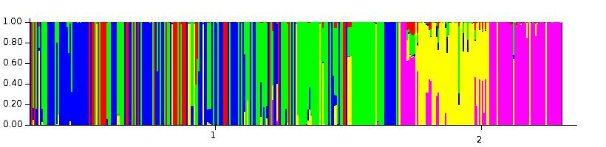
California vs. New Zealand
CALIFORNIA
NEW ZEALAND
 | Pop1 | Pop2 | Pop3 | Pop4 | Pop5
CA | 0.130 | 0.427 | 0.382 | 0.059 | 0.0002
NZ | 0.012 | 0.027 | 0.010 | 0.435 | 0.516

Slide 15
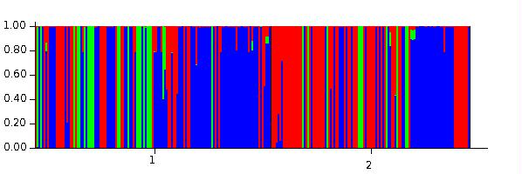
Locations within California
Hopkins
Pt. Lobos
 | Pop 1 | Pop2 | Pop3
Hopkins | 0.28 | 0.17 | 0.57
Pt. Lobos | 0.52 | 0.09 | 0.39

Slide 16
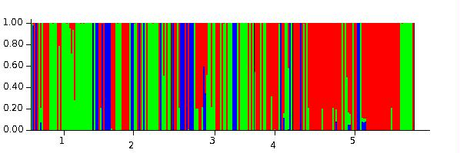
California Across Time
2007
2008
2009
2010
2011

Slide 17
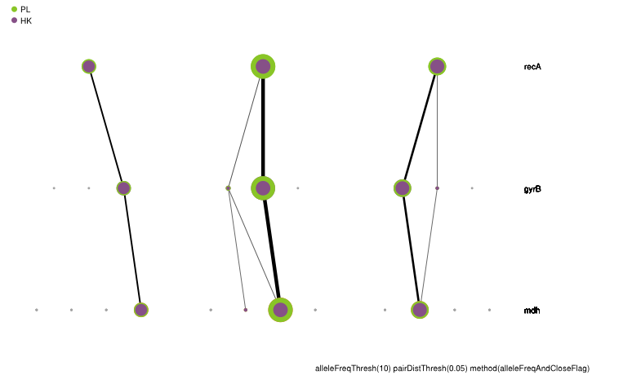
Considering Allele Types
recA
gyrB
mdh
Point Lobos
Hopkins

Slide 18
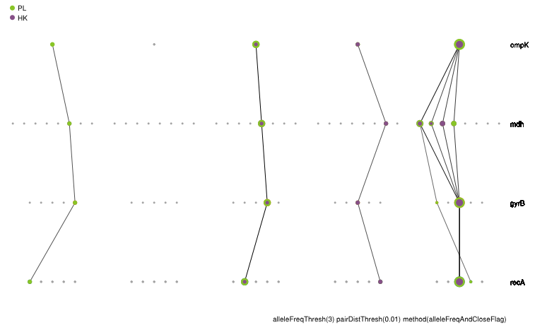
ompK across California & Allele Types
ompK
recA
gyrB
mdh
Point Lobos
Hopkins

Slide 19
Conclusions & Future Directions
Distinct local vs global patterns in Vibrio sequence types
Investigate further:
  Environmental data
  Temporal data
  Spatial distribution of hybridization
  Competition experiments to determine local adaptation
Notes:
Vibrio genes and genotypes are different at global scales, with more subtle local (and temporal?) effects
Unique OTUs in each hemisphere
More recombination in NZ than CA
Three populations in CA don’t correspond to 2 geographic locations—what are they?
Investigate: ecological data – what are the relevant environmental dimensions?
Continue monitoring shifts in populations over time
Do a transect – Is there a hybrid zone?
Why different amounts of recombination? Feature of the genes, or feature of the environment?

Slide 21
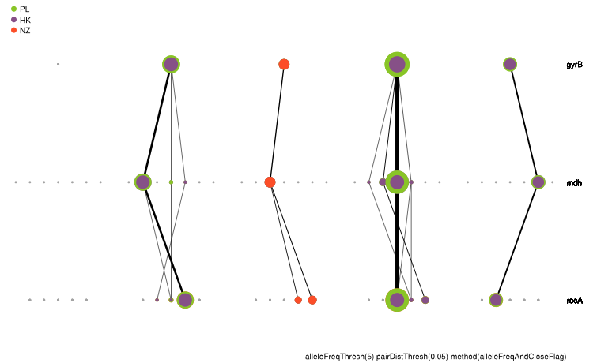

Slide 22
