Slide 1
Colorless Sulfur Bacteria
Hopkins Microbiology Course
Kristin Matulich
July 15th, 2011

Slide 2
Microbial Mat Ecology
Aerobic heterotroph H₂O + HCO₃⁻ ⬅ <CH₂O> + O₂ + HO⁻
Cyanobacteria H₂O + HCO₃⁻ ➔ <CH₂O> + O₂ + HO⁻
Colorless S⁰ H⁺ + SO₄²⁻ ⬅ HS⁻ + 2O₂
Purple/Green S⁰ 2<CH₂O> + SO₄²⁻ ⬅ HS⁻ + 2HCO₃⁻ + H⁺
Sulfate-Reducing 2<CH₂O> + SO₄²⁻ ➔ HS⁻ + 2HCO₃⁻ + H⁺
Anabolic reactions (Biomass production)
⬅ Catabolic reactions (ATP production)

Slide 3
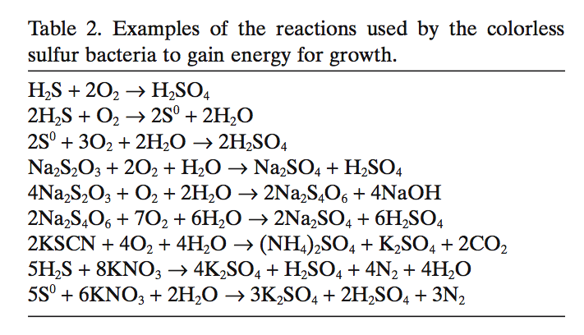
Metabolism
Gradient Tubes
Aerobic Thiosulfate Plates
Robertson and Kuenen, Prokayotes (2006)

Slide 4
General Characteristics
Mostly gram-negative aerobes
Chemolithoautotrophic
  Can fix carbon, and uses inorganic compounds to generate energy.
Visible in dark field of microscope due to sulfur on or in cells.

Slide 5
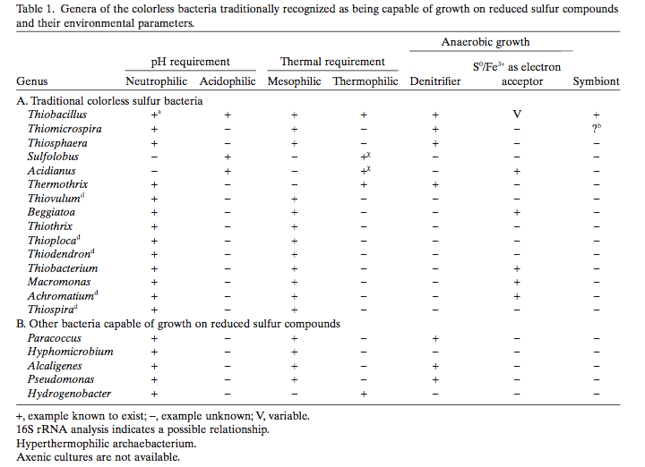
Notable Examples
Robertson and Kuenen, Prokayotes (2006)

Slide 6
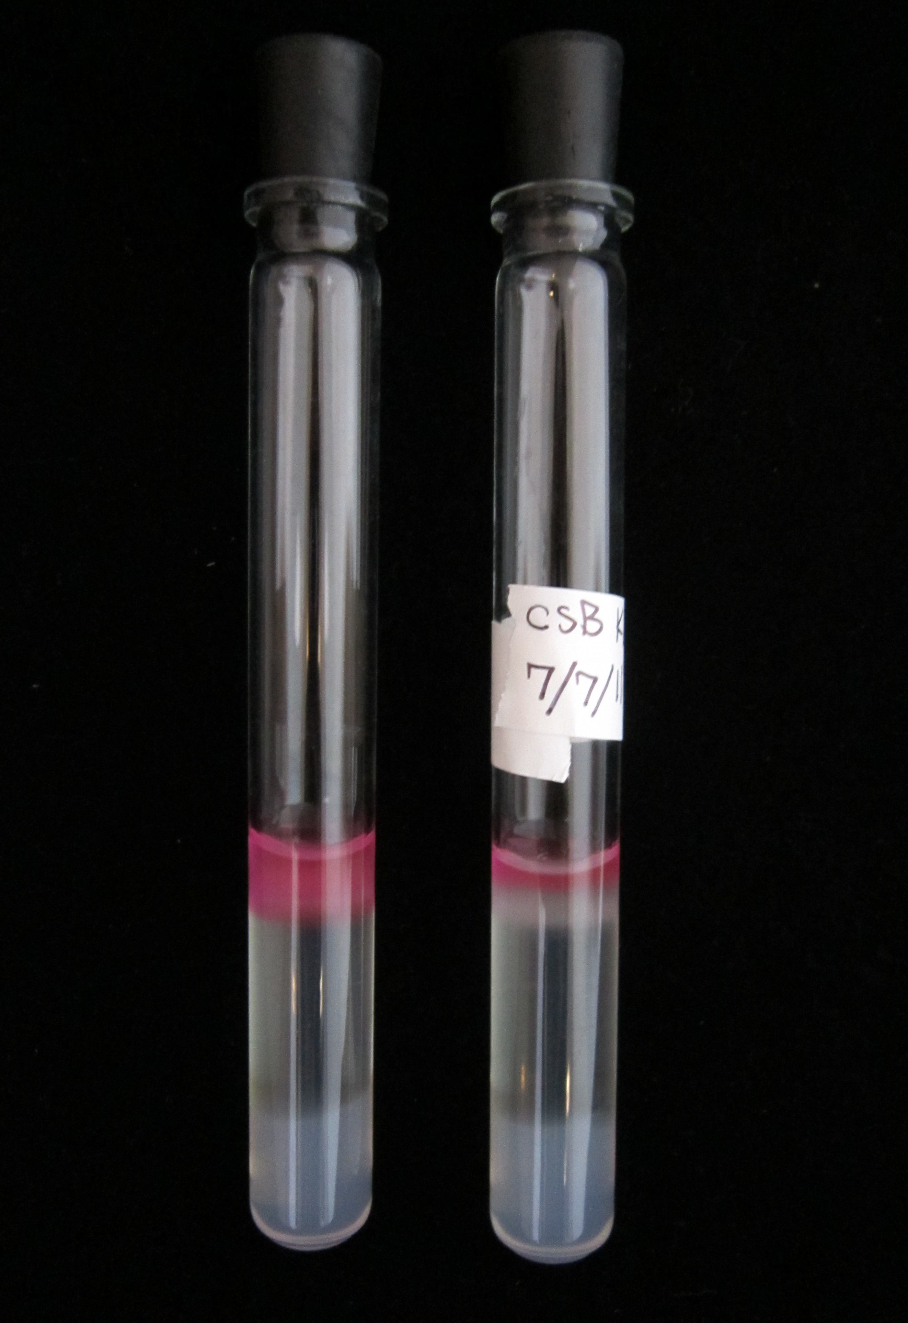
Gradient Tubes
Used to isolate CSB that live at O₂-H₂S interface.
Media
  Sulfide-Agar Plug
    Contains S source (Na₂S) and allows S diffusion upward.
  Overlay Medium
    Allows O₂ diffusion downward.

Slide 7
Thiosulfate Plates
Medium contains sodium thiosulfate (Na₂S₂O₃) as electron donor.
Can be used in aerobic and anaerobic conditions.
  Aerobic: O₂ electron acceptor
  Anaerobic: NO₃⁻ electron acceptor
Identification:
  Production of sulfuric acid, resulting in agar plate to change color.
  Cells will accumulate elemental sulfur, causing colonies to appear pale yellow.

Slide 8
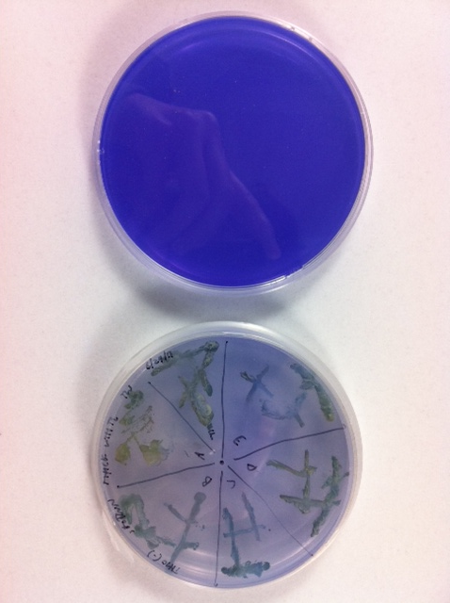
Thiosulfate Plates

Slide 9
Enrichment Success
 | Gradient Tubes | Thiosulfate Plates (Aerobic) | Thiosulfate Plates (Anaerobic)
Class Success | High | Moderate | Low

Slide 10
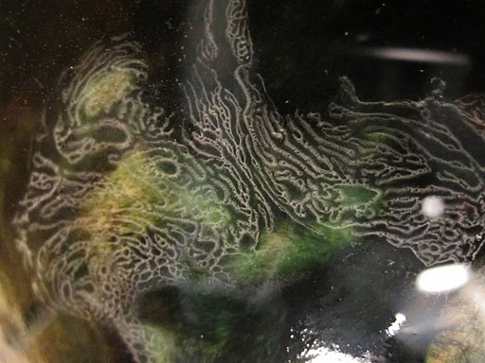
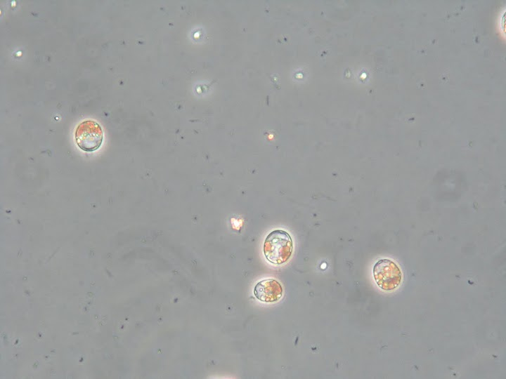
Images
Thiovulum veil
Thiovulum

Slide 11
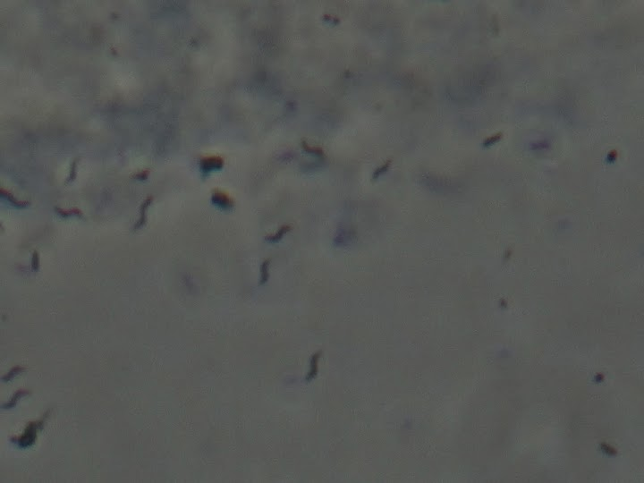
Images
Enrichment (Aerobic Plate)
Enrichment (Gradient Tube)

