Slide 1




Comparative Vibrio Genomics
Yan Wei Lim (San Diego State University)
Ann Lesnefsky (Stanford University)
Sarah Douglas (Harvard University)
Julian Damashek (Stanford University)
Bradley Tolar (University of Georgia)
Hopkins Microbiology Course 2011

Slide 2
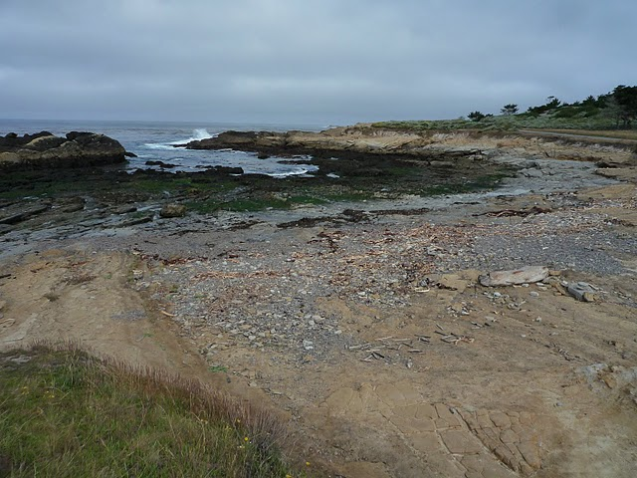
Point Lobos

Slide 3
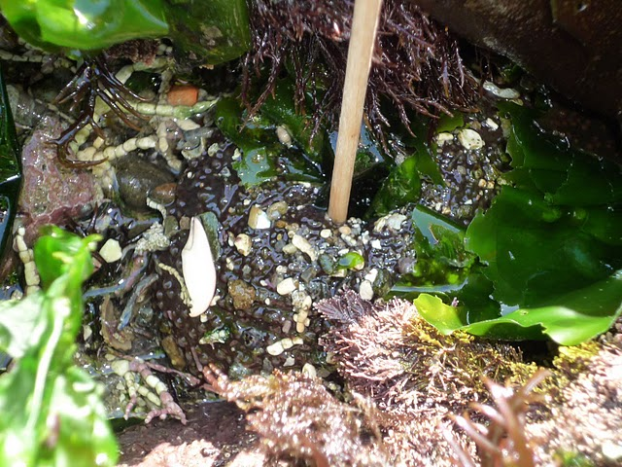
2011 Sampling Effort

Slide 4
2011 HMC Vibrio Genomes
 | PA2D | PA2G
No of .fnn Contigs | 195 | 184
Genes | 4,765 | 4,334
Genes of known or predicted molecular function | 1,544 | 1,414
Pathways | 323 | 299
Metabolic reactions | 1,242 | 1,200
Transport reactions | 13 | 13
Compounds | 1,008 | 981

Slide 5
HMC Vibrio Genomes
Sample ID | Sampling Site | Total Number of Contigs
HA7E | Hopkins_2009 | 97
PA16E | Point Lobos 2009 | 112
HA8H | Hopkins 2010 | 140
PA1E | Point Lobos 2010 | 118
PA2D | Point Lobos 2011 | 195
PA2G | Point Lobos 2011 | 184

Slide 6
Publicly available
Complete Genome (Annotated)
Species | UID | Chrom1 | Chrom2 | Chrom3
Vibrio anguillarum 775 | id68057 | NC_015633 | NC_015637
Vibrio cholerae M66 2 | id59355 | NC_012578 | NC_012580
Vibrio cholerae MJ 1236 | id59387 | NC_012668 | NC_012667
Vibrio cholerae O1 biovar El Tor N16961 | id57623 | NC_002505 | NC_002506
Vibrio cholerae O395 | id58425 | NC_009457 | NC_009456
Vibrio Ex25 | id41601 | NC_013456 | NC_013457
Vibrio fischeri ES114 | id58163 | NC_006840 | NC_006841 | NC_006842
Vibrio fischeri MJ11 | id58907 | NC_011184 | NC_011186 | NC_011185
Vibrio harveyi ATCC BAA 1116 | id58957 | NC_009783 | NC_009784 | NC_009777
Vibrio parahaemolyticus RIMD 2210633 | id57969 | NC_004603 | NC_004605
Vibrio splendidus LGP32 | id59353 | NC_011753 | NC_011744
Vibrio vulnificus CMCP6 | id62909 | NC_004459 | NC_004460
Vibrio vulnificus MO6 24 O | id62243 | NC_014965 | NC_014966
Vibrio vulnificus YJ016 | id58007 | NC_005139 | NC_005140 | NC_005128

Slide 7
Bioinformatics Tools for Determining Core Genes
COREGENES: Only allow 5 genomes at a time. No standalone version
CUPID: Not available
PROCOM: Not flexible, not able to upload genomes, and only have eukaryotic genomes in the web browser
EDGAR: Not able to upload own genomes, genomes in there are not complete, but generate very nice file to work downstream.

Slide 8
Bioinformatics Tools for Determining Core Genes
COREGENES: Only allow 5 genomes at a time. No standalone version
CUPID: Not available
PROCOM: Not flexible, not able to upload genomes, and only have eukaryotic genomes in the web browser
EDGAR: Not able to upload own genomes, genomes in there are not complete, but generate very nice file to work downstream.
USELESS

Slide 9
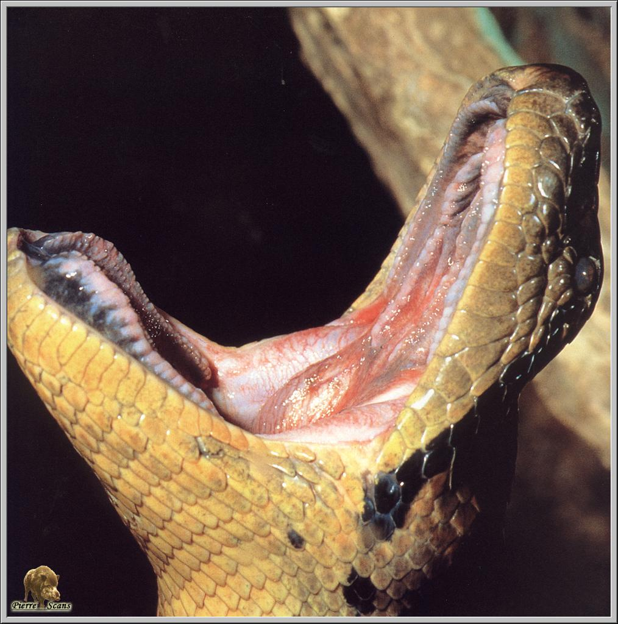
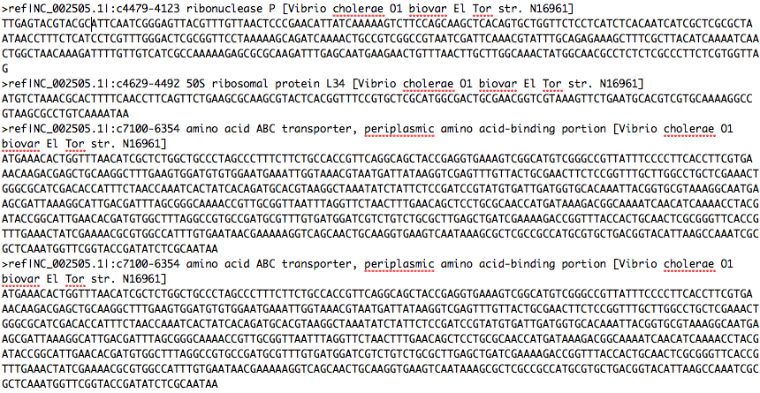
Core Gene Databases
Core gene set: genomic estimation of what makes a Vibrio a Vibrio, clues about distinctive Vibrio phenotype
With closed genomes: highlight “abnormal” genes
Chrom1
Chrom2
Chrom2
Chrom1
Compare genes in our Vibrio genomes to Vibrio core gene database
Chrom1
Chrom2
Genes present in all publicly-available Vibrio genomes = “core genes”
Compiled into database of core Vibrio genes
PYTHON!

Slide 10
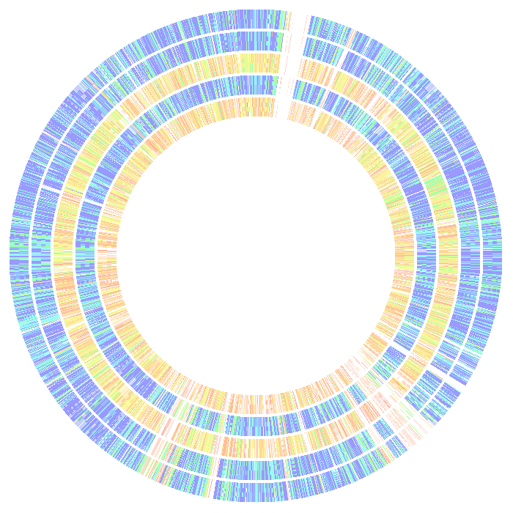

Genome
Comparison
HA7E
PA16E
HA8H
PA2D
PA2G
AWESOME!
PA1E as
the Reference
SEED – RAST
http://rast.nmpdr.org/

Slide 11
Average Nucleotide Identity
Calculated pairwise comparison between 2 genomes
Used script from Kostas Konstantinidis to calculate ANI (Konstantinidis and Tiedje, 2005)

Slide 12
Distance Table Made Using % ANI
 | PA16E | HA7E | PA1E | HA8H | PA2D | PA2G
PA16E | 0 | 99.14 | 98.93 | 77.1 | 99.08 | 77.11
HA7E | 99.14 | 0 | 98.95 | 77.07 | 99.06 | 77.02
PA1E | 98.93 | 98.95 | 0 | 77.13 | 98.84 | 77.12
HA8H | 76.84 | 76.97 | 77.24 | 0 | 77.14 | 76.28
PA2D | 99.08 | 99.06 | 98.87 | 77.12 | 0 | 77.21
PA2G | 76.7 | 76.92 | 77.26 | 76.12 | 77.32 | 0

Slide 13
Average Nucleotide Identity
Calculated pairwise comparison between 2 genomes
Used script from Kostas Konstantinidis to calculate ANI (Konstantinidis and Tiedje, 2005)
Used distance matrix generated to make tree with Phylip’s Neighbor (http://mobyle.pasteur.fr)

Slide 14
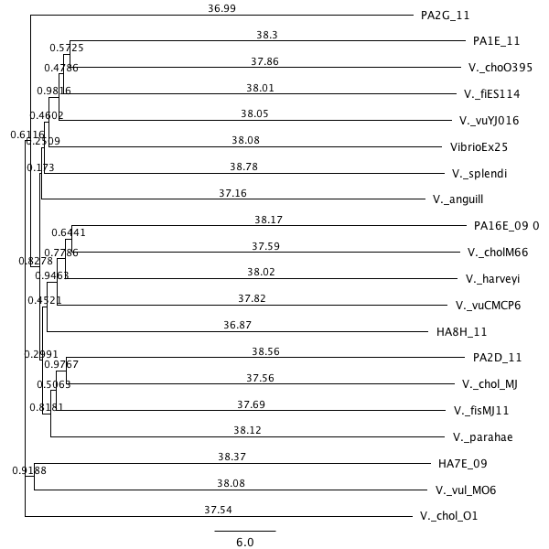
ANI
Tree
V. cholerae
V. fischeri
V. vulnificus
Vibrio sp. Ex25
V. splendidus
V. anguillensis
V. cholerae
V. harveyi
V. vulnificus
V. cholerae
V. fischeri
V. parahaemolyticus
V. vulnificus
V. cholerae

Slide 15
Average Nucleotide Identity
Calculated pairwise comparison between 2 genomes
Used script from Kostas Konstantinidis to calculate ANI (Konstantinidis and Tiedje, 2005)
Used distance matrix generated to make tree with Phylip’s Neighbor (http://mobyle.pasteur.fr)
Blasted all genomes against PA1E to get comparison across the entire genome (blastall command in UNIX)
Used R to plot all comparisons

Slide 16
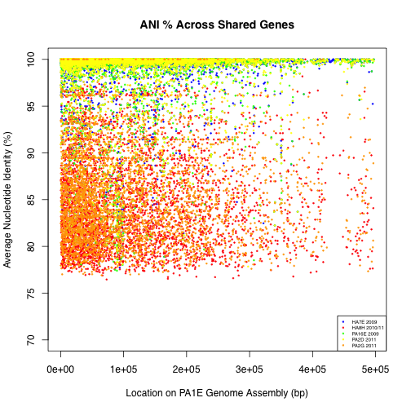

Slide 17
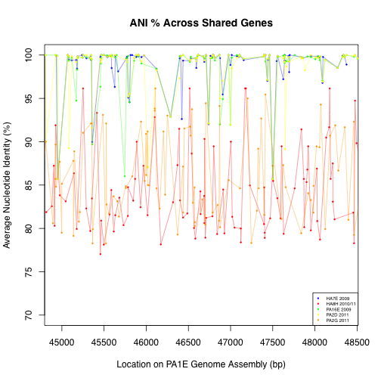

Slide 18
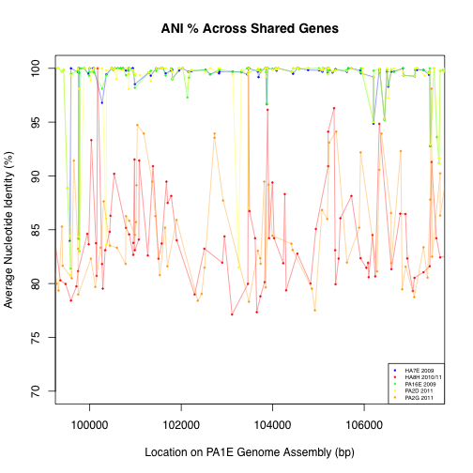

Slide 19
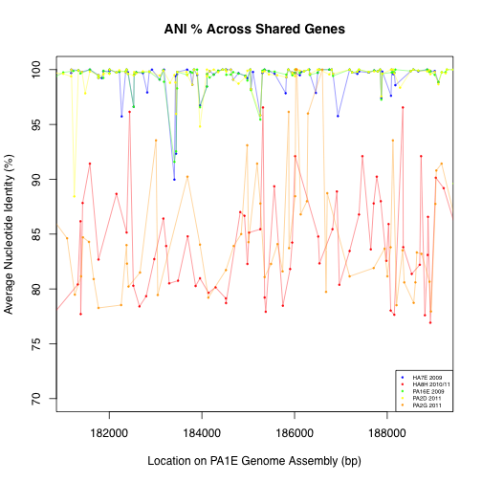

Slide 20
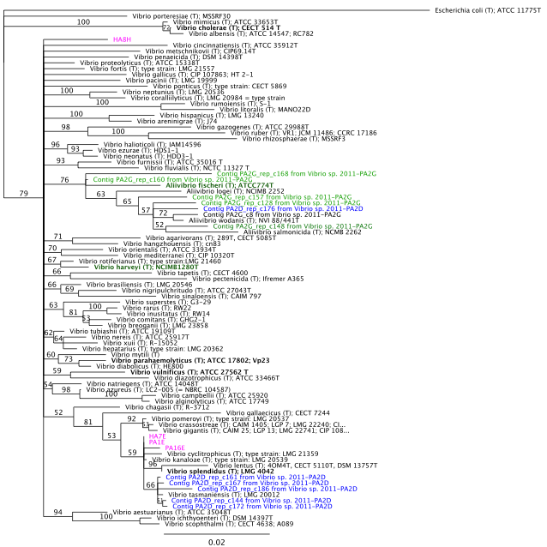
Diversity based on 16S rRNA genes
72 Vibrio and Aliivibrio species
6 class genomes
  4 alumni genomes
    One 16S sequence each
  2 from this year
    Six 16S sequences each
Aligned in RDP database
Tree grown in Geneious, with Neighbor-Joining

Slide 21
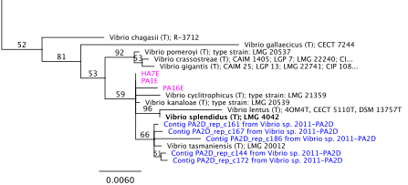
Cluster of Class Genomes

Slide 22
Cluster of Class Genomes

Slide 23
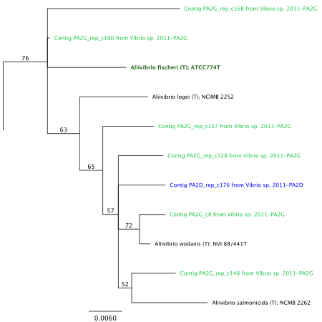
Bioluminescence Cluster
All PA2G 16S sequences fall in Aliivibrio clade
Aliivibrio fischeri also bioluminescent
 | PA2D_c176 | PA2G_c157 | PA2G_c160 | PA2G_c148 | PA2G_c168 | PA2G_c8 | PA2G_c128
PA2D_c176 | 0.000
PA2G_c157 | 0.018 | 0.000
PA2G_c160 | 0.025 | 0.007 | 0.000
PA2G_c148 | 0.019 | 0.037 | 0.044 | 0.000
PA2G_c168 | 0.040 | 0.057 | 0.065 | 0.047 | 0.000
PA2G_c8 | 0.020 | 0.038 | 0.045 | 0.028 | 0.048 | 0.000
PA2G_c128 | 0.024 | 0.042 | 0.049 | 0.031 | 0.052 | 0.024 | 0.000
 | PA2D_c176 | PA2D_c186 | PA2D_c167 | PA2D_c172 | PA2D_c144 | PA2D_c161
PA2D_c176 | 0.000
PA2D_c186 | 0.056 | 0.000
PA2D_c167 | 0.050 | 0.009 | 0.000
PA2D_c172 | 0.050 | 0.009 | 0.002 | 0.000
PA2D_c144 | 0.052 | 0.011 | 0.004 | 0.003 | 0.000
PA2D_c161 | 0.052 | 0.010 | 0.003 | 0.002 | 0.001 | 0.000

Slide 24
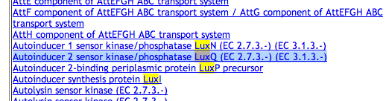
What type of Lux pathways detected in PA2G?
Hybrid HSL-two-component quorum sensing
uses two autoinducers to regulate density-dependent light production
LuxI → synthesis of N-(3-hydroxybutanoyl)-homoserine lactone
LuxN → AI-1 = N-(3-hydroxybutanoyl)-homoserine lactone
LuxQ → AI-2 = unknown structure
LuxP → require for AI-2 detection
Notes:
LuxN is responsible for detection of AI-1 and LuxQ is responsible for AI-2
LuxN and LuxQ are hybrid sensor kinases that contain a sensor kinase domain and attached response regulator domain
LuxP is a periplasmic binding protein require for AI-2 detection
The LuxI protein (square) is responsible for synthesis of the HSL autoinducer N-(3-oxohexanoyl)-homoserine lactone
- Vibrio fisheri and Vibrio harvery were the two luminous marine bacterial species that leads to the discovery of quorum sensing 25 years ago.
The enzymes responsible for the light production are encoded by the luciferase structural operon luxCDABE in response to high cell population density
The LuxI protein (square) is responsible for synthesis of the HSL autoinducer N-(3-oxohexanoyl)-homoserine lactone (hexagons). As the cell-population density increases, the concentration of the autoinducer increases both intra- and extracellularly. At a critical autoinducer concentration, the LuxR protein (circle) binds the autoinducer. The LuxR-autoinducer complex binds at the luxICDABE promoter and activates transcription of this operon.
This action results in an exponential increase in autoinducer synthesis via the increase in transcription of luxI and an exponential increase in light production via the increase in transcription of luxCDABE. The LuxR-autoinducer complex also binds at the luxR promoter, but in this case the complex represses the transcription of luxR. This negative action compensates for the positive action at the luxICDABE promoter

Slide 25
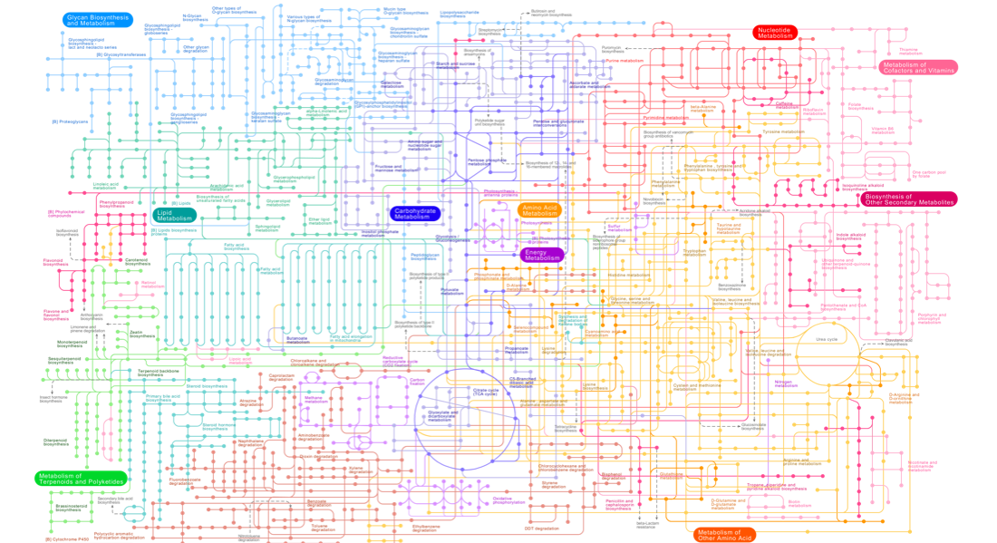
Metabolic functions of 6 Genomes

Slide 26
Metabolic functions of 6 Genomes
MEGAN
Pathway-tools
Notes:
RAST: fully automated service for annotating bacterial and archaeal genomes.

Slide 27
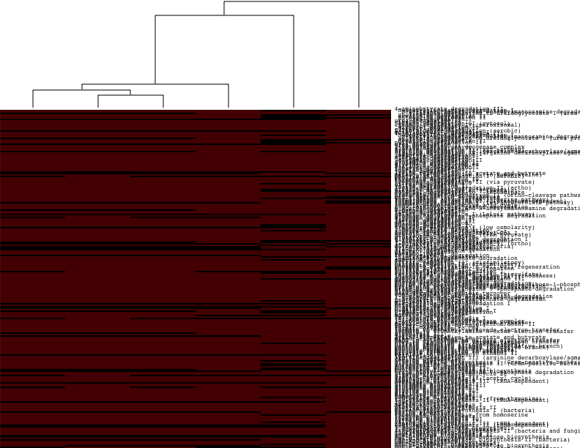
Hierarchical Clustering of Samples
(Metabolic Pathways Presence/Absence)
HA8H
PA2G
PA2D
PA16E
PA1E
HA7E

Slide 28
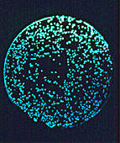
Putrescine Biosynthesis
PA2G
More Efficient Biosynthetic Pathway
Important in essential biological processes!!!
All except PA2G (Bioluminescent) use pathway 1 and/or 2; indirectly from decarboxylation of L-arginine
PA2G uses pathway 3 ; directly from L-ornithine
Notes:
Polyamines, positively charged organic polycations important in processes e.g. binding to nucleic acids, stabilizing membranes & stimulating several enzymes
Pathway 1: Generates Urea (2 steps)
Pathway 2: Generates Ammonia (3 steps)
Pathway 3: Generates CO2 (1 steps)
Substrates got reduced

Slide 29
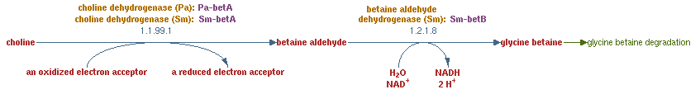
Choline Degradation &
Glycine betaine biosynthesis
Important for osmoregulation
Alternative carbon and nitrogen source under normal osmolarity
Present in all genomes except PA2G (Bioluminescent)

Slide 30
Hierarchical Clustering of Samples
(Metabolic Pathways Presence/Absence)
HA8H
PA2G
PA2D
PA16E
PA1E
HA7E

Slide 31
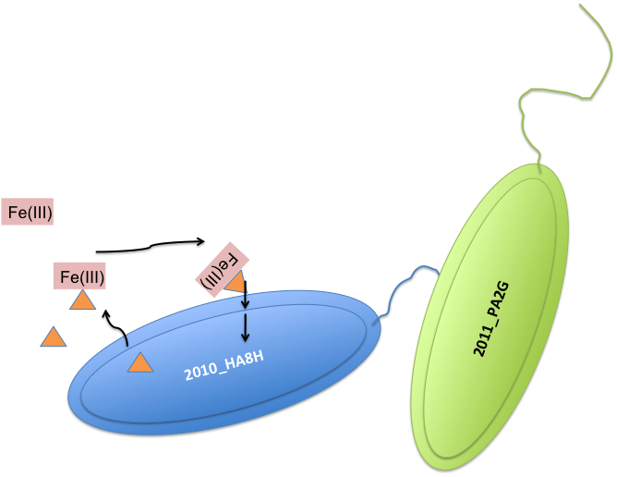
Advantageous trait for selection
Aerobactin The Siderophores
Notes:
Iron = essential trace elements
Fe(III) is insoluble, therefore is not readily available to organism
Siderophores is used as a specialized transport system to acquire Fe (III) from the environment.

Slide 32
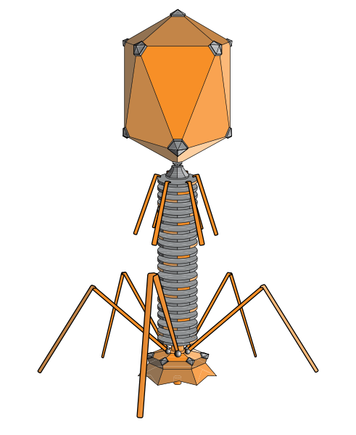


CRISPRs
http://crispr.u-psud.fr
Clustered
Randomly
Interspersed
Short
Palindromic
Repeat
V. cholerae (1)
V. harveyi (1)
V. parahaemolyticus (1)
V. vulnificus (2)
HMC 2010 HA8H (2)
HMC 2009 PA16E (1)
Direct Repeat
Spacer Region
HA8H 1
HA8H 2
PA16E
Image: Wikipedia

Slide 33
Codon Bias
Hypothesis:
Core genes will exhibit greater codon bias than accessory genes
Genes common to all Vibrios more likely homologous than horizontally transferred
Synonymous substitutions accumulate over time

Slide 34
Codon Bias
Nc: Effective number of codons
  takes the value of 61 when all codons are being used with equal frequency
  value decreases as codon usage becomes less uniform.
Nc prime: Nc values adjusted to nucleotide background of each gene

Slide 35
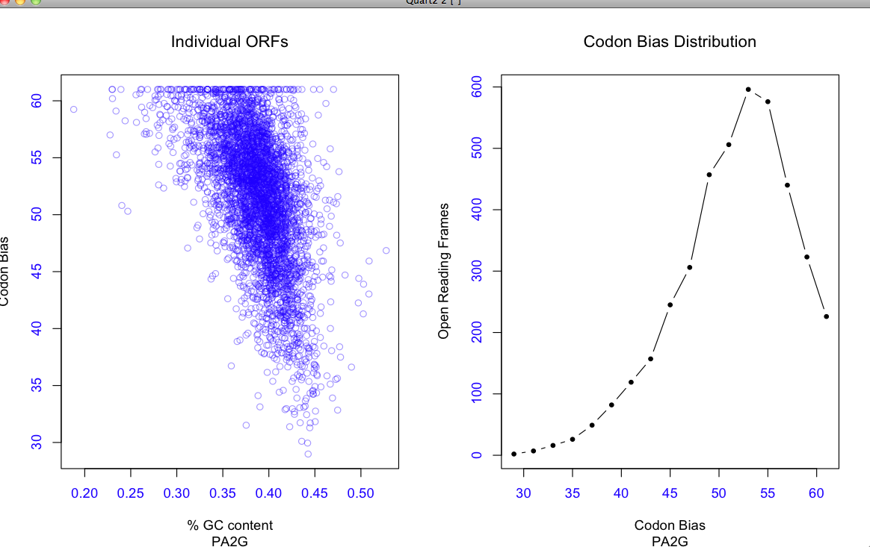
Determining Codon Bias and GC skew
Class_genome.fasta
>class_genome_annotation
>class_genome_annotation
blastn
V. Splendidus core genome
Class genome core genes
SeqCount
Class_genome.acgtfreq
Class_genome.codfreq
Magical python scrubbing
ENCprime
Class_genome_results.txt
>class_genome_annotation Nc NcP
>class_genome_annotation Nc NcP
Rrrrrrrrrrrrr

Slide 36
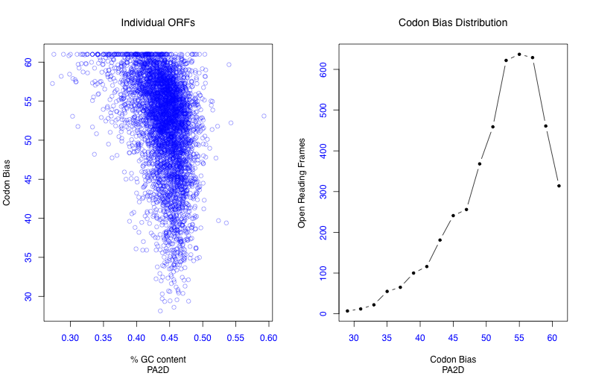
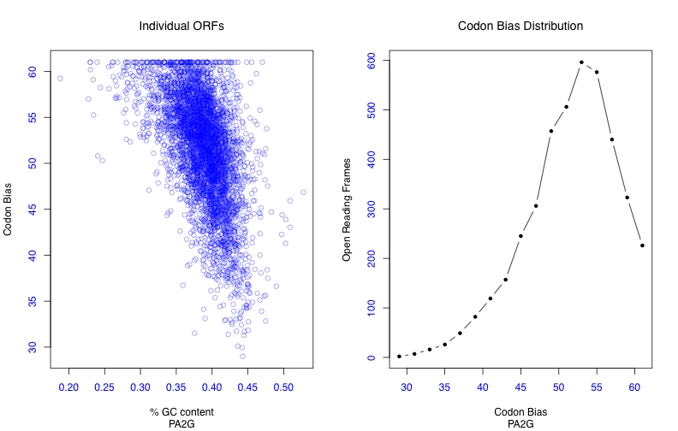

Slide 37
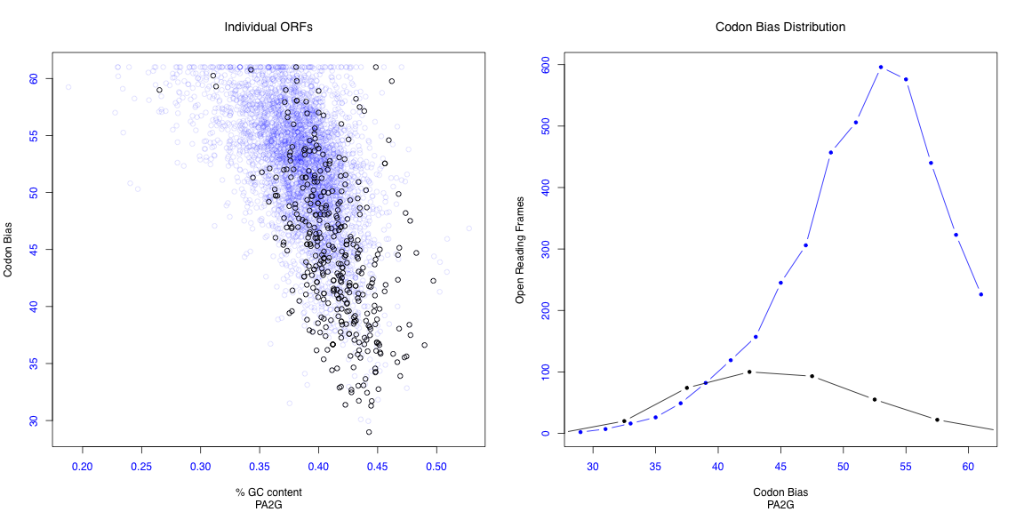
Core Genes Show Greater Codon Bias

Slide 38
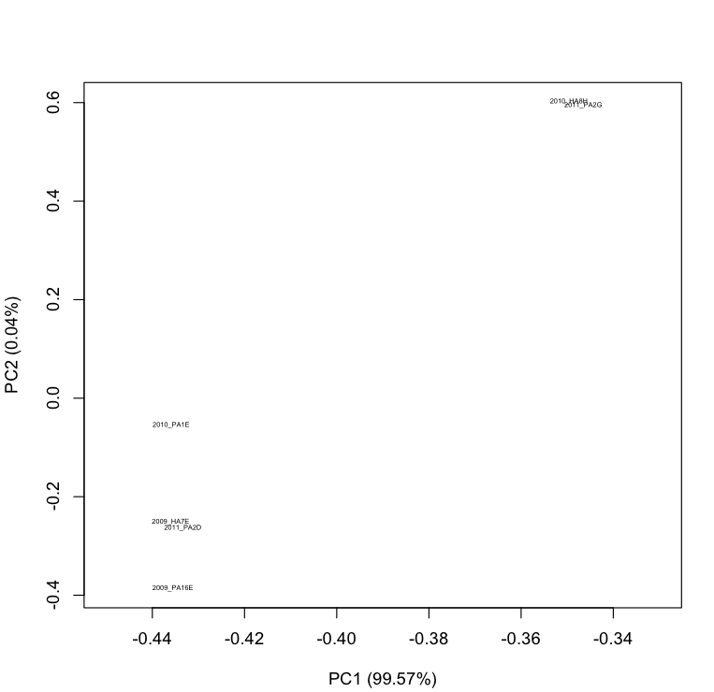
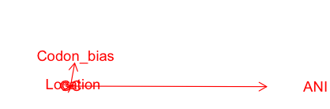
Vibrio genomes: What Matter Most?

Slide 39
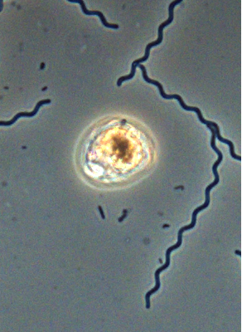
Thiovulum Genome
Contrast to Vibrio Analysis
  No closely related ancestors
Analysis Approach
  Thiovulum Genome Analysis
    Identify pathways in the Thiovulum genome
  Comparison Analysis
    Identify closest relatives
      16S rRNA tree
    Average Nucleotide Identity (ANI)
    Amino Acid Similarity
    MEGAN
Photo by Erin Nuccio
Notes:
Identify pathways in Thiovulum: is to create a baseline for comparison, know what thiovulum is capable of

Slide 40
Thiovulum Pathway Determination
Pathway Tools was used to compile potential pathways from the annotated genes
Chemotaxis genes not detected because they are not related to metabolism
  There are chemotaxis related genes scattered throughout the contigs

Slide 41
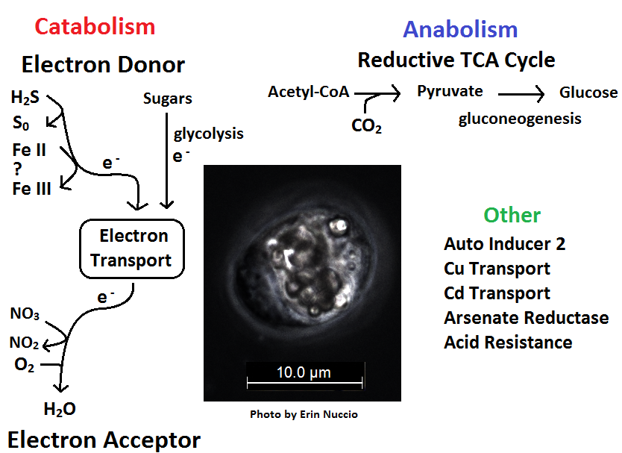

Slide 42
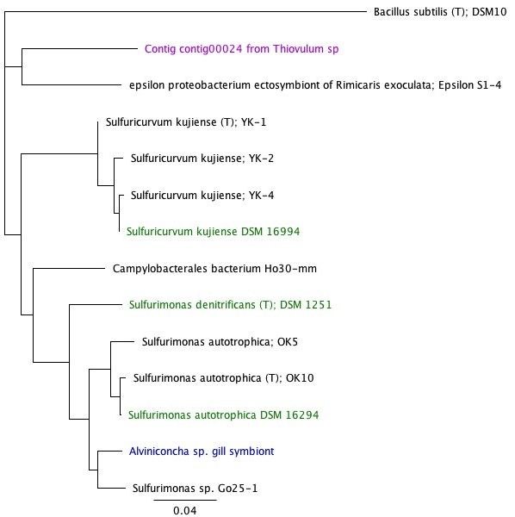
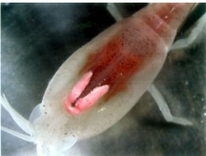
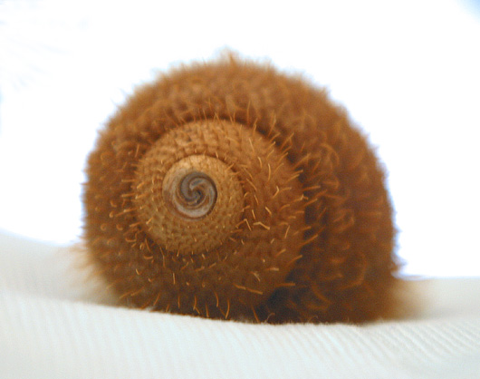
Thiovulum 16S rRNA Analysish
Ribosomal Database Project
  Website that contains and aligns 16S rRNA
Three finished genomes
  S. kujiense DSM 16994
    Drain water from crude oil storage cavity, Japan
  S. autotrophica DSM 16294
    Deep sea sediments
  S. denitrificans DSM 1251
    Estuarian mud, Netherlands
Rimicaris exoculata
  Eyeless vent shirmp
Alviniconcha sp. Gill Symbiont
  Deep water sea snail
http://www.southernfriedscience.com/?tag=rimicaris-exoculata
http://scienceblogs.com/deepseanews/2007/03/from_the_desk_of_zelnio_alvini_1.php

Slide 43
Thiovulum ANI Comparision
Species | ANI % similarity | Total fragments compared | 16S rRNA % similarity
S. kujiense DSM 16994 | 85.7 | 36 | 85.7
S. autotrophica DSM 16294 | 73.10 | 72 | 84.1
S. denitrificans DSM 1251 | 73.41 | 74 | 84.0
ANI Analysis performed with Kostas Konstantinidis’ perl script
16S rRNA comparision performed with RDP

Slide 44
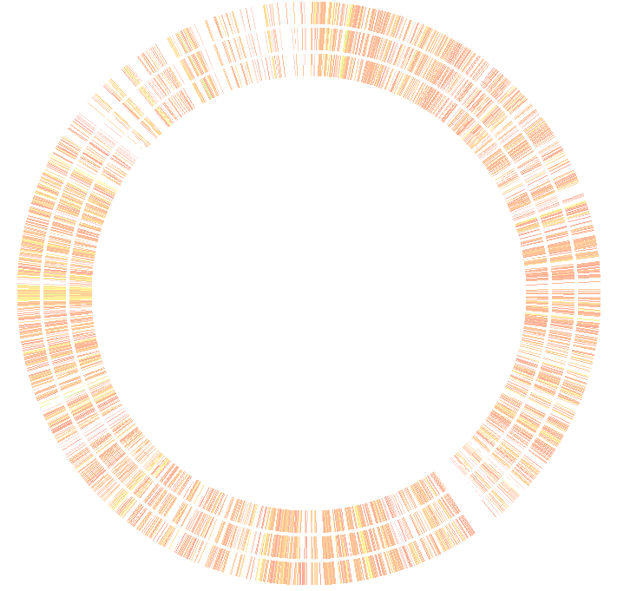

Thiovulum Amino Acid Comparison
Analysis done in RAST
Thiovulum as reference
Comparison Genomes
  S. kujiense DSM 16994
  S. autotrophica DSM 16294
  S. denitrificans DSM 1251

Slide 45
Thiovulum Pathway Comparison
Analysis done in MEGAN
  BLASTp of the Thiovulum genome contigs vs. database of the 3 finished genomes selected from the 16S rRNA analysis
  Upload into MEGAN and open with SEED to compare protein functions

Slide 46
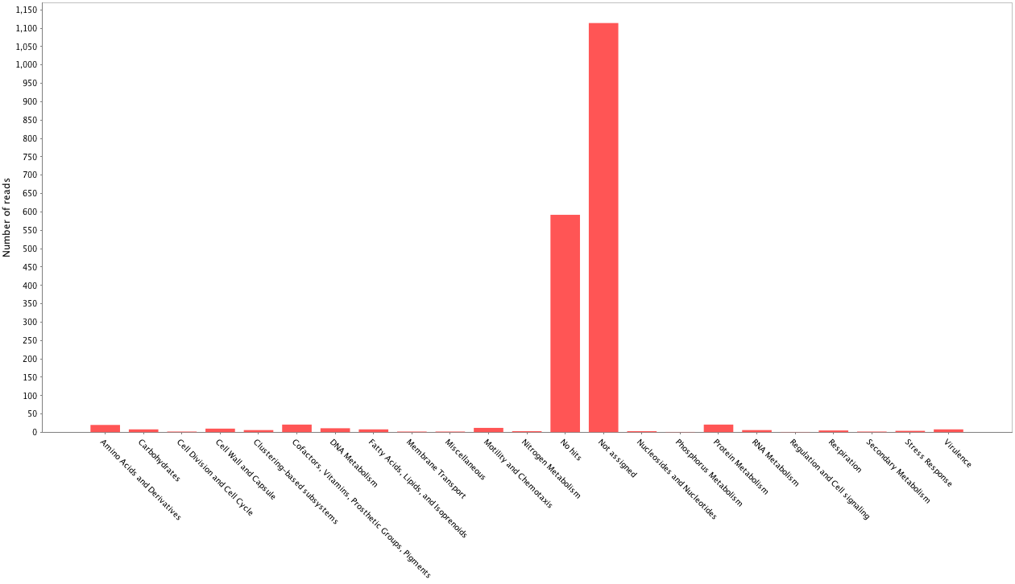
Thiovulum Pathway Comparison
Analysis done in MEGAN
Number of Reads
Not Assigned
No Hits
Notes:
Not Assigned: Could not be placed into one of the core metabolisms
No Hits: did not match anything

Slide 47
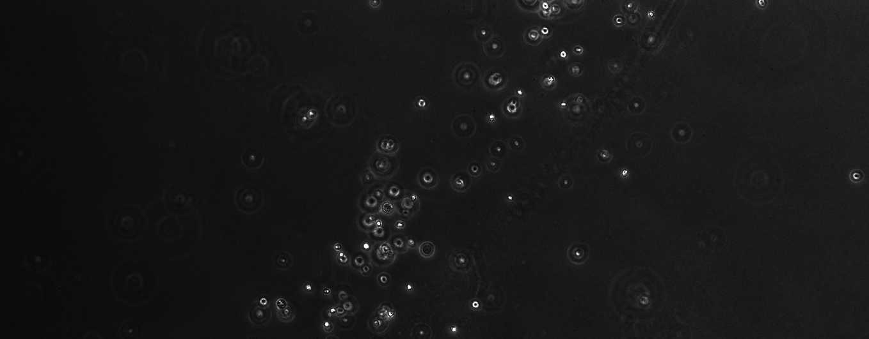
Pathway Comparison Conclusion
  Thiovulum is in a different genus then the closest related genomes by a 16S rRNA comparison
  There are not enough conserved genes in a single metabolism to perform a pathway or synteny comparison with the other genomes
Photo by Shelbi Russell

Slide 48
Conclusions
Assessing relationships very complicated with huge body of data
ANI can be useful to look at differences on the whole genome level; less useful as tree
Genomic differences highlight metabolic differences between isolates
Species diversity despite co-localization
Codon bias more distinct in core genome
Thiovulum too divergent to compare to other organisms

Slide 50
Exclusive Pathways in PA2G
Aerobactin biosynthesis
Cellulose biosynthesis
dTDP-L-rhamnose biosynthesis I
Formaldehyde oxidation II
Acrylonitrile degradation
Glycocholate merabolism (bacteria)

Slide 51
Exlusive Pathways in PA2D
Choline degradation I
Glycine betaine biosynthesis I & II
Putrescine biosynthesis I & II
Glutamate biosynthesis III
Homocysteine biosynthesis
Serine racemization
Tyrosine biosynthesis IV
Glytathione redox reactions I
Lipoate salvage and modification
4-aminobutyrate degradation III
Allantoin degradation to ureidoglycolate I (urea producing)
Choline degradataion I
Creatinine degradataion II
14. Arginine degradation IV (arginine decarboxylase/agmatine deiminase pathway)
15. Tryptophan degradation II (via pyruvate)
16. 3-chlorocatechol degradation II (ortho)
17. Atrazine degradation I (aerobic)
18. Urate degradation to allantoin
19. Melibiose degradation
20. Sucrose degradation I
21. 2-methylcitrate cycle I
22. Glycolate and glyoxylate degradatio I
23. L-ascorbate degradation, anaerobic
24. 2-aminoethylphosphate degradation
25. Sulfoaceraldehyde degradation I
26. Adenosine nucleotides degradation II
27. 5-dehydro-4-deoxy-D-glucuronate degradation
28. D-galactonate degradation I

Slide 52
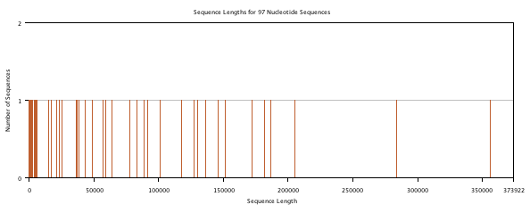
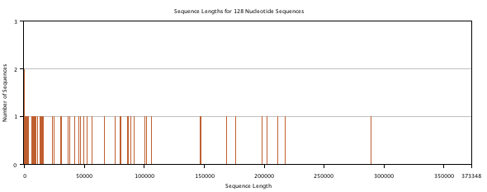
Contigs Size

Slide 53
