Slide 1
Vibrio genome analysis
Christina
Isabella
Roland
Sarahi
Veronica

Slide 2
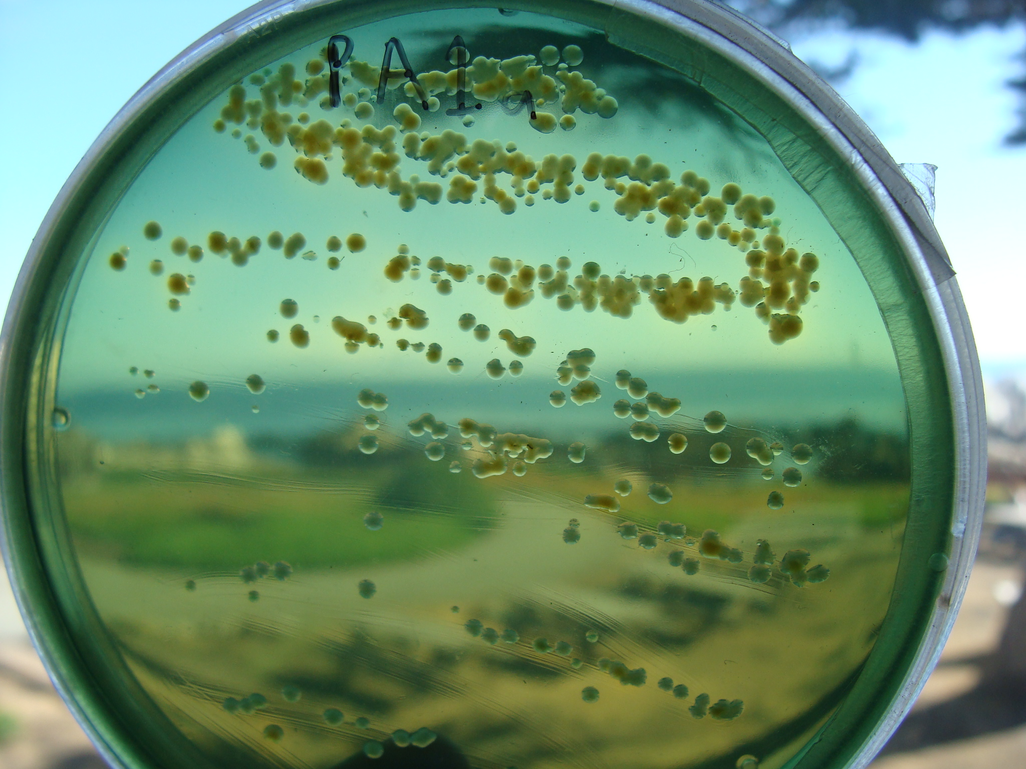
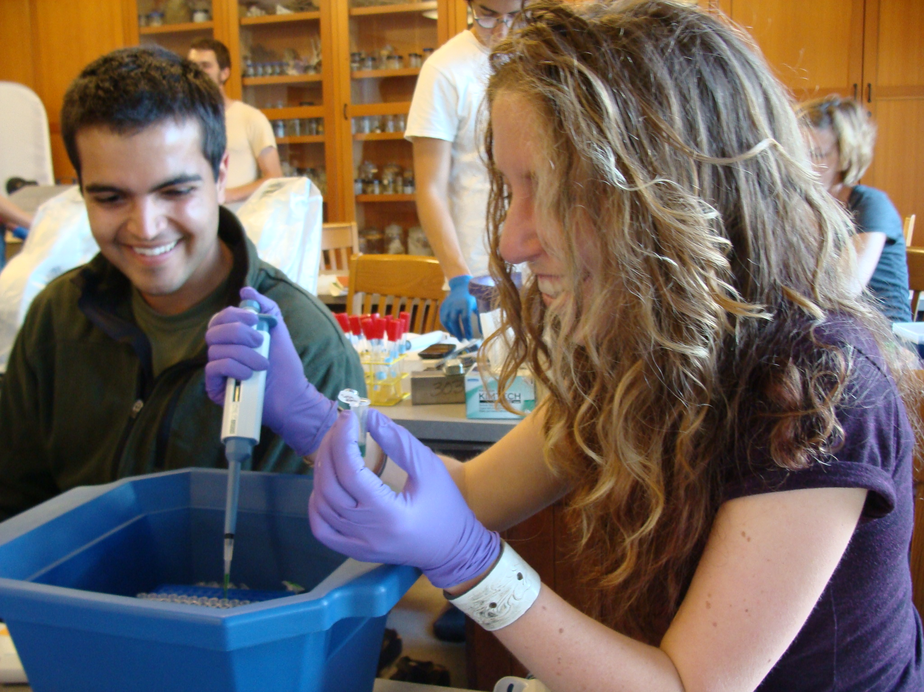
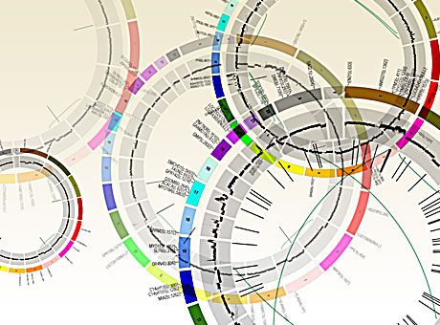
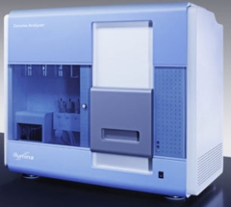
General protocol
Isolation of vibrios
DNA extraction
Assembly and annotation
Illumina sequencing

Slide 3
Quality of data
 | Year
HS0A | 2012
HS0B | 2012
HS0C | 2012
*HA8H | 2012
PA2D | 2011
PA2G | 2011
PA1E | 2010
PA16E | 2009
HA7E | 2009

Slide 4
General genomic features
 | HS0A | HS0B | HS0C | HA8H
Genome size(Mbp) | 5.30 | 5.37 | 4.91 | 5.52
# Contigs | 75 | 63 | 75 | 104
# Coding sequences | 4668 | 4654 | 4283 | 5076
# RNAs | 85 | 96 | 97 | 86
% GC content | 44.07 | 44.09 | 43.61 | 43.93
N50 (Kbp) | 236 | 385 | 235 | 165

Slide 5
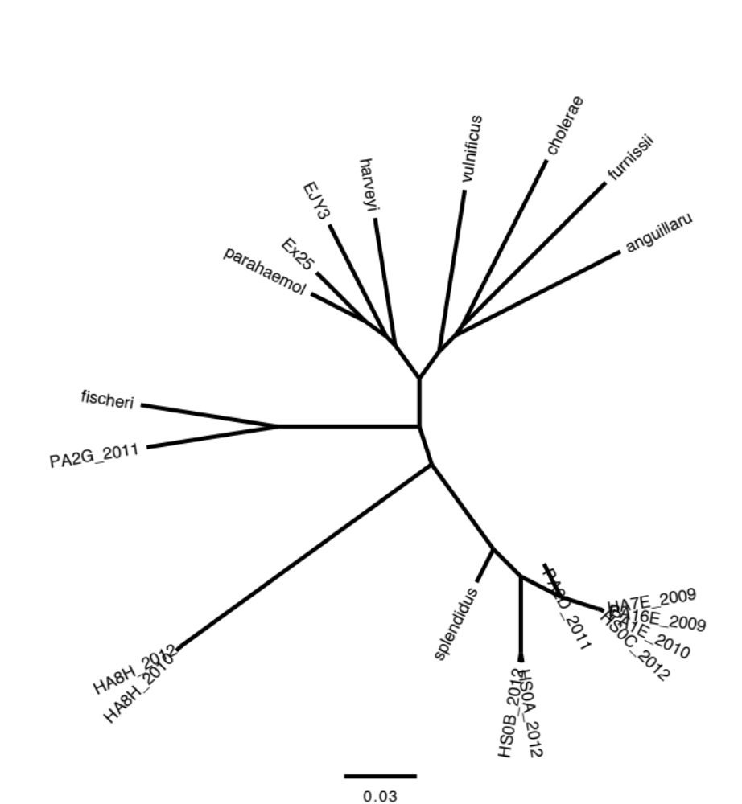
Whole genome tree using Kr method

Slide 6
Vibrio core genome analysis

Slide 7
Core genus genome
 | Gene Number | % of Total
Total number of genes | 834 | 100
COG (clusters of orthologous groups) | 811 | 97.2
Enzymes | 333 | 39.3
KEGG | 400 | 47.9

Slide 8
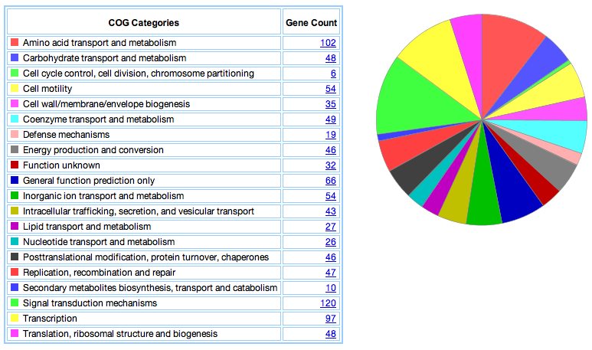
Core genus genome
Notes:
Aminoacid transporters and synthesis
Carbohydrate. Fructose utilization. Chitinases
Motility. Chemotaxis. Flagela
Defense mechanisms. Efflux pumps
Energy production. Succinate dehydrogenase and fumarate reductase

Slide 9
Whole genome tree using Kr method

Slide 10
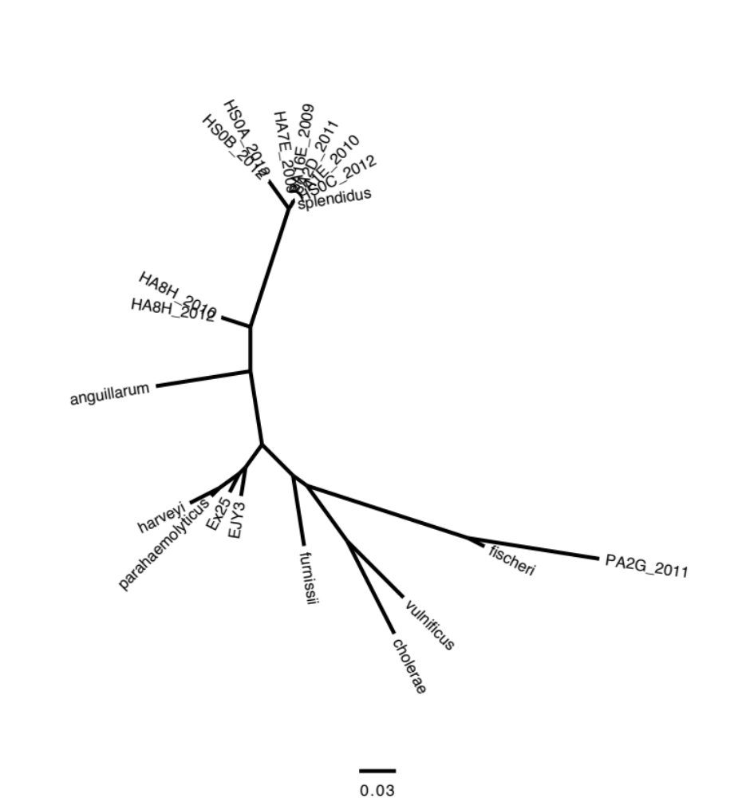
Whole genome tree
recA tree

Slide 11
What makes the clusters different
PA2G contains a bioluminescent operon
HA8H contains Siderophore Biosyn Pathway
What about HS0A, HS0B and HS0C?

Slide 12
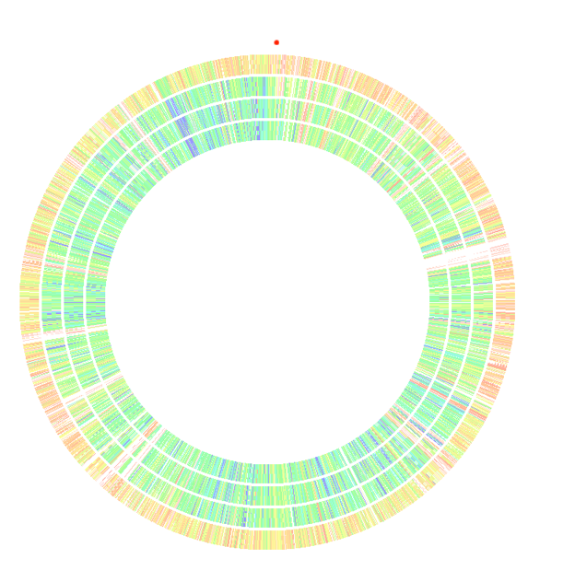
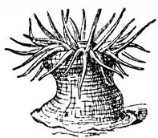


Genome similarity to V. Splendidus
Vibrio 2012-HA8H
Vibrio 2012-HS0C
Vibrio HS0B
Vibrio HS0A
Sequence comparison to V. Splendidus

Slide 13
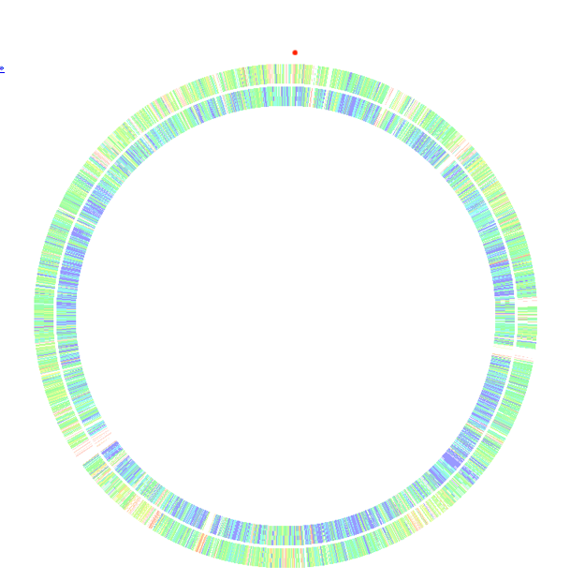
How does HS0A compare to …
HS0C
HSOB
Comparison to HS0A

Slide 14
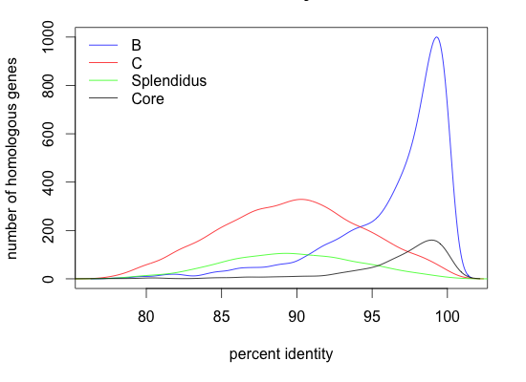
How does HS0A compare to …
Number of homologous genes
Percent identity

Slide 15
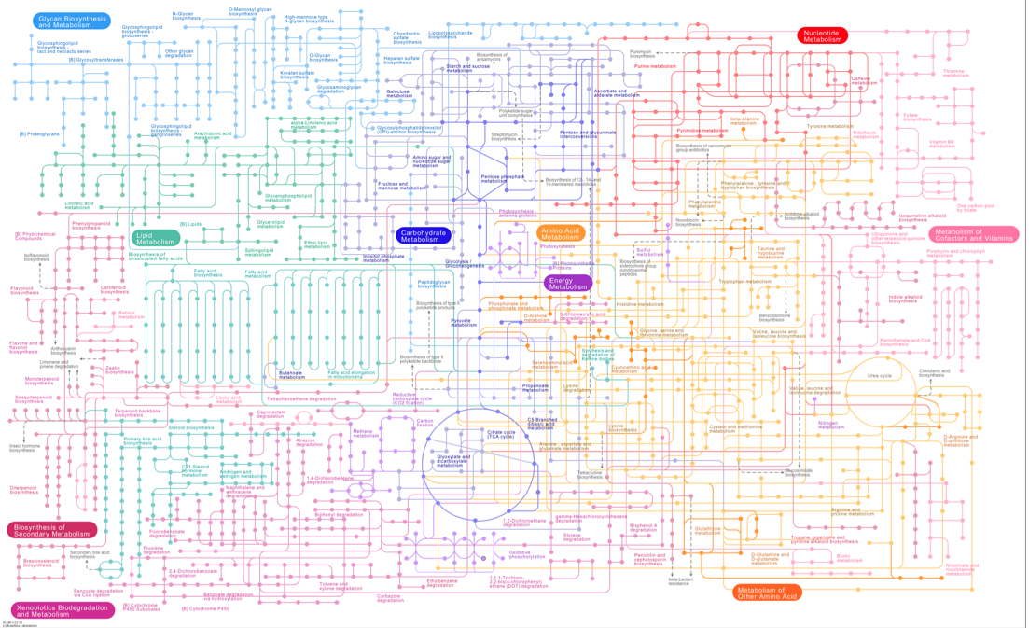
Metabolic Pathways of Vibrio HS0A-2012

Slide 16
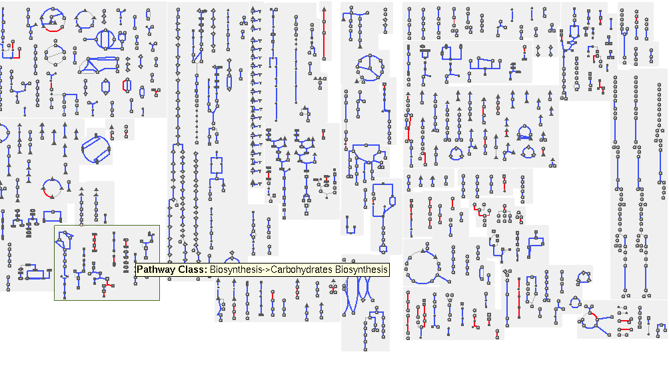
Metabolic comparison using Pathway Tools:
Differences between HS0A and HS0B are highlighted in red

Slide 17
Metabolic Comparison using KEGG
Compares the “functioning parts” of two organisms
A functioning part is indicated as present if all of the genes to carry out a given subsystem are found in a given genome

Slide 18
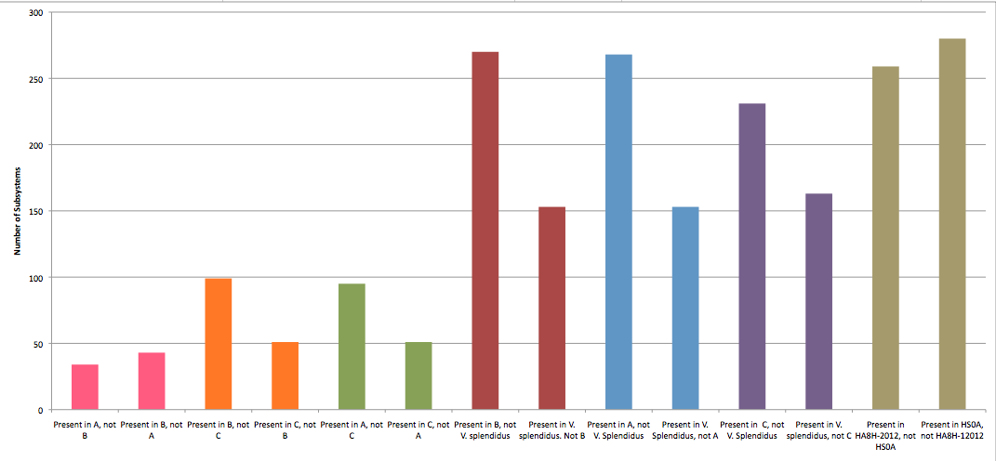
Metabolic Functional Comparison of Vibrios using KEGG

Slide 19
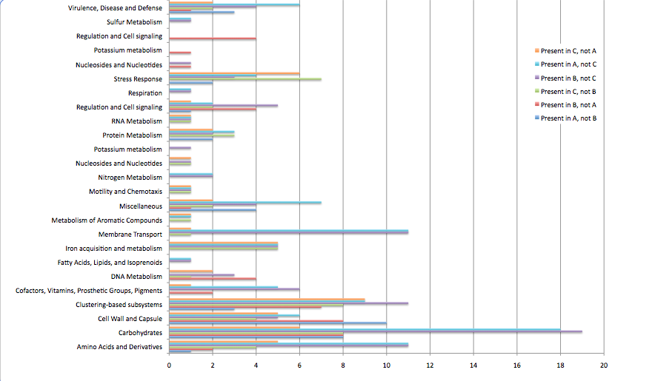
# of Subsystems

Slide 20
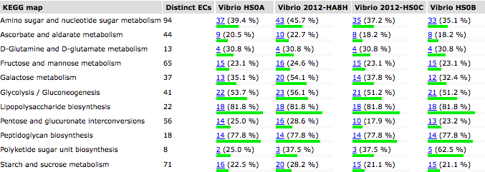
Metabolic Comparison using RAST database

Slide 21

Looking for homology
ALFY
Comparing HS0A to HS0B & HS0C
A – B 87%
A – C 5%
A – non homologous 8%

Slide 22
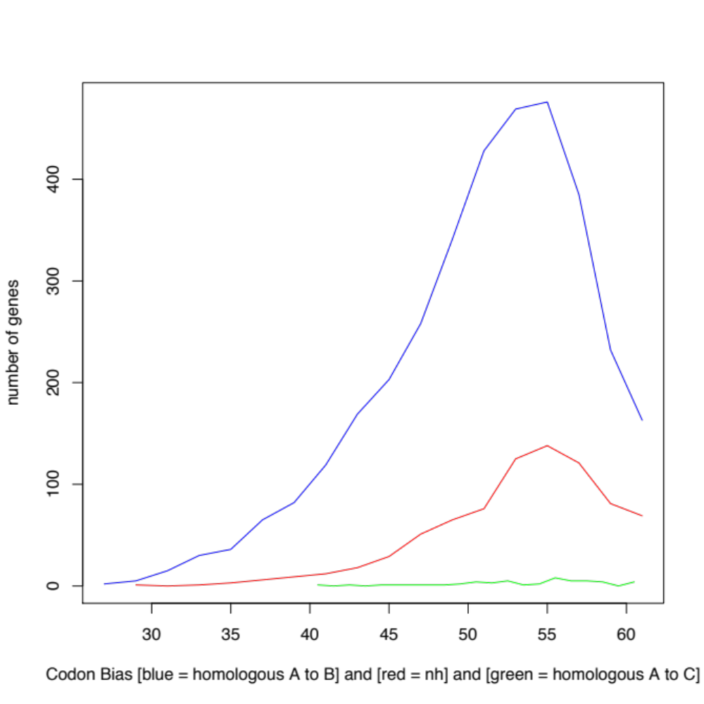
Is homology reflected in the DNA signatures?

Slide 23
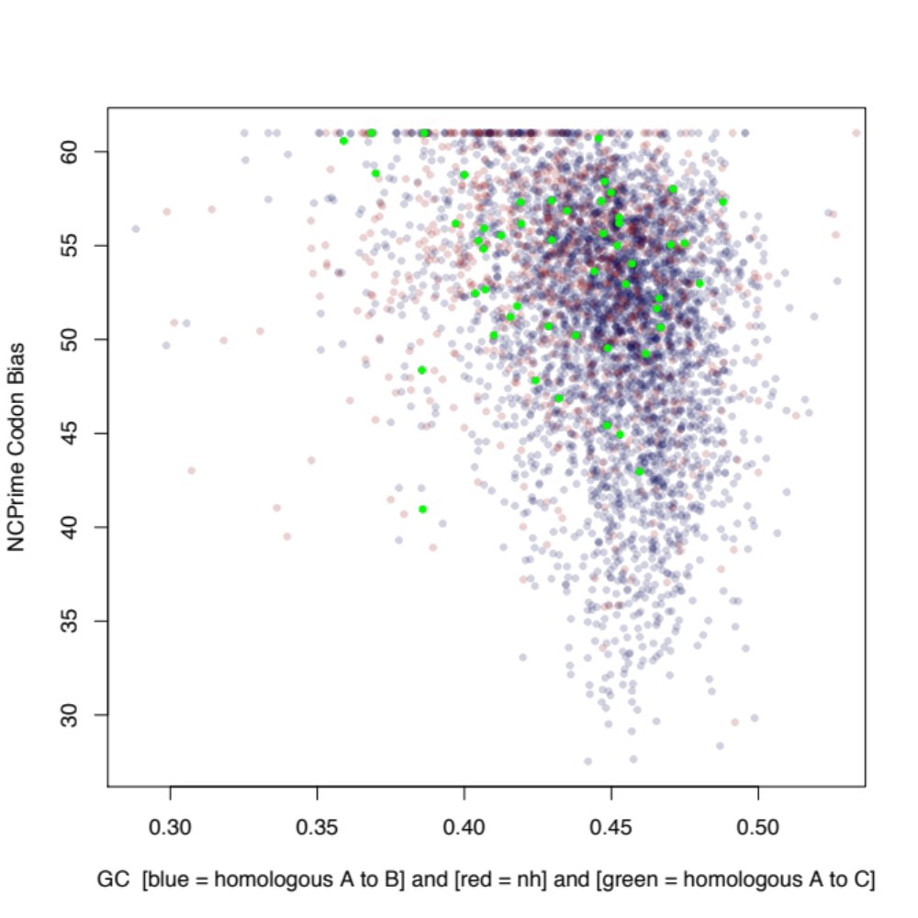
Is homology reflected in the DNA signatures?

Slide 24
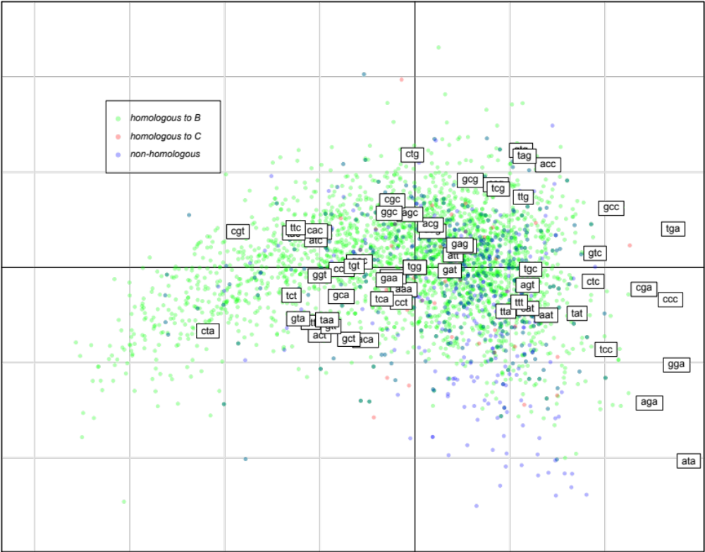
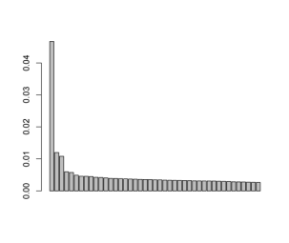
PCoA plot of Codon Usage in HS0A
5.6%
21.9%
Notes:
Alfy Results: group alfy results: most homologous to B, most homologous to C, not homologous

Slide 25
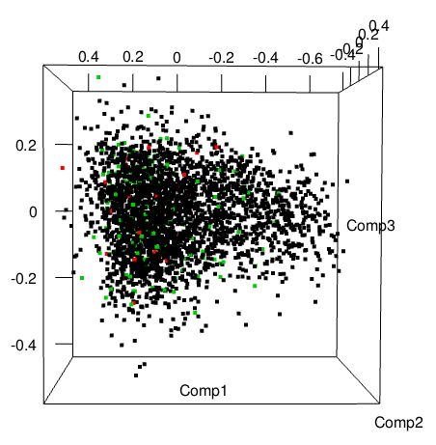
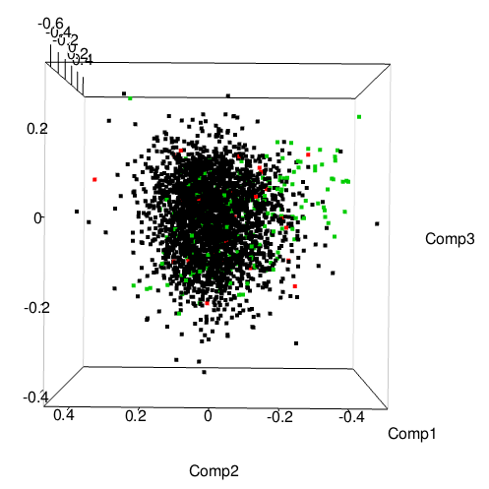
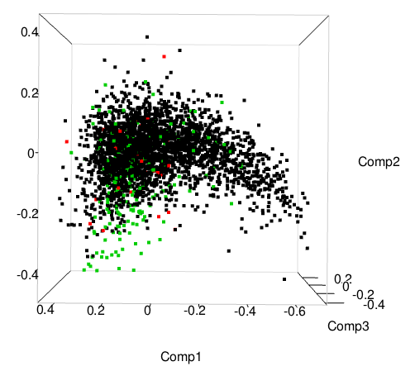
PCoA plot of Codon Usage in HS0A

Slide 26
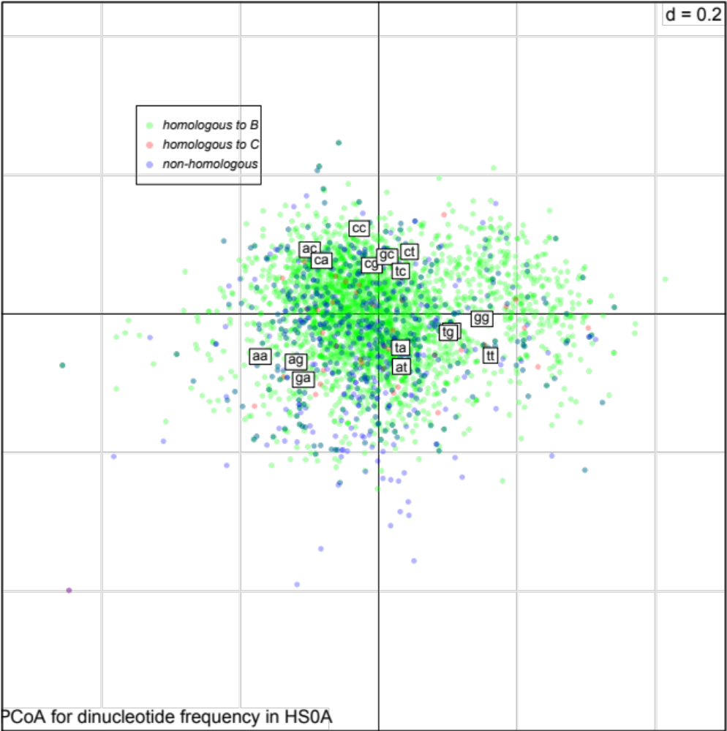
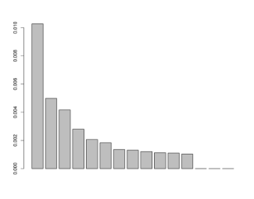
PCoA plot of Dinucleotide Frequencies in HS0A
15.0%
30.9%
Notes:
Alfy Results: group alfy results: most homologous to B, most homologous to C, not homologous

Slide 27
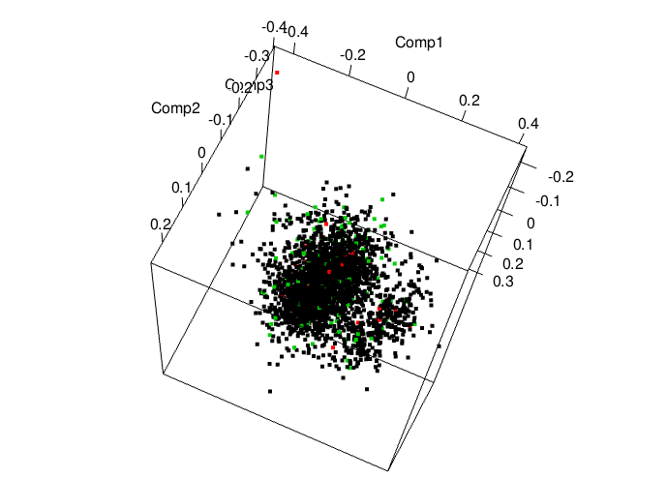
PCoA plot of Dinucleotide Frequencies in HS0A

Slide 28
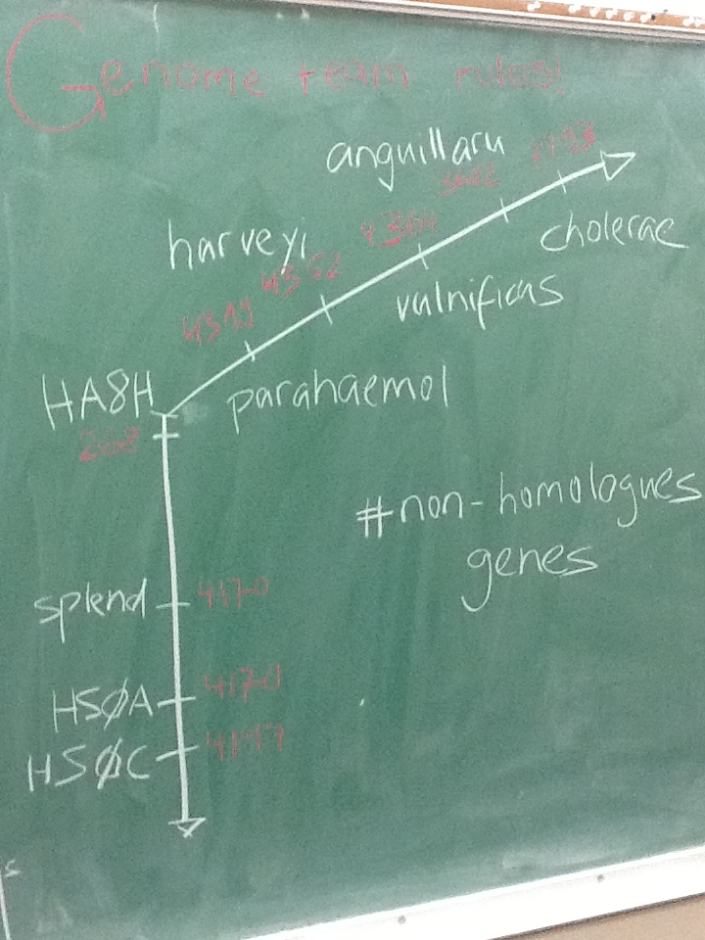
A gene transect … ?

Slide 29
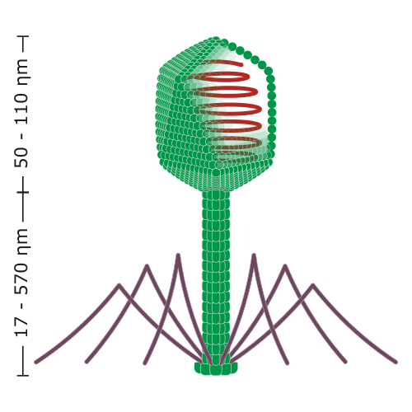
And the molecular biology producing the patterns?
Phage receptors – strong positive selection
Integrons

Slide 30
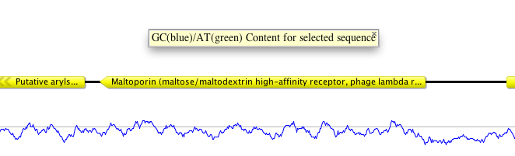
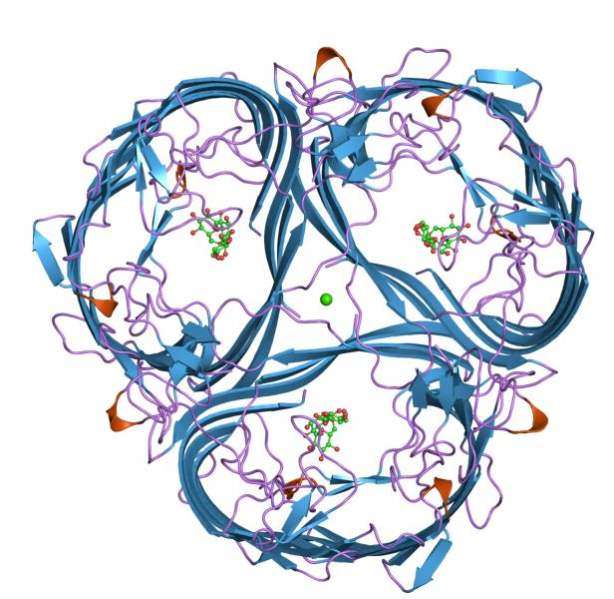
Maltoporin
membrane protein
lamda phage receptor
found in HA0A, neither HA0B or HA0C have it

Slide 31
What are integrons?
Selfish genetic elements
  In circular form
  Integrated in the genome
  Carrying and expressing a variety of “useful” genes
Integrases originate from phages
Conserved recognition site to direct recombination
Transmission via conjugation

Slide 32
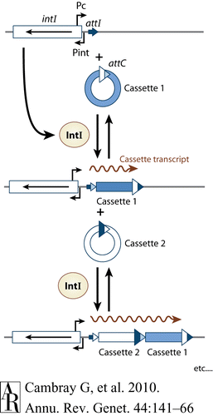
acquiring gene cassettes

Slide 33
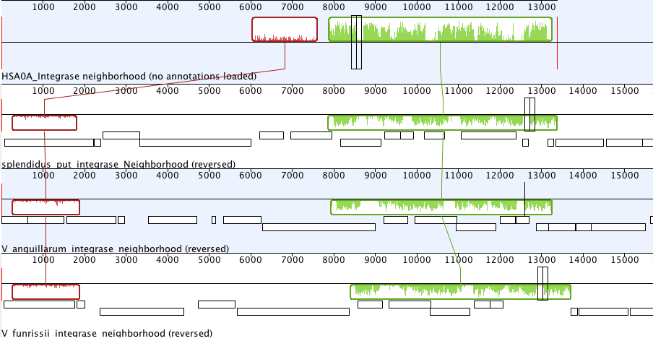
Inversion of the integrase neighborhood

Slide 34
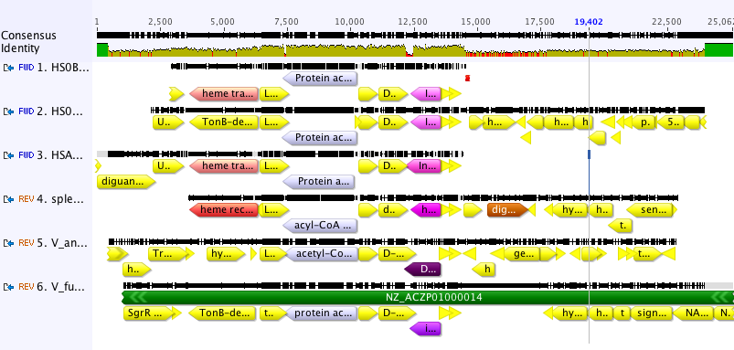
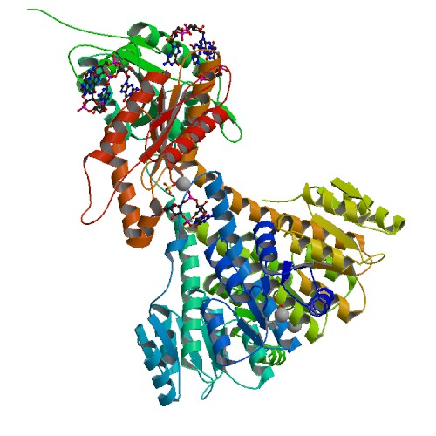

Alignment A,B,C, V. splendidus, anguillarium, furnissii

Slide 35
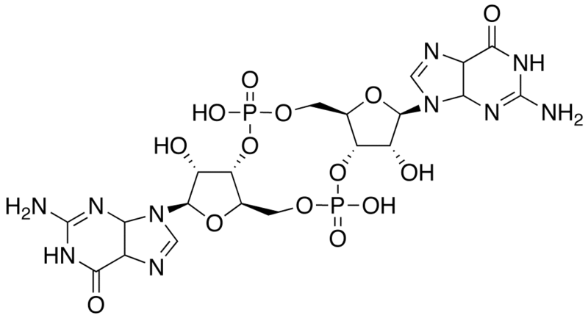
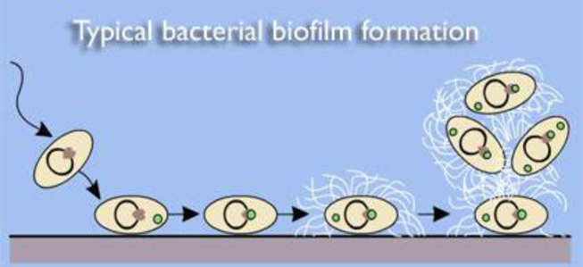
diguanylate cyclase
2 Guanosine triphosphate ↔ 2 diphosphate + cyclic di-3',5'-guanylate
(cyclic-di-GMP)
a bacterial second messenger
  involved in…
http://tts.imtranslator.net/LgOh

