Slide 1
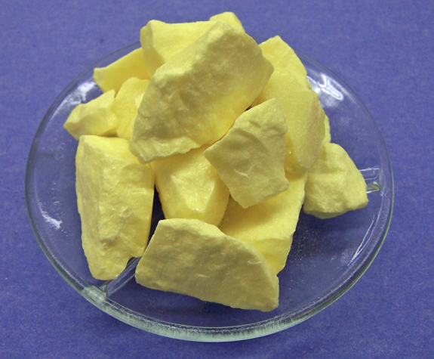
Purple Non-Sulfur Bacteria
Christina Machak
HMC 2012

Slide 2
Where are PNS found?
Originally named “non-sulfur” because it was thought that they could not use sulfide as electron donor
Can tolerate small concentrations of sulfur, but much lower than green and purple sulfur bacteria. High Concentrations of H₂S are toxic
Primarily anaerobes, but can carry out respiration in low O₂ concentrations
Therefore they occupy a specific niche….

Slide 3
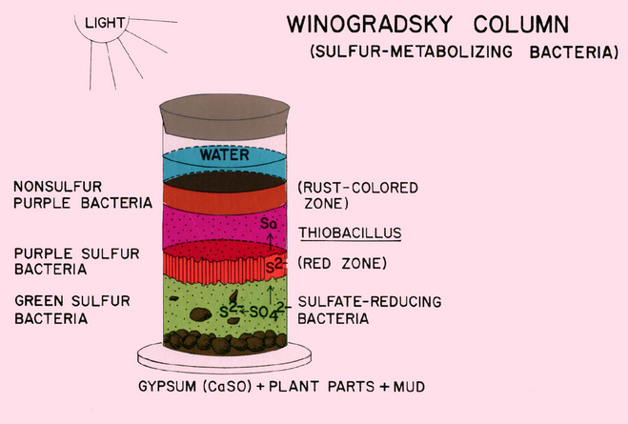
Purple non-sulfur bacteria grow in where they have access to sunlight and are not in contact with oxygen

Slide 4

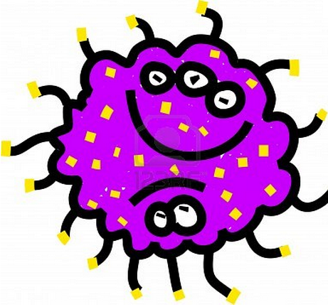
Variety in metabolism…
Most PNS can use fermentation or respiration to grow in the dark.
Photo-auto-trophic growth
Photo-hetero-trophic growth
CO₂+H₂ CO₂+H₂S
Sugars
Amino Acids
Fatty Acids

Slide 5
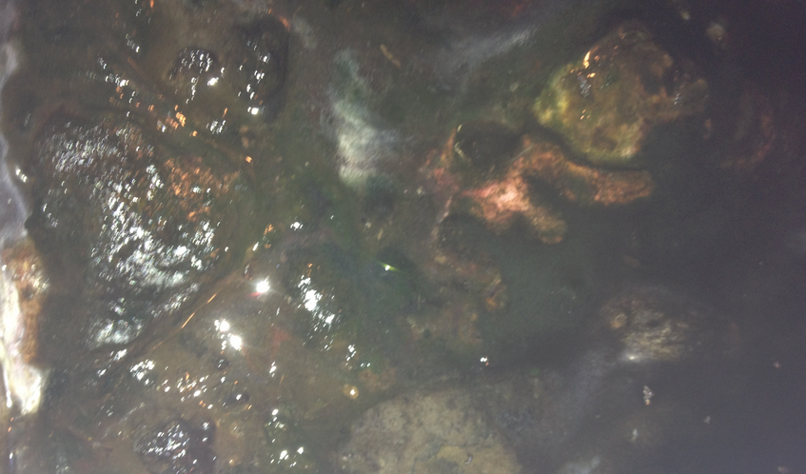
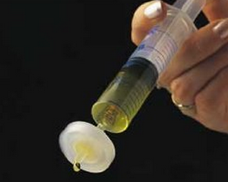
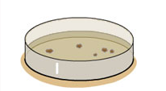
Day 1: Samples from the mats were filtered and the filters were placed on enrichment plates.
NH₄⁺
Day 7: re-streak colonies
ADD NITROGEN SOURCE!

Slide 6
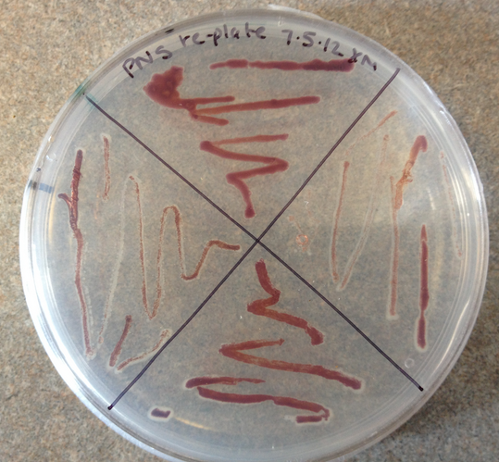
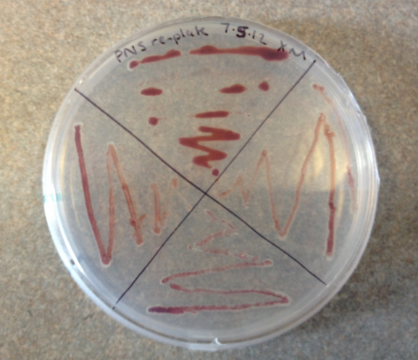
Day 14: Results

Slide 7
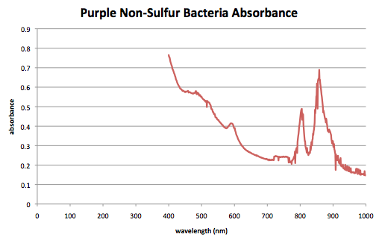
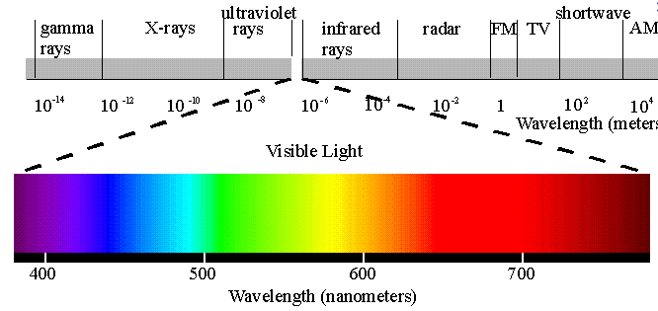
Carotenoid pigments and bacteriochlorophylls give phototrophic purple bacteria their color.

Slide 8
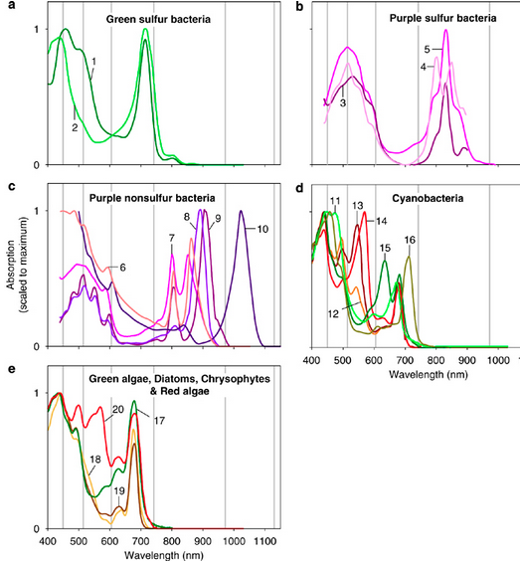
From: Stomp et al., 2007

