Slide 1
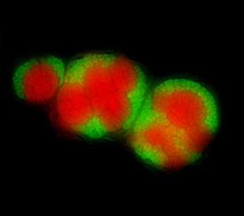
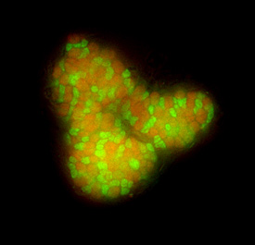
Chiharu Ishii
Stefan Braun
Hopkins Microbiology Course
18-July-2013
CARD-FISH
Catalyzed Reporter Deposition
Fluorescence In-Situ Hybridization
AOM-consortium from sediments off the coast of Monterey Bay
Courtesy of Annelie Pernthaler

Slide 2
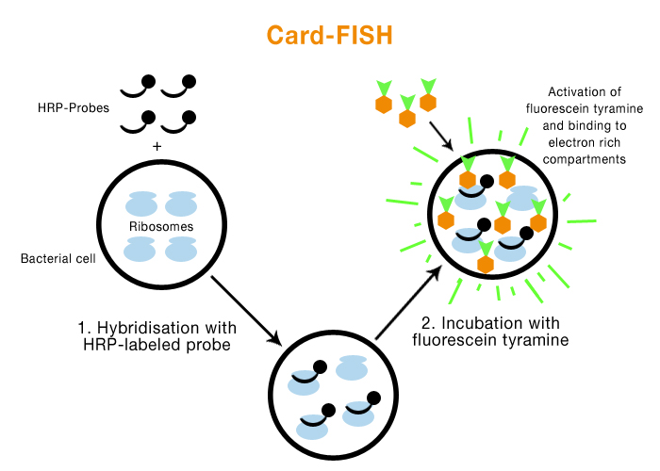
Catalyzed reporter deposition (CARD)
Fluorescence in-situ hybridization (FISH)
Enzyme Horseradish peroxidase (HRP)
Notes:
HRP (after hybridization) catalyzes the deposition of a large number of fluorescently labeled tyramides by binding them covalently to cellular proteins → greatly enhanced signal intensity

Slide 3
HRP-labeled probes
Probe | Target group
GAM42a | Gamma-Proteobacteria
VIB572a | Genus Vibrio
NON338 | Non-binding control
General fluorescent dye for DNA
Probe | Target
DAPI | All cells (nucleic acid)

Slide 4
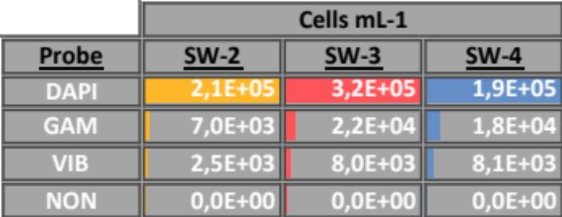
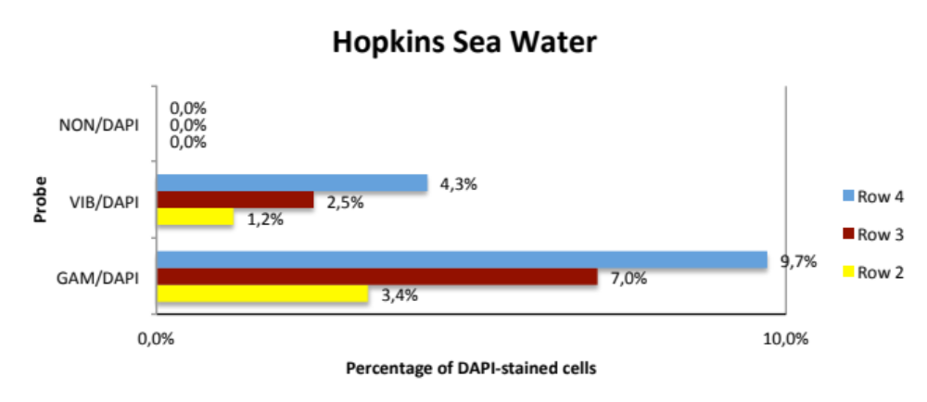
Results
30-40 % of Gamma-Proteobacteria is Vibrio
Notes:
≈ 105 microbial cells per mL sea water
≈ 104 Gamma-Protebacteria per mL sea water

Slide 5
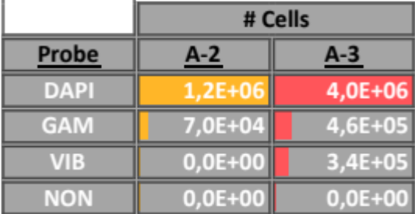
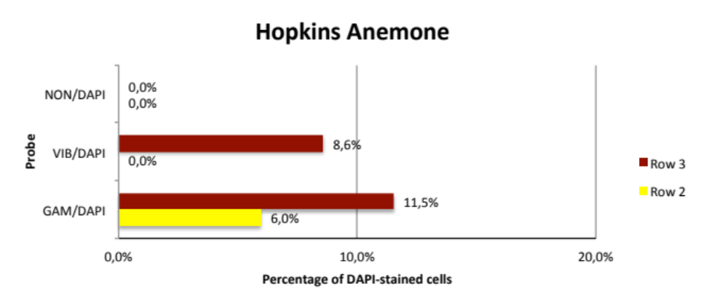
Results
4 anemones pooled
≈ 10⁶ cells on first cotton swap
Note: Vibs were present, but in low amount

Slide 6
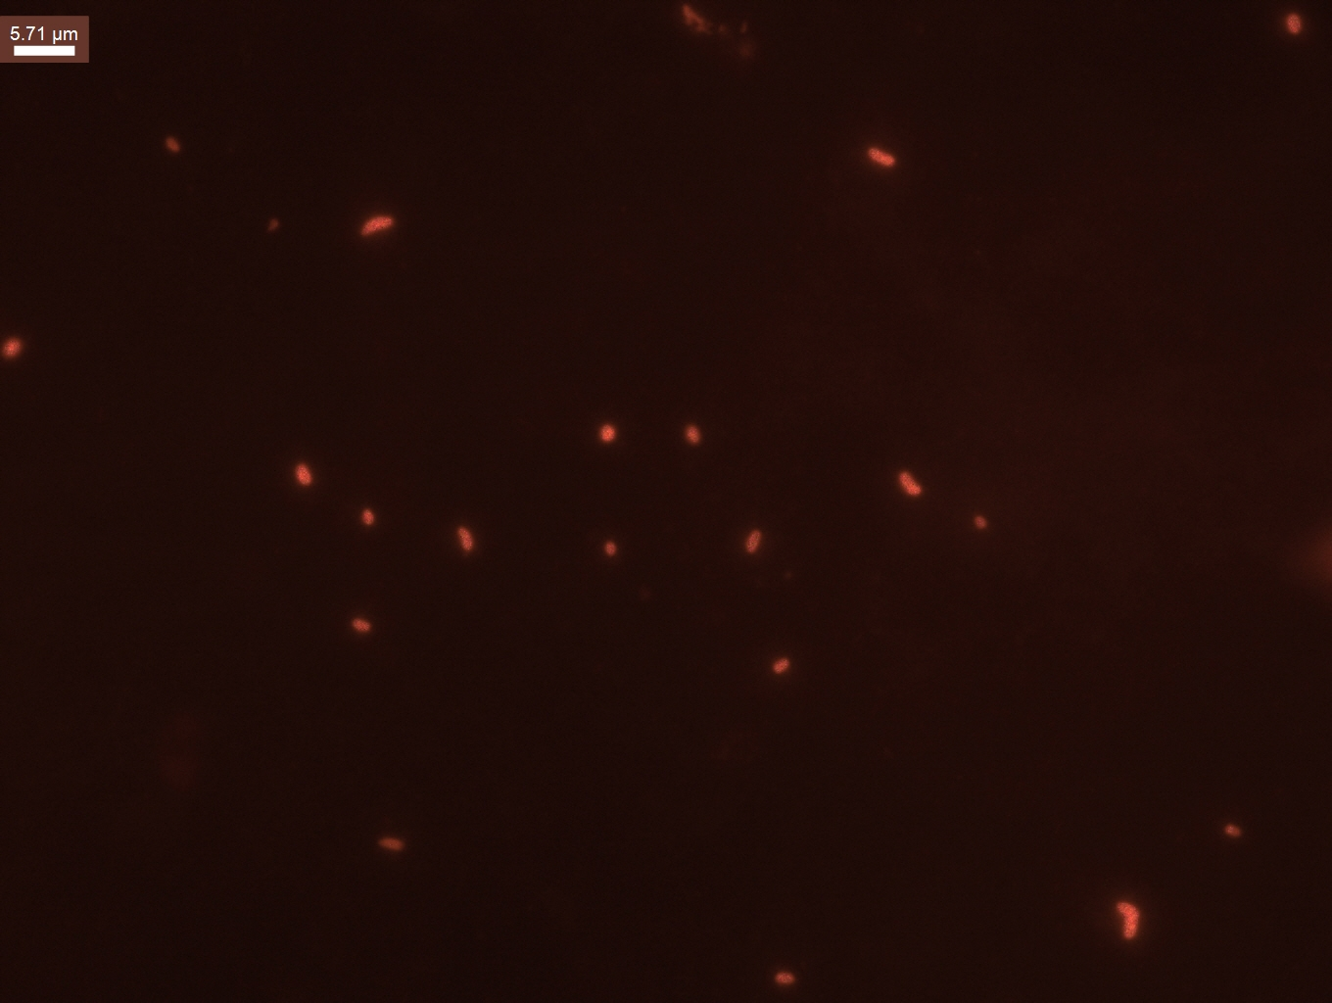
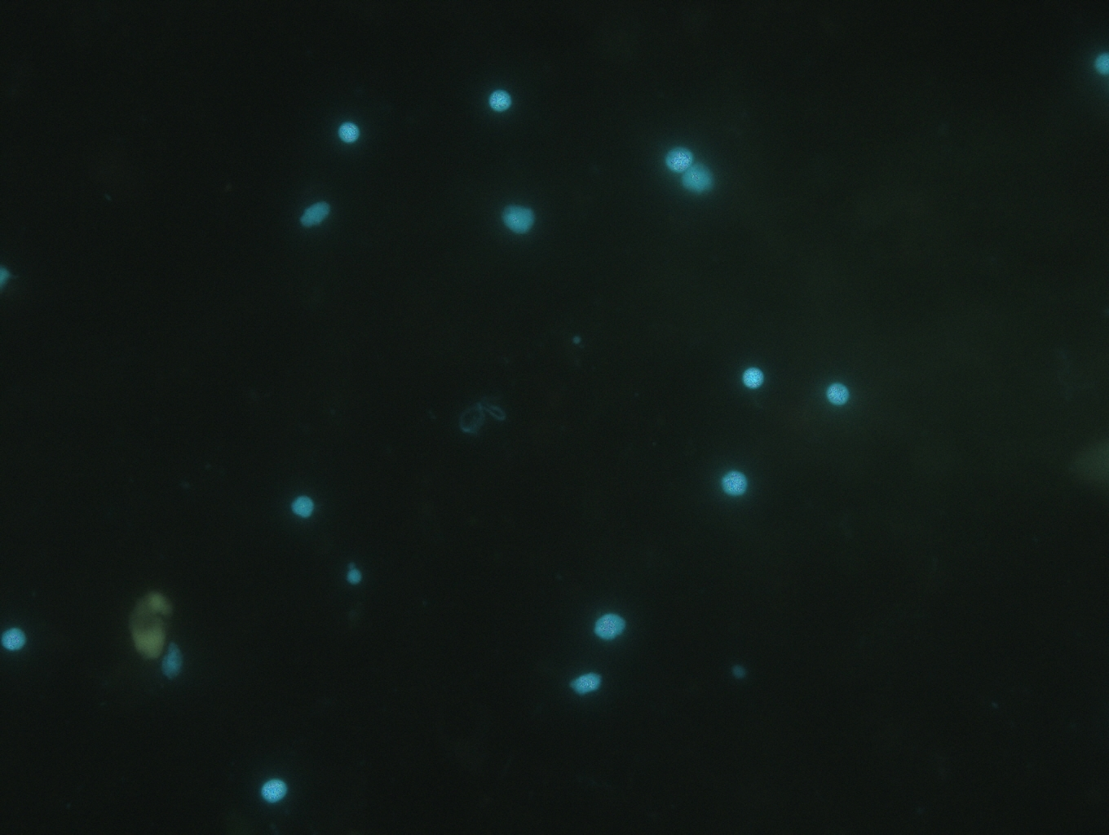
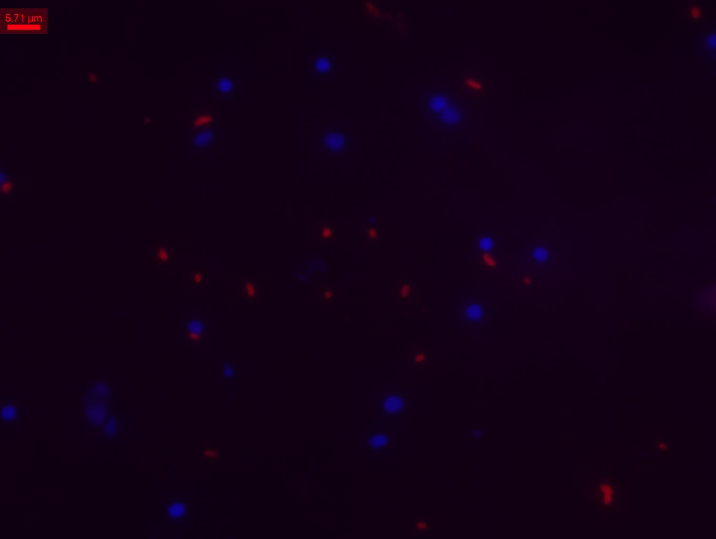
cy3
DAPI
Symbionts
Vibrios
overlay

