Slide 1
Introduction to CS 106J
Eric Roberts and Jerry Cain
CS 106J
April 3, 2017

Slide 2
Course Description
CS 106J: Programming Methodology in JavaScript
Introduction to the engineering of computer applications emphasizing modern software engineering principles: object-oriented design, decomposition, encapsulation, abstraction, and testing. Emphasis is on good programming style. This course covers the same material as CS 106A but does so using JavaScript, the most common language for implementing interactive web pages, instead of Java. No prior programming experience required. Enrollment limited to 100.
Terms: Spr | Units: 3-5 | UG Reqs: WAY-FR | Grading: Letter or CR/NC
CS 106J covers the same material and meets the same WAYS requirements as any other CS 106A section.

Slide 3
Why JavaScript?
When Stanford adopted Java a little over a decade ago, we expected—along with its designers—that it would become the “language of the web.”
That didn’t happen.
Today, the “language of the web” is JavaScript, which has become the most widely used language in industry.
Along with JavaScript expert Douglas Crockford, we believe that, as long as you avoid some of its most commonly abused features, JavaScript is “a beautiful, elegant, highly expressive language” that is ideal for a first course in programming.
  It is considerably easier to learn than Java.
  There are far fewer confusing details to memorize.
  It offers much cleaner implementations of modern features.
  It is universally supported on the web.

Slide 4
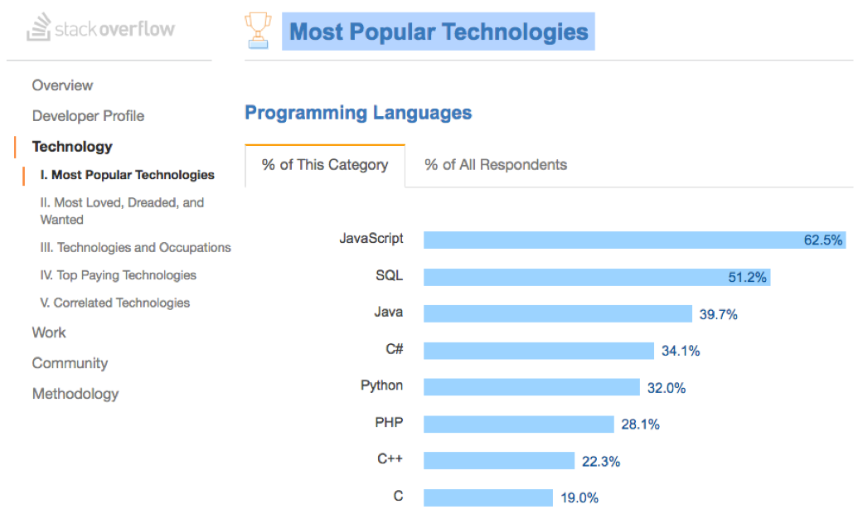
JavaScript is the Most Popular Language

Slide 5
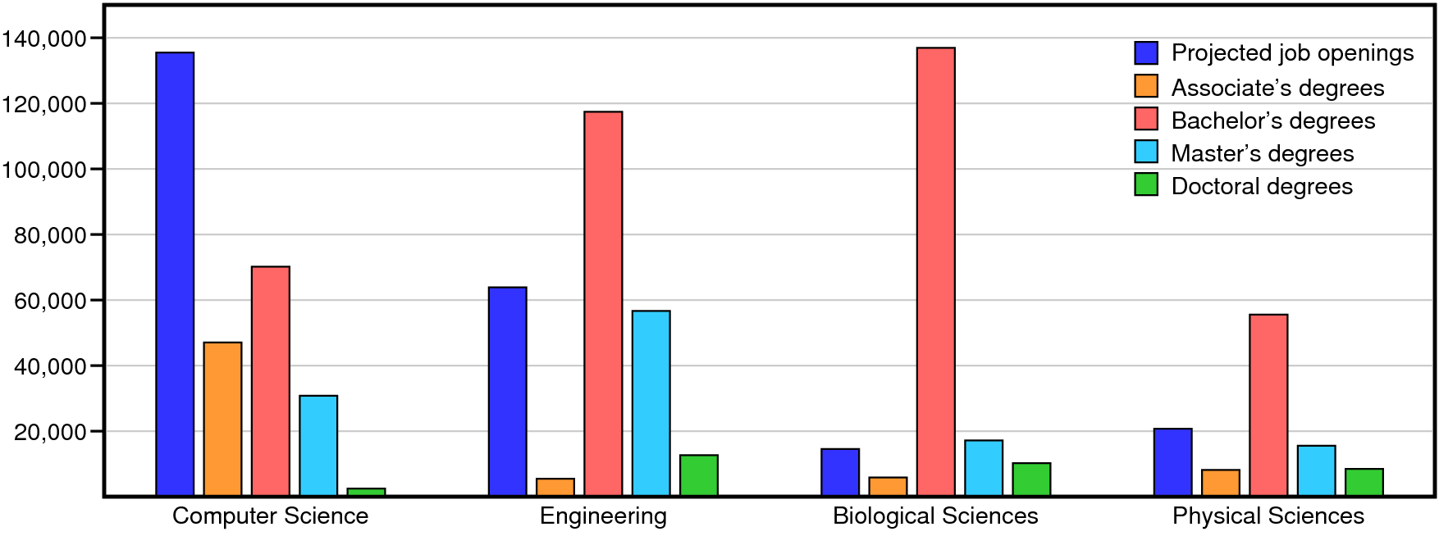
Why Study Computer Science?
Sources: National Center for Education Statistics 2014; Bureau of Labor Statistics 2014-2024 projections.
We are very happy with the students that we get from this university. . . . We just wish we could hire two to three times as many of them.
—
Bill Gates at Stanford, February 19, 2008

Slide 6
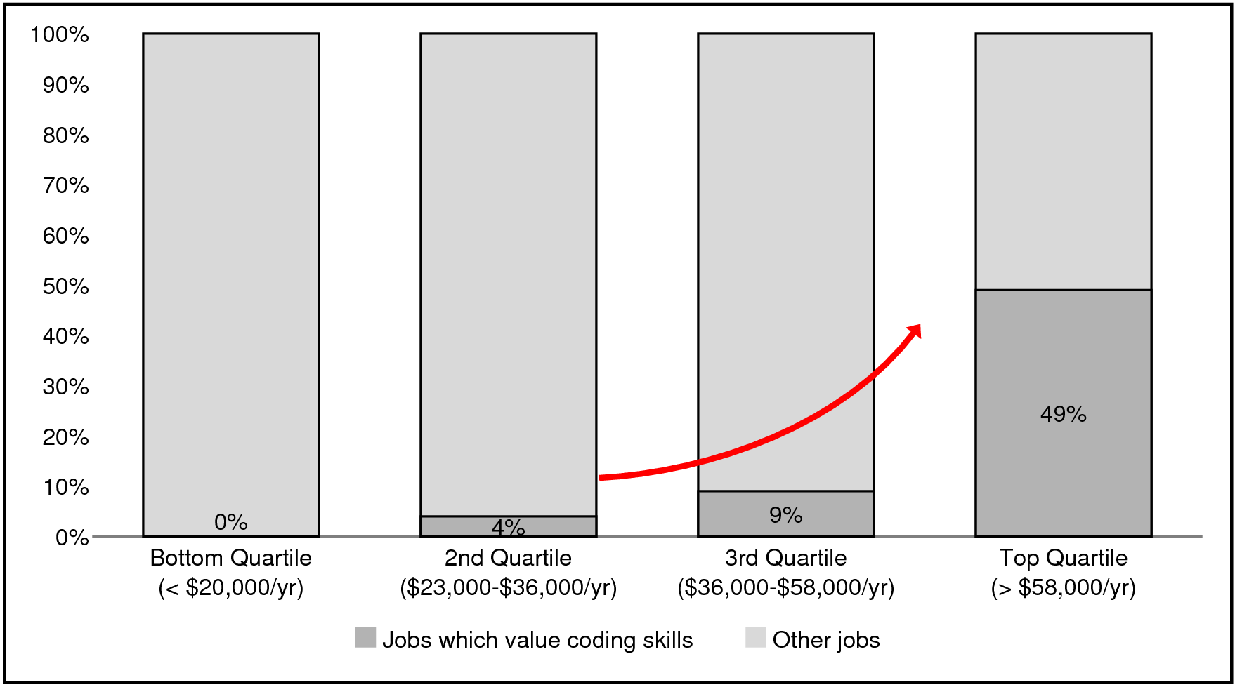
Everyone Needs Some Programming
Half of all jobs in the top income quartile value coding skills.
Source: Burning Glass Technologies, “Beyond Point and Click: The Expanding Demand for Coding Skills,” June 2016.

Slide 7
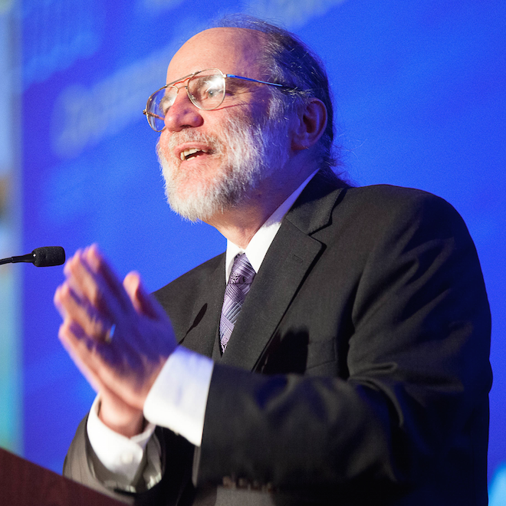

CS 106J Course Staff
Eric Roberts
eroberts@cs.stanford.edu
Office Hours (Gates 202):
Tuesdays 9:30–11:00
Jerry Cain
jerry@cs.stanford.edu
Office Hours (Gates 192):
Wednesdays: 3:30–5:00
Jason Chen
cheson@stanford.edu
Office Hours (TBA):
TBA

Slide 8


Syllabus—Week 1
April 3
5
7
Administration
Course overview
Meet Karel the Robot
Simple Karel programs
Control structures in Karel
Problem-solving in Karel
Program decomposition
The idea of an algorithm
Read: Sections 1.1-1.3
Read: Sections 1.4-1.5

Slide 9
Syllabus—Week 2
10
12
14
Programming by example
Variables and values
Arithmetic expressions
Functions
Strings and concatenation
Simple graphics
Control statements
Boolean data
Read: Sections 2.1-2.4
Read: Sections 2.5-2.6
Read: Sections 3,1-3.5

Slide 10
Syllabus—Week 3
17
19
21
Arguments and parameters
Libraries
Random numbers
The mechanics of functions
Decomposition
First-class functions
Event-driven programming
Responding to mouse events
Read: Sections 4.1-4.2
Due: HW #1 (Karel)
Read: Sections 4.3-4.4
Due: Karel contest
Read: Sections 5.1-5.4

Slide 11
Syllabus—Week 4
24
26
28
Simple animation
Timers
The GArc class
The GPolygon class
The GCompound class
Binary representation
Representing characters
Read: Section 5.5
Due: HW #2 (Simple JS)
Read: Section 5.6
Read: Section 6.1

Slide 12
Syllabus—Week 5
May 1
3
5
JavaScript’s String class
Common string patterns
Problem solving with strings
String applications
Cryptography
The GLabel class
Read: Sections 6.2-6.3
Read: Section 6.4
Read: Section 6.5
Due: HW #3 (Breakout)

Slide 13
Syllabus—Week 6
8
10
12
Debugging strategies
Simple arrays and files
Using arrays for tabulation
Midterm Exam
Tuesday, May 9
3:30 P.M. or 7:00 P.M.
Due: Graphics contest
Read: Sections 7.1-7.2
Read: Section 7.3

Slide 14
Syllabus—Week 7
15
17
19
Multidimensional arrays
Pixel arrays
The GImage class
Objects as aggregates
JavaScript and OOP
Libraries and interfaces
Defining classes and methods
Read: Sections 7.4-7.5
Due: HW #4 (HangKarel)
Read: Sections 8.1-8.2
Read: Sections 8.3-8.5

Slide 15
Syllabus—Week 8
22
24
26
Objects as maps
Large-scale data structures
Data-driven programs
Overview of Adventure!
Read: Section 8.6
Read: Section 8.7
Read: Adventure handout
Due: HW #5 (Yahtzee)

Slide 16
Syllabus—Week 9
29
31
June 2
Memorial Day
(no class)
JavaScript and the web
Using web interactors
Read: (handouts for the day)
Read: (handouts for the day)

Slide 17
Dead Week and Beyond
5
7
Looking ahead
Frontiers of computing
(optional)
Read: (handouts for the day)
Due: HW #6 (Adventure)
Due: Adventure contest
Review session:
Monday, June 12
7:00-9:00 P.M.
Final exam:
Wednesday, June 14
8:30-11:30 A.M.

Slide 18
Assignments in CS 106J
Assignments in CS 106J are due at 5:00P.M. Assignments that come in after 5:00 will be considered late.
Everyone in CS 106J starts the quarter with two “late days” that you can use at any time you need some extra time. In my courses, late days correspond to class meetings, so that, if an assignment is due on Wednesday and you turn it in on Friday, that counts as one late day.
Extensions can be approved only by the TA, Jason Chen.
Assignments are graded by your section leader, who discusses your work in an interactive, one-on-one grading session.
Each assignment is given two grades: one on functionality and one on programming style. Style matters. Companies in Silicon Valley expect Stanford graduates to understand how to write code that other programmers can maintain.

Slide 19


The CS 106J Grading Scale
Functionality and style grades for the assignments use the following scale:
A submission so good it “makes you weep.”
Exceeds requirements.
Satisfies all requirements of the assignment.
Meets most requirements, but with some problems.
Some more serious problems.
Even worse than that.
Why did you turn this in?

Slide 20
Contests
CS 106J will have three contests as follows:
  The Karel Contest associated with Assignment #1
  The Graphics Contest associated with Assignment #3
  The Adventure Contest associated with Assignment #6
First prize in the contest is a score of 100% on one of the graded components of the course, typically the final exam.
As an additional incentive, entering any of the contests gives you a virtual ticket to win an additional grand prize in a random drawing at the end of the quarter. So does receiving a runner-up or honorable mention on a contest and finding errors in the text and tools.
Entering a contest also earns “house points” for your class in the style of the Hogwarts School from Harry Potter.

Slide 21
Honor Code Rules
Rule 1:
You must not look at solutions or program code that is not your own.
Rule 2:
You must not share your solution code with other students.
Rule 3:
You must indicate on your submission any assistance you received.

Slide 22
Meet Karel the Robot
Karel the Robot was developed here at Stanford by Richard Pattis over 30 years ago. Since then Karel has given many generations of CS 106J students a “gentle introduction” to programming and problem solving.
Karel’s world is composed of streets and avenues numbered from the southwest corner. (As in Manhattan, streets run east-west and avenues run north-south.) In this world, Karel is facing east at the corner of 1st Street and 1st Avenue.
Karel’s world is surrounded by a solid wall through which it cannot move. Depending on the problem, there may also be walls in the interior of the world that block Karel’s passage.
The only other objects that exist in Karel’s world are beepers, which are small plastic cones that emit a quiet beeping noise. In this world, for example, I’ve added a beeper to the corner of 1st Street and 2nd Avenue.
Initially, Karel understands only four primitive commands:
move()
Move forward one square
turnLeft()
Turn 90 degrees to the left
pickBeeper()
Pick up a beeper from the current square
putBeeper()
Put down a beeper on the current square
3
+
+
+
+
+
2
+
+
+
+
+
1
+
+
+
+
+
1
2
3
4
5

Slide 23
Your First Challenge
How would you program Karel to pick up the beeper and transport it to the top of the ledge? Karel should drop the beeper at the corner of 2nd Street and 4th Avenue and then continue one more corner to the east, ending up on 5th Avenue.
3
+
+
+
+
+
2
+
+
+
+
+
1
+
+
+
+
+
1
2
3
4
5

Slide 24
The End

