Slide 1
Simple JavaScript
Eric Roberts
CS 106J
April 10, 2017

Slide 2
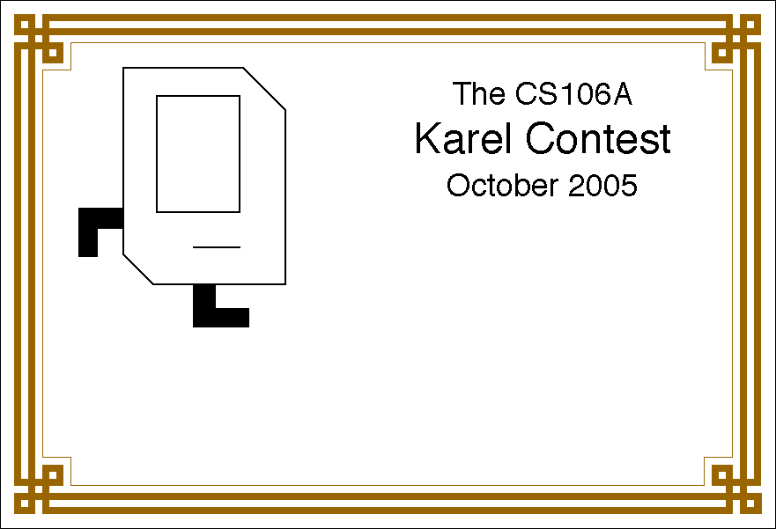
The Karel Contest
The CS 106A
Karel Contest
Winners from previous years

Slide 3
JavaScript and SJS
JavaScript was developed at the Netscape Communications Corporation in 1995, reportedly by a single programmer in just 10 days. The language, which was called Mocha at the time, was designed to serve as a programming language that could be embedded in web pages viewed in the browser.
JavaScript has since become the dominant language for all interactive web content and appears in some surveys as the most popular language in the computing industry.
CS 106J uses a subset of JavaScript that we are calling SJS for Stanford JavaScript. The SJS subset includes those parts of JavaScript that are important for learning the fundamentals of programming, which is the primary goal of all the CS 106 classes.

Slide 4
Arithmetic Expressions
Like most languages, JavaScript specifies computation in the form of an arithmetic expression, which consists of terms joined together by operators.
Each term in an arithmetic expression is one of the following:
  An explicit numeric value, such as 2 or 3.14159265
  A variable name that serves as a placeholder for a value
  A function call that computes a value
  An expression enclosed in parentheses
The operators are typically the familiar ones from arithmetic:
+
Addition
–
Subtraction
*
Multiplication
/
Division
%
Remainder

Slide 5
The Remainder Operator
The only arithmetic operator that has no direct counterpart in traditional mathematics is %, which computes the remainder when the first divided by the second:
14 % 5
returns
4
14 % 7
returns
0
7 % 14
returns
7
The result of the % operator make intuitive sense only if both operands are positive. The examples in the book do not depend on knowing how % works with negative numbers.
The remainder operator turns out to be useful in a surprising number of programming applications and is well worth a bit of study.

Slide 6
Using the SJS Console
The easiest way to get a sense of how arithmetic expressions work is to enter them on the SJS console.
JavaScript Console
->
2 + 2
4
->
342 - 173
169
->
12345679 * 63
777777777
->
9 * 9 * 9 + 10 * 10 * 10
1729
->

Slide 7
Variables
The simplest terms that appear in expressions are constant literals and variables. A variable is a placeholder for a value that can be updated as the program runs.
A variable in JavaScript is most easily envisioned as a box capable of storing a value
answer
42
Each variable has the following attributes:
  A name, which enables you to tell the variables apart.
  A value, which represents the current contents of the variable.
The name of a variable is fixed; the value changes whenever you assign a new value to the variable.

Slide 8
Variable Declarations
In JavaScript, you must declare a variable before you can use it. The declaration establishes the name of the variable and, in most cases, specifies the initial value as well.
The most common form of a variable declaration is
var name = value;
where name is an identifier that indicates the name of the variable, and value is an expression specifying the initial value.
Most declarations appear as statements in the body of a function definition. Variables declared in this way are called local variables and are accessible only inside that function.

Slide 9
Constant Declarations
It is often useful to give names to values that you don’t intend to change while the program runs. Such values are called constants.
A constant declaration is similar to a variable declaration:
const name = value;
As before, name is an identifier that indicates the name of the constant, and value is an expression specifying its value.

Slide 10
Naming Conventions
In JavaScript, all names must conform to the syntactic rules for identifiers, which means that the first character must be a letter and the remaining characters must be letters, digits, or the underscore character.
Beyond these rules that apply to all JavaScript names, there are several conventions that programmers use to make their identifier names easier to recognize:
  Variable names and function names begin with a lowercase letter. If a name consists of more than one word, the first letter in each word is capitalized, as in numberOfStudents. This convention is called camel case.
  Class names and program names begin with an uppercase letter.
  Constant names are written entirely in uppercase and use the underscore character to separate words, as in MAX_HEADROOM.

Slide 11
Precedence
If an expression contains more than one operator, JavaScript uses precedence rules to determine the evaluation order. The arithmetic operators have the following relative precedence:
unary -
highest
* / %
+ -
lowest
Thus, JavaScript evaluates unary – operators first, then the operators *, /, and %, and then the operators + and -.
Precedence applies only when two operands compete for the same operator. If the operators are independent, JavaScript evaluates expressions from left to right. Parentheses may be used to change the order of operations.

Slide 12
Exercise: Precedence Evaluation
What is the value of the expression at the bottom of the screen?
42
51
45
6
3
2
9
15
1
*
2
*
3
+
(
4
+
5
)
%
6
*
(
7
+
8
)
-
9

Slide 13
Assignment Statements
You can change the value of a variable in your program by using an assignment statement, which has the general form:
variable = expression;
The effect of an assignment statement is to compute the value of the expression on the right side of the equal sign and assign that value to the variable that appears on the left. Thus, the assignment statement
total = total + value;
adds together the current values of the variables total and value and then stores that sum back in the variable total.
When you assign a new value to a variable, the old value of that variable is lost.

Slide 14
Shorthand Assignments
Statements such as
total = total + value;
are so common that JavaScript allows the following shorthand:
total += value;
The general form of a shorthand assignment is
variable op= expression;
where op is any of JavaScript’s binary operators. The effect of this statement is the same as
variable = variable op (expression);

Slide 15
Increment and Decrement Operators
Another important shorthand that appears frequently in JavaScript programs is the increment operator, which is most commonly written immediately after a variable, like this:
x++;
The effect of this statement is to add one to the value of x, which means that this statement is equivalent to
x += 1;
or
x = x + 1;
The -- operator (which is called the decrement operator) is similar but subtracts one instead of adding one.

Slide 16
Functions Revisited
Last week, you learned that a function in Karel is a sequence of statements that has been collected together and given a name.
Although that definition also applies in JavaScript, it fails to capture the idea that functions can process information.
In JavaScript, a function can take information from its caller, perform some computation, and then return a result.
This notion that functions exist to manipulate information and return results makes functions in programming similar to functions in mathematics, which is historically the reason for the name.

Slide 17
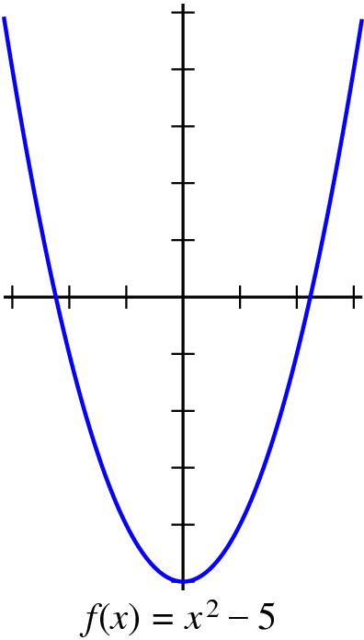
Functions in Mathematics
The graph at the right shows the values of the function
f (x) = x ² − 5
Plugging in a value for x allows you to compute the value of f (x), as follows:
f (0) = 0² − 5 = −5
f (1) = 1² − 5 = −4
f (2) = 2² − 5 = −1
f (3) = 3² − 5 = 4
The JavaScript version of f (x) is
function f(x) {
return x * x – 5;
}

Slide 18
Writing JavaScript Functions
The general form of a function definition is
function name(parameter list) {
statements in the function body
}
where name is the name of the function, and parameter list is a list of variables used to hold the values of each argument.
You can return a value from a function by including a return statement, which is usually written as
return expression;
where expression is an expression that specifies the value you want to return.

Slide 19
Examples of Simple Functions
The following function converts Fahrenheit temperatures to their Celsius equivalent:
function fahrenheitToCelsius(f) {
return 5 / 9 * (f – 32);
}
The following function computes the area of a triangle from its base and height:
function triangleArea(base, height) {
return (base * height) / 2;
}

Slide 20
Exercise: Money in the Wizarding World
In J. K. Rowling’s Harry Potter books, wizards use a currency with the following equivalences:
29 knuts
=
1 sickle
17 sickles
=
1 galleon
Write a function
function numberOfGalleons(knuts, sickles)
that returns the number of galleons (which will usually have a decimal fraction) corresponding to the specified number of knuts and sickles. For example, calling
numberOfGalleons(29 * 17, 17)
should return 2.

Slide 21
Useful Functions in the Math Class
Math.PI
The mathematical constant π
Math.E
The mathematical constant e
Math.abs(x)
The absolute value of x
Math.max(x, y, . . .)
The largest of the arguments
Math.min(x, y, . . .)
The smallest of the arguments
Math.round(x)
The closest integer to x
Math.floor(x)
The largest integer not exceeding x
Math.log(x)
The natural logarithm of x
Math.exp(x)
The inverse logarithm (e ^{x})
Math.pow(x, y)
The value x raised to the y power (x ^{y})
Math.sin(θ )
The sine of θ, measured in radians
Math.cos(θ )
The cosine of θ, measured in radians
Math.random(x)
A random number between 0 and 1

Slide 22
Exercise: Calculating a Quotient
It is often useful to be able to compute the quotient of two numbers, which is the whole number that results if you divide the first by the second and then throw away any remainder. The usual way to calculate a quotient is to use Math.floor like this:
function quotient(x, y) {
return Math.floor(x / y);
}
Rewrite the quotient function so that it uses only the standard arithmetic operators. Your function may assume that both x and y are positive.

Slide 23
The End

