Slide 1
Mechanics of Functions
(Errata)
Jerry Cain and Eric Roberts
CS 106J
April 19, 2017

Slide 2
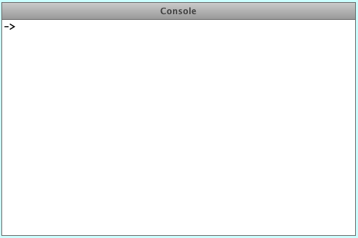
Exercise: Generating Prime Factorizations
A more computationally intense problem is to generate the prime factorization of a positive integer n.
An integer is prime if it’s greater than 1 and has no positive integer divisors other than 1 and itself.
  5 is prime: it’s divisible only by 1 and 5.
  6 is not prime: it’s divisible by 1, 2, 3, and itself.
Some prime factorizations:
-> PrimeFactorizations(501, 512)
501 = 3 * 167
502 = 2 * 251
503 = 503
504 = 2 * 2 * 2 * 3 * 3 * 7
505 = 5 * 101
506 = 2 * 11 * 23
507 = 3 * 13 * 13
508 = 2 * 2 * 127
509 = 509
510 = 2 * 3 * 5 * 17
511 = 7 * 73
512 = 2 * 2 * 2 * 2 * 2 * 2 * 2 * 2 * 2
->

Slide 3
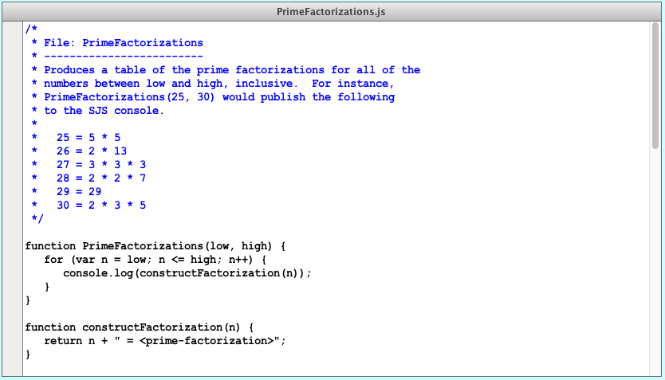
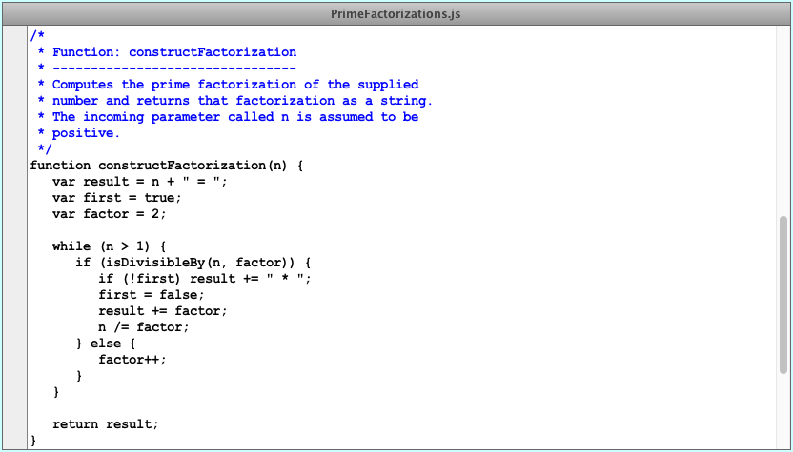
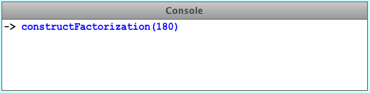
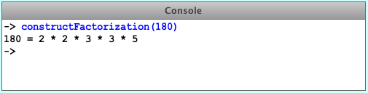
PrimeFactorizations.js
Remember to decompose the problem, not the program.
Synthesizing a sequence of prime factorizations is much easier if you operate as if you have a function that synthesizes one.
Invent a series of milestones that advance you towards your overall goal. Each milestone should be a small perturbation to the last fully functional milestone you successfully implemented.
The program you see to the left does something if constructFactorization produces something.
My first milestone? A for loop that prints something on behalf of all numbers between low and high, inclusive.
Invent a placeholder implementation of constructFactorization that returns a gesture to what’s ultimately needed, and call it progress towards your overall goal.
180
90
45
15
5
n
1
"180 = "
"180 = 2"
"180 = 2 * "
"180 = 2 * 2"
"180 = 2 * 2 * "
"180 = 2 * 2 * 3"
"180 = 2 * 2 * 3 * "
"180 = 2 * 2 * 3 * 3"
"180 = 2 * 2 * 3 * 3 * "
result
"180 = 2 * 2 * 3 * 3 * 5"
true
first
false
2
3
4
factor
5

Slide 4
PrimeFactorizations.js
Some thought questions and exercises:
The solution relies on a single Boolean called first. What problem is first solving for us?
During our trace of constructFactorization(180), factor assumed the values of 2, 3, 4, and 5. 2, 3, and 5 are prime numbers and therefore qualified to appear in a factorization? How does the implementation guarantee 4 will never make an appearance in the returned factorization?
What is returned by constructFactorization(1)? How could you have changed the implementation to return "1 = 1" as a special case return value?
Trace through the execution of constructFactorization(363) as we did for constructFactorization(180).
Our implementation relies on a parameter named n to accept a value from the caller, and then proceeds to destroy n by repeatedly dividing it down to 1. Does this destruction of n confuse PrimeFactorizations’s for loop? Note that its counting variable is also named n.

Slide 5
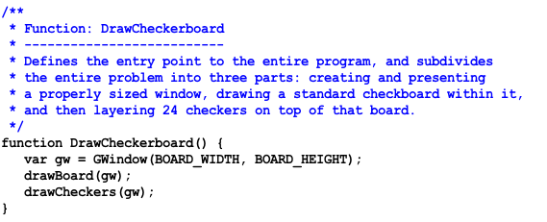

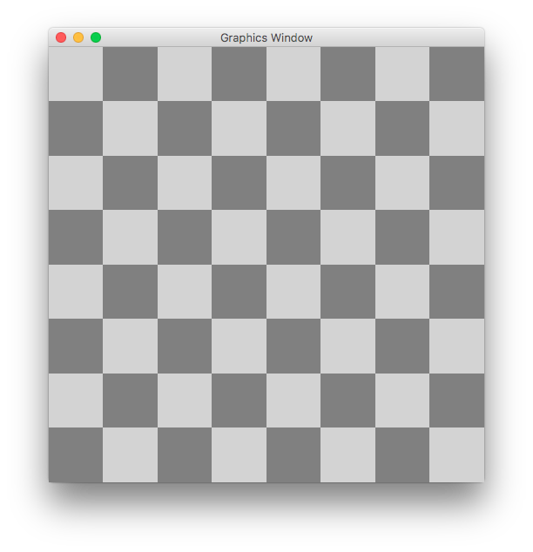
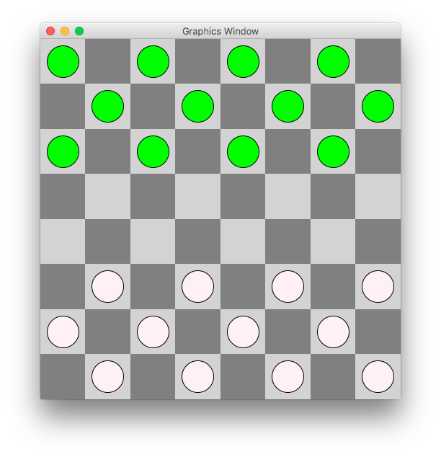
Exercise: Drawing A Checkerboard
For the rest of lecture, we’ll collectively design and decompose (and to the extent we have time, implement) a graphics program that draws the initial configuration for a game of checkers.

Slide 6
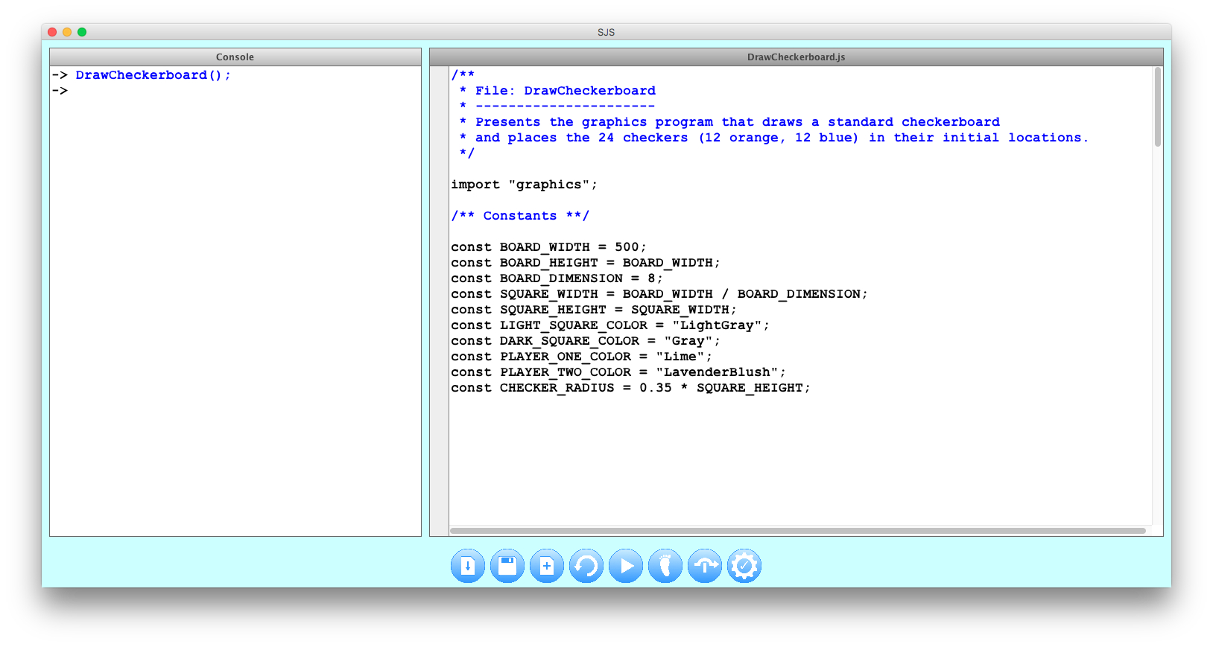
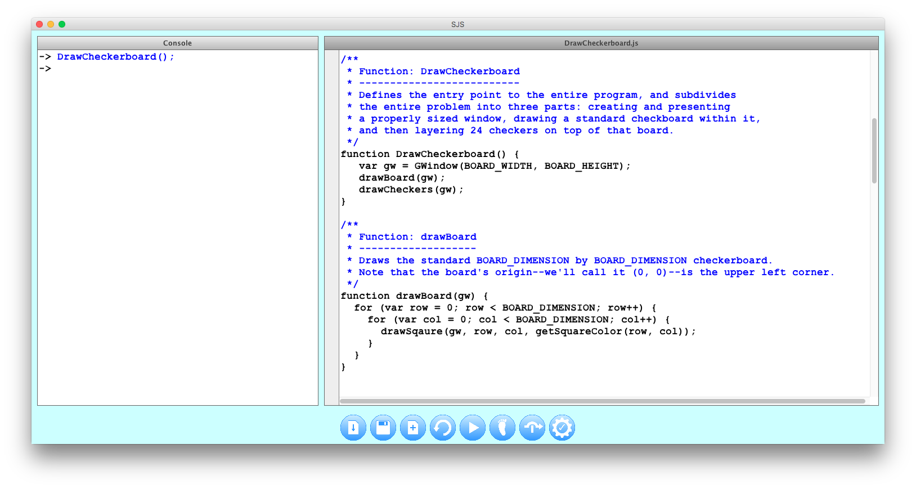
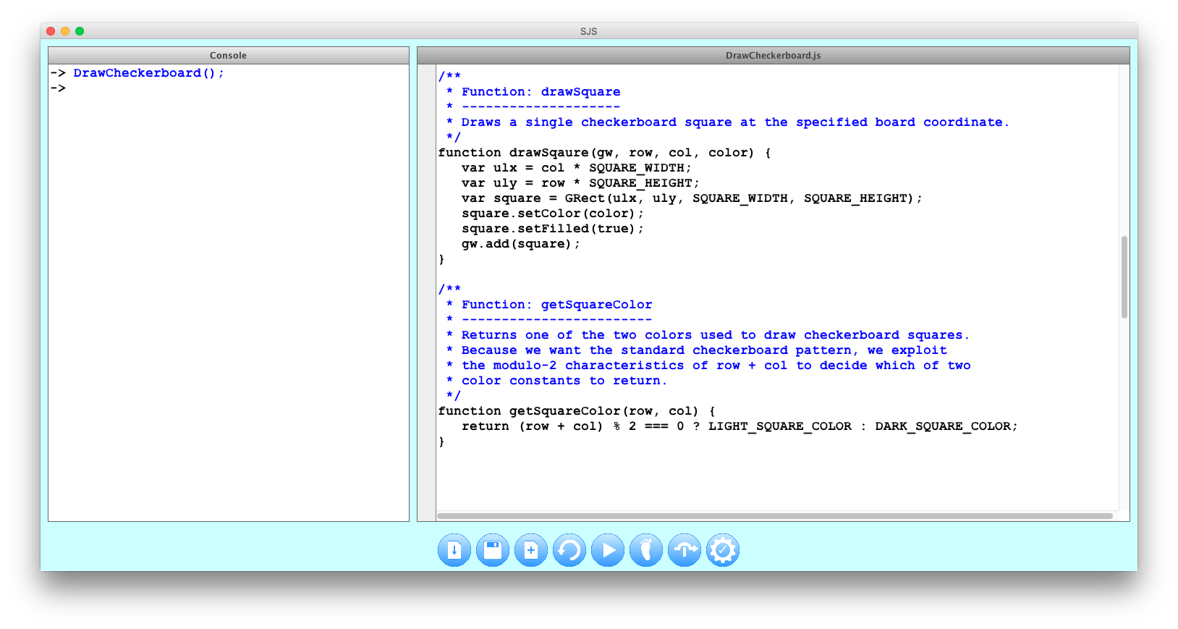
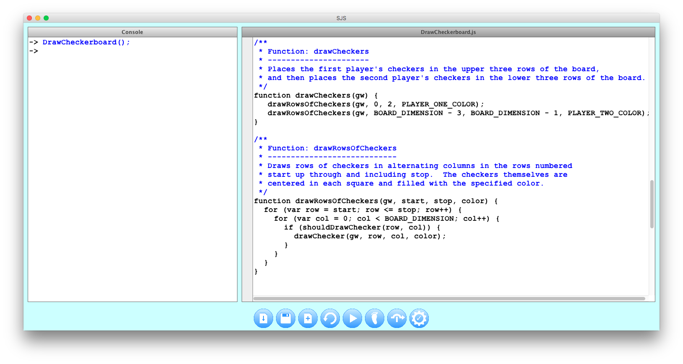
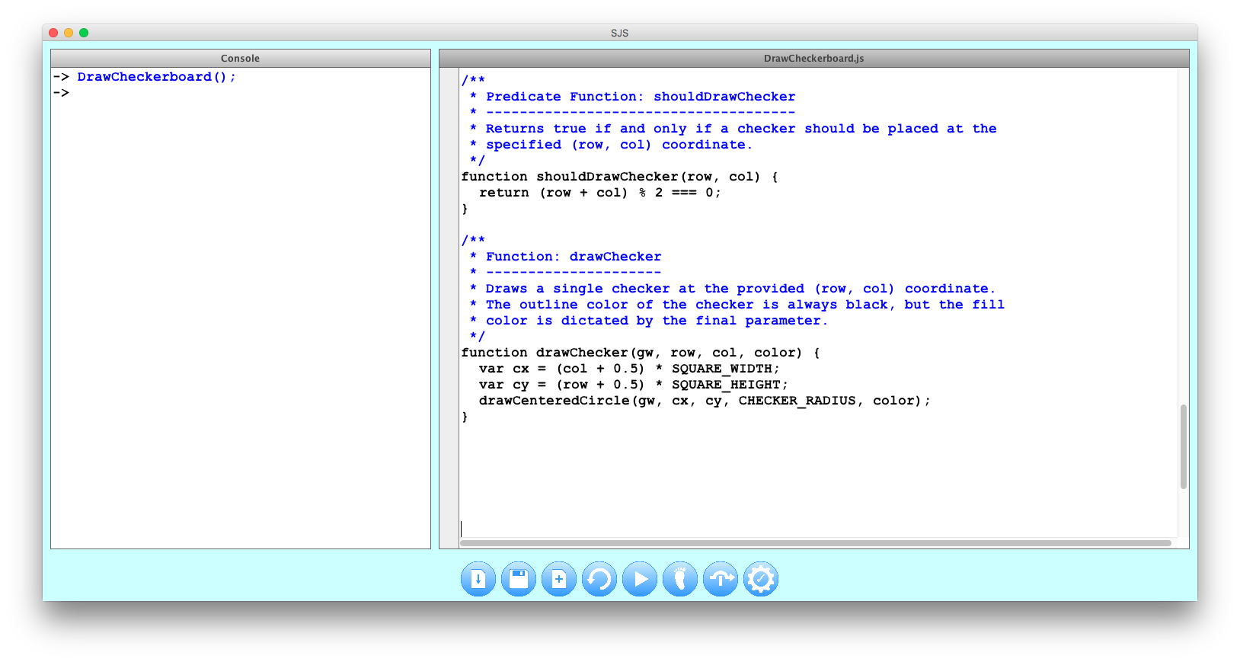
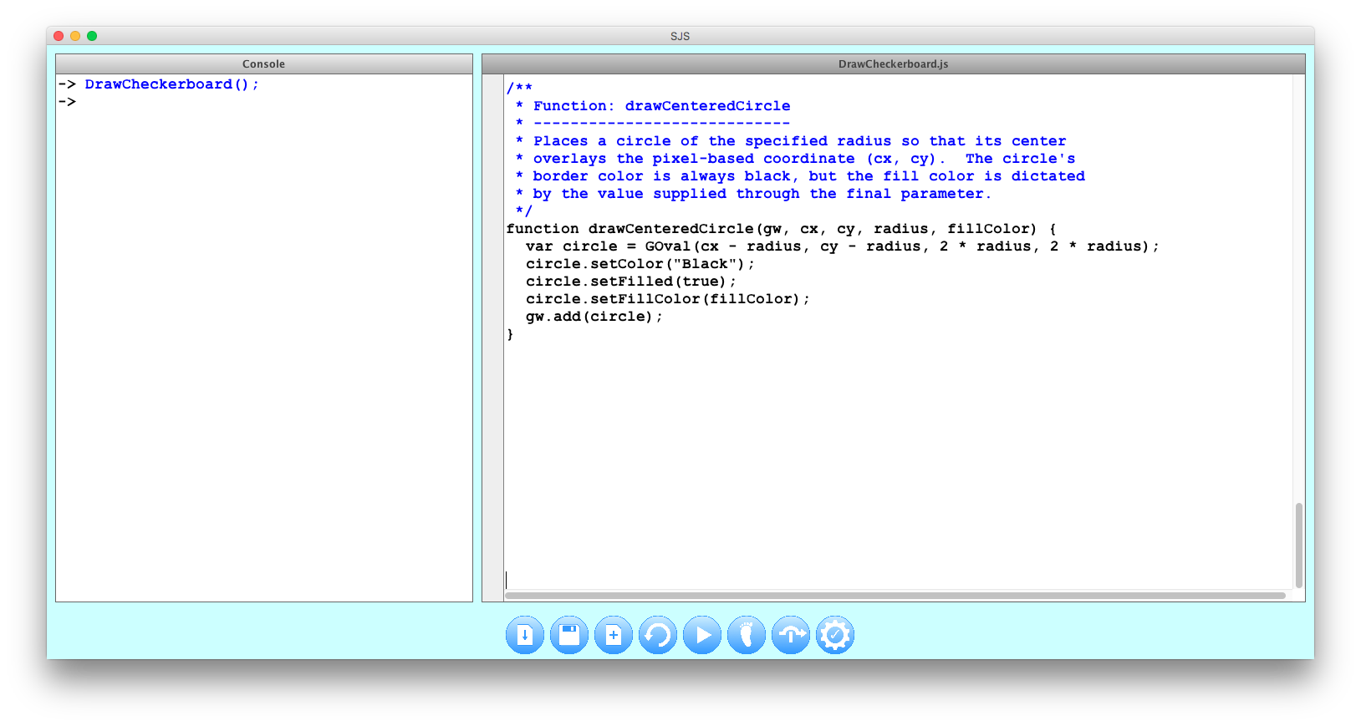
DrawCheckerboard.js

Slide 7
The End

