Slide 1
Timer-Based Animation
Jerry Cain
CS 106J
April 24, 2017

Slide 2
Timer Events
The programs you saw on Friday responded to mouse events by adding an event listener to the GWindow object.
JavaScript also allows you to listen for timer events, which occur after a specified time interval.
As with mouse events, you specify the listener for a timer event in the form of a callback function that is automatically invoked at the end of the time interval.
You can add animation to a JavaScript program by setting a timer for a short interval and having the callback function make small updates to the graphical objects in the window.
If the time interval is short enough (typically between 20 and 30 milliseconds), the animation will appear smooth to the human eye.

Slide 3
Timeouts
JavaScript supports two kinds of timers. A one-shot timer invokes its callback function once after a specified delay. You create a one-shot timer by calling
setTimeout(function, delay);
where function is the callback function and delay is the time interval in milliseconds.
An interval timer invokes its callback function repeatedly at regular intervals. You create an interval timer by calling
setInterval(function, delay);
The setInterval function returns a numeric value that you can later use to stop the timer by calling clearTimeout with that numeric value as an argument.

Slide 4
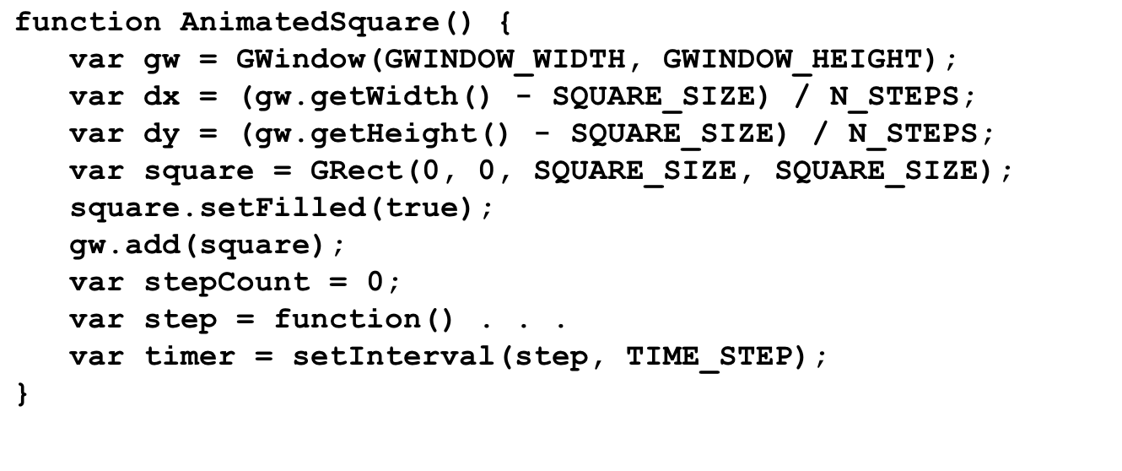
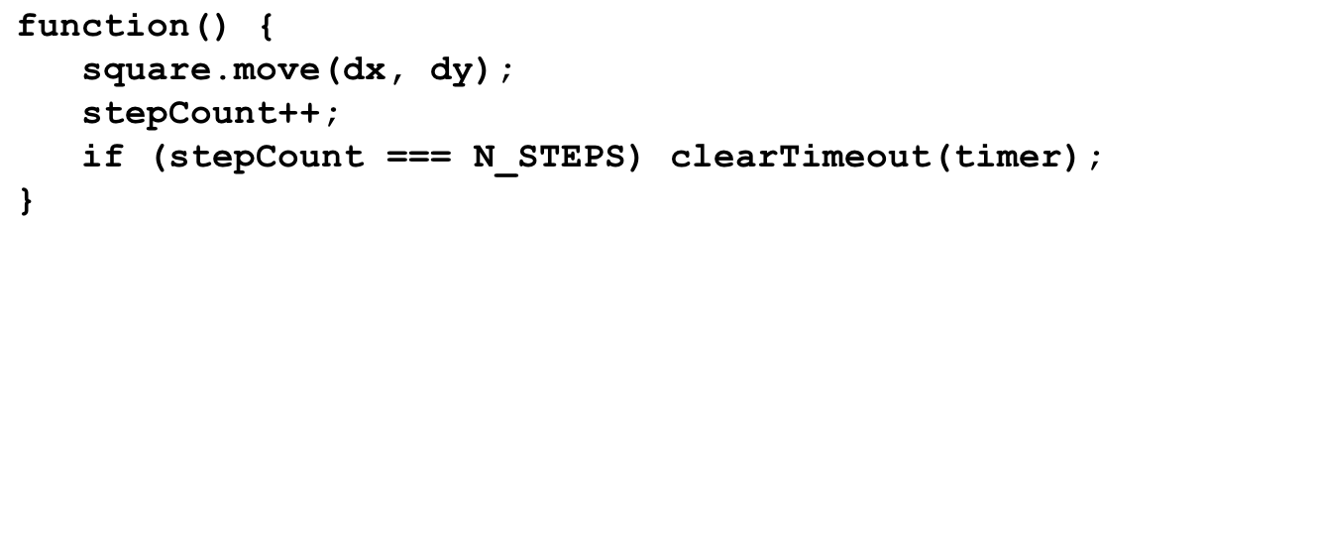
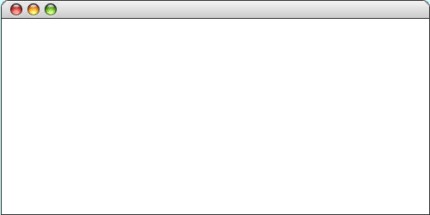
A Simple Example of Animation
gw
gw
dx
dx
dy
dy
square
square
stepCount
stepCount
step
step
timer
timer
. . .
. . .
4.5
1
4.5
2.5
2.5
0
0
id
id
AnimatedSquare

Slide 5
The End

