Slide 1
Graphical Structures
Eric Roberts and Jerry Cain
CS 106J
April 26, 2017

Slide 2
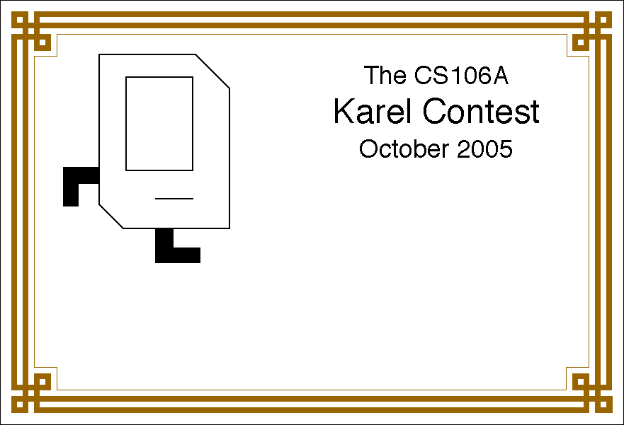
Karel Contest Results
The CS106J
Karel Contest
April 2017
Your Name Here

Slide 3
Karel Contest Results
First place (algorithmic):
Carissa Cirelli, Hilbert Curve
Runner-up (algorithmic):
Kyle Denton, Sierpinski
Runner-up (algorithmic):
Jordi Montana-Lopez, Karel Painter
First place (aesthetic):
Vinh Ton, Karel Love Story
Runner-up (aesthetic):
Tomonori Sugimoto, Chameleon
Runner-up (aesthetic):
Gabrielle Daso, Night Sky
Honorable mention:
Jenny Kim, Golconda
Honorable mention:
AJ Alvaro, Mancala Karel

Slide 4




Class Standings
7/9
0.78
6/12
0.50
8/19
0.42
0/3 = 0.00
Freshman
Sophomore
Junior
Senior+

Slide 5
Graphical Structures

Slide 6
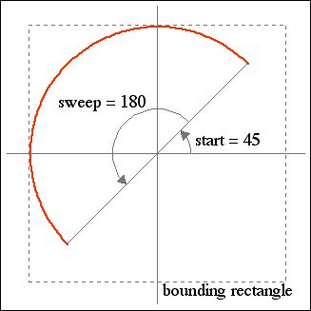
The GArc Class
The GArc class represents an arc formed by taking a section from the perimeter of an oval.
Conceptually, the steps necessary to define an arc are:
  Specify the coordinates and size of the bounding rectangle.
  Specify the start angle, which is the angle at which the arc begins.
  Specify the sweep angle, which indicates how far the arc extends.
The geometry used by the GArc class is shown in the diagram on the right.
In keeping with the graphics model, angles are measured in degrees starting at the +x axis (the 3:00 o’clock position) and increasing counterclockwise.
Negative values for the start and sweep angles signify a clockwise direction.

Slide 7
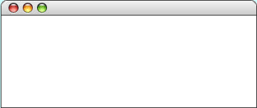
Exercise: GArc Geometry
Suppose that the variables cx and cy contain the coordinates of the center of the window and that the variable d is 0.8 times the screen height. Sketch the arcs that result from each of the following code sequences:
var a1 = GArc(d, d, 0, 90);
gw.add(a1, cx - d / 2, cy - d / 2);
var a2 = GArc(d, d, 45, 270);
gw.add(a2, cx - d / 2, cy - d / 2);
GArcExamples
GArcExamples
var a3 = GArc(d, d, -90, 45);
gw.add(a3, cx - d / 2, cy - d / 2);
var a4 = GArc(d, d, 0, -180);
gw.add(a4, cx - d / 2, cy - d / 2);
GArcExamples
GArcExamples

Slide 8
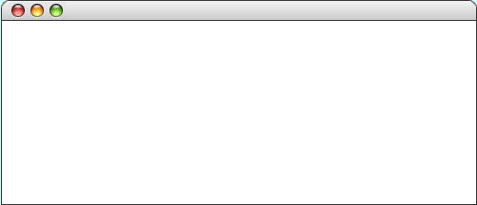
Filled Arcs
The GArc class implements the functions setFilled and setFilledColor.
A filled GArc is displayed as the pie-shaped wedge formed by the center and the endpoints of the arc, as follows:
function FilledEllipticalArc() {
var gw = GWindow(GWINDOW_WIDTH, GWINDOW_HEIGHT);
var arc = GArc(0, 0, gw.getWidth(), gw.getHeight(),
0, 90);
arc.setFilled(true);
gw.add(arc);
}
FilledEllipticalArc

Slide 9
Additional Methods for GArc
setStartAngle(start)
Sets the start angle for the arc
getSweepAngle()
Returns the start angle for the arc
setSweepAngle(sweep)
Sets the sweep angle for the arc
getSweepAngle()
Returns the sweep angle
setFrameRectangle(x, y, width, height)
Resets the bounds for the frame
These methods allow you to animate the appearance of an arc.
The setStartAngle and setSweepAngle methods make it possible to change the starting position and the extent of the arc dynamically.
The setFrameRectangle method changes the bounds of the rectangle circumscribing the oval from which the arc is taken.

Slide 10
Exercise: PacMan
Write a program that uses the GArc class to display a PacMan figure at the left edge of the graphics window.
Add the necessary timer animation so that PacMan moves to the right edge of the window. As it moves, your program should change the start and sweep angles of the arc so that the mouth appears to open and close.
PacMan

Slide 11
Questions about the PacMan Problem
We’re going to divide into four groups and spend the next five minutes discussing important questions you would need to answer while solving the PacMan problem. Each group will discuss one of the following four questions:
How would you create the initial PacMan object at the left of the window?
What needs to happen on each time step?
How do you get the program to stop?
How would you design milestones that would allow you to test the program in pieces?

Slide 12
The GPolygon Class
The GPolygon class is used to represent graphical objects bound by line segments. In mathematics, such figures are called polygons and consist of a set of vertices connected by edges. The following figures are examples of polygons:
diamond
regular hexagon
five-pointed star
Unlike the other shape classes, that location of a polygon is not fixed at the upper left corner. What you do instead is pick a reference point that is convenient for that particular shape and then position the vertices relative to that reference point.
The most convenient reference point is usually the geometric center of the object.

Slide 13
Constructing a GPolygon Object
The GPolygon function creates an empty polygon. Once you have the empty polygon, you then add each vertex to the polygon, one at a time, until the entire polygon is complete.
The most straightforward way to create a GPolygon is to call the method addVertex(x, y), which adds a new vertex to the polygon. The x and y values are measured relative to the reference point for the polygon rather than the origin.
When you start to build up the polygon, it always makes sense to use addVertex(x, y) to add the first vertex. Once you have added the first vertex, you can call any of the following methods to add the remaining ones:
  addVertex(x, y) adds a new vertex relative to the reference point
  addEdge(dx, dy) adds a new vertex relative to the preceding one
  addPolarEdge(r, theta) adds a new vertex using polar coordinates

Slide 14
Using addVertex and addEdge
The addVertex and addEdge methods each add one new vertex to a GPolygon object. The only difference is in how you specify the coordinates. The addVertex method uses coordinates relative to the reference point, while the addEdge method indicates displacements from the previous vertex.
Your decision about which of these methods to use is based on what information you have readily at hand. If you can easily calculate the coordinates of the vertices, addVertex is probably the right choice. If, however, it is easier to describe each edge, addEdge is probably a better strategy.
No matter which of these methods you use, the GPolygon class closes the polygon before displaying it by adding an edge from the last vertex back to the first one, if necessary.

Slide 15
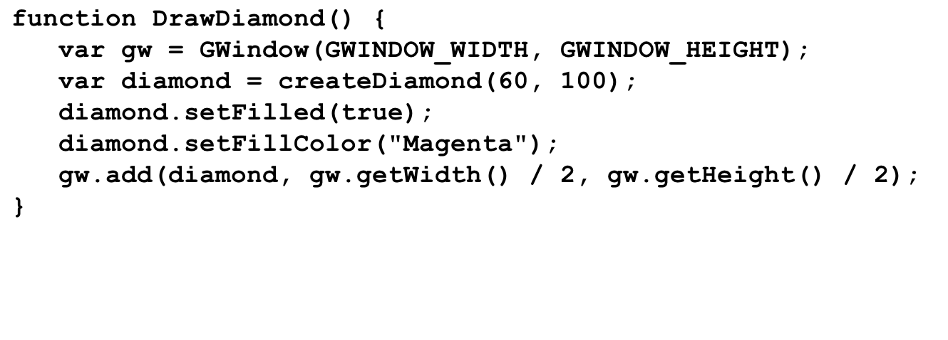
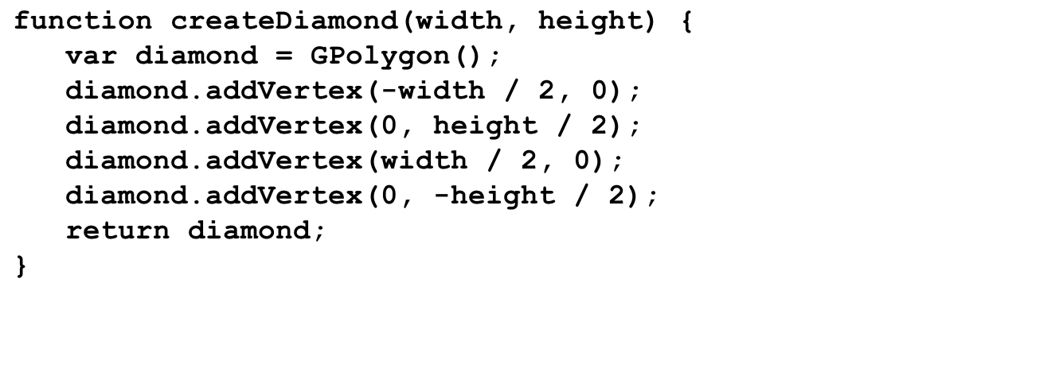
Drawing a Diamond (addVertex)
diamond
diamond
diamond
gw
width
width
height
height
60
100
DrawDiamond

Slide 16
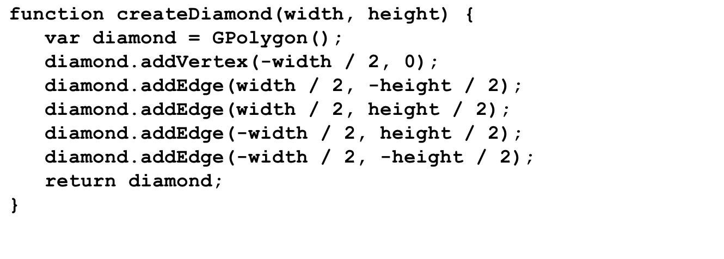
Drawing a Diamond (addEdge)
diamond
diamond
diamond
gw
width
width
height
height
60
100
DrawDiamond

Slide 17
Using addPolarEdge
In many cases, you can determine the length and direction of a polygon edge more easily than you can compute its x and y coordinates. In such situations, the best strategy for building up the polygon outline is to call addPolarEdge(r, theta), which adds an edge of length r at an angle that extends theta degrees counterclockwise from the +x axis, as illustrated by the following diagram:
r
theta
The name of the method reflects the fact that addPolarEdge uses what mathematicians call polar coordinates.

Slide 18
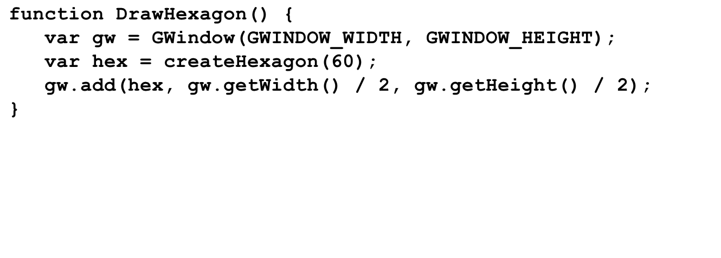
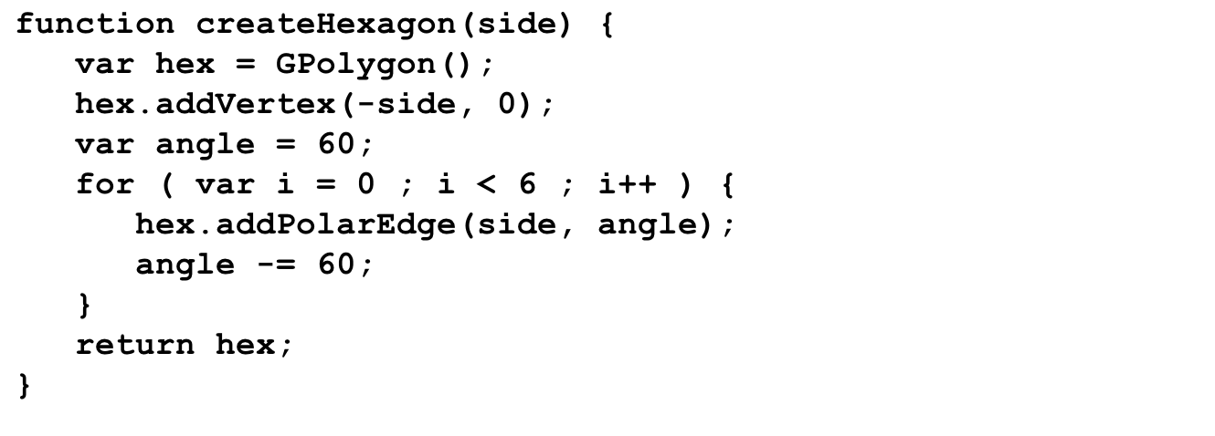
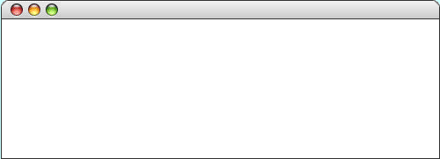
Drawing a Hexagon
hex
hex
hex
gw
side
side
angle
angle
i
i
60
60
0
-60
-120
-180
-240
-300
0
1
2
3
4
5
6
DrawHexagon

Slide 19
Creating Compound Objects
The GCompound class in the graphics library makes it possible to combine several graphical objects so that the resulting structure behaves as a single GObject.
The easiest way to think about the GCompound class is as a combination of a GWindow and a GObject. A GCompound is like a GWindow in that you can add objects to it, but it is also like a GObject in that you can add it to the graphics window.
As was true in the case of the GPolygon class, a GCompound object has its own coordinate system that is expressed relative to a reference point. When you add new objects to the GCompound, you use the local coordinate system based on the reference point. When you add the GCompound to the graphics window, all you have to do is set the location of the reference point; the individual components will automatically appear in the right locations relative to that point.

Slide 20
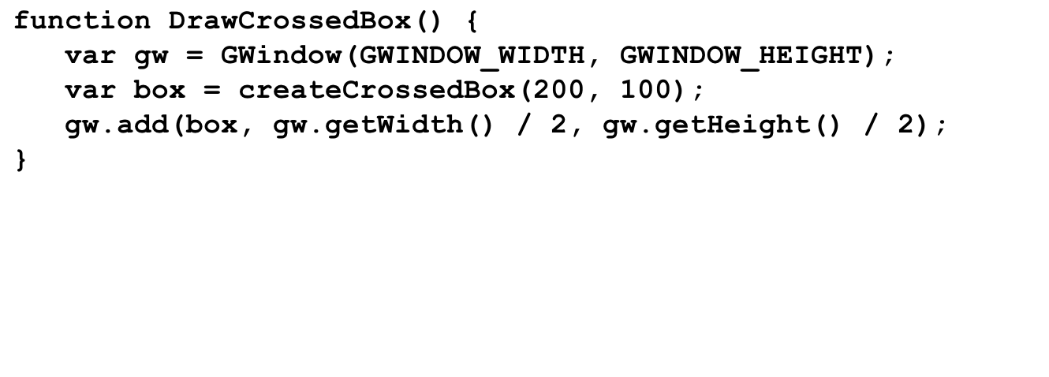
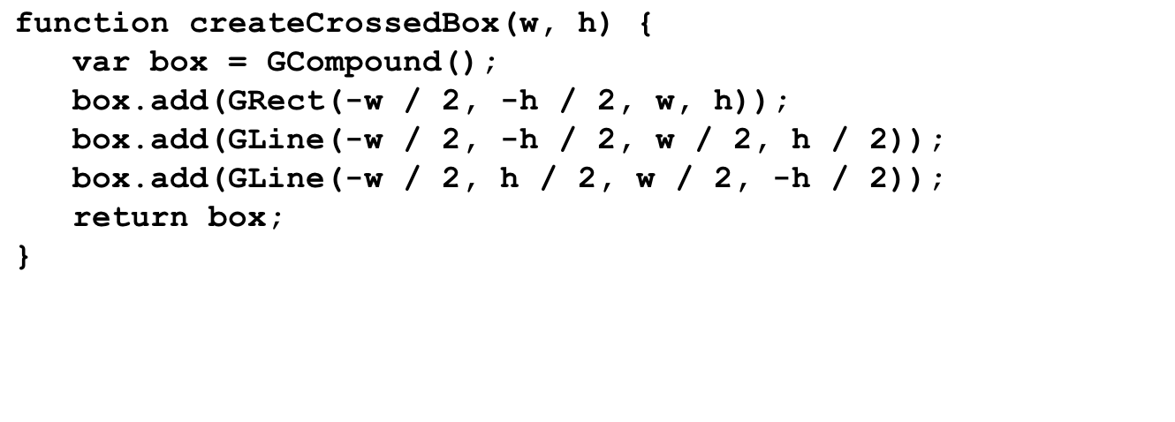
Using the GCompound Class
box
box
box
gw
w
w
h
h
200
100
DrawCrossedBox

Slide 21
The End

