Slide 1
Binary Representation
Eric Roberts and Jerry Cain
CS 106J
April 28, 2017

Slide 2
Once upon a time . . .

Slide 3

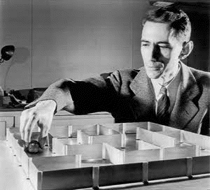
Claude Shannon
Claude Shannon was one of the pioneers who shaped computer science in its early years. In his master’s thesis, Shannon showed how it was possible to use Boolean logic and switching circuits to perform arithmetic calculations. That work led directly to the use of binary arithmetic inside computers—an idea that initially generated considerable resistance among more established scientists.
Claude Shannon (1916-2001)
Shannon is best known as the inventor of information theory, which provides the mathematical foundation for understanding data communication. To many, however, Shannon’s great contribution was that he never lost his sense of fun throughout his long career.

Slide 4
Binary Representation

Slide 5
The Power of Bits
The fundamental unit of memory inside a computer is called a bit—a term introduced in a paper by Claude Shannon as a contraction of the words binary digit.
An individual bit exists in one of two states, usually denoted as 0 and 1.
More sophisticated data can be represented by combining larger numbers of bits:
  Two bits can represent four (2 × 2) values.
  Three bits can represent eight (2 × 2 × 2) values.
  Four bits can represent 16 (2⁴) values, and so on.
This laptop has 16GB of main memory and can therefore exist in 2^{549,755,813,888} states. If you were to write that number out, it would contain more than fifty billion digits.

Slide 6
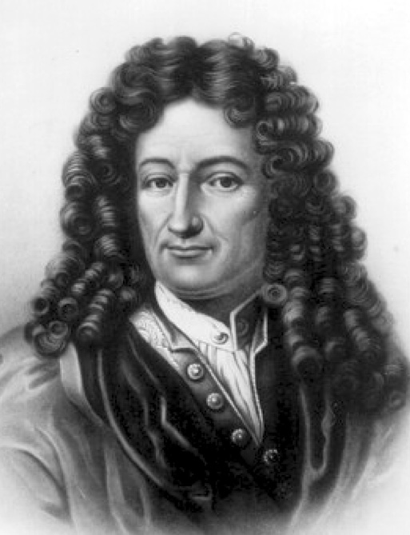
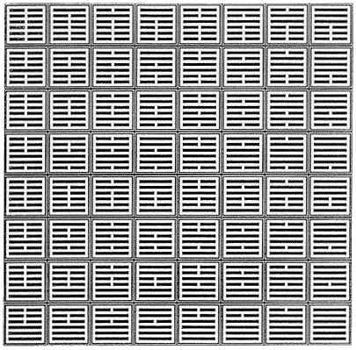
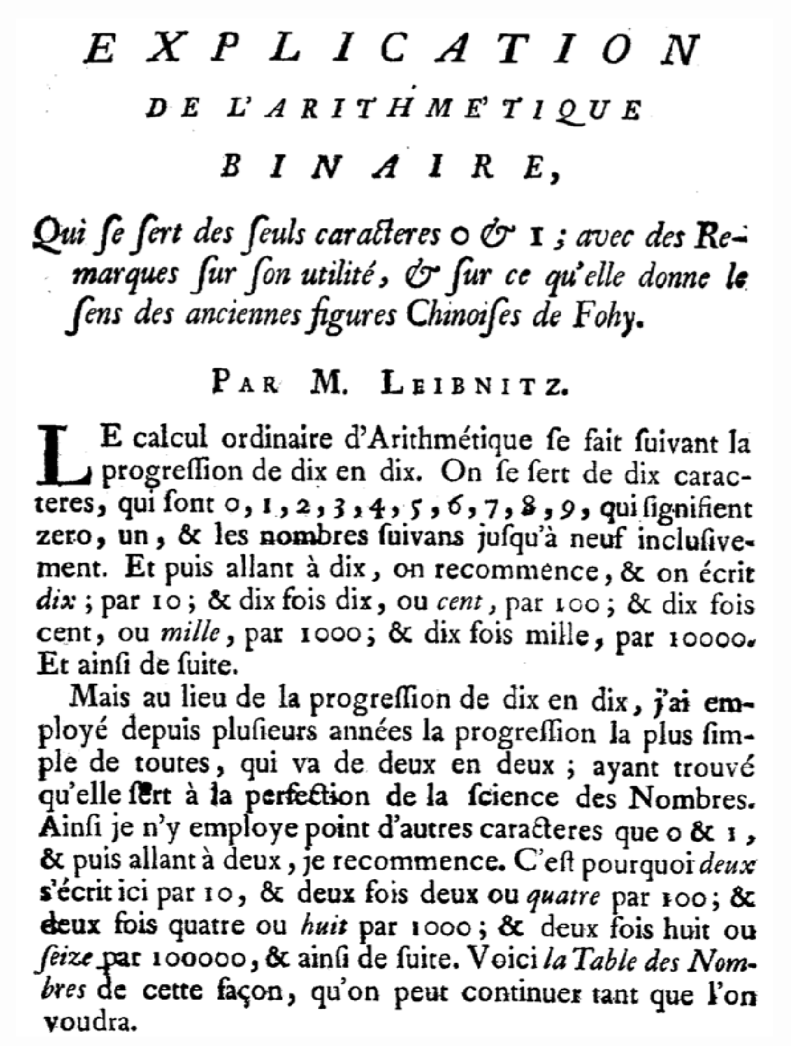
Leibniz and Binary Notation
Binary notation is an old idea. It was described back in 1703 by the German mathematician Gottfried Wilhelm von Leibniz.
Writing in the proceedings of the French Royal Academy of Science, Leibniz describes his use of binary notation in a simple, easy-to-follow style.
Leibniz’s paper further suggests that the Chinese were clearly familiar with binary arithmetic 2000 years earlier, as evidenced by the patterns of lines found in the I Ching.

Slide 7
Using Bits to Represent Integers
Binary notation is similar to decimal notation but uses a different base. Decimal numbers use 10 as their base, which means that each digit counts for ten times as much as the digit to its right. Binary notation uses base 2, which means that each position counts for twice as much, as follows:
0
0
1
0
1
0
1
0
1
0 ^{x}
0
=
2
1 ^{x}
2
The next digit gives
the number of 4s.
=
The next digit gives
the number of 2s.
The rightmost digit
is the units place.
4
0 ^{x}
0
=
8
1 ^{x}
8
=
16
0 ^{x}
0
=
32
1 ^{x}
32
=
64
0 ^{x}
0
=
128
0 ^{x}
0
=
42

Slide 8
Numbers and Bases
The calculation at the end of the preceding slide makes it clear that the binary representation 00101010 is equivalent to the number 42. When it is important to distinguish the base, the text uses a small subscript, like this:
00101010₂ = 42₁₀
Although it is useful to be able to convert a number from one base to another, it is important to remember that the number remains the same. What changes is how you write it down.
The number 42 is what you get if you count how many stars are in the pattern at the right. The number is the same whether you write it in English as forty-two, in decimal as 42, or in binary as 00101010.
Numbers do not have bases; representations do.

Slide 9
Octal and Hexadecimal Notation
Because binary notation tends to get rather long, computer scientists often prefer octal (base 8) or hexadecimal (base 16) notation instead. Octal notation uses eight digits: 0 to 7. Hexadecimal notation uses sixteen digits: 0 to 9, followed by the letters A through F to indicate the values 10 to 15.
The following diagrams show how the number forty-two appears in both octal and hexadecimal notation:
octal
hexadecimal
5
2
2
A
1
1
2 ^{x}
=
2
10 ^{x}
10
=
8
16
5 ^{x}
=
40
02 ^{x}
32
=
42
42
The advantage of using either octal or hexadecimal notation is that doing so makes it easy to translate the number back to individual bits because you can convert each digit separately.

Slide 10
Exercises: Number Bases
What is the decimal value for each of the following numbers?
10001₂
177₈
AD₁₆
1
0
0
0
1
1
7
7
A
D
17
127
173
1
1
1 ^{x}
1
7 ^{x}
7
1
13 ^{x}
13
2
8
0 ^{x}
0
7 ^{x}
56
16
10 ^{x}
160
As part of a code to identify the file type, every Java class file begins with the following sixteen bits:
4
64
0 ^{x}
0
1 ^{x}
64
173
8
0 ^{x}
0
127
16
1 ^{x}
1
1
1
0
0
1
0
1
0
1
1
1
1
1
1
1
0
17
How would you express that number in hexadecimal notation?
1
1
0
0
1
0
1
0
1
1
1
1
1
1
1
0
1
1
0
0
1
0
1
0
1
1
1
1
1
1
1
0
A
F
E
CAFE₁₆

Slide 11
Exercise: Perfect Numbers in Binary
Greek mathematicians took a special interest in numbers that are equal to the sum of their proper divisors, which are simply those divisors less than the number itself. They called such numbers perfect numbers. For example, 6 is a perfect number because it is the sum of 1, 2, and 3, which are the integers less than 6 that divide evenly into 6. The next three perfect numbers—all of which were known to the Greeks—are 28, 496, and 8128.
Convert each of these numbers into its binary representation:
6
=
110₂
28
=
11100₂
496
=
111110000₂
8128
=
1111111000000₂

Slide 12
Bits and Representation
Sequences of bits have no intrinsic meaning except for the representation that we assign to them, both by convention and by building particular operations into the hardware.
As an example, a 32-bit word represents an integer only because we have designed hardware that can manipulate those words arithmetically, applying operations such as addition, subtraction, and comparison.
By choosing an appropriate representation, you can use bits to represent any value you can imagine:
  Characters are represented using numeric character codes.
  Floating-point representation supports real numbers.
  Two-dimensional arrays of bits represent images.
  Sequences of images represent video.
  And so on . . .

Slide 13

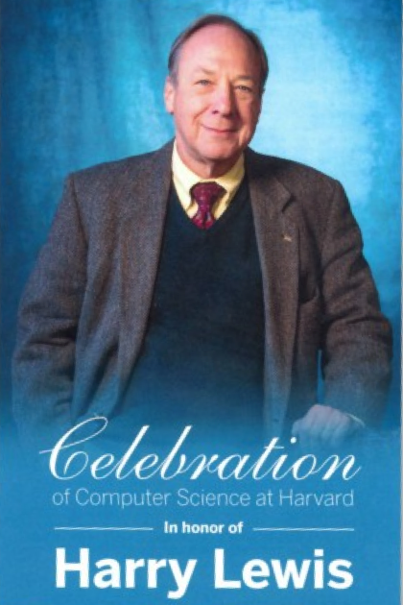
Bits Are Everywhere

Slide 14
Representing Characters
Computers use numeric encodings to represent character data inside the memory of the machine, in which each character is assigned an integral value.
Character codes, however, are not very useful unless they are standardized. When different computer manufacturers use different coding sequence (as was indeed the case in the early years), it is harder to share such data across machines.
The first widely adopted character encoding was ASCII (American Standard Code for Information Interchange).
With only 256 possible characters, the ASCII system proved inadequate to represent the many alphabets in use throughout the world. It has therefore been superseded by Unicode, which allows for a much larger number of characters.

Slide 15
The ASCII Subset of Unicode
The Unicode value for any character in the table is the sum of the octal numbers at the beginning of that row and column.
The letter A, for example, has the Unicode value 101₈, which is the sum of the row and column labels.
The following table shows the first 128 characters in the Unicode character set, which are the same as in the older ASCII scheme:
0
1
2
3
4
5
6
7
00x
\000
\000
\001
\001
\002
\002
\003
\003
\004
\004
\005
\005
\006
\006
\007
\007
01x
\b
\b
\t
\t
\n
\n
\011
\011
\f
\f
\r
\r
\016
\016
\017
\017
02x
\020
\020
\021
\021
\022
\022
\023
\023
\024
\024
\025
\025
\026
\026
\027
\027
03x
\030
\030
\031
\031
\032
\032
\033
\033
\034
\034
\035
\035
\036
\036
\037
\037
04x
space
space
!
!
"
"
#
#
$
$
%
%
&
&
'
'
05x
(
(
)
)
*
*
+
+
,
,
-
-
.
.
/
/
06x
0
0
1
1
2
2
3
3
4
4
5
5
6
6
7
7
07x
8
8
9
9
:
:
;
;
<
<
=
=
>
>
?
?
10x
@
@
A
A
B
B
C
C
D
D
E
E
F
F
G
G
11x
H
H
I
I
J
J
K
K
L
L
M
M
N
N
O
O
12x
P
P
Q
Q
R
R
S
S
T
T
U
U
V
V
W
W
13x
X
X
Y
Y
Z
Z
[
[
\
\
]
]
^
^
_
_
14x
`
`
a
a
b
b
c
c
d
d
e
e
f
f
g
g
15x
h
h
i
i
j
j
k
k
l
l
m
m
n
n
o
o
16x
p
p
q
q
r
r
s
s
t
t
u
u
v
v
w
w
17x
x
x
y
y
z
z
{
{
|
|
}
}
~
~
\177
\177

Slide 16

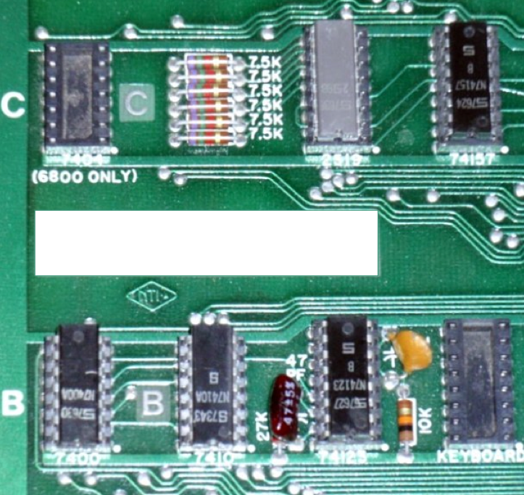
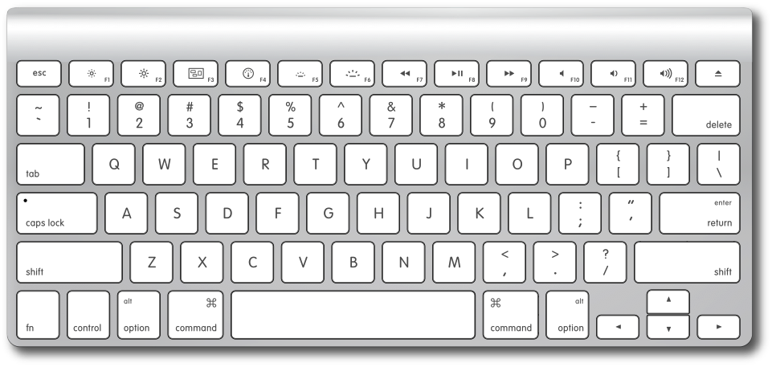
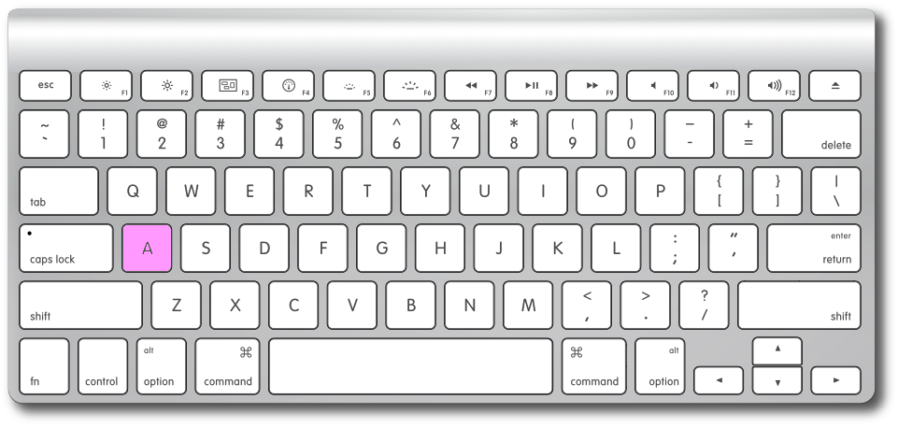
Hardware Support for Characters
a
=97
0
1
1
0
0
0
0
1

Slide 17
Strings as an Abstract Idea
Characters are most often used in programming when they are combined to form collections of consecutive characters called strings.
As you will discover when you have a chance to look more closely at the internal structure of memory, strings are stored internally as a sequence of characters in sequential memory addresses.
The internal representation, however, is really just an implementation detail. For most applications, it is best to think of a string as an abstract conceptual unit rather than as the characters it contains.
JavaScript emphasizes the abstract view by defining a built-in string type that defines high-level operations on string values.

Slide 18
The End

Slide 19
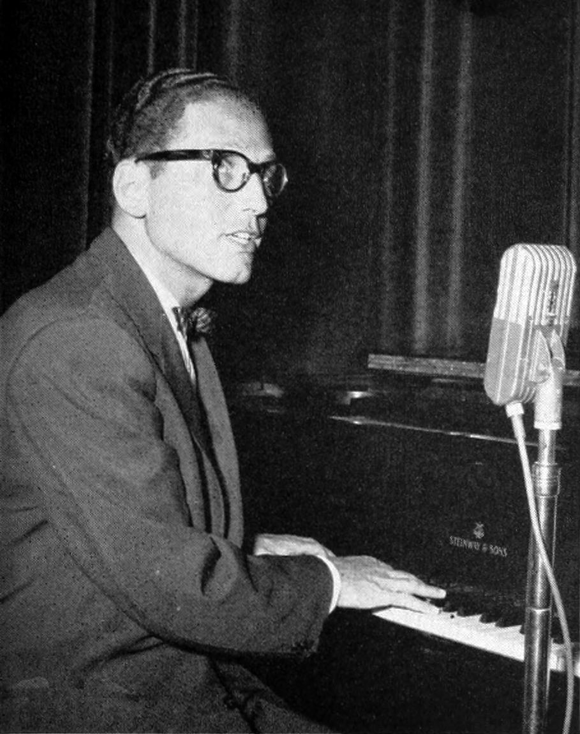

Tom Lehrer on “The New Math”
3 4 2
1 7 3
8
–
8
Tom Lehrer (1928–)

