Slide 1
JavaScript and OOP
Eric Roberts and Jerry Cain
CS 106J
May 19, 2017

Slide 2
Once upon a time . . .
Notes:
2

Slide 3
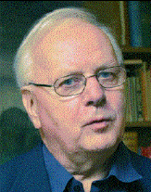

Object-Oriented Programming
The most prestigious prize in computer science, the ACM Turing Award, was given in 2002 to two Norwegian computing pioneers, who jointly developed SIMULA in 1967, which was the first language to use the object-oriented paradigm.
In addition to his work in computer science, Kristen Nygaard also took an active role in making sure that computers served the interests of workers, not just their employers. In 1990, Nygaard’s social activism was recognized in the form of the Norbert Wiener Award for Social and Professional Responsibility.
Kristen Nygaard
Ole Johan Dahl

Slide 4

A Quick Walkthrough of Assignment #5
Notes:
4

Slide 5
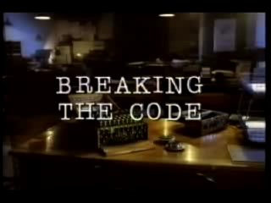

Breaking the Code
CS 106J Movie Night: Breaking the Code
Monday, May 22, 7:00-9:00P.M.
Hewlett 102

Slide 6
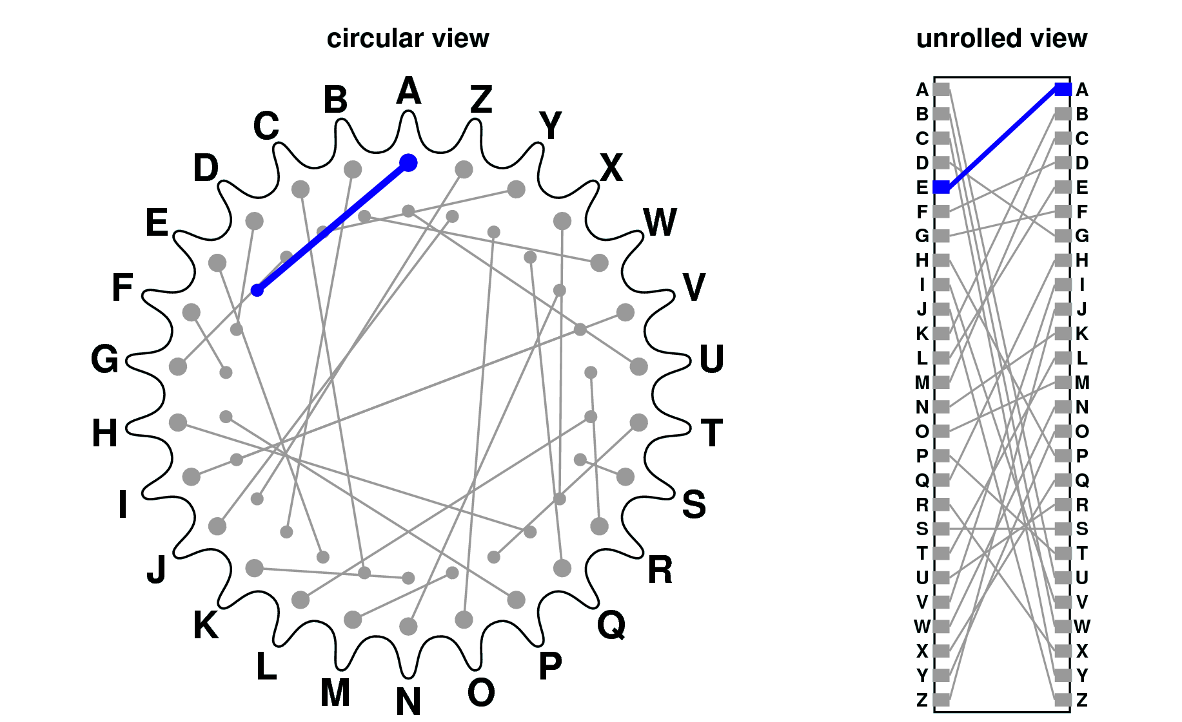
The Enigma Rotors
Notes:
6

Slide 7
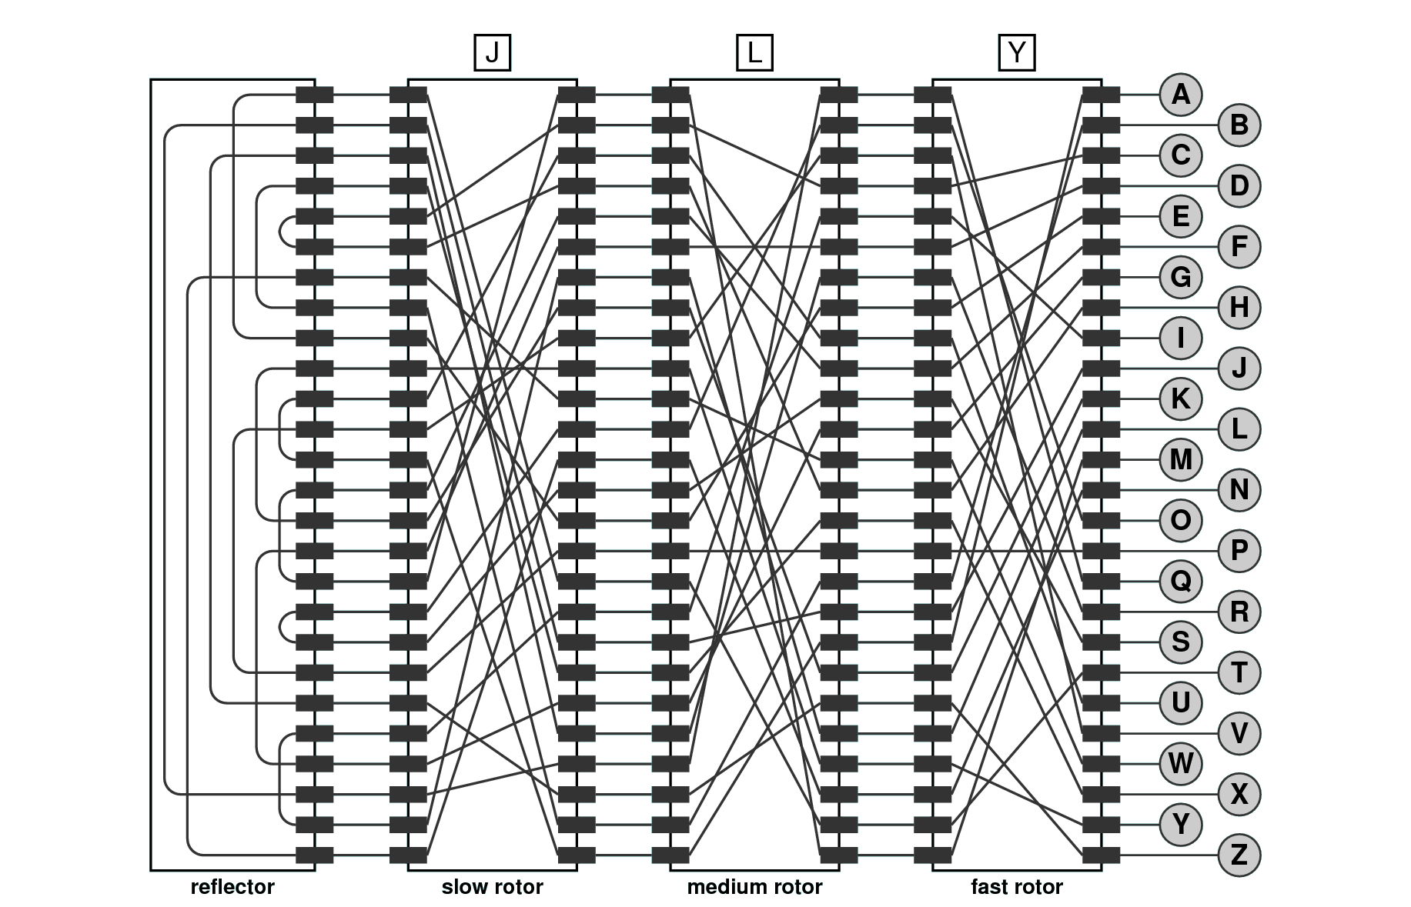
The Enigma Structure
Notes:
7

Slide 8
Operation of the Enigma Machine
Whenever the operator types a letter key on the Enigma, the following things happen:
1.
The force of the key press advances the fast rotor one position. If the indicator on the fast rotor wraps around from Z to A, that action “carries” to the medium rotor, just like the digits on an odometer. Similarly, if the medium rotor passes Z, the slow rotor advances one position.
2.
An electrical signal is fed into the wire corresponding to the key, which then flows through seven letter-substitution steps:
–
Through the fast rotor from right to left.
–
Through the medium rotor from right to left.
–
Through the slow rotor from right to left.
–
Through the reflector, which turns the signal around.
–
Through the slow rotor from left to right.
–
Through the medium rotor from left to right.
–
Through the fast rotor from left to right and then on to the lamp.

Slide 9
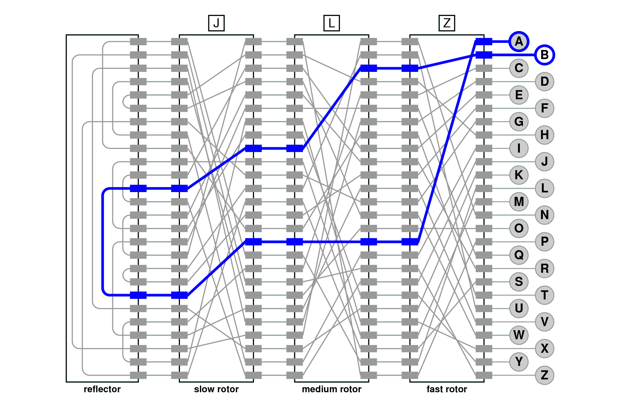
Encoding the Letter “A”
Notes:
9

Slide 10
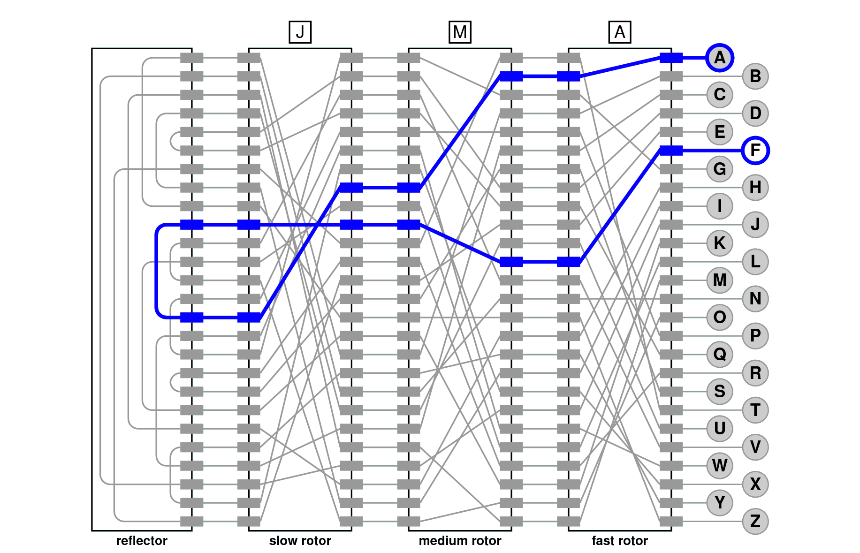
The Next “A” Is Different
Notes:
10

Slide 11
JavaScript and OOP
Notes:
11

Slide 12

Review: Clients and Interfaces
Libraries—along with programming abstractions at many other levels—can be viewed from two perspectives. Code that uses a library is called a client. The code for the library itself is called the implementation.
The point at which the client and the implementation meet is called the interface, which serves as both a barrier and a communication channel:
client
implementation
interface

Slide 13

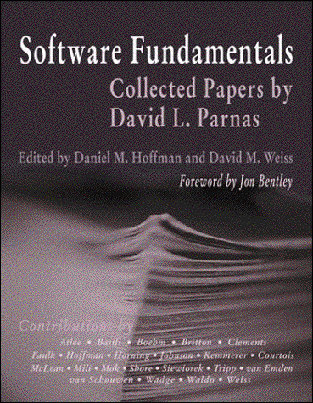
David Parnas on Modular Development
David Parnas is Professor of Computer Science at Limerick University in Ireland, where he directs the Software Quality Research Laboratory, and has also taught at universities in Germany, Canada, and the United States.
Parnas’s most influential contribution to software engineering is his groundbreaking 1972 paper “On the criteria to be used in decomposing systems into modules,” which laid the foundation for modern structured programming. This paper appears in many anthologies and is available on the web at
http://portal.acm.org/citation.cfm?id=361623

Slide 14
Information Hiding
Our module structure is based on the decomposition criteria known as information hiding. According to this principle, system details that are likely to change independently should be the secrets of separate modules.
—
David Parnas, Paul Clements, and David Weiss, “The modular structure of complex systems,” 1984
One of the central principles of modern software design is that each level of abstraction should hide as much complexity as possible from the layers that depend on it. This principle is called information hiding.
When you use a function, for example, it is more important to know what the function does than to understand exactly how it works. The underlying details are of interest only to the programmer who implements the function. Clients who use that function as a tool can usually ignore the implementation altogether.

Slide 15



Thinking About Objects
"graphics"
library
GRect class
location
size
color
fill status
fill color
GRect
GOval
GLine
GLabel
I need a bunch of GRects.
.
.
.
"graphics"
library
GRect
GOval
GLine
GLabel
.
.
.
client
abstraction boundary
implementation
with thanks to Randall Munroe at xkcd.com

Slide 16
Principles of Object-Oriented Design
Object-oriented programming can be characterized by several important features. Informally, object-oriented programming differs from earlier programming paradigms in that it focuses attention on the data objects rather than the code.
In practice, this idea of making objects the center of attention can be expressed as three principles:
  1.
  Integration. Objects should combine the internal representation of the data with the operations that implement the necessary behavior into an integrated whole.
  2.
  Encapsulation. Insofar as possible, objects should restrict the client’s access to the internal state, mediating all communication across the interface boundary through the use of methods.
  3.
  Inheritance. Objects should be able to inherit behavior from other, more general object classes.

Slide 17
Turning Points into Objects
On Wednesday, Jerry defined the following factory method to create a Point as an aggregate of an x and a y value:
function Point(x, y) {
if (x === undefined) {
x = 0;
y = 0;
}
return { x: x, y: y };
}
The goal in the next few slides is to turn this aggregate into a data structure that more closely resembles an object in the sense that the term is used in object-oriented programming.

Slide 18
Adding Methods
A method is a function that belongs to an object. Given that functions are first-class values in JavaScript, it is perfectly legal to assign a function to one of the fields in an aggregate. Those functions are then JavaScript methods and are invoked using the traditional receiver syntax for methods:
object.name(arguments)
Methods, however, are not very useful unless they can have access to the fields of the object to which they apply.
JavaScript addresses this problem by defining a keyword this that automatically refers to the receiver for the current method call. Thus, in the earlier example, any references to this inside the method name refer to object.
The next slide adds getX and getY methods to the Point class.

Slide 19
A Method-Based Definition of Point
/*
* Creates a new Point object. If this factory function is
* called with no arguments, it creates a Point object at the
* origin. This version of the Point factory defines the
* getter methods getX and getY.
*/
function Point(x, y) {
if (x === undefined) { x = 0; y = 0; }
return {
x: x,
y: y,
getX: function() { return this.x; },
getY: function() { return this.y; }
};
}

Slide 20
Keeping Data Private
Although the example on the previous slide supports the syntax of object-oriented programming by defining the getX and getY methods, it doesn’t support the object-oriented principle of encapsulation because the x and y fields are visible to clients.
To ensure that variables are completely private to the object in JavaScript, the best strategy is to ensure that those variables are part of the closure that defines the method and not define them as fields.
The code that results from applying this strategy appears on the next slide. This approach has several advantages:
  The data values x and y are inaccessible to clients.
  The code is several lines shorter.
  The keyword this is no longer required.

Slide 21
An Encapsulated Point Class
/*
* Creates a new Point object. If this factory function is
* called with no arguments, it creates a Point object at the
* origin. This version of the Point factory ensures that the
* data fields are in the function closure, which makes them
* inaccessible outside the function, even though they are
* available to the getter methods getX and getY.
*/
function Point(x, y) {
if (x === undefined) { x = 0; y = 0; }
return {
getX: function() { return x; },
getY: function() { return y; }
};
}

Slide 22
Converting Objects to Strings
JavaScript makes it possible for implementers to define how objects of a particular class are displayed by console.log or how they combine with strings through concatenation.
When JavaScript needs to convert an object to a string, it checks to see whether that object defines a toString method. The toString method takes no arguments and returns a string that represents the desired textual appearance of the value.
The code on the next slide adds a toString method to the Point class.

Slide 23
Adding a toString Function
/*
* Creates a new Point object. If this factory function is
* called with no arguments, it creates a Point object at the
* origin. This version of the Point factory ensures that the
* data fields are in the function closure, which makes them
* inaccessible outside the function, even though they are
* available to the getter methods getX and getY. This version
* also exports a toString method.
*/
function Point(x, y) {
if (x === undefined) { x = 0; y = 0; }
return {
getX: function() { return x; },
getY: function() { return y; },
toString: function () {
return "(" + x + ", " + y + ")";
}
};
}

Slide 24

Rational Numbers
In his introduction of aggregates on Wednesday, Jerry offered the example of rational numbers, which are a single unit with a numerator and a denominator.
To get a sense of how rational numbers might in some cases be preferable to the numeric approximations that JavaScript uses, try to predict the output of the following program:
function FractionSum() {
var a = 1/2;
var b = 1/3;
var c = 1/6;
var sum = a + b + c;
console.log("1/2 + 1/3 + 1/6 = " + sum);
}
JavaScript Console
1/2 + 1/3 + 1/6 = 0.9999999999999999

Slide 25
JavaScript Numbers Are Approximations
The reason that the program on the previous slide produces a surprising answer is that most fractions do not have a precise binary representation but are instead stored as approximations.
For example, the fractions 1/3 and 1/6 cannot be represented exactly. When you add these together with 1/2, the result is not the expected value. By contrast, arithmetic with rational numbers is exact.
Rational numbers support the standard arithmetic operations:
Addition:
Multiplication:
a
+
c
=
ad + bc
a
x
c
=
ac
b
d
bd
b
d
bd
Subtraction:
Division:
a
c
ad – bc
a
.
c
ad
–
=
.
=
bc
b
d
bd
b
d

Slide 26
Implementing the Rational Class
The next two slides show the code for the Rational class along with some brief annotations.
As you read through the code, the following features are worth special attention:
  The factory method takes one, two, or three parameters. Calling Rational with no arguments returns the rational equivalent of 0, calling it with one argument creates an integer, and calling it with two arguments creates a fraction.
  The constructor makes sure that the number is reduced to lowest terms. Moreover, since these values never change once a Rationalis created, this property will remain in force.
  Operations are specified using the receiver syntax. When you apply an operator to two Rational values, one of the operands is the receiver and the other is passed as an argument, as in
r1.add(r2)

Slide 27
The Rational Class
/*
* This class represents a rational number, which is defined as
* the quotient of two integers.
*/
function Rational(x, y) {
if (x === undefined) x = 0;
if (y === undefined) y = 1;
var g = gcd(Math.abs(x), Math.abs(y));
var num = x / g;
var den = Math.abs(y) / g;
if (y < 0) num = -num;
return {
. . . see object definition on next slide . . .
};
}
/* Include definition of gcd from Chapter 3 */
The factory method looks for missing arguments and assigns default values. It then calls gcd to reduce the fraction to lowest terms. Finally, it makes sure that the denominator is positive.

Slide 28
The Rational Class
/*
* This class represents a rational number, which is defined as
* the quotient of two integers.
*/
function Rational(x, y) {
if (x === undefined) x = 0;
if (y === undefined) y = 1;
var g = gcd(Math.abs(x), Math.abs(y));
var num = x / g;
var den = Math.abs(y) / g;
if (y < 0) num = -num;
return {
. . . see object definition on next slide . . .
};
}
return {
getNum: function() { return num; },
getDen: function() { return den; },
add: function(r) {
return Rational(num * r.getDen() + r.getNum() * den,
den * r.getDen());
},
sub: function(r) {
return Rational(num * r.getDen() - r.getNum() * den,
den * r.getDen());
},
mul: function(r) {
return Rational(num * r.getNum(), den * r.getDen());
},
div: function(r) {
return Rational(num * r.getDen(), den * r.getNum());
},
toString: function() {
if (den === 1) return "" + num;
return num + "/" + den;
}
};

Slide 29
Rational Numbers Are Exact
Here is the same program using the Rational class.
function RationalSum() {
var a = Rational(1, 2);
var b = Rational(1, 3);
var c = Rational(1, 6);
var sum = a.add(b).add(c);
console.log("1/2 + 1/3 + 1/6 = " + sum);
}
JavaScript Console
1/2 + 1/3 + 1/6 = 1

Slide 30
Inheritance
Object-oriented languages allow one class to inherit behavior from another. For example, classes like GRect and GOval inherit behavior from GObject.
The simplest way to implement inheritance in JavaScript is to have the factory method for the subclass call the factory method for the superclass and then add fields to the result.
This model is illustrated in the text using the Employee class and the subclasses HourlyEmployee, SalariedEmployee, and CommissionedEmployee.
None of the assignments or section problems require you to implement inheritance, and the topic will not appear on the final exam.

Slide 31
The End

