Slide 1
CS107, Lecture 1
Welcome to CS107!
readings:
Course Syllabus
Bryant & O’Hallaron, Ch. 1 (skim)
Honor Code and Collaboration Page

Slide 2
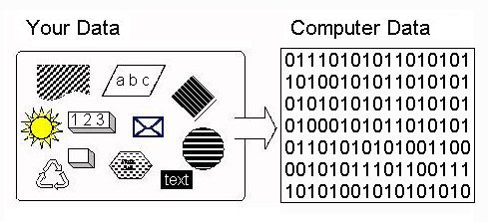
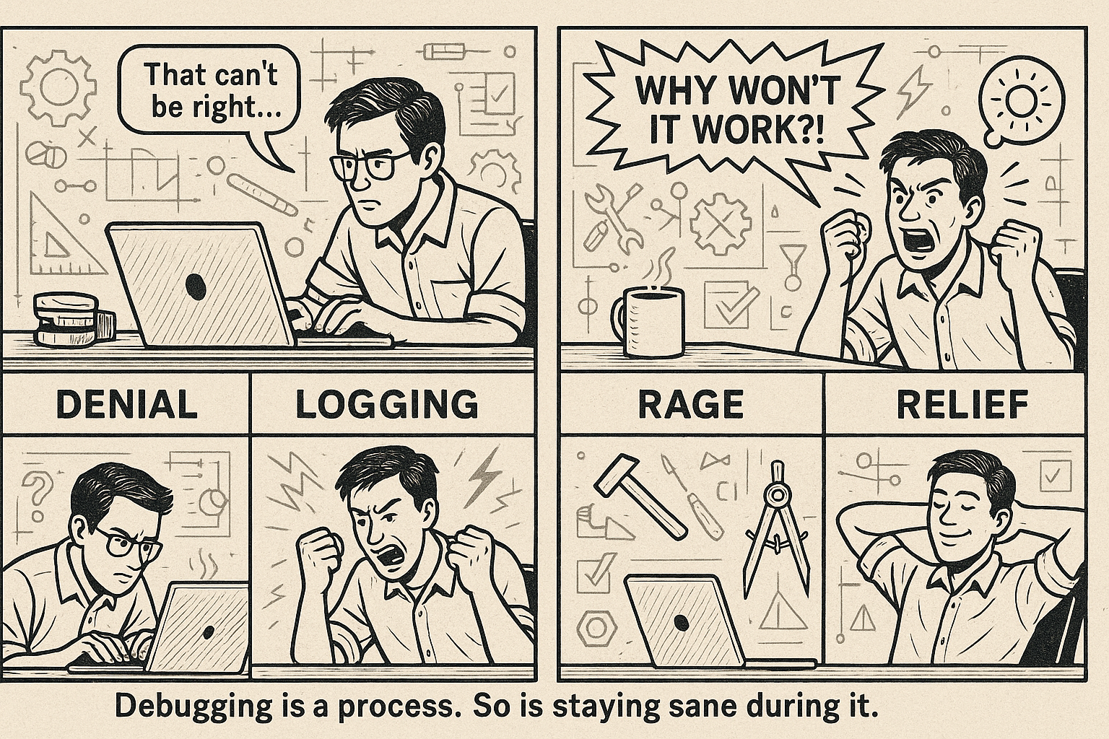
CS107 Asks How and Why?
CS106B teaches you to solve problems using high-level programming languages.
CS107 digs deeper into how and why programs truly work.
How is data (e.g., an int, a string, a struct) represented
on hardware?
How does a computer execute code?
How does an executable map onto memory and hardware?
How does the heap work—and how is it implemented?
Why is my code doing one thing when I expect it to do
something else?
Studying programming at this level of detail reveals why systems work the way they do and helps us become better software engineers.

Slide 3
CS107 and Programming Experience
For the duration of the quarter, CS107 will:
further develop your programming ability and give you some more coding mileage
focus on debugging strategies that get to the crux of why code isn't working as expected
emphasize how to become a better debugger, write professional-grade code, and refine your software development skills

Slide 4
CS107 Learning Goals
What do we hope you get out of the course? We’d love for students to:
attain fluency with
  pointers and memory, and how to use them effectively in C
  an executable's address space and runtime behavior
develop competency with
  the translation between C code and assembly
  implementing programs that respect the limits of computer arithmetic
  the ability to identify bottlenecks and improve runtime performance
  the ability to navigate your own Unix development environment
  ethical frameworks to consider when designing and implementing software
  gain exposure to
  the basics of computer architecture
  compilers and assemblers and how they work

Slide 5
CS107’s Topics and Big Questions
Bits and Bytes: How can a computer represent int values? or floats?
Characters and C Strings: How can a computer represent and manipulate
more complex data, like text?
Pointers, Stack and Heap Memory: How can we effectively manage all
forms of memory in our programs?
Generics: How can we leverage our understanding of memory and data
representation to write code that works with any data type?
Assembly: How does a computer compile and execute C programs to
assembly code? What does assembly code look like?
Heap Allocators: How do core memory allocation functions like
malloc and free work? Are the built-in versions always good enough?
Notes:
Don’t list everything, just pick a few

Slide 6
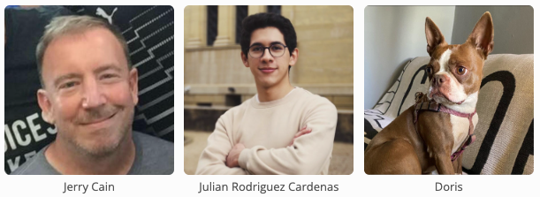
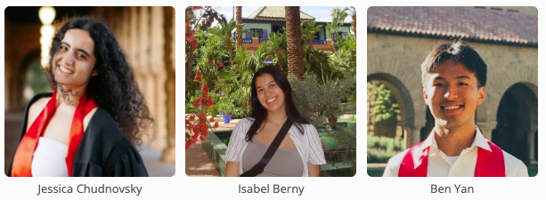
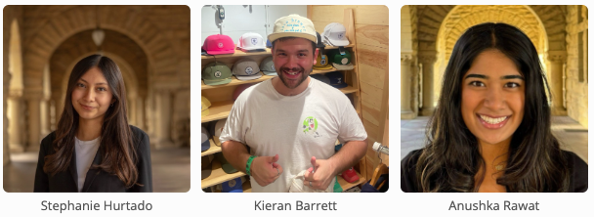
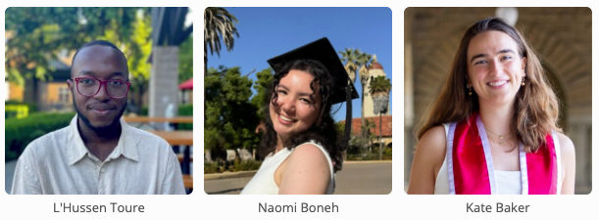

CS107 Teaching Team
Jerry Cain (jerry@cs.stanford.edu):
Chemistry undergrad MIT, began a chemistry Ph.D. here, switched to CS in 1994
Taught CS107 for the ﬁrst time in 1999, have taught it nearly 30 times since

Slide 7
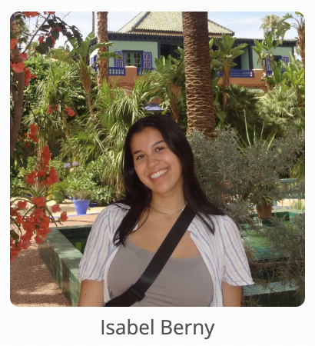
Companion Class: CS107ACE
CS107ACE is an extra, single-unit discussion section providing additional support, practice, and instruction.
Class meets on Tuesdays & Thursdays from 10:30 – 11:20am in Lathrop 017.
Admission is by application, and everyone is welcome to apply. In past quarters, most students who've applied have been accepted.

Slide 8
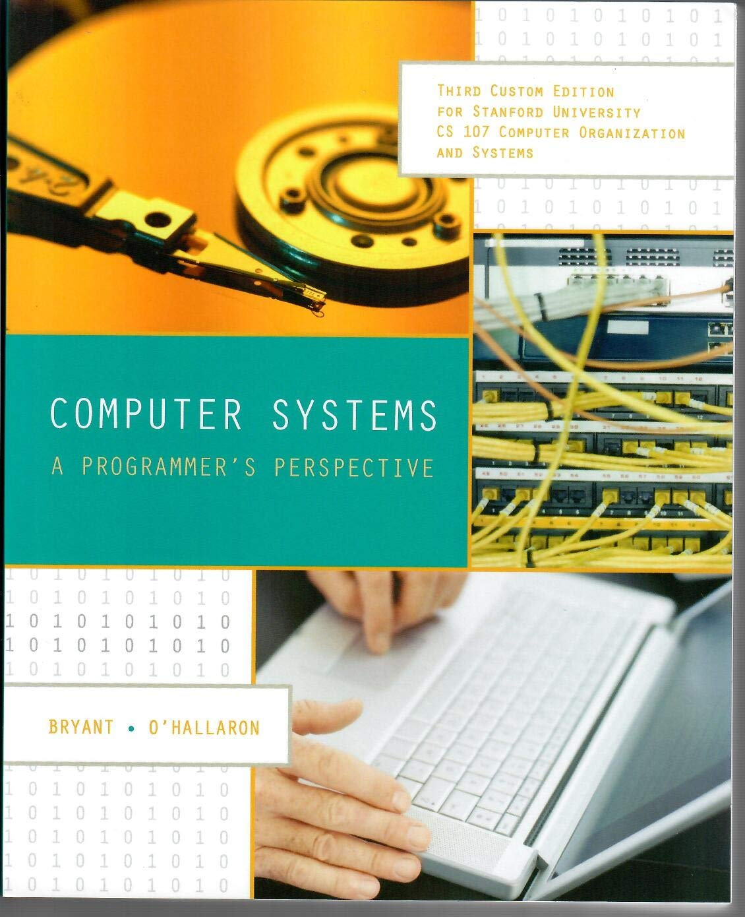

Textbooks
Computer Systems: A Programmer's Perspective by Bryant & O'Hallaron, 3rd Edition
  3rd edition matters – important updates to content
  Stanford Library has scanned all readings for CS107 under "fair use" (private study, scholarship, research). [Canvas -> Files].
  If you want more, you can purchase a full copy.
Any C programming reference of your choice
  The C Programming Language by Kernighan and Ritchie (free link on course website Resources page)
  Other C programming books, websites, or reference sheets
Full textbook
CS107 full chapters
CS107-specific readings
The textbook and our C programming references are solid resources, and especially helpful post-midterm!
Notes:
t’s also good to give a reminder to the students that the PDF shouldn’t be distributed/reuploaded anywhere beyond their personal computers.

Slide 9
Course Structure
Lectures: understand concepts, see demos
Labs: learn tools, study code, discuss with peers
Assignments: build programming skills, synthesize lecture/lab content
  CS107 labs will meet at various times on Thursdays, and you’ll use that time to more fully digest and exercise the prior week’s material
assign0: goes out Wednesday and falls due on Wednesday, January 14th (requires today’s, Wednesday’s, and some of Friday’s material)
Great preamble to homework!
 | Monday | Wednesday | Friday
Week N |  | Lecture: part A | Lecture: part B
Week N + 1 | Lecture: part C

Slide 10
CS107 Grading
  ******** 40% Assignments
  ** 10% Lab Participation
  **** 20% Midterm Exam
  ****** 30% Final Exam

Slide 11
CS107 Grading: Assignments
  ******** 40% Assignments
  ** 10% Lab Participation
  **** 20% Midterm Exam
  ****** 30% Final Exam

Slide 12
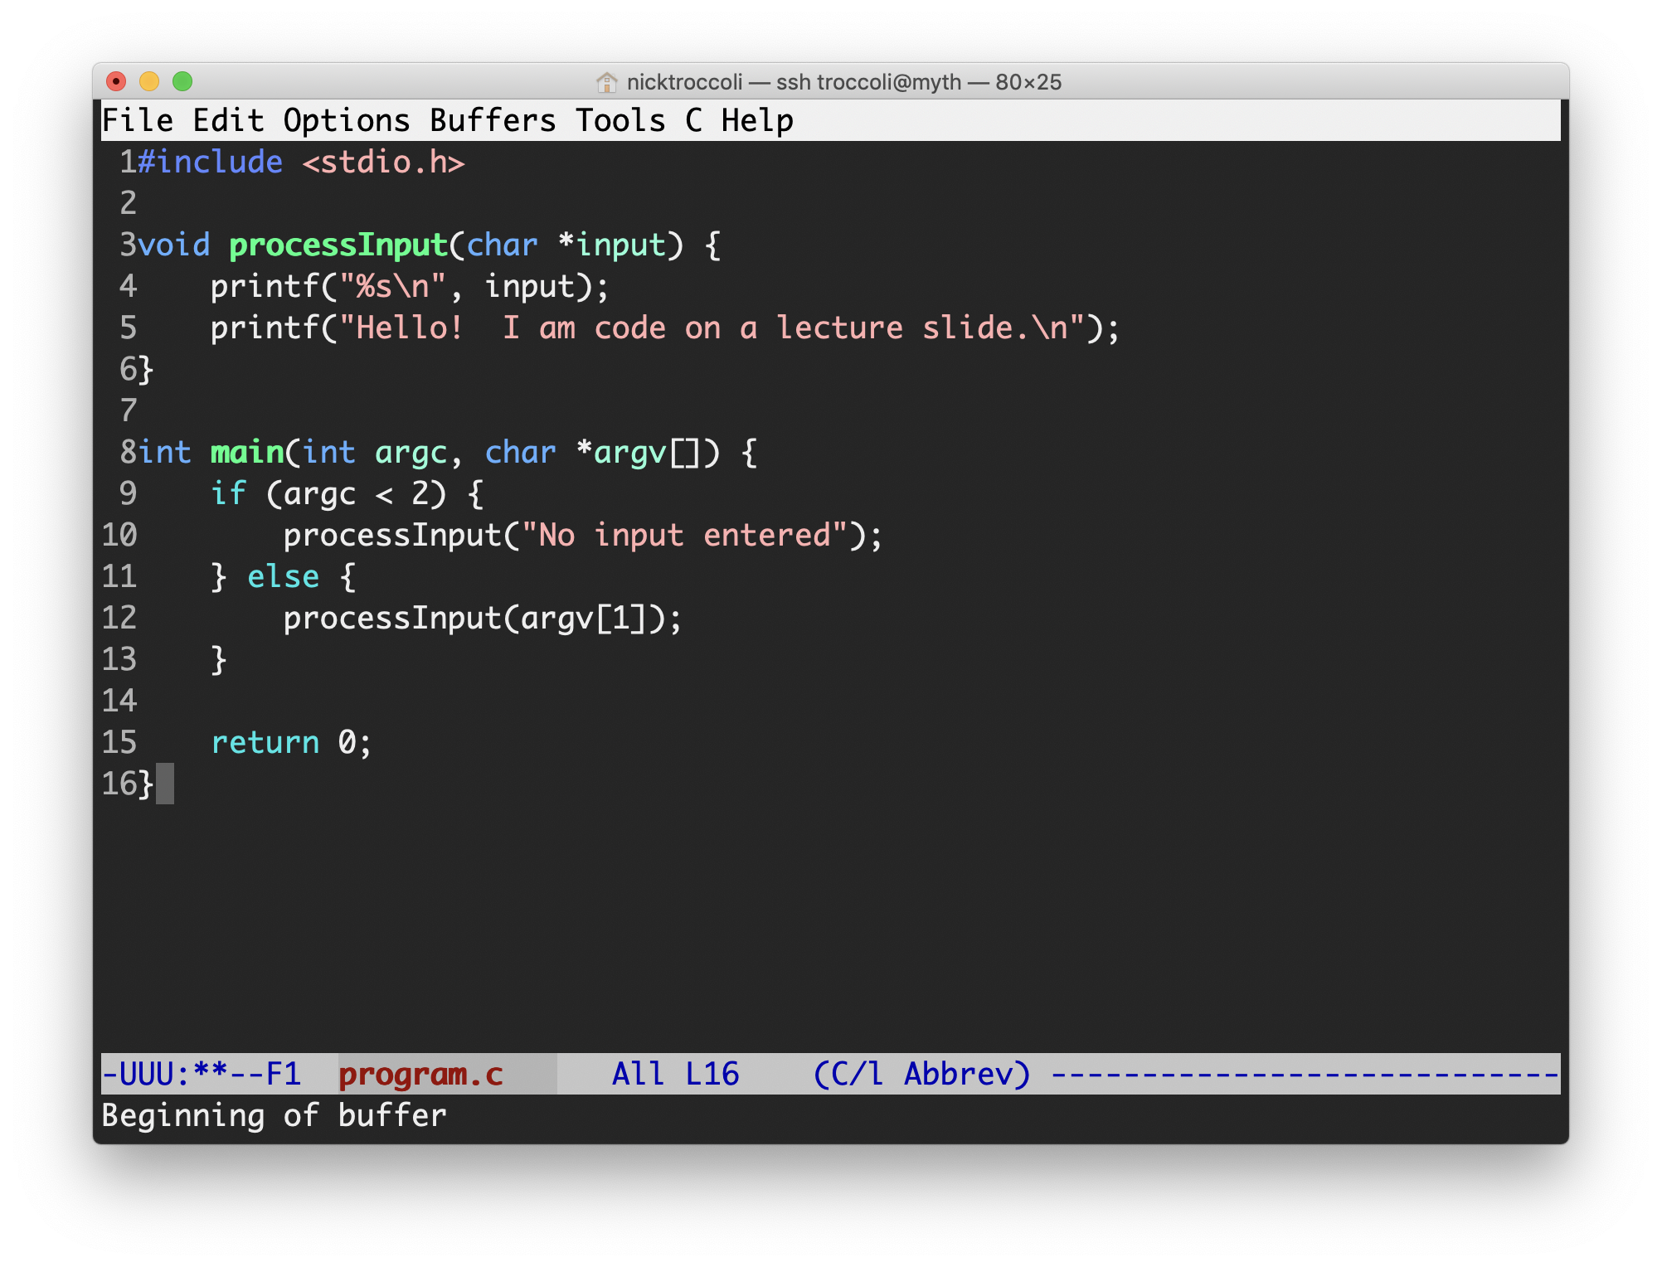
CS107 Assignments
7 programming assignments completed individually using Unix command line tools
  Free software, already installed on myth machines / available on course website
  We supply starter projects for each assignment
Graded on functionality and style
  Functionality graded using automated tools, given as point score, with minimal CA review
  Style graded via code review (with occasional automated tests) given as bucket score
  Grades posted to website and shared via email
Notes:
AUTOMATED functionality grading

Slide 13
CS107 Style Bucket System
+ | An outstanding job: rarely given, particularly on early assignments
ok | A solid job: strong overall, with opportunity for improvement.
- | Conveys some effort and understanding but has larger problems that would need to be addressed before submitting to a professional repo.
-- | Suffers from many issues and represents minimally passing work.
0 | No work submitted or barely changes any of the supplied starter code.
Notes:
Mostly ok

Slide 14
CS107 Late Assignment Policy
All programming assignments are due a minute before midnight, Stanford time, on whatever day they fall due.
If you need to submit an assignment after the deadline, you still can. Doing so, however, imposes a cap on the maximum number of points you can get, depending on how late the submission.
  Submit an assignment before the published deadline? You can get 100%. Seems right.
  Submit after the deadline, but within 24 hours? Functionality score is capped at 95%.
    What does capped mean here? It means that all scores between 96% and 100% are demoted to 95%, but all other scores are left alone.
  Submit an assignment between 24 and 48 hours post-deadline? Score capped at 90%.
  Submit an assignment between 48 and 72 hours post-deadline? Score capped at 85%.
  Unless you've made prior arrangements with us, no work is accepted after 72 hours.

Slide 15
CS107 Assignment Resubmission Policy
For all assignments except assign6, I will allow anyone who pulled less than 85% of the functionality points to resubmit to get to up to 85%.
You must, however, have received at least 25% of the functionality points in the first place. Otherwise, the maximum you can get is three times your original score.
We only rerun the automated tests.
  We don’t review your code again or reread responses to short answer questions.
Once grade reports for an assignment are shared with the class, you have seven calendar days to resubmit.
Email Jerry when you’d like to resubmit and I’ll let you know how.

Slide 16
CS107 Grading: Labs
  ******** 40% Assignments
  ** 10% Lab Participation
  **** 20% Midterm Exam
  ****** 30% Final Exam

Slide 17
CS107 Labs
Weekly, in-person labs led by CAs, starting next week, offered on Wednesdays and Thursdays.
Hands-on practice with lecture material and course concepts.
Graded on attendance + participation. You get points for literally showing up on time, working through some exercises with everyone else, and staying for the duration.
CGOE students complete lab work (and take exam exams) remotely. More info in CGOE Handout.
Lab preference submissions are already open, but you take your time finalizing your schedule before submitting. You may submit your preferences anytime until Sunday 01/11 at 5PM PST.

Slide 18
CS107 Grading: Exams
  ******** 40% Assignments
  ** 10% Lab Participation
  **** 20% Midterm Exam
  ****** 30% Final Exam

Slide 19
CS107 Exams
Midterm exam: Wednesday, February 11th, 7:00 - 9:00pm outside of class
Midterm exam: Wednesday, February 11th, 3:30 - 5:30pm if first time is bad
  Email me by Friday, February 6th if you have an academic or extracurricular conflict with both times and absolutely cannot make either.
Final exam: Monday, March 16th, 3:30 - 6:30pm
  If and only if you hold a conflict with this time because of a competing final exam—that is, you're taking two MWF 10:30am classes and your other class also has a final—can you take the final on the same day, on March 16th, from 12:15 – 3:15pm instead.
Both exams are closed book, closed notes, and closed electronic device. You'll be provided with a reference sheet with common function prototypes and other pertinent information not easily memorized.
Both the midterm and final are administered as pencil-and-paper exams.

Slide 20
CS107 Grading
  ******** 40% Assignments
  ** 10% Lab Participation
  **** 20% Midterm Exam
  ****** 30% Final Exam
Read our full course policies document:
https://cs107.stanford.edu/syllabus.html

Slide 21
Getting Help
Post on the Ed Discussion Forum
  Online discussion forum for students, post questions, answer other student questions
  Best for course material discussions, policy questions, debugging questions or general assignment concerns. Never post assignment code to Ed.
Visit Office Hours in CoDa Basement
  Chat about course topics or just hang out
  Sign up in queues for 1:1 CA help, schedule to soon be posted on course website
  Best for group work, debugging questions (with CAs, of course) or longer discussions about course material
Email the Course Staff
  cs107-win2526-staff@lists.stanford.edu or individual staff members
  Best for private concerns (e.g., grading questions, academic accommodations, etc.)

Slide 22
Stanford Honor Code
The Honor Code is an undertaking of the Stanford academic community, individually and collectively. Its purpose is to uphold a culture of academic honesty.
  Students will support this culture of academic honesty by neither giving nor accepting unpermitted academic aid in any work that serves as a component of grading or evaluation, including assignments, examinations, and research.
  Instructors will support this culture of academic honesty by providing clear guidance, both in their course syllabi and in response to student questions, on what constitutes permitted and unpermitted aid. Instructors will also not take unusual or unreasonable precautions to prevent academic dishonesty.
  Students and instructors will also cultivate an environment conducive to academic integrity. While instructors alone set academic requirements, the Honor Code is a community undertaking that requires students and instructors to work together to ensure conditions that support academic integrity.
(drawn from https://communitystandards.stanford.edu/policies-guidance/honor-code)
It is your responsibility to read and become familiar with the honor code guidelines on the CS107 course website. Please read them and come speak with us if you have questions.
https://cs107.stanford.edu/collaboration
Notes:
Environment for all to do best work

Slide 23
Stanford Honor Code and CS107
Be fully transparent about how you get your work done
  Indicate any assistance received on homework (books, friends, etc.).
  Don’t look at other people's solution code or answers and never share solutions with others or post them to the web.
  Never use LLMs to generate assignment code.
    This replaces the intellectual work the assignment is designed to assess and is therefore
    considered one of the most egregious and indefensible forms of academic dishonesty.
Assignment submissions are regularly examined using software tools.
If you need help, contact us and we'll help you make good choices.
  If you feel you’ve made a mistake, you may retract any assignment submission at any time before the final exam by simply emailing me and telling me.
https://cs107.stanford.edu/collaboration

Slide 24
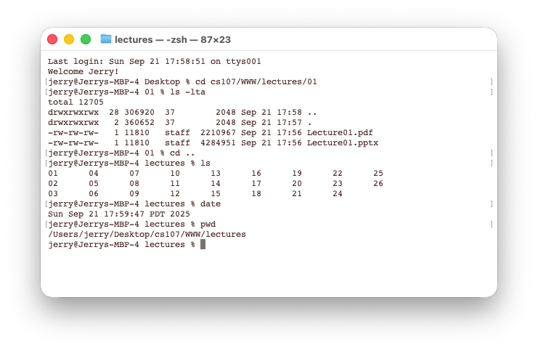
What is Unix?
Unix: provides a set of standards and many tools used to write software.
  macOS and Linux are operating systems built on top of Unix
You navigate a Unix system using the command line (aka "the terminal")
All Unix systems work using the same tools and commands

Slide 25
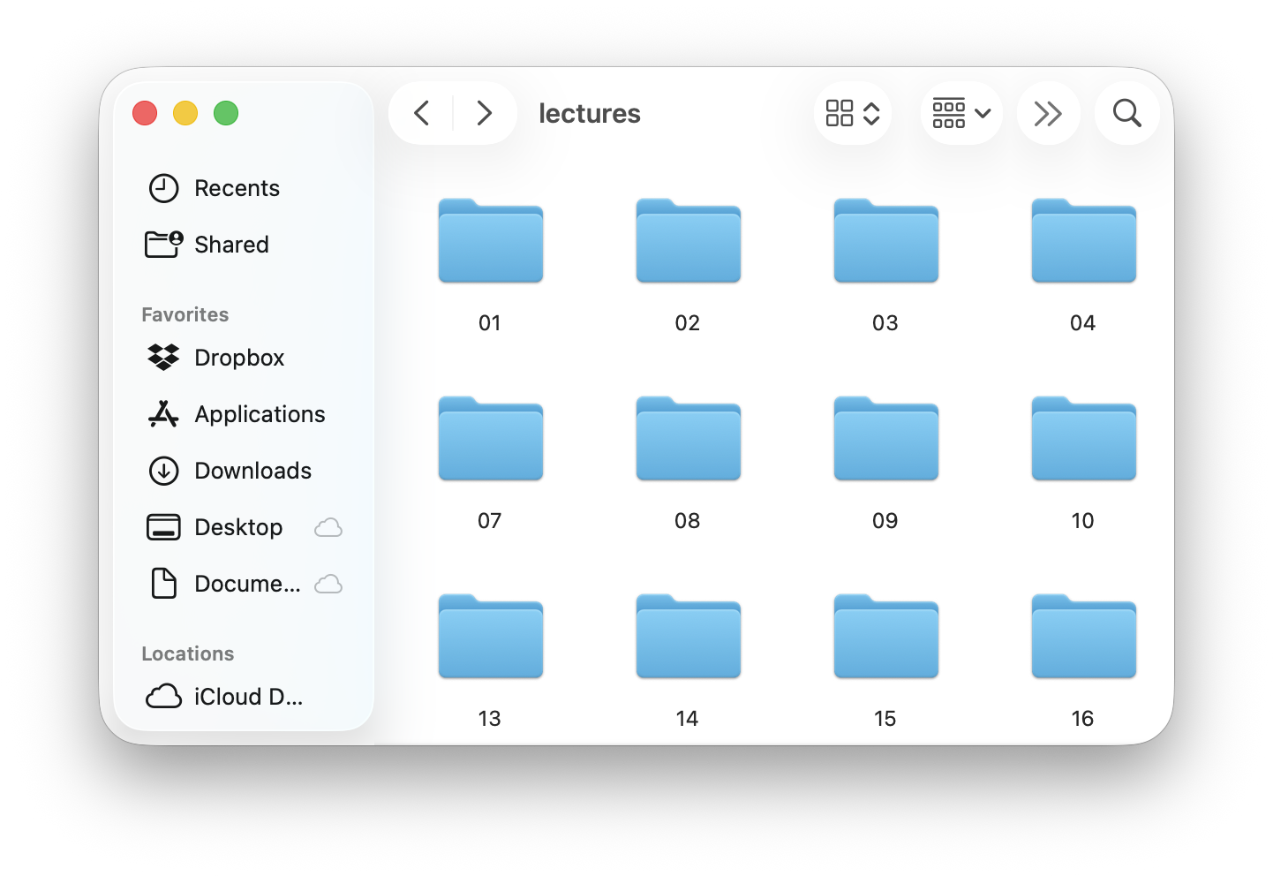
What is the Command Line?
The command line is a text-based interface to navigate a computer’s file system and launch executables. It’s a popular, lightweight alternative to the more traditional graphical user interfaces you've used before.
Graphical User Interface
Command line interface

Slide 26
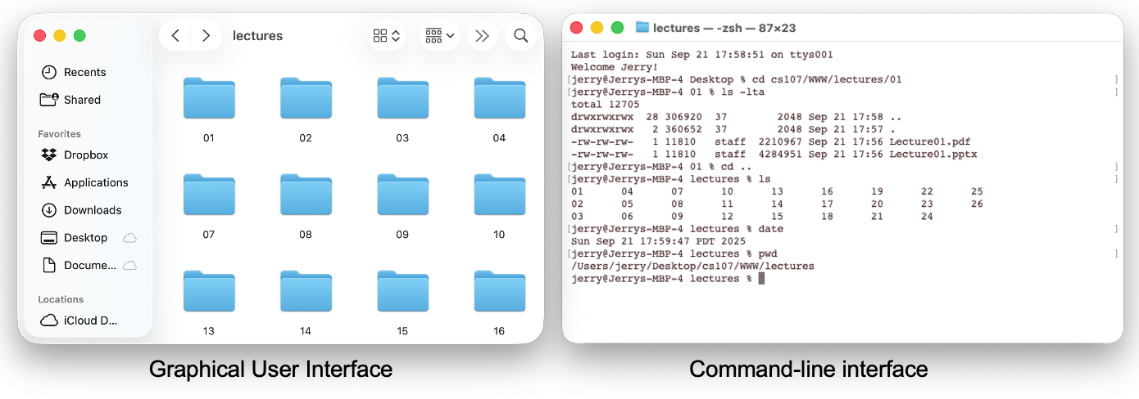
CLI vs. GUI
Just like a GUI file explorer, a terminal:
shows you a specific place on your computer at any given time
lets you descend into folders and ascend out of them
lets you create new files and directories and edit existing ones
lets you execute programs

Slide 27
Why Unix?
You can navigate virtually any device using the same tools and commands:
  laptops and desktops
  embedded devices (Raspberry Pi, etc.)
  mobile Devices (Android, etc.)
  microwaves, dishwashers, air conditioners, cameras
Used frequently by software engineers for:
  web development: running servers and web tools on servers
  machine learning: processing data, training models
  systems: implementing operating systems, networks, compilers, and drivers
  mobile development: running tools, managing libraries
We'll use Unix and the command line to implement and test C programs.
Notes:
Remote access is easy

Slide 28
Unix Commands To Try
cd: change directories
ls: list directory contents
mkdir: create a new directory
emacs: open text editor
rm: irreversibly delete file or folder
man: read documentation for standard C functions
See the course website for more commands and a complete reference.

Slide 29
Demo: Using Unix and the Command Line
Get up and running with our guide:
http://cs107.stanford.edu/getting-started.html
Notes:
Everything documented in next slide!

Slide 30

Learning Unix and the Command Line
Using Unix and the command line can be very intimidating at first.
  How do I know what to type?
  It looks retro! It is retro!
You're learning a new language.
  You should repeatedly look things up (resources on course website)
  Spend as much time as possible (during labs and assignments) building muscle memory with the tools
Notes:
Ask questions!

Slide 31
Question Break
Get up and running with our guide:
http://cs107.stanford.edu/getting-started.html

Slide 32
assign0
assign0 (Intro to Unix and C) goes out on Wednesday and falls due a week later, on Wednesday, January 14th at 11:59PM PDT.
There are 5 parts to the assignment, which is meant to get you comfortable using the command line, and editing/compiling/running C programs:
surveying the course website to learn a few different Unix commands
clone the assign0 starter project
answer several questions in readme.txt
compile a provided C program and modify it
submit the assignment

Slide 33
Lecture Recap
CS107 is a programming class in C that teaches you about programming languages and software and what goes on under the hood.
We’ll use Unix and its tools to implement, debug and test our programs.
Please visit the course website, https://cs107.stanford.edu, where you can read the lecture schedule, the syllabus, the information we provide about the Honor Code in CS107, and much, much more.
I’m looking forward to an awesome quarter!

