Slide 1
CS107, Lecture 2
Unix, C, Bits and Bytes Intro
Reading: Bryant & O’Hallaron, Ch. 2.2-2.3 (skim)

Slide 2
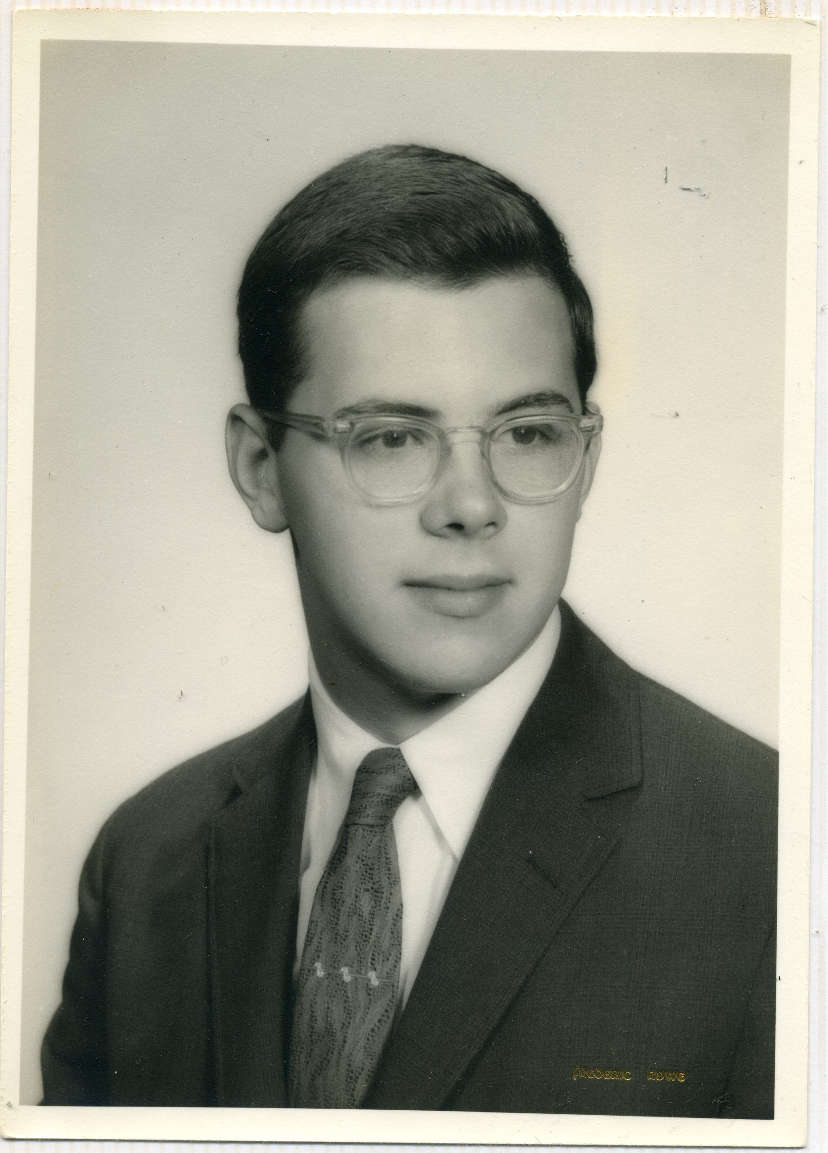
The C Language
C was created by Dennis Ritchie at Bell Labs between 1969 and 1972, with its first stable form emerging around 1972, and was invented to solve practical systems engineering problems, including the implementation of Unix.
Early Unix was written in:
  assembly language (difficult to maintain and impossible to port)
  the B programming language (lacked strong types, arrays, and records)
C is an extension of B and introduced:
  chars and longs, pointers, arrays, and records
  pointer arithmetic and the ability to reason about computer memory

Slide 3
C vs C++ and Java
All three share:
syntax
primitive data types
arithmetic, relational, and logical operators
common control idioms, e.g., for loops, switch statements, if/else clauses, functions
C limitations:
no advanced features like operator overloading, default arguments, true pass by reference, object orientation
few native libraries (no graphics, networking, etc.)
  small language footprint, though 😇
minimalist runtime model, near zero runtime error checking by default

Slide 4
Programming Language Philosophies
C is procedural: you write functions, rather than define new variable types with classes and invoke methods. C is small, fast and efficient.
Python is multi-paradigm but dynamically typed: you still write functions and call methods on objects but traditionally omit data types when coding. The development process is very different.
C++ is procedural, but with objects: you still write functions, and define new variable types with classes, and call methods on objects.
Java is primarily object oriented: virtually everything is an object and everything you write must conform to the object-oriented paradigm.
Notes:
C++ is C+1!

Slide 5
Why C? Nostalgia?
C lets you see what the computer is really doing. Memory, pointers, and data layout are explicit and not hidden behind abstractions.
C is the language many systems are implemented in. Operating systems, compilers, databases, drivers, and embedded firmware are largely written in C.
C is the foundation underlying many higher-level programming languages. Many languages and their runtimes are implemented in C, so understanding C explains language performance and limitations.
Learning C first makes learning other systems languages easier. Rust, Go, and others make more sense once you understand the problems C exposes directly.
Notes:
Manipulations that are easy in C, harder elsewhere

Slide 6
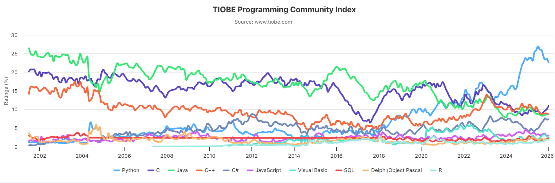
Programming Language Popularity
The ratings percentage is the proportion of all programming language related search hits that mention a given language, relative to all languages tracked by TIOBE.
https://www.tiobe.com/tiobe-index/

Slide 7
Baby’s First C Program
/*
* hello.c
* This program prints a welcome message
* to the user.
*/
#include <stdio.h> // exposes printf
int main(int argc, char *argv[]) {
printf("Hello, world!\n");
return 0;
}

Slide 8
Baby’s First C Program
/*
* hello.c
* This program prints a welcome message
* to the user.
*/
#include <stdio.h> // exposes printf
int main(int argc, char *argv[]) {
printf("Hello, world!\n");
return 0;
}
Program comments
You can write block or inline comments.

Slide 9
Baby’s First C Program
/*
* hello.c
* This program prints a welcome message
* to the user.
*/
#include <stdio.h> // exposes printf
int main(int argc, char *argv[]) {
printf("Hello, world!\n");
return 0;
}
Import statements
C libraries are written with angle brackets.
Local libraries use quotes instead, as with
#include "wordle-utils.h"

Slide 10
Baby’s First C Program
/*
* hello.c
* This program prints a welcome message
* to the user.
*/
#include <stdio.h> // exposes printf
int main(int argc, char *argv[]) {
printf("Hello, world!\n");
return 0;
}
main function: entry point for the program,
should always return a small integer (0 == success)

Slide 11
Baby’s First C Program
/*
* hello.c
* This program prints a welcome message
* to the user.
*/
#include <stdio.h> // exposes printf
int main(int argc, char *argv[]) {
printf("Hello, world!\n");
return 0;
}
main parameters – main takes two parameters, both constructed using the command line arguments used to launch the program.
argc is the number of arguments in argv
argv is an array of arguments (char * is C string)
Notes:
What are provided to the program when it is run on command line

Slide 12
Baby’s First C Program
/*
* hello.c
* This program prints a welcome message
* to the user.
*/
#include <stdio.h> // exposes printf
int main(int argc, char *argv[]) {
printf("Hello, world!\n");
return 0;
}
printf prints output to the screen
Notes:
\n
stdio

Slide 13
Console Output: printf
printf(control, arg1, arg2, arg3,...);
printf makes it easy to print out the values of variables or expressions.
If you include placeholders in your printed text, printf will replace each placeholder with the values of subsequent parameters, passed after the text.
%s (string) %d (integer)
// Example
    char *department = "CS";
    int number = 107;
    printf("You are in %s%d\n", department, number); // You are in CS107
Notes:
TODO: motivate more by showing multiline print

Slide 14
Familiar Syntax
int x = 23
int y = 42 - 5 * x; // variables, types
double pi = 3.14159;
char c = 'Q'; /* two comment styles */
for (int i = 0; i < 100; i++) { // for loops
if (i % 2 == 0) { // if statements
x += i;
}
}
while (x > 0 && c == 'Q' || b) { // while loops, logic
x = x / 2;
if (x == 42) return 0;
}
return binky(x, y, pi, c); // function call

Slide 15
Boolean Variables
To declare Booleans, (e.g., bool b = __;), you include stdbool.h
#include <stdio.h> // for printf
#include <stdbool.h> // for bool
int main(int argc, char *argv[]) {
bool x = argc > 2 && argv[argc - 1][0] != 'A';
if (x) {
printf("Hello, world!\n");
} else {
printf(”Greetings, traveler!\n");
}
return 0;
}

Slide 16
Command Line Arguments
argv captures array of tokens used to run program, and
argc counts how many tokens
/* File: args.c */
#include <stdio.h> // for printf
int main(int argc, char *argv[]) {
printf("This program got %d argument(s).\n", argc);
for (size_t i = 0; i < argc; i++) {
printf("Argument %zu: %s\n", i, argv[i]);
}
return 0;
}
myth$ ./args 1 2 "3 4" five
This program got 5 argument(s).
Argument 0: ./args
Argument 1: 1
Argument 2: 2
Argument 3: 3 4
Argument 4: five

Slide 17
Writing, Debugging and Compiling
We will use:
the emacs text editor to write our C programs
the make tool to compile our C programs
the gdb debugger to debug our programs
the valgrind tools to debug memory errors and measure program efficiency
this week
next week

Slide 18
Customary Workflow
ssh – remotely log in to myth computers
emacs – text editor to write and edit C programs
  Use the mouse to position cursor, scroll, and highlight text
  Ctrl-x Ctrl-s to save, Ctrl-x Ctrl-c to quit
make – compile program using provided Makefile
./myprogram – run executable program (perhaps with arguments)
make clean – remove executables and other compiler files

Slide 19
Demo: Compiling And Running A C Program
Get up and running with our guide:
http://cs107.stanford.edu/getting-started.html

Slide 20
CS107 Topic 1: Bits and Bytes
How can a computer represent int values? or floats?
Why is answering this question useful?
Helps us understand the limitations of computer arithmetic (today and Friday)
Shows us how to more efficiently perform arithmetic (Friday and Monday)
Shows us how we can encode data more compactly and efficiently (Monday)

Slide 21
Demo: Unexpected Behavior
cp -r /afs/ir/class/cs107/lecture-code/lect02 .
Notes:
Demo overflow
Change numbers, consistently incorrect!

Slide 22

The Binary Digit aka Bit

Slide 23
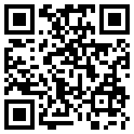
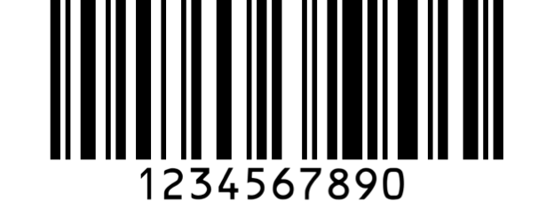
One Bit At A Time
We can combine bits, as with base-10 numbers, to represent a larger collection of values
8 bits = 1 byte.
Computer memory is just a large array of bytes. It is byte addressable, meaning you can’t address a bit in isolation, only a full byte.
Computers still fundamentally operate on bits. It's just that we’ve gotten more creative about how to encode information.
  images
  audio
  video
  text
Notes:
Nibble!

Slide 24
Base 10
5 9 3 4
digits 0 – 9
(or rather, 0 through base – 1)

Slide 25
Base 10
5 9 3 4
tens
ones
thousands
hundreds
= 5 * 1000 + 9 * 100 + 3 * 10 + 4 * 1

Slide 26
Base 10
5 9 3 4
10³
10²
10¹
10⁰

Slide 27
Base 10
5 9 3 4
10^{x}:
3
2
1
0

Slide 28
Base 2
1 0 1 1
2^{n}:
3
2
1
0
digits 0 – 1
(or rather, 0 through base – 1)

Slide 29
Base 2
1 0 1 1
2³
2²
2¹
2⁰

Slide 30
Base 2
most significant bit (MSB)
least significant bit (LSB)
1 0 1 1
eights
fours
twos
ones
= 1 * 8 + 0 * 4 + 1 * 2 + 1 * 1 = 11₁₀

Slide 31
Base 10 to Base 2
Question: What is 6 in base 2?
Strategy:
  What is the largest power of 2 ≤ 6?
  Now, what is the largest power of 2 ≤ 6 – 2²?
  6 – 2² – 2¹ = 0
2²=4
2¹=2
0
1
1
0
_ _ _ _
2³
2²
2¹
2⁰
= 0*8 + 1*4 + 1*2 + 0*1 = 6

Slide 32
Practice: Base 2 to Base 10
What is the base-2 value of 1010 in base-10?
20
101
10
5
Other
1010 isn’t 1010 so much as it is 8 + 2
Notes:
On your own
c

Slide 33
Practice: Base 10 to Base 2
What is the base-10 value of 14 in base 2?
1111
1110
1010
Other
14 can be written as a sum of powers
14 isn't 14 so much as it is 8 + 4 + 2
that can be encoded as 1110
Notes:
On your own
b

Slide 34
Byte Values
What are the minimum and maximum base-10 values that
a single byte can represent?
255
minimum = 0 maximum = ?
11111111
2^{x}: 7 6 5 4 3 2 1 0
Strategy 1: 1 * 2⁷ + 1 * 2⁶ + 1 * 2⁵ + 1 * 2⁴ + 1 * 2³+ 1 * 2² + 1 * 2¹ + 1 * 2⁰ = 255
Strategy 2: 2⁸ – 1 = 255

Slide 35
Multiplying by Base
7453 x 10 = 74530
1100₂ x 10₂ = 11000
Key Idea: appending a 0 to the end effectively multiplies by the base.
Notes:
Whiteboard work

Slide 36
Integer Dividing by Base
1458 / 10 = 145
1101₂ / 10₂ = 110
Key Idea: chomping off the last digit at the end integer divides by the base.
Notes:
Whiteboard work

Slide 37
Hexadecimal
When working with 32- or 64-bit figures, binary representations get long. Instead, we'll often encode numbers in base 16, or hexadecimal.
0110 1010 0011
0-15
0-15
0-15

Slide 38
Hexadecimal
When working with 32- or 64-bit figures, binary representations get long. Instead, we'll often encode numbers in base 16, or hexadecimal.
0-15
0-15
0-15
Each quartet of bits can be rewritten as a single digit in base 16!

Slide 39
Hexadecimal
Hexadecimal is base 16, so we need digits for 0 through 15, inclusive.
But how?
0 1 2 3 4 5 6 7 8 9 a b c d e f
10 11 12 13 14 15

Slide 40
Hexadecimal
If it's not clear from context, we can explicitly identify numbers as hexadecimal by prefixing them with 0x and identify numbers as binary using 0b.
0xf5 (or 0xF5) is binary number 0b11110101 is decimal number 245
0x f 5
1111
0101

Slide 41
Practice: Hexadecimal to Binary
What is 0x173A in binary?
0x173A = 0b1011100111010
Hexadecimal | 1 | 7 | 3 | A
Binary | 0001 | 0111 | 0011 | 1010

Slide 42
Practice: Binary to Hexadecimal
What is 0b1111001010 in hexadecimal? (Hint: start from the right)
0b1111001010 = 0x3CA
Binary | 11 | 1100 | 1010
Hexadecimal | 3 | C | A

Slide 43
Hexadecimal: Quirky but concise
Let’s look at a single byte, encoded three ways:
165
base 10: human-readable,
but cannot easily interpret on/off bits
0b10100101
base 2: computers love this,
but most humans lack that love.
0xA5
base 16: easy to convert to base 2, more easily digested format for humans
Notes:
Each hexadecimal digit represents four bits (binary digits), also known as a nibble (or nybble), which is half a byte.

Slide 44
Number Representations
Unsigned Integers: positive integers and 0 (e.g., 0, 1, 2, … 99999…)
Signed Integers: negative, positive and 0 (e.g., …-2, -1, 0, 1, … 99999, …)
Floating Point Numbers: real numbers (e,g. 0.1, -12.2, 1.18743 x 10¹²)

