Slide 1
CS107 Lecture 2
Unix and C
While you’re waiting – get set up with PollEverywhere!
Visit pollev.stanford.edu to set up your account.

Slide 2
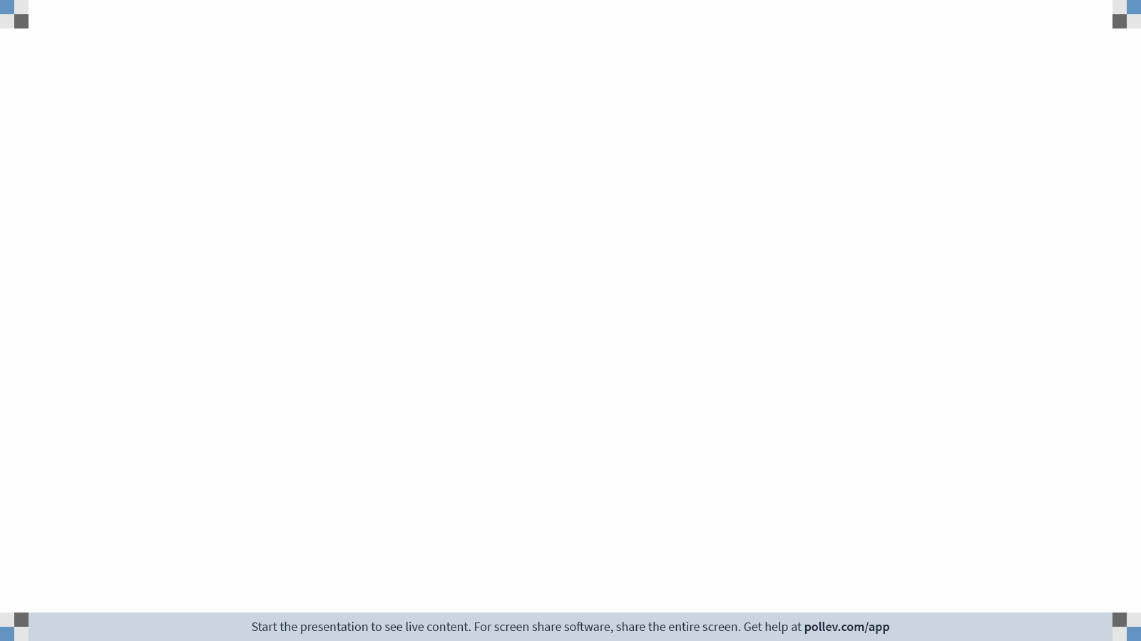
Notes:
Do not modify the notes in this section to avoid tampering with the Poll Everywhere activity.
More info at polleverywhere.com/support
How are you doing? (This is an open ended question, answer however you like!)
https://www.polleverywhere.com/free_text_polls/C4ypr4yFHbvT6jBwrXWr0

Slide 3
PollEverywhere
Today we’re doing a “trial run” of using PollEverywhere for poll questions
  Not counted for attendance (that starts next lecture), just a chance to try it out
  Canvas Gradebook records lecture scores
  Responses not anonymized, but we look only at aggregated results and totals
  Poll responses require being present in the lecture room to receive credit
  Alternative option instead of lecture credit is to shift the full 5% weight to the final exam
Visit pollev.stanford.edu to log in (or use the PollEverywhere app) and sign in with your @stanford.edu email – NOT your personal email!
Compatible with any device with a web browser, mobile app also available.
Poll questions in slides will automatically activate the poll and respond at pollev.com/cs107.
Polls will prompt for location check-in; check in prior to inputting response.

Slide 4
Announcements
Remember to input your lab preferences through 11:30AM Fri! Link is on the course website (under “Labs”).
Helper Hours scheduled and starting this week!
assign0 released, due Mon 11:59PM PDT
Make sure to submit our OAE accommodations form or our exam information form on the course homepage if applicable!

Slide 5
Learning Goals
Learn how to navigate a computer and edit/run programs using the terminal
Understand the differences between C and other languages and how to write C programs

Slide 6
Lecture Plan
Unix and the Command Line
Getting Started With C

Slide 7
Lecture Plan
Unix and the Command Line
Getting Started With C

Slide 8


What is the Command Line?
The command-line is a text-based interface (i.e., terminal interface) to navigate a computer, instead of a Graphical User Interface (GUI).
Graphical User Interface
Text-based interface

Slide 9
Unix Commands To Try
cd – change directories (..)
ls – list directory contents
mkdir – make directory
emacs – open text editor
rm – remove file or folder
man – view manual pages
See the course website for more commands and a complete reference.

Slide 10
Demo: Using Unix and the Command Line
Get up and running with our guide:
http://cs107.stanford.edu/resources/getting-started.html
Notes:
Everything documented in next slide!

Slide 11
Lecture Plan
Unix and the Command Line
Getting Started With C

Slide 12
The C Language
C was created around 1970 to make writing Unix and Unix tools easier.
Part of the C/C++/Java family of languages (C++ and Java were created later)
Design principles:
  Small, simple abstractions of hardware
  Minimalist aesthetic
  Prioritizes efficiency and minimalism over safety and high-level abstractions
Procedural (you write functions, no classes or methods) – vs. C++ or Python where you can write functions but also classes with methods
Doesn’t have all features you may know from other languages (e.g., no pass by reference, no classes and objects, no ADTs, no extensive libraries, weak compiler and almost no runtime checks – which can cause security vulnerabilities!)
Notes:
Is goal to only code in C? No – one more tool in your toolbox
Right language for the situation

Slide 13
Why C?
Many tools (and even other languages, like Python!) are built with C.
C is the language of choice for fast, highly efficient programs.
C is popular for systems programming (operating systems, networking, etc.)
C lets you work at a lower level to manipulate and understand the underlying system.
Notes:
Manipulations that are easy in C, harder elsewhere

Slide 14
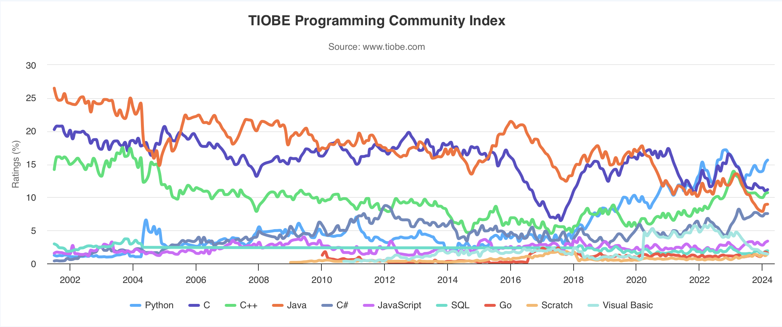
Programming Language Popularity
https://www.tiobe.com/tiobe-index/

Slide 15
Our First C Program
/*
* hello.c
* This program prints a welcome message
* to the user.
*/
#include <stdio.h> // for printf
int main(int argc, char *argv[]) {
printf("Hello, world!\n");
return 0;
}

Slide 16
Our First C Program
/*
* hello.c
* This program prints a welcome message
* to the user.
*/
#include <stdio.h> // for printf
int main(int argc, char *argv[]) {
printf("Hello, world!\n");
return 0;
}
Program comments
You can write block or inline comments.

Slide 17
Our First C Program
/*
* hello.c
* This program prints a welcome message
* to the user.
*/
#include <stdio.h> // for printf
int main(int argc, char *argv[]) {
printf("Hello, world!\n");
return 0;
}
Import statements
C libraries are written with angle brackets.
Local libraries have quotes:
#include "lib.h"

Slide 18
Our First C Program
/*
* hello.c
* This program prints a welcome message
* to the user.
*/
#include <stdio.h> // for printf
int main(int argc, char *argv[]) {
printf("Hello, world!\n");
return 0;
}
Main function – entry point for the program
Should always return an integer (0 = success)

Slide 19
Our First C Program
/*
* hello.c
* This program prints a welcome message
* to the user.
*/
#include <stdio.h> // for printf
int main(int argc, char *argv[]) {
printf("Hello, world!\n");
return 0;
}
If user runs ls -a:
argv = [“ls”, “-a”]
argc = 2
Main parameters – main takes two parameters, both relating to the command line arguments used to execute the program. (split by spaces)
argc is the number of arguments in argv
argv is an array of arguments (char * is C string)
Notes:
What are provided to the program when it is run on command line

Slide 20
Our First C Program
/*
* hello.c
* This program prints a welcome message
* to the user.
*/
#include <stdio.h> // for printf
int main(int argc, char *argv[]) {
printf("Hello, world!\n");
return 0;
}
printf – prints output to the screen
Notes:
\n
stdio

Slide 21
Console Output: printf
printf(text, arg1, arg2, arg3,...);
printf supports printing out the values of variables or expressions, but C does not support string concatenation with “+”.
Instead, we can include placeholders in our printed text, and printf will replace each placeholder in order with the values of the parameters passed after the text.
%s (string) %d (integer) %f (double)
// Example
    char *classPrefix = "CS";
    int classNumber = 107;
    printf("You are in %s%d!", classPrefix, classNumber); // You are in CS107!
Notes:
TODO: motivate more by showing multiline print

Slide 22
Familiar Syntax
int x = 42 + 7 * -5; // variables, types
double pi = 3.14159;
char c = 'Q'; /* two comment styles */
for (int i = 0; i < 10; i++) { // for loops
if (i % 2 == 0) { // if statements
x += i;
}
}
while (x > 0 && c == 'Q' || b) { // while loops, logic
x = x / 2;
if (x == 42) {
return 0;
}
}
binky(x, 17, c); // function call

Slide 23
Boolean Variables
To declare Booleans, (e.g. bool b = ____), you must include stdbool.h:
#include <stdio.h> // for printf
#include <stdbool.h> // for bool
int main(int argc, char *argv[]) {
bool x = 5 > 2 && binky(argc) > 0;
if (x) {
printf("Hello, world!\n");
} else {
printf("Howdy, world!\n");
}
return 0;
}

Slide 24
Boolean Expressions
C treats a nonzero value as true, and a zero value as false:
#include <stdio.h>
int main(int argc, char *argv[]) {
int x = 5;
if (x) { // true
printf("Hello, world!\n");
} else {
printf("Howdy, world!\n");
}
return 0;
}

Slide 25
Writing, Debugging and Compiling
We will use:
the emacs text editor to write our C programs
the make tool to compile our C programs
the gdb debugger to debug our programs
the valgrind tools to debug memory errors and measure program efficiency
Now
Next week

Slide 26
Working On C Programs
ssh – remotely log in to Myth computers
Emacs – text editor to write and edit C programs
  Use the mouse to position cursor, scroll, and highlight text
  Ctl-x Ctl-s to save, Ctl-x Ctl-c to quit
make – compile program using provided Makefile
./myprogram – run executable program (optionally with arguments)
make clean – remove executables and other compiler files
Lecture code is accessible at /usr/class/cs107/lecture-code/lect[N]
  Make your own copy: cp -r /usr/class/cs107/lecture-code/lect[N] lect[N]
  See the website for even more commands, and a complete reference.

Slide 27
Demo: Compiling And Running A C Program
Get up and running with our guide:
http://cs107.stanford.edu/resources/getting-started.html

Slide 28
Assign0
Assignment 0 (Intro to Unix and C) is due on Mon. 4/7 at 11:59PM PDT.
There are 5 parts to the assignment, which is meant to get you comfortable using the command line, and editing/compiling/running C programs:
Visit the website resources to become familiar with different Unix commands
Clone the assign0 starter project
Answer several questions in readme.txt
Compile a provided C program and modify it
Submit the assignment

Slide 29
Preview: Next Time
Make sure to reboot Boeing Dreamliners every 248 days
Comair/Delta airline had to cancel thousands of flights days before Christmas
Many operating systems may have issues storing timestamp values beginning on Jan 19, 2038
Reported vulnerability CVE-2019-3857 in libssh2 may allow a hacker to remotely execute code
Next time: How can a computer represent integer numbers? What are the limitations?

