Slide 1
CS107 Lecture 3
Bits and Bytes, Integer Representations
Reading: Bryant & O’Hallaron, Ch. 2.2-2.3 (skim)

Slide 2
Data Types: Then and Now
Early 2000s: most computers were 32-bit. That meant longs and pointers were 32 bits or 4 bytes.
32-bit pointers store memory addresses ranging from 0 to 2³² - 1, for a total of 2³² bytes of addressable memory. That's 4 gigabytes, meaning 32-bit computers could address up to 4GB of memory! That was a lot back then!
Now, most computers are 64-bit. Some data types (especially pointers, and oftentimes longs) were given more memory.
64-bit pointers can distinguish between addresses 0 to 2⁶⁴ - 1, equaling 2⁶⁴ bytes. This equals 16 exabytes, meaning that 64-bit computers could theoretically address up to 16 * 1024 * 1024 * 1024 GB of memory!
Notes:
Fun fact: mobile devices still transitioning

Slide 3
Unsigned Integers
An unsigned integer is either 0 or some positive whole number. There is no support for negative numbers in an unsigned world.
We’ve already discussed the conversion between decimal and binary, and we’ve implicitly assumed all numbers are nonnegative.
0101₂ = 5₁₀
1011₂ = 11₁₀
1111₂ = 15₁₀
The range of an unsigned integer is understood to be 0 → 2^{w} - 1, where w is the bit count—e.g., 32-bit figures can represent 0 to 2³² – 1.

Slide 4
Unsigned Integers
Our little number wheel to the right tells us a little about the range of values an imagined, 4-bit unsigned mini would be.
Think of the wheel as a binary odometer that tracks a count and turns over from 1111 to 0000 in the same way that real odometers turn over from 999 999 to 000 000.
The rotary nature of the wheel implies that 15 precedes 0 in the same way that 0 precedes 1. In many ways, that’s accurate.

Slide 5
Signed Integers
A signed integer can be either positive, negative, or zero.
Dilemma: How do we represent both negative and positive numbers?
Proposal: use the most significant bit to represent sign and let all others represent magnitude.
Happy side effect: for every positive number there’s a corresponding negative number. That suggests a 50/50 split between positive and negative.

Slide 6
Proposal: MSB represents + vs -
0110
positive
6
1110
negative
6

Slide 7
Proposal: MSB represents + vs -
0011
positive
3
1011
negative
3

Slide 8
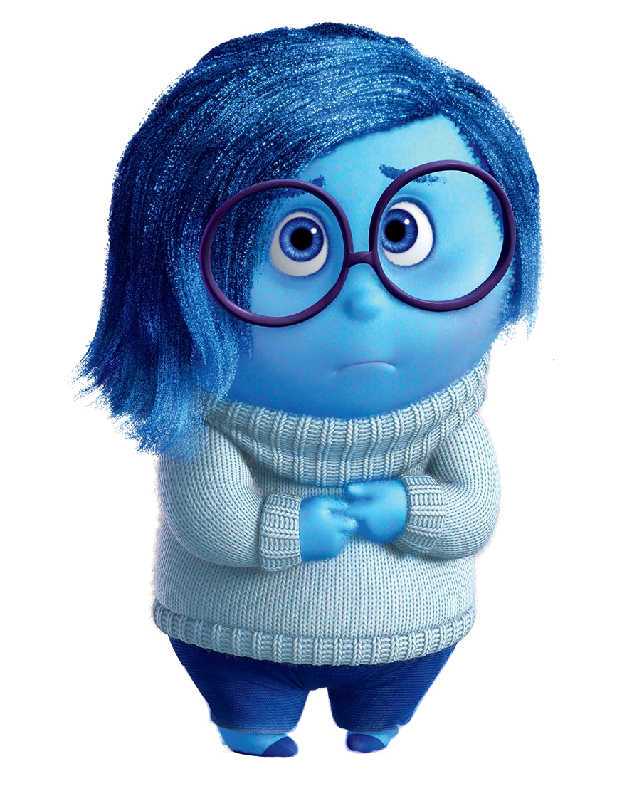
Proposal: MSB represents + vs -
0000
positive
0
1000
negative
0

Slide 9
Proposal: MSB represents + vs -
1 000 = -0
1 001 = -1
1 010 = -2
1 011 = -3
1 100 = -4
1 101 = -5
1 110 = -6
1 111 = -7
0 000 = 0
0 001 = 1
0 010 = 2
0 011 = 3
0 100 = 4
0 101 = 5
0 110 = 6
0 111 = 7
We’re only representing 15 different values via 16 different patterns.
#sadness

Slide 10
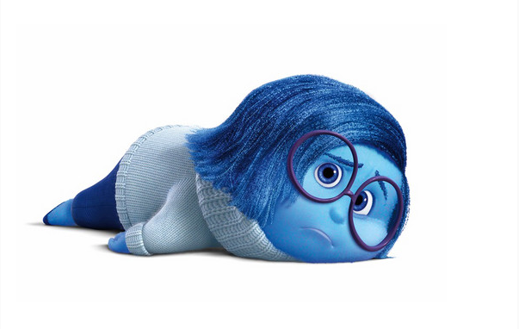
Proposal: MSB represents + vs -
Pro: easy to represent, and easy for humans to convert to and from decimal.
Con: +/-0 is
Con: we lose a bit that could be used to represent more numbers
Legit Con: arithmetic is tricky: we need to find the sign, perhaps subtract (borrow and carry, etc.), maybe change the sign, maybe not. This complicates how hardware implements something as fundamental as addition. This is the disadvantage we really care about.
Can we do better?
Of course we can, else I wouldn’t have asked.

Slide 11
Proposal: Optimize for Addition
Ideally, binary addition should work the same whether the numbers
are positive or negative.
0101
????
What pattern can be paired with 0101 so that bit-by-bit addition produces all zeros?
+
0000
Notes:
Extra digits just fall off

Slide 12
Proposal: Optimize for Addition
Ideally, binary addition should work the same whether the numbers
are positive or negative.
yes, it's really 1 0000, but there’s no fifth bit available to store that
leftmost one, so we let it fall away. The binary odometer analogy comes back.
0101
1011
+
0000

Slide 13
Proposal: Optimize for Addition
Ideally, binary addition should work the same whether the numbers
are positive or negative.
0011
????
+
0000

Slide 14
Proposal: Optimize for Addition
Ideally, binary addition should work the same whether the numbers
are positive or negative.
0011
1101
The CPU adds numbers by column-wise adding bits and throwing away anything that doesn’t fit. This works for negative numbers too, without any special cases.
+
0000

Slide 15
Proposal: Optimize for Addition
Ideally, binary addition should work the same whether the numbers
are positive or negative.
0000
????
+
0000

Slide 16
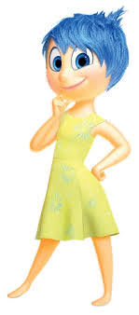
Proposal: Optimize for Addition
Ideally, binary addition should work the same whether the numbers
are positive or negative.
0000
0000
+
0000

Slide 17
Proposal: Optimize for Addition
0101
0011
0000
1011
1101
0000
+
+
+
0000
0000
0000
The negated number is the original number bitwise inverted, plus one more.

Slide 18
Proposal: Optimize for Addition
A binary number plus its inverse is all 1s.
Add 1 to this to carry over all 1s and get 0!
0101
1111
1010
0001
+
+
1111
0000
This "proposal" is in fact the scheme used in practice, and it’s called two’s complement.

Slide 19
Redux: Two’s Complement
We represent a positive number as we did before, and its negative counterpart via its two's complement.
The two’s complement of a number is formed by inverting all bits and then adding 1.
This works to convert from positive to negative and back from negative to positive!

Slide 20
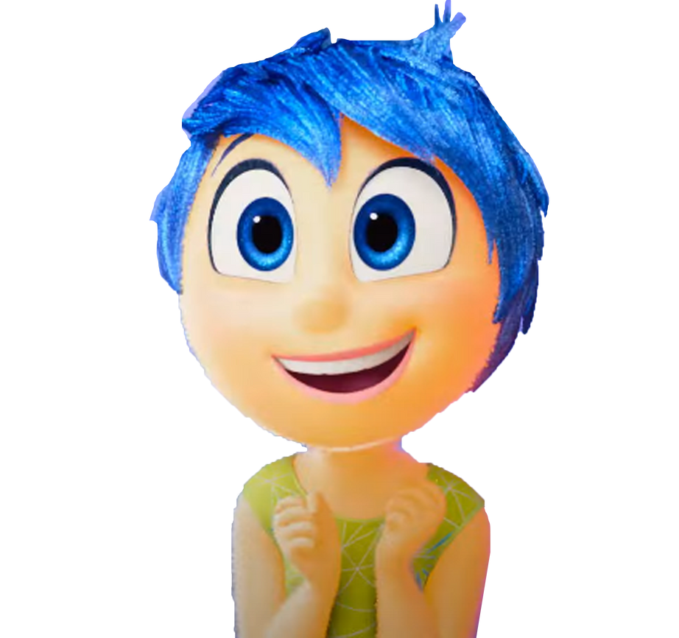
Redux: Two’s Complement
Con: more difficult to represent than unsigned, and difficult to convert to and from decimal, between positive and negative.
Pro: only 1 representation for 0. 😍
Pro: the most significant bit still indicates the sign of a number.
Pro: addition now works uniformly for any combination of positive and negative numbers.

Slide 21
Binary Representation and Overflow
If you exceed the maximum unsigned value representable with a fixed number of bits n, the result wraps around, modulo 2ⁿ. This is called overflow.
111111₂ + 000001₂ = 000000₂
If you go below the minimum unsigned value—i.e., 0—representable with a fixed number of bits, the result wraps around from the top (also modulo 2ⁿ).
000000000₂ - 000000001₂ = 111111111₂
Aside: With signed numbers, the hardware still wraps modulo $2^{n}$, but C doesn’t really define signed overflow, so you’re not supposed to rely on that behavior—even though, for n = 4, +7 typically becomes −8 on real machines.
Notes:
Technically overflowing with signed integers in C is undefined. But it is predictable

Slide 22
Binary Representation and Overflow
  At which points can overflow occur for signed and unsigned int? (assume binary values shown are 32-bit and that signed overflow is legit)
  signed and unsigned can both overflow at points X and Y
  signed can overflow only at X, unsigned only at Y
  signed can overflow only at Y, unsigned only at X
  signed can overflow at X and Y, unsigned only at X
111…111
000…000
111…110
000…001
111…101
000…010
111…100
X
000…011
…
…
Y
100…010
011…101
100…001
011…110
Key Idea: Assume overflow means discontinuity.
100…000
011…111
Notes:
Think-Pair-Share
C
DISCONTINUITY = overflow

Slide 23
Unsigned Integers and Overflow
≈ +4billion
0
111…111
000…000
111…110
000…001
111…101
000…010
111…100
discontinuity means wraparound occurs here
000…011
more increasing positive numbers
…
increasing positive numbers
…
100…010
011…101
100…001
011…110
100…000
011…111

Slide 24
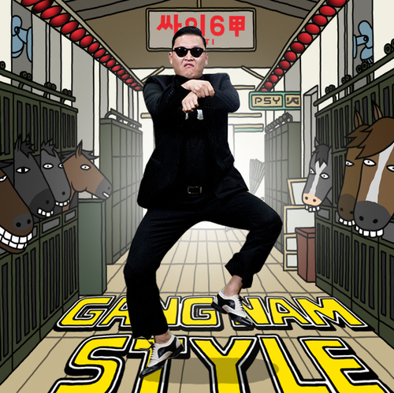
Signed Integers and "Overflow"
-1
0
+1
111…111
000…000
111…110
000…001
111…101
000…010
111…100
000…011
negative numbers becoming less negative
positive numbers becoming more positive
…
…
discontinuity means wraparound occurs here
100…010
011…101
100…001
011…110
100…000
011…111
≈ +2billion
≈ -2billion

Slide 25

Overflow In The Wild: PSY
YouTube: "We never thought a video would be watched in numbers greater than a 32-bit integer (up to 2,147,483,647 views), but that was before we met PSY. 'Gangnam Style' has been viewed so many times we had to upgrade to a 64-bit integer (9,223,372,036,854,775,808)!" [link]
"We saw this coming a couple months ago and updated our systems to prepare for it." [link]

Slide 26
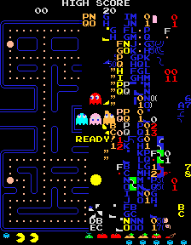
Overflow In The Wild: Pac-Man
Pac-Man is a 1980 arcade game where players guide a yellow character through a maze, eating dots while avoiding four ghosts with distinct movement patterns. Power pellets briefly let Pac-Man eat the ghosts for bonus points.
Pac-Man hit market saturation in 1981 and not only became the highest-grossing arcade game ever—it became a full-on cultural phenomenon, with hit songs, TV shows, and massive merchandising.
Jerry was in 7th grade in 1981. He stole quarters from his mom’s purse and went to Palombo’s to play for hours after school almost every day.
In the original game, the Map 256 Glitch [link] happened because the game’s level counter overflowed an 8-bit byte. When you reach level 256—you know, after clearing two cherry levels, two strawberries, two oranges, two apples, two melons, two spaceships, two bells, and 241 keys—the game draws too many pieces of fruit and corrupts the right half of the maze with garbled letters, tiles, and symbols, making the game almost unplayable. At level 256, half the dots aren’t displayed properly (though Pac-Man is expected to eat them), so progress beyond level 256 becomes impossible.
Jerry never got to level 56, much less 256.

Slide 27
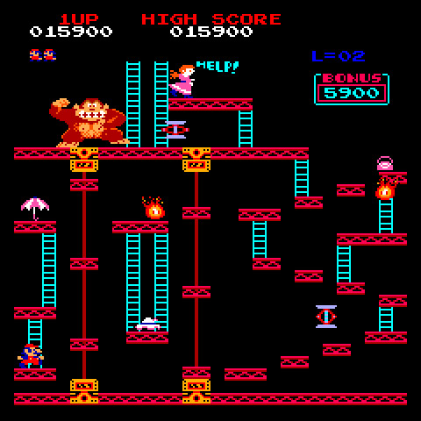
Overflow In The Wild: Donkey Kong
Donkey Kong is a 1981 Nintendo arcade game where players guide Mario to climb ladders, scale platforms, and ultimately rescue a captive woman from a giant gorilla. Gameplay centers on jumping obstacles and avoiding runaway barrels and Brownian-motion fireballs.
Donkey Kong surfed the wake of Pac-Man, became absurdly popular in 1982, and launched both Mario (originally named Jumpman) and Donkey Kong as enduring icons of arcade history.
Jerry was in 8th grade in 1982, carried on his life of change purse crime, and went to that same Palombo’s three blocks from home to play for hours after school almost every day.
In the original Donkey Kong, a timer is stored as an 8-bit unsigned value. On level 22, the timer calculation overflowed, because the number of time units Mario is granted to finish any level—including Level 22—is computed as 10 x (level + 4) = 260. 260 is really 1 0000 0100 in binary, but only 0000 0100 fits. That means Mario was given just 4 time units to complete a level designed to take 260.
Guess what level Jerry never got to.
Notes:
Boeing hundredths of a second
How to fix? Sat_add

Slide 28
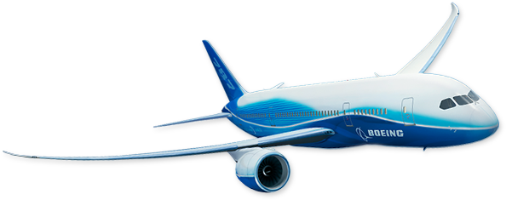

Overflow In The Wild: Real Problems
Back in 2015, in Boeing 787 Dreamliners [link], a counter in each of four generator control units stored as a signed, 32-bit integer. This counter would overflow after 2³¹ – 1 centiseconds (or about 248.5 days) of continuous power, triggering a shutdown of the GCU. If all four GCUs hit this overflow together—not unlikely if all four are powered up at the same time—the aircraft could lose all electrical power.
In December 2004, Delta Air Lines experienced an operational collapse [link] because of an overflow bug in software used to schedule flight crew. A counter tracking crew changes was stored as a signed, 16-bit int—the size of ints on most systems in 2004—with a maximum value of 32,767.
Severe weather disruptions pushed this count above that limit, prompting it to wrap around to -32,768. This compromised the system’s ability to properly count crew members available to work.
The result? Thousands of delays and cancellations.
Notes:
Boeing hundredths of a second
How to fix? Sat_add

