Slide 1
CS107 Lecture 3
Bits and Bytes; Integer Representations
reading:
Bryant & O’Hallaron, Ch. 2.2-2.3

Slide 2
CS107 Topic 1: How can a computer represent integer numbers?

Slide 3
CS107 Topic 1
How can a computer represent integer numbers?
Why is answering this question important?
Helps us understand the limitations of computer arithmetic (today)
Shows us how to more efficiently perform arithmetic (next time)
Shows us how we can encode data more compactly and efficiently (next time)
assign1: implement 3 programs that manipulate binary representations to (1) work around the limitations of arithmetic with addition, (2) simulate an evolving colony of cells, and (3) print Unicode text to the terminal.

Slide 4
Learning Goals
Understand the limitations of computer arithmetic and how that can impact our programs, such as with overflow
Understand how positive and negative numbers stored in ints, longs, etc. are represented in binary
Learn about the binary and hexadecimal number systems and how to convert between number systems

Slide 5
Delta/Comair Airline Holiday Chaos
Case study: Comair/Delta airline had to cancel thousands of flights days before Christmas due to a system malfunction. An unusually high number of crew reassignments caused a bug in the system. What happened?

Slide 6
Demo: Unexpected Behavior
cp -r /afs/ir/class/cs107/lecture-code/lect3 .
Notes:
Demo overflow
Change numbers, consistently incorrect!

Slide 7
Lecture Plan
Integer Representations
Bits and Bytes
Hexadecimal
Unsigned Integers
Signed Integers
Overflow

Slide 8
Lecture Plan
Integer Representations
Bits and Bytes
Hexadecimal
Unsigned Integers
Signed Integers
Overflow

Slide 9
Number Representations
Numeric types are generally a fixed size (e.g. int is 4 bytes). This means there is a limit to the range of numbers they can store.
Overflow occurs when we exceed the maximum value or go below the minimum value of a numeric type. It can cause unintended bugs!
C Declaration | Size (Bytes)
int | 4
double | 8
float | 4
char | 1
short | 2
long | 8
Notes:
Technically overflowing with signed integers in C is undefined. But it is predictable

Slide 10
The sizeof Operator
long sizeof(type);
// Example
    long int_size_bytes = sizeof(int); // 4
    long short_size_bytes = sizeof(short); // 2
    long char_size_bytes = sizeof(char); // 1
sizeof takes a variable type (or a variable itself) as a parameter and returns the size of that type, in bytes.

Slide 11
Number Representations
Unsigned Integers: positive and 0 integers. (e.g. 0, 1, 2, … 99999…
Signed Integers: negative, positive and 0 integers. (e.g. …-2, -1, 0, 1,… 9999…)
Floating Point Numbers: real numbers. (e,g. 0.1, -12.2, 1.5x10¹²)
Look up IEEE floating point if you’re interested!

Slide 12
Lecture Plan
Integer Representations
Bits and Bytes
Hexadecimal
Unsigned Integers
Signed Integers
Overflow

Slide 13
One Bit At a Time
A bit is 0 or 1
Computers are built around the idea of two states: “on” and “off”. Bits represent this idea in software! (transistors represent this in hardware).
We can combine bits, like with base-10 numbers, to represent more data. 8 bits = 1 byte.
Computer memory is just a large array of bytes! It is byte-addressable; you can’t address (store location of) a bit; only a byte.
Computers fundamentally operate on bits; but we creatively represent different data as bits!
  Images
  Video
  Text
  And more…
Notes:
Nibble!

Slide 14
Base 10
5 9 3 4
Digits 0-9 (0 to base-1)

Slide 15
Base 10
5 9 3 4
tens
ones
thousands
hundreds
= 5*1000 + 9*100 + 3*10 + 4*1

Slide 16
Base 10
5 9 3 4
10³
10²
10¹
10⁰

Slide 17
Base 10
5 9 3 4
10^{X}:
3
2
1
0

Slide 18
Base 2
1 0 1 1
2^{X}:
3
2
1
0
Digits 0-1 (0 to base-1)

Slide 19
Base 2
1 0 1 1
2³
2²
2¹
2⁰

Slide 20
Base 2
Most significant bit (MSB)
Least significant bit (LSB)
1 0 1 1
eights
fours
twos
ones
= 1*8 + 0*4 + 1*2 + 1*1 = 11₁₀
Notes:
MSB is most significant bit, not most significant on bit

Slide 21
Practice: Base 2 to Base 10
What is the base-2 value 1010 in base-10?
20
101
10
5
Other
Notes:
On your own
c

Slide 22
Base 10 to Base 2
Question: What is 6 in base 2?
Strategy:
  What is the largest power of 2 ≤ 6?
  Now, what is the largest power of 2 ≤ 6 – 2²?
  6 – 2² – 2¹ = 0!
2²=4
2¹=2
0
1
1
0
_ _ _ _
2³
2²
2¹
2⁰
= 0*8 + 1*4 + 1*2 + 0*1 = 6

Slide 23
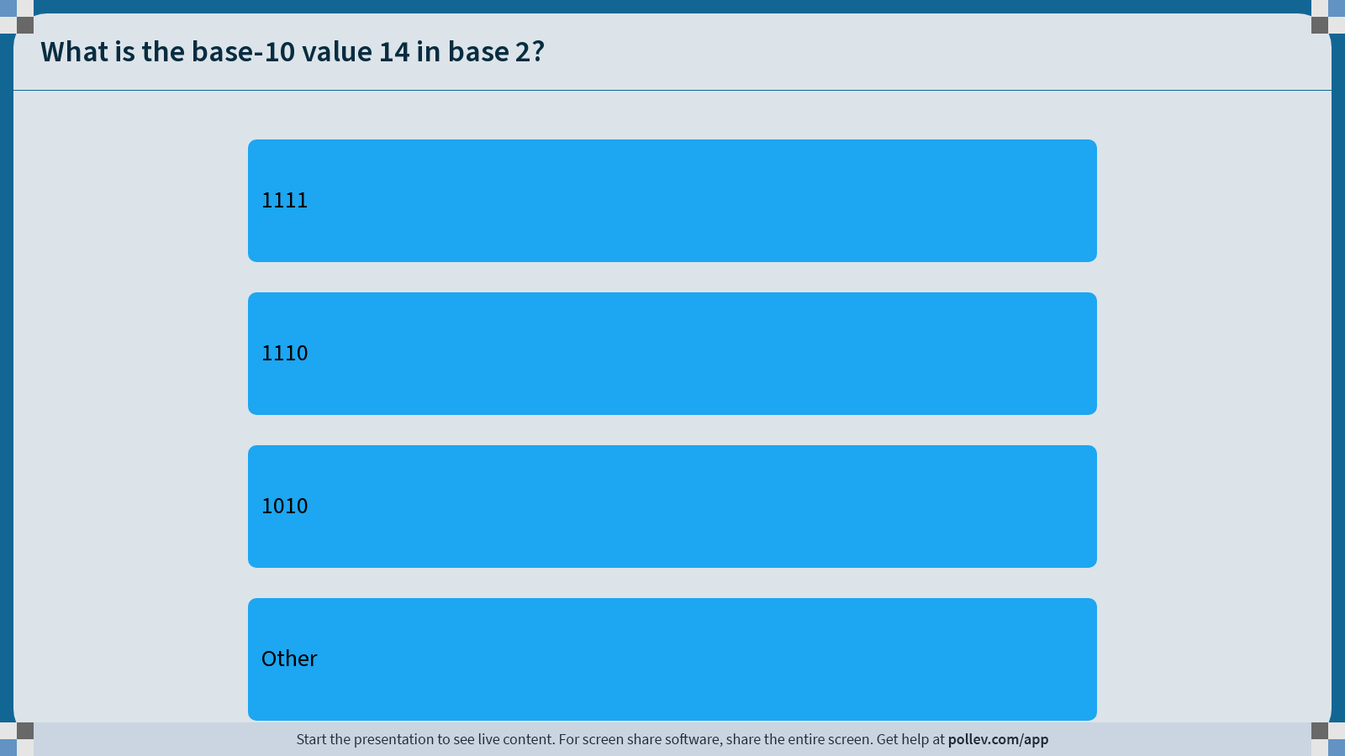
Notes:
Do not modify the notes in this section to avoid tampering with the Poll Everywhere activity.
More info at polleverywhere.com/support
What is the base-10 value 14 in base 2?
https://www.polleverywhere.com/multiple_choice_polls/cD0cAIlYhUoSBgLOyEhwc?display_state=instructions&activity_state=opened&state=opened&flow=Instructor&onscreen=persist

Slide 24
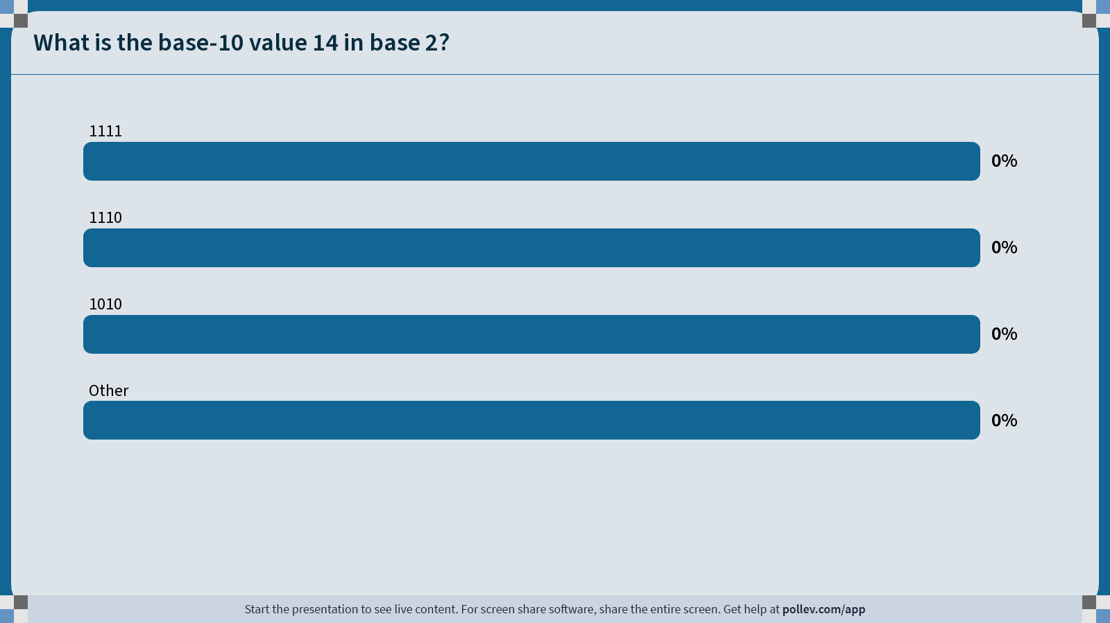
Notes:
Do not modify the notes in this section to avoid tampering with the Poll Everywhere activity.
More info at polleverywhere.com/support
What is the base-10 value 14 in base 2?
https://www.polleverywhere.com/multiple_choice_polls/cD0cAIlYhUoSBgLOyEhwc?display_state=chart&activity_state=closed&state=closed&flow=Instructor&onscreen=persist

Slide 25
Notes:
Do not modify the notes in this section to avoid tampering with the Poll Everywhere activity.
More info at polleverywhere.com/support
What is the base-10 value 14 in base 2?
https://www.polleverywhere.com/multiple_choice_polls/cD0cAIlYhUoSBgLOyEhwc?display_state=chart&activity_state=closed&display=correctness&state=closed&flow=Instructor&onscreen=persist

Slide 26
Byte Values
What is the minimum and maximum unsigned (>=0) base-10 value a single byte (8 bits) can store?
minimum = 0 maximum = ?
255
11111111
2^{x}: 7 6 5 4 3 2 1 0
Strategy 1: 1*2⁷ + 1*2⁶ + 1*2⁵ + 1*2⁴ + 1*2³+ 1*2² + 1*2¹ + 1*2⁰ = 255
Strategy 2: 2⁸ – 1 = 255
Notes:
You'll see this a lot

Slide 27
Multiplying by Base
1450 x 10 = 14500
1100₂ x 2 = 11000
Key Idea: inserting 0 at the end multiplies by the base!
Notes:
Whiteboard work

Slide 28
Dividing by Base
1450 / 10 = 145
1100₂ / 2 = 110
Key Idea: removing 0 at the end divides by the base!
Notes:
Whiteboard work

Slide 29
Lecture Plan
Integer Representations
Bits and Bytes
Hexadecimal
Unsigned Integers
Signed Integers
Overflow

Slide 30
Hexadecimal
When working with bits, oftentimes we have large numbers with 32 or 64 bits.
Instead, we’ll represent bits in base-16 instead; this is called hexadecimal.
0110 1010 0011
0-15
0-15
0-15

Slide 31
Hexadecimal
When working with bits, oftentimes we have large numbers with 32 or 64 bits.
Instead, we’ll represent bits in base-16 instead; this is called hexadecimal.
0-15
0-15
0-15
Each is a base-16 digit!

Slide 32
Hexadecimal
Hexadecimal is base-16, so we need digits for 1-15. How do we do this?
0 1 2 3 4 5 6 7 8 9 a b c d e f
10 11 12 13 14 15

Slide 33
Hexadecimal
Hex digit | 0 | 1 | 2 | 3 | 4 | 5 | 6 | 7
Decimal value | 0 | 1 | 2 | 3 | 4 | 5 | 6 | 7
Binary value | 0000 | 0001 | 0010 | 0011 | 0100 | 0101 | 0110 | 0111
Hex digit | 8 | 9 | A | B | C | D | E | F
Decimal value | 8 | 9 | 10 | 11 | 12 | 13 | 14 | 15
Binary value | 1000 | 1001 | 1010 | 1011 | 1100 | 1101 | 1110 | 1111

Slide 34
Hexadecimal
We distinguish hexadecimal numbers by prefixing them with 0x, and binary numbers with 0b.
E.g. 0xf5 is 0b11110101
0x f 5
1111
0101

Slide 35
Practice: Hexadecimal to Binary
What is 0x173A in binary?
Hexadecimal | 1 | 7 | 3 | A
Binary | 0001 | 0111 | 0011 | 1010

Slide 36
Practice: Binary to Hexadecimal
What is 0b1111001010 in hexadecimal? (Hint: start from the right)
Binary | 11 | 1100 | 1010
Hexadecimal | 3 | C | A

Slide 37
Hexadecimal: It’s funky but concise
Let’s take a byte (8 bits):
165
Base-10: Human-readable,
but cannot easily interpret on/off bits
0b10100101
Base-2: Yes, computers use this,
but not human-readable
0xa5
Base-16: Easy to convert to Base-2,
More “portable” as a human-readable format
(fun fact: a half-byte is called a nibble or nybble)
Notes:
Each hexadecimal digit represents four bits (binary digits), also known as a nibble (or nybble), which is half a byte.

Slide 38
Lecture Plan
Integer Representations
Bits and Bytes
Hexadecimal
Unsigned Integers
Signed Integers
Overflow

Slide 39
Unsigned Integers
An unsigned integer is 0 or a positive integer (no negatives).
We have already discussed converting between decimal and binary, which is a nice 1:1 relationship. Examples:
0b0001 = 1
0b0101 = 5
0b1011 = 11
0b1111 = 15
The range of an unsigned number is 0 → 2^{w} - 1, where w is the number of bits. E.g. a 32-bit integer can represent 0 to 2³² – 1 (4,294,967,295).

Slide 40
Example: 4-bit Unsigned Integer

Slide 41
Unsigned Integer Representations
We commonly omit leading zeroes, but make sure to note how many total bits you are working with! E.g. if an unsigned short, 0b1101 has 12 implicit leading 0s.
C Declaration | Size (Bytes)
unsigned int | 4
unsigned char | 1
unsigned short | 2
unsigned long | 8

Slide 42
From Unsigned to Signed
A signed integer is a negative, 0, or positive integer. How can we represent both negative and positive numbers in binary?

Slide 43
Lecture Plan
Integer Representations
Bits and Bytes
Hexadecimal
Unsigned Integers
Signed Integers
Overflow

Slide 44
Signed Integers
A signed integer is a negative integer, 0, or a positive integer.
Problem: How can we represent negative and positive numbers in binary?
One primary goal: want to make arithmetic easy; “just works”.

Slide 45
A Better Idea
Ideally, binary addition would just work regardless of whether the number is positive or negative.
0101
????
+
0000
Notes:
Extra digits just fall off

Slide 46
A Better Idea
Ideally, binary addition would just work regardless of whether the number is positive or negative.
0101
1011
+
10000

Slide 47
A Better Idea
Ideally, binary addition would just work regardless of whether the number is positive or negative.
0101
1011
+
0000

Slide 48
A Better Idea
Ideally, binary addition would just work regardless of whether the number is positive or negative.
0011
????
+
0000

Slide 49
A Better Idea
Ideally, binary addition would just work regardless of whether the number is positive or negative.
0011
1101
+
0000

Slide 50
A Better Idea
Ideally, binary addition would just work regardless of whether the number is positive or negative.
0000
????
+
0000

Slide 51
A Better Idea
Ideally, binary addition would just work regardless of whether the number is positive or negative.
0000
0000
+
0000

Slide 52
A Better Idea
Decimal | Positive | Negative
0 | 0000 | 0000
1 | 0001 | 1111
2 | 0010 | 1110
3 | 0011 | 1101
4 | 0100 | 1100
5 | 0101 | 1011
6 | 0110 | 1010
7 | 0111 | 1001
Decimal | Positive | Negative
8 | 1000 | 1000
9 | 1001 (same as -7!) | NA
10 | 1010 (same as -6!) | NA
11 | 1011 (same as -5!) | NA
12 | 1100 (same as -4!) | NA
13 | 1101 (same as -3!) | NA
14 | 1110 (same as -2!) | NA
15 | 1111 (same as -1!) | NA

Slide 53
There Seems Like a Pattern Here…
0101
0011
0000
1011
1101
0000
+
+
+
0000
0000
0000
The negative number is the positive number inverted, plus one!

Slide 54
There Seems Like a Pattern Here…
A binary number plus its inverse is all 1s.
Add 1 to this to carry over all 1s and get 0!
0101
1111
1010
0001
+
+
1111
0000

Slide 55
Two’s Complement

Slide 56
Two’s Complement
In two’s complement, we represent a positive number as itself, and its negative equivalent as the two’s complement of itself.
The two’s complement of a number is the binary digits inverted, plus 1.
This works to convert from positive to negative, and back from negative to positive!

Slide 57
Two’s Complement
Pro: addition works for any combination of positive and negative!
Con: takes some steps to convert between positive and negative, can’t eyeball a negative number and immediately know what value it is.
Pro: the most significant bit indicates the sign of a number.

Slide 58
Two’s Complement
Adding two numbers is just…adding! There is no special case needed for negatives. E.g. what is 2 + -5?
0010
2
1011
-5
+
1101
-3

Slide 59
Lecture Plan
Integer Representations
Bits and Bytes
Hexadecimal
Unsigned Integers
Signed Integers
Overflow

Slide 60
Overflow
If you exceed the maximum value of your bit representation, you wrap around or overflow back to the smallest bit representation. E.g. with 4 bits:
0b1111 + 0b1 = 0b0000
0b1111 + 0b10 = 0b0001
If you go below the minimum value of your bit representation, you wrap around or overflow back to the largest bit representation. E.g. with 4 bits:
0b0000 - 0b1 = 0b1111
0b0000 - 0b10 = 0b1110
Notes:
Technically overflowing with signed integers in C is undefined. But it is predictable

Slide 61
Overflow
Overflow occurs because we don’t have enough bits to store a value.
E.g. if we have unsigned short x = 65535 and add 2, we get 1!
1111 1111 1111 1111
0000 0000 0000 0010
+
10000 0000 0000 0001

Slide 62
Overflow

Slide 63
Overflow
Overflow occurs because we don’t have enough bits to store a value.
E.g. if we have unsigned short x = 65535 and add 2, we get 1!
Overflow means discontinuity in values (i.e. not what we expect).
1111 1111 1111 1111
0000 0000 0000 0010
+
10000 0000 0000 0001

Slide 64
Min and Max Integer Values
Type | Size (Bytes) | Minimum | Maximum
char | 1 | -128 | 127
unsigned char | 1 | 0 | 255
short | 2 | -32768 | 32767
unsigned short | 2 | 0 | 65535
int | 4 | -2147483648 | 2147483647
unsigned int | 4 | 0 | 4294967295
long | 8 | -9223372036854775808 | 9223372036854775807
unsigned long | 8 | 0 | 18446744073709551615
Provided. Constants in C: INT_MIN, INT_MAX, UINT_MAX, LONG_MIN, LONG_MAX, ULONG_MAX, …

Slide 65
Unsigned Integers
≈+4billion
0
111…111
000…000
111…110
000…001
111…101
000…010
111…100
Discontinuity means overflow possible here
000…011
More increasing positive numbers
…
Increasing positive numbers
…
100…010
011…101
100…001
011…110
100…000
011…111

Slide 66
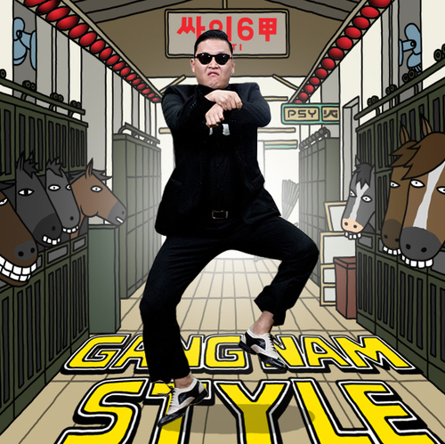
Signed Numbers
-1
0
+1
111…111
000…000
111…110
000…001
111…101
000…010
111…100
000…011
Negative numbers becoming less negative
(i.e. increasing)
Increasing positive numbers
…
…
Discontinuity means overflow possible here
100…010
011…101
100…001
011…110
100…000
011…111
≈+2billion
≈-2billion

Slide 67

Overflow In Practice: PSY
YouTube: “We never thought a video would be watched in numbers greater than a 32-bit integer (=2,147,483,647 views), but that was before we met PSY. "Gangnam Style" has been viewed so many times we had to upgrade to a 64-bit integer (9,223,372,036,854,775,808)!” [link]
“We saw this coming a couple months ago and updated our systems to prepare for it” [link]

Slide 68
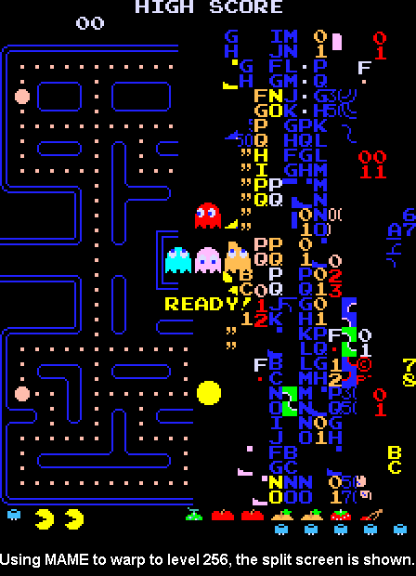
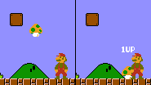
Overflow In Practice: Games
Super Mario Bros (NES):
losing all extra lives if you exceed 127
Impossible Pacman Level 256
Notes:
The level counter in the original Pac-Man is stored as an 8-bit integer, meaning the highest value it can hold is 255. The level counter starts with 0 internally, but for calculating the fruit counter it adds 1; however, because of overflow, adding 1 to 255 would result in 0, and the game tries to count fruits from 1, causing the game to attempt to draw 256 fruit to the screen until it overflows to 0.
Super Mario Bros. allows players to earn up to 127 lives, but (in the NES version only) earning more than that gives a Game Over in the next death due to a signed integer overflow.

Slide 69
Overflow In Practice
Many systems store timestamps as the number of seconds since Jan. 1, 1970 in a signed 32-bit integer.
Problem: the latest timestamp that can be represented this way is 3:14:07 UTC on Jan. 13 2038!
Casino erroneous slot machine payout ($42,949,672.76) due to overflow
Reported vulnerability CVE-2019-3857 in libssh2 may allow a hacker to remotely execute code
Apple CoreGraphics overflow bug exploited via iMessage, used in known spyware

Slide 70
Demo Revisited: Unexpected Behavior
Comair/Delta airline had to cancel thousands of flights days before Christmas because of integer overflow – they exceeded 32,767 crew changes (limit of short).
int main(int argc, char *argv[]) {
short airlineCrewChangesThisMonth = 0;
for (int i = 0; i < 31; i++) {
airlineCrewChangesThisMonth += 1200;
printf(...);
}
}

Slide 71
Recap
Integer Representations
Bits and Bytes
Hexadecimal
Unsigned Integers
Signed Integers
Overflow
Next time: How can we manipulate individual bits and bytes?
Lecture 3 takeaway: computers represent everything in binary. We must determine how to represent our data (e.g., base-10 numbers) in a binary format so a computer can manipulate it. There may be limitations to these representations! (overflow)

Slide 72
Extra Slides

Slide 73
Truncating Bit Representation
If we want to reduce the bit size of a number, C truncates the representation and discards the more significant bits.
int x = 53191;
short sx = x; // -12345!
x = 0000 0000 0000 0000 1100 1111 1100 0111
sx = 1100 1111 1100 0111

Slide 74
Truncating Bit Representation
If we want to reduce the bit size of a number, C truncates the representation and discards the more significant bits.
int x = -3;
short sx = x; // still -3
x = 1111 1111 1111 1111 1111 1111 1111 1101
sx = 1111 1111 1111 1101

Slide 75
Expanding Bit Representations
Sometimes, we want to carry over a value to a larger variable (e.g. make an int and set it equal to a short).
For unsigned values, C adds leading zeros to the representation (“zero extension”)
For signed values, C repeats the sign of the value for new digits (“sign extension”
Notes:
How can we convert an unsigned value?
How can we convert a signed value?

Slide 76
Expanding Bit Representation
If we want to expand the bit size of an unsigned number, C adds leading zeros.
unsigned short s = 4;
unsigned int i = s; // still 4
s = 0000 0000 0000 0100
i = 0000 0000 0000 0000 0000 0000 0000 0100

Slide 77
Expanding Bit Representation
If we want to expand the bit size of an signed number, C adds repeats the sign.
short s = -4;
int i = s; // still -4
s = 1111 1111 1111 1100
i = 1111 1111 1111 1111 1111 1111 1111 1100

Slide 78
Expanding Bit Representation
If we want to expand the bit size of an signed number, C adds repeats the sign.
short s = 4;
int i = s; // still 4
s = 0000 0000 0000 0100
i = 0000 0000 0000 0000 0000 0000 0000 0100

Slide 79
Practice: Two’s Complement
What are the negative or positive equivalents of the numbers below?
-4 (1100)
7 (0111)
3 (0011)
Notes:
0100
1001
1101

Slide 80
Practice: Two’s Complement
Fill in the below table:
It’s easier to compute base-10 for positive numbers, so use two’s complement first if negative.
 | char x = ____; |  | char y = -x;
 | decimal | binary | decimal | binary
1. |  | 0b1111 1100
2. |  | 0b0001 1000
3. |  | 0b0010 0100
4. |  | 0b1101 1111
🤔

Slide 81
Practice: Two’s Complement
Fill in the below table:
It’s easier to compute base-10 for positive numbers, so use two’s complement first if negative.
 | char x = ____; |  | char y = -x;
 | decimal | binary | decimal | binary
1. |  | 0b1111 1100
2. |  | 0b0001 1000
3. |  | 0b0010 0100
4. |  | 0b1101 1111
-4
4
0b0000 0100
🤔

Slide 82
Practice: Two’s Complement
Fill in the below table:
It’s easier to compute base-10 for positive numbers, so use two’s complement first if negative.
 | char x = ____; |  | char y = -x;
 | decimal | binary | decimal | binary
1. |  | 0b1111 1100
2. |  | 0b0001 1000
3. |  | 0b0010 0100
4. |  | 0b1101 1111
-4
24
36
-33
4
-24
-36
33
0b0000 0100
0b1110 1000
0b1101 1100
0b0010 0001

Slide 83
Underspecified question
What is the following base-2 number in base-10?
signed
0b1101
15
0
1
14
2
13
unsigned
3
12
4
11
5
10
6
9
8
7
🤔
Notes:
No overflow at x for signed numbers

Slide 84
Underspecified question
What is the following base-2 number in base-10?
signed
0b1101
15
0
1
14
2
If 4-bit signed: -3
If 4-bit unsigned: 13
If >4-bit signed or unsigned: 13
13
unsigned
3
12
4
11
5
10
6
9
8
7
You need to know the type to determine the number! (Note by default, numeric constants in C are signed ints)
Notes:
No overflow at x for signed numbers

Slide 85
Overflow
What is happening here? Assume 4-bit numbers.
signed
0b1101
+
0b0100
15
0
1
14
2
13
unsigned
3
12
4
11
5
10
6
9
8
7
🤔
Notes:
No overflow at x for signed numbers

Slide 86
Overflow
What is happening here? Assume 4-bit numbers.
signed
0b1101
+
0b0100
15
0
1
14
2
13
unsigned
3
12
4
Signed
-3 + 4 = 1
No overflow
Unsigned
13 + 4 = 1
Overflow
11
5
10
6
9
8
7
Notes:
No overflow at x for signed numbers

Slide 87
Limits and Comparisons
What is
the…
 | Largest unsigned? |  | Largest signed? | Smallest signed?
char
int
🤔

Slide 88
Limits and Comparisons
What is
the…
 | Largest unsigned? |  | Largest signed? | Smallest signed?
char
int
2⁸ - 1 = 255
2⁷ – 1 = 127
-2⁷ = -128
2³² - 1 =
4294967296
2³¹ - 1 =
2147483647
-2³¹ =
-2147483648
These are available as UCHAR_MAX, INT_MIN, INT_MAX, etc. in the <limits.h> header.

