Slide 1
CS107 Lecture 4
Bits and Bytes; Bitwise Operators
reading:
Bryant & O’Hallaron, Ch. 2.1

Slide 2
CS107 Topic 1
How can a computer represent integer numbers?
Why is answering this question important?
Helps us understand the limitations of computer arithmetic (last time)
Shows us how to more efficiently perform arithmetic (today)
Shows us how we can encode data more compactly and efficiently (today)
assign1: implement 3 programs that manipulate binary representations to (1) work around the limitations of arithmetic with addition, (2) simulate an evolving colony of cells, and (3) print Unicode text to the terminal.

Slide 3
Today
Today, we’ll learn about a new set of operators to manipulate bits. For example:
int x = 2;
// NEW: shift all bits X places to the left or right
x = x << 1; // now x is 4!
// NEW: check if the least significant bit is a 0
if (x & 1 == 0) {...
This is useful because we can perform some arithmetic more efficiently, and also store data more compactly in individual bits.

Slide 4
Learning Goals
Learn about the bitwise C operators and how to use them to manipulate bits
Understand when to use one bitwise operator vs. another in your program
Get practice with writing programs that manipulate binary representations

Slide 5
Lecture Plan
Recap and continuing: Integer Representations
Bitwise Operators
Bitmasks

Slide 6
Lecture Plan
Recap and continuing: Integer Representations
Bitwise Operators
Bitmasks

Slide 7
Bits and Bytes So Far
All data, including integer variables, are ultimately stored in memory in binary:
int x = 5; // really 0b0…0101 in memory!
Unsigned numbers store the direct binary representation of its value
Signed numbers use two’s complement to store its positive/negative/0 value
Overflow occurs when we exceed the the minimum or maximum value of the bit representation – it can cause some funky bugs!
  If an operation needs more bits to represent the result than we have, upper bits are lost

Slide 8
Base 10 vs. Binary vs. Hex
Let’s take a byte (8 bits):
165
Base-10: Human-readable,
but cannot easily interpret on/off bits
0b10100101
Base-2: Yes, computers use this,
but not human-readable
0xa5
Base-16: Easy to convert to Base-2,
More “portable” as a human-readable format
(fun fact: a half-byte is called a nibble or nybble)
Notes:
Each hexadecimal digit represents four bits (binary digits), also known as a nibble (or nybble), which is half a byte.

Slide 9
Overflow

Slide 10
Min and Max Integer Values
In C, there are various constants that represent these minimum and maximum values: INT_MIN, INT_MAX, UINT_MAX, LONG_MIN, LONG_MAX, ULONG_MAX, …

Slide 11
Truncating Bit Representation
If we want to reduce the bit size of a number, C truncates the representation and discards the more significant bits.
int x = 53191;
short sx = x; // -12345!
x = 0000 0000 0000 0000 1100 1111 1100 0111
sx = 1100 1111 1100 0111

Slide 12
Truncating Bit Representation
If we want to reduce the bit size of a number, C truncates the representation and discards the more significant bits.
int x = -3;
short sx = x; // still -3
x = 1111 1111 1111 1111 1111 1111 1111 1101
sx = 1111 1111 1111 1101

Slide 13
Expanding Bit Representations
Sometimes, we want to carry over a value to a larger variable (e.g. make an int and set it equal to a short).
For unsigned values, C adds leading zeros to the representation (“zero extension”)
For signed values, C repeats the sign of the value for new digits (“sign extension”)
Notes:
How can we convert an unsigned value?
How can we convert a signed value?

Slide 14
Expanding Bit Representation
If we want to expand the bit size of an unsigned number, C adds leading zeros.
unsigned short s = 4;
unsigned int i = s; // still 4
s = 0000 0000 0000 0100
i = 0000 0000 0000 0000 0000 0000 0000 0100

Slide 15
Expanding Bit Representation
If we want to expand the bit size of an signed number, C repeats the sign bit.
short s = 4;
int i = s; // still 4
s = 0000 0000 0000 0100
i = 0000 0000 0000 0000 0000 0000 0000 0100

Slide 16
Expanding Bit Representation
If we want to expand the bit size of an signed number, C repeats the sign bit.
short s = -4;
int i = s; // still -4
s = 1111 1111 1111 1100
i = 1111 1111 1111 1111 1111 1111 1111 1100

Slide 17
Casting
You can cast something to another type (treat as other type temporarily) by putting that type in parentheses in front of the value:
short s = -12345;
...(unsigned short)s...
Casting between variable types can cause tricky issues; the bits remain the same but are interpreted differently.
Here, s is -12345, but casted it is 53191! (1100 1111 1100 0111 in binary)

Slide 18
Casting
You can store the result as well:
short s = -12345;
unsigned short us = (unsigned short)s; // 53191!
You can also use the U suffix after a number literal to treat it as unsigned:
-12345U

Slide 19
Casting
Notes:
SECURITY CONCERNS! Left side means different things

Slide 20
Comparisons Between Different Types
Be careful when comparing signed and unsigned integers. C will implicitly cast the signed argument to unsigned, and then performs the operation assuming both numbers are non-negative.
int x = -1; // 1111 1111 1111 1111 1111 1111 1111 1111
unsigned int y = 0;
if (x < y) { ... // will be false!!
Note: when doing <, >, <=, >= comparison between different size types, it will promote to the larger type.

Slide 21
Lecture Plan
Recap and continuing: Integer Representations
Bitwise Operators
Bitmasks

Slide 22
Bitwise Operators
You’re already familiar with many operators in C:
  Arithmetic operators: +, -, *, /, %
  Comparison operators: ==, !=, <, >, <=, >=
  Logical Operators: &&, ||, !
Today, we’re introducing a new category of operators: bitwise operators:
  &, |, ~, ^, <<, >>

Slide 23
And (&)
AND is a binary operator. The AND of 2 bits is 1 if both bits are 1, and 0 otherwise.
output = a & b;
a | b | output
0 | 0 | 0
0 | 1 | 0
1 | 0 | 0
1 | 1 | 1
& with 1 to let a bit through, & with 0 to zero out a bit

Slide 24
Or (|)
OR is a binary operator. The OR of 2 bits is 1 if either (or both) bits is 1.
output = a | b;
a | b | output
0 | 0 | 0
0 | 1 | 1
1 | 0 | 1
1 | 1 | 1
| with 1 to turn on a bit, | with 0 to let a bit go through

Slide 25
Not (~)
NOT is a unary operator. The NOT of a bit is 1 if the bit is 0, or 1 otherwise.
output = ~a;
a | output
0 | 1
1 | 0

Slide 26
Exclusive Or (^)
Exclusive Or (XOR) is a binary operator. The XOR of 2 bits is 1 if exactly one of the bits is 1, or 0 otherwise.
output = a ^ b;
a | b | output
0 | 0 | 0
0 | 1 | 1
1 | 0 | 1
1 | 1 | 0
^ with 1 to flip a bit, ^ with 0 to let a bit go through

Slide 27
Operators on Multiple Bits
When these operators are applied to numbers (multiple bits), the operator is applied to the corresponding bits in each number. For example:
AND
OR
XOR
NOT
0110
& 1100
----
0100
0110
| 1100
----
1110
0110
^ 1100
----
1010
~ 1100
----
0011

Slide 28
Bit Operators
int x = 6; // 0000 ... 0110
int y = 5; // 0000 ... 0101
// 4
int anded = x & y; // 0000 ... 0100
// 7
int ored = x | y; // 0000 ... 0111
// -7
int notX = ~x; // 1111 ... 1111 1111 1001
int xored = x ^ y; // what would this give us?

Slide 29
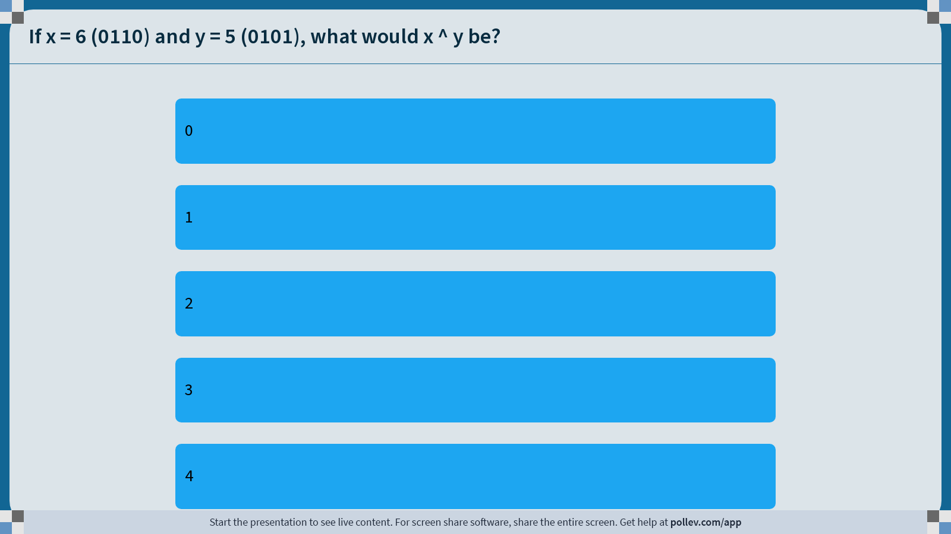
Notes:
Do not modify the notes in this section to avoid tampering with the Poll Everywhere activity.
More info at polleverywhere.com/support
If x = 6 (0110) and y = 5 (0101), what would x ^ y be?
https://www.polleverywhere.com/multiple_choice_polls/v2TvFTzgYyfsRkjAMgd1H?display_state=instructions&activity_state=opened&state=opened&flow=Instructor&onscreen=persist

Slide 30
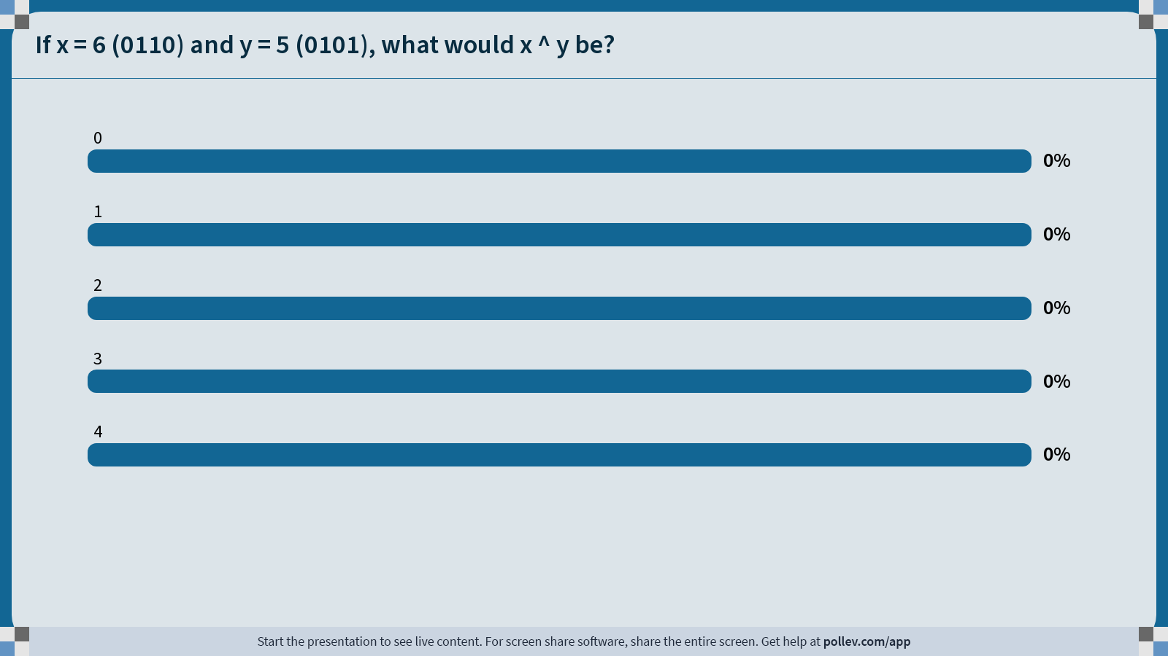
Notes:
Do not modify the notes in this section to avoid tampering with the Poll Everywhere activity.
More info at polleverywhere.com/support
If x = 6 (0110) and y = 5 (0101), what would x ^ y be?
https://www.polleverywhere.com/multiple_choice_polls/v2TvFTzgYyfsRkjAMgd1H?display_state=chart&activity_state=closed&state=closed&flow=Instructor&onscreen=persist

Slide 31
Notes:
Do not modify the notes in this section to avoid tampering with the Poll Everywhere activity.
More info at polleverywhere.com/support
If x = 6 (0110) and y = 5 (0101), what would x ^ y be?
https://www.polleverywhere.com/multiple_choice_polls/v2TvFTzgYyfsRkjAMgd1H?display_state=chart&activity_state=closed&display=correctness&state=closed&flow=Instructor&onscreen=persist

Slide 32
Operators on Multiple Bits
When these operators are applied to numbers (multiple bits), the operator is applied to the corresponding bits in each number. For example:
AND
OR
XOR
NOT
0110
& 1100
----
0100
0110
| 1100
----
1110
0110
^ 1100
----
1010
~ 1100
----
0011
Note: these are different from the logical operators AND (&&), OR (||) and NOT (!).

Slide 33
Bit Operators
int x = 4; // 0000 ... 0100
int y = 5; // 0000 ... 0101
// This is checking if x and y are both nonzero
if (x && y) { …
// This is checking if the result of x & y is nonzero
if (x & y) { …

Slide 34
Lecture Plan
Recap and continuing: Integer Representations
Bitwise Operators
Bitmasks

Slide 35
Bitmasks
We will frequently want to manipulate or isolate out specific bits in a larger collection of bits.
Motivating Example: Bit vectors

Slide 36
Bit Vectors and Sets
Instead of using arrays of e.g., Booleans in our programs, sometimes it’s beneficial to store that information in bits instead – more compact.
Example: we can represent current courses taken using a char and manipulate its contents using bit operators.
0 | 0 | 1 | 0 | 0 | 0 | 1 | 1
CS161
CS109
CS103
CS111
CS107
CS107E
CS106B
CS106A

Slide 37
Bit Masking
#define CS106A 0x1 /* 0000 0001 */
#define CS106B 0x2 /* 0000 0010 */
#define CS107E 0x4 /* 0000 0100 */
#define CS107 0x8 /* 0000 1000 */
#define CS111 0x10 /* 0001 0000 */
#define CS103 0x20 /* 0010 0000 */
#define CS109 0x40 /* 0100 0000 */
#define CS161 0x80 /* 1000 0000 */
// Bit pattern: 0000 1011
unsigned char myClasses = CS106A | CS106B | CS107;

Slide 38
Bit Vectors and Sets
0 | 0 | 1 | 0 | 0 | 0 | 1 | 1
CS161
CS109
CS103
CS111
CS107
CS107E
CS106B
CS106A
How do we find the union of two sets of courses taken? Use OR:
00100011
| 01100001
--------
01100011

Slide 39
Bit Masking
#define CS106A 0x1 /* 0000 0001 */
#define CS106B 0x2 /* 0000 0010 */
#define CS107E 0x4 /* 0000 0100 */
#define CS107 0x8 /* 0000 1000 */
#define CS111 0x10 /* 0001 0000 */
#define CS103 0x20 /* 0010 0000 */
#define CS109 0x40 /* 0100 0000 */
#define CS161 0x80 /* 1000 0000 */
unsigned char myClasses = CS106A | CS106B | CS107;
unsigned char otherClasses = CS106A | CS106B | CS103;
// 0010 1011
unsigned char either = myClasses | otherClasses;

Slide 40
Bit Vectors and Sets
0 | 0 | 1 | 0 | 0 | 0 | 1 | 1
CS161
CS109
CS103
CS111
CS107
CS107E
CS106B
CS106A
How do we find the intersection of two sets of courses taken? Use AND:
00100011
& 01100001
--------
00100001

Slide 41
Bit Masking
Example: how do we update our bit vector to indicate we’ve taken CS107?
0 | 0 | 1 | 0 | 0 | 0 | 1 | 1
CS161
CS109
CS103
CS111
CS107
CS107E
CS106B
CS106A
00100011
| 00001000
--------
00101011

Slide 42
Bit Masking
Example: how do we update our bit vector to indicate we’ve taken CS107?
A bitmask is a constructed bit pattern that we can use, along with bit operators, to manipulate a value.
0 | 0 | 1 | 0 | 0 | 0 | 1 | 1
CS161
CS109
CS103
CS111
CS107
CS107E
CS106B
CS106A
00100011
| 00001000
--------
00101011

Slide 43
Bit Masking
#define CS106A 0x1 /* 0000 0001 */
#define CS106B 0x2 /* 0000 0010 */
#define CS107E 0x4 /* 0000 0100 */
#define CS107 0x8 /* 0000 1000 */
#define CS111 0x10 /* 0001 0000 */
#define CS103 0x20 /* 0010 0000 */
#define CS109 0x40 /* 0100 0000 */
#define CS161 0x80 /* 1000 0000 */
char myClasses = ...;
myClasses = myClasses | CS107; // Add CS107

Slide 44
Bit Masking
#define CS106A 0x1 /* 0000 0001 */
#define CS106B 0x2 /* 0000 0010 */
#define CS107E 0x4 /* 0000 0100 */
#define CS107 0x8 /* 0000 1000 */
#define CS111 0x10 /* 0001 0000 */
#define CS103 0x20 /* 0010 0000 */
#define CS109 0x40 /* 0100 0000 */
#define CS161 0x80 /* 1000 0000 */
char myClasses = ...;
myClasses |= CS107; // Add CS107

Slide 45
Bit Masking
Example: how do we update our bit vector to indicate we’ve not taken CS103?
0 | 0 | 1 | 0 | 0 | 0 | 1 | 1
CS161
CS109
CS103
CS111
CS107
CS107E
CS106B
CS106A
00100011
& 11011111
--------
00000011
What operator is good for turning off certain bits?
What mask do we want?
How do we create that mask?
char myClasses = ...;
myClasses = myClasses & ~CS103; // Remove CS103

Slide 46
Bit Masking
Example: how do we update our bit vector to indicate we’ve not taken CS103?
0 | 0 | 1 | 0 | 0 | 0 | 1 | 1
CS161
CS109
CS103
CS111
CS107
CS107E
CS106B
CS106A
00100011
& 11011111
--------
00000011
char myClasses = ...;
myClasses &= ~CS103; // Remove CS103

Slide 47
Bit Masking
Example: how do we check if we’ve taken CS106B?
0 | 0 | 1 | 0 | 0 | 0 | 1 | 1
CS161
CS109
CS103
CS111
CS107
CS107E
CS106B
CS106A
00100011
& 00000010
--------
00000010
char myClasses = ...;
if (myClasses & CS106B) {...
// taken CS106B!
Notes:
Booleans are just nonzero!

Slide 48
Bit Masking
Example: how do we check if we’ve not taken CS107?
0 | 0 | 1 | 0 | 0 | 0 | 1 | 1
CS161
CS109
CS103
CS111
CS107
CS107E
CS106B
CS106A
00100011
& 00001000
--------
00000000
char myClasses = ...;
if (!(myClasses & CS107)) {...
// not taken CS107!

Slide 49
Bitwise Operator Tricks
| with 1 is useful for turning select bits on
& with 0 is useful for turning select bits off
| is useful for taking the union of bits
& is useful for taking the intersection of bits
^ is useful for flipping select bits
~ is useful for flipping all bits
3 Step Process:
What operator is good for the task we are trying to do?
What mask do we need for this operation?
How do we create that mask?

Slide 50
Recap
Recap and continuing: Integer Representations
Bitwise Operators
Bitmasks
Lecture 4 takeaways: We can use bit operators like &, |, ~, etc. to manipulate the binary representation of values. A number is a bit pattern that can be manipulated arithmetically or bitwise at your convenience!

Slide 51
Extra Practice

Slide 52
Hexadecimal and Truncation
For each initialization of x, what will be printed?
  x = 130; // 0x82
  x = -132; // 0xff7c
  x = 25; // 0x19
short x = ______; char cx = x;
printf("%d", cx);
🤔
Notes:
-126
124
25

Slide 53
Hexadecimal and Truncation
For each initialization of x, what will be printed?
  x = 130; // 0x82
  x = -132; // 0xff7c
  x = 25; // 0x19
-126
124
short x = ______; char cx = x;
printf("%d", cx);
25
Notes:
-126
124
25

Slide 54
Limits and Comparisons
Will the following char comparisons evaluate to true or false?
  -7 < 4
  -7 < 4U
true
  (char) 130 > 4
  (char) -132 > 2
false
false
true
By default, numeric constants in C are signed ints, unless they are suffixed with u (unsigned) or L (long).

Slide 55
Bitwise Warmup
How can we use bitmasks + bitwise operators to…
…turn on a particular
set of bits?
0b00001101
…turn off a particular
set of bits?
…flip a particular
set of bits?
0b00001101
0b00001101
0b00001101
0b00001111
0b00001001
0b00001011
🤔

Slide 56
Bitwise Warmup
How can we use bitmasks + bitwise operators to…
…turn on a particular
set of bits?
0b00001101
…turn off a particular
set of bits?
…flip a particular
set of bits?
OR
AND
XOR
0b00001101
0b00001101
0b00001101
0b00000010 |
0b11111011 &
0b00000110 ^
0b00001111
0b00001001
0b00001011

