Slide 1
CS107, Lecture 6
C Strings
Reading: K&R (1.9, 5.5, Appendix B3) or Essential C section 3

Slide 2
CS107 Topic 2: How can a computer represent and manipulate more complex data like text?

Slide 3
CS107 Topic 2
How can a computer represent and manipulate more complex data like text?
Why is answering this question important?
Shows us how strings are represented in C and other languages (this time)
Helps us better understand buffer overflows, a common bug (this time)
Introduces us to pointers, because strings can be pointers (next time)
assign2: implement 2 functions and 1 program using those functions to find the location of different built-in commands in the filesystem. You’ll write functions to extract a list of possible locations and tokenize that list of locations.

Slide 4
Learning Goals
Learn how strings are represented in C; as an array of null-terminated characters.
Understand how to use the built-in string functions for common string tasks
Learn about buffer overflow and what might cause it

Slide 5

Goal: String Diamond
Write a function diamond that accepts a string parameter and prints its letters in a "diamond" format as shown below.
For example, diamond("BAILEY") should print:
  B
  BA
  BAI
  BAIL
  BAILE
  BAILEY
  AILEY
  ILEY
  LEY
  EY
  Y

Slide 6
Lecture Plan
Characters
Strings
Common String Operations
    Comparing
    Copying
    Concatenating
    Substrings
cp -r /afs/ir/class/cs107/lecture-code/lect6 .

Slide 7
Lecture Plan
Characters
Strings
Common String Operations
    Comparing
    Copying
    Concatenating
    Substrings
cp -r /afs/ir/class/cs107/lecture-code/lect6 .

Slide 8
Char
A char is a variable type that represents a single character or “glyph”.
char letterA = 'A';
char plus = '+';
char zero = '0';
char space = ' ';
char newLine = '\n';
char tab = '\t';
char singleQuote = '\'';
char backSlash = '\\';

Slide 9
ASCII
Under the hood, C represents each char as an integer (its “ASCII value”).
Uppercase letters are sequentially numbered
Lowercase letters are sequentially numbered
Digits are sequentially numbered
Lowercase letters are 32 more than their uppercase equivalents (cool trick – can bit flip!)
char uppercaseA = 'A'; // Actually 65
char lowercaseA = 'a'; // Actually 97
char zeroDigit = '0’; // Actually 48

Slide 10
ASCII
We can take advantage of C representing each char as an integer:
bool areEqual = 'A' == 'A'; // true
bool earlierLetter = 'f' < 'c'; // false
char uppercaseB = 'A' + 1;
int diff = 'c' - 'a'; // 2
int numLettersInAlphabet = 'z' – 'a' + 1;
// or
int numLettersInAlphabet = 'Z' – 'A' + 1;

Slide 11
ASCII
We can take advantage of C representing each char as an integer:
// prints out every lowercase character
for (char ch = 'a'; ch <= 'z'; ch++) {
printf("%c", ch);
}

Slide 12
Common ctype.h Functions
Function | Description
isalpha(ch) | true if ch is 'a' through 'z' or 'A' through 'Z'
islower(ch) | true if ch is 'a' through 'z'
isupper(ch) | true if ch is 'A' through 'Z'
isspace(ch) | true if ch is a space, tab, new line, etc.
isdigit(ch) | true if ch is '0' through '9'
toupper(ch) | returns uppercase equivalent of a letter
tolower(ch) | returns lowercase equivalent of a letter
Remember: these return a char; they cannot modify an existing char!
More documentation with man isalpha, man tolower

Slide 13
Common ctype.h Functions
bool isLetter = isalpha('A'); // true
bool capital = isupper('f'); // false
char uppercaseB = toupper('b');
bool isADigit = isdigit('4'); // true

Slide 14
Lecture Plan
Characters
Strings
Common String Operations
    Comparing
    Copying
    Concatenating
    Substrings
cp -r /afs/ir/class/cs107/lecture-code/lect6 .

Slide 15
C Strings
C has no dedicated variable type for strings. Instead, a string is represented as an array of characters with a special ending sentinel value.
'\0' is the null-terminating character; you always need to allocate one extra space in an array for it. '\0' is the character with numerical value 0. (Note: different from NULL – NULL is 0 pointer, null terminator is 0 character).
index | 0 | 1 | 2 | 3 | 4 | 5
char | 'H' | 'e' | 'l' | 'l' | 'o' | '\0'
"Hello"

Slide 16
C Strings
char myString[6];
myString[0] = 'H';
myString[1] = 'e';
myString[2] = 'l';
…
myString[5] = '\0';

Slide 17
String Length
Strings are not objects. They do not embed additional information (e.g., string length). We must calculate this!
We can use the provided strlen function to calculate string length. The null-terminating character does not count towards the length.
int length = strlen(myStr); // e.g. 13
index | 0 | 1 | 2 | 3 | 4 | 5 | 6 | 7 | 8 | 9 | 10 | 11 | 12 | 13
value | 'H' | 'e' | 'l' | 'l' | 'o' | ',' | ' ' | 'w' | 'o' | 'r' | 'l' | 'd' | '!' | '\0'
Caution: strlen is O(N) because it must scan the entire string! Tip: save the value if you plan to refer to the length later.

Slide 18
C Strings As Parameters
When we pass a string as a parameter, it is passed as a char *. C passes the location of the first character rather than a copy of the whole array.
int doSomething(char *str) {
...
}
char myString[6];
...
doSomething(myString);

Slide 19
C Strings As Parameters
When we pass a string as a parameter, it is passed as a char *. C passes the location of the first character rather than a copy of the whole array.
int doSomething(char *str) {
...
str[0] = 'c'; // modifies original string!
printf("%s\n", str); // prints cello
}
char myString[6];
... // e.g. this string is “Hello”
doSomething(myString);
We can still use a char * the same way as a char[].

Slide 20
Lecture Plan
Characters
Strings
Common String Operations
    Comparing
    Copying
    Concatenating
    Substrings
cp -r /afs/ir/class/cs107/lecture-code/lect6 .

Slide 21
Common string.h Functions
Function | Description
strlen(str) | returns the # of chars in a C string (before null-terminating character).
strcmp(str1, str2), strncmp(str1, str2, n) | compares two strings; returns 0 if identical, <0 if str1 comes before str2 in alphabet, >0 if str1 comes after str2 in alphabet. strncmp stops comparing after at most n characters.
strchr(str, ch) strrchr(str, ch) | character search: returns a pointer to the first occurrence of ch in str, or NULL if ch was not found in str. strrchr find the last occurrence.
strstr(haystack, needle) | string search: returns a pointer to the start of the first occurrence of needle in haystack, or NULL if needle was not found in haystack.
strcpy(dst, src), strncpy(dst, src, n) | copies characters in src to dst, including null-terminating character. Assumes enough space in dst. Strings must not overlap. strncpy stops after at most n chars, and does not add null-terminating char.
strcat(dst, src), strncat(dst, src, n) | concatenate src onto the end of dst. strncat stops concatenating after at most n characters. Always adds a null-terminating character.
strspn(str, accept), strcspn(str, reject) | strspn returns the length of the initial part of str which contains only characters in accept. strcspn returns the length of the initial part of str which does not contain any characters in reject.
Notes:
Man pages work too!

Slide 22
Common string.h Functions
Function | Description
strlen(str) | returns the # of chars in a C string (before null-terminating character).
strcmp(str1, str2), strncmp(str1, str2, n) | compares two strings; returns 0 if identical, <0 if str1 comes before str2 in alphabet, >0 if str1 comes after str2 in alphabet. strncmp stops comparing after at most n characters.
strchr(str, ch) strrchr(str, ch) | character search: returns a pointer to the first occurrence of ch in str, or NULL if ch was not found in str. strrchr find the last occurrence.
strstr(haystack, needle) | string search: returns a pointer to the start of the first occurrence of needle in haystack, or NULL if needle was not found in haystack.
strcpy(dst, src), strncpy(dst, src, n) | copies characters in src to dst, including null-terminating character. Assumes enough space in dst. Strings must not overlap. strncpy stops after at most n chars, and does not add null-terminating char.
strcat(dst, src), strncat(dst, src, n) | concatenate src onto the end of dst. strncat stops concatenating after at most n characters. Always adds a null-terminating character.
strspn(str, accept), strcspn(str, reject) | strspn returns the length of the initial part of str which contains only characters in accept. strcspn returns the length of the initial part of str which does not contain any characters in reject.
Many string functions assume valid string input; i.e., ends in a null terminator.
Notes:
Man pages work too!

Slide 23
Comparing Strings
We cannot compare C strings using comparison operators like ==, < or >. This compares addresses!
// e.g. str1 = 0x7f42, str2 = 0x654d
void doSomething(char *str1, char *str2) {
if (str1 > str2) { … // compares 0x7f42 > 0x654d!
Instead, use strcmp.

Slide 24
The string library: strcmp
strcmp(str1, str2): compares two strings.
returns 0 if identical
<0 if str1 comes before str2 in alphabet
>0 if str1 comes after str2 in alphabet.
int compResult = strcmp(str1, str2);
if (compResult == 0) {
// equal
} else if (compResult < 0) {
// str1 comes before str2
} else {
// str1 comes after str2
}
$ ./strcmp_ex cat camel 2
String "cat" comes after "camel" in the alphabet.
Up to character 2, "cat" is the same as "camel" in the alphabet.

Slide 25
Copying Strings
We cannot copy C strings using =. This copies addresses!
// e.g. param1 = 0x7f42, param2 = 0x654d
void doSomething(char *param1, char *param2) {
param1 = param2; // copies 0x654d. Points to same string!
param2[0] = 'H'; // modifies the one original string!
Instead, use strcpy.
Notes:
To make a copy of a string, we need to copy its actual characters

Slide 26
The string library: strcpy
strcpy(dst, src): copies the contents of src into the string dst, including the null terminator. (Note: string literal has automatic ending null terminator)
char str1[6];
strcpy(str1, "hello");
char str2[6];
strcpy(str2, str1);
str2[0] = 'c';
printf("%s", str1); // hello
printf("%s", str2); // cello
$ ./strcmp_ex cat camel 2
String "cat" comes after "camel" in the alphabet.
Up to character 2, "cat" is the same as "camel" in the alphabet.
Notes:
String literals have implied null terminator
What are you making a copy of? Characters vs. pointer

Slide 27
Copying Strings - strcpy
We must make sure there is enough space in the destination to hold the entire copy, including the null-terminating character.
char str2[6]; // not enough space!
strcpy(str2, "hello, world!"); // overwrites other memory!
Writing past memory bounds is called a “buffer overflow”. It can allow for security vulnerabilities!

Slide 28
Copying Strings – Buffer Overflows
char str1[14];
strcpy(str1, "hello, world!");
char str2[6];
strcpy(str2, str1); // not enough space - overwrites other memory!
0 | 1 | 2 | 3 | 4 | 5 | 6 | 7 | 8 | 9 | 10 | 11 | 12 | 13
'h' | 'e' | 'l' | 'l' | 'o' | ',' | ' ' | 'w' | 'o' | 'r' | 'l' | 'd' | '!' | '\0'
str1
0 | 1 | 2 | 3 | 4 | 5
? | ? | ? | ? | ? | ?
str2
- other program memory -

Slide 29
Copying Strings – Buffer Overflows
char str1[14];
strcpy(str1, "hello, world!");
char str2[6];
strcpy(str2, str1); // not enough space - overwrites other memory!
0 | 1 | 2 | 3 | 4 | 5 | 6 | 7 | 8 | 9 | 10 | 11 | 12 | 13
'h' | 'e' | 'l' | 'l' | 'o' | ',' | ' ' | 'w' | 'o' | 'r' | 'l' | 'd' | '!' | '\0'
str1
0 | 1 | 2 | 3 | 4 | 5
'h' | ? | ? | ? | ? | ?
str2
- other program memory -

Slide 30
Copying Strings – Buffer Overflows
char str1[14];
strcpy(str1, "hello, world!");
char str2[6];
strcpy(str2, str1); // not enough space - overwrites other memory!
0 | 1 | 2 | 3 | 4 | 5 | 6 | 7 | 8 | 9 | 10 | 11 | 12 | 13
'h' | 'e' | 'l' | 'l' | 'o' | ',' | ' ' | 'w' | 'o' | 'r' | 'l' | 'd' | '!' | '\0'
str1
0 | 1 | 2 | 3 | 4 | 5
'h' | 'e' | ? | ? | ? | ?
str2
- other program memory -

Slide 31
Copying Strings – Buffer Overflows
char str1[14];
strcpy(str1, "hello, world!");
char str2[6];
strcpy(str2, str1); // not enough space - overwrites other memory!
0 | 1 | 2 | 3 | 4 | 5 | 6 | 7 | 8 | 9 | 10 | 11 | 12 | 13
'h' | 'e' | 'l' | 'l' | 'o' | ',' | ' ' | 'w' | 'o' | 'r' | 'l' | 'd' | '!' | '\0'
str1
0 | 1 | 2 | 3 | 4 | 5
'h' | 'e' | 'l' | ? | ? | ?
str2
- other program memory -

Slide 32
Copying Strings – Buffer Overflows
char str1[14];
strcpy(str1, "hello, world!");
char str2[6];
strcpy(str2, str1); // not enough space - overwrites other memory!
0 | 1 | 2 | 3 | 4 | 5 | 6 | 7 | 8 | 9 | 10 | 11 | 12 | 13
'h' | 'e' | 'l' | 'l' | 'o' | ',' | ' ' | 'w' | 'o' | 'r' | 'l' | 'd' | '!' | '\0'
str1
0 | 1 | 2 | 3 | 4 | 5
'h' | 'e' | 'l' | 'l' | ? | ?
str2
- other program memory -

Slide 33
Copying Strings – Buffer Overflows
char str1[14];
strcpy(str1, "hello, world!");
char str2[6];
strcpy(str2, str1); // not enough space - overwrites other memory!
0 | 1 | 2 | 3 | 4 | 5 | 6 | 7 | 8 | 9 | 10 | 11 | 12 | 13
'h' | 'e' | 'l' | 'l' | 'o' | ',' | ' ' | 'w' | 'o' | 'r' | 'l' | 'd' | '!' | '\0'
str1
0 | 1 | 2 | 3 | 4 | 5
'h' | 'e' | 'l' | 'l' | 'o' | ?
str2
- other program memory -

Slide 34
Copying Strings – Buffer Overflows
char str1[14];
strcpy(str1, "hello, world!");
char str2[6];
strcpy(str2, str1); // not enough space - overwrites other memory!
0 | 1 | 2 | 3 | 4 | 5 | 6 | 7 | 8 | 9 | 10 | 11 | 12 | 13
'h' | 'e' | 'l' | 'l' | 'o' | ',' | ' ' | 'w' | 'o' | 'r' | 'l' | 'd' | '!' | '\0'
str1
0 | 1 | 2 | 3 | 4 | 5
'h' | 'e' | 'l' | 'l' | 'o' | ','
str2
- other program memory -

Slide 35
Copying Strings – Buffer Overflows
char str1[14];
strcpy(str1, "hello, world!");
char str2[6];
strcpy(str2, str1); // not enough space - overwrites other memory!
0 | 1 | 2 | 3 | 4 | 5 | 6 | 7 | 8 | 9 | 10 | 11 | 12 | 13
'h' | 'e' | 'l' | 'l' | 'o' | ',' | ' ' | 'w' | 'o' | 'r' | 'l' | 'd' | '!' | '\0'
str1
0 | 1 | 2 | 3 | 4 | 5
'h' | 'e' | 'l' | 'l' | 'o' | ','
' '
str2
- other program memory -

Slide 36
Copying Strings – Buffer Overflows
char str1[14];
strcpy(str1, "hello, world!");
char str2[6];
strcpy(str2, str1); // not enough space - overwrites other memory!
0 | 1 | 2 | 3 | 4 | 5 | 6 | 7 | 8 | 9 | 10 | 11 | 12 | 13
'h' | 'e' | 'l' | 'l' | 'o' | ',' | ' ' | 'w' | 'o' | 'r' | 'l' | 'd' | '!' | '\0'
str1
0 | 1 | 2 | 3 | 4 | 5
'h' | 'e' | 'l' | 'l' | 'o' | ','
' ' | 'w'
str2
- other program memory -

Slide 37
Copying Strings – Buffer Overflows
char str1[14];
strcpy(str1, "hello, world!");
char str2[6];
strcpy(str2, str1); // not enough space - overwrites other memory!
0 | 1 | 2 | 3 | 4 | 5 | 6 | 7 | 8 | 9 | 10 | 11 | 12 | 13
'h' | 'e' | 'l' | 'l' | 'o' | ',' | ' ' | 'w' | 'o' | 'r' | 'l' | 'd' | '!' | '\0'
str1
0 | 1 | 2 | 3 | 4 | 5
'h' | 'e' | 'l' | 'l' | 'o' | ','
' ' | 'w' | 'o'
str2
- other program memory -

Slide 38
Copying Strings – Buffer Overflows
char str1[14];
strcpy(str1, "hello, world!");
char str2[6];
strcpy(str2, str1); // not enough space - overwrites other memory!
0 | 1 | 2 | 3 | 4 | 5 | 6 | 7 | 8 | 9 | 10 | 11 | 12 | 13
'h' | 'e' | 'l' | 'l' | 'o' | ',' | ' ' | 'w' | 'o' | 'r' | 'l' | 'd' | '!' | '\0'
str1
0 | 1 | 2 | 3 | 4 | 5
'h' | 'e' | 'l' | 'l' | 'o' | ','
' ' | 'w' | 'o' | 'r'
str2
- other program memory -

Slide 39
Copying Strings – Buffer Overflows
char str1[14];
strcpy(str1, "hello, world!");
char str2[6];
strcpy(str2, str1); // not enough space - overwrites other memory!
0 | 1 | 2 | 3 | 4 | 5 | 6 | 7 | 8 | 9 | 10 | 11 | 12 | 13
'h' | 'e' | 'l' | 'l' | 'o' | ',' | ' ' | 'w' | 'o' | 'r' | 'l' | 'd' | '!' | '\0'
str1
0 | 1 | 2 | 3 | 4 | 5
'h' | 'e' | 'l' | 'l' | 'o' | ','
' ' | 'w' | 'o' | 'r' | 'l'
str2
- other program memory -

Slide 40
Copying Strings – Buffer Overflows
char str1[14];
strcpy(str1, "hello, world!");
char str2[6];
strcpy(str2, str1); // not enough space - overwrites other memory!
0 | 1 | 2 | 3 | 4 | 5 | 6 | 7 | 8 | 9 | 10 | 11 | 12 | 13
'h' | 'e' | 'l' | 'l' | 'o' | ',' | ' ' | 'w' | 'o' | 'r' | 'l' | 'd' | '!' | '\0'
str1
0 | 1 | 2 | 3 | 4 | 5
'h' | 'e' | 'l' | 'l' | 'o' | ','
' ' | 'w' | 'o' | 'r' | 'l' | 'd'
str2
- other program memory -

Slide 41
Copying Strings – Buffer Overflows
char str1[14];
strcpy(str1, "hello, world!");
char str2[6];
strcpy(str2, str1); // not enough space - overwrites other memory!
0 | 1 | 2 | 3 | 4 | 5 | 6 | 7 | 8 | 9 | 10 | 11 | 12 | 13
'h' | 'e' | 'l' | 'l' | 'o' | ',' | ' ' | 'w' | 'o' | 'r' | 'l' | 'd' | '!' | '\0'
str1
0 | 1 | 2 | 3 | 4 | 5
'h' | 'e' | 'l' | 'l' | 'o' | ','
' ' | 'w' | 'o' | 'r' | 'l' | 'd' | '!'
str2
- other program memory -

Slide 42
Copying Strings – Buffer Overflows
char str1[14];
strcpy(str1, "hello, world!");
char str2[6];
strcpy(str2, str1); // not enough space - overwrites other memory!
0 | 1 | 2 | 3 | 4 | 5 | 6 | 7 | 8 | 9 | 10 | 11 | 12 | 13
'h' | 'e' | 'l' | 'l' | 'o' | ',' | ' ' | 'w' | 'o' | 'r' | 'l' | 'd' | '!' | '\0'
str1
0 | 1 | 2 | 3 | 4 | 5
'h' | 'e' | 'l' | 'l' | 'o' | ','
' ' | 'w' | 'o' | 'r' | 'l' | 'd' | '!' | '\0'
str2
- other program memory -

Slide 43
Copying Strings – Buffer Overflows
char str1[14];
strcpy(str1, "hello, world!");
char str2[6];
strcpy(str2, str1); // not enough space - overwrites other memory!
0 | 1 | 2 | 3 | 4 | 5 | 6 | 7 | 8 | 9 | 10 | 11 | 12 | 13
'h' | 'e' | 'l' | 'l' | 'o' | ',' | ' ' | 'w' | 'o' | 'r' | 'l' | 'd' | '!' | '\0'
str1
0 | 1 | 2 | 3 | 4 | 5
'h' | 'e' | 'l' | 'l' | 'o' | ','
' ' | 'w' | 'o' | 'r' | 'l' | 'd' | '!' | '\0'
str2
- other program memory -

Slide 44
Copying Strings - strncpy
strncpy(dst, src, n): copies at most the first n bytes from src into the string dst. If there is no null-terminating character in these bytes, then dst will not be null terminated!
// copying "hello"
char str2[5];
strncpy(str2, "hello, world!", 5); // doesn’t copy '\0'!
If there is no null-terminating character, we may not be able to tell where the end of the string is anymore. E.g. strlen may continue reading into some other memory in search of '\0'!

Slide 45
Copying Strings - strncpy
char str2[5];
strncpy(str2, "hello, world!", 5);
int length = strlen(str2);
0 | 1 | 2 | 3 | 4 | 5 | 6 | 7 | 8 | 9 | 10 | 11 | 12 | 13
'h' | 'e' | 'l' | 'l' | 'o' | ',' | ' ' | 'w' | 'o' | 'r' | 'l' | 'd' | '!' | '\0'
str1
0 | 1 | 2 | 3 | 4
? | ? | ? | ? | ?
str2
- other program memory -

Slide 46
Copying Strings - strncpy
char str2[5];
strncpy(str2, "hello, world!", 5);
int length = strlen(str2);
0 | 1 | 2 | 3 | 4 | 5 | 6 | 7 | 8 | 9 | 10 | 11 | 12 | 13
'h' | 'e' | 'l' | 'l' | 'o' | ',' | ' ' | 'w' | 'o' | 'r' | 'l' | 'd' | '!' | '\0'
str1
0 | 1 | 2 | 3 | 4
'h' | 'e' | 'l' | 'l' | 'o'
str2
- other program memory -

Slide 47
Copying Strings - strncpy
char str2[5];
strncpy(str2, "hello, world!", 5);
int length = strlen(str2);
0 | 1 | 2 | 3 | 4 | 5 | 6 | 7 | 8 | 9 | 10 | 11 | 12 | 13
'h' | 'e' | 'l' | 'l' | 'o' | ',' | ' ' | 'w' | 'o' | 'r' | 'l' | 'd' | '!' | '\0'
str1
0 | 1 | 2 | 3 | 4
'h' | 'e' | 'l' | 'l' | 'o'
str2
- other program memory -

Slide 48
Copying Strings - strncpy
char str2[5];
strncpy(str2, "hello, world!", 5);
int length = strlen(str2);
0 | 1 | 2 | 3 | 4 | 5 | 6 | 7 | 8 | 9 | 10 | 11 | 12 | 13
'h' | 'e' | 'l' | 'l' | 'o' | ',' | ' ' | 'w' | 'o' | 'r' | 'l' | 'd' | '!' | '\0'
str1
0 | 1 | 2 | 3 | 4
'h' | 'e' | 'l' | 'l' | 'o'
str2
- other program memory -

Slide 49
Copying Strings - strncpy
char str2[5];
strncpy(str2, "hello, world!", 5);
int length = strlen(str2);
0 | 1 | 2 | 3 | 4 | 5 | 6 | 7 | 8 | 9 | 10 | 11 | 12 | 13
'h' | 'e' | 'l' | 'l' | 'o' | ',' | ' ' | 'w' | 'o' | 'r' | 'l' | 'd' | '!' | '\0'
str1
0 | 1 | 2 | 3 | 4
'h' | 'e' | 'l' | 'l' | 'o'
str2
- other program memory -

Slide 50
Copying Strings - strncpy
char str2[5];
strncpy(str2, "hello, world!", 5);
int length = strlen(str2);
0 | 1 | 2 | 3 | 4 | 5 | 6 | 7 | 8 | 9 | 10 | 11 | 12 | 13
'h' | 'e' | 'l' | 'l' | 'o' | ',' | ' ' | 'w' | 'o' | 'r' | 'l' | 'd' | '!' | '\0'
str1
0 | 1 | 2 | 3 | 4
'h' | 'e' | 'l' | 'l' | 'o'
str2
- other program memory -

Slide 51
Copying Strings - strncpy
char str2[5];
strncpy(str2, "hello, world!", 5);
int length = strlen(str2);
0 | 1 | 2 | 3 | 4 | 5 | 6 | 7 | 8 | 9 | 10 | 11 | 12 | 13
'h' | 'e' | 'l' | 'l' | 'o' | ',' | ' ' | 'w' | 'o' | 'r' | 'l' | 'd' | '!' | '\0'
str1
0 | 1 | 2 | 3 | 4
'h' | 'e' | 'l' | 'l' | 'o'
str2
- other program memory -

Slide 52
Copying Strings - strncpy
char str2[5];
strncpy(str2, "hello, world!", 5);
int length = strlen(str2);
0 | 1 | 2 | 3 | 4 | 5 | 6 | 7 | 8 | 9 | 10 | 11 | 12 | 13
'h' | 'e' | 'l' | 'l' | 'o' | ',' | ' ' | 'w' | 'o' | 'r' | 'l' | 'd' | '!' | '\0'
str1
0 | 1 | 2 | 3 | 4
'h' | 'e' | 'l' | 'l' | 'o'
str2
- other program memory -

Slide 53
Copying Strings - strncpy
char str2[5];
strncpy(str2, "hello, world!", 5);
int length = strlen(str2);
0 | 1 | 2 | 3 | 4 | 5 | 6 | 7 | 8 | 9 | 10 | 11 | 12 | 13
'h' | 'e' | 'l' | 'l' | 'o' | ',' | ' ' | 'w' | 'o' | 'r' | 'l' | 'd' | '!' | '\0'
str1
0 | 1 | 2 | 3 | 4
'h' | 'e' | 'l' | 'l' | 'o'
str2
- other program memory -

Slide 54
Copying Strings - strncpy
char str2[5];
strncpy(str2, "hello, world!", 5);
int length = strlen(str2);
0 | 1 | 2 | 3 | 4 | 5 | 6 | 7 | 8 | 9 | 10 | 11 | 12 | 13
'h' | 'e' | 'l' | 'l' | 'o' | ',' | ' ' | 'w' | 'o' | 'r' | 'l' | 'd' | '!' | '\0'
str1
0 | 1 | 2 | 3 | 4
'h' | 'e' | 'l' | 'l' | 'o'
str2
- other program memory -

Slide 55
Copying Strings - strncpy
char str2[5];
strncpy(str2, "hello, world!", 5);
int length = strlen(str2);
0 | 1 | 2 | 3 | 4 | 5 | 6 | 7 | 8 | 9 | 10 | 11 | 12 | 13
'h' | 'e' | 'l' | 'l' | 'o' | ',' | ' ' | 'w' | 'o' | 'r' | 'l' | 'd' | '!' | '\0'
str1
0 | 1 | 2 | 3 | 4
'h' | 'e' | 'l' | 'l' | 'o'
str2
- other program memory -

Slide 56
Copying Strings - strncpy
If necessary, we can add a null-terminating character ourselves.
// copying "hello"
char str2[6]; // room for string and '\0'
strncpy(str2, "hello, world!", 5); // doesn’t copy '\0'!
str2[5] = '\0'; // add null-terminating char

Slide 57
C Doesn’t Automatically Initialize
Important note: C doesn’t automatically initialize variables or values to a default value.
int x; // contains garbage value
char str[6]; // contains garbage characters

Slide 58
Copying Strings - strncpy
char str1[14];
strncpy(str1, "hello there", 5);
0 | 1 | 2 | 3 | 4 | 5 | 6 | 7 | 8 | 9 | 10 | 11 | 12 | 13
? | ? | ? | ? | ? | ? | ? | ? | ? | ? | ? | ? | ? | ?
str1

Slide 59
Copying Strings - strncpy
char str1[14];
strncpy(str1, "hello there", 5);
0 | 1 | 2 | 3 | 4 | 5 | 6 | 7 | 8 | 9 | 10 | 11 | 12 | 13
'h' | 'e' | 'l' | 'l' | 'o' | ? | ? | ? | ? | ? | ? | ? | ? | ?
str1

Slide 60
Copying Strings - strncpy
char str1[14];
strncpy(str1, "hello there", 5);
printf("%s\n", str1);
0 | 1 | 2 | 3 | 4 | 5 | 6 | 7 | 8 | 9 | 10 | 11 | 12 | 13
'h' | 'e' | 'l' | 'l' | 'o' | ? | ? | ? | ? | ? | ? | ? | ? | ?
str1
hello⍰⍰J⍰⍰⍰
Notes:
Make sure we initialize data before we read it
(ok if uninitialized space after null terminator as long as we don’t access it)
Null terminator is stop sign

Slide 61

String Exercise
What is printed out by this program? (%zu is for “size_t”, ≃ unsigned long)
int main(int argc, char *argv[]) {
char str[9];
strcpy(str, "Hi earth");
str[2] = '\0';
printf("str = %s, len = %zu\n",
str, strlen(str));
return 0;
}
1
2
3
4
5
6
7
8
str = Hi, len = 8
str = Hi, len = 2
str = Hi earth, len = 8
str = Hi earth, len = 2
None/other
Respond on PollEv:
pollev.com/cs107
🤔
Notes:
strlen ld
B

Slide 62
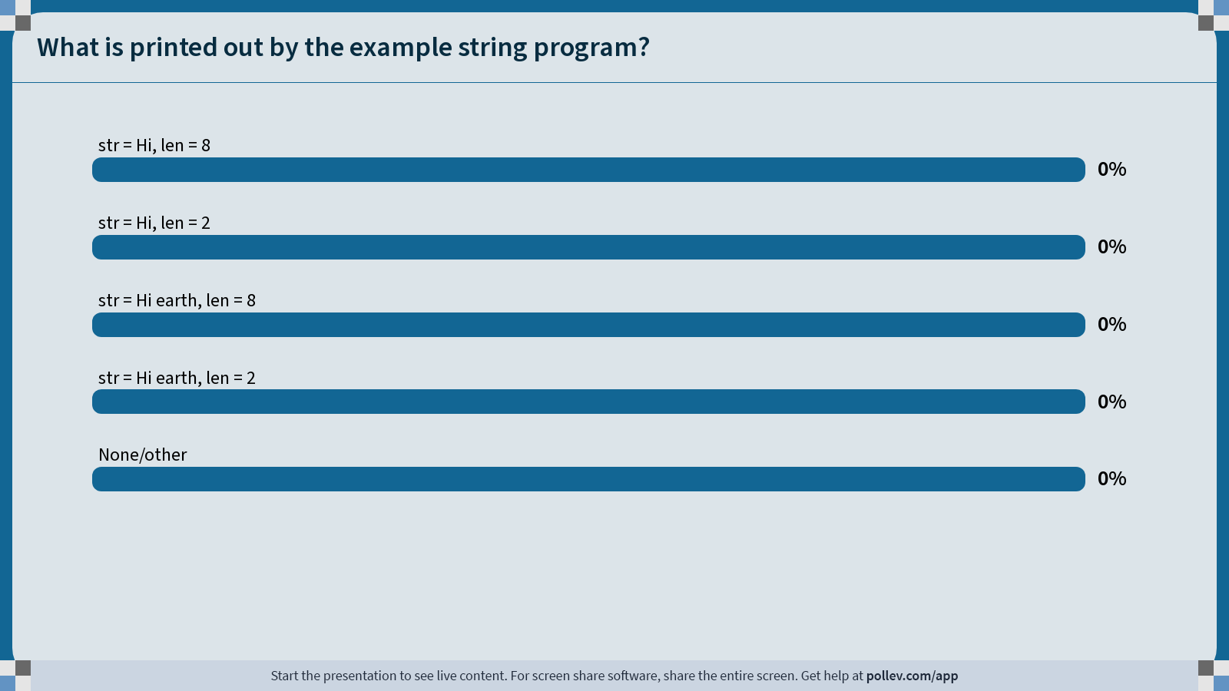
Notes:
Do not modify the notes in this section to avoid tampering with the Poll Everywhere activity.
More info at polleverywhere.com/support
What is printed out by the example string program?
https://www.polleverywhere.com/multiple_choice_polls/dkwSiU07fmFCKN9FPALVF?state=opened&flow=Default&onscreen=persist

Slide 63
Concatenating Strings
We cannot concatenate C strings using +. This adds addresses!
// e.g. param1 = 0x7f, param2 = 0x65
void doSomething(char *param1, char *param2) {
printf("%s", param1 + param2); // adds 0x7f and 0x65!
Instead, use strcat.

Slide 64
The string library: str(n)cat
strcat(dst, src): concatenates the contents of src into the string dst.
strncat(dst, src, n): same, but concats at most n bytes from src.
char str1[13]; // enough space for strings + '\0'
strcpy(str1, "hello ");
strcat(str1, "world!"); // removes old '\0', adds new '\0' at end
printf("%s", str1); // hello world!
Both strcat and strncat remove the old '\0' and add a new one at the end.
$ ./strcmp_ex cat camel 2
String "cat" comes after "camel" in the alphabet.
Up to character 2, "cat" is the same as "camel" in the alphabet.
Notes:
Strcat vs strcpy

Slide 65
Concatenating Strings
char str1[13];
strcpy(str1, "hello ");
char str2[7];
strcpy(str2, "world!");
strcat(str1, str2);
0 | 1 | 2 | 3 | 4 | 5 | 6 | 7 | 8 | 9 | 10 | 11 | 12
'h' | 'e' | 'l' | 'l' | 'o' | ' ' | '\0' | ? | ? | ? | ? | ? | ?
str1
0 | 1 | 2 | 3 | 4 | 5 | 6
'w' | 'o' | 'r' | 'l' | 'd' | '!' | '\0'
str2

Slide 66
Concatenating Strings
char str1[13];
strcpy(str1, "hello ");
char str2[7];
strcpy(str2, "world!");
strcat(str1, str2);
0 | 1 | 2 | 3 | 4 | 5 | 6 | 7 | 8 | 9 | 10 | 11 | 12
'h' | 'e' | 'l' | 'l' | 'o' | ' ' | 'w' | 'o' | 'r' | 'l' | 'd' | '!' | '\0'
str1
0 | 1 | 2 | 3 | 4 | 5 | 6
'w' | 'o' | 'r' | 'l' | 'd' | '!' | '\0'
str2
Notes:
Why can’t first strcpy call be strcat?

Slide 67
Substrings
To omit characters at the end, make a new string that is a partial copy of the original.
// Want just "race"
char str1[8];
strcpy(str1, "racecar");
char str2[5];
strncpy(str2, str1, 4);
str2[4] = '\0';
printf("%s\n", str1); // racecar
printf("%s\n", str2); // race

Slide 68
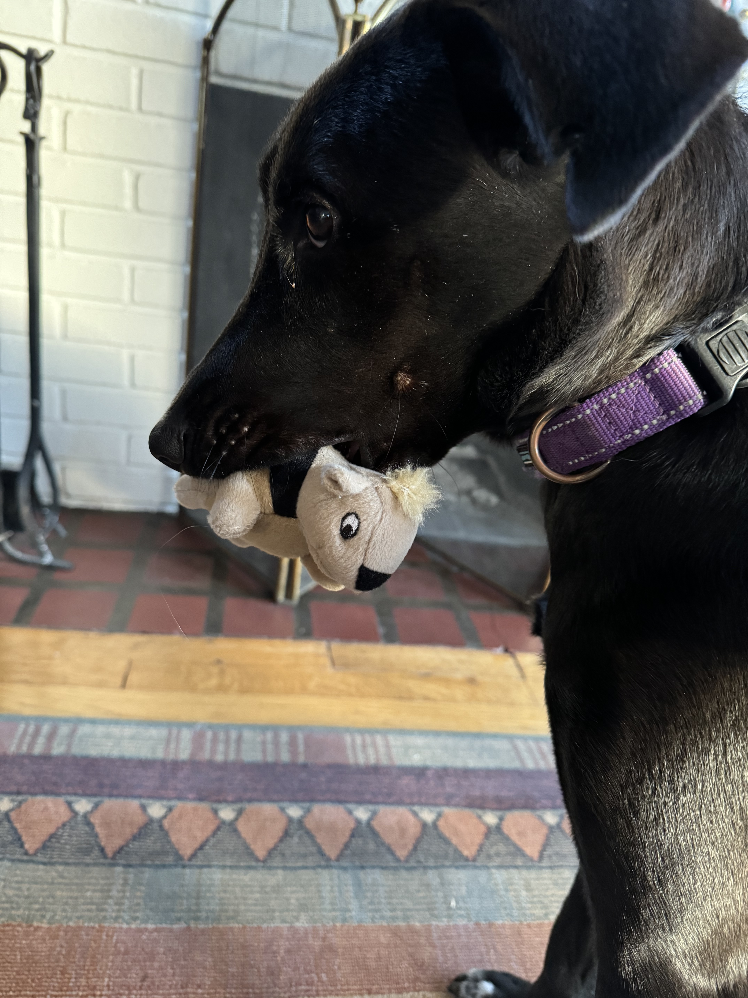
Goal: String Diamond
Write a function diamond that accepts a string parameter and prints its letters in a "diamond" format as shown below.
For example, diamond("BAILEY") should print:
  B
  BA
  BAI
  BAIL
  BAILE
  BAILEY
  AILEY
  ILEY
  LEY
  EY
  Y
We can use this to print the top half of the diamond! What about the bottom half?

Slide 69
Substrings and char *
You can also create a char * variable yourself that points to an address within in an existing string.
char myString[3];
myString[0] = 'H';
myString[1] = 'i';
myString[2] = '\0';
char *otherStr = myString; // points to 'H'

Slide 70
Substrings
char *s (pointers to characters) are strings. We can use them to create substrings of larger strings.
// Want just "car"
char chars[8];
strcpy(chars, "racecar");
char *str1 = chars;
0xf1 | 0xf2 | 0xf3 | 0xf4 | 0xf5 | 0xf6 | 0xf7 | 0xf8
'r' | 'a' | 'c' | 'e' | 'c' | 'a' | 'r' | '\0'
chars
0xee
0xf1
str1

Slide 71
Substrings
Since C strings are pointers to characters, we can adjust the pointer to omit characters at the beginning.
// Want just "car"
char chars[8];
strcpy(chars, "racecar");
char *str1 = chars;
char *str2 = chars + 4;
0xf1 | 0xf2 | 0xf3 | 0xf4 | 0xf5 | 0xf6 | 0xf7 | 0xf8
'r' | 'a' | 'c' | 'e' | 'c' | 'a' | 'r' | '\0'
chars
0xee
0xf1
0xd2
0xf5
str1
str2

Slide 72
Substrings
Since C strings are pointers to characters, we can adjust the pointer to omit characters at the beginning.
char chars[8];
strcpy(chars, "racecar");
char *str1 = chars;
char *str2 = chars + 4;
printf("%s\n", str1); // racecar
printf("%s\n", str2); // car
0xf1 | 0xf2 | 0xf3 | 0xf4 | 0xf5 | 0xf6 | 0xf7 | 0xf8
'r' | 'a' | 'c' | 'e' | 'c' | 'a' | 'r' | '\0'
chars
0xee
0xf1
0xd2
0xf5
str1
str2

Slide 73
Substrings
Since C strings are pointers to characters, we can adjust the pointer to omit characters at the beginning. NOTE: the pointer still refers to the same characters!
char chars[8];
strcpy(chars, "racecar");
char *str1 = chars;
char *str2 = chars + 4;
str2[0] = 'f';
printf("%s %s\n", chars, str1);
printf("%s\n", str2);
0xf1 | 0xf2 | 0xf3 | 0xf4 | 0xf5 | 0xf6 | 0xf7 | 0xf8
'r' | 'a' | 'c' | 'e' | 'f' | 'a' | 'r' | '\0'
chars
0xee
0xf1
0xd2
0xf5
str1
str2

Slide 74
Substrings
Since C strings are pointers to characters, we can adjust the pointer to omit characters at the beginning. NOTE: the pointer still refers to the same characters!
char chars[8];
strcpy(chars, "racecar");
char *str1 = chars;
char *str2 = chars + 4;
str2[0] = 'f';
printf("%s %s\n", chars, str1); // racefar racefar
printf("%s\n", str2); // far
0xf1 | 0xf2 | 0xf3 | 0xf4 | 0xf5 | 0xf6 | 0xf7 | 0xf8
'r' | 'a' | 'c' | 'e' | 'f' | 'a' | 'r' | '\0'
chars
0xee
0xf1
0xd2
0xf5
str1
str2

Slide 75
Substrings
We can combine pointer arithmetic and copying to make any substrings we’d like.
// Want just "ace"
char str1[8];
strcpy(str1, "racecar");
char str2[4];
strncpy(str2, str1 + 1, 3);
str2[3] = '\0';
printf("%s\n", str1); // racecar
printf("%s\n", str2); // ace

Slide 76
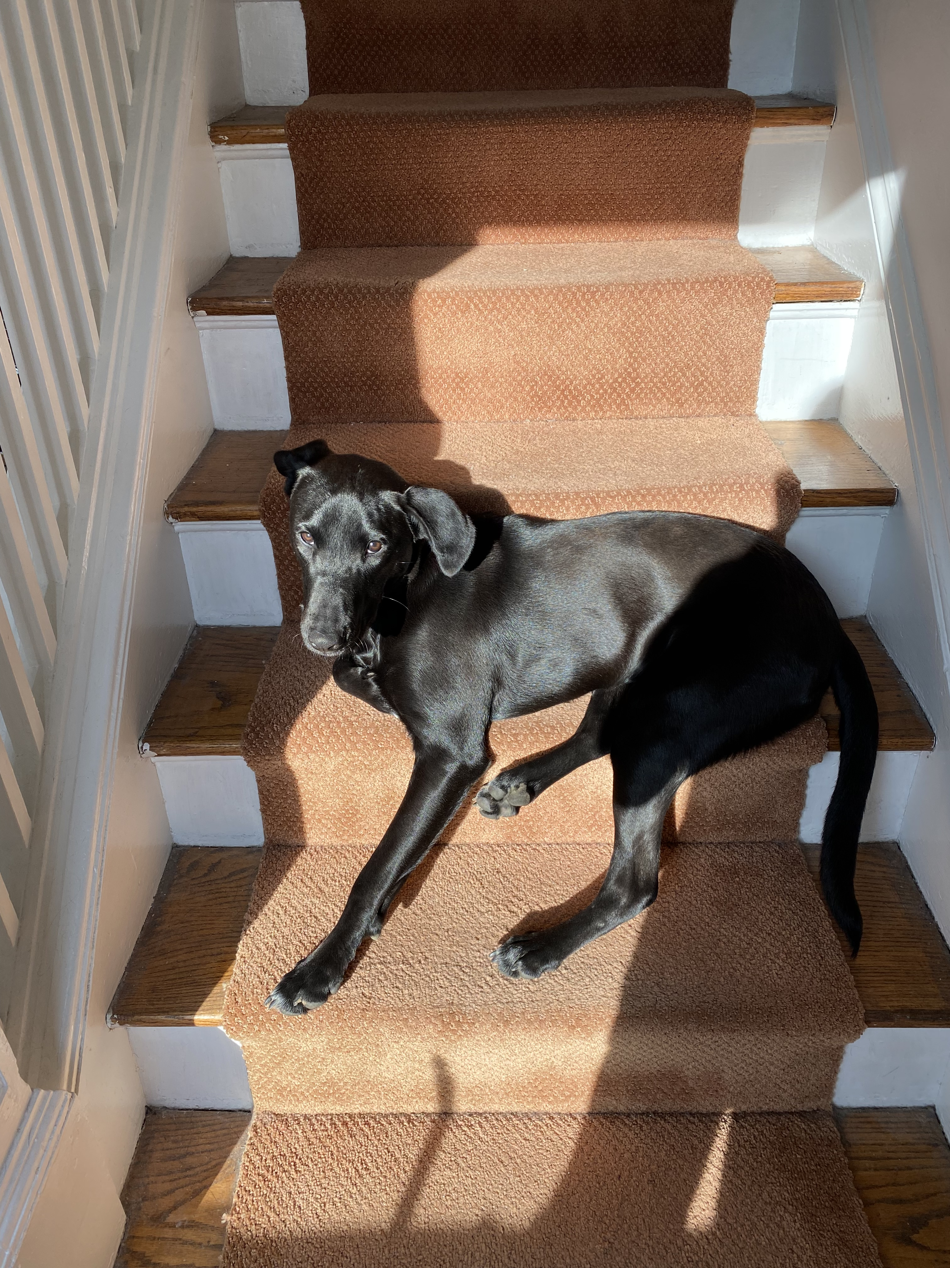
Goal: String Diamond
Write a function diamond that accepts a string parameter and prints its letters in a "diamond" format as shown below.
For example, diamond("BAILEY") should print:
  B
  BA
  BAI
  BAIL
  BAILE
  BAILEY
  AILEY
  ILEY
  LEY
  EY
  Y

Slide 77
Demo: Diamond
diamond.c
Notes:
Demo overflow etc.

Slide 78
char * vs. char[]
char * is an 8-byte pointer – it stores an address of a character
char[] is an array of characters – it stores the actual characters in a string
When you pass a char[] as a parameter, it is automatically passed as a char * (pointer to its first character)
Stay tuned for next lecture for more!
Notes:
Didn’t get to last time

Slide 79
Recap
Characters
Strings
Common String Operations
  Comparing
  Copying
  Concatenating
  Substrings
Next time: more strings
Lecture 6 takeaway: C strings are null-terminated arrays of characters. We can manipulate them using string and pointer operations.
cp -r /afs/ir/class/cs107/lecture-code/lect6 .

Slide 80
Extra Practice

Slide 81
Copycat exercise
Challenge: implement strcat using other string functions.
char src[9];
strcpy(src, "We Climb");
char dst[200]; // lots of space
strcpy(dst, "The Hill ");
strcat(dst, src);
How could we replace a call to strcat with a call to strcpy instead?
🤔

Slide 82
Copycat exercise
Challenge: implement strcat using other string functions.
char src[9];
strcpy(src, "We Climb");
char dst[200]; // lots of space
strcpy(dst, "The Hill ");
strcat(dst, src);
equivalent
strcpy(dst + strlen(dst), src);

Slide 83
Strings Practice
Line 6: What is printed?
char buf[9];
strcpy(buf, "Potatoes");
printf("%s\n", buf);
char *word = buf + 2;
strncpy(word, "mat", 3);
printf("%s\n", buf);
1
2
3
4
5
6
matoes
mattoes
Pomat
Pomatoes
Something else
Compile error
0xf0
word
0xe0 | 0xe1 | 0xe2 | 0xe3 | 0xe4 | 0xe5 | 0xe6 | 0xe7 | 0xe8
'P' | 'o' | 't' | 'a' | 't' | 'o' | 'e' | 's' | '\0'
🤔
buf
Notes:
C, D, or F
D

