Slide 1
CS107, Lecture 8
Introduction to Pointers
Reading: K&R (1.9, 5.5, Appendix B3) or Essential C section 3

Slide 2
Reminiscing C++
How might we write a C++ program with a function that takes in an int and changes it? We might use pass by reference.
Had num been declared as a standard int, it would catch a copy of x’s value at the time of the call.
Because it’s declared as an int&—that is, a reference to an int—num functions as a second name of a previously existing int. Accessing or updating num is really an operation on x itself.
Hot Take: num behaves like an automatically dereferenced pointer. In practice, that’s usually how references work under the hood.
Sadly, C does not support C++-style pass by reference.
void func(int& num) {
num = 3;
}
int main(int argc, char *argv[]) {
int x = 2;
func(x);
cout << x << endl; // prints 3
return 0;
}

Slide 3
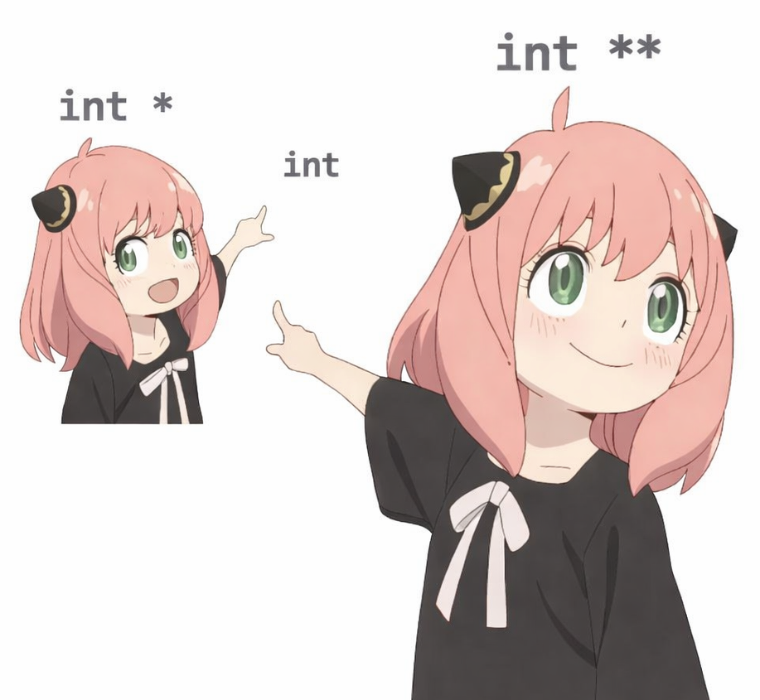
Pointers Revisited
A pointer is a variable that stores a memory address—typically the address of something meaningful.
You’ve already used C++ pointers in CS106B. C programmers use them even more.
There is no true pass-by-reference mechanism in C like there is in C++, so C coders rely on pointers to expose the variable addresses to helper functions so those functions can access and even update their values.
Pointers are essential to dynamic memory allocation—arguably more so—in pure C than they are in C++.
  C doesn't define vectors, maps, and hash_maps like C++ does via its standard libraries.
  C programmers often need to wire up their own implementations of them using pointers and dynamically allocated memory.

Slide 4
Looking Ahead to C
All parameters in C are passed by value. When passing arrays as parameters, the base address of the array decays to a pointer.
If an address is passed as a parameter, the address itself is copied, just like any other parameter.
  But because that address is the location of some data residing elsewhere, we have access to and can even modify that data.
More generally, if we want to modify a value in a helper function and have any changes persist after the function returns, you can pass in the address of the value—that is, its location—instead of passing the value itself. This way we copy the address instead of the value.

Slide 5
Pointers Revisited: CS106B Style
STACK
A pointer is a variable that stores a memory address.
main
void myFunc(int *intPtr) {
*intPtr = 3;
}
int main(int argc, char *argv[]) {
int x = 2;
myFunc(&x);
printf("%d\n", x); // prints 3
...
}
myFunc accepts that location as an address of an int. That's why the type here is int * instead of int.
Here, the value of intPtr identifies where the shared int lives. By dereferencing intPtr, the code identifies the int it points to—and not intPtr itself—as the recipient of the 3. Think of intPtr as a hyperlink and the * in front of it as a mouse click that drills through the link to the destination.
By passing &x to myFunc, main tells myFunc where x lives. Here, the & is the address-of operator and produces the address of x.

Slide 6
Pointers Revisited: CS106B Style
STACK
A pointer is a variable that stores a memory address.
main
x
2
void myFunc(int *intPtr) {
*intPtr = 3;
}
int main(int argc, char *argv[]) {
int x = 2;
myFunc(&x);
printf("%d\n", x); // prints 3
return 0;
}

Slide 7
Pointers Revisited: CS106B Style
STACK
A pointer is a variable that stores a memory address.
main
x
2
void myFunc(int *intPtr) {
*intPtr = 3;
}
int main(int argc, char *argv[]) {
int x = 2;
myFunc(&x);
printf("%d\n", x); // prints 3
return 0;
}
myFunc
intPtr

Slide 8
Pointers Revisited: CS106B Style
STACK
A pointer is a variable that stores a memory address.
main
x
2
void myFunc(int *intPtr) {
*intPtr = 3;
}
int main(int argc, char *argv[]) {
int x = 2;
myFunc(&x);
printf("%d\n", x); // prints 3
return 0;
}
myFunc
intPtr

Slide 9
Pointers Revisited: CS106B Style
STACK
A pointer is a variable that stores a memory address.
main
x
3
void myFunc(int *intPtr) {
*intPtr = 3;
}
int main(int argc, char *argv[]) {
int x = 2;
myFunc(&x);
printf("%d\n", x); // prints 3
return 0;
}
myFunc
intPtr

Slide 10
Pointers Revisited: CS106B Style
STACK
A pointer is a variable that stores a memory address.
main
x
3
void myFunc(int *intPtr) {
*intPtr = 3;
}
int main(int argc, char *argv[]) {
int x = 2;
myFunc(&x);
printf("%d\n", x); // prints 3
return 0;
}

Slide 11
Pointers Revisited: CS107 Style
A pointer is a variable that stores a memory address.
STACK
Address | Value
 | …
0x1f0 | 2
 | …
main
x
void myFunc(int *intPtr) {
*intPtr = 3;
}
int main(int argc, char *argv[]) {
int x = 2;
myFunc(&x);
printf("%d\n", x); // prints 3
return 0;
}

Slide 12
Pointers Revisited: CS107 Style
A pointer is a variable that stores a memory address.
STACK
Address | Value
 | …
0x1f0 | 2
 | …
main
x
void myFunc(int *intPtr) {
*intPtr = 3;
}
int main(int argc, char *argv[]) {
int x = 2;
myFunc(&x);
printf("%d\n", x); // prints 3
return 0;
}

Slide 13
Pointers Revisited: CS107 Style
A pointer is a variable that stores a memory address.
STACK
Address | Value
 | …
0x1f0 | 2
 | …
0x10 | 0x1f0
 | …
main
x
void myFunc(int *intPtr) {
*intPtr = 3;
}
int main(int argc, char *argv[]) {
int x = 2;
myFunc(&x);
printf("%d\n", x); // prints 3
return 0;
}
myFunc
intPtr

Slide 14
Pointers Revisited: CS107 Style
A pointer is a variable that stores a memory address.
STACK
Address | Value
 | …
0x1f0 | 2
 | …
0x10 | 0x1f0
 | …
main
x
void myFunc(int *intPtr) {
*intPtr = 3;
}
int main(int argc, char *argv[]) {
int x = 2;
myFunc(&x);
printf("%d\n", x); // prints 3
return 0;
}
myFunc
intPtr

Slide 15
Pointers Revisited: CS107 Style
A pointer is a variable that stores a memory address.
STACK
Address | Value
 | …
0x1f0 | 3
 | …
0x10 | 0x1f0
 | …
main
x
void myFunc(int *intPtr) {
*intPtr = 3;
}
int main(int argc, char *argv[]) {
int x = 2;
myFunc(&x);
printf("%d\n", x); // prints 3
return 0;
}
myFunc
intPtr

Slide 16
Pointers Revisited: CS107 Style
A pointer is a variable that stores a memory address.
STACK
Address | Value
 | …
0x1f0 | 3
 | …
main
x
void myFunc(int *intPtr) {
*intPtr = 3;
}
int main(int argc, char *argv[]) {
int x = 2;
myFunc(&x);
printf("%d\n", x); // prints 3
return 0;
}

Slide 17
Pointers Revisited: CS107 Style
A pointer is a variable that stores a memory address.
STACK
Address | Value
 | …
0x1f0 | 3
 | …
main
x
void myFunc(int *intPtr) {
*intPtr = 3;
}
int main(int argc, char *argv[]) {
int x = 2;
myFunc(&x);
printf("%d\n", x); // prints 3
return 0;
}

Slide 18
Pointers and Parameters Etudes
We want to write a function that flips the case of a letter.
What should go in each of the blanks?
void flip_case(char *cp) {
if (isupper(*cp)) {
*cp = tolower(*cp);
} else if (islower(*cp)) {
*cp = toupper(*cp);
}
}
int main(int argc, char *argv[]) {
char ch = 'g';
flip_case(&ch);
printf("%c\n", ch); // print 'G'
return 0;
}
The address of a char must be caught by a char *.
The flipped char must be written back to the original through cp. *cp identifies where the flipped char should be placed.
The case of the char to be flipped must be determined, and *cp identifies at that char.
We want flip_case, to modify main’s ch, so we need to pass ch’s address.

Slide 19

Pointers and Parameters Etudes
Sometimes, we want to modify a pointer—e.g., a char *—by reference by sharing the address of that pointer with a function.
Consider the following (broken) implementation of skip_spaces, which purports to update a C string to leap beyond its leading whitespace.
void skip_spaces(char *s) {
s += strspn(s, " ")
}
int main(int argc, char *argv[]) {
char *str = " hello";
skip_spaces(str);
printf("%s\n", str); // should print hello
return 0;
}
Here’s a compact autopsy report outlining why this version is dead on arrival.
skip_spaces receives a copy of the address stored in main’s str variable.
The strspn call is correct and successfully advances the local variable s, but it doesn’t advance or otherwise change main’s str.
When skip_spaces returns, its updated pointer s is discarded. main’s str wasn’t touched, much less updated.

Slide 20

Pointers and Parameters Etudes
Now consider a new version of skip_spaces, which relies on
a char ** parameter ( ) to capture the address of main's str.
Because main now shares the location of str with skip_spaces, skip_spaces can access and even directly modify str's value.
😱
Here’s the new version's grade report:
main now passes &str, the address of its own char * variable, not some copy of str.
The char **p_str parameter points directly to main’s str, so dereferencing p_str accesses the original char *.
The expression *p_str += ... updates the value stored in str, advancing the original pointer beyond all those spaces. What failed to happen in v1 now works.
Redux: To modify a pointer owned by the caller, the callee must receive that pointer’s address.
void skip_spaces(char **p_str) {
*p_str += strspn(*p_str, " ");
}
int main(int argc, char *argv[]) {
char *str = " hello";
skip_spaces(&str);
printf("%s\n", str); // should print hello
return 0;
}

Slide 21
Pointers: Key Takeaways
Summary:
If you’re working with some input and do not care about any changes to the input, pass the data by value.
If you are modifying a specific instance of some value, pass the location of what you would like to modify.
If a function accept an address as a parameter, that function can travel to that address if need be.
If a function accepts an int *, it can modify the int at the supplied address.
If a function accepts a char *, it can modify the char at the supplied address.
If a function accepts a char **, it can modify the char * at the supplied address.

Slide 22
Strongly Typed Swaps and Rotations
Here are few functions that do more meaningful work than earlier examples.
int main(int argc, char *argv[]) {
int x = 17, y = 29;
printf("x = %d, y = %d\n", x, y);
swap_ints(&x, &y);
printf("x = %d, y = %d\n", x, y);
char *h = "Fred", *w = "Wilma";
printf("husband: %s, wife: %s\n", h, w);
swap_strings(&h, &w);
printf("husband: %s, wife: %s\n", h, w);
swap_strings(&h, &w); // restore
char *b = "Pebbles";
printf("husband: %s, wife: %s, baby: %s\n", h, w, b);
rotate(&h, &w, &b);
printf("husband: %s, wife: %s, baby: %s\n", h, w, b);
return 0;
}
void swap_ints(int *one, int *two) {
int temp = *one;
*one = *two;
*two = temp;
}
void swap_strings(char **one, char **two) {
char *temp = *one;
*one = *two;
*two = temp;
}
void rotate(char **p, char **q, char **r) {
swap_strings(p, q);
swap_strings(p, r);
}

