Slide 1
CS107 Lecture 9
Arrays and Pointers
Reading: K&R (5.2-5.5) or Essential C section 6

Slide 2
The Seven Commandments of C Strings
If we create a new string as a local char[], we can modify its characters because the relevant, writable memory resides in the stack frame of the declaring function.
We cannot set the name of a char[] equal to another value, because it is not a true pointer, as it refers to the block of memory reserved for the original array.
If we pass a char[] as a parameter, set something equal to it, or perform arithmetic with it, it's automatically converted to a char *.
If we create a new string from a string literal as a char *, we cannot modify its characters because the characters reside in the read-only data segment.
We can set a char * equal to another value, because it is an assignable pointer.
Adding an offset to a C string delivers another string—often a suffix string—beginning many positions beyond the leading character.
If we change characters through a string parameter, those changes persist beyond the function call, because the pointer aliases memory that existed before the call.

Slide 3
The First Commandment
String Behavior #1: If we create a new string as a local char[], we can modify its characters because the relevant, writable memory resides in the stack frame of the declaring function.

Slide 4
The First Commandment
STACK
When we declare an array of characters, memory is reserved in the stack to store the contents of the entire array, and we can modify the characters stored there.
Address | Value
 | …
0x105 | '\0'
0x104 | 'e'
0x103 | 'l'
0x102 | 'p'
0x101 | 'p'
0x100 | 'a'
 | …
char str[6];
strcpy(str, "apple");
alternatively, with same effect
char str[] = "apple";
str

Slide 5
The Second Commandment
String Behavior #2: We cannot set the name of a char[] equal to another value, because it is not a true pointer, as it refers to the block of memory reserved for the original array.

Slide 6
The Second Commandment
An array variable refers to an entire block of memory. We can't reassign the name of an existing array to refer to another.
Once declared, an array's size cannot be changed.
We must create another array instead.
char good[12];
strcpy(good, "Dr. Jekyll");
char evil[] = "Mr. Hyde";
good = evil; // nope, Jekyll is safe

Slide 7
The Third Commandment
String Behavior #3: If we pass a char[] as a parameter, set something equal to it, or perform arithmetic using it, it's automatically converted to a char *.

Slide 8

Third Commandment Etudes
How do you think the parameter str is being represented?
void fun_times(char *str) {
...
}
int main(int argc, char *argv[]) {
char local_str[5];
strcpy(local_str, "rice");
fun_times(local_str);
return 0;
}
?
str
0xa0 | 0xa1 | 0xa2 | 0xa3 | 0xa4
'r' | 'i' | 'c' | 'e' | '\0'
local_str
A copy of the array local_str
A pointer containing an address to
the first element in local_str
Notes:
The “professional programmer language.”
Takeaway #2: An string name is the address of the first element.

Slide 9
Third Commandment Etudes
How do you think the parameter str is being represented?
void fun_times(char *str) {
...
}
int main(int argc, char *argv[]) {
char local_str[5];
strcpy(local_str, "rice");
fun_times(local_str);
return 0;
}
str
0xa0
0xa0 | 0xa1 | 0xa2 | 0xa3 | 0xa4
'r' | 'i' | 'c' | 'e' | '\0'
local_str
A copy of the array local_str
A pointer containing an address to
the first element in local_str
Notes:
The “professional programmer language.”
Takeaway #2: An string name is the address of the first element.

Slide 10
Third Commandment Etudes
How do you think the parameter str is being represented?
int main(int argc, char *argv[]) {
char local_str[5];
strcpy(local_str, "rice");
char *str = local_str + 2;
...
return 0;
}
?
str
0xa0 | 0xa1 | 0xa2 | 0xa3 | 0xa4
'r' | 'i' | 'c' | 'e' | '\0'
local_str
A copy of the array local_str + 2
A pointer containing an address to
the third element in local_str
Notes:
The “professional programmer language.”
Takeaway #2: An string name is the address of the first element.

Slide 11
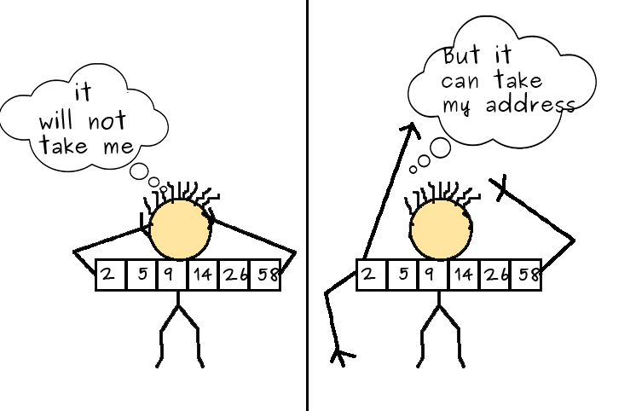
Third Commandment Etudes
How do you think the parameter str is being represented?
int main(int argc, char *argv[]) {
char local_str[5];
strcpy(local_str, "rice");
char *str = local_str + 2;
...
return 0;
}
str
0xa2
0xa0 | 0xa1 | 0xa2 | 0xa3 | 0xa4
'r' | 'i' | 'c' | 'e' | '\0'
local_str
A copy of the array local_str + 2
A pointer containing an address to
the third element in local_str
Notes:
The “professional programmer language.”
Takeaway #2: An string name is the address of the first element.

Slide 12
Commandments 1 – 3: Redux
All standard string functions expect pointers to characters (either char * or const char *) as parameters. They might accept a char[] instead, but they are implicitly converted to char * or const char * before being passed.
A char * can still be a string in all the core ways a char[] is.
Takeaway: We can create strings using char[] and still pass them around as parameters using either char[] or char *.
Array and pointers are not the same. They do, however, cooperate.
size_t strlen(const char *s);
int strcmp(const char *s1, const char *s2);
char *strstr(const char *haystack, const char *needle);
char *strncat(char *dest, const char *src, size_t n);
size_t strlen(const char s[]);
int strcmp(const char s1[], const char s2[]);
char *strstr(const char haystack[], const char needle[]);
char *strncat(char dest[], const char src[], size_t n);

Slide 13
The Fourth Commandment
String Behavior #4: If we create a new string from a string literal as a char *, we cannot modify its characters because the characters reside in the read-only data segment.

Slide 14
The Fourth Commandment
There is another convenient way to create a string if we do not need to modify it later. We can create a char * and set it directly equal to a string literal.
These first four lines run without drama. salutation’s characters are mutable, and greeting is used in a read-only manner.
char salutation[] = "Good day!";
char *greeting = "Hello, world!";
salutation[3] = 'f';
printf("%s", greeting);
greeting[0] = 'h';
Because greeting is declared as a char * and initialized to a string literal, those characters are read-only and can't be safely overwritten. This fifth of five lines compiles on the myth machines, but when executed results in undefined behavior (e.g., on the myths, this crash crashes).

Slide 15


Fourth Commandment Etudes
For each code snippet below, can we modify characters through str?
Key Questions: Where do the characters live? In the read-only data segment? Or in writable memory like the stack? What else determines mutability?
char str[6];
void one(char *str) { ... }
void two(const char *str) { ... }
int main(int argc, char *argv[]) {
char satword[15];
strcpy(satword, "absquatulation");
one(satword);
two(satword);
return 0;
}
char *str = "rutabaga";
char silly[12];
strcpy(silly, "hootenanny");
char *str = silly;
char *s = "barnacle";
char *str = s;

Slide 16

Fourth Commandment Gotchas
Question: Is there a runtime check that can be used to determine whether a string's characters are modifiable?
Answer: Not reliably. This is something you can only tell by looking at the code itself and knowing how the string was created.
  In principle, you might be able to guess from the character addresses, since string literals reside in a wildly different part of memory than stack arrays do. But this is neither reliable nor exhaustive.
Question: So then if I am writing a string function that overwrites characters, how can I tell if the string passed in can be safely modified?
Answer: You can’t! This is something you can clarify as an assumption in documentation.
  If someone calls your function on a read-only string, it will crash on the myths.
  That, however, is not your function's fault if it's clear read-only strings are a no-no.

Slide 17
The Fifth Commandment
String Behavior #5: We can set a char * equal to another value, because it is an assignable pointer.

Slide 18
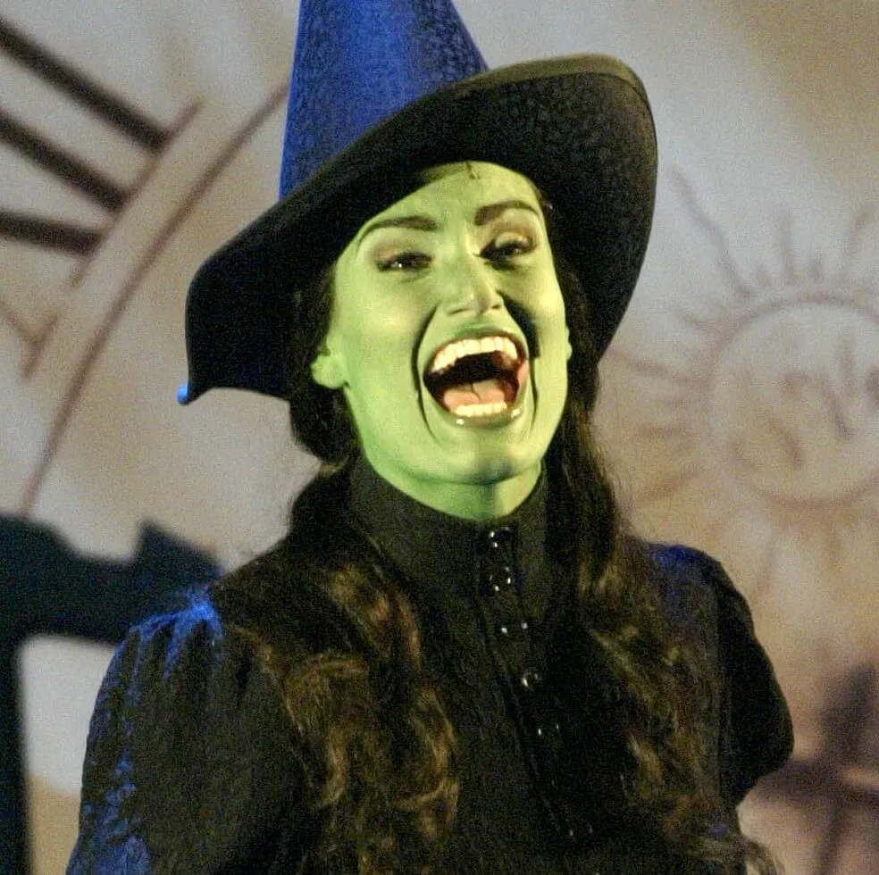
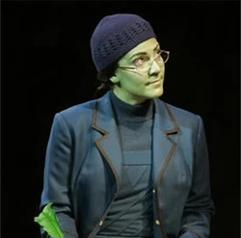
The Fifth Commandment
A char * variable refers to a single character. We can reassign an existing
char * pointer to be equal to another char * pointer.
char *elphaba = "Idina Menzel"; // e.g., 0xfff0
char *understudy = "Shoshana Bean"; // e.g., 0xffe0
elphaba = understudy; // legit! both now store 0xffe0

Slide 19
The Fifth Commandment
STACK
We can also set a pointer equal to an array name so it addresses the first element of that array.
Address | Value
 | …
0x105 | '\0'
0x104 | 'e'
0x103 | 'l'
0x102 | 'p'
0x101 | 'p'
0x100 | 'a'
0xf8 | 0x100
 | …
int main(int argc, char *argv[]) {
char fruit[6];
strcpy(fruit, "apple");
char *food = str;
// equivalent
char *food = &str[0];
// equivalent but misleading, avoid
char *food = &str;
...
}
main
fruit
food

Slide 20
The Sixth Commandment
String Behavior #6: Adding an offset to a C string delivers another string—often a suffix string—beginning many positions beyond the leading character.

Slide 21
Sixth Commandment Trivia
When we compute pointer arithmetic, we advance a pointer by a certain number of characters.
READ-ONLY DATA
Address | Value
 | …
0xff5 | '\0'
0xff4 | 'h'
0xff3 | 'c'
0xff2 | 'a'
0xff1 | 'e'
0xff0 | 'p'
 | …
char *a = "peach"; // e.g., 0xff0
char *b = str + 1; // e.g., 0xff1
char *c = str + 3; // e.g., 0xff3
printf("%s", a); // prints peach
printf("%s", b); // prints each
printf("%s", c); // prints ch

Slide 22
Sixth Commandment Trivia
When we use bracket notation on anything array-like, we are really performing pointer arithmetic and dereferencing.
READ-ONLY DATA
Address | Value
 | …
0xff5 | '\0'
0xff4 | 'e'
0xff3 | 'z'
0xff2 | 'o'
0xff1 | 'o'
0xff0 | 'b'
 | …
char *str = "booze"; // e.g., 0xff0
char ch1 = str[4]; // 'e'
char ch2 = *(str + 4); // 'e'
// both add 4 to 0xff0, then dereference
// dereference 0xff4 to surface the 'e'
// unorthodox alternatives to the above
// that you can use, but should not
char ch3 = *(4 + str);
char ch4 = 4[str];
The compiler generally translates array notation to the equivalent pointer arithmetic, then generates assembly from the pointer version.
In fact, when looking at the assembly, you can’t truly know whether array or pointer notation was used.

Slide 23
The Seventh Commandment
String Behavior #7: If we change characters through a string parameter, those changes persist beyond the function call, because the pointer aliases memory that existed before the call.

Slide 24
Seventh Commandment Scenarios
When we pass a char * string as a parameter, C makes a copy of the address stored in the char * and passes it to the function. This means they both refer to the same memory location.
STACK
Address | Value
 | …
0xfff0 | 0x10
 | …
 | …
0xffd0 | 0x10
 | …
main
fancy
void func(char *s) {
printf("%s\n", s);
}
int main(int argc, char *argv[]) {
char *fancy = "pulchritude";
func(fancy);
...
}
func
s

Slide 25
Seventh Commandment Scenarios
STACK
When we pass a char array as a parameter, C makes a copy of the address of the first array element and passes it (as a char *) to the function.
Address | Value
 | …
0x105 | '\0'
0x104 | 'e'
0x103 | 'r'
0x102 | 'a'
0x101 | 'p'
0x100 | 's'
 | …
 | …
0xf | 0x100
 | …
void func(char *s) {
s[4] = 'k';
}
int main(int argc, char *argv[]) {
char str[] = "spare";
func(str);
...
}
main
str
func
s

Slide 26
The Seven Commandments of C Strings
If we create a new string as a local char[], we can modify its characters because the relevant, writable memory resides in the stack frame of the declaring function.
We cannot set the name of a char[] equal to another value, because it is not a true pointer, as it refers to the block of memory reserved for the original array.
If we pass a char[] as a parameter, set something equal to it, or perform arithmetic with it, it's automatically converted to a char *.
If we create a new string from a string literal as a char *, we cannot modify its characters because the characters reside in the read-only data segment.
We can set a char * equal to another value, because it is an assignable pointer.
Adding an offset to a C string delivers another string—often a suffix string—beginning many positions beyond the leading character.
If we change characters through a string parameter, those changes persist beyond the function call, because the pointer aliases memory that existed before the call.

